Slide 1
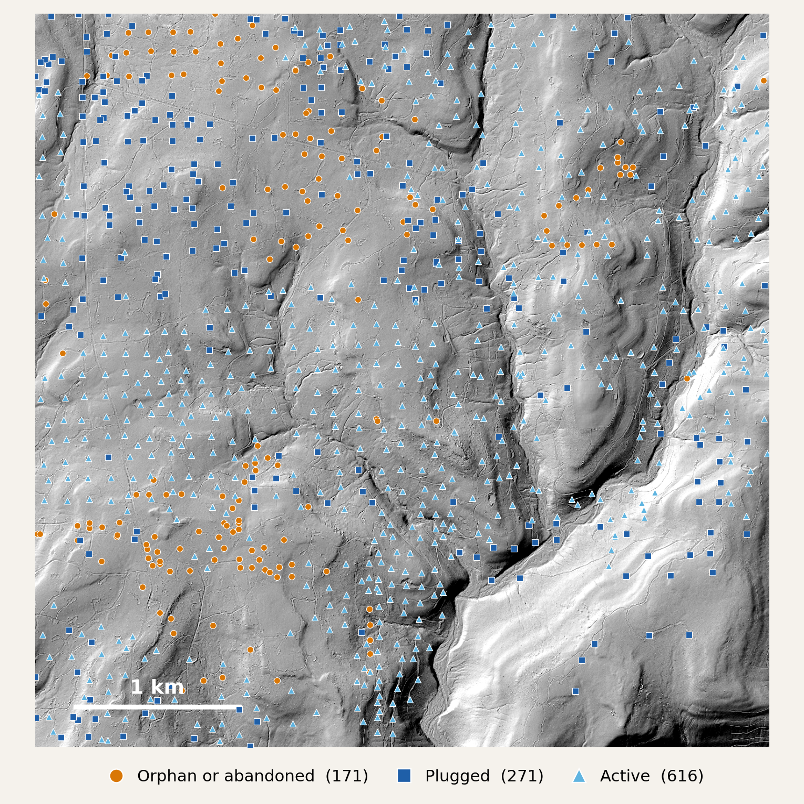
1 · THE PROBLEM
The oil came before the paperwork
Wells were drilled here for decades before anyone had to record them.
An abandoned, unplugged well can leak methane and brine. The open hole is a hazard too.
Many old wells are on no list. Others are listed in the wrong place, or with no date.
Right: one 4.5 km tile in Venango County, with every DEP well record on it.
Notes:
The problem is simple to state. Oil drilling here started in 1859, and for decades nobody had to record a well. When an old well is abandoned without a plug, it can leak methane into the air and brine into the ground and water. The open hole is also a physical hazard. The state keeps lists of orphaned and abandoned wells, but they are incomplete. Many old wells are on no list at all. Others are listed at the wrong spot, or with no drilling date. In Venango County about half of the 20,108 DEP records have no usable drilling date. The map is one 4.5 km square of our study area. Every mark is a DEP record: 171 orphaned or abandoned, 271 plugged and 616 active. The wells we care about most are the ones that are not on this map.

Slide 2
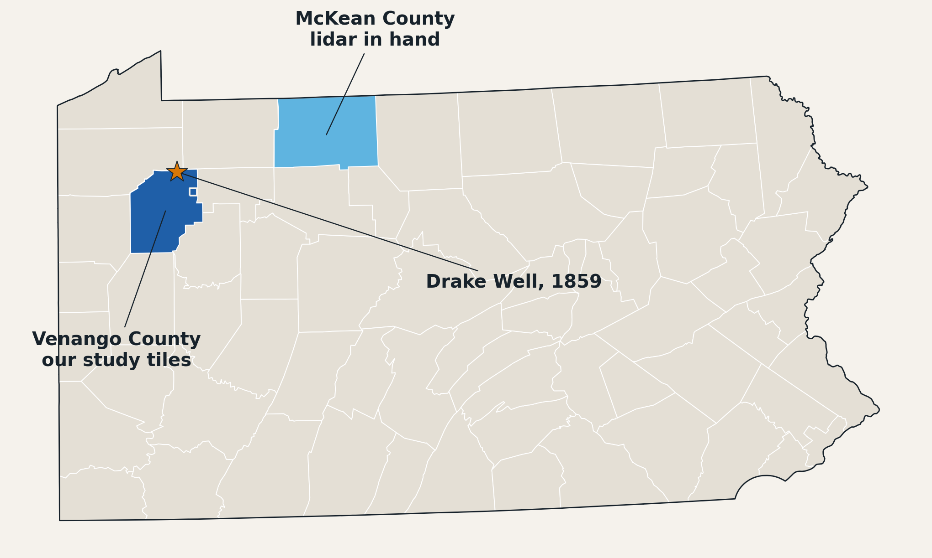
2 · THE AREA
Venango County, where the oil industry began
Drake Well, 1859. America's first commercial oil well is here.
Hard ground to search. Steep hills and deep stream valleys, under thick hardwood forest.
McKean County is old oil country too. We already hold its lidar.
Notes:
Our study area is Venango County in northwest Pennsylvania. This is where the American oil industry started. Drake's well, drilled in 1859, sits at the north edge of the county, marked by the star. The boom that followed put thousands of wells into these hills. The ground itself makes the search hard. It is Appalachian Plateau: steep slopes, deep stream valleys and thick hardwood forest. From the air or in a satellite photo, the trees hide almost everything. McKean County, in light blue, is another old oil region to the northeast. We already have its lidar, so it is the natural next place to look.

Slide 3
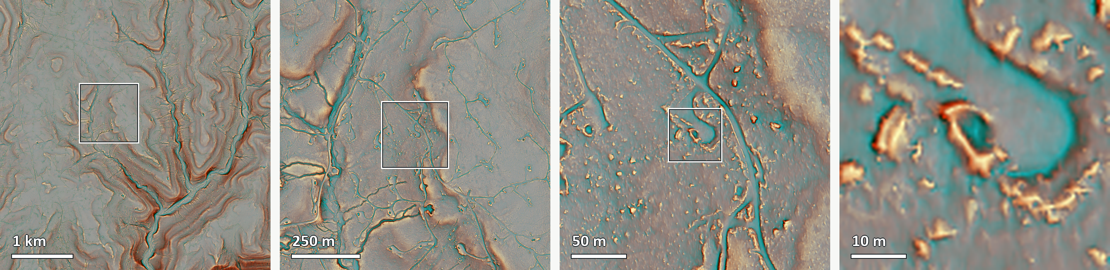
3 · HOW WE LOOK
Old drilling still marks the forest floor
Pit a dug hollow beside the wellhead
Pad the levelled clearing the rig stood on
Road the track that served the site
Notes:
Lidar is a laser flown over the ground. Enough pulses pass through gaps in the canopy to map the bare ground under the trees. This relief map is built from that ground surface. Hollows are blue and ridges are orange. Left to right, we zoom from the whole 4.5 km tile in Venango County to one pit 10 m across. Every old well site leaves up to three marks: the pit dug beside the wellhead, the pad the rig stood on, and the road that served it. These marks outlast the wells and the paperwork.

Slide 4
4 · IN PENNSYLVANIA
What we want to do on the ground
Check candidates in person
Visit a blind, random sample, strong scores and weak. This measures how many hits are real.
Look where no well is recorded
Sites far from any DEP record may be undocumented wells. We report them as candidates for DEP to confirm.
Cover more ground
Run the detectors over McKean County. Its denser 2019 lidar is already in hand.
Watch the sites over time
Use NISAR radar from snow-free passes to ask whether the ground over a cluster of wells is moving.
[Dates] · [Number of sites] · [Who we would work with]
Notes:
This is what a trip to Pennsylvania is for. First, precision. Our annotations miss real pits, so only visiting sites tells us how many hits are real. The sample is blind and random, so we see weak scores as well as strong ones. Second, the real prize: sites that look like a well but sit far from any DEP record. Those are possible undocumented wells. We call them candidates until DEP confirms them. Third, scale. McKean County has denser 2019 lidar, already downloaded. Fourth, time. NISAR is a radar satellite that passes every 12 days. It cannot see a pit, but from snow-free passes it can tell whether the ground over a cluster of wells is sinking.

