Slide 1

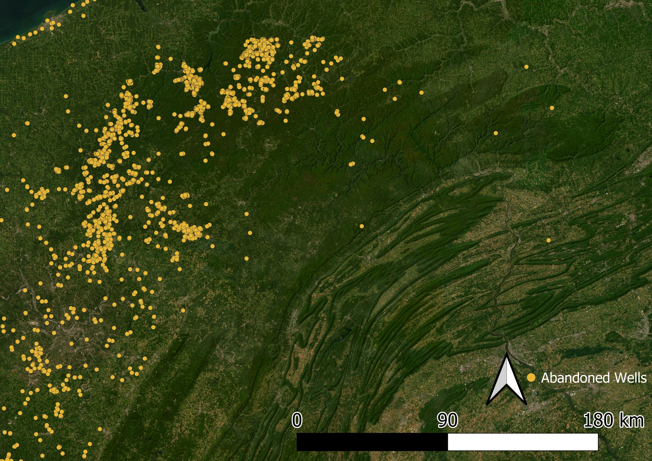
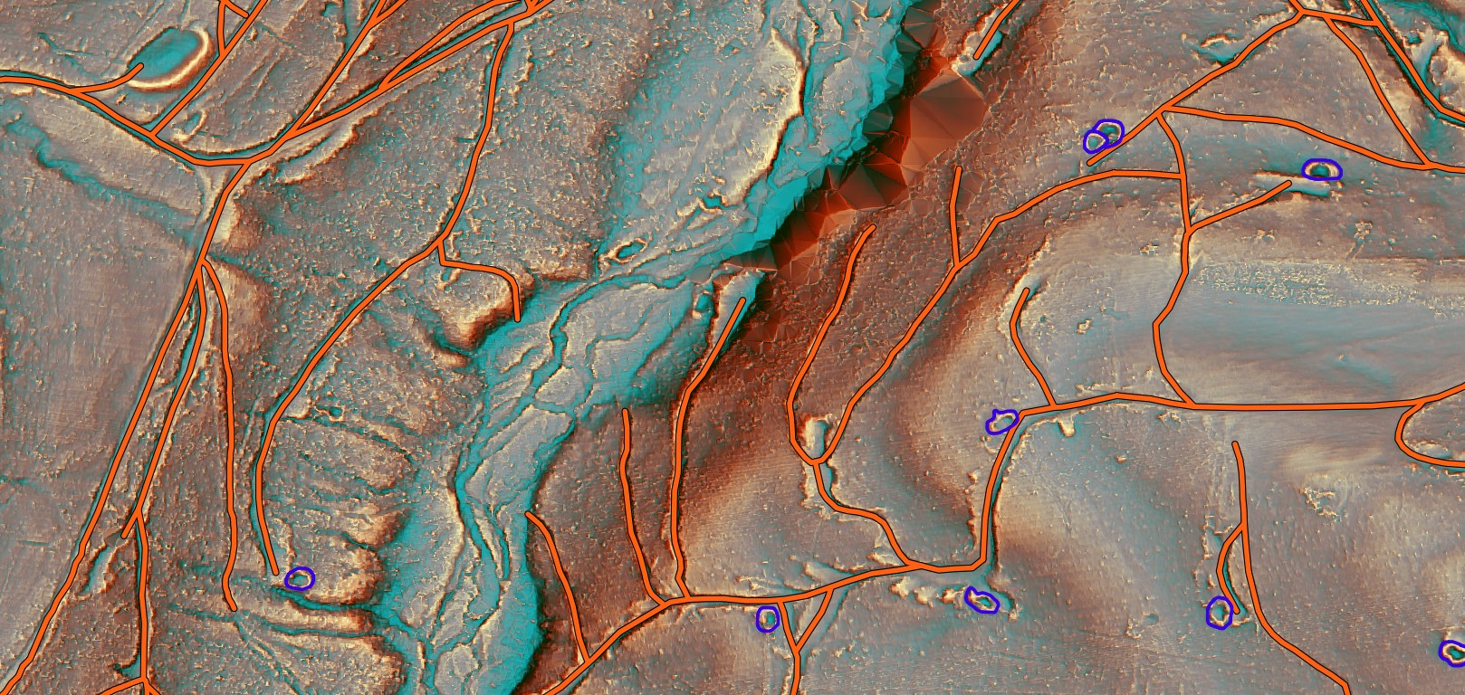
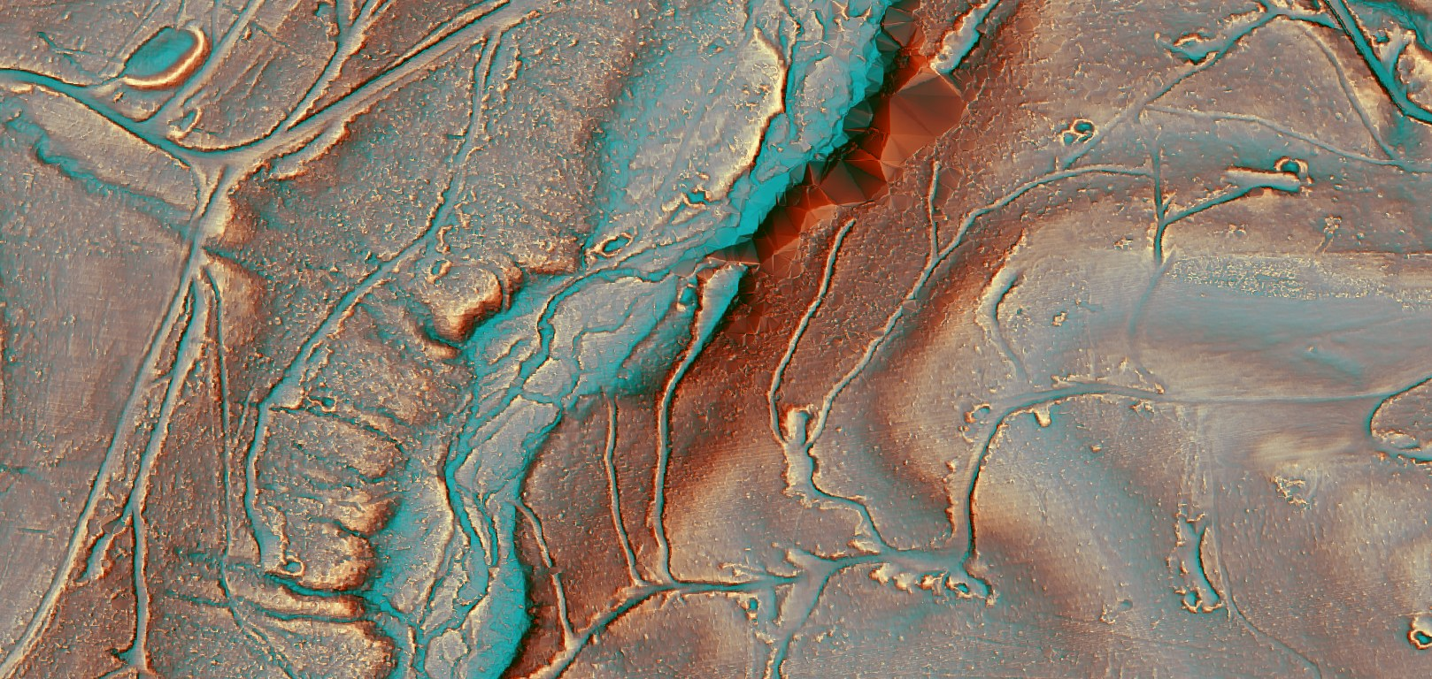
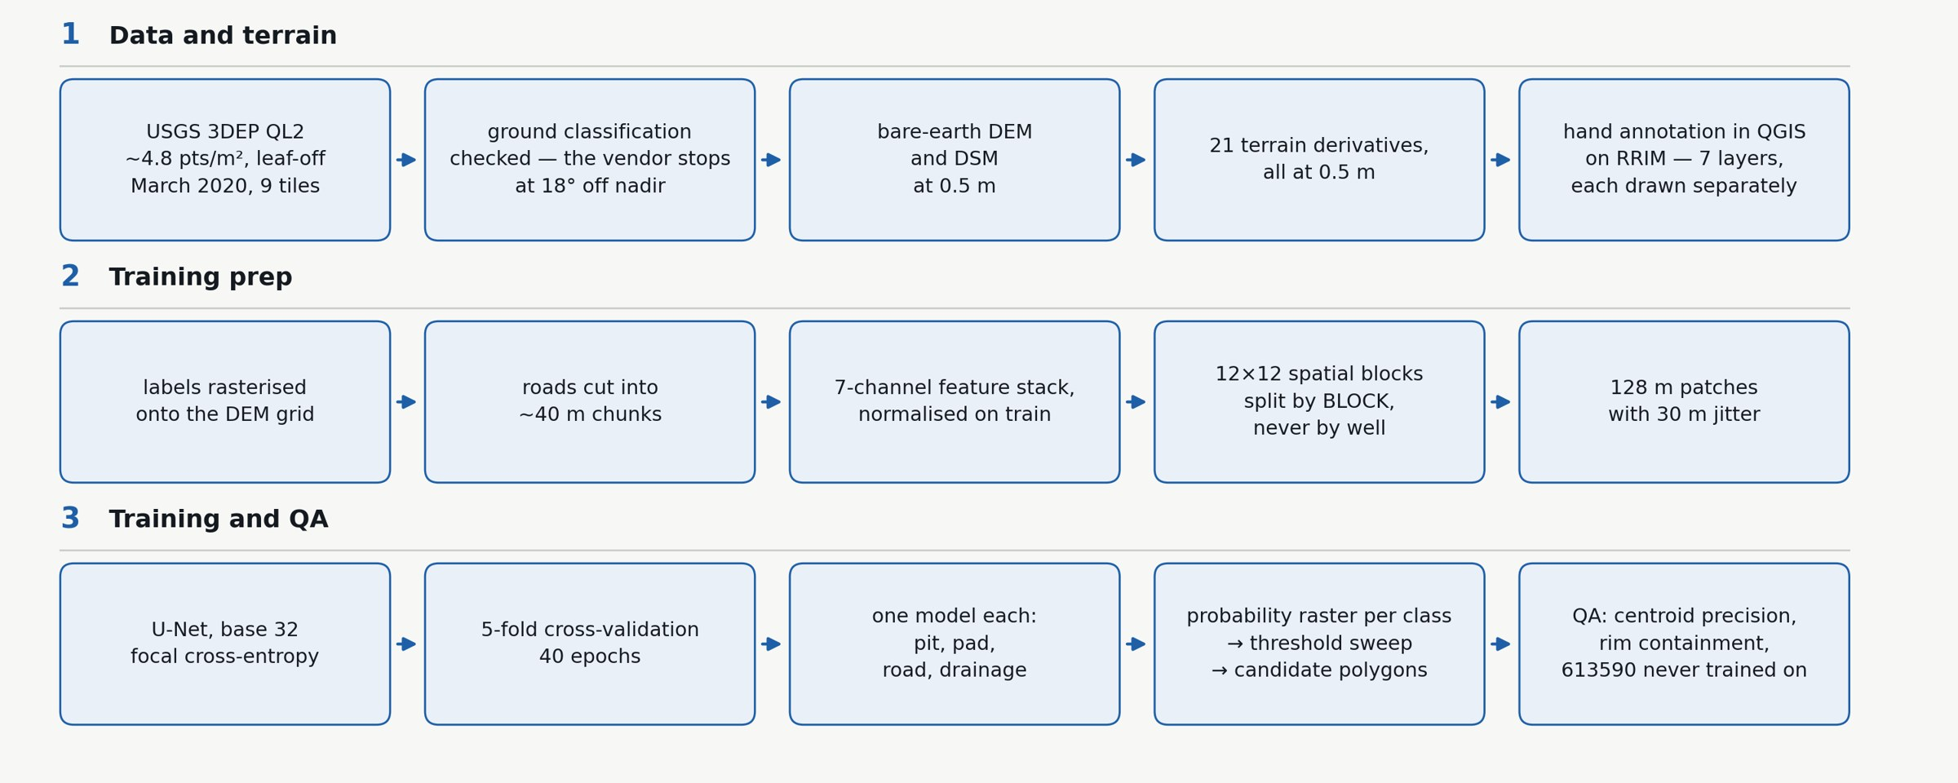
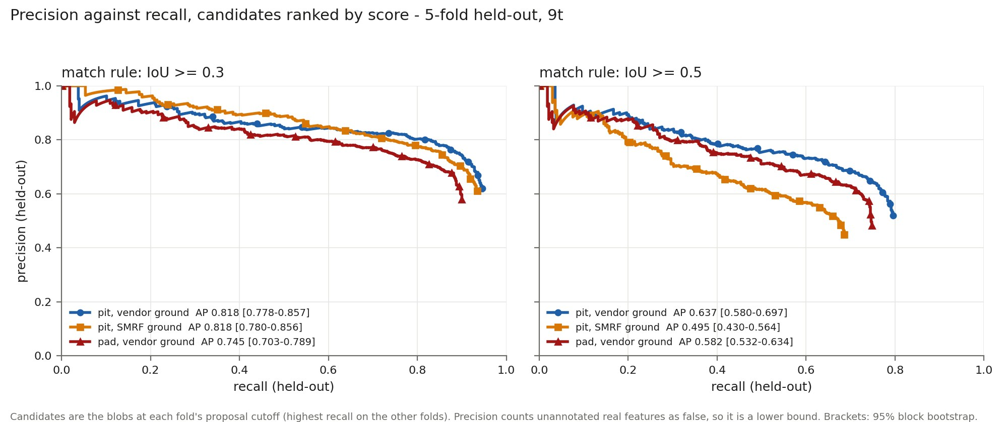
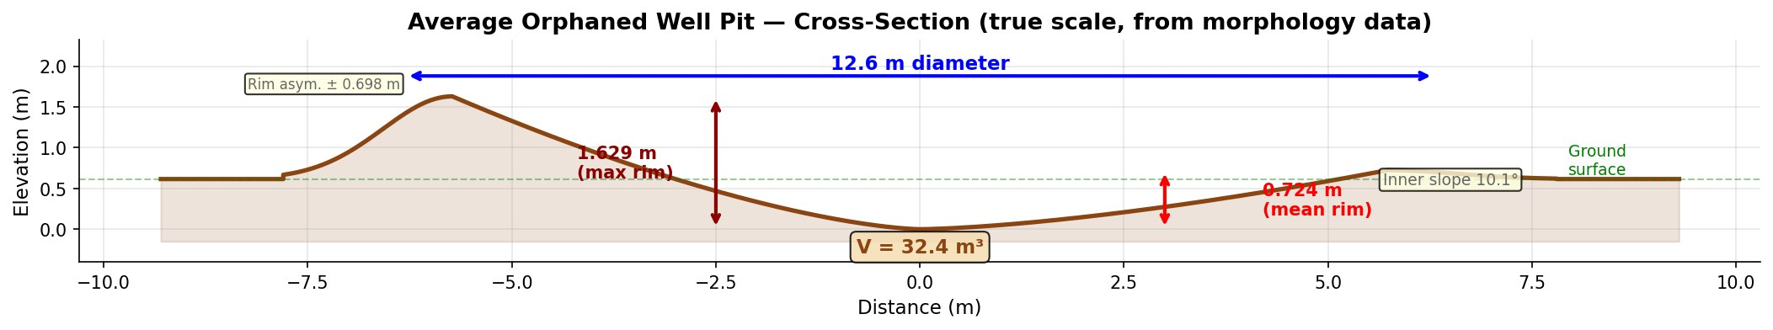
[Poster title]
Colton Goodrich, [co-authors]
Cullen College of Engineering, University of Houston
Forests hide old wells from air photos
Airborne lidar finds 9 in 10 old well pits and pads under forest canopy
stand-in: map of pennsylvania documented orphan wells
Pennsylvania lists thousands of orphan wells. Many more were never recorded.
Lidar sees the ground under the trees
stand-in: hero figure. one held-out block. hillshade base, hand annotation as outlines, model output filled. zoom insets: a hit, a miss, a false alarm
One U-Net per sign, seven terrain channels
Nine in ten pits and pads found
stand-in: optical vs lidar pair, then the seven-channel strip of one pit
[93%]
[91%]
[98%]
USGS 3DEP lidar, flown leaf-off Nov 2019 to Mar 2020. 1 m bare-earth model.
pits
pads
roads
found in held-out blocks
A well leaves a pit, a pad and a road
stand-in: pipeline diagram: points, ground, dem, channels, u-net, candidates
Each model maps one sign. Roads also learn drainage as a look-alike.
Scored only by models that never saw the feature
stand-in: precision-recall curves, pits and pads
Fold map: tile split into five spatial blocks
What this means
stand-in: three-up drawing: pit profile, pad, road
Lidar can screen whole counties for unrecorded wells.
Next: more survey blocks and field checks.
We drew [712] pits, [995] pads and [735] road segments by hand.
Each of five spatial blocks is tested by a model trained on the other four.
References
Acknowledgements
Full methods, data and code
QR
Short reference list. 3DEP citation.
Funding and data credits.

