Slide 1

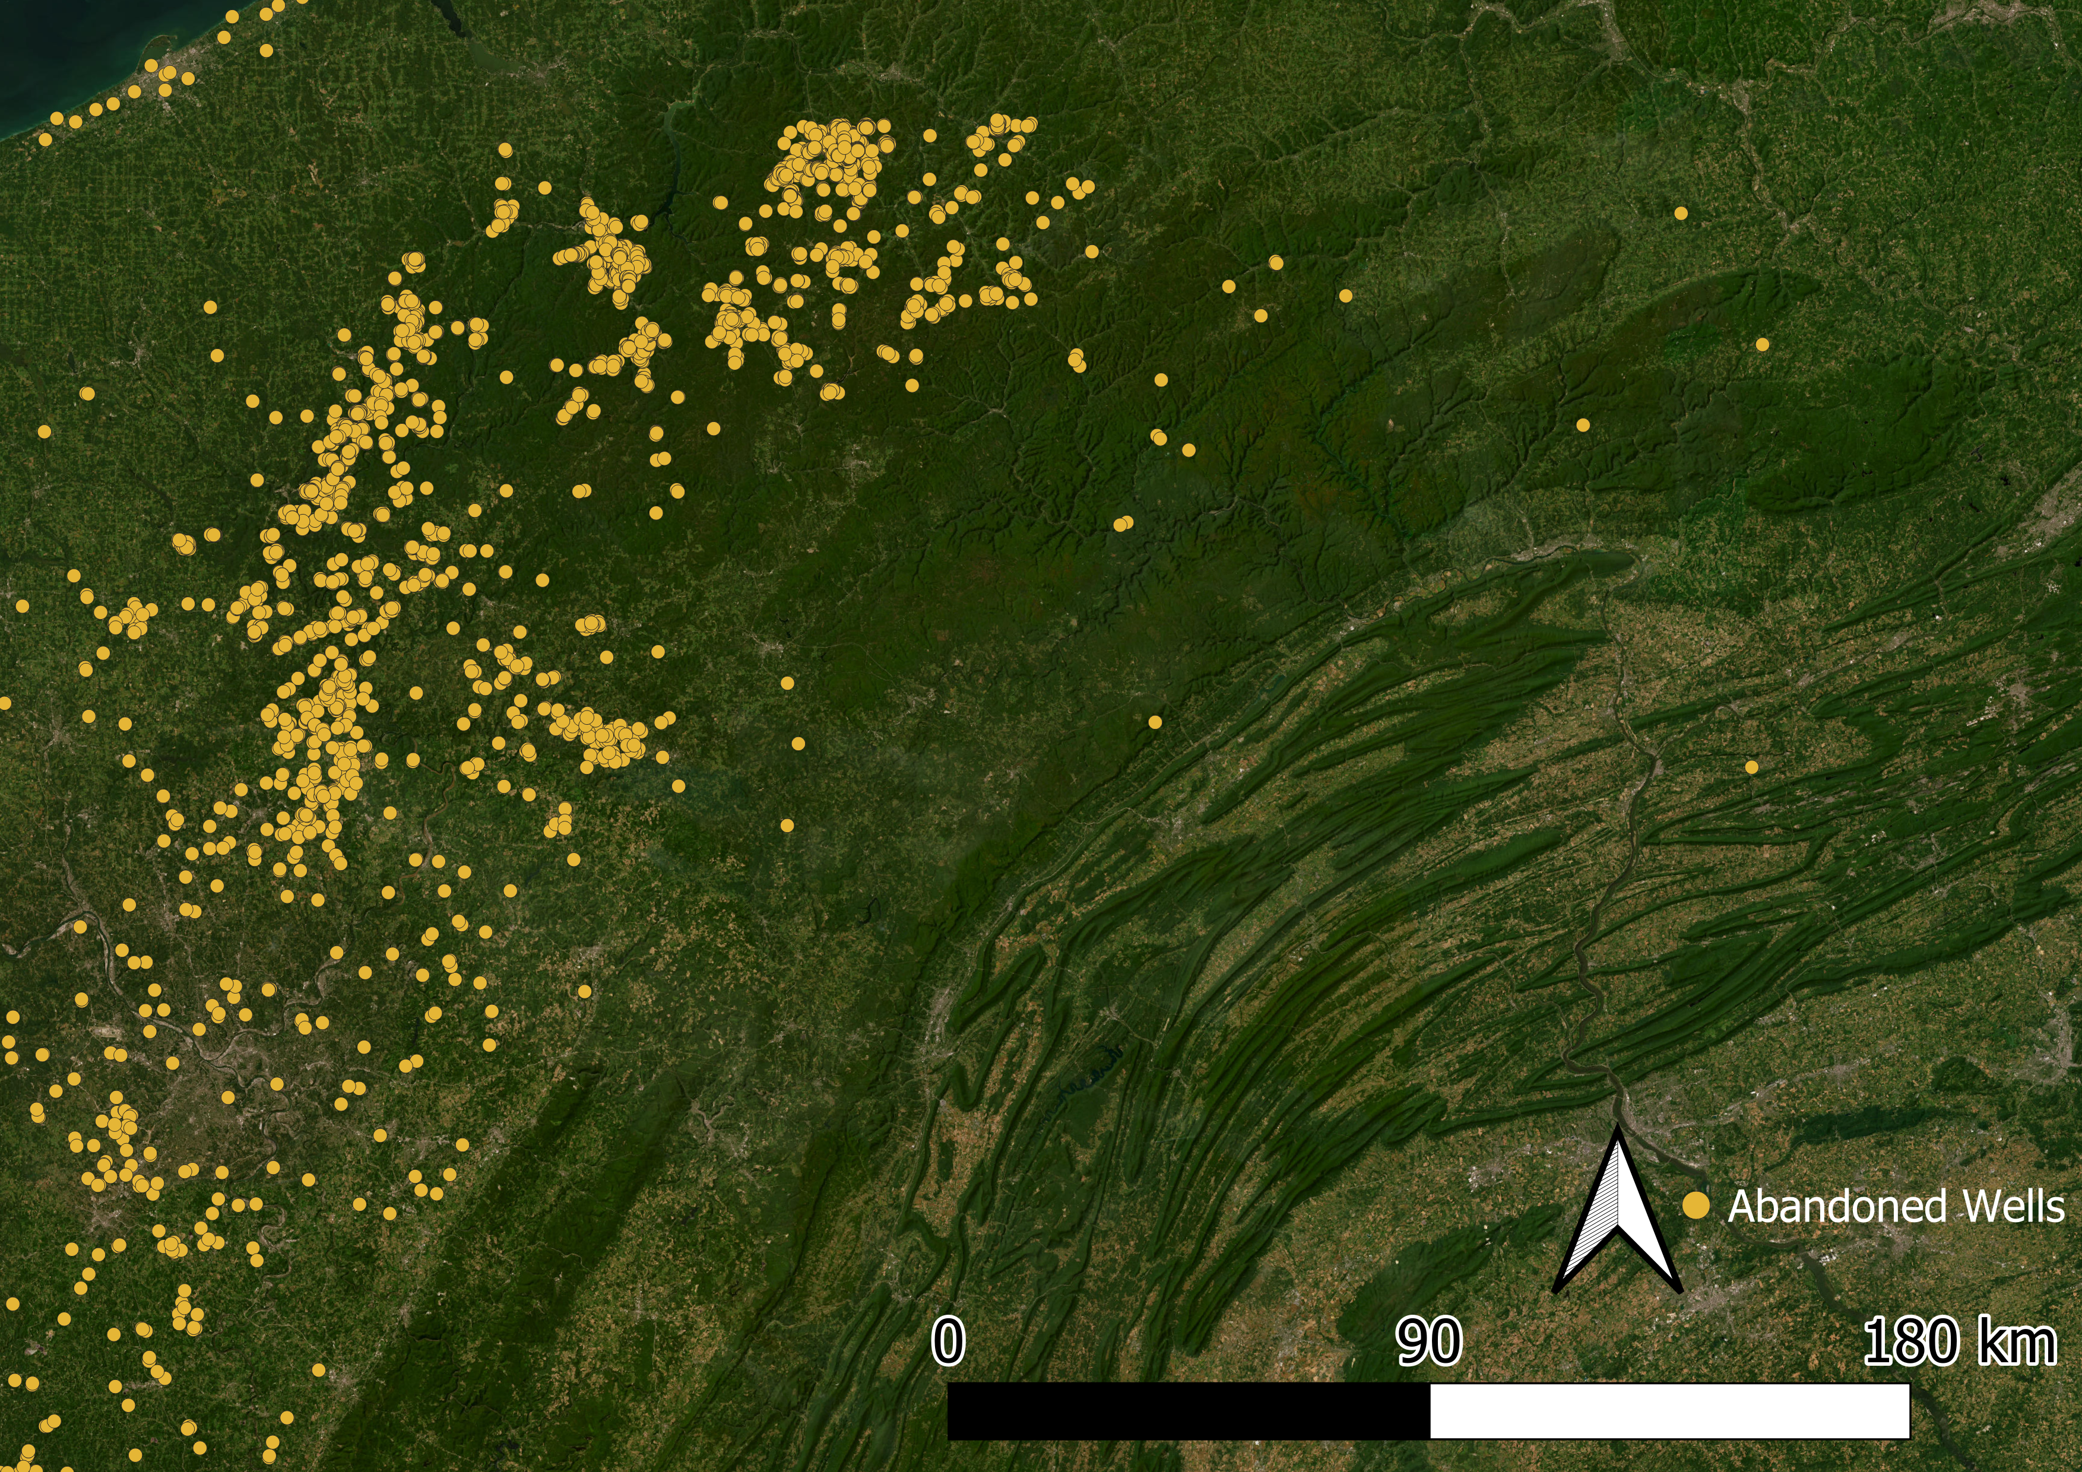
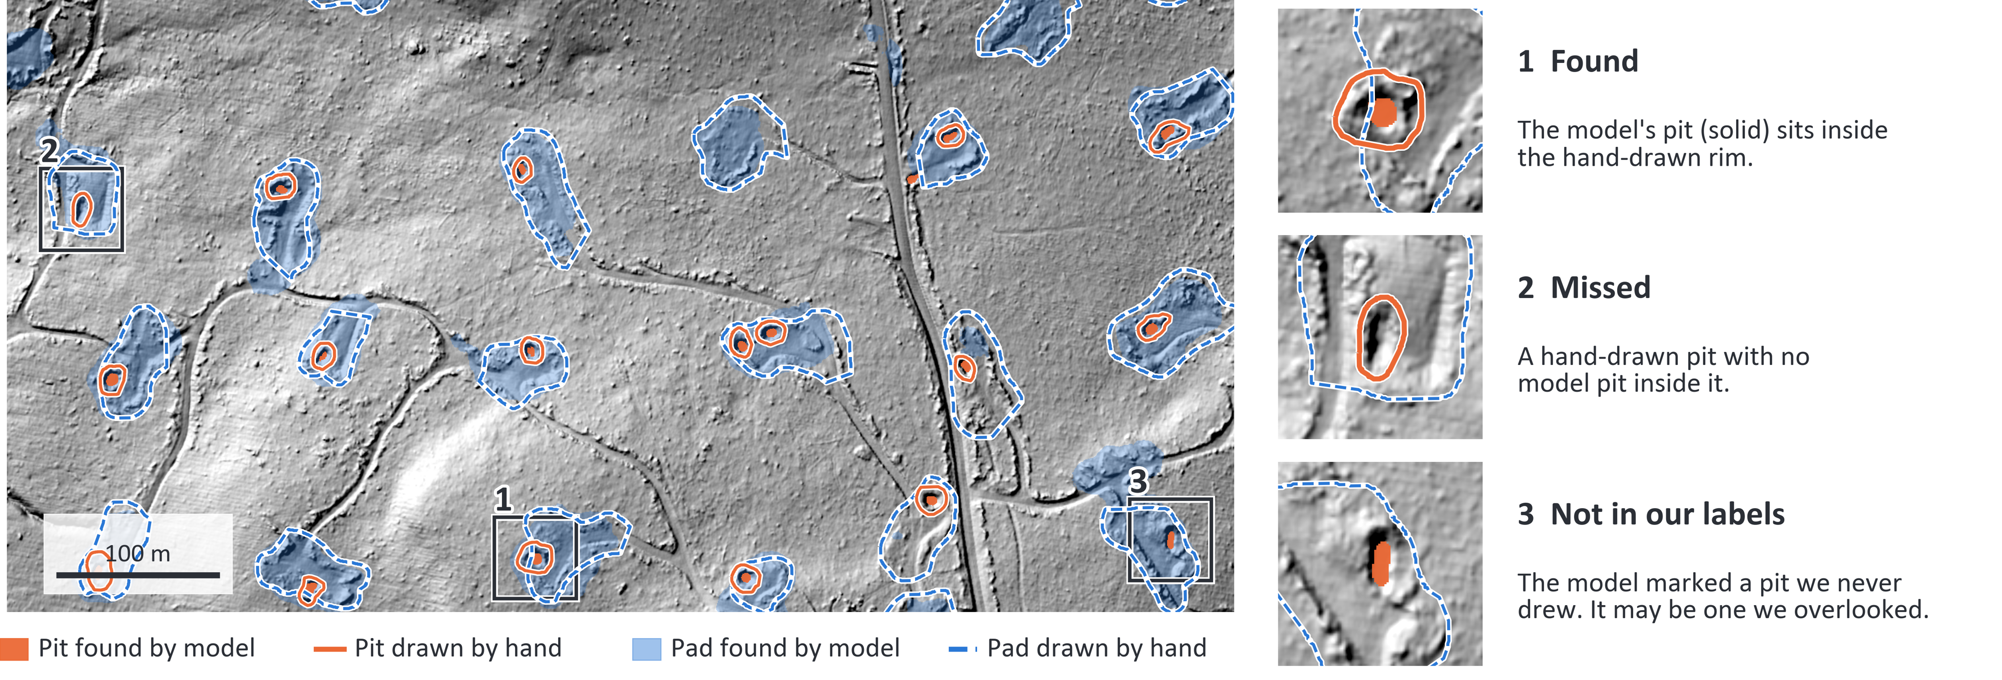
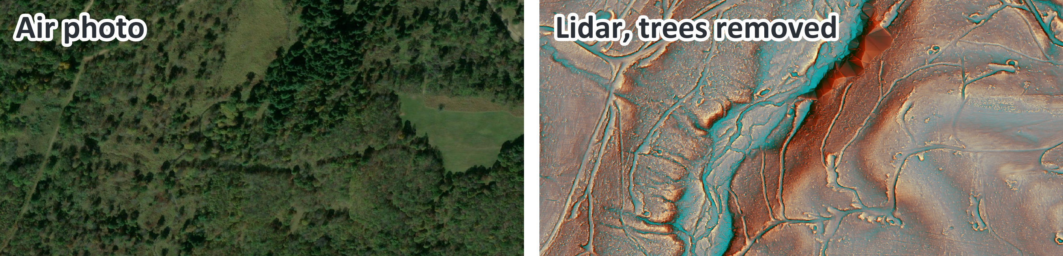
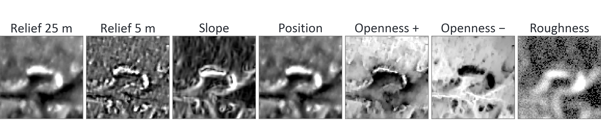
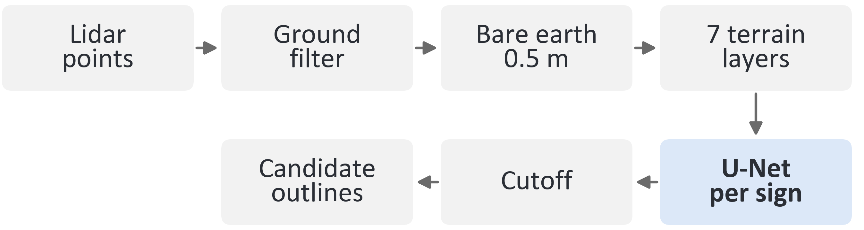
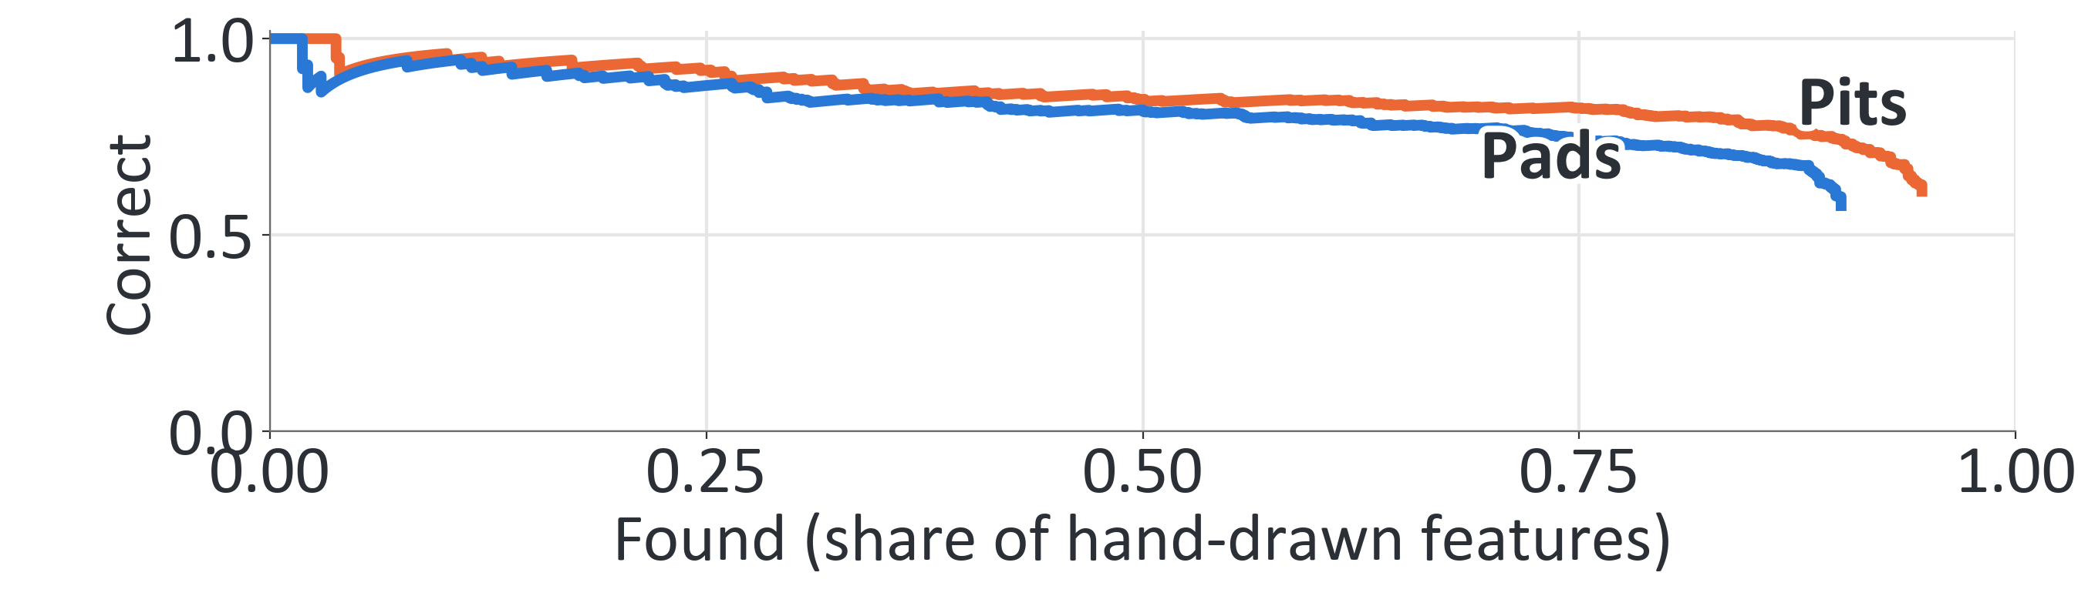
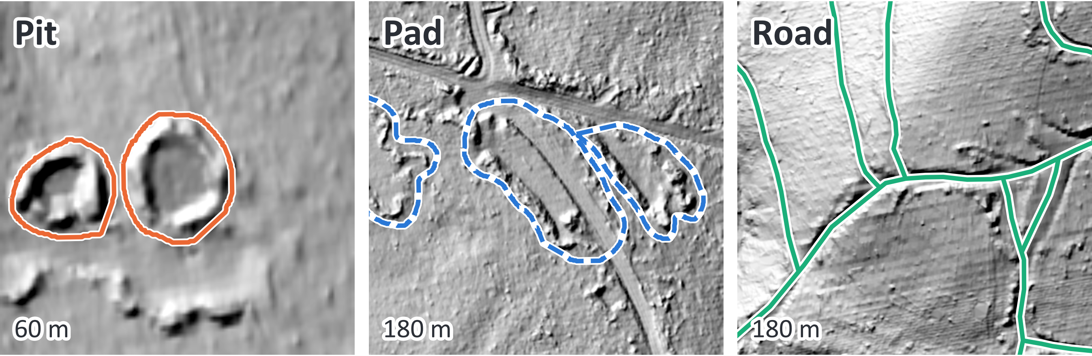
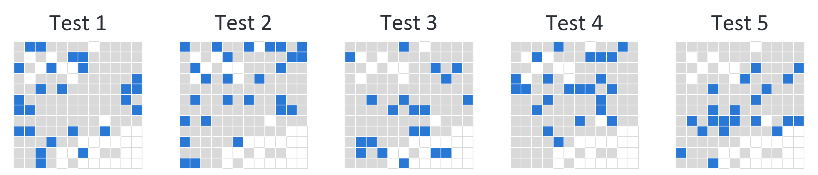
[Poster title]
[Authors]
[Affiliation]
[Heading: why the problem matters]
[Main finding in one sentence]
[Background: what orphan wells are and why they matter]
[Prior work here: satellite and lidar studies, then the question]
[Heading: why lidar]
[Data: lidar source, area, flight dates, terrain layers built]
[Hero caption: what the map shows and where]
[Heading: the model]
[Heading: main result]
Pits
Found
Correct
Tight fit
Pads
[xx%]
[xx%]
[xx%]
Roads
[xx%]
[xx%]
[xx%]
[xx%]
[xx%]
[xx%]
[Heading: what a well leaves behind]
[Table note: define each column]
[Method: model type, outputs, cutoff, how roads differ]
[Heading: how it was tested]
[Results: what the numbers say, where it is weak and why]
[Signs: describe pit, pad and road. Number of hand labels]
[Heading: implications]
[Heading: where this goes next]
[Validation: blocks, test sets, match rule, road test set]
[Implications here]
[Limits here]
[Next steps here]
[New areas: Warren, Forest, other states]
[New signals: magnetometry, old maps, drone lidar]
[New tasks: era, risk ranking, well records]
[Adjacent: confusers, coal, CO2, field methane]
[Scale: field campaign, active learning, benchmark]
References
Acknowledgements
Full methods, data and code
QR
[References here]
[Funding and data credits here]

