Slide 1
Morphological Characterization of Orphaned Oil and Gas
Well Pits Using Remote Sensing in Western Pennsylvania
Colton Goodrich
NCALM
University of Houston
Notes:
Title slide.
The work: finding old oil wells that have no usable record, by the shape of the
ground they left behind.
"Morphological" means "by shape". Not by paperwork, and not by anything visible
from the air. By the dent in the dirt.
Location is western Pennsylvania, where the American oil industry began.

Slide 2
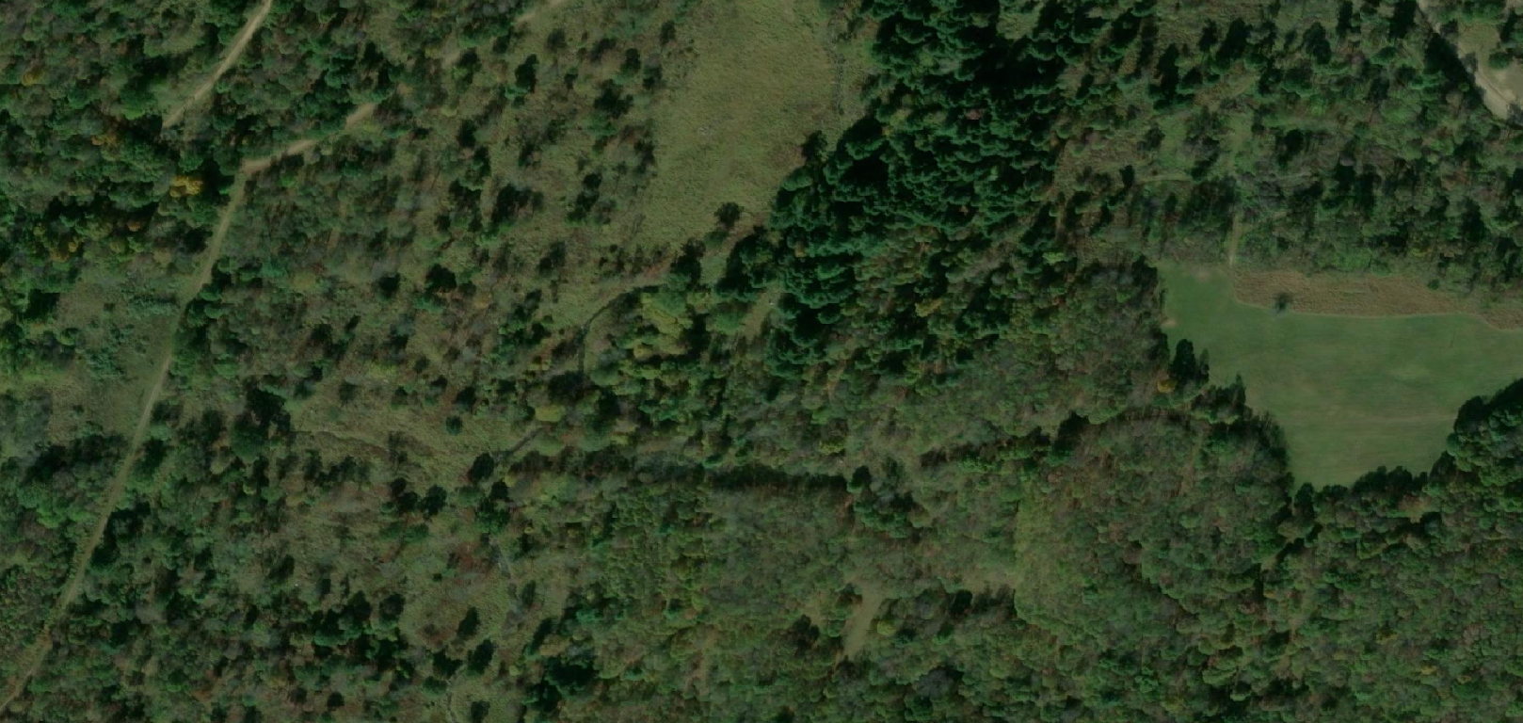
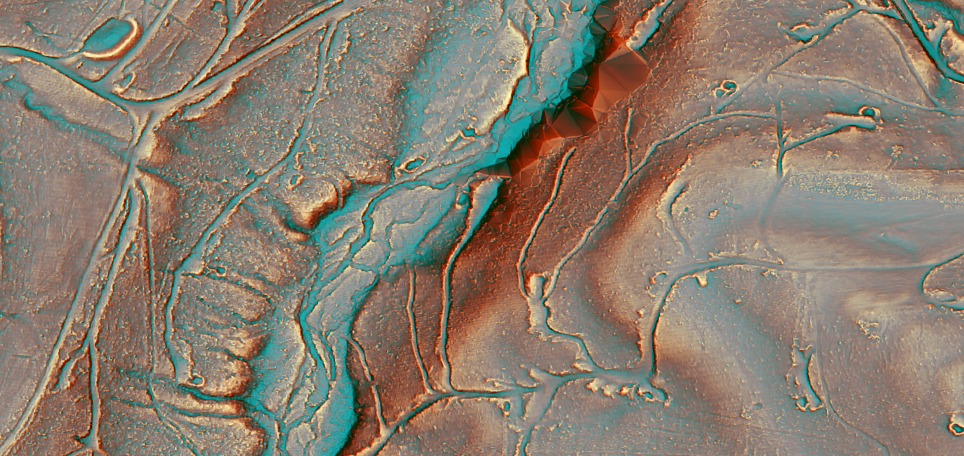
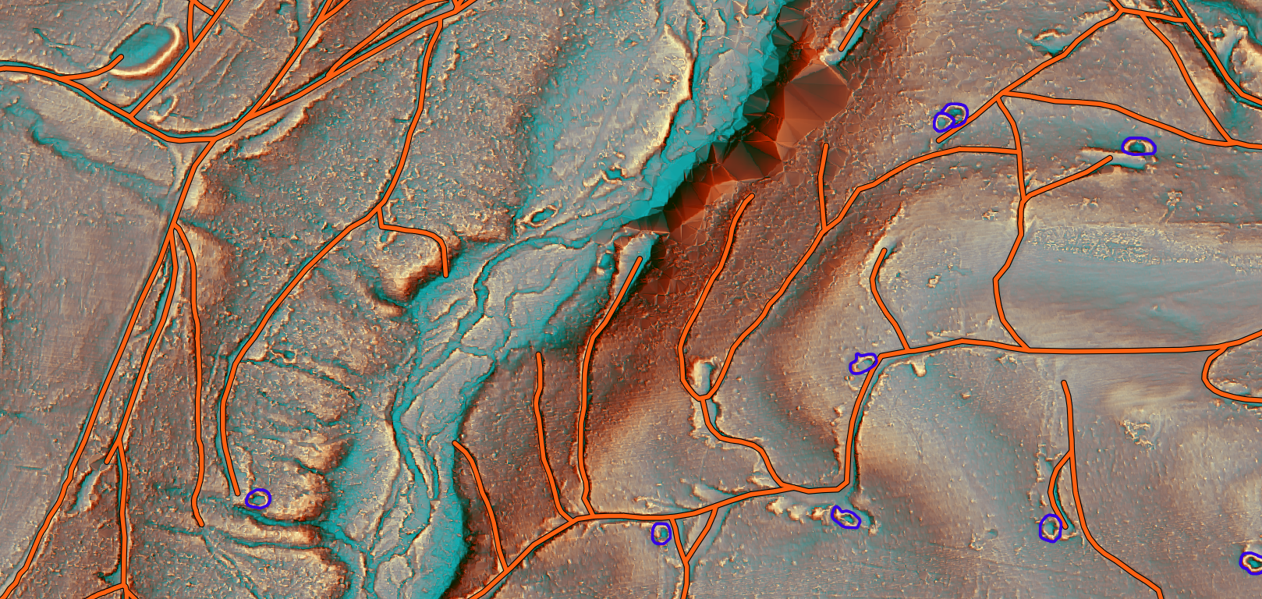

First American oil wells drilled in western PA in the mid-1800s
Abandoned: no production, extraction or injection for twelve months, and no equipment left on site. Treated as a dry well, not equipped to produce again.
Impossible to see in most optical
LiDAR saves the day.
User created components
  Pits (interior and exterior), pads, roads, drainage
Unet modeling to predict in adjacent sections
Test new NISAR datasets (L-band)
Notes:
Two images of the same location, side by side. Satellite on one side showing
canopy, LiDAR hillshade on the other showing the ground beneath it.
LiDAR is a laser flown on an aircraft. It fires pulses and times the return,
which gives a distance and so a height.
Some pulses find gaps in the leaves and reach bare dirt. Keep only those and
you have a map of the ground under the forest.
The bullets: roads, pads and collapse pits become visible, and 1 m resolution
resolves features larger than about 2 m across.
The comparison is the argument. The satellite image shows trees. The LiDAR
shows roads and pits.

Slide 3
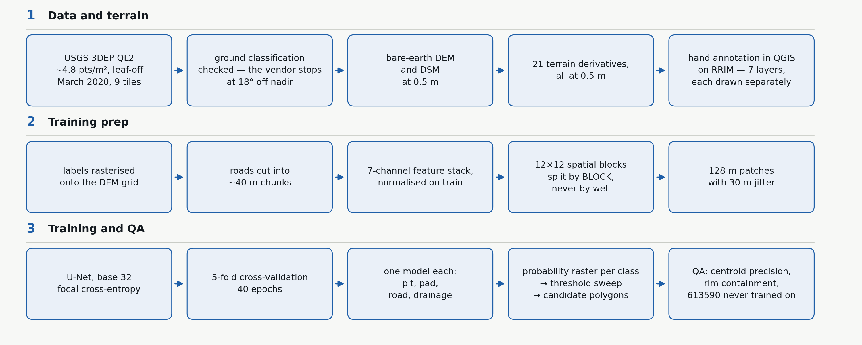
• Pits — cross-validation recovered 467 of 503 annotated floors, 92.8%
• Roads — 722 of 735 fully-withheld segments, 98.2%. Across the full withheld set, 43.07 km, 98.8% of length recovered. Flags 5.0%.
• Pads — cross-validation recovered 593 of 650, 91.2%; a separate sweep held its recall while flagging 9.8%
• On a second tile, never trained on: pit recall averages 0.911 across the five models, down 0.017
• Precision 0.633 for pits and 0.587 for pads at the same recall-weighted setting, measured against what one person drew
Notes:
Two images of the same location, side by side. Satellite on one side showing
canopy, LiDAR hillshade on the other showing the ground beneath it.
LiDAR is a laser flown on an aircraft. It fires pulses and times the return,
which gives a distance and so a height.
Some pulses find gaps in the leaves and reach bare dirt. Keep only those and
you have a map of the ground under the forest.
The bullets: roads, pads and collapse pits become visible, and 1 m resolution
resolves features larger than about 2 m across.
The comparison is the argument. The satellite image shows trees. The LiDAR
shows roads and pits.

