Slide 1
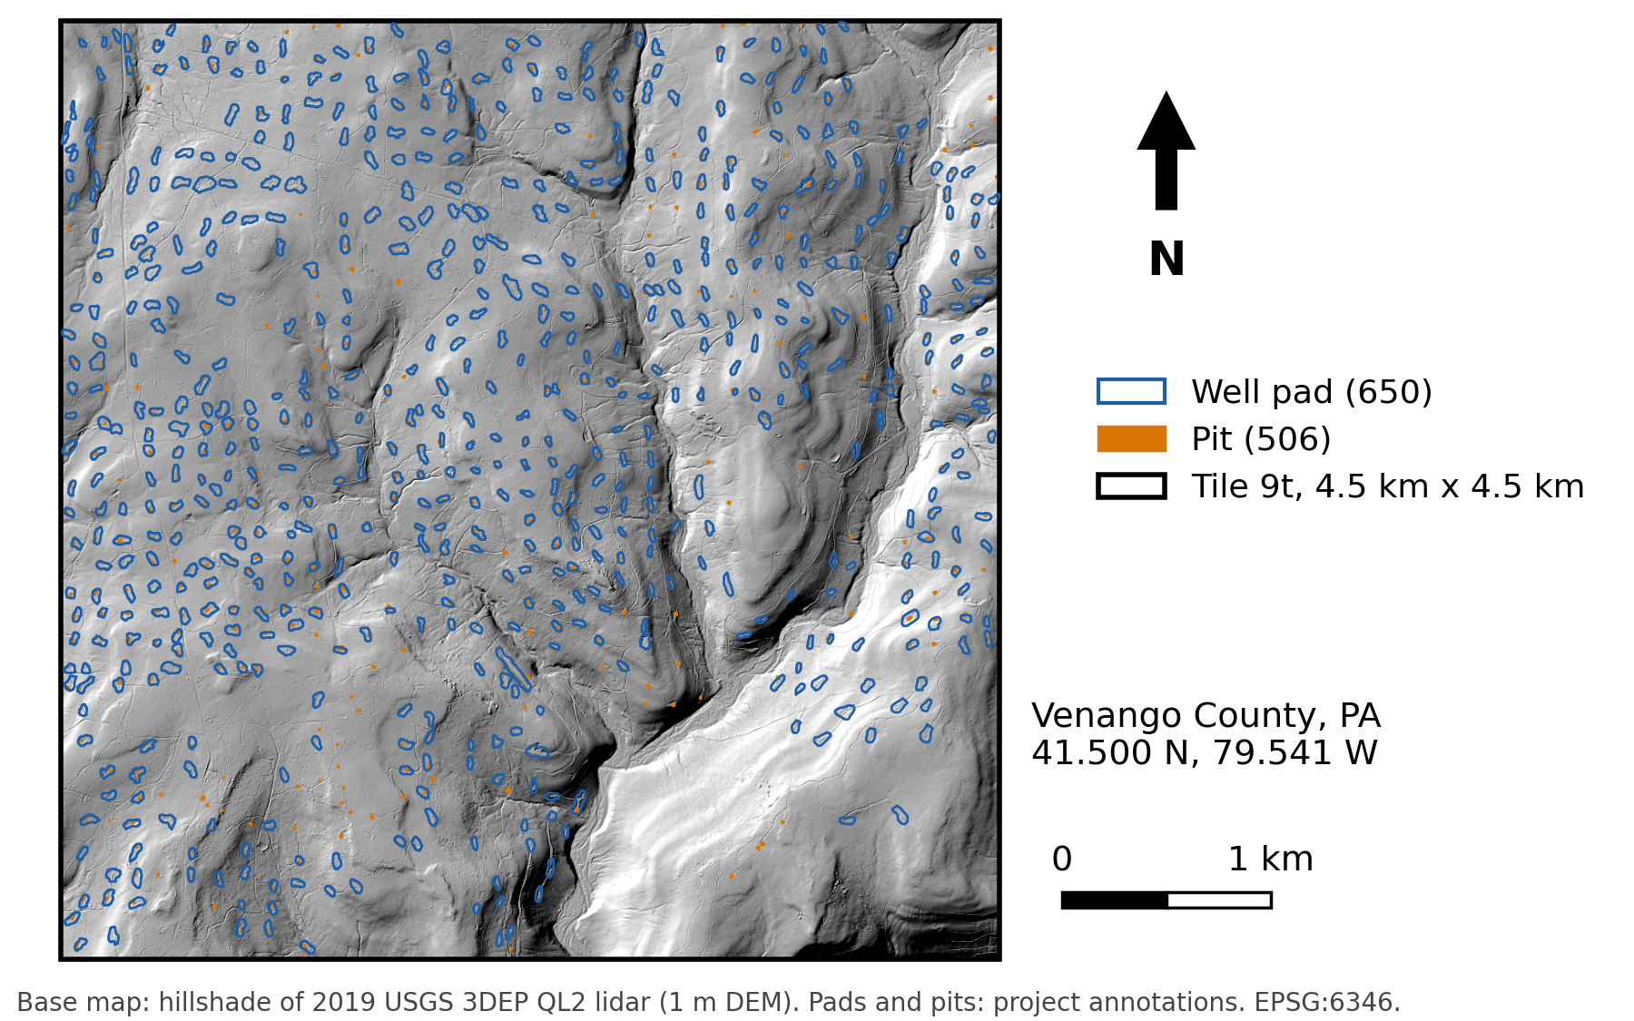
CIVE 6359 · Project checkpoint
Colton Goodrich · 1 of 3
1 QUESTION AND SITE
Can NISAR L-band radar help find oil-well pads and pits under forest beyond what lidar finds?
Site
Tile 9t in Venango County, PA. 20 km² of hardwood forest with 650 mapped well pads and 506 pits from 150 years of oil drilling.
Expected signal
Any rise or fall in HH or HV backscatter, or a drop in coherence, at pads and pits compared with nearby forest. Size and sign are not assumed. Speckle is large on one date, so the signal is measured over many repeat dates.
Why a radar sees it
The 24 cm L-band wave passes through much of the canopy. Clearings, water and metal change the echo, and 12-day repeats let speckle be averaged out.
Notes:
About 1 minute 40 seconds. Read the question. The site is tile 9t in Venango County, 4.5 by 4.5 km of forest with 650 pads and 506 pits mapped from lidar. I am not assuming a size or a sign. I am looking for any rise or fall in backscatter, or a drop in coherence, at pads and pits compared with matched forest nearby, measured over many dates rather than one. L-band is the band most likely to reach the ground through leaves. The practical question is narrower. Does radar raise the number of real pads a field crew finds for the same number of site visits?

Slide 2
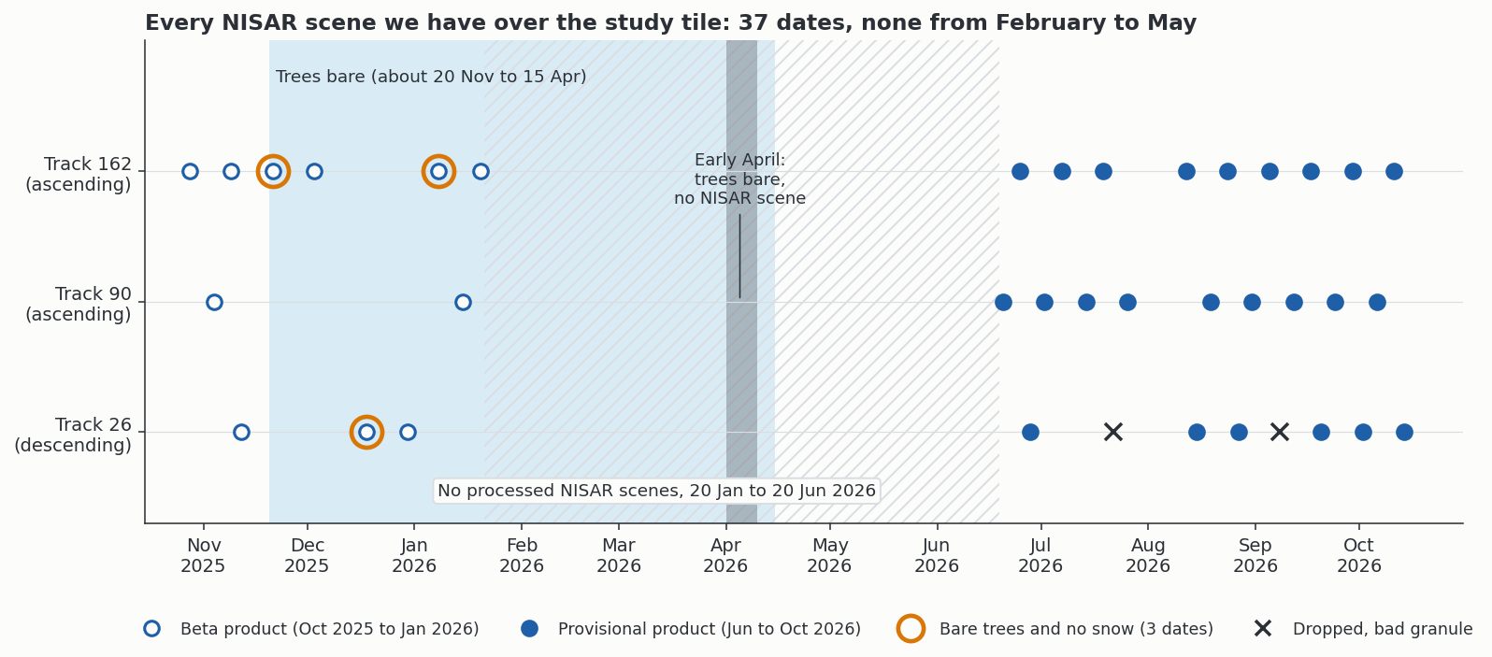
CIVE 6359 · Project checkpoint
Colton Goodrich · 2 of 3
2 DATA
37 NISAR L-band dates on three tracks, October 2025 to October 2026, cover the whole tile.
Mission and band | NISAR L-band (24 cm), HH and HV. The longest wavelength in orbit, so the best chance under canopy.
Product | Level-2 GSLC on a 5 m grid (amplitude and phase), plus RSLC to geocode again on lidar heights.
Track and geometry | Tracks 90 and 162 ascending, looking west. Track 26 descending, looking east. Incidence 39°, 47° and 41°.
Dates and count | 2025-10-28 to 2026-10-14. 12-day repeat. 37 dates (11 beta, 26 provisional). 35 pass the coverage screen. Nothing released for February to May.
Source | NASA Earthdata and the Alaska Satellite Facility (search.asf.alaska.edu). Read in 9 MB windows by HTTP range requests.
Check against | Lidar-mapped pads and pits (2019, 1 m), PA DEP well records, Sentinel-1 C-band and Sentinel-2.
NISAR dates over tile 9t by track. The gap from February to May is release timing, not missed collection.
Notes:
About 1 minute 40 seconds. L-band because it is the band that best sees under leaves, and NISAR is the first free L-band mission with this revisit. I use the GSLC product, and the raw RSLC so I can place the image on lidar heights myself. Three tracks cover the tile, two ascending and one descending, at 39 to 47 degrees incidence. 37 dates delivered from October 2025 to October 2026. Every date, its processing level and any exclusion go into one input manifest that every step reads. I check everything against our lidar maps of pads and pits, the state well records, and Sentinel-1 and Sentinel-2.

Slide 3
CIVE 6359 · Project checkpoint
Colton Goodrich · 3 of 3
3 PROCESSING STEPS AND WHAT COULD GO WRONG
Verified pads found at a fixed inspection budget, lidar alone against lidar plus radar, answer the question. The bar is +0.05 recall.
1 Build one input manifest for every date and layer
Tool: Python, h5py Key choice: dates, masks, bands and exclusions listed; runs stop on a mismatch
What could go wrong
Risk | How you would notice | What you would do instead
Image placed off the ground, because the Copernicus DEM sits on the canopy | Lidar simulation or surveyed reflectors sit offset from the image | Geocode on lidar heights. Check on reflectors not used to fit
Score learns location, not the target | Map x and y alone score as high as the radar | Fixed spatial folds. Coordinate-only and placebo controls
Labels favour what lidar already sees | Radar can only confirm features lidar drew | Independent labels on a reserved area, plus a sample outside the candidates
2 Geocode again on lidar heights
Tool: own geocoder Key choice: lidar DEM in place of Copernicus DEM, offsets fit on reference targets
3 Stack dates into a small fixed radar feature set
Tool: numpy, rasterio Key choice: HH and HV level, local contrast and texture only
4 Score the lidar detector's candidates with and without radar
Tool: scikit-learn Key choice: same candidates and spatial folds, fixed once
5 Recall at a fixed budget on a reserved area
Tool: cluster bootstrap Key choice: budget, bar and labels fixed before scoring
Notes:
About 1 minute 40 seconds. Five steps. First, one input manifest. It lists every date, mask, band and exclusion, and every later step reads it, so no step can quietly use a different set of files. Second, geocode again on lidar heights, because NASA's elevation model sits on the treetops and can shift the image. The offsets are fit on reference targets and checked on others. Third, a small fixed set of radar layers, chosen before any scoring. Fourth, the lidar detector proposes candidate sites, and the same candidates and the same spatial folds are scored with and without radar. Fifth, on an area held back from all choices, count how many verified pads each version finds for the same number of site visits. The budget, the +0.05 recall bar and the labels are fixed first. Three risks. Misplacement, checked on reflectors not used for fitting. A score that learns location, checked with map coordinates alone and a placebo. Labels that only contain what lidar can see, handled with independent labels and a sample outside the candidates.

