Slide 1
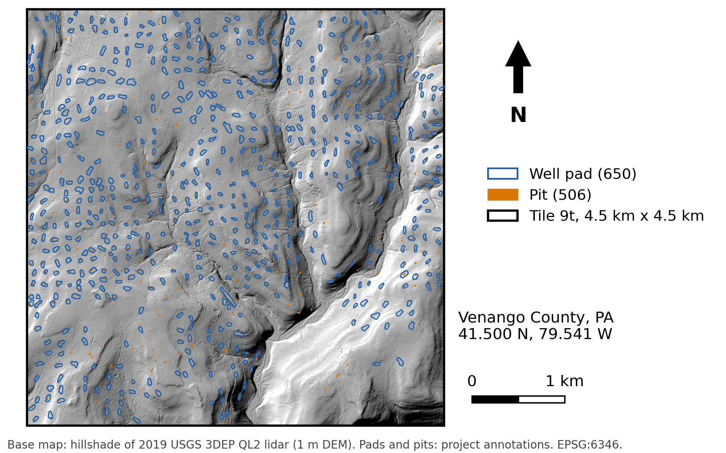
CIVE 6359 · Project checkpoint
Colton Goodrich · 1 of 3
1 QUESTION AND SITE
Can NISAR L-band radar detect oil-well pads and pits under forest, and does it add anything to lidar?
Site
Tile 9t in Venango County, PA. 20 km² of hardwood forest with 650 mapped well pads and 506 pits from 150 years of oil drilling.
Expected signal
Any rise or fall in HH or HV backscatter, or a drop in coherence, at pads and pits compared with matched forest nearby. Speckle is large on one date, so a small signal needs many repeat dates.
Why a radar sees it
The 24 cm L-band wave passes through much of the canopy. Clearings, water and metal change the echo, and 12-day repeats let speckle be averaged out.
Notes:
About 1 minute 40 seconds. Read the question. The site is tile 9t in Venango County, 4.5 by 4.5 km of forest with 650 pads and 506 pits mapped from lidar. I am not assuming a size or a sign. I am looking for any rise or fall in backscatter, or a drop in coherence, at pads and pits compared with matched forest nearby, larger than the scatter from one date to the next. L-band is the band most likely to reach the ground through leaves.

Slide 2
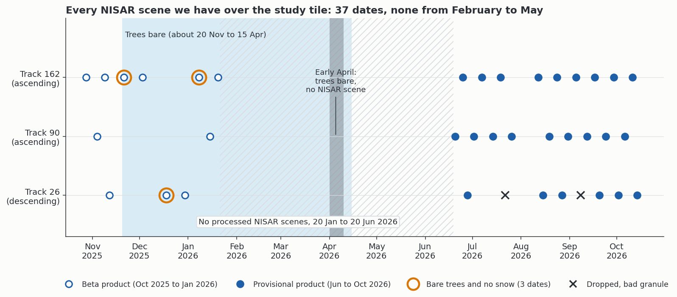
CIVE 6359 · Project checkpoint
Colton Goodrich · 2 of 3
2 DATA
37 NISAR L-band dates on three tracks, October 2025 to October 2026, cover the whole tile.
Mission and band | NISAR L-band (24 cm), HH and HV. The longest wavelength in orbit, so the best chance under canopy.
Product | Level-2 GSLC on a 5 m grid (amplitude and phase), plus RSLC to geocode again on lidar heights.
Track and geometry | Tracks 90 and 162 ascending, looking west. Track 26 descending, looking east. Incidence 39°, 47° and 41°.
Dates and count | 2025-10-28 to 2026-10-14. 12-day repeat. 37 dates (11 beta, 26 provisional). Nothing released for February to May.
Source | NASA Earthdata and the Alaska Satellite Facility (search.asf.alaska.edu). Read in 9 MB windows by HTTP range requests.
Check against | Lidar-mapped pads and pits (2019, 1 m), PA DEP well records, Sentinel-1 C-band and Sentinel-2.
NISAR dates over tile 9t by track. The gap from February to May is release timing, not missed collection.
Notes:
About 1 minute 40 seconds. L-band because it is the band that best sees under leaves, and NISAR is the first free L-band mission with this revisit. I use the GSLC product, and the raw RSLC so I can place the image on lidar heights myself. Three tracks cover the tile, two ascending and one descending, at 39 to 47 degrees incidence. 37 dates delivered from October 2025 to October 2026, 35 usable after dropping an empty and a misplaced one. I check everything against our lidar maps of pads and pits, the state well records, and Sentinel-1 and Sentinel-2.

Slide 3
CIVE 6359 · Project checkpoint
Colton Goodrich · 3 of 3
3 PROCESSING STEPS AND WHAT COULD GO WRONG
Radar scores at pads and pits against matched decoys, and the gain over lidar, answer the question. The bar is +0.05 AUC.
1 Download GSLC and RSLC windows over tile 9t from ASF
Tool: Python, h5py Key choice: read only the tile, drop 2 bad track-26 dates
What could go wrong
Risk | How you would notice | What you would do instead
Image placed about 10 m off, because the Copernicus DEM sits above the ground | Lidar simulation slides 9 to 12 m to match the image | Geocode on lidar heights and solve one offset per date
Score learns location, not the target | Map x and y alone, or fake pads, score as high as the radar | Decoys within 1.5 km and a placebo test
Target smaller than a pixel. Single-look speckle on each date | Pit contrast smaller than one-date speckle | Average many dates. Use lidar intensity for wet pits
2 Geocode again on lidar heights
Tool: own geocoder Key choice: lidar DEM in place of Copernicus DEM
3 Stack dates into backscatter and coherence layers
Tool: numpy, rasterio Key choice: leaf-off and leaf-on seasons kept apart
4 Score pads and pits against decoys
Tool: scikit-learn Key choice: decoys matched for canopy, within 1.5 km
5 AUC of radar alone and gain over lidar, per target
Tool: block bootstrap Key choice: +0.05 gain bar fixed before scoring
Notes:
About 1 minute 40 seconds. Five steps. Download only the tile windows. Geocode again on lidar heights, because NASA's elevation model sits on the treetops and shifts the image by about two pixels. Stack the dates by season. Score pads and pits against decoys matched for canopy and slope. Then measure the gain over a lidar-only model against a bar of +0.05 AUC set before scoring. Three risks. Misplacement, which a lidar simulation reveals. A score that learns location, which map coordinates and fake pads reveal. And targets smaller than a pixel, which I handle by averaging dates and by checking wet pits with lidar intensity.

