Slide 1
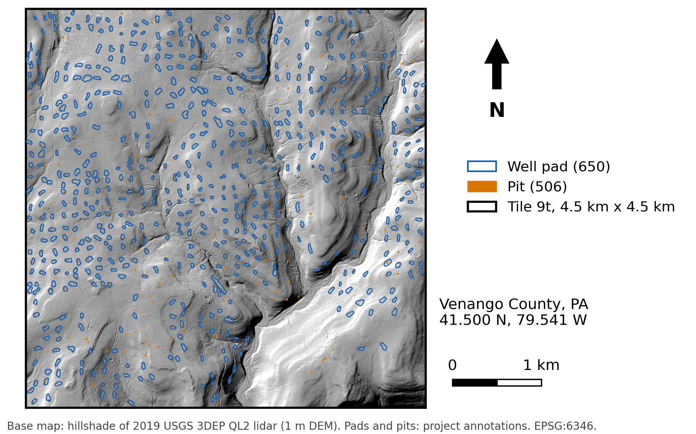
CIVE 6359 · Project checkpoint
Colton Goodrich · 1 of 3
1 QUESTION AND SITE
[Research question in one sentence]
Site
[Study site: where, how big, what is there]
Expected signal
[Expected signal: what should change at pads and pits]
Why a radar sees it
[Why radar can see it: the physics in one or two lines]
Notes:
[Speaker notes for slide 1, about 1 minute 40 seconds]

Slide 2
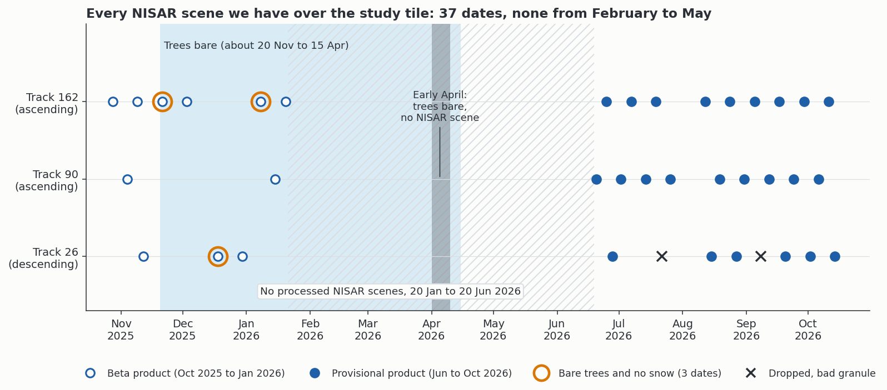
CIVE 6359 · Project checkpoint
Colton Goodrich · 2 of 3
2 DATA
[Data headline: sensor, number of dates, time span, coverage]
Mission and band | [Sensor and band, and why]
Product | [Product level and grid spacing]
Track and geometry | [Tracks, look direction and incidence angles]
Dates and count | [Date range, repeat interval, number of dates, exclusions]
Source | [Sources here: archive and access method]
Check against | [Reference data: lidar maps, well records, other sensors]
[Figure caption: what the calendar shows and why the gap exists]
Notes:
[Speaker notes for slide 2, about 1 minute 40 seconds]

Slide 3
CIVE 6359 · Project checkpoint
Colton Goodrich · 3 of 3
3 PROCESSING STEPS AND WHAT COULD GO WRONG
[Method headline: the test and the pass mark]
1 [Step 1 name]
Tool: [tool] Key choice: [key choice]
What could go wrong
Risk | How you would notice | What you would do instead
[Risk 1] | [How you would notice 1] | [Fix 1]
[Risk 2] | [How you would notice 2] | [Fix 2]
[Risk 3] | [How you would notice 3] | [Fix 3]
2 [Step 2 name]
Tool: [tool] Key choice: [key choice]
3 [Step 3 name]
Tool: [tool] Key choice: [key choice]
4 [Step 4 name]
Tool: [tool] Key choice: [key choice]
5 [Step 5 name]
Tool: [tool] Key choice: [key choice]
Notes:
[Speaker notes for slide 3, about 1 minute 40 seconds]

