Slide 1


Pervasive Computing...
Requirements to Revenue

Slide 2
Who We Are…
Established in 1987- “Statemate”
  Systems design and validation
“Rhapsody” launched in 1998
  UML compliant software application development
Rhapsody in Micro C launched in 2000
  Software development for automotive applications
$41.5m invested
  ABS Ventures, Commonwealth Capital, Gilde, One Liberty, North Bridge, Philips, Dain Rauscher, Needham & Company
Core technological competencies
  Behavioral modeling and validation
  Production quality code generation
  Formal verification
  UML

Slide 3

What we do…
We integrate and automate the systems and software design and development process
We validate behavior up front
We facilitate reuse
We increase team collaboration
We improve productivity
We improve quality
We shorten development cycles
…we save you a lot of money!

Slide 4

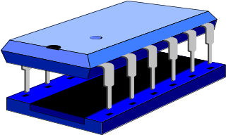


Embedded computing environment
Pervasive
System Design
Application software
Textual
Requirements
Configuration Mgt.
Editors
Debuggers
Compilers
Test Tools
RTOS
OS /

Slide 5




Pervasive computing: An era in transition
Mainframe era PC era Pervasive computing era
Application software
Wintel
Mainframe
Key Impact:
Automation
Key enablers:
1st: Proprietary CPU
2nd: High level languages
Complexity:Basic
Productivity
Microprocessor
GUI
Linear
Quality of life
Software
More of Moore
Exponential
Software is the key enabler…but is also the primary roadblock!

Slide 6
Traditional development process
Customer requirements
Hand write code
Written specification
Low level code debug
Analysis
Test code
Design
Product Iterations
Prototype

Slide 7
Defects Introduced
vs Defects Found
Defects
Defects Found
Defects Introduced
Specification
Design
Development
Test
Time
Source: “Software Engineering” Ramamoorthy et al, IEEE Computer, 10/84
Notes:
This chart reflects a well known study done in 1984! Yet, it’s exactly accurate today…you can see where defects are introduced into a design and (CLICK) you can see where they are found. This is exactly what we are saying…and the premise is that for chip design…the process is reversed…you eliminate the defects AS YOU DESIGN…but for software that hasn’t happened yet…or at least not until a few slides ahead when we talk about our products.

Slide 8
Design Productivity Gap
Gates/cm² Moore’s Law
(59% CAGR)
Log Scale
Software Design Productivity
( ≈ 10 – 15% CAGR)
Source: Philips Semiconductor
Notes:
This is a study that was doen at Philips. They calculated their hardware design productivity which has enjoyed a compounded improvement of almost 60% (CLICK)to their software design productivity…which falls between 10% and 15%

Slide 9
Availability of resources…
SW Resource affordable
SW Resource need
Source: Philips Semiconductor
Notes:
Philips also studies their staffing requirements based on the projected workload and known productivity and then compared it to the (CLICK) available resources…not yet counting the cost of these needed resources assuming they could afford them. Obviously the issue of productivity is at the core of the software design problem

Slide 10
The “1.0” syndrome
Lost revenues
Penetration of DigitalBroadcasting Technology
‘’Wait & see’’ by end-users
Year 1 Year 2 Year 3 Year 4 =>
Source: Philips Semiconductor
Notes:
Philips also calculated the cost of quality…on the one hand making the time-to-market window but then losing sales (CLICK) because of the buyers concern about acquiring a new product because they want to wait until it settles down and is debugged in the market…versus before it is shipped.

Slide 11



The Options….
Add more development staff (37%)
  Rewrite modules (74.9%)
Miss functionality expectations (87%) or cancel the project (18%)
Deliver the project late (72.8%)
Source: ElectronicMarket Forecasters
Notes:
There are a few options to address this dilemma. If you can find them then you can add resources. 37% of the people responding to an Embedded Market Forecasters survey tried to do just that. 75% go through the process of rewriting existing code to save time.
Many projects strip functionality to meet the time-to-market window. In fact, nearly 20% of those responding to the survey cancelled the project.
The most popular choice to respond to higher complexity and increased functionality is to deliver the project late. 75% of the respondents to the survey did just that.
Or … you take the opportunity and enhance the process and make the available development staff more productive.

Slide 12
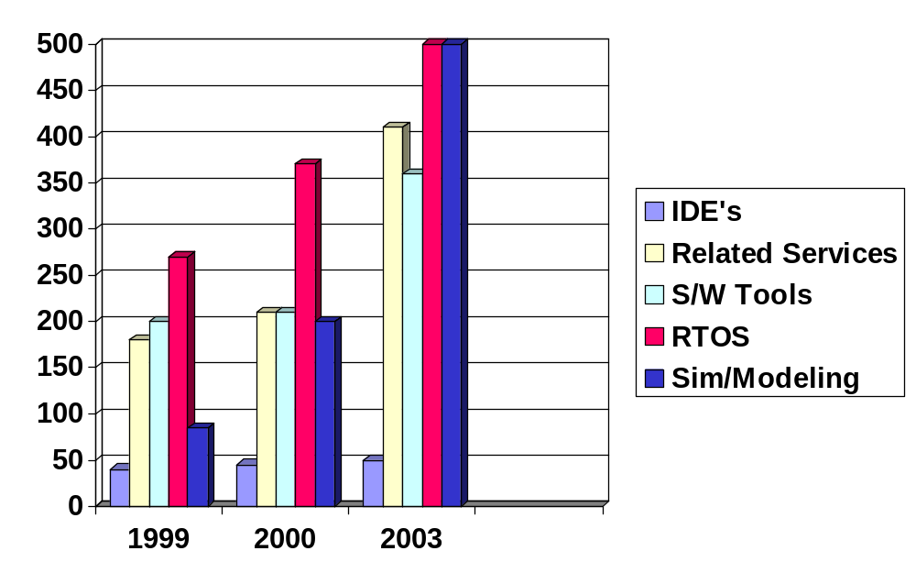
Development tools market data
($000’s)
Source: Electronic Market Forecasters

Slide 13
I-Logix products….
Complex
Specification
Validation
Statemate MAGNUM
Training and Consulting
System Design
Model Checking &
Verification
UML
Requirements
Analysis
Analysis &
Design
Rhapsody
in
Micro C
Rhapsody
in
C
(UML)
Rhapsody
in
C++
(UML)
Rhapsody
in
J
(UML)
Rhapsody
in
ADA
(UML)
Software Design & Development
Implementation
Test
Test Conductor
Test Conductor
Test Conductor
Test Conductor
Test Conductor
Functional Decomposition
Object Oriented

Slide 14


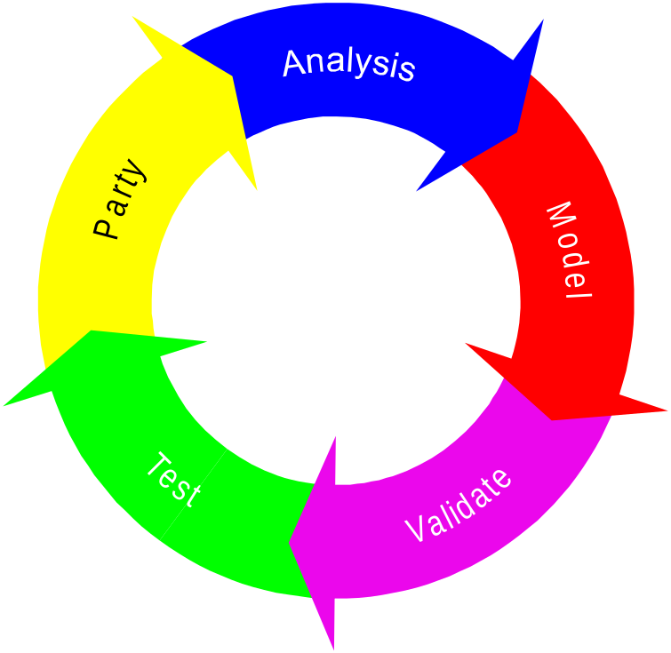

Statemate Iterative Development
Analyze, model, validate, and test...iteratively
System Modification
Requirements Analysis
Visual
Modeling
(executable)
Use Case Models
Requirements
Capture & Analysis
Test Scenarios
Test Scenarios
System
Acceptance
Conceptual/Architectural
System Model
Systems
Analysis & Design
Knowledge Base
System
Integration & Test
Implementation Model
HW / SW
Design
Module
Integration & Test
Test
Design
Validation
HW / SW
Implementation
& Unit Test

Slide 15
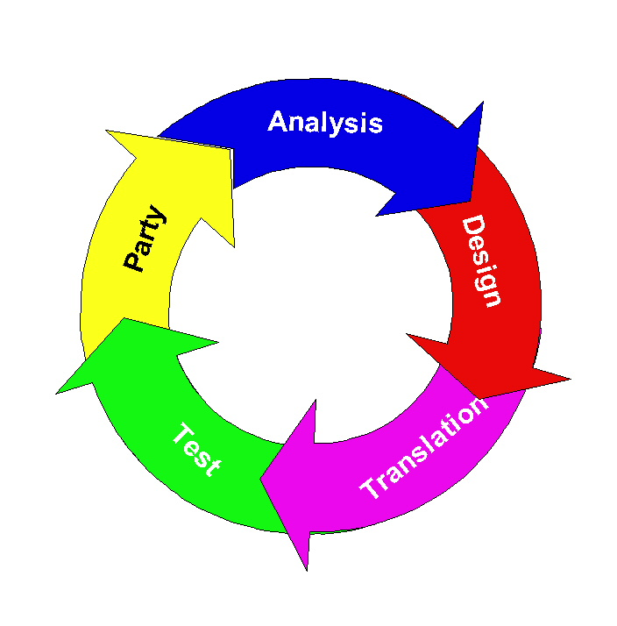
Rhapsody Iterative Development
Design, validate, code and test...iteratively
Requirements Analysis
Design
Validation
Test
Implementation

Slide 16

I-Logix…Iterative design and development
Focus on key concepts
Macro
Focus on refinement of concepts
Focus on design and implementation
Focus on optimization & deployment
Micro
Prototype increments
Micro
Prototype increments
Micro
Prototype increments
Micro
Prototype increments
Micro
Prototype increments
Nano
Nano
Nano
Nano
Nano
Nano
Nano
Nano
Nano
Nano
Nano
Nano
Nano
Nano
Nano

Slide 17
Concept to Code…through iteration
Requirements Analysis
Systems Engineering
Analysis
Design
Implementation
Integration and Test
Validation Testing

Slide 18
So…what does it all do?
Executes the model & validates behavior
Facilitates reuse
Integrates the design and development process with UML or by linking structured design with UML
Provides an exact design and development environment that maps exactly to your needs
Generates 100% accurate production quality C, C++, Java & ADA
Provides complete documentation and dynamically “associates” it with implementation

Slide 19
And what does that mean?
Shorter development cycles
Increased productivity
Improved quality
More effective collaboration
Better communications
No negative surprises
Promotions and bonuses!
New Cars! Bigger homes!
World peace!

Slide 20
World-Wide Support
Scandinavia
Detroit, MI
Headquarters
Madison, WI
Andover, MA
UK
Ann Arbor, MI
Germany
Seattle, WA
France
San Jose, CA
Princeton, NJ
Italy
Japan
Los Angeles, CA
Chicago, IL
China
Hong Kong
San Diego, CA
Orlando, FL
Israel
Taiwan
Phoenix, AZ
Dallas, TX
Singapore
India
Korea
New Zealand
Australia
Headquarters
Sales / Support Location
Distributors

Slide 21
Representative Customers…
Telecom/Datacom
Alcatel
Cadent
3Com
ECI
Ericsson
L3COM
Marconi
Motorola
Next Level
Nokia
Nortel Networks
Racal Electronics
Samsung
Siemens Telecom
Symmetry Networks
Tiara Networks
Tellabs
Yotta Networks
Wavelength Digital
Consumer Electronics/
Office Automation
Canon
DataProducts
EMC
Exabyte
Fujitsu
FujiXerox
HP
Hitachi
Intel
Kodak
Maxoptics
Mitsubishi Electric
Oki Electric
Panasonic
Peerless
Philips
Seagate
Sony
Toshiba
Military / Aerospace
BAE Systems
Boeing
General Dynamics
Goodrich
Honeywell
Hughes
JPL
Lockheed Martin
Northrop Grumman
Raytheon
Rafael
SAAB
Thales
Automotive
BMW
DaimlerChrysler
Denso
Delphi Automotive
Ford
General Motors
Lear
Nissan
Peugeot
Renault
Visteon
Valeo
Volvo
Industrial Automation
AMD
Applied Materials
Bell & Howell
Carrier
KLA-Tencor
Mitsubishi
Otis
Rockwell
Trane
Medical
Agilent
Eastman Kodak
Guidant
GE medical
MDI
Medtronic
Varian medical
Rhapsody
Statemate/Rhapsody
Notes:
This next slide gives a representative list of our Rhapsody customers. It is important to note that we cover virtually every vertical segment that could pertain to real-time embedded applications, including but not limited to, Telecom/Datacom, Consumer electronics and office automation, mil/aero, medical, automotive, and industrial automation. Rhapsody is being used to deploy both critical and creative applications in virtually every domain. Applications ranging from handsets, to set top boxes, to avionics, to highly distributed industrial applications, Rhapsody is serving as the development platform of choice for the real-time embedded industry.

Slide 22
Automating application development is only part of the solution…

Slide 23
Traditional product management process
Development Team
Chicago
Document
management
Defect
management
Development Team
India
Change
management
Requirements
Analysis
Design
Implementation
Test
Marketing
Boston
Application Development
Project
management
Support
San Jose
Collaboration
management
Assets reuse
management

Slide 24
Enter…iNotion
Document
management
iNOTION Product Management Portal
Development team
Chicago
Defect
management
Development team
India
Change
management
Requirements
Analysis
Design
Implementation
Test
Application Development
Marketing
Boston
Project
management
Support
San Jose
Collaboration
management
Component
management

Slide 25

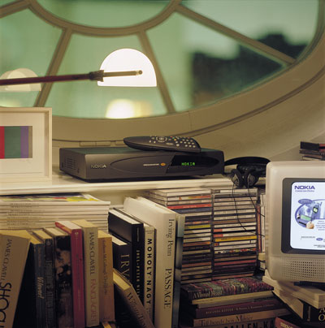



I-Logix
Visual application development
Virtual product management
Notes:
Thank you all for joining both XXX and YYY for this seminar on improving your productivity in embedded real-time software development. I hope you were able to identify with what Rhapsody will offer you in terms of productivity gains. If you have any questions please feel free to raise them now and we would be happy to answer them. In addition, you will be receiving a survey to be filled out regarding the seminar. If you complete this survey you will be entered to win a free “Doing Hard Time” book by Dr. Bruce Douglass. Thank you.

Slide 26
Q&A…

Slide 27
Appendix

Slide 28



Rhapsody Positioning
UML
compliance
Model code
bi-directional
associativity
Design level
debugging
Code
quality
Rhapsody
Rose RT
Rose 2000
Artisan
Telelogic (SDL)
= Yes / Good = No / Poor

