Slide 1
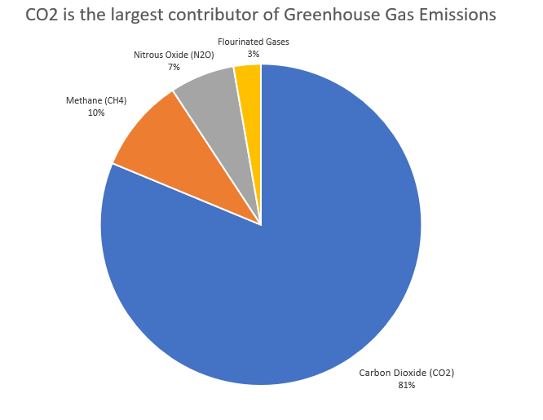
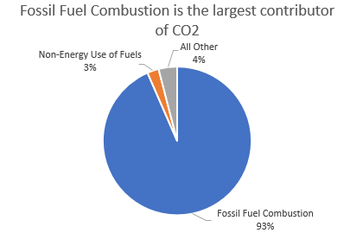

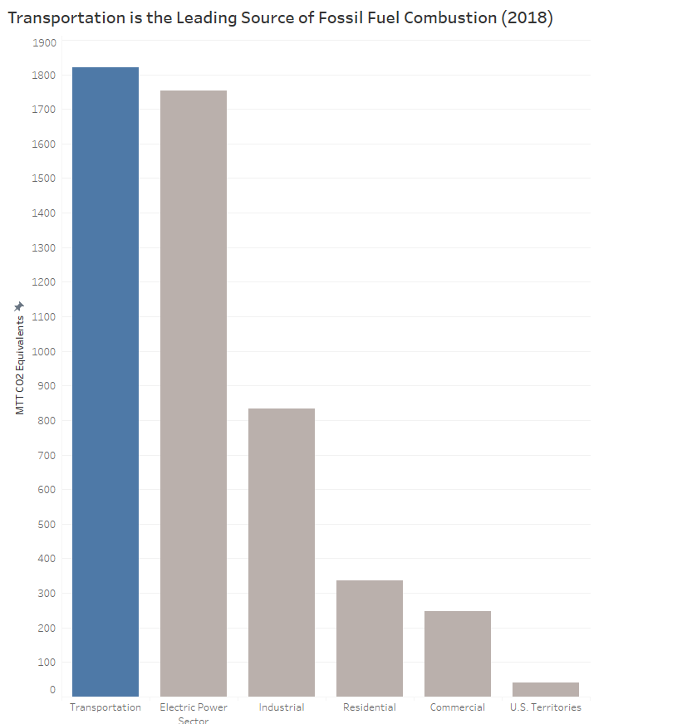

The Problem – Greenhouse gas pollution
The largest source of CO2 emitted into the air is from Fossil Fuel Combustion.
Carbon Dioxide is the largest contributor of Greenhouse gas so reducing CO2 should be a priority
Transportation is the leading source of Fossil Fuel Combustion
Greenhouse gas emissions is leading to higher pollution causing poor air quality, smog, and clement change.
1-gallon gas
(6.3lbs)
20lbs of CO2

Slide 2
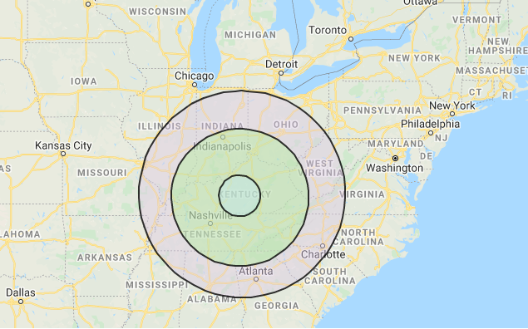

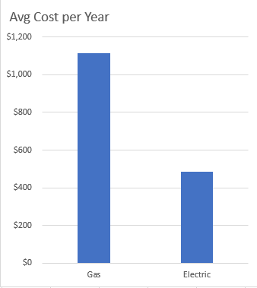
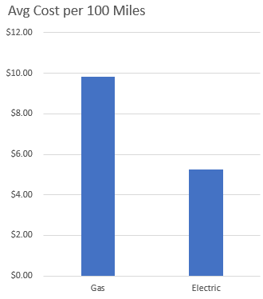
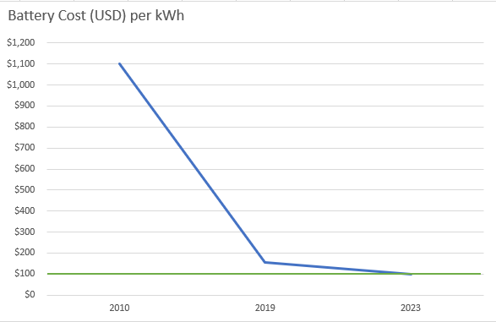

The Solution – Electric Vehicles
Charging stations have increased
300 Miles
200 Miles
60 Miles
Phone Apps allow the driver to find a charging station near them or on a specific route.
1990: Most models got 60 miles to a charge
2019: > 8 models can that have a range of > 200 miles per charge.
2020: expects several models to exceed 300 miles per charge
Large contributor to the cost of Electric vehicles is the battery cost. Battery cost has dropped 87% in the last 10 years and it is expected to continue to decline. $100 per kWh is a breakeven target for car manufactures.
The annual cost of ownership of an electric car is significantly less then a gas vehicle.
On avg, it is almost double the cost to drive 100 miles in a gas-powered vehicle then an electric-powered vehicle
With more models then ever to chose from big cars, small cars, luxury cars, economy cars, and trucks, now is a great time to start thinking about how your next vehicle should be an electric vehicle.

