Slide 1

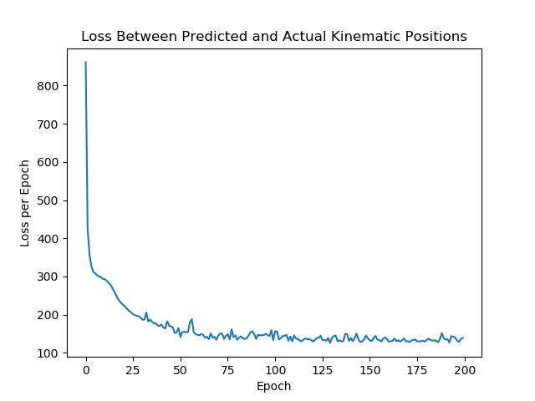
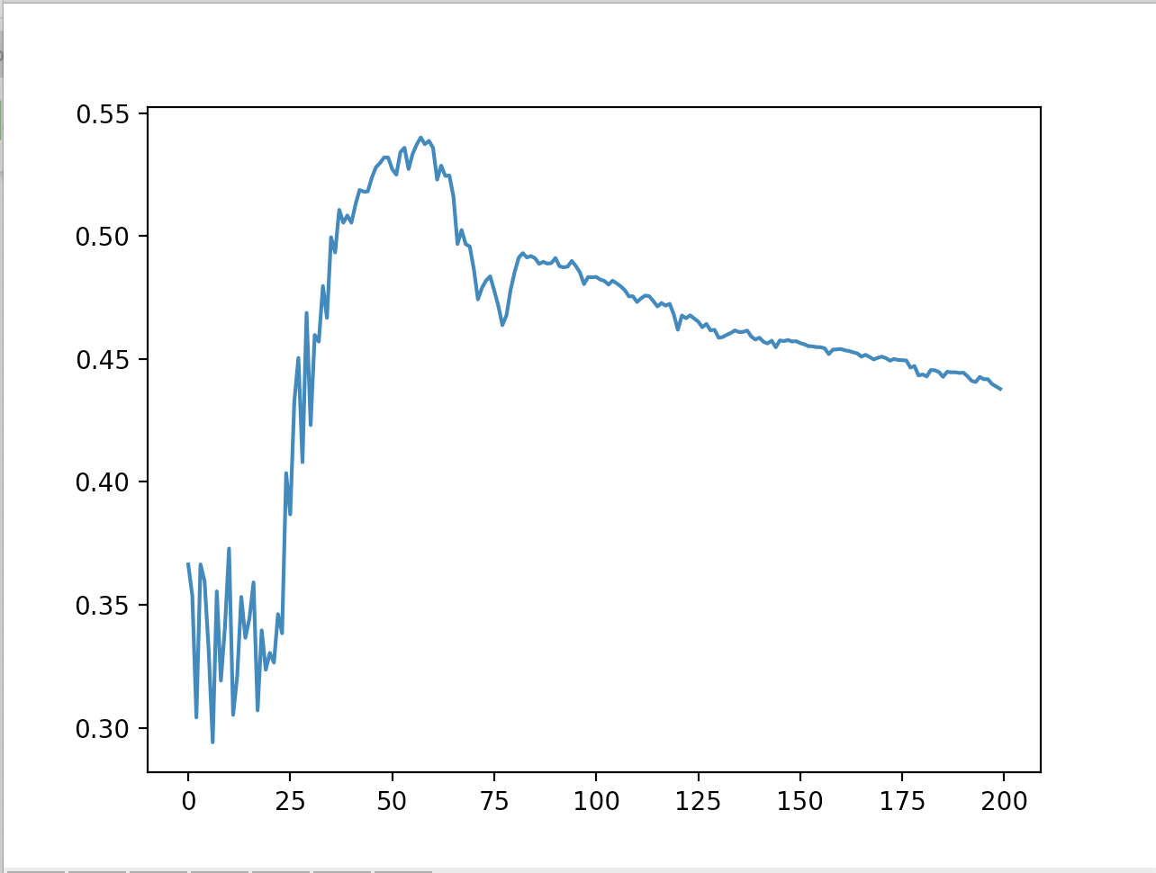
Predicting Primate Upper Limb Movements Via Neuron Firing Rates is No Monkey Business
Cindy Li, Jason Manuel, Put Dam
Introduction
Methodology
Discussion
Our objective is to predict kinematic arm positions given neuron firing rates gathered from electrode arrays. We aim to match or improve on the original prediction model as described in the paper Decoding Complete Reach and Grasp Actions from Local Primary Motor Cortex Populations by Dr. Carlos Vargas-Irwin, et al.
The original implementation utilized linear state-space models and achieved a 20% improvement over simple least-squares linear filters.
Our implementation utilizes an LSTM (Longer Short Term Memory) model to predict the kinematic positions of a monkey’s upper limb by training over the firing rates of about 260 neurons.
We have employed an LSTM since this type of network excels in remembering key parts of data in the past − in this case, key firing rates values − which can be used to better train the network.
To preprocess this data, (Monkeys, Trials, Neurons, Kins, Interpolation)
For monkey C,
Found the minimum and maximum kinematic times for each of the six trials.
Processed the kinematic positions for every trial.
For each trial, iterated through all 260 neurons to get a list of spike counts
Interpolated kinematic times with kinematic positions
Binned the data, the firing rates, into bins of size 10.
Returned firing rates and kinematic positions, where firing rates is a tensor with shape 862 X 10 X 260 (number of bins X bin size X number of neurons) and kinematic positions is a tensor with shape 862 X 29 (number of bins X number of kinematic positions)
For our model architecture, we used a combination of an LSTM layer and dense layers. We passed the firing rates through an LSTM, followed by a dense layer with ReLU activation, followed by a flattening layer, and finally another dense layer. We found the loss by finding the mean squared error between the actual kinematic positions and the predicted kinematic positions.
Hyperparameters:
Batch_size = 100
Window_size = 10
Rnn_size = 300
Dense_Layer_1 output size = 1000
Learning Rate = 0.001
Learning Rate Modification
Changing the learning rate from 0.01 to 0.001 substantially stabilized our training, especially after epoch 50, and it decreased our loss from about 180 to 110.
While the GRU model is slightly faster in training relative to the LSTM model, it lags significantly behind the LSTM in regards to minimizing the loss, or the mean squared error, and maximizing the correlation coefficient. The sizeable disparity in performance can be attributed to the ability of LSTM’s to take in new information and still remember the gradients of key, or relevant data from the past for much longer via storing it in a separate cell state, while GRU’s are only able to remember such data for a relatively short period of time before the data is “forgotten;” the gradients become almost nil after several iterations through the network.
Results
Data Collection
The dataset we worked with was collected from two male macaque monkeys (monkeys C and G). Monkeys were trained to single-handedly intercept and hold objects swinging toward them at the end of a string. The objects used in the grasping task included balls, cylinders, a cube, a rectangular prism, an isosceles triangular prism, a disk, and a ring. Upper limb motion from shoulder to fingers was recorded using reflective markers tracked with an optical motion capture system and synchronized with neural recordings. A total of 29 markers were attached to each monkey. Neural data were recorded using microelectrode arrays implanted into the M1 upper limb area of the monkeys.
The saturation of the loss and the reduction in the correlation coefficient in the second half of training, or the last 100 epochs, could be tied to potentially including neurons that were not important or involved in the kinematic positions we were trying to predict, i.e. neurons with low firing rates. There were neurons in the data set whose absolute value correlation coefficient approached the goal of about 0.6, but there were many outliers which seemed to indicate that they were not involved in the corresponding kinematic position.
Future Work
The loss between the predicted and actual kinematic positions starts at ~3000 and ends at ~180. During the first twenty five epochs, the loss quickly dips to about 250, but then fluctuates for another 50 epochs before it begins to level off at around 110. The remaining epochs showed little to no improvement as the point of diminishing returns seems to be reached consistently within the first 100 epochs.
The results of the R coefficient graph have a close correspondence to the graph of the kinematic position loss. Over the first twenty five epochs, the correlation coefficient fluctuates frequently between 0.3 and 0.4 as the loss is steeply decreasing. Then over the next 50 epochs, as the loss stabilizes, the coefficient spikes to about 0.5 before gradually decreasing leveling off at around 0.45 for the remaining epochs.
For future work, we suggest isolating a subset of relevant neurons before passing it in through our LSTM model, and we would also train a new LSTM model for the second monkey used for data collection since the neurons which we would need to use to train the model would be different for the second monkey.

