Slide 1
Data Analytics, Data Engineering & Data Science
MODULE 1 · ORIENTATION
Zero to First Project in 8 hours
Notes:
Deck title. Shown for 3 seconds at the start of Video 1.1.

Slide 2
Welcome & how this course works
VIDEO 1.1 · 5 MIN
Notes:
SEGMENTS: Face cam + Slides
Video 1.1. Start on face cam, cut to this slide after the first 20 seconds.

Slide 3
After 8 hours, you will be able to
Clean messy data in Google Sheets or Excel
Read data like a statistician, without heavy maths
Write SQL queries across three tables
Analyse 5,000 rows with Python and pandas
Build an automatic data pipeline into a warehouse
Build a Power BI dashboard and your first ML model
THE PROMISE
Everything is practised on one real-looking project, so you finish with a portfolio piece.
Notes:
Video 1.1. Read each line slowly; these are the outcomes.

Slide 4
Course map – Modules 1 to 6
Module | What you learn | Tool | Minutes
1 | Orientation and setup | All four tools | 20
2 | Spreadsheets: clean, summarise, report | Google Sheets | 60
3 | Statistics for analysts | Sheets + board | 45
4 | SQL: your first real code | SQLite Online | 65
5 | Python basics | Google Colab | 60
6 | Pandas: cleaning and EDA | Google Colab | 65
Coding starts in Module 4. Modules 2 and 3 use formulas only.
Notes:
Video 1.1. Point out that code starts in Module 4.

Slide 5
Course map – Modules 7 to 11
Module | What you learn | Tool | Minutes
7 | Data engineering: build a pipeline | Google Colab | 30
8 | Visualisation and storytelling | Colab + Power BI | 40
9 | Intro to machine learning | Google Colab | 50
10 | Capstone: ShopKart, then FitGym | All tools | 35
11 | Career and certificate | – | 10
11 modules, 55 videos, 480 minutes. Analytics, engineering and science.
Notes:
Video 1.1. Point out Module 7, where learners build a data pipeline. The learner's own capstone uses a new dataset, FitGym.

Slide 6
One project the whole way: ShopKart
5,000
800
60
10
orders in 2025 (after cleaning)
customers
products in 5 categories
Indian cities
Notes:
Video 1.1. ShopKart is fictional but built to behave like a real Indian online store.

Slide 7
How to learn in this course
1
2
3
4
Pause and type
Do the practice task
Take the quiz
Break it on purpose
Type every formula and line of code yourself. Watching is not learning.
Every video ends with a small task on ShopKart. Do it before the next video.
Each module has a short quiz. It tells you what to revise.
Change a value, see what happens. Errors are teachers.
Notes:
Video 1.1. Stress 'pause and type'.

Slide 8
How you earn the certificate
Attempt every module quiz
Final exam: 40 questions, 60 minutes
Pass mark 70%, up to 3 attempts
Capstone project on FitGym data
Capstone needs 60 out of 100 on the rubric
CAPSTONE RUBRIC
Cleaning 20, SQL and prep 15, EDA and insights 25, charts 15, model 15, communication 10.
Notes:
Video 1.1. Details again in Module 11.

Slide 9
Recap – Video 1.1
11 modules, 8 hours, one project
Analytics, engineering and science
Code starts in Module 4
Certificate = quizzes + exam + capstone
PRACTICE TASK
Write down one business question you hope to answer with data by the end of this course. Keep it; we revisit it in Module 11.
Notes:
Video 1.1. End on face cam.

Slide 10
Data analytics vs data science vs data engineering
VIDEO 1.2 · 8 MIN
Notes:
SEGMENTS: Slides + Handwriting board
Video 1.2.

Slide 11
Where should we open the next cloud kitchen?
A food-delivery app wants kitchen number 51
Which areas order the most, at what times?
Why did orders drop in one area last month?
How many orders will a new area get?
Which area gives the best profit after costs?
HOOK
One business question, three different data jobs. Let us see who does what.
Notes:
Video 1.2. Ask learners to guess which job each question belongs to.

Slide 12
Three roles, one company
A
S
E
Data Analyst
Data Scientist
Data Engineer
What happened and why? Reports, dashboards, SQL, spreadsheets.
What will happen and what should we do? Statistics, Python, models.
The plumbers. Builds pipelines so clean data arrives on time.
Notes:
Video 1.2. Use the plumbing analogy for engineers. This course gives a real start in all three roles.

Slide 13
Four types of analytics
1
2
3
4
Descriptive
Diagnostic
Predictive
Prescriptive
What happened? Orders per area last month
Why? Orders fell when delivery got slow
What will happen? Forecast for a new area
What should we do? Open in area X
Left to right: harder, and more valuable.
Notes:
Video 1.2. Map each to the cloud kitchen questions.

Slide 14
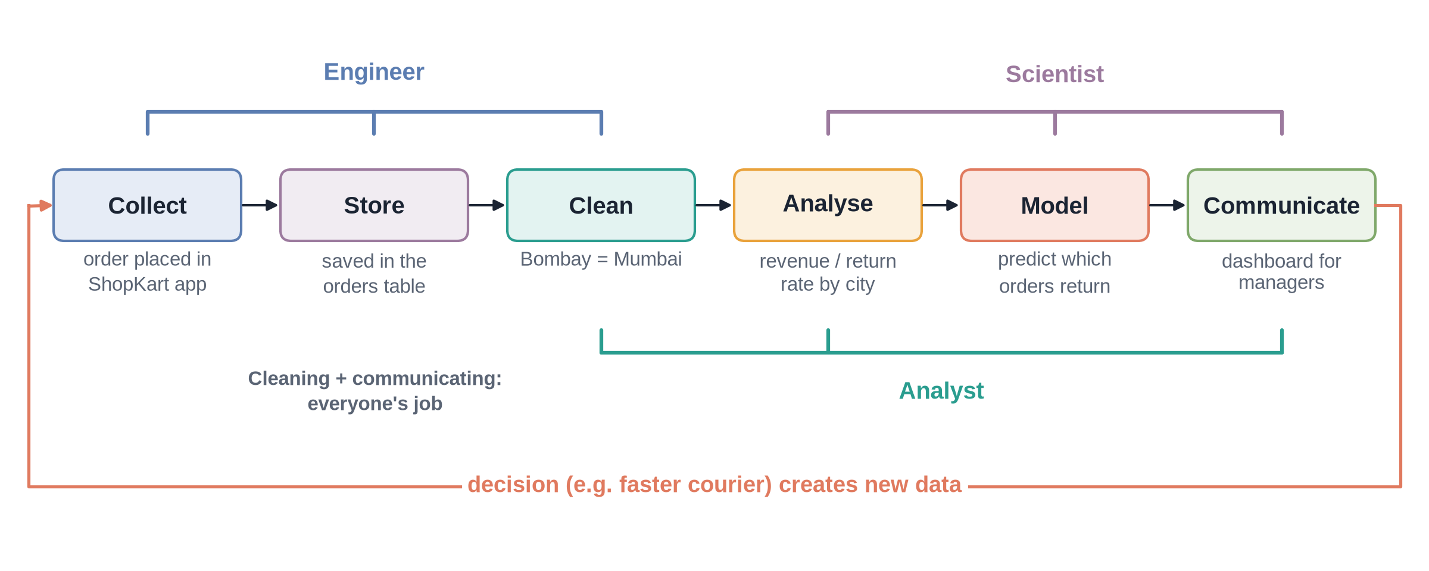
The data lifecycle
Notes:
✏ DRAW THIS SLIDE – hand-draw it live; the slide diagram is your reference
Video 1.2. Handwriting board segment, about 2 minutes.
What to draw:
• Six boxes left to right: Collect, Store, Clean, Analyse, Model, Communicate
• Under each, one ShopKart example: app order, database, fix city names, revenue by city, predict returns, dashboard
• Bracket Collect + Store + Clean as Engineer
• Bracket Clean + Analyse + Communicate as Analyst
• Bracket Analyse + Model + Communicate as Scientist
• Circle back arrow: decisions create new data

Slide 15
Tools by role
Role | Everyday tools | In this course
Data Analyst | Excel/Sheets, SQL, Power BI/Tableau | Modules 2, 4, 6, 8
Data Engineer | SQL, Python, pipelines, Airflow, Spark | Modules 4, 7
Data Scientist | Python, pandas, statistics, scikit-learn | Modules 3, 5, 6, 9
You get a real start in all three roles. The capstone (Module 10) uses all three.
Notes:
Video 1.2.

Slide 16
Fresher job titles to search for
1
2
3
4
Data Analyst
Business Analyst
MIS / Reporting Analyst
Junior Data Scientist
Most common entry role. SQL + Excel + one BI tool.
More business-facing. Requirements, reports, Excel, SQL.
Builds regular reports. Strong Excel, growing SQL.
Python, statistics, ML. Usually needs a project portfolio.
5
6
7
Junior Data Engineer
Product Analyst
Analytics Trainee
SQL, Python, pipelines. Show a working pipeline project.
Studies app usage, A/B tests, funnels.
Graduate programmes in banks, consultancies, e-commerce.
Notes:
Video 1.2. Do not quote salary numbers; tell learners to check current ranges on job portals.

Slide 17
Recap – Video 1.2
Analyst: what happened and why
Scientist: what will happen, what to do
Engineer: pipelines that deliver clean data
Descriptive, diagnostic, predictive, prescriptive
Lifecycle: collect to communicate
PRACTICE TASK
For a food-delivery app, write one question of each type: descriptive, diagnostic, predictive, prescriptive.
Notes:
Video 1.2.

Slide 18
Set up your tools and meet ShopKart
VIDEO 1.3 · 7 MIN
Notes:
SEGMENTS: Screen recording
Video 1.3. Mostly screen recording.

Slide 19
Your free toolkit
S
Q
P
B
Google Sheets
SQLite Online
Google Colab
Power BI Desktop
Modules 2–3. Free with a Google account, runs in the browser.
Module 4. sqliteonline.com, nothing to install.
Modules 5–10. Python in the browser, free.
Video 8.4. Free, Windows. Mac: Tableau Public.
Notes:
Video 1.3. Excel users can use Excel instead of Sheets.

Slide 20
Get set up in five steps
1
2
3
4
5
Download
Sheets
SQL
Colab
Check
Course files zip, then unzip it
Import shopkart_raw.xlsx
Open shopkart.db at sqliteonline.com
New notebook, print a line
Tick the setup checklist
Notes:
Video 1.3.

Slide 21
Your first SQL query
SQL
SELECT * means all columns
FROM orders names the table
LIMIT 5 shows only 5 rows
You will learn every word in Module 4
SELECT *
FROM orders
LIMIT 5;
Notes:
Video 1.3. Just run it; no explanation needed yet.

Slide 22
Your first line of Python
PYTHON
Type it in a Colab cell
Press Shift + Enter to run
Output appears under the cell
print("Hello, data!")
Notes:
Video 1.3.

Slide 23
ShopKart orders table – key columns
Column | Meaning | Example
order_id | Unique order number | O10001
order_date | Date of the order | 2025-01-01
customer_id / product_id | Who bought, what they bought | C0593 / P048
quantity, unit_price | How many, price of one (₹) | 6, 362
discount | Fraction off, 0.2 = 20% | 0.2
city, payment_mode | Delivery city, how they paid | Delhi, COD
delivery_days, rating | Days to deliver, 1–5 stars | 4, 2
returned | Was it returned? Y/N | N
Notes:
Video 1.3. Full dictionary in project README.

Slide 24
The other two tables
customers (800 rows)
products (60 rows)
customer_id, name, gender, age
city, signup_date
membership: Prime or Free
product_id, product_name
category: 5 categories
list_price, cost_price (₹)
Notes:
Video 1.3. IDs link the three tables; we use that in SQL joins.

Slide 25
The data is messy on purpose
Same city spelt many ways: Delhi, DELHI, New Delhi
Some prices stored as text: ₹1,299
Blank discounts and payment modes
55 duplicate rows hiding in 5,055
Two date formats mixed together
DO NOT FIX IT YET
Real company data looks like this. Cleaning it is your first job in Module 2.
Notes:
Video 1.3.

Slide 26
Recap – Video 1.3
Sheets, SQLite Online, Colab, Power BI
Course files unzipped and ready
First SQL query and first Python line done
ShopKart: orders, customers, products
PRACTICE TASK
Complete the setup checklist. In SQLite Online run SELECT COUNT(*) FROM orders; and note the number.
Notes:
Video 1.3.

