Slide 1
Excel & Google Sheets for analysts
MODULE 2 · SPREADSHEETS
Clean, summarise and report on 5,055 ShopKart orders
Notes:
Deck title.

Slide 2
Spreadsheet basics
VIDEO 2.1 · 8 MIN
Notes:
SEGMENTS: Slides + Screen recording
Video 2.1.

Slide 3
Why spreadsheets still matter
5,055
12
0
raw ShopKart order rows to tame
columns per order
lines of code needed in this module
Notes:
Video 2.1. Hook: the manager wants revenue by city by Friday.

Slide 4
The words you need
1
2
3
Cell
Range
Row = record
One box, named by column letter + row number, like B2.
A block of cells, like A2:A5056.
One order. Every row is one thing.
4
5
6
Column = field
Sheet / tab
Formula
One property of every order, like city.
One table. Our file has orders, customers, products.
Starts with =. Calculates from other cells.
Notes:
Video 2.1.

Slide 5
Shortcuts that save hours
Ctrl + Arrow: jump to the end of data
Ctrl + Shift + Arrow: select to the end
Ctrl + Z: undo (use it freely)
View > Freeze > 1 row: keep headers visible
Data > Create a filter: sort and filter
Format > Number: show ₹ and %
KEY IDEA
On a Mac use Cmd instead of Ctrl. Sheets and Excel share these shortcuts.
Notes:
Video 2.1. Demo each on orders sheet.

Slide 6
Recap – Video 2.1
Cell, range, row, column, sheet
One row = one order
Freeze headers, add a filter
Ctrl + Arrow to move fast
PRACTICE TASK
In the orders sheet, filter city to show only Pune. How many rows appear in the status bar count? Then clear the filter.
Notes:
Video 2.1.

Slide 7
Cleaning dirty data
VIDEO 2.2 · 12 MIN
Notes:
SEGMENTS: Screen recording
Video 2.2.

Slide 8
What is wrong in orders_raw
Problem | Example | Fix
Duplicate rows | 55 repeated orders | Remove duplicates
City spellings | DELHI, New Delhi, Bombay | TRIM + PROPER + map
Price as text | ₹1,299 | SUBSTITUTE + VALUE
Blank discount | (empty) | Treat as 0
Blank / lowercase payment | (empty), upi | Unknown, UPI
Returned Yes/No | Yes, No, Y, N | Make Y / N
Quantity typo | 99 | Set to 1
Two date formats | 02-01-2025 | DATE(...)
FIND DUPLICATES FIRST · orders_raw
M2 =ARRAYFORMULA(IF(A2:A="","",IF(COUNTIFS(A2:A,A2:A,ROW(A2:A),"<="&ROW(A2:A))>1,"DUPLICATE","")))
P2 =COUNTIF(M2:M5056,"DUPLICATE") → 55
Notes:
Video 2.2. Rating blanks stay blank: customer did not rate.

Slide 9
Our cleaning workflow
1
2
3
4
5
Copy
Dedupe
Helper cols
Check
Name it
Never edit raw data
5,055 rows become 5,000
One formula per problem
COUNTIF each clean column
Sheet orders_clean
Notes:
Video 2.2.

Slide 10
Cleaning formulas (row 2)
EXCEL
Write once in row 2
Fill down: Name Box → O2:U5001, then Ctrl + D
O2 tidies spaces and case, P2 maps old names
O2 =PROPER(TRIM(H2))
P2 =IFERROR(VLOOKUP(O2,city_map!$A$2:$B$6,2,FALSE),O2)
Q2 =IF(ISNUMBER(F2),F2,VALUE(SUBSTITUTE(SUBSTITUTE(F2,"₹",""),",","")))
R2 =IF(E2=99,1,E2)
S2 =IF(G2="",0,G2)
T2 =IF(I2="","Unknown",IF(I2="upi","UPI",I2))
U2 =IF(L2="Yes","Y",IF(L2="No","N",L2))
Notes:
Video 2.2.

Slide 11
Fixing dates (M2, N2)
EXCEL
3rd character a dash? Then it is DD-MM-YYYY
DATE(year, month, day) builds a real date
Format M as yyyy-mm-dd; N = month number
Fill down: Name Box → M2:N5001, then Ctrl + D
M2 =IF(ISNUMBER(B2),B2,
IF(MID(B2,3,1)="-",
DATE(VALUE(RIGHT(B2,4)),VALUE(MID(B2,4,2)),VALUE(LEFT(B2,2))),
DATE(VALUE(LEFT(B2,4)),VALUE(MID(B2,6,2)),VALUE(RIGHT(B2,2)))))
N2 =MONTH(M2)
2025-01-02 (YYYY-MM-DD) → 2 Jan 2025
02-01-2025 (DD-MM-YYYY) → 2 Jan 2025
Notes:
Video 2.2. Type M2 as one line; it is split here only to read. 120 rows use DD-MM-YYYY (Indian day-first, confirmed by ShopKart).

Slide 12
Recap – Video 2.2
Keep raw data untouched
Remove duplicates: 5,055 to 5,000
One helper column per problem
Blank rating is real missing data: keep it
PRACTICE TASK
Add a COUNTIF check: how many rows in city_clean equal Delhi? You should get 804.
Notes:
Video 2.2.

Slide 13
Formulas you will use every day
VIDEO 2.3 · 12 MIN
Notes:
SEGMENTS: Handwriting board + Screen recording
Video 2.3.

Slide 14
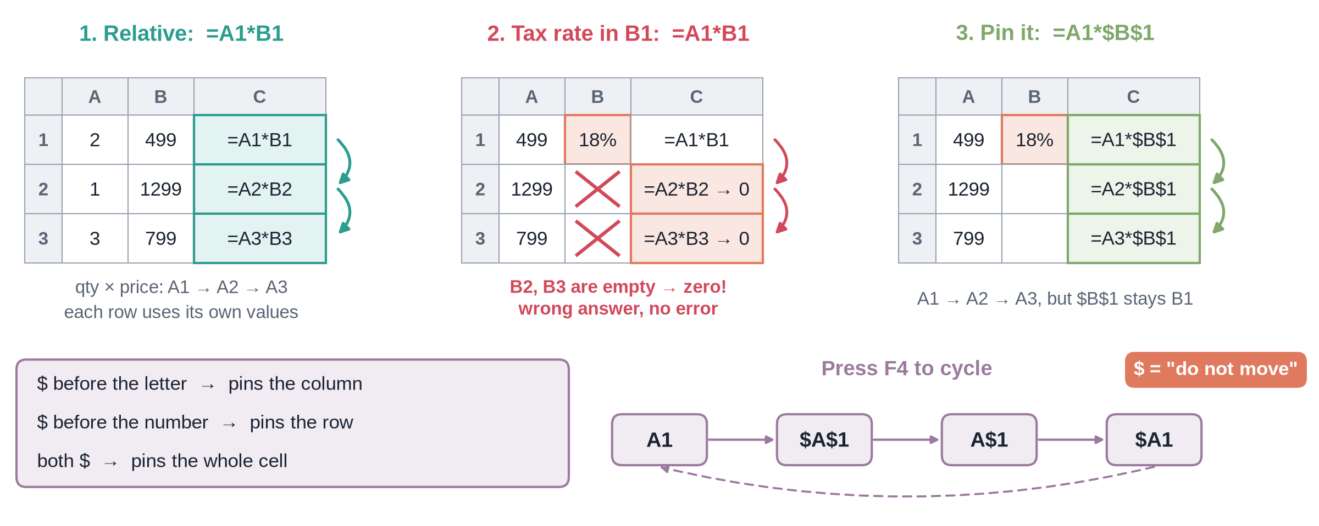
Relative vs absolute references
Notes:
✏ DRAW THIS SLIDE – hand-draw it live; the slide diagram is your reference
Video 2.3. Board segment about 3 minutes.
What to draw:
• Draw a 3x3 grid, write =A1*B1 in C1
• Drag it down: arrows show A1 becoming A2, A3
• Now write =A1*$B$1: the dollar pins B1
• Write the rule: $ before letter pins column, before number pins row
• Press F4 to cycle: A1, $A$1, A$1, $A1

Slide 15
Revenue for one order
EXCEL
Brackets first: 1 - 0.2 = 0.8
ROUND to 2 decimals = paise
This is order O10001
V2 =ROUND(R2*Q2*(1-S2),2)
quantity R2 = 6
unit_price Q2 = 362
discount S2 = 0.2
6 x 362 x (1 - 0.2) = 1,737.60
Notes:
Video 2.3.

Slide 16
Five everyday functions on ShopKart
Formula | What it gives | Result
=SUM(V2:V5001) | Total revenue | ₹1,47,04,649.70
=COUNTA(A2:A5001) | Number of orders | 5,000
=AVERAGE(V2:V5001) | Average order value | ₹2,940.93
=MAX(V2:V5001) | Biggest order | ₹1,49,990
=COUNTIF(U2:U5001,"Y") | Returned orders | 687
Notes:
Video 2.3. All on orders_clean.

Slide 17
IF: make a decision per row
EXCEL
Test compares: >, <, =, >=, <>
Text answers go in double quotes
Nested IF: an IF inside an IF
=IF(V2>=5000,"Big","Normal")
=IF(test, value_if_true, value_if_false)
Notes:
Video 2.3.

Slide 18
Recap – Video 2.3
$ pins a reference, F4 toggles
Revenue = qty x price x (1 - discount)
SUM, COUNTA, AVERAGE, MAX, COUNTIF
IF labels each row
PRACTICE TASK
Add an order_size column: Big if revenue is at least ₹5,000, else Normal. Count the Big orders (answer: 560).
Notes:
Video 2.3.

Slide 19
Conditional totals and lookups
VIDEO 2.4 · 10 MIN
Notes:
SEGMENTS: Screen recording + Handwriting board
Video 2.4.

Slide 20
The IFS family
EXCEL
Pin ranges with $, leave A11 free
Add more criteria pairs as needed
Returns in Pune: COUNTIFS city + returned Y
=SUMIFS(sum_range, crit_range1, crit1, ...)
=COUNTIFS(crit_range1, crit1, ...)
=AVERAGEIFS(avg_range, crit_range1, crit1, ...)
Revenue in Delhi:
=SUMIFS(orders_clean!$V$2:$V$5001,
orders_clean!$P$2:$P$5001, A11)
Notes:
Video 2.4.

Slide 21
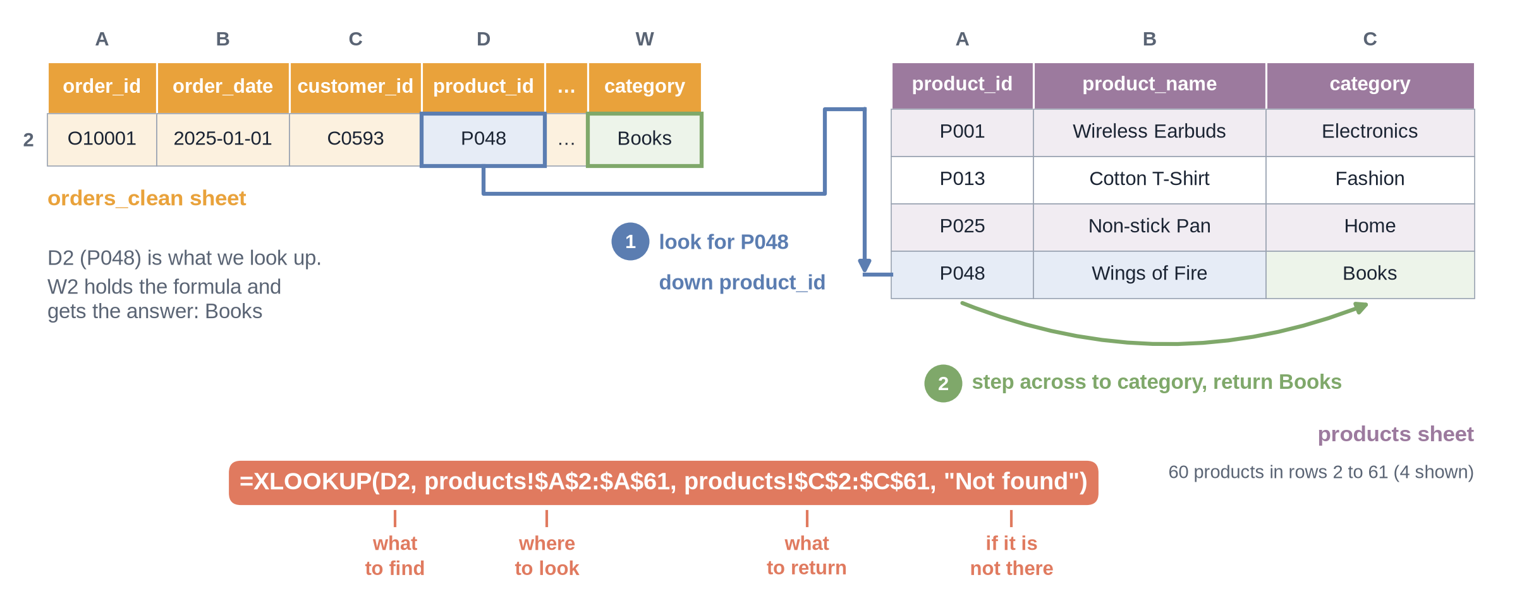
How XLOOKUP finds a category
Notes:
✏ DRAW THIS SLIDE – hand-draw it live; the slide diagram is your reference
Video 2.4. Mention INDEX/MATCH and VLOOKUP as older options.
What to draw:
• Left: orders_clean row 2: product_id P048 in column D, category goes in column W
• Right: products table, columns product_id and category (P048 = Wings of Fire)
• Arrow 1: look for P048 down product_id
• Arrow 2: step across to category, return Books
• Write: =XLOOKUP(D2, products!$A$2:$A$61, products!$C$2:$C$61, "Not found")

Slide 22
Summary sheet: every formula
TOP NUMBERS (B3 to B7)
B3 =SUM(orders_clean!$V$2:$V$5001) ← total revenue
B4 =COUNTA(orders_clean!$A$2:$A$5001) ← orders
B5 =B3/B4 ← average order value
B6 =COUNTIF(orders_clean!$U$2:$U$5001,"Y") ← returned orders
B7 =B6/B4 ← return rate
CITY TABLE (type row 11, fill down to row 20) V = revenue · P = city_clean · U = returned
B11 =SUMIFS(orders_clean!$V$2:$V$5001, orders_clean!$P$2:$P$5001, A11)
C11 =COUNTIFS(orders_clean!$P$2:$P$5001, A11)
D11 =AVERAGEIFS(orders_clean!$V$2:$V$5001, orders_clean!$P$2:$P$5001, A11)
E11 =COUNTIFS(orders_clean!$P$2:$P$5001, A11, orders_clean!$U$2:$U$5001, "Y")
F11 =E11/C11 ← format as %
CHECK ROW (row 22: leave row 21 empty below the table)
B22 =SUM(B11:B20) C22 =SUM(C11:C20) ← must equal B3 and B4
CATEGORY TABLE (first W2 in orders_clean, then row 25, fill down to row 29)
W2 =XLOOKUP(D2, products!$A$2:$A$61, products!$C$2:$C$61, "Not found")
B25:F25 the same five formulas as row 11, with $W$2:$W$5001 in place of
$P$2:$P$5001, and A25 in place of A11
Notes:
Video 2.4. Show after the category table is built, before 'What the summary sheet tells us'. Walk through it top to bottom: every line is a cell in the Summary tab (W2 is in orders_clean). Students can pause here and copy.

Slide 23
What the summary sheet tells us
₹23.2L
₹73.3L
32.4%
13.7%
Delhi revenue, the top city
Electronics revenue, half of all
Pune return rate
overall return rate
Notes:
Video 2.4. All from Summary sheet.

Slide 24
Recap – Video 2.4
SUMIFS adds with conditions
COUNTIFS counts, AVERAGEIFS averages
XLOOKUP brings category from products
Total check row catches spelling errors
PRACTICE TASK
Use AVERAGEIFS to find the average order value for Fashion (answer: about ₹2,354). Then find Fashion's return rate with COUNTIFS.
Notes:
Video 2.4.

Slide 25
Pivot tables
VIDEO 2.5 · 10 MIN
Notes:
SEGMENTS: Screen recording
Video 2.5.

Slide 26
Build a pivot in Google Sheets
1
2
3
4
5
Select
Insert
Rows
Columns
Values
Click any cell in orders_clean
Insert > Pivot table > New sheet
Add city_clean
Add category
Add revenue, SUM
Excel: Insert > PivotTable, then drag fields into Rows, Columns, Values.
Notes:
Video 2.5.

Slide 27
Pivot table or SUMIFS?
Pivot table
SUMIFS summary
Fast: drag and drop
Great for exploring
Shape changes when data changes
You control the layout
Feeds a fixed report and charts
Easy to check cell by cell
Notes:
Video 2.5. Pivot_check sheet holds the SUMIFS version so numbers can be compared.

Slide 28
Recap – Video 2.5
Rows, Columns, Values, Filters
Summarise by SUM, COUNTA, AVERAGE
Show values as % of total
Check against Pivot_check
PRACTICE TASK
Build a pivot: rows payment_clean, columns returned_clean, values COUNTA of order_id. Which payment mode has the highest return rate?
Notes:
Video 2.5. Answer: COD, about 19.1%.

Slide 29
Charts and a one-page report
VIDEO 2.6 · 8 MIN
Notes:
SEGMENTS: Slides + Screen recording
Video 2.6.

Slide 30
Pick the chart from the question
Question | Chart
Compare categories (cities) | Bar / column
Change over time (months) | Line
Share of a whole (2–4 parts) | Pie, use rarely
Relationship between two numbers | Scatter
Notes:
Video 2.6. More in Video 8.1.

Slide 31
Three questions, three answers
1
2
3
Top city?
Peak month?
Return problem?
Delhi: ₹23,23,405, 15.8% of all revenue.
October: ₹19,78,317, about 2.5x May, the weakest month.
Pune returns 32.4% of orders vs 13.7% overall, about 2.4x.
Notes:
Video 2.6. Report sheet answers are live formulas.

Slide 32
Recap – Video 2.6
Question first, then chart
Bar for comparison, line for time
Title says the finding
One page: KPIs, 3 answers, 3 charts
PRACTICE TASK
Add a fourth chart to your Report: revenue by category as a bar chart, with a title that states the finding.
Notes:
Video 2.6. Next: Module 3 statistics on this clean data.

