Slide 1
Statistics for analysts
MODULE 3 · STATISTICS
Average, spread, shape, correlation and A/B tests on ShopKart
Notes:
Deck title.

Slide 2
Types of data
VIDEO 3.1 · 6 MIN
Notes:
SEGMENTS: Slides + Handwriting board
Video 3.1.

Slide 3
Two big families
Categorical (labels)
Numerical (numbers)
Nominal: city, category, payment_mode
Binary: returned Y / N
Ordinal: rating 1 < 2 < 3 < 4 < 5
Maths: count, %, mode
Discrete: quantity, delivery_days
Continuous: unit_price, revenue
Maths: sum, mean, median, SD
Notes:
Video 3.1.

Slide 4
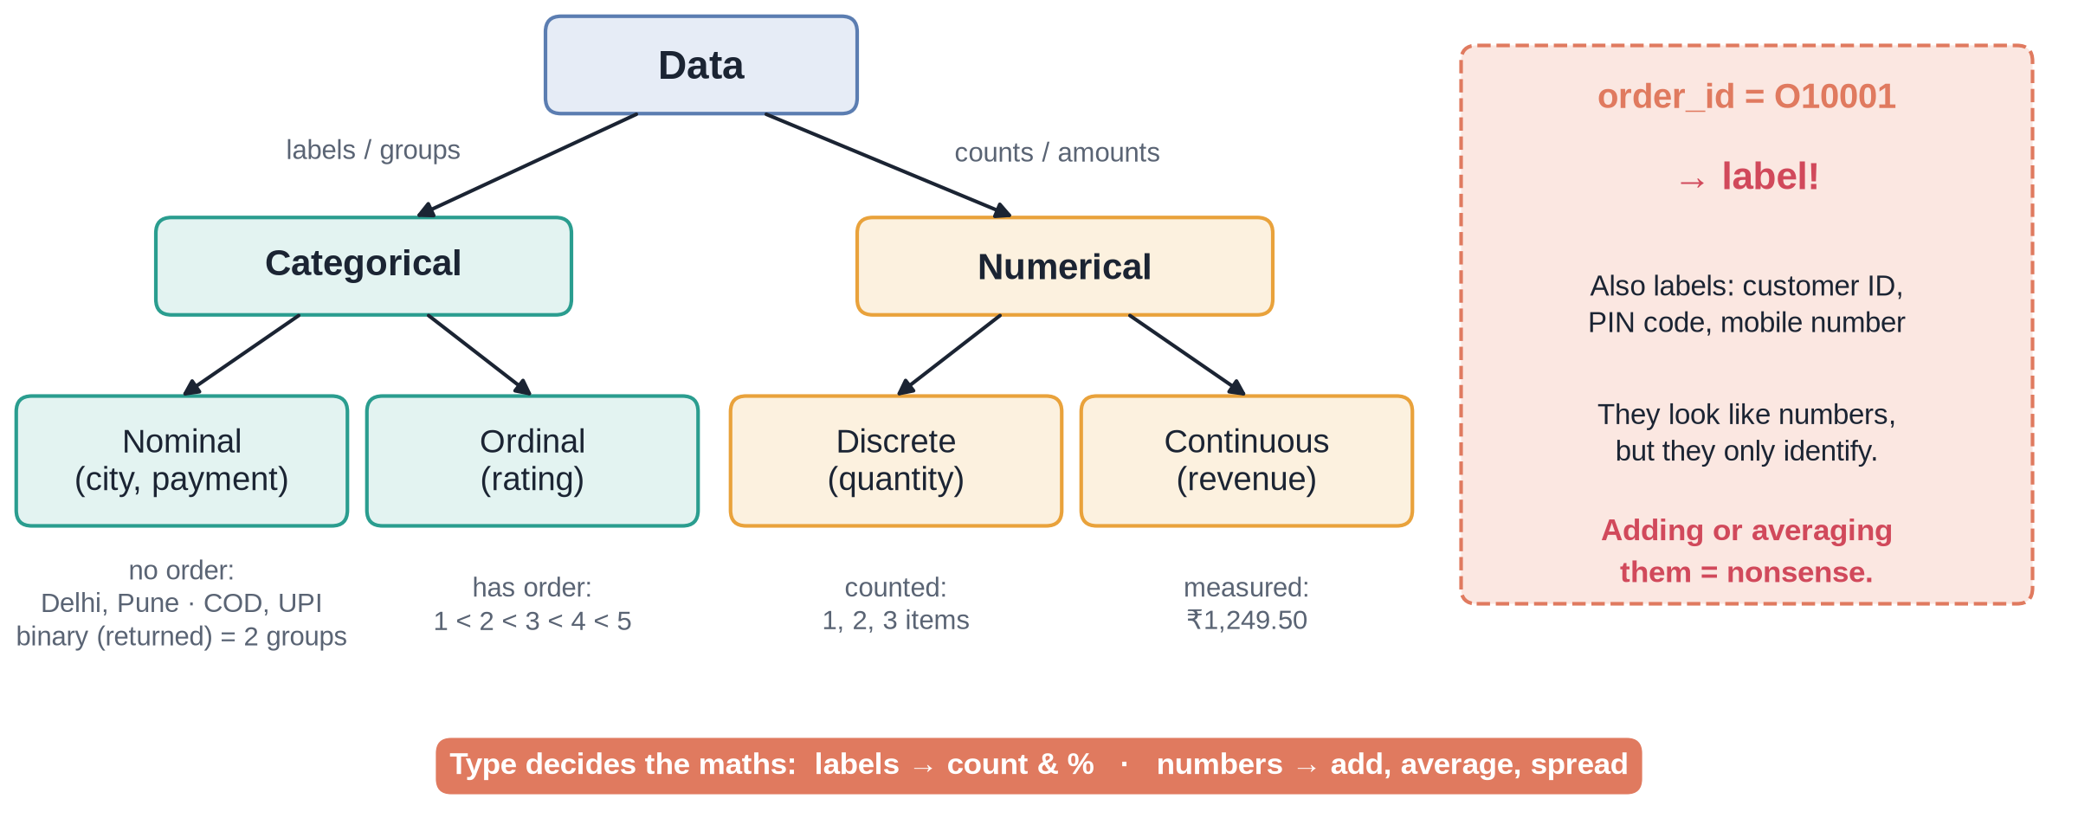
The data-type tree
Notes:
✏ DRAW THIS SLIDE – hand-draw it live; the slide diagram is your reference
Video 3.1.
What to draw:
• Top box: Data
• Two branches: Categorical, Numerical
• Under Categorical: Nominal (city), Ordinal (rating)
• Under Numerical: Discrete (quantity), Continuous (revenue)
• Side note: order_id looks like a number-ish code but is a label: never average it

Slide 5
Recap – Video 3.1
Categorical = labels, numerical = amounts
Nominal has no order, ordinal does
Discrete counts, continuous measures
Type decides which maths is allowed
PRACTICE TASK
Classify every column in the customers table (customer_id, name, gender, age, city, signup_date, membership). Check with 3.1_Types.
Notes:
Video 3.1.

Slide 6
Mean, median and mode
VIDEO 3.2 · 7 MIN
Notes:
SEGMENTS: Handwriting board + Screen recording
Video 3.2.

Slide 7
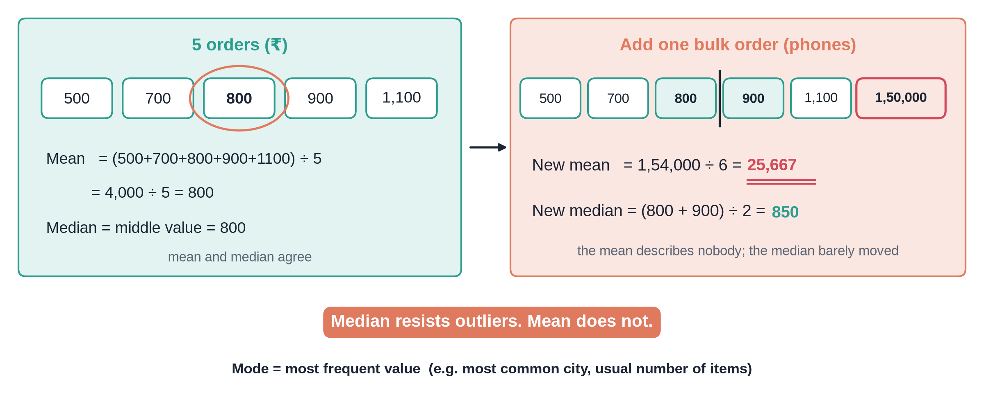
One bulk order breaks the average
Notes:
✏ DRAW THIS SLIDE – hand-draw it live; the slide diagram is your reference
Video 3.2.
What to draw:
• Write 5 orders: 500, 700, 800, 900, 1,100
• Mean = 4,000 / 5 = 800. Median = middle = 800
• Add one order of 1,50,000
• New mean = 1,54,000 / 6 = 25,667
• New median = (800 + 900) / 2 = 850
• Write: median resists outliers, mean does not

Slide 8
ShopKart order revenue, 5,000 orders
₹2,941
₹1,525
₹2,859
mean (average) order
median order
mean without 3 bulk orders
Notes:
Video 3.2. Mean is nearly double the median: a few big orders pull it up.

Slide 9
In Google Sheets
EXCEL
Mode suits categories and small whole numbers
For money, report the median as typical
=AVERAGE(data!K2:K5001)
→ 2,940.93
=MEDIAN(data!K2:K5001)
→ 1,524.80
=AVERAGEIF(data!K2:K5001,"<100000")
→ 2,858.65
=MODE(data!E2:E5001)
→ 1 (quantity)
Notes:
Video 3.2.

Slide 10
Recap – Video 3.2
Mean = total / count
Median = middle value
Mode = most frequent
Skewed money data: use the median
PRACTICE TASK
Find the mean and median of delivery_days. Are they close? Answer: 4.15 and 4. Explain why in one sentence.
Notes:
Video 3.2.

Slide 11
Spread: range, variance, SD, IQR, box plot
VIDEO 3.3 · 9 MIN
Notes:
SEGMENTS: Handwriting board + Screen recording
Video 3.3.

Slide 12
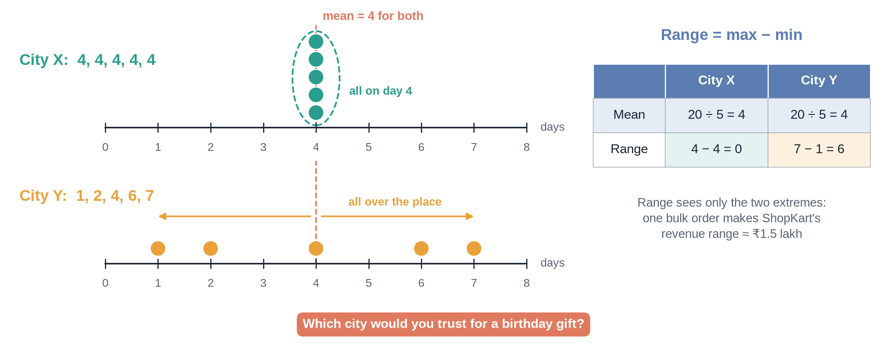
Same average, different promise
Notes:
✏ DRAW THIS SLIDE – hand-draw it live; the slide diagram is your reference
Video 3.3.
What to draw:
• City X delivery days: 4, 4, 4, 4, 4
• City Y delivery days: 1, 2, 4, 6, 7
• Both means = 4. Draw dots on a number line
• Range: X = 0, Y = 6
• SD: X = 0, Y = about 2.5
• Which city would you trust for a birthday gift?

Slide 13
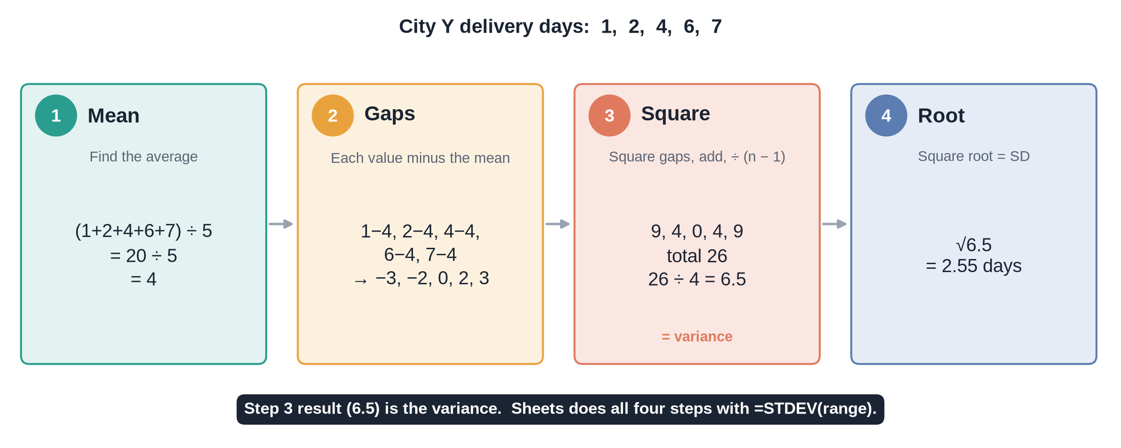
Standard deviation in four steps
Notes:
✏ DRAW THIS SLIDE – hand-draw it live; the slide diagram is your reference
Video 3.3.
What to draw:
• 1 – Mean – Find the average
• 2 – Gaps – Each value minus the mean
• 3 – Square – Square gaps, add, divide by n − 1
• 4 – Root – Square root = SD
• Step 3 result is the variance. Sheets does all of this with =STDEV(range).

Slide 14
Spread on ShopKart
Measure | delivery_days | revenue (₹)
Mean | 4.15 | 2,940.93
SD | 1.53 | 6,025.46
Q1 / median / Q3 | 3 / 4 / 5 | 807 / 1,525 / 2,906
IQR | 2 | 2,098.54
Upper fence | 8 | 6,053.34
Orders above fence | 36 | 406
Notes:
Video 3.3.

Slide 15
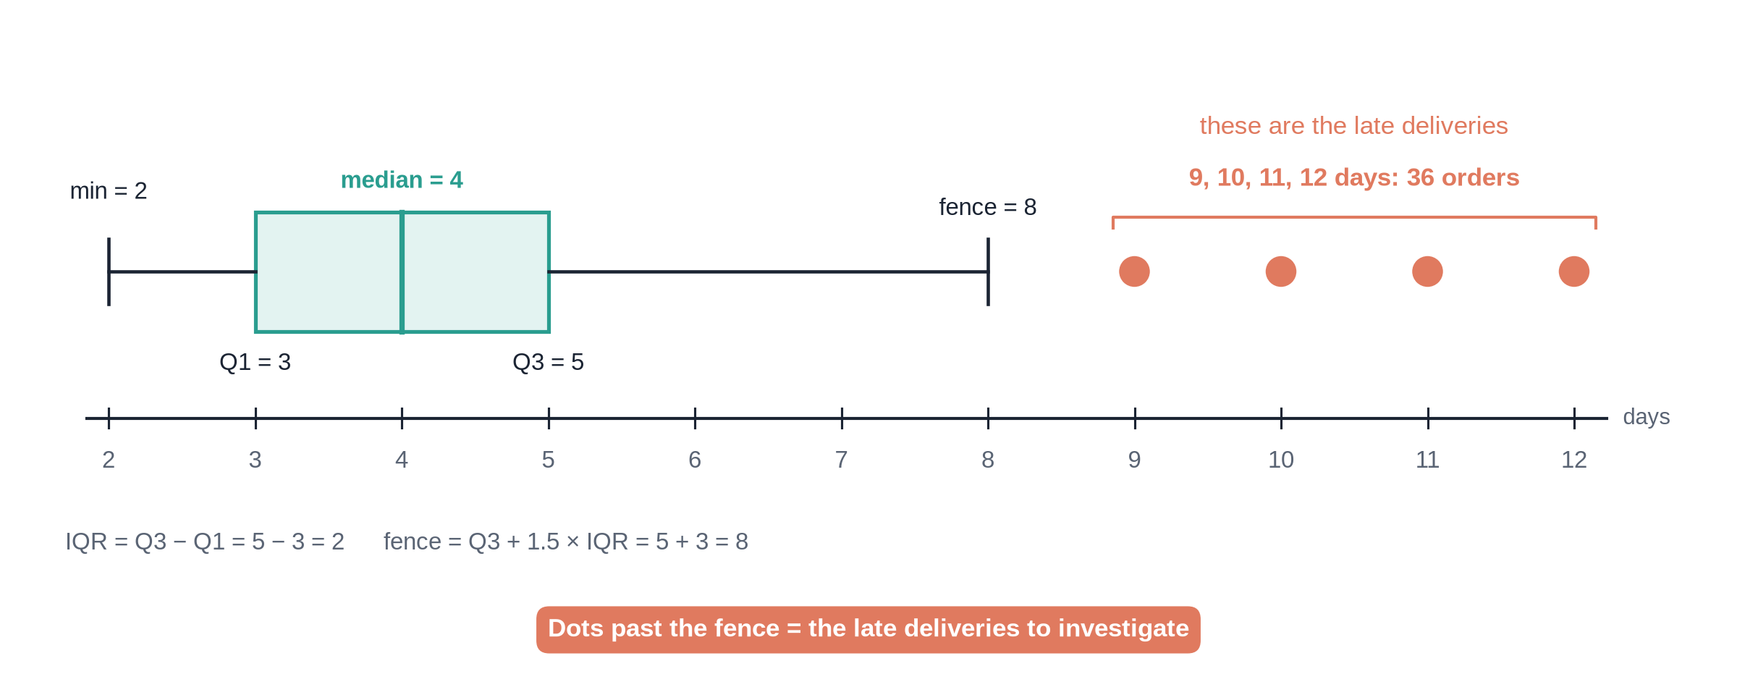
Box plot of delivery days
Notes:
✏ DRAW THIS SLIDE – hand-draw it live; the slide diagram is your reference
Video 3.3.
What to draw:
• Number line 2 to 12
• Box from Q1 = 3 to Q3 = 5, line at median 4
• Whisker left to min 2, whisker right to fence 8
• Dots for 9, 10, 11, 12 days: 36 orders
• Label: these are the late deliveries to investigate

Slide 16
Recap – Video 3.3
Range = max − min, sensitive to outliers
SD = typical distance from the mean
IQR = middle 50%, robust
Box plot shows five numbers + outliers
PRACTICE TASK
Use QUARTILE on unit_price to get Q1, median and Q3. Compute the IQR. Answer: 571, 1,213, 1,982; IQR 1,411.
Notes:
Video 3.3.

Slide 17
Distributions: histogram, normal, skew
VIDEO 3.4 · 7 MIN
Notes:
SEGMENTS: Handwriting board + Slides
Video 3.4.

Slide 18
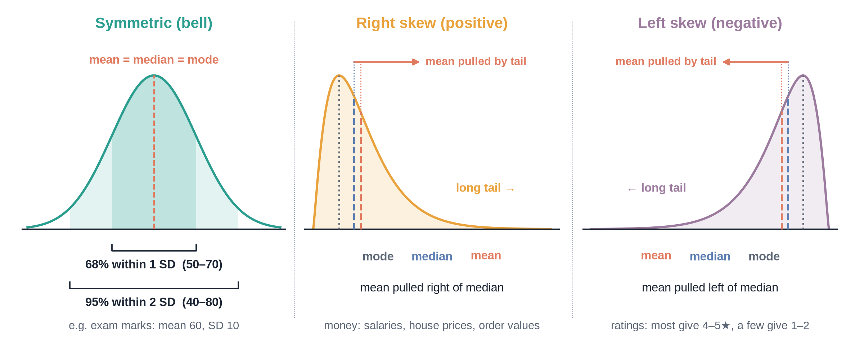
Three shapes
Notes:
✏ DRAW THIS SLIDE – hand-draw it live; the slide diagram is your reference
Video 3.4.
What to draw:
• Bell curve: label mean = median = mode in the middle
• Right-skewed hill: long tail to the right, mean pulled right of median
• Left-skewed: tail to the left
• Under the bell: 68% within 1 SD, 95% within 2 SD

Slide 19
ShopKart's two shapes
delivery_days: mild right skew
revenue: strong right skew
Peak at 3–4 days
Skewness 0.63
67% within 1 SD, 98% within 2 SD
Close to bell-shaped
1,638 orders under ₹1,000
Long tail up to ₹1,49,990
Skewness 10.5
Mean ₹2,941 far above median ₹1,525
Notes:
Video 3.4. Histograms are on 3.4_Distribution.

Slide 20
Recap – Video 3.4
Histogram = counts per bin
Normal: symmetric bell
Right skew: mean above median
Skewed? Report the median
PRACTICE TASK
Make a histogram of rating (1 to 5) with COUNTIF. Which way is it skewed? Answer: left, most ratings are 4 and 5.
Notes:
Video 3.4.

Slide 21
Correlation vs causation
VIDEO 3.5 · 7 MIN
Notes:
SEGMENTS: Handwriting board + Slides
Video 3.5.

Slide 22
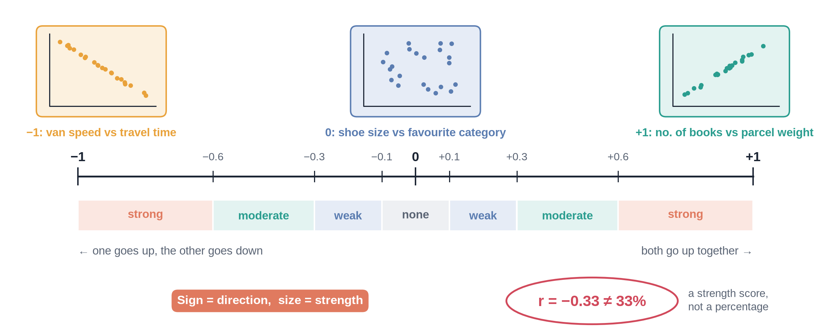
The correlation scale
Notes:
✏ DRAW THIS SLIDE – hand-draw it live; the slide diagram is your reference
Video 3.5.
What to draw:
• Line from −1 to +1, 0 in the middle
• Three mini scatter plots: up-slope (+), down-slope (−), cloud (0)
• Mark bands: under 0.1 none, 0.1–0.3 weak, 0.3–0.6 moderate, above 0.6 strong
• Write: correlation measures straight-line togetherness only

Slide 23
Correlations in ShopKart
+0.27
−0.33
−0.03
discount vs quantity (weak positive)
delivery days vs rating (moderate negative)
unit price vs quantity (no relationship)
Notes:
Video 3.5. =CORREL(range1, range2).

Slide 24
Why correlation is not causation
1
2
3
4
Hidden third factor
Reverse direction
Pure chance
The fix
Ice-cream sales and AC sales both rise in May. Heat drives both.
Do big orders get discounts, or do discounts create big orders?
With enough columns, some pairs match by luck.
Run a controlled experiment: an A/B test.
Notes:
Video 3.5.

Slide 25
Recap – Video 3.5
CORREL gives −1 to +1
Sign = direction, size = strength
Slow delivery goes with lower ratings
Correlation never proves cause
PRACTICE TASK
Use CORREL for delivery_days vs quantity. What does the number tell you? Write one sentence a manager would understand.
Notes:
Video 3.5.

Slide 26
Sampling and A/B testing intuition
VIDEO 3.6 · 9 MIN
Notes:
SEGMENTS: Slides + Handwriting board
Video 3.6.

Slide 27
A 1-in-10 sample vs all orders
Measure | All 5,000 | Sample of 500
Return rate | 13.7% | 13.0%
Avg delivery days | 4.15 | 4.07
Avg order value | ₹2,941 | ₹2,534
Bulk orders included | 3 | 0
Rates land close. The average order value misses because the sample skipped the rare bulk orders.
Notes:
Video 3.6.

Slide 28
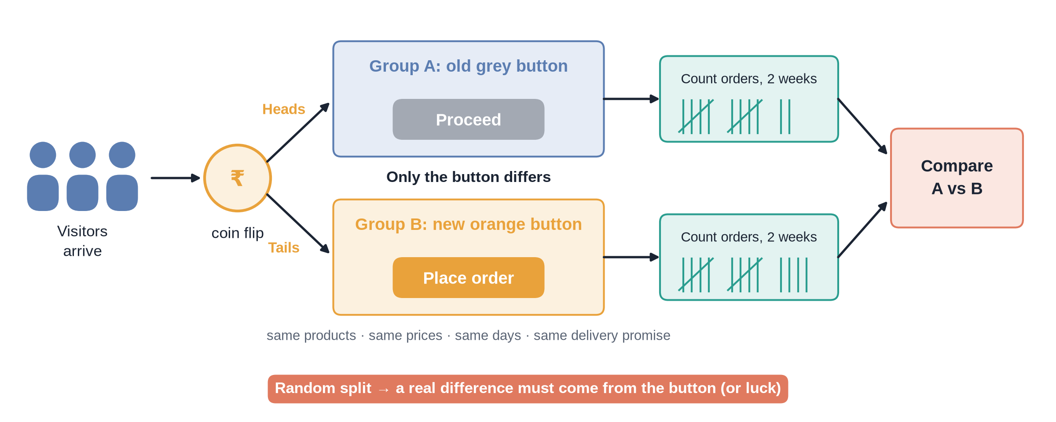
How an A/B test works
Notes:
✏ DRAW THIS SLIDE – hand-draw it live; the slide diagram is your reference
Video 3.6. Clearly say: made-up example.
What to draw:
• Visitors arrive, coin flip splits them 50/50
• Group A sees old grey Proceed button
• Group B sees new orange Place order button
• Count orders in each group for two weeks
• Only the button differs, so a real gap must come from the button

Slide 29
Made-up checkout button test
4.2%
4.8%
+14%
0.04
A: 420 orders / 10,000 visitors
B: 480 orders / 10,000 visitors
relative lift
p-value: chance a gap this big is pure luck
Notes:
Video 3.6. Teaching example, not ShopKart data.

Slide 30
Same rates, different confidence
10,000 visitors each
200 visitors each
4.2% vs 4.8%
p ≈ 0.04
Probably a real effect
4.0% vs 5.0% (8 vs 10 orders)
p ≈ 0.63
Could easily be luck
Notes:
Video 3.6. Sample size matters.

Slide 31
Recap – Video 3.6
A good sample is random and big enough
Rare events can hide from samples
A/B test: random split, change one thing
Small p (under 0.05): probably real
PRACTICE TASK
On 3.6_AB_Test change B's orders to 440. Is the result still probably real? Answer: no, p is about 0.49.
Notes:
Video 3.6. Next: Module 4 SQL on the same clean data.

