Slide 1
SQL: Talking to a Database
MODULE 4
Your first real code – answering ShopKart questions with SQL

Slide 2
What is a database? Keys and schema
VIDEO 4.1 · 6 MIN
Notes:
SEGMENTS: Slides + Handwriting board
4.1 – Hook: our cleaned Excel data now lives in a database. Today = first code of the course.

Slide 3
Today you write your first real code
Modules 2–3: spreadsheet formulas, no code
Module 4: SQL – your first programming language
Module 5 onwards: Python in Google Colab
Tool: sqliteonline.com, free, nothing to install
Data: shopkart.db – our cleaned Module 2 data
WHY SQL
SQL is how analysts ask questions to a database. Almost every analyst job description in India asks for it.
Notes:
4.1 – Say clearly: this is where coding starts.

Slide 4
Database words you must know
DB
T
R
Database
Table
Row
A collection of related tables, like one workbook with many sheets
One topic: orders, customers or products
One record, e.g. one order
C
PK
FK
Column
Primary key
Foreign key
One property of every row, e.g. city
Unique ID of each row, never repeats: order_id
Column pointing to another table's primary key
Notes:
4.1 – Compare each word with Excel: table = sheet, row = row, column = column.

Slide 5
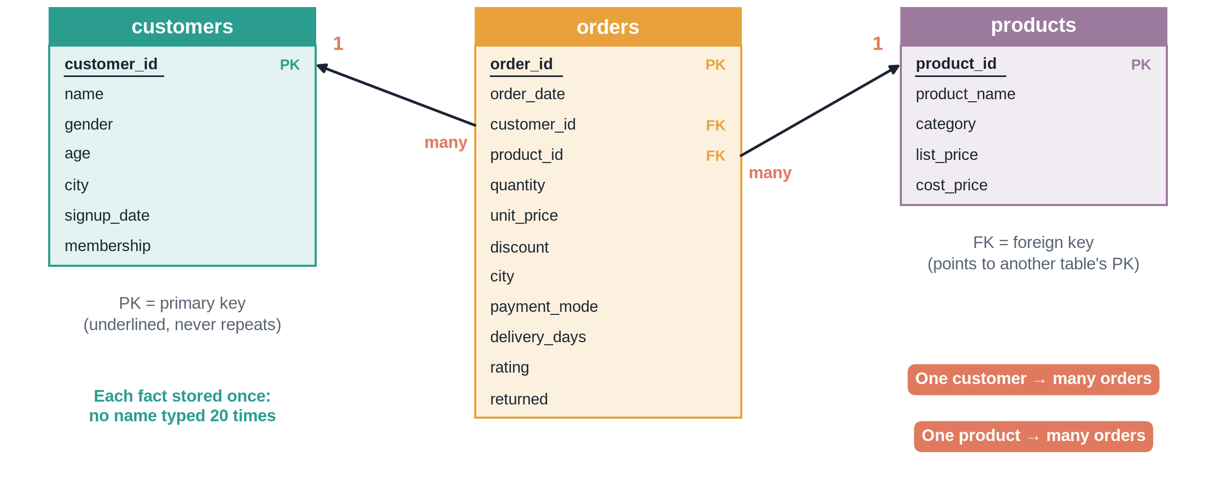
The ShopKart schema
Notes:
✏ DRAW THIS SLIDE – hand-draw it live; the slide diagram is your reference
4.1 – Board segment 1. Take your time, this picture is used all module.
What to draw:
• Draw three boxes: customers (left), orders (middle), products (right)
• List columns inside each; underline the primary key
• orders: write customer_id and product_id, label FK
• Arrow orders.customer_id → customers.customer_id
• Arrow orders.product_id → products.product_id
• Write 1 and many on each arrow: one customer, many orders

Slide 6
The three ShopKart tables
Table | Rows | One row means | Primary key
orders | 5,000 | one order line | order_id
customers | 800 | one customer | customer_id
products | 60 | one product | product_id
orders also holds two foreign keys: customer_id and product_id

Slide 7
Open shopkart.db in SQLite Online
1
2
3
4
5
Open site
Open DB
Check
Type
Run
Go to sqliteonline.com, SQLite selected
File → Open DB → choose shopkart.db
Three tables appear on the left
Write a query in the editor
Click Run or press Shift+Enter
Notes:
4.1 – Then switch to screen and run M04_4.1_explore_schema.sql Q1 and Q6.

Slide 8
Recap – Video 4.1
A database is a set of related tables
Primary key = unique ID of each row
Foreign key links a row to another table
Schema = the map of tables, columns and keys
shopkart.db: orders, customers, products
PRACTICE TASK
Run Q6 of M04_4.1_explore_schema.sql. Check you see 5,000 orders, 800 customers, 60 products.

Slide 9
SELECT, FROM, LIMIT, aliases, DISTINCT
VIDEO 4.2 · 7 MIN
Notes:
SEGMENTS: Screen recording
4.2 – Hook: show me 5 orders and the revenue of each.

Slide 10
Anatomy of your first query
SQL
SELECT: which columns to show
FROM: which table
AS: a new name for a column
LIMIT: only the first few rows
SELECT order_id,
quantity,
unit_price,
discount,
quantity * unit_price * (1 - discount)
AS revenue
FROM orders
LIMIT 5;
Notes:
4.2 – Then go to screen recording.

Slide 11
Small rules that save big headaches
Do
Remember
End each query with ;
Text in 'single quotes'
Use snake_case aliases
Run one query at a time
Keywords are not case sensitive
SELECT never changes the table
* means all columns
DISTINCT removes repeats
Notes:
4.2 – Show briefly before the recap.

Slide 12
Recap – Video 4.2
SELECT columns FROM table
LIMIT shows a few rows
AS gives a column a nickname
Calculated columns: revenue = qty × price × (1 − discount)
DISTINCT lists unique values
PRACTICE TASK
Show product_name, list_price, cost_price and list_price − cost_price AS margin for the first 10 products.

Slide 13
WHERE, operators and ORDER BY
VIDEO 4.3 · 9 MIN
Notes:
SEGMENTS: Screen recording + Slides
4.3 – Hook: the manager only wants Pune orders that were returned.

Slide 14
WHERE operators on ShopKart
Operator | Means | Example
= <> | equal / not equal | city = 'Pune'
> >= < <= | compare numbers | quantity >= 4
AND / OR | both / either | city = 'Pune' AND returned = 'Y'
IN | any in a list | city IN ('Delhi','Mumbai')
BETWEEN | range, ends included | list_price BETWEEN 500 AND 1000
LIKE | pattern, % = anything | product_name LIKE '%phone%'
IS NULL | value is missing | rating IS NULL
Notes:
4.3 – Keep this on screen for 30 seconds, then demo each.

Slide 15
Brackets and sorting
SQL
Without brackets AND runs before OR
ORDER BY ... DESC = high to low
ASC (low to high) is the default
-- Returned orders from Pune or Kolkata
SELECT COUNT(*) AS returns_pune_kolkata
FROM orders
WHERE returned = 'Y'
AND (city = 'Pune' OR city = 'Kolkata');
-- 205
-- Most expensive products first
SELECT product_name, list_price
FROM products
ORDER BY list_price DESC
LIMIT 5;

Slide 16
The first insight from WHERE
451
146
32.4%
Orders from Pune
Pune orders returned
Pune return rate
Notes:
4.3 – 146 / 451 = 32.4%. We will compare with other cities in 4.4.

Slide 17
Recap – Video 4.3
WHERE keeps only rows that match
AND, OR, IN, BETWEEN, LIKE, IS NULL
Never write = NULL, use IS NULL
Brackets when mixing AND and OR
ORDER BY column DESC for top lists
PRACTICE TASK
Count orders from Delhi paid by COD with quantity 2 or more. Then list the 5 cheapest Fashion products.

Slide 18
Aggregates, GROUP BY and HAVING
VIDEO 4.4 · 10 MIN
Notes:
SEGMENTS: Handwriting board + Screen recording
4.4 – Hook: which city brings the most revenue?

Slide 19
Five aggregate functions
#
+
A
COUNT
SUM
AVG
How many rows: 5,000 orders
Add up: Rs 1.47 crore revenue
Average: Rs 2,940.93 per order
v
^
MIN
MAX
Smallest: Rs 139.30 order
Biggest: Rs 1,49,990 bulk order
Notes:
4.4 – Same idea as SUM/COUNT/AVERAGE in Module 2.

Slide 20
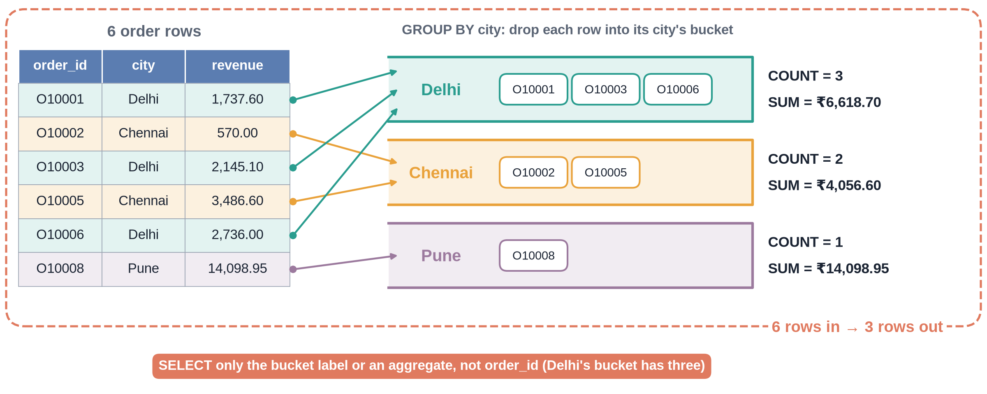
GROUP BY makes buckets
Notes:
✏ DRAW THIS SLIDE – hand-draw it live; the slide diagram is your reference
4.4 – Board segment. Use rows O10001 to O10008 (values in script).
What to draw:
• Write 6 order rows: city and revenue
• Draw 3 buckets labelled Delhi, Chennai, Pune
• Drop each row into its city's bucket
• Under each bucket write SUM and COUNT
• Circle: many rows in, one row per bucket out

Slide 21
WHERE vs HAVING
WHERE
HAVING
Filters rows
Runs before grouping
Cannot use COUNT or SUM
WHERE returned = 'Y'
Filters groups
Runs after grouping
Can use COUNT, SUM, AVG
HAVING COUNT(*) > 500

Slide 22
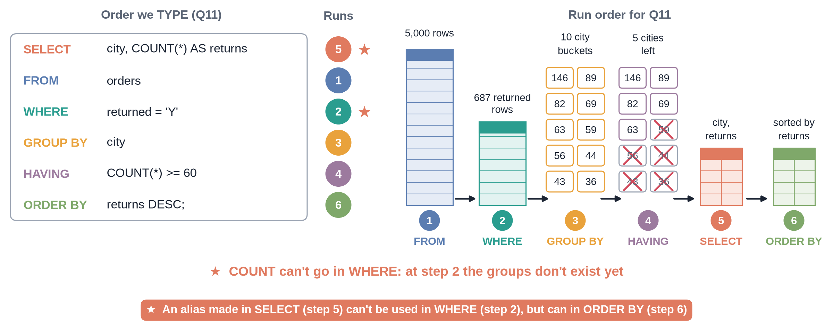
The order SQL really runs in
Notes:
✏ DRAW THIS SLIDE – hand-draw it live; the slide diagram is your reference
4.4 – Board segment: logical order of execution.
What to draw:
• Write the query in the order we TYPE it
• Next to it, number the order SQL RUNS it
• 1 FROM, 2 WHERE, 3 GROUP BY, 4 HAVING, 5 SELECT, 6 ORDER BY
• Draw the table shrinking at each step
• Star: aliases from SELECT are unknown to WHERE

Slide 23
Logical order of a query
1
2
3
4
5
6
FROM
WHERE
GROUP BY
HAVING
SELECT
ORDER BY
Pick the table (and joins)
Drop rows that do not match
Put rows into buckets
Drop buckets that do not match
Compute the output columns
Sort, then LIMIT

Slide 24
Return rate by city (top 4 and bottom 2)
City | Orders | Returns | Return rate
Pune | 451 | 146 | 32.4%
Kolkata | 414 | 59 | 14.3%
Ahmedabad | 303 | 43 | 14.2%
Lucknow | 326 | 44 | 13.5%
Delhi | 804 | 82 | 10.2%
Mumbai | 759 | 69 | 9.1%
Overall return rate 13.7%. Pune is about 2.4 times the average.

Slide 25
Recap – Video 4.4
COUNT, SUM, AVG, MIN, MAX squash rows
GROUP BY gives one row per group
HAVING filters groups, WHERE filters rows
Run order: FROM, WHERE, GROUP BY, HAVING, SELECT, ORDER BY
PRACTICE TASK
Find the average rating per payment mode. Which payment modes have more than 800 orders?

Slide 26
INNER JOIN: combining two tables
VIDEO 4.5 · 10 MIN
Notes:
SEGMENTS: Handwriting board + Screen recording
4.5 – Hook: which category earns the most? orders has no category column.

Slide 27
Why do we need JOIN?
orders knows product_id, not category
products knows category and cost_price
Same key in both tables: product_id
JOIN glues matching rows side by side
Like XLOOKUP in Module 2, for all columns at once
ONE-LINE IDEA
A JOIN is a lookup. ON tells SQL which columns must match.

Slide 28
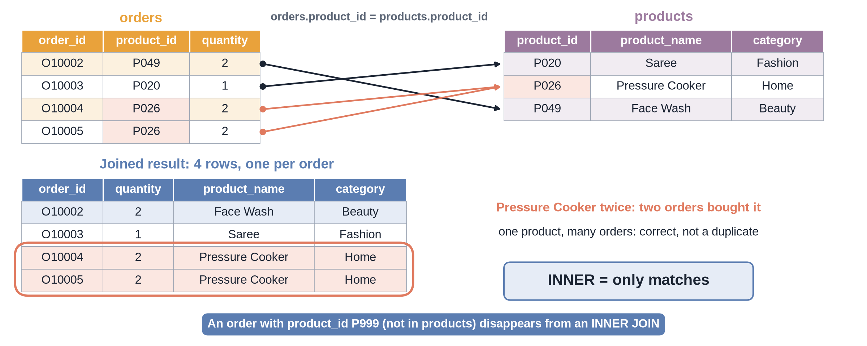
How JOIN matches rows
Notes:
✏ DRAW THIS SLIDE – hand-draw it live; the slide diagram is your reference
4.5 – Board segment: JOIN matching with O10001-O10005 and P048, P049, P020, P026.
What to draw:
• Left: mini orders table, 4 rows with product_id
• Right: mini products table, 3 rows
• Draw a line from each order to its product_id
• Write the joined rows below, side by side
• Show one product used by two orders: it repeats

Slide 29
INNER JOIN syntax
SQL
o and p are table aliases
ON = the matching rule
Prefix columns: o.quantity, p.category
INNER keeps only rows that match
SELECT p.category,
COUNT(*) AS orders,
ROUND(SUM(o.quantity * o.unit_price
* (1 - o.discount)), 2)
AS revenue
FROM orders AS o
INNER JOIN products AS p
ON o.product_id = p.product_id
GROUP BY p.category
ORDER BY revenue DESC;

Slide 30
Revenue and returns by category
Category | Orders | Revenue (Rs) | Return rate
Electronics | 1,152 | 73,31,018 | 13.5%
Fashion | 1,326 | 31,21,346 | 21.0%
Home | 1,020 | 26,55,047 | 12.5%
Beauty | 750 | 8,77,640 | 9.5%
Books | 752 | 7,19,598 | 7.3%
Electronics is half of revenue. Fashion: most orders, highest return rate.

Slide 31
Recap – Video 4.5
JOIN combines tables on a matching key
ON o.product_id = p.product_id
Use table aliases and prefixes
INNER JOIN keeps only matches
JOIN + GROUP BY answers category questions
PRACTICE TASK
Join orders with customers and find total revenue by gender.

Slide 32
LEFT JOIN, other joins and 3-table joins
VIDEO 4.6 · 9 MIN
Notes:
SEGMENTS: Handwriting board + Screen recording
4.6 – Hook: which customers signed up but never ordered?

Slide 33
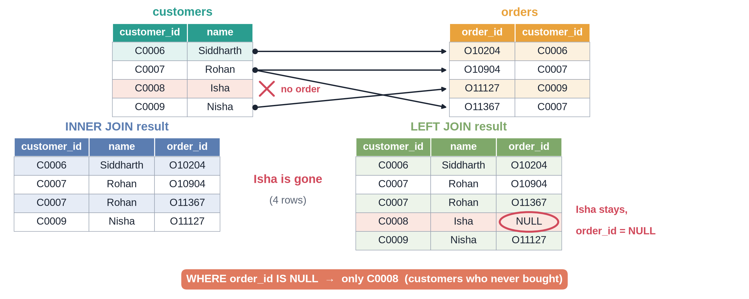
LEFT JOIN keeps everyone
Notes:
✏ DRAW THIS SLIDE – hand-draw it live; the slide diagram is your reference
4.6 – Board segment: LEFT JOIN NULLs. C0008 Isha Reddy has 0 orders.
What to draw:
• Left: customers C0006, C0007, C0008, C0009
• Right: a few orders; none for C0008
• INNER JOIN result: C0008 disappears
• LEFT JOIN result: C0008 stays, order_id = NULL
• Circle the NULL: this is how we find non-buyers

Slide 34
The four joins
I
L
R
F
INNER JOIN
LEFT JOIN
RIGHT JOIN
FULL JOIN
Only rows that match in both tables
All rows of left table, NULL where no match
All rows of right table. Same as LEFT with tables swapped
All rows of both tables, NULLs on either side
RIGHT and FULL JOIN exist in SQLite 3.39+. In this course we always write LEFT JOIN.

Slide 35
Joining three tables
SQL
Start from orders, the middle table
Add one JOIN per extra table
Each JOIN has its own ON
SELECT o.order_id,
c.name AS customer,
c.membership,
p.product_name,
p.category
FROM orders AS o
INNER JOIN customers AS c
ON o.customer_id = c.customer_id
INNER JOIN products AS p
ON o.product_id = p.product_id
LIMIT 5;

Slide 36
Customers who never ordered
42
29
13
Never ordered
Free members
Prime members, paying but not buying
Notes:
4.6 – 5,042 LEFT rows minus 5,000 INNER rows = 42.

Slide 37
Recap – Video 4.6
LEFT JOIN keeps every left row
No match gives NULL on the right side
WHERE right.id IS NULL finds the missing ones
RIGHT and FULL: know the idea, write LEFT
Chain JOINs for 3 tables
PRACTICE TASK
How many products were never ordered? Count the 42 non-buying customers by city.

Slide 38
CASE and handy functions
VIDEO 4.7 · 7 MIN
Notes:
SEGMENTS: Screen recording
4.7 – Hook: are we a small-order or a big-order business?

Slide 39
CASE: IF-THEN inside SQL
SQL
Checked top to bottom, first TRUE wins
ELSE catches everything left
END closes the CASE
SELECT CASE
WHEN quantity*unit_price*(1-discount) < 1000
THEN 'Small'
WHEN quantity*unit_price*(1-discount) < 5000
THEN 'Medium'
ELSE 'Large'
END AS order_size,
COUNT(*) AS orders
FROM orders
GROUP BY order_size;

Slide 40
Five functions worth knowing
Function | Does | Example result
ROUND(x, 2) | keeps 2 decimals | 1737.6
UPPER(text) | capital letters | SMARTWATCH
LENGTH(text) | counts characters | 10
strftime('%m', date) | month from a date | '11'
COALESCE(x, y) | y if x is NULL | 'Not rated'

Slide 41
Order-size buckets
1,638
2,802
560
50%
Small orders (< Rs 1,000)
Medium orders
Large orders (Rs 5,000+)
of revenue from Large
Notes:
4.7 – Large = Rs 73.7 lakh of Rs 1.47 crore.

Slide 42
Recap – Video 4.7
CASE WHEN ... THEN ... ELSE ... END
ROUND, UPPER, LENGTH for tidy output
strftime('%m', order_date) gives the month
COALESCE fills NULLs for display
Do not turn missing ratings into 0
PRACTICE TASK
Bucket customers into age groups 18-24, 25-34 and 35+ and count each group.

Slide 43
Subqueries, CTEs and a business case
VIDEO 4.8 · 7 MIN
Notes:
SEGMENTS: Screen recording + Slides
4.8 – Hook: CEO asks top 3 categories for Prime vs Free.

Slide 44
Subquery vs CTE
Subquery
CTE (WITH)
A query inside brackets
Inner query runs first
WHERE price > (SELECT AVG ...)
Hard to read when nested
A named temporary result
Written at the top
Read top to bottom like steps
Best for multi-step questions

Slide 45
Business case as a CTE
SQL
Step 1: revenue per membership and category
Step 2 in the file: rank and keep top 3
WITH member_category AS (
SELECT c.membership, p.category,
SUM(o.quantity * o.unit_price
* (1 - o.discount)) AS revenue
FROM orders o
JOIN customers c ON o.customer_id = c.customer_id
JOIN products p ON o.product_id = p.product_id
GROUP BY c.membership, p.category
)
SELECT *
FROM member_category
ORDER BY membership, revenue DESC;

Slide 46
Top 3 categories: Prime vs Free
Rank | Prime (Rs) | Free (Rs)
1 | Electronics 39,83,051 | Electronics 33,47,967
2 | Fashion 16,66,185 | Fashion 14,55,161
3 | Home 14,02,887 | Home 12,52,160
Same order value (about Rs 2,940) but Prime customers order about twice as often: 9.8 vs 4.8.

Slide 47
What you can now do with SQL
Explore any database schema
Filter, sort and summarise 5,000 orders
Join three tables on keys
Bucket, clean and format with functions
Answer a multi-step business question
NEXT MODULE
Next: Module 5. We move to Python in Google Colab, and in Module 6 load this same data with pandas.

Slide 48
Recap – Video 4.8
Subquery = query inside a query
CTE = named step with WITH
Business case: Electronics, Fashion, Home lead for both
Run M04_shopkart_sql_project.sql end to end
PRACTICE TASK
Use a subquery to count orders with revenue above the average order value. Then take the Module 4 quiz.

