Slide 1
Python Basics in Google Colab
MODULE 5
From spreadsheet formulas and SQL to your first Python code
Notes:
Video 5.1: show 3 seconds before the hook.

Slide 2
Why Python + Colab tour
VIDEO 5.1 · 7 MIN
Notes:
SEGMENTS: Slides + Screen recording
Video 5.1: Hook: 5,000 orders today, 50 lakh tomorrow.

Slide 3
Why Python after Excel and SQL?
1
2
3
4
Scale
Repeatable
Everything in one
Jobs
Lakhs of rows without the sheet freezing
Rerun the same cleaning every month in one click
Clean, analyse, chart and predict in one notebook
Python + SQL appear in most analyst job posts
Notes:
Video 5.1: Excel and SQL are not wasted - Python adds scale and repeatability.

Slide 4
Google Colab: the parts you need
C
T
F
Code cell
Text cell
Files panel
Grey box. Type Python, press Shift + Enter
Notes and headings in Markdown
Folder icon on the left. Drag data files in
R
D
G
Runtime menu
Save to Drive
Free machine
Run all, Restart session, Disconnect
File → Save a copy in Drive
Google's computer runs your code, nothing to install
Notes:
Video 5.1: Point to each part on screen right after this slide.

Slide 5
Every Colab session, in this order
1
2
3
4
5
Upload
Save
Add data
Run
Re-upload
File → Upload notebook
Save a copy in Drive
Drag CSV into Files panel
Shift + Enter, top to bottom
After a reset, files are gone
Notes:
Video 5.1: Stress: uploaded files disappear when the runtime resets.

Slide 6
Recap – Video 5.1
Python adds scale and repeatability
Code cells run with Shift + Enter
Data goes in the Files panel
Runtime reset deletes uploaded files
Save a copy in Drive first
PRACTICE TASK
Open M05_5.1_colab_tour_follow_along.ipynb in Colab, upload orders_raw.csv, and calculate what order O10004 paid: 2 x ₹2,020 with 15% off.
Notes:
Video 5.1: answer is ₹3,434.

Slide 7
Variables and data types
VIDEO 5.2 · 10 MIN
Notes:
SEGMENTS: Handwriting board + Screen recording
Video 5.2: Hook: why can't Python add ₹1,299 + 100?

Slide 8
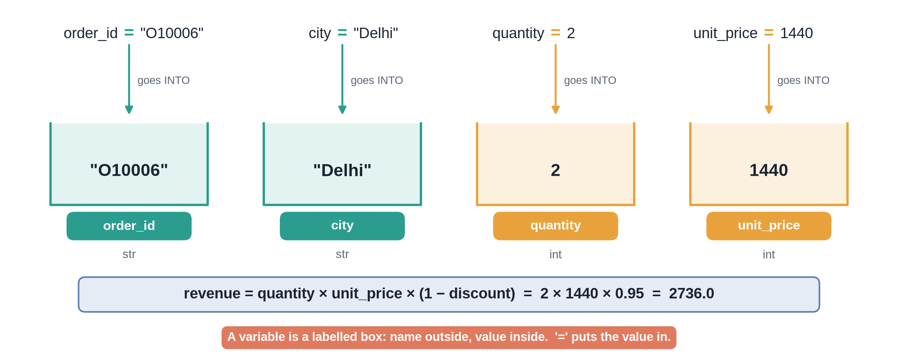
Variables are labelled boxes
Notes:
✏ DRAW THIS SLIDE – hand-draw it live; the slide diagram is your reference
Video 5.2: Draw slowly; say 'equals means store'.
What to draw:
• Draw 4 boxes. Labels: order_id, city, quantity, unit_price
• Write inside: "O10006", "Delhi", 2, 1440
• Arrow from '=' : value goes INTO the box
• Write revenue = 2 x 1440 x 0.95 = 2736.0

Slide 9
Four basic types, ShopKart examples
Type | Means | ShopKart example
str | Text | "Delhi", "O10006"
int | Whole number | quantity = 2
float | Decimal number | discount = 0.05
bool | True / False | is_returned = False
Check any value with type(...)
Notes:
Video 5.2: Same idea as column types in Excel and SQL.

Slide 10
Order O10006 in Python
PYTHON
Same formula as the Excel revenue column
f-string puts variables in a sentence
quantity = 2
unit_price = 1440
discount = 0.05
revenue = (quantity * unit_price
* (1 - discount))
print(revenue) # 2736.0
print(f"Revenue is ₹{revenue}")
Notes:
Video 5.2: Then switch to Colab and type it live.

Slide 11
Text that looks like a number
PYTHON
153 raw prices look like this
replace() removes characters
int() converts text to a number
price = "₹1,299" # text in raw file
clean = price.replace("₹", "")
clean = clean.replace(",", "")
price = int(clean) # 1299, a number
print(price * 2) # 2598
Notes:
Video 5.2: This exact fix comes back in 6.3 for all rows.

Slide 12
Recap – Video 5.2
A variable is a labelled box
str, int, float, bool
type() tells you the type
Clean text with replace(), convert with int()
PRACTICE TASK
Order O10007: 2 Smartphones at ₹15,303, 20% off, city " kolkata". Clean the city and print one f-string sentence with the revenue.
Notes:
Video 5.2: answer Kolkata, ₹24,484.8.

Slide 13
Lists and dictionaries
VIDEO 5.3 · 12 MIN
Notes:
SEGMENTS: Handwriting board + Screen recording
Video 5.3: Hook: one variable per order won't work for 5,000 orders.

Slide 14
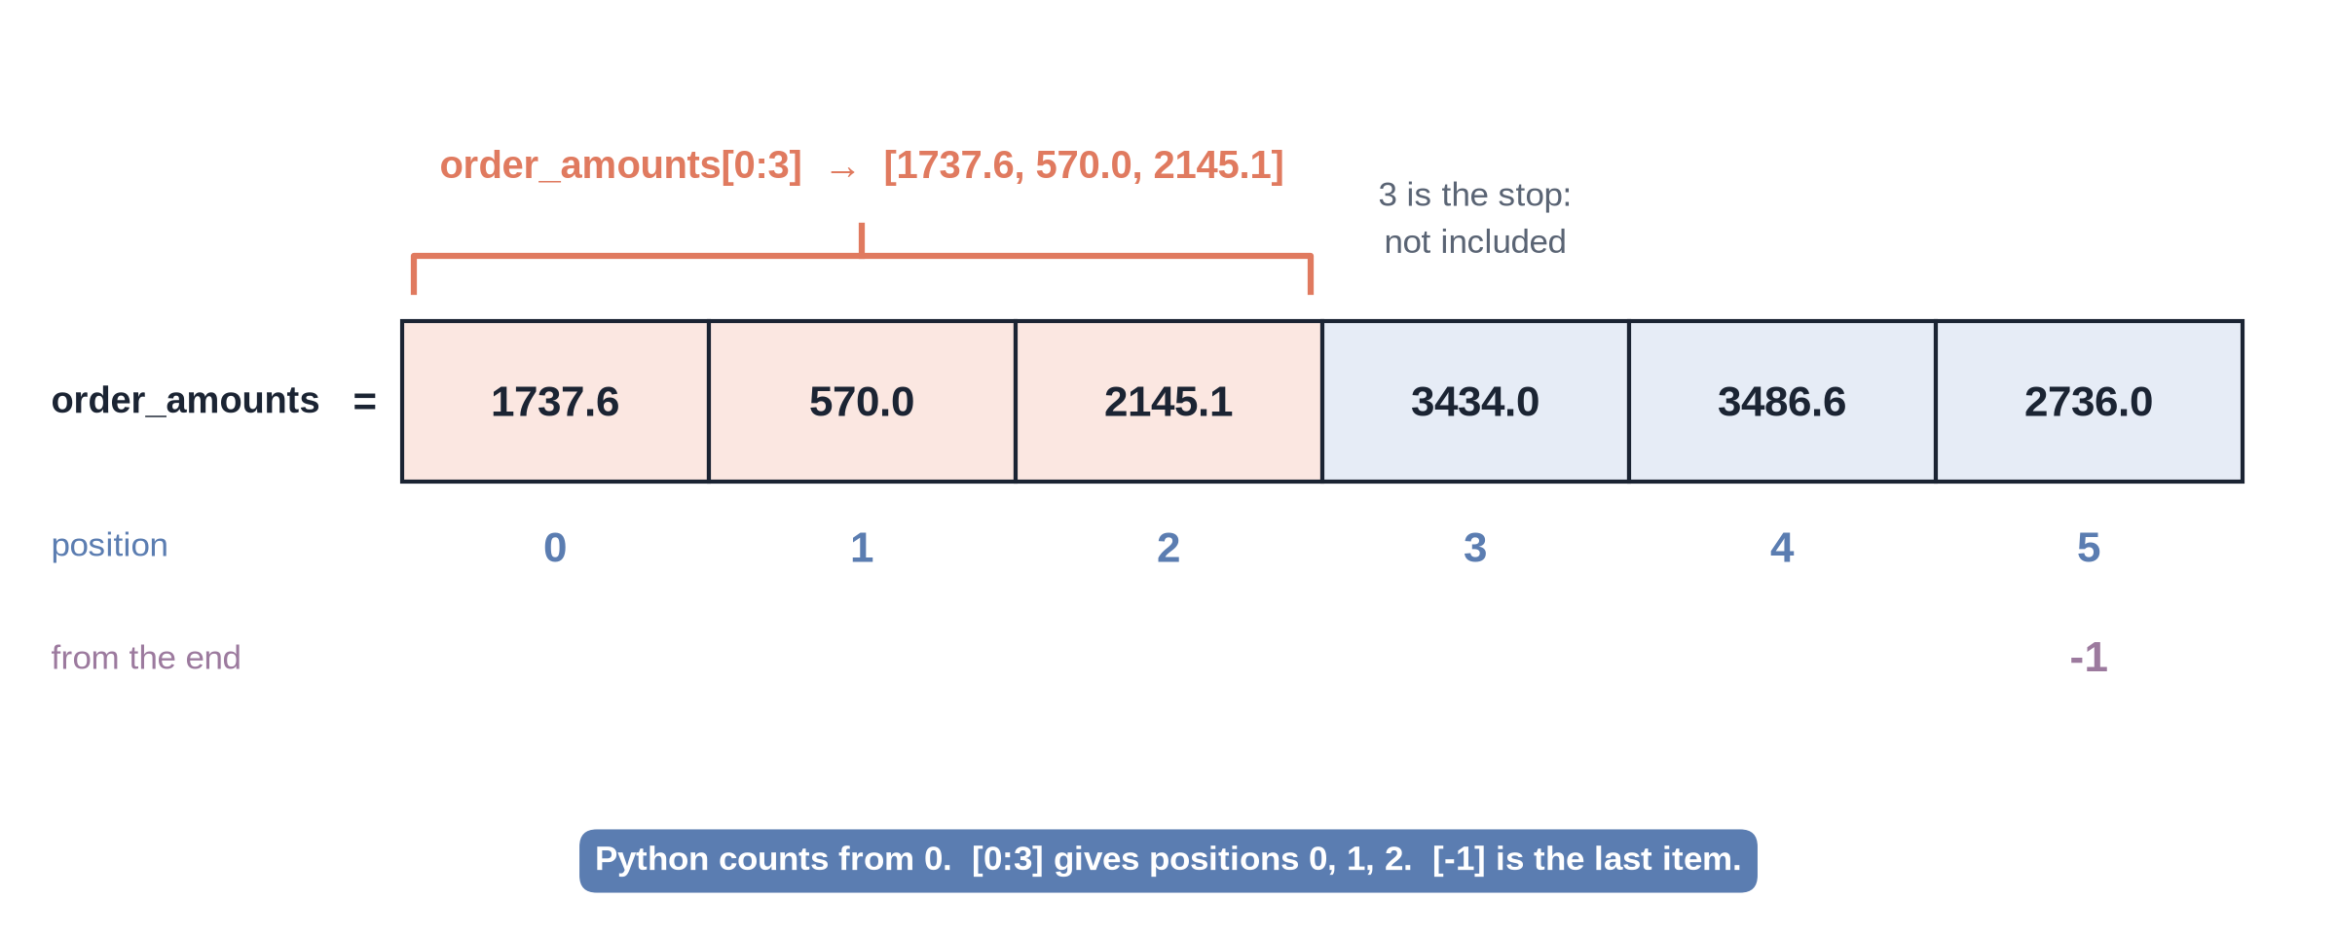
A list with positions
Notes:
✏ DRAW THIS SLIDE – hand-draw it live; the slide diagram is your reference
Video 5.3: Emphasise counting from zero.
What to draw:
• Draw 6 boxes in a row: 1737.6, 570.0, 2145.1, 3434.0, 3486.6, 2736.0
• Write 0 to 5 under them (Python counts from 0)
• Write -1 under the last box
• Bracket boxes 0-2: order_amounts[0:3]

Slide 15
Lists: many values, one name
PYTHON
Square brackets make a list
len, sum, max, min work on lists
order_amounts = [1737.6, 570.0, 2145.1,
3434.0, 3486.6, 2736.0]
len(order_amounts) # 6
sum(order_amounts) # 14109.3
order_amounts[0] # 1737.6
order_amounts[-1] # 2736.0
order_amounts.append(24484.8)
Notes:
Video 5.3: Revenue of the first six ShopKart orders.

Slide 16
List or dictionary?
List [ ]
Dictionary { }
Many values in order
Access by position: [0]
Example: order amounts
Like one column
Labelled values: key → value
Access by key: ["city"]
Example: one customer
Like one row
Notes:
Video 5.3: Column vs row is the key mental model.

Slide 17
Customer C0593 as a dictionary
PYTHON
customer = {
"customer_id": "C0593",
"name": "Kavya Khan",
"age": 26,
"city": "Delhi",
"membership": "Prime",
}
customer["name"] # 'Kavya Khan'
customer["age"] = 27 # update
customer.get("phone", "-") # safe lookup
Notes:
Video 5.3: Real row from customers.csv.

Slide 18
A list of dictionaries is a mini table
order_id | city | product | revenue | returned
O10001 | Delhi | Wings of Fire | 1737.6 | N
O10002 | Chennai | Face Wash | 570.0 | N
O10003 | Delhi | Saree | 2145.1 | N
O10004 | Lucknow | Pressure Cooker | 3434.0 | Y
Each dictionary = a row. Each key = a column. pandas (Module 6) turns this into a DataFrame.
Notes:
Video 5.3: Bridge to pandas.

Slide 19
Recap – Video 5.3
List = ordered values, index from 0
Dictionary = key → value
List = column, dictionary = row
List of dictionaries = mini table
PRACTICE TASK
Make a dictionary for product P009 Smartphone (list_price 14999, cost_price 11260) and print the margin per unit.
Notes:
Video 5.3: answer ₹3,739.

Slide 20
Conditions and loops
VIDEO 5.4 · 12 MIN
Notes:
SEGMENTS: Handwriting board + Screen recording
Video 5.4: Hook: label every order Big, Medium or Small.

Slide 21
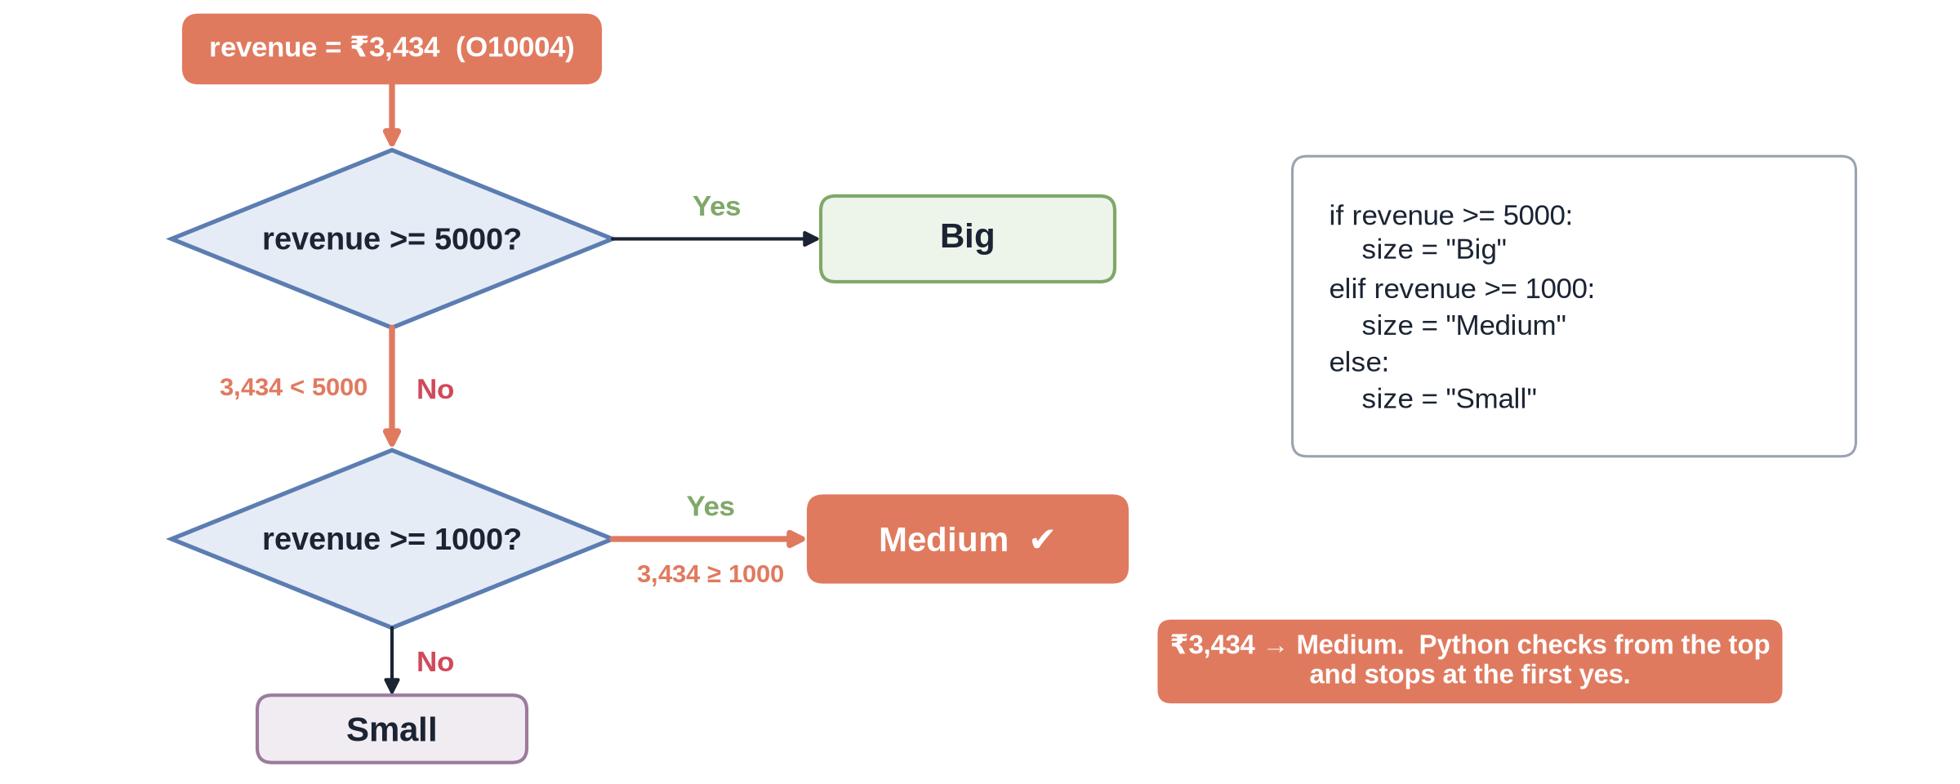
The if / elif / else decision
Notes:
✏ DRAW THIS SLIDE – hand-draw it live; the slide diagram is your reference
Video 5.4: Same logic as nested IF in Excel and CASE WHEN in SQL.
What to draw:
• Diamond: revenue >= 5000? Yes → Big
• No → second diamond: revenue >= 1000? Yes → Medium
• No → Small
• Write ₹3,434 at the top and trace it to Medium

Slide 22
Order size with if / elif / else
PYTHON
Colon at the end of each test
4-space indent marks the block
revenue = 3434.0
if revenue >= 5000:
size = "Big"
elif revenue >= 1000:
size = "Medium"
else:
size = "Small"
print(size) # Medium
Notes:
Video 5.4: Point at the colon and the indent.

Slide 23
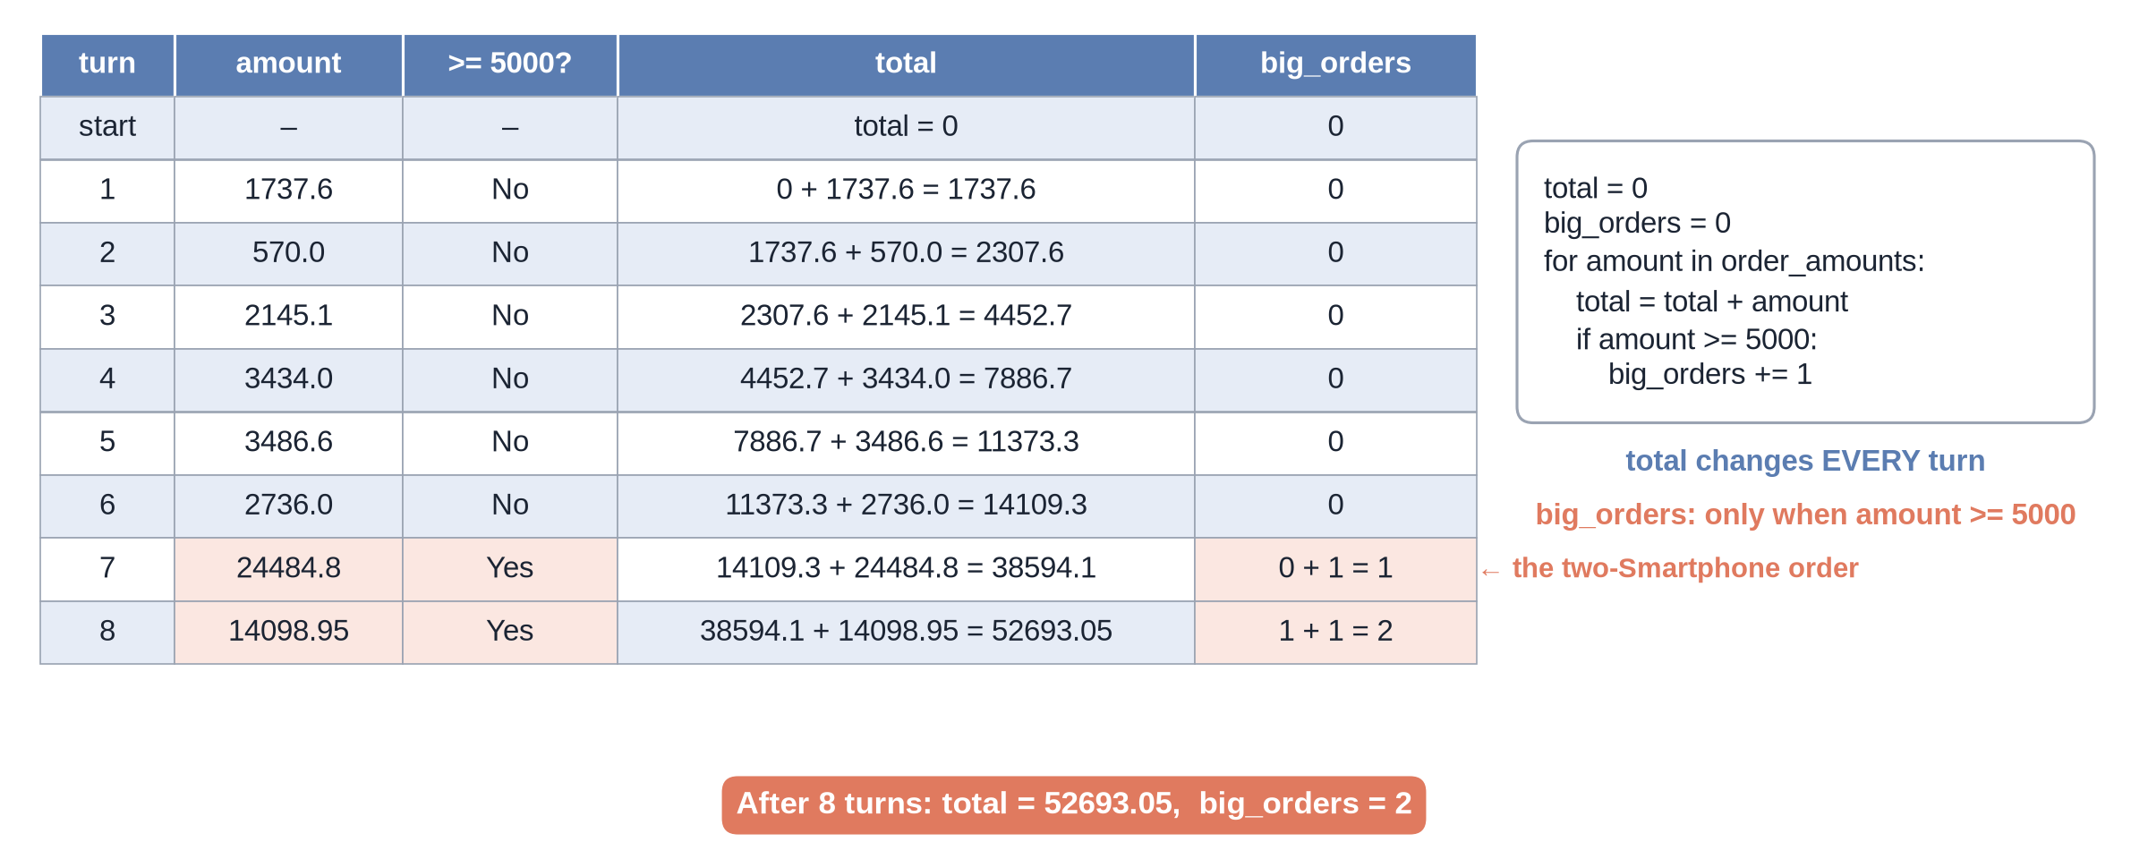
Tracing a loop
Notes:
✏ DRAW THIS SLIDE – hand-draw it live; the slide diagram is your reference
Video 5.4: Trace by hand before running.
What to draw:
• Table with columns: amount, total, big_orders
• Row per loop turn: 1737.6 → 570.0 → ... → 24484.8
• Update total each row
• Add 1 to big_orders only when amount >= 5000

Slide 24
Loop: clean messy city names
PYTHON
for repeats the indented block
Real spellings from orders_raw.csv
rename = {"Bombay": "Mumbai",
"Madras": "Chennai"}
clean = []
for c in [" Mumbai", "DELHI", "Bombay"]:
c = c.strip().title()
c = rename.get(c, c)
clean.append(c)
print(clean)
# ['Mumbai', 'Delhi', 'Mumbai']
Notes:
Video 5.4: Module 6 does this for all 5,000 rows.

Slide 25
Recap – Video 5.4
if / elif / else picks one branch
Indentation is part of the code
for loops repeat work for every item
Build results with append()
PRACTICE TASK
From the 8 order amounts, make a list of orders under ₹3,000 and print how many there are.
Notes:
Video 5.4: answer 4 orders.

Slide 26
Functions and reading errors
VIDEO 5.5 · 10 MIN
Notes:
SEGMENTS: Screen recording
Video 5.5: Hook: write the revenue formula once, use it forever.

Slide 27
A function is a reusable recipe
PYTHON
def name(inputs):
return sends the answer back
discount=0 is a default
def calc_revenue(qty, price, discount=0):
rev = qty * price * (1 - discount)
return round(rev, 2)
calc_revenue(2, 1440, 0.05) # 2736.0
calc_revenue(6, 362, 0.2) # 1737.6
calc_revenue(1, 2258) # 2258
Notes:
Video 5.5: Then build clean_price and clean_city in Colab.

Slide 28
Read the LAST line of the error first
Error | Plain meaning | Fix
IndentationError | Missing 4 spaces | Indent after if / for / def
NameError | Name never created | Fix typo, run earlier cell
TypeError | "₹1,299" + 100 | Convert to a number first
ValueError | int("₹1,299") | Remove ₹ and comma first
KeyError | Key not found | Check spelling and capitals
FileNotFoundError | File not uploaded | Upload again to Files panel
Notes:
Video 5.5: Show each error live in Colab.

Slide 29
Recap – Video 5.5
def creates a function, return gives the answer
Functions remove copy-paste
Read the last line of an error first
TypeError on ₹1,299 means: clean the text
PRACTICE TASK
Write order_size(revenue) returning Big, Medium or Small and test it on 570.0, 3434.0 and 24484.8.
Notes:
Video 5.5: Small, Medium, Big.

Slide 30
Libraries and NumPy
VIDEO 5.6 · 9 MIN
Notes:
SEGMENTS: Slides + Screen recording
Video 5.6: Hook: maths on 5,000 prices without a loop.

Slide 31
Libraries we use in this course
np
pd
M
NumPy
pandas
Matplotlib
Fast maths on arrays. import numpy as np
Tables in Python. import pandas as pd (Module 6)
Basic charts (Module 8)
S
ML
Seaborn
scikit-learn
Nicer statistical charts (Module 8)
Machine learning models (Module 9)
Notes:
Video 5.6: All pre-installed in Colab.

Slide 32
Python list vs NumPy array
List
NumPy array
prices * 2 repeats the list
Needs a loop for maths
Slow for big data
prices * 2 doubles every price
Maths on all values at once
Called vectorised
Notes:
Video 5.6: Show both in Colab.

Slide 33
Vectorised maths on 8 ShopKart orders
PYTHON
Operations apply to every element
Filter with a condition in [ ]
import numpy as np
prices = np.array([362, 300, 2258, 2020,
1937, 1440, 15303, 14841])
qty = np.array([6, 2, 1, 2, 2, 2, 2, 1])
gross = prices * qty # no loop
gross.sum() # 61271
prices[prices > 10000] # Smartphones only
Notes:
Video 5.6: Next: pandas = arrays with column names.

Slide 34
Recap – Video 5.6
import numpy as np, import pandas as pd
Arrays do maths on every value at once
pandas columns are NumPy arrays with names
Next: clean all 5,000 orders in pandas
PRACTICE TASK
Make an array of delivery days 4, 4, 2, 4, 2, 5, 3, 4. Print the average and how many took more than 3 days.
Notes:
Video 5.6: answer 3.5 and 5.

