Slide 1
Data Engineering Basics
MODULE 7
Turn the ShopKart cleaning into a pipeline that runs by itself
Notes:
Video 7.1: show 3 seconds before the hook.

Slide 2
What data engineers build: pipelines, ETL vs ELT
VIDEO 7.1 · 8 MIN
Notes:
SEGMENTS: Slides + Handwriting board
Video 7.1: Hook: the manager wants yesterday's numbers at 9 am, every day.

Slide 3
Module 6 by hand vs a data pipeline
Module 6: by hand
Pipeline: automatic
You open Colab and run cells
Works once, on one laptop
Forget a step, numbers change
New file? Do it all again
One command runs every step
Same order, every time
Checks stop bad data
New file? Only new rows added
Notes:
Video 7.1: Same cleaning code; the difference is automation.

Slide 4
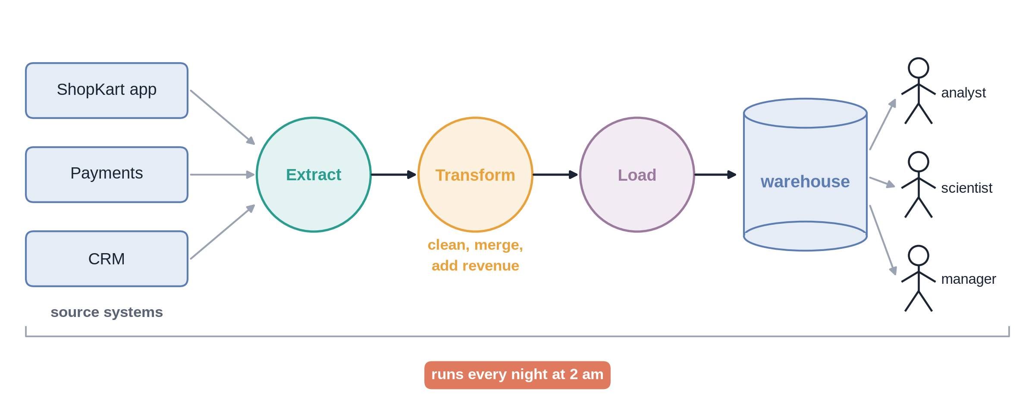
A data pipeline from source to user
Notes:
✏ DRAW THIS SLIDE – hand-draw it live; the slide diagram is your reference
Video 7.1: Draw left to right, slowly. Keep it on screen while explaining ETL.
What to draw:
• Left: three boxes – ShopKart app, payments, CRM (source systems)
• Arrows into three circles: Extract → Transform → Load
• Right: a cylinder labelled 'warehouse'
• Far right: stick figures – analyst, scientist, manager
• Under Transform write: clean, merge, add revenue
• Under the whole line: 'runs every night at 2 am'

Slide 5
ETL in three steps (plus the people who use it)
1
2
3
4
Extract
Transform
Load
Use
Copy data out of source systems
Clean, fix types, merge, add columns
Write into the warehouse
Analysts, dashboards, ML models
Notes:
Video 7.1: E, T, L. The T is what we did all of Module 6.

Slide 6
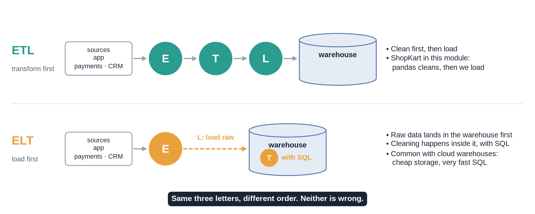
ETL vs ELT
Notes:
✏ DRAW THIS SLIDE – hand-draw it live; the slide diagram is your reference
Video 7.1: Same three letters, different order. Both are normal in industry.
What to draw:
• ETL (transform first)
• Extract → Transform → Load
• Only clean data enters
• Transform runs in Python or a tool
• ShopKart in this module
• ELT (load first)
• Extract → Load → Transform
• Raw data lands in warehouse
• Transform with SQL inside it
• Common with cloud warehouses

Slide 7
Batch vs streaming
B
1
S
2
Batch
Batch example
Streaming
Streaming example
Process a pile of data on a schedule, e.g. every night at 2 am.
ShopKart's daily sales report, monthly new-orders file.
Process each event within seconds of it happening.
UPI fraud alert, live delivery tracking on your phone.
Notes:
Video 7.1: Beginners and most analytics work: batch. Streaming is a later topic.

Slide 8
ShopKart on the pipeline: mostly done already
Pipeline part | In ShopKart | Where you saw it
Source | orders_raw.csv, customers, products | Module 2
Extract | pd.read_csv(...) | Module 6
Transform | the 9 cleaning steps + merge | Module 6
Load | shopkart.db (SQLite) | Module 4
Use | SQL, EDA, charts, ML | Modules 4, 6, 8, 9
Automate it | shopkart_pipeline.py | Video 7.2
Notes:
Video 7.1: Module 6 = the T, shopkart.db = the L.

Slide 9
Three data jobs, one course
A
E
S
Data analyst
Data engineer
Data scientist
Answers business questions: SQL, Excel, EDA, dashboards.
Builds pipelines and warehouses so data arrives clean, on time.
Builds models that predict: revenue, returns, churn.
Notes:
Video 7.1: This module lets the course honestly cover all three, at an introductory level.

Slide 10
Recap – Video 7.1
Pipeline = steps that run by themselves
ETL: Extract, Transform, Load
ELT: load raw first, transform in warehouse
Batch on a schedule; streaming in seconds
Module 6 = T, shopkart.db = L
PRACTICE TASK
Pick an app you use (Swiggy, Ola, IRCTC). Write its source systems and one batch and one streaming use of its data.
Notes:
Video 7.1: Next video we build the pipeline in Colab.

Slide 11
Build ShopKart's first pipeline in Python
VIDEO 7.2 · 14 MIN
Notes:
SEGMENTS: Screen recording + Slides
Video 7.2: Hook: January 2026 orders just arrived. Load them without a single duplicate.

Slide 12
What we build today
1
2
3
4
5
extract()
transform()
checks
load()
incremental
Read the 3 raw files
Module 6 cleaning + merge
7 checks; stop if one fails
Star schema in SQLite
Add only new January orders
Notes:
Video 7.2: Files to upload: orders_raw, customers, products, new_orders_2026_01.

Slide 13
The warehouse: shopkart_warehouse.db
Table | One row per | Rows after 2025 | After January
fact_orders | order | 5,000 | 5,036
dim_customer | customer | 800 | 800
dim_product | product | 60 | 60
dim_date | date with orders | 336 | 357
fact = events and numbers; dim = descriptions. Drawn on the board in Video 7.3.
Notes:
Video 7.2: Show before running load().

Slide 14
Incremental load: only add what is new
PYTHON
~ means NOT
append adds rows, replace rebuilds
Safe to re-run: second run adds 0
new_df = transform(new_raw, customers, products)
conn = sqlite3.connect(WAREHOUSE_DB)
loaded = pd.read_sql("SELECT order_id FROM fact_orders",
conn)["order_id"]
# keep only order_ids the warehouse has not seen
to_add = new_df[~new_df["order_id"].isin(loaded)]
make_fact_orders(to_add).to_sql("fact_orders", conn,
if_exists="append", index=False)
Notes:
Video 7.2: Simplified from the notebook (dim_date update left out).

Slide 15
What our pipeline did
5,000
7 / 7
36
2 + 2
2025 orders loaded (= Module 6)
quality checks passed
January orders added
duplicates removed + old orders skipped
Notes:
Video 7.2: 40 rows in the file: 2 exact duplicates, 2 already-loaded 2025 orders, 36 new.

Slide 16
Recap – Video 7.2
Pipeline = functions run in order
Quality checks raise an error and load nothing
Star schema: fact_orders + 3 dimensions
Incremental load appends only new order_ids
Same code runs as shopkart_pipeline.py
PRACTICE TASK
Add a check that every discount is between 0 and 0.5. Test it on a copy where one discount is 0.9.
Notes:
Video 7.2: Answer in practice/M07_practice_solutions.ipynb, Task 1.

Slide 17
Warehouses, scheduling and the modern data stack
VIDEO 7.3 · 8 MIN
Notes:
SEGMENTS: Slides + Handwriting board
Video 7.3: Hook: who presses Run at 2 am? Nobody.

Slide 18
Database (OLTP) vs data warehouse (OLAP)
OLTP database
OLAP warehouse
Runs the app: orders, payments
Many tiny writes per second
Must be fast for one row
Example: ShopKart checkout
Feeds analysis and reports
Few big reads, many rows
Loaded by pipelines
Example: shopkart_warehouse.db
Notes:
Video 7.3: Never run heavy analysis on the app's live database.

Slide 19
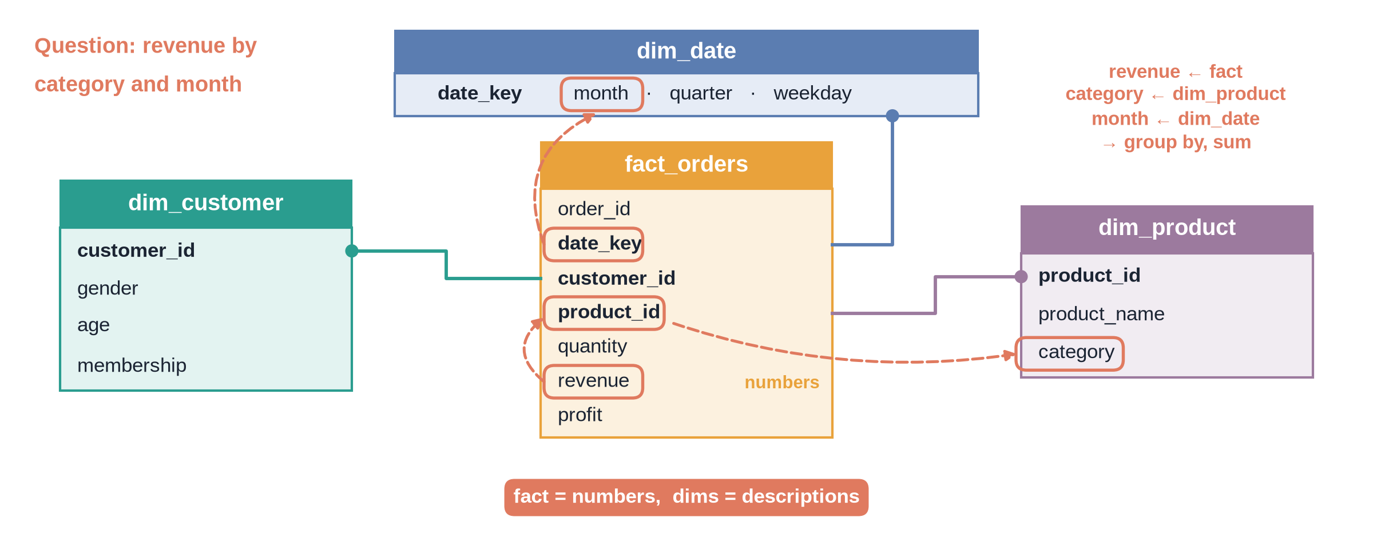
The ShopKart star schema
Notes:
✏ DRAW THIS SLIDE – hand-draw it live; the slide diagram is your reference
Video 7.3: Then trace one query: revenue by category and month.
What to draw:
• Centre: big box fact_orders – order_id, date_key, customer_id, product_id, quantity, revenue, profit
• Top: dim_date – date_key, month, quarter, weekday
• Left: dim_customer – customer_id, gender, age, membership
• Right: dim_product – product_id, product_name, category
• Draw a line from each key in the fact to its dim: a star
• Write: 'fact = numbers, dims = descriptions'

Slide 20
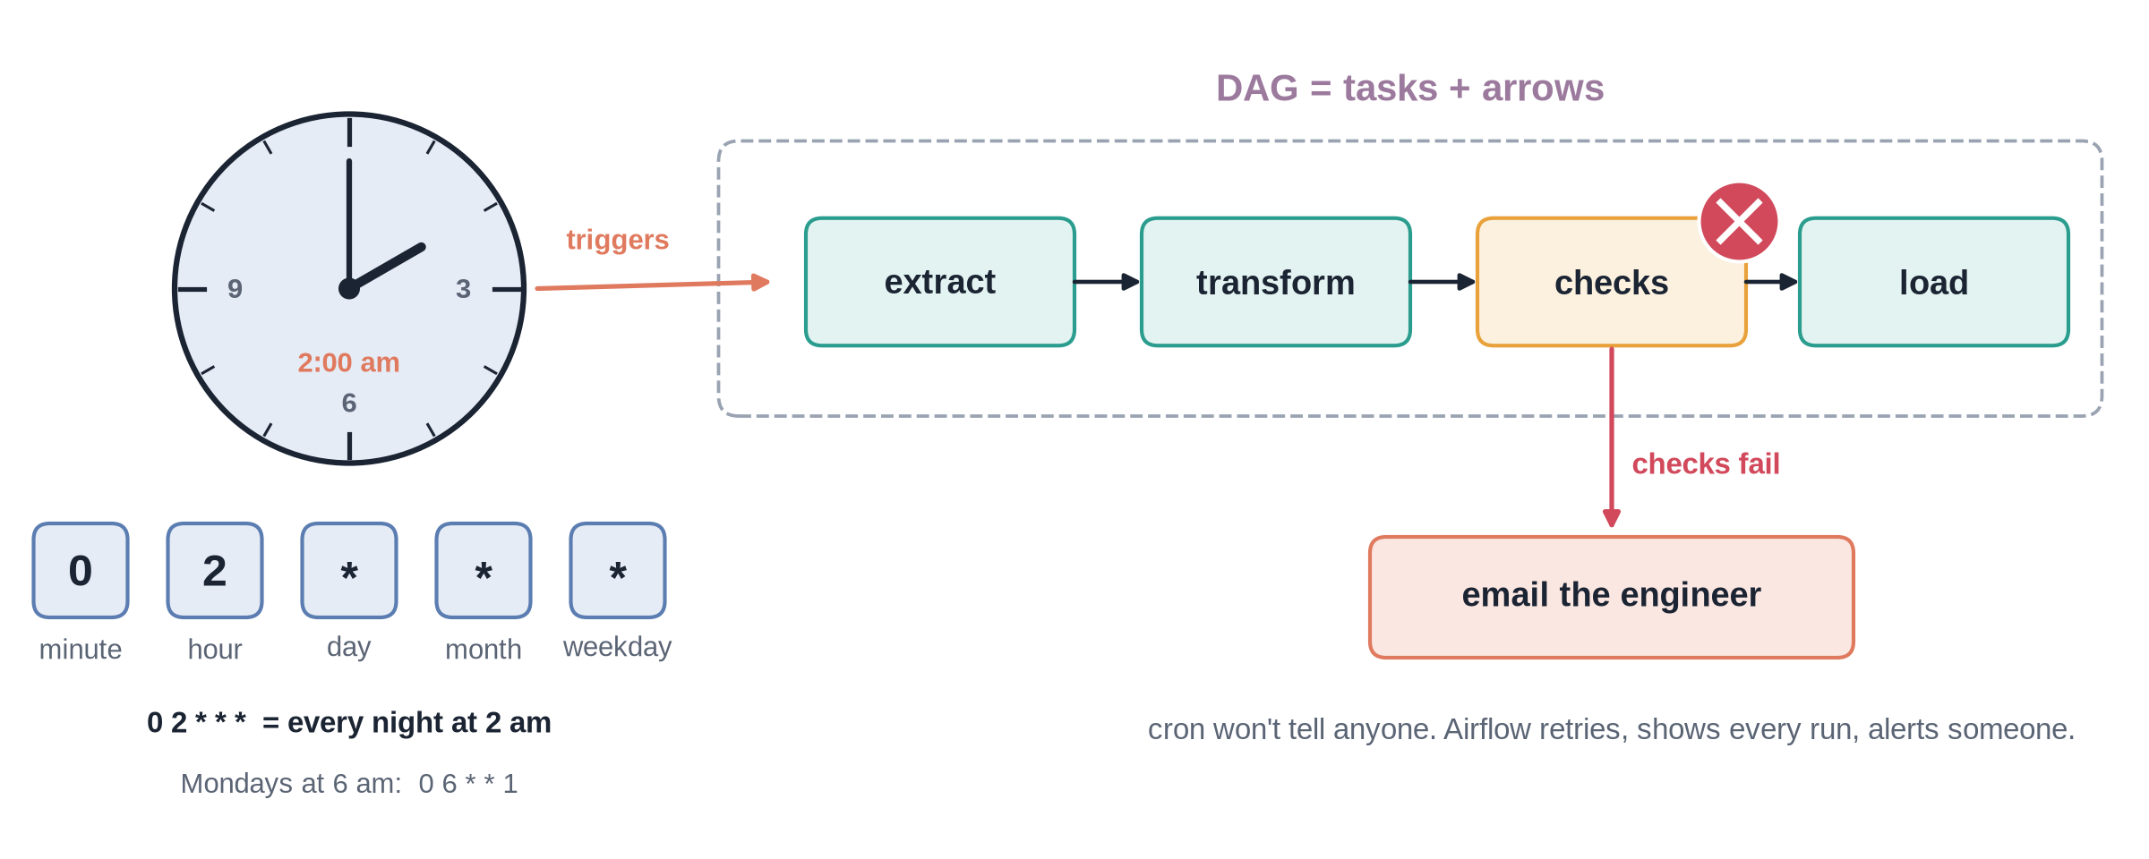
Scheduling – who runs it at 2 am?
Notes:
✏ DRAW THIS SLIDE – hand-draw it live; the slide diagram is your reference
Video 7.3: cron = simple timer; Airflow = timer + order + retries + alerts.
What to draw:
• Draw a clock showing 2:00
• Arrow to four boxes: extract → transform → checks → load
• Under the clock write the cron line: 0 2 * * *
• Label minute, hour, day, month, weekday
• Red cross on 'checks' box → arrow to 'email the engineer'
• Title the boxes 'DAG = tasks + arrows'

Slide 21
An Airflow DAG (illustration only, not run in this course)
PYTHON
schedule: every day at 2 am
Each task calls our own function
>> sets the order
Airflow adds retries and alerts
# Illustration only: NOT run in this course
from datetime import datetime
from airflow import DAG
from airflow.operators.python import PythonOperator
import shopkart_pipeline as sp
with DAG("shopkart_nightly",
schedule="0 2 * * *",
start_date=datetime(2026, 1, 1)):
load = PythonOperator(task_id="load_new_orders",
python_callable=sp.incremental_load,
op_args=["new_orders.csv"])
count = PythonOperator(task_id="count_rows",
python_callable=sp.table_sizes)
load >> count # count_rows runs after the load
Notes:
Video 7.3: Read it like English. Do not ask learners to install Airflow.

Slide 22
Big data in one slide: Apache Spark
pandas works on one computer's memory
Billions of rows do not fit in one machine
Spark splits data across many machines
Each machine cleans its part, results combined
Code looks similar: read, filter, groupBy, join
Learn it after you are strong in pandas and SQL
WHEN DO YOU NEED IT?
ShopKart's 5,000 orders fit easily in pandas. Spark is for when a company has crores of rows a day.
Notes:
Video 7.3: One slide only; no demo.

Slide 23
The modern data stack: names you will see in job posts
BQ
SF
RS
BigQuery
Snowflake
Redshift
Google Cloud's data warehouse. Pay per query.
Cloud warehouse that runs on AWS, Azure or Google Cloud.
Amazon Web Services' data warehouse.
db
AF
SP
dbt
Airflow
Spark
Write transformations as SQL files, tested and versioned (the T in ELT).
Schedules and monitors pipelines (DAGs).
Processes data too big for one machine.
Notes:
Video 7.3: Same ideas as our SQLite pipeline, at company scale.

Slide 24
Data engineering as a fresher
What the job looks like
What to learn next
Titles: Associate / Junior Data Engineer, ETL Developer
Fix failed nightly jobs
Write SQL and Python transforms
Add data-quality checks
Document tables for analysts
SQL deeply: window functions, CTEs
Python + Git + basic Linux
One cloud: GCP, AWS or Azure
Airflow and dbt basics
Data modelling, then Spark
Notes:
Video 7.3: No salary talk; career details in Module 11.

Slide 25
Recap – Video 7.3
OLTP runs the app; OLAP warehouse feeds analysis
Star schema: fact in the middle, dims around
cron / Airflow run pipelines on a schedule
Spark for big data; BigQuery, Snowflake, Redshift, dbt
Next: Module 8 – charts and dashboards
PRACTICE TASK
Add a dim_city table (city, state, zone) to the warehouse and find 2025 revenue by zone with SQL.
Notes:
Video 7.3: Answer: South ₹50,84,788.90 is highest (practice Task 2).

