Slide 1
Introduction to Machine Learning
MODULE 9
Predict ShopKart revenue and returns with scikit-learn

Slide 2
What is machine learning?
VIDEO 9.1 · 7 MIN
Notes:
SEGMENTS: Slides + Handwriting board
9.1 Hook: can we know which orders will be returned before they ship?

Slide 3
Rules vs learning from examples
Traditional programming
Machine learning
You write the rules
Rules + data → answers
If city is Pune, flag order
Computer finds the rules
Data + answers → rules
Learns from 4,000 past orders
Notes:
9.1 Draw arrows on board after this slide.

Slide 4
Three kinds of ML you will meet
₹
Y
◎
Regression
Classification
Clustering
Predict a number. How much revenue will this order bring?
Predict a category. Will this order be returned: yes or no?
No answer column. Find groups of similar customers.
Notes:
9.1 First two are supervised; clustering is unsupervised.

Slide 5
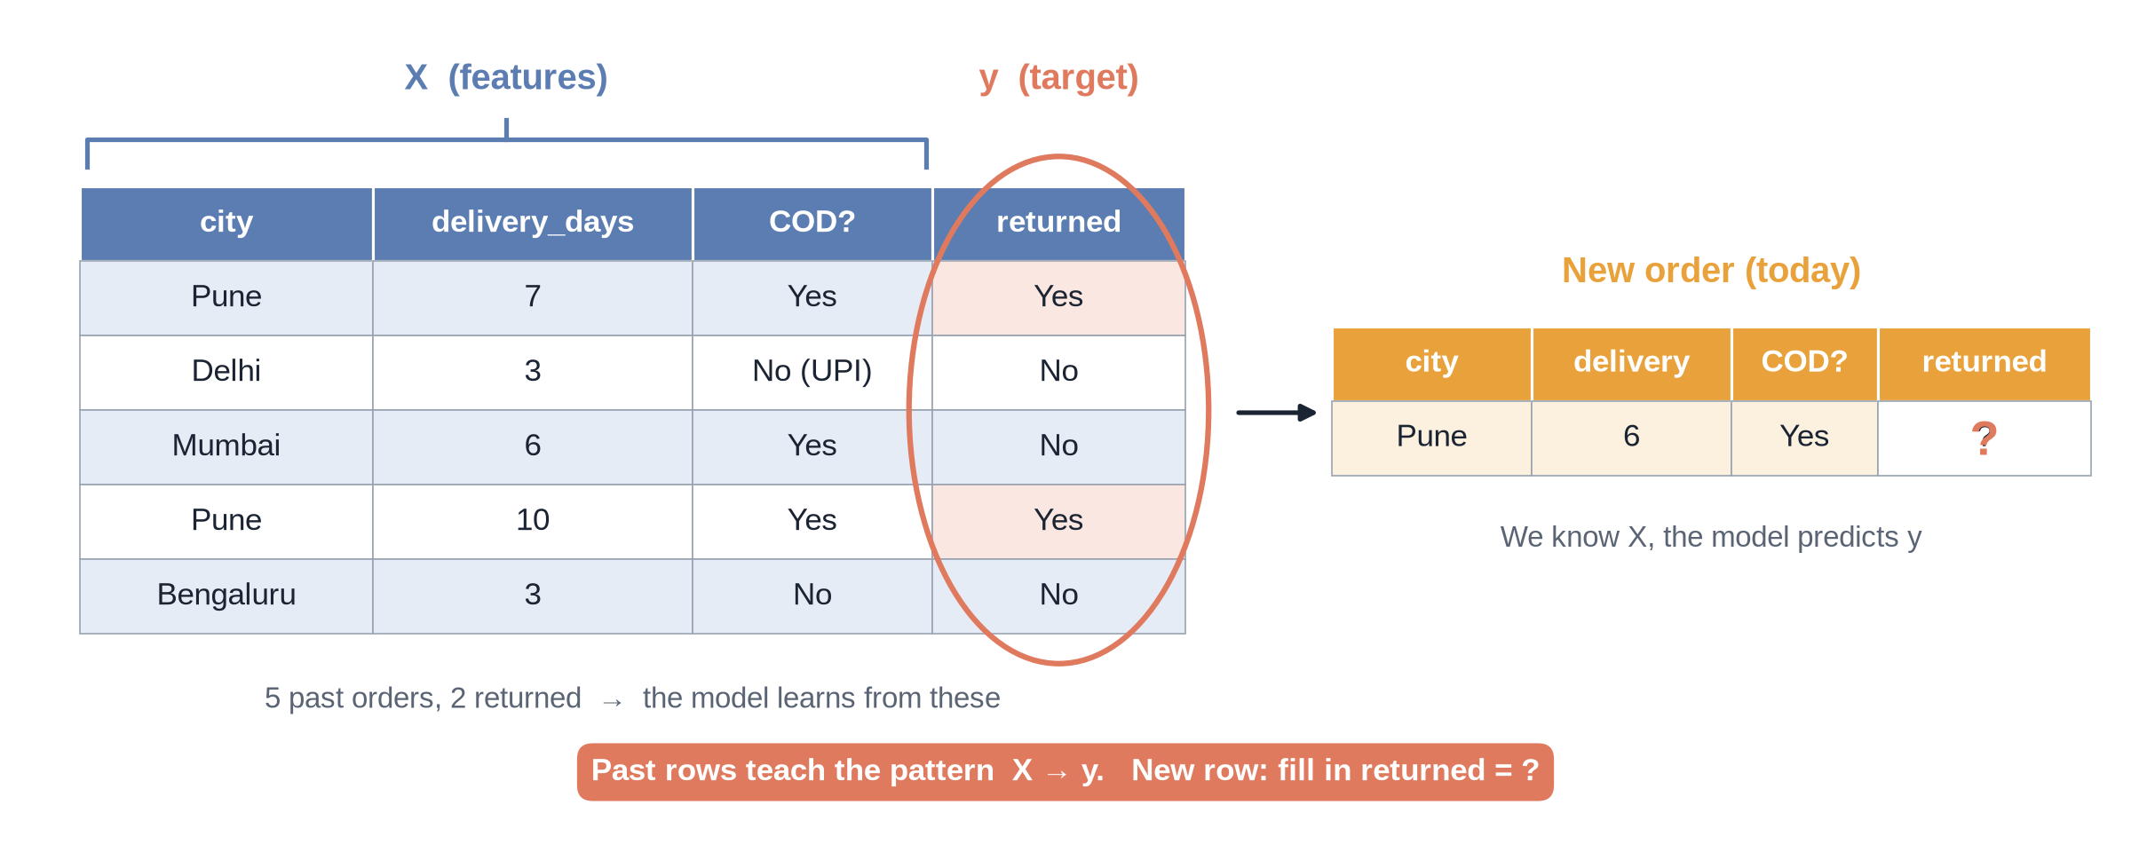
Learning from past orders
Notes:
✏ DRAW THIS SLIDE – hand-draw it live; the slide diagram is your reference
9.1 Board segment.
What to draw:
• Draw a small table: city, delivery days, COD?, returned
• Fill 5 rows; 2 returned
• Circle the last column: this is y (target)
• Bracket the other columns: X (features)
• Arrow to a new row with returned = ?

Slide 6
ML words in ShopKart language
Word | Meaning | ShopKart example
Feature (X) | A clue column | delivery_days, city
Target (y) | What we predict | returned
Training | Learning from examples | 4,000 past orders
Model | The learned rules | A decision tree
Prediction | Model's answer | P(return) = 0.25
Notes:
9.1 Learners will reuse these words all module.

Slide 7
ML is not magic
It finds patterns in past data only
Bad or biased data → bad model
Needs enough examples of each outcome
Often a simple rule or chart is enough
Always test on data it has not seen
GOLDEN RULE
Start with a business question, not with an algorithm.

Slide 8
Recap – Video 9.1
ML learns rules from examples
Regression = number
Classification = category
Clustering = groups, no target
X = features, y = target
PRACTICE TASK
List 3 apps you use that predict something. For each, say: regression or classification, and what is y?

Slide 9
The ML workflow and train/test split
VIDEO 9.2 · 8 MIN
Notes:
SEGMENTS: Handwriting board + Screen recording
9.2 Open M09_9.2_Train_Test_Split_follow_along.ipynb.

Slide 10
Every ML project, six steps
1
2
3
4
5
6
Question
X and y
Split
Train
Predict
Evaluate
Will this order be returned?
Clues and target
80% train, 20% test
model.fit(X_train, y_train)
model.predict(X_test)
Is it good enough?

Slide 11
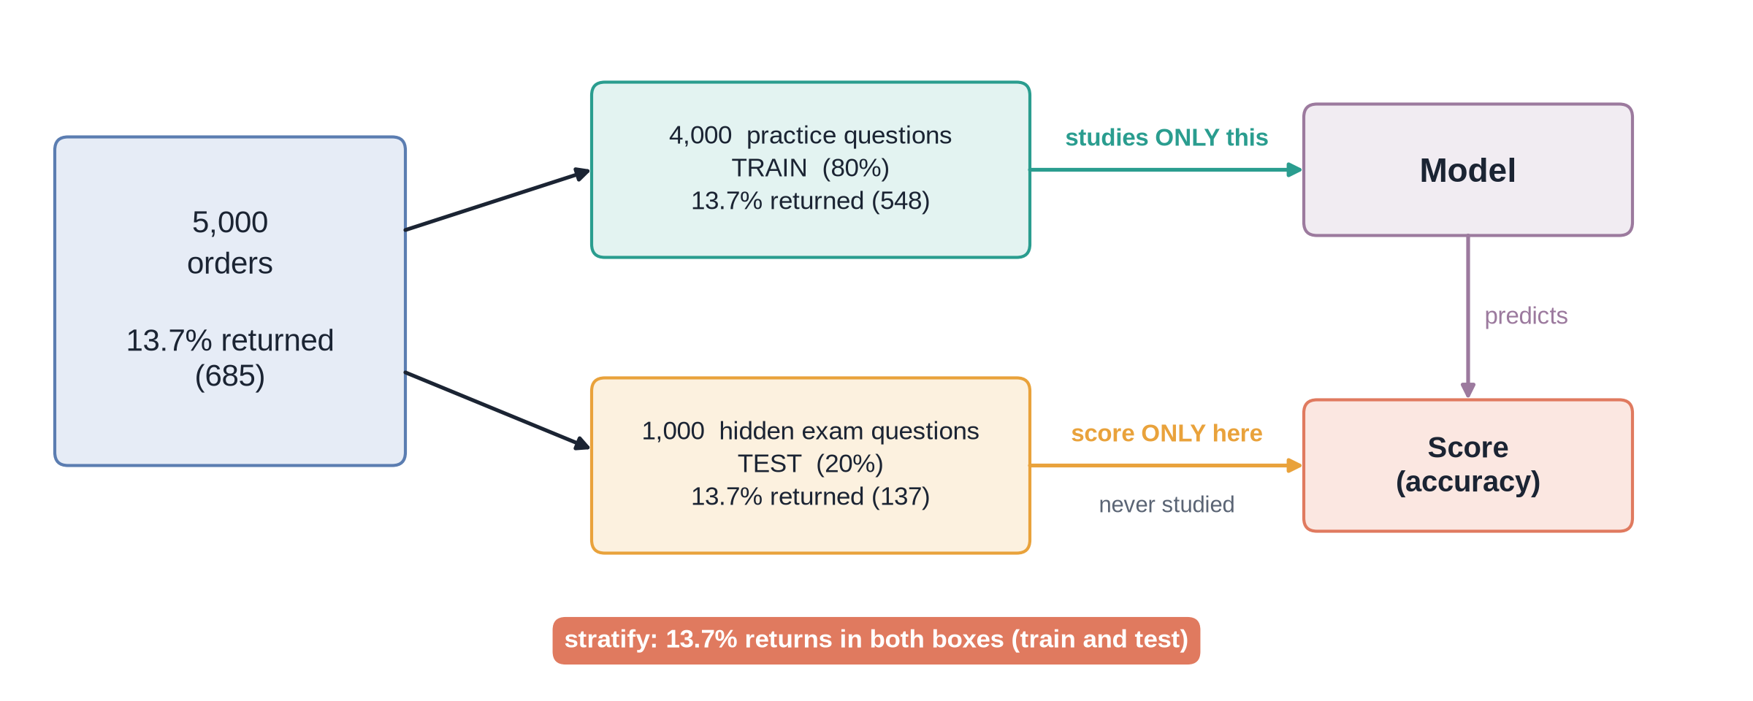
The exam analogy
Notes:
✏ DRAW THIS SLIDE – hand-draw it live; the slide diagram is your reference
9.2 Board segment.
What to draw:
• Big box: 5,000 orders
• Split: 4,000 practice questions (train) | 1,000 exam (test)
• Model studies only the practice box
• Score only on the exam box
• Write: stratify keeps 13.7% returns in both

Slide 12
Split in one line
PYTHON
get_dummies turns text into 0/1 columns
8 columns become 23
random_state=42 = same split every time
y = (df["returned"] == "Y").astype(int)
X = pd.get_dummies(df[features],
drop_first=True, dtype=int)
X_train, X_test, y_train, y_test = train_test_split(
X, y, test_size=0.2,
random_state=42, stratify=y)
# Train: 4,000 rows Test: 1,000 rows

Slide 13
Recap – Video 9.2
Question → X, y → split → train → predict → evaluate
Models need numbers: get_dummies
Test set stays hidden
random_state=42 for repeatable results
PRACTICE TASK
Make y = 1 for COD orders. Split 75/25 with stratify and print the COD share in train and test.

Slide 14
Linear regression: predict order revenue
VIDEO 9.3 · 10 MIN
Notes:
SEGMENTS: Handwriting board + Screen recording
9.3 Open M09_9.3_Linear_Regression_follow_along.ipynb.

Slide 15
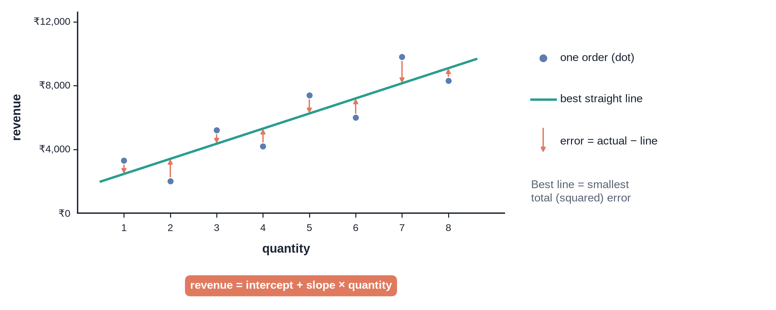
The best straight line
Notes:
✏ DRAW THIS SLIDE – hand-draw it live; the slide diagram is your reference
9.3 Board segment.
What to draw:
• Axes: quantity (x), revenue (y)
• Plot 8 dots, scattered
• Draw a line through the middle
• Draw vertical arrows from dots to line: errors
• Write: revenue = intercept + slope × quantity

Slide 16
Choosing features honestly
Don't use
We use
unit_price with quantity and discount
Revenue is a formula of these
R² jumps to 0.80: answer in disguise
category, quantity, discount
membership, city
Question: expected revenue before product is known

Slide 17
Results on 1,000 test orders
 | MAE | RMSE | R²
Always guess average | ₹2,438 | ₹4,909 | 0.00
Linear regression | ₹2,403 | ₹4,494 | 0.16
Better than guessing, but modest. Prices within a category vary too much to know without the product.
Notes:
9.3 Say clearly: this is a realistic first model.

Slide 18
Recap – Video 9.3
fit learns, predict estimates
Coefficients = ₹ effect per feature
MAE and RMSE in rupees, R² 0 to 1
Always compare with a baseline
No answer-in-disguise features
PRACTICE TASK
Predict profit with the same features. Report MAE and R² and compare with the baseline.

Slide 19
Classification: will this order be returned?
VIDEO 9.4 · 10 MIN
Notes:
SEGMENTS: Handwriting board + Screen recording
9.4 Open M09_9.4_Classification_follow_along.ipynb.

Slide 20
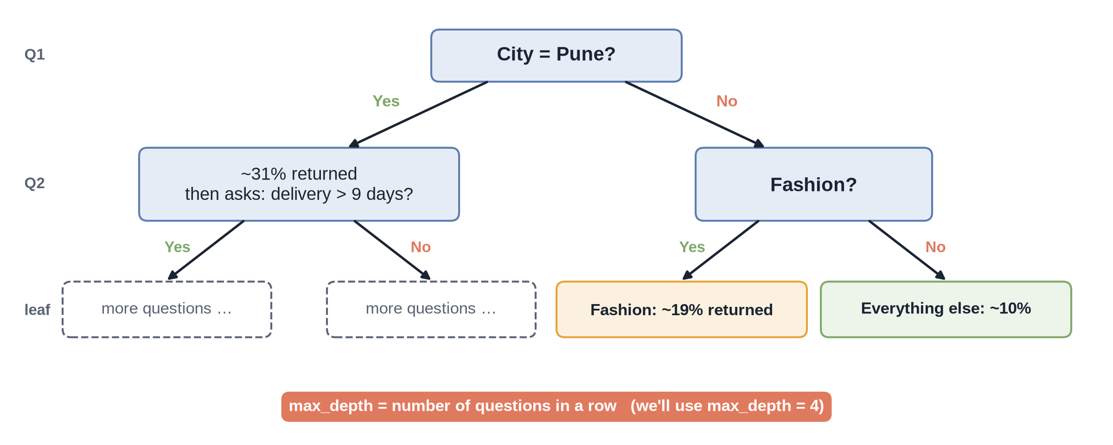
A decision tree for one order
Notes:
✏ DRAW THIS SLIDE – hand-draw it live; the slide diagram is your reference
9.4 Our tree's top question really is city_Pune.
What to draw:
• Top box: City = Pune?
• Yes branch: 31% returned → then asks delivery > 9 days?
• No branch: Fashion? → 19% returned vs 10%
• Leaves show % returned
• Write: max_depth = number of questions

Slide 21
Two classifiers
Decision tree
Logistic regression
Flowchart of yes/no questions
Easy to explain
Top feature: city_Pune (0.42)
Gives a probability 0 to 1
predict_proba = risk score
Scale numbers first (StandardScaler)

Slide 22
Data leakage: why rating is banned
Rating comes after delivery or return
Kept orders average 4.15 stars
Returned orders average 2.78 stars
With rating, accuracy jumps to 90.2%
But at shipping time, no rating exists
LEAKAGE RULE
Only use features you would truly have at the moment of prediction.

Slide 23
The risk score works: test orders in 4 equal groups
4.9%
24.8%
13.7%
Return rate, lowest-risk quarter
Return rate, highest-risk quarter
Average return rate
Notes:
9.4 The model rarely says yes at 0.5, but its ranking is useful.

Slide 24
Recap – Video 9.4
Classification predicts yes/no
Tree = questions; logistic = probability
predict_proba ranks orders by risk
Never use future data (rating)
PRACTICE TASK
Retrain the tree with max_depth=3. Which feature does it split on first?

Slide 25
Evaluating classifiers
VIDEO 9.5 · 8 MIN
Notes:
SEGMENTS: Handwriting board + Screen recording
9.5 Open M09_9.5_Evaluation_follow_along.ipynb.

Slide 26
The accuracy trap
86.3%
86.1%
0 of 137
Accuracy of 'always say not returned'
Accuracy of our model at 0.5
Returns our model caught at 0.5
Notes:
9.5 Hook slide.

Slide 27
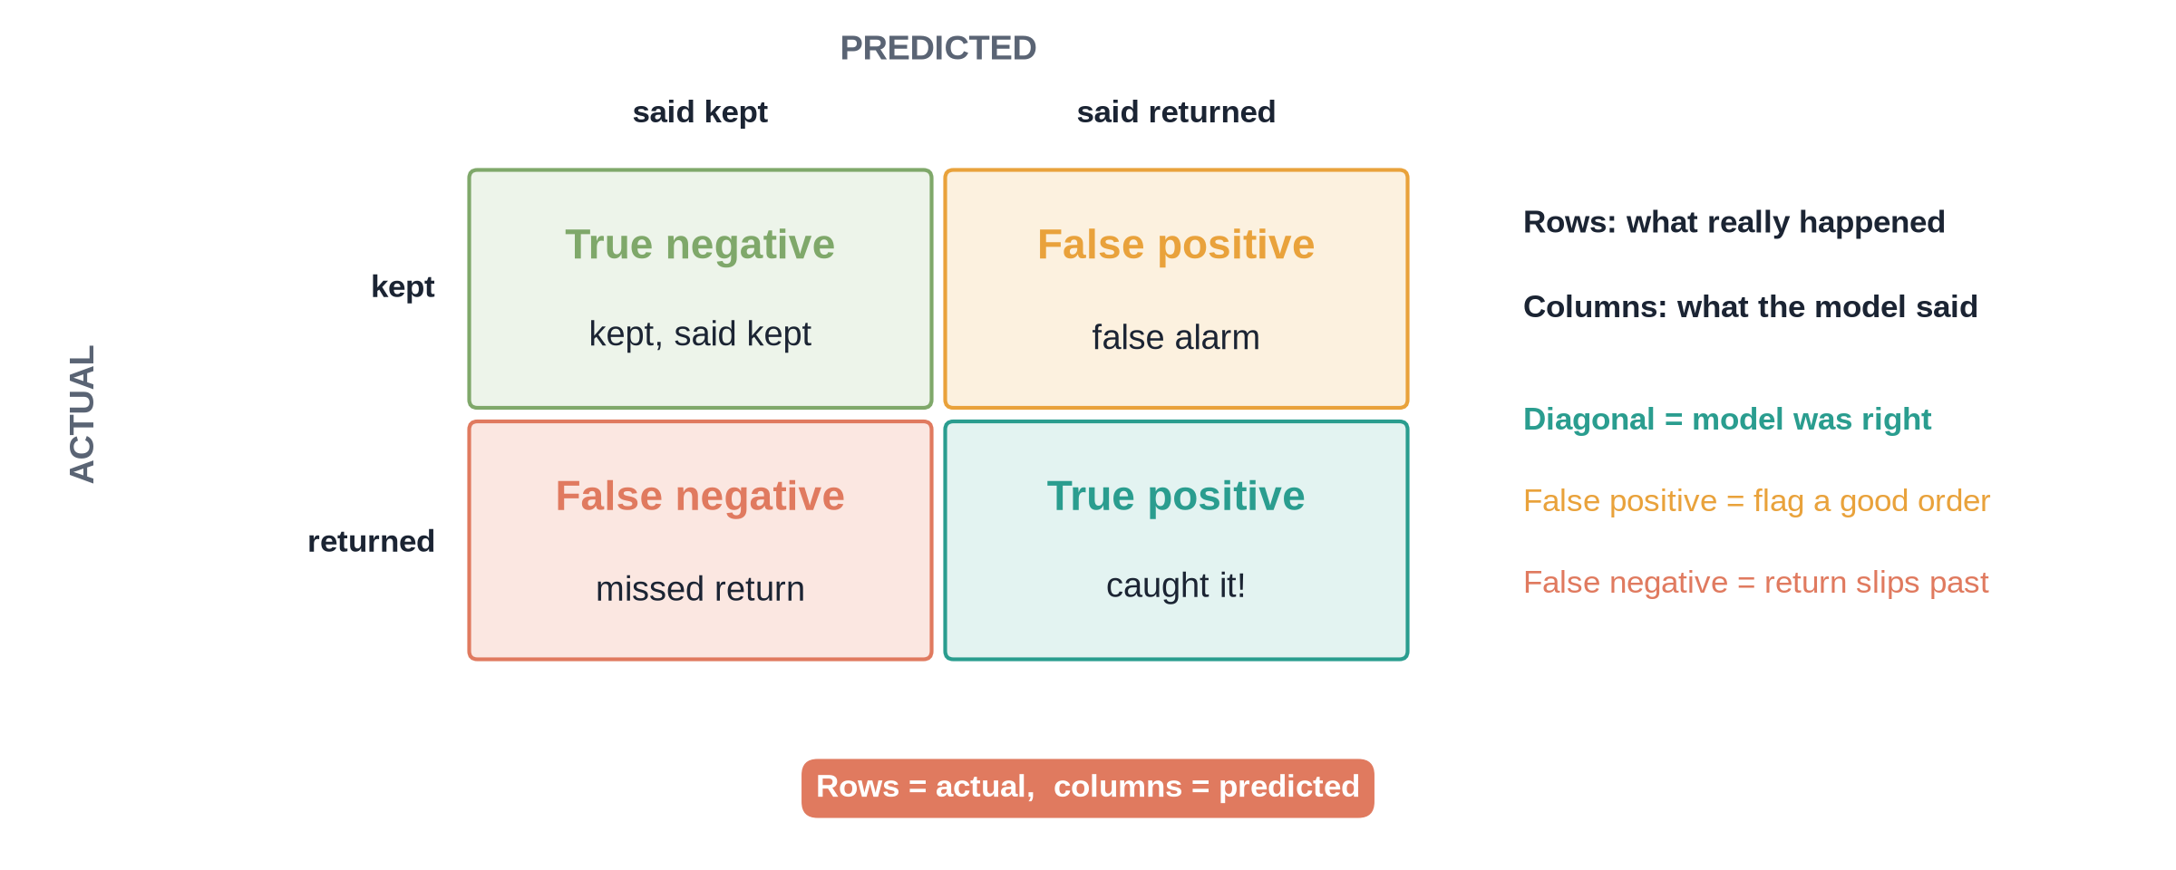
The confusion matrix
Notes:
✏ DRAW THIS SLIDE – hand-draw it live; the slide diagram is your reference
9.5 Fill in 861, 2, 137, 0 from the notebook.
What to draw:
• 2x2 grid: rows = actual, columns = predicted
• TN top-left (kept, said kept)
• FP top-right: false alarm
• FN bottom-left: missed return
• TP bottom-right: caught it

Slide 28
Three better scores
1
2
3
Precision
Recall
F1
TP ÷ (TP + FP). When I say 'return', am I right?
TP ÷ (TP + FN). Of all returns, how many did I catch?
Balance of the two. High only when both are decent.

Slide 29
Threshold is a business knob
Threshold | Flagged | Caught | Precision | Recall
0.50 | 2 | 0 | 0.00 | 0.00
0.30 | 42 | 17 | 0.40 | 0.12
0.20 | 179 | 47 | 0.26 | 0.34
0.15 | 323 | 71 | 0.22 | 0.52
Out of 1,000 test orders, 137 returned. Lower threshold: more caught, more false alarms.

Slide 30
Recap – Video 9.5
Accuracy lies when a class is rare
Confusion matrix: TN, FP, FN, TP
Precision vs recall trade-off
Choose threshold by business cost
PRACTICE TASK
At threshold 0.25, print the confusion matrix, precision and recall. Would you use it?

Slide 31
Overfitting and next steps
VIDEO 9.6 · 7 MIN
Notes:
SEGMENTS: Handwriting board + Slides
9.6 Show the chart from M09_9.6_Overfitting_KMeans_solution.ipynb.

Slide 32
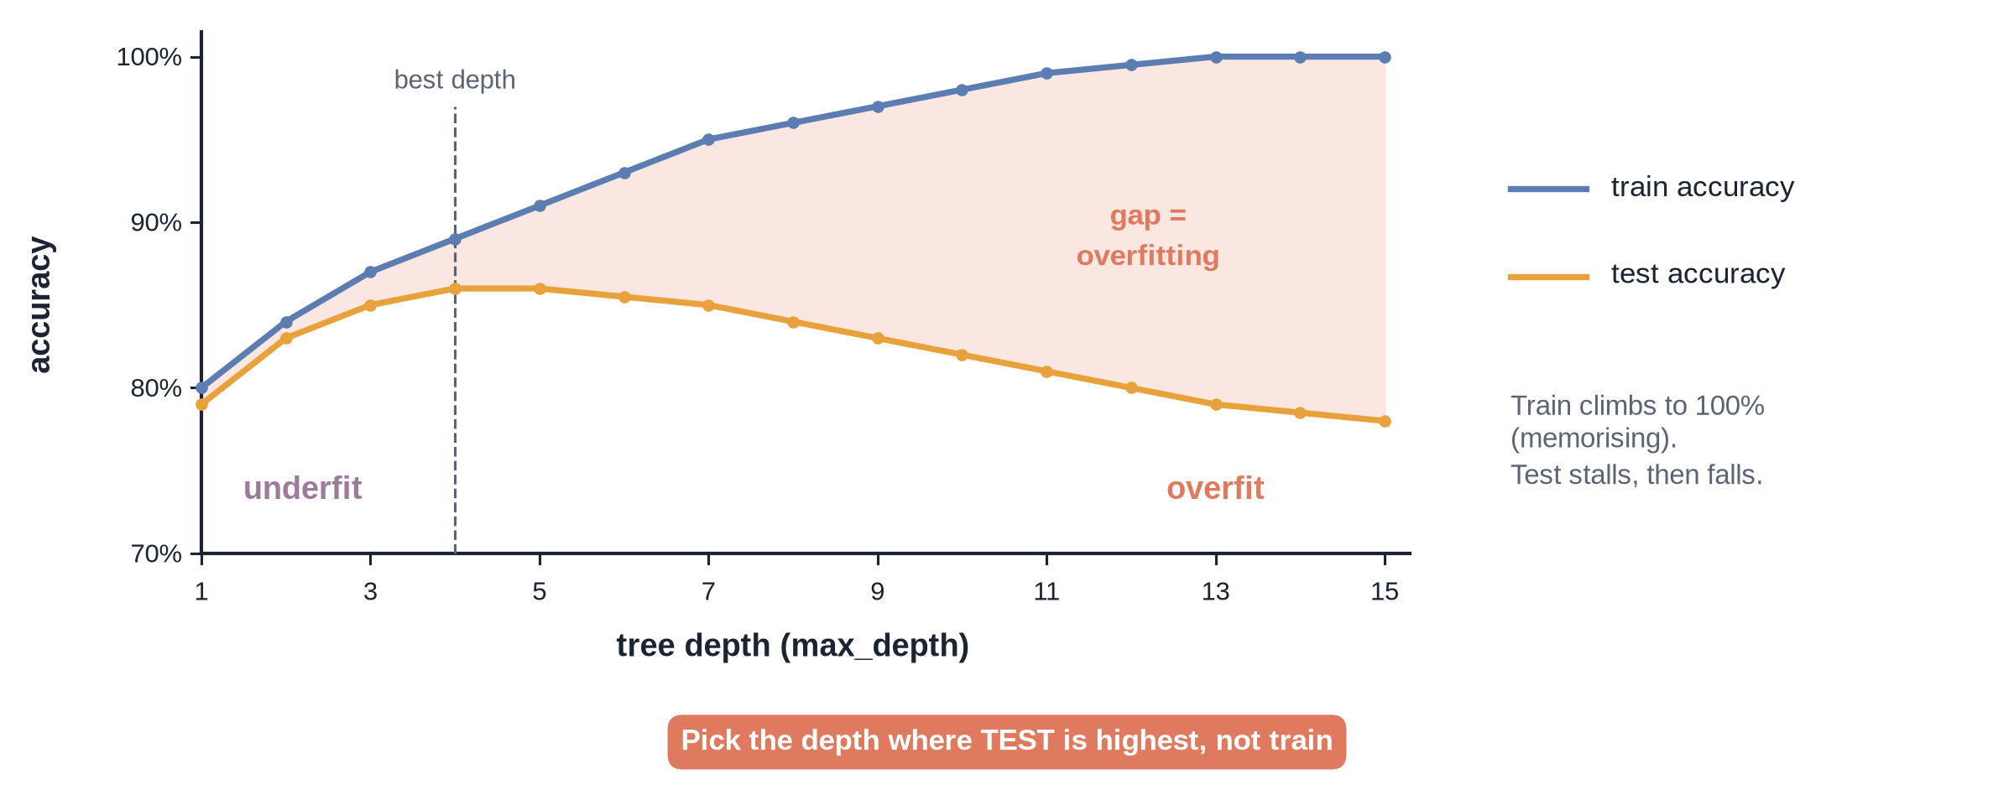
The two curves
Notes:
✏ DRAW THIS SLIDE – hand-draw it live; the slide diagram is your reference
What to draw:
• x-axis: tree depth 1 to 15
• Train line climbing towards 100%
• Test line flat, then falling
• Shade the gap: overfitting
• Label left side underfit, right side overfit

Slide 33
Our tree: train vs test accuracy
Depth | Train | Test | Gap (pts)
1 | 86.2% | 86.3% | ≈0
4 | 86.7% | 86.1% | 0.6
8 | 87.6% | 85.0% | 2.6
12 | 91.5% | 81.7% | 9.8
15 | 94.1% | 79.8% | 14.3
No depth limit: depth 31, train 100%, test 76%.

Slide 34
Underfitting vs overfitting
Underfitting
Overfitting
Model too simple
Bad on train and test
Fix: more features, more complex model
Model memorises noise
Great on train, worse on test
Fix: limit depth, more data

Slide 35
Bonus: K-Means finds 3 customer groups
1
2
3
Loyal big spenders
Deal hunters
Regulars
214 customers, ~10.8 orders, ~₹38,100 spend each
252 customers, ~4.9 orders, 16% average discount
292 customers, ~5.0 orders, 8% average discount
Notes:
9.6 Names are ours; K-Means only gives numbers 0, 1, 2.

Slide 36
Where to go next
1
2
3
4
Better models
Better testing
Better features
Your capstone
Random Forest, Gradient Boosting
Cross-validation
Feature engineering, e.g. festive month
Module 10: predict FitGym churn

Slide 37
Recap – Video 9.6
Judge on test data, not train
Deeper is not always better
Underfit vs overfit
Clustering: groups without a target
PRACTICE TASK
Find the max_depth with the best test accuracy. Then try K-Means with 4 clusters and describe each group.

