Slide 1
Excel & Google Sheets for analysts
MODULE 2 · SPREADSHEETS
Clean, summarise and report on 5,055 ShopKart orders
Notes:
Deck title.

Slide 2
Spreadsheet basics
VIDEO 2.1 · 8 MIN
Slides
Screen recording
Notes:
Video 2.1.

Slide 3
Why spreadsheets still matter
5,055
12
0
raw ShopKart order rows to tame
columns per order
lines of code needed in this module
Notes:
Video 2.1. Hook: the manager wants revenue by city by Friday.

Slide 4
The words you need
1
2
3
Cell
Range
Row = record
One box, named by column letter + row number, like B2.
A block of cells, like A2:A5056.
One order. Every row is one thing.
4
5
6
Column = field
Sheet / tab
Formula
One property of every order, like city.
One table. Our file has orders, customers, products.
Starts with =. Calculates from other cells.
Notes:
Video 2.1.

Slide 5
Shortcuts that save hours
Ctrl + Arrow: jump to the end of data
Ctrl + Shift + Arrow: select to the end
Ctrl + Z: undo (use it freely)
View > Freeze > 1 row: keep headers visible
Data > Create a filter: sort and filter
Format > Number: show ₹ and %
KEY IDEA
On a Mac use Cmd instead of Ctrl. Sheets and Excel share these shortcuts.
Notes:
Video 2.1. Demo each on orders sheet.

Slide 6
Recap – Video 2.1
Cell, range, row, column, sheet
One row = one order
Freeze headers, add a filter
Ctrl + Arrow to move fast
PRACTICE TASK
In the orders sheet, filter city to show only Pune. How many rows appear in the status bar count? Then clear the filter.
Notes:
Video 2.1.

Slide 7
Cleaning dirty data
VIDEO 2.2 · 12 MIN
Screen recording
Notes:
Video 2.2.

Slide 8
What is wrong in orders_raw
Problem | Example | Fix
Duplicate rows | 55 repeated orders | Remove duplicates
City spellings | DELHI, New Delhi, Bombay | TRIM + PROPER + map
Price as text | ₹1,299 | SUBSTITUTE + VALUE
Blank discount | (empty) | Treat as 0
Blank / lowercase payment | (empty), upi | Unknown, UPI
Returned Yes/No | Yes, No, Y, N | Make Y / N
Quantity typo | 99 | Set to 1
Two date formats | 02-01-2025 | DATE(...)
Notes:
Video 2.2. Rating blanks stay blank: customer did not rate.

Slide 9
Our cleaning workflow
1
2
3
4
5
Copy
Dedupe
Helper cols
Check
Name it
Never edit raw data
5,055 rows become 5,000
One formula per problem
COUNTIF each clean column
Sheet orders_clean
Notes:
Video 2.2.

Slide 10
Cleaning formulas (row 2)
EXCEL
Write once in row 2
Double-click the fill handle to copy down
O2 tidies spaces and case, P2 maps old names
O2 =PROPER(TRIM(H2))
P2 =IFERROR(VLOOKUP(O2,
city_map!$A$2:$B$6,2,FALSE),O2)
Q2 =IF(ISNUMBER(F2),F2,VALUE(
SUBSTITUTE(SUBSTITUTE(F2,"₹",""),
",","")))
R2 =IF(E2=99,1,E2)
S2 =IF(G2="",0,G2)
T2 =IF(I2="","Unknown",
IF(I2="upi","UPI",I2))
U2 =IF(L2="Yes","Y",
IF(L2="No","N",L2))
Notes:
Video 2.2.

Slide 11
Recap – Video 2.2
Keep raw data untouched
Remove duplicates: 5,055 to 5,000
One helper column per problem
Blank rating is real missing data: keep it
PRACTICE TASK
Add a COUNTIF check: how many rows in city_clean equal Delhi? You should get 804.
Notes:
Video 2.2.

Slide 12
Formulas you will use every day
VIDEO 2.3 · 12 MIN
Diagram slides
Screen recording
Notes:
Video 2.3.

Slide 13
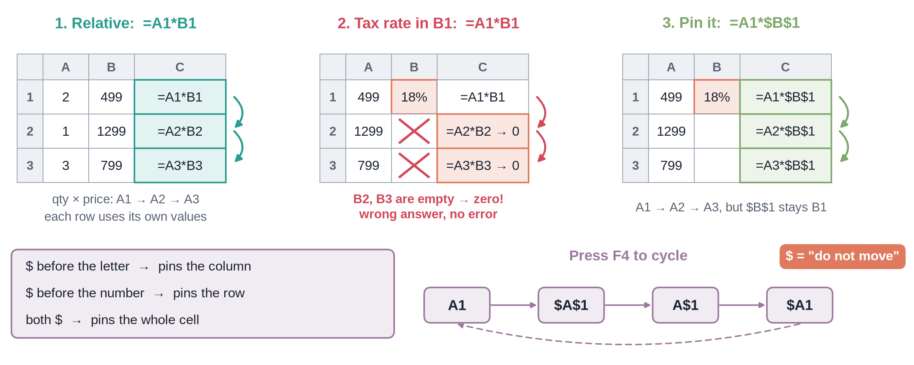
Relative vs absolute references
Notes:
Video 2.3. Diagram slide about 3 minutes.

Slide 14
Revenue for one order
EXCEL
Brackets first: 1 - 0.2 = 0.8
ROUND to 2 decimals = paise
This is order O10001
V2 =ROUND(R2*Q2*(1-S2),2)
quantity R2 = 6
unit_price Q2 = 362
discount S2 = 0.2
6 x 362 x (1 - 0.2) = 1,737.60
Notes:
Video 2.3.

Slide 15
Five everyday functions on ShopKart
Formula | What it gives | Result
=SUM(V2:V5001) | Total revenue | ₹1,47,04,649.70
=COUNTA(A2:A5001) | Number of orders | 5,000
=AVERAGE(V2:V5001) | Average order value | ₹2,940.93
=MAX(V2:V5001) | Biggest order | ₹1,49,990
=COUNTIF(U2:U5001,"Y") | Returned orders | 687
Notes:
Video 2.3. All on orders_clean.

Slide 16
IF: make a decision per row
EXCEL
Test compares: >, <, =, >=, <>
Text answers go in double quotes
Nested IF: an IF inside an IF
=IF(V2>=5000,"Big","Normal")
=IF(test, value_if_true, value_if_false)
Notes:
Video 2.3.

Slide 17
Recap – Video 2.3
$ pins a reference, F4 toggles
Revenue = qty x price x (1 - discount)
SUM, COUNTA, AVERAGE, MAX, COUNTIF
IF labels each row
PRACTICE TASK
Add an order_size column: Big if revenue is at least ₹5,000, else Normal. Count the Big orders (answer: 560).
Notes:
Video 2.3.

Slide 18
Conditional totals and lookups
VIDEO 2.4 · 10 MIN
Screen recording
Diagram slides
Notes:
Video 2.4.

Slide 19
The IFS family
EXCEL
Pin ranges with $, leave A11 free
Add more criteria pairs as needed
Returns in Pune: COUNTIFS city + returned Y
=SUMIFS(sum_range, crit_range1, crit1, ...)
=COUNTIFS(crit_range1, crit1, ...)
=AVERAGEIFS(avg_range, crit_range1, crit1, ...)
Revenue in Delhi:
=SUMIFS(orders_clean!$V$2:$V$5001,
orders_clean!$P$2:$P$5001, A11)
Notes:
Video 2.4.

Slide 20
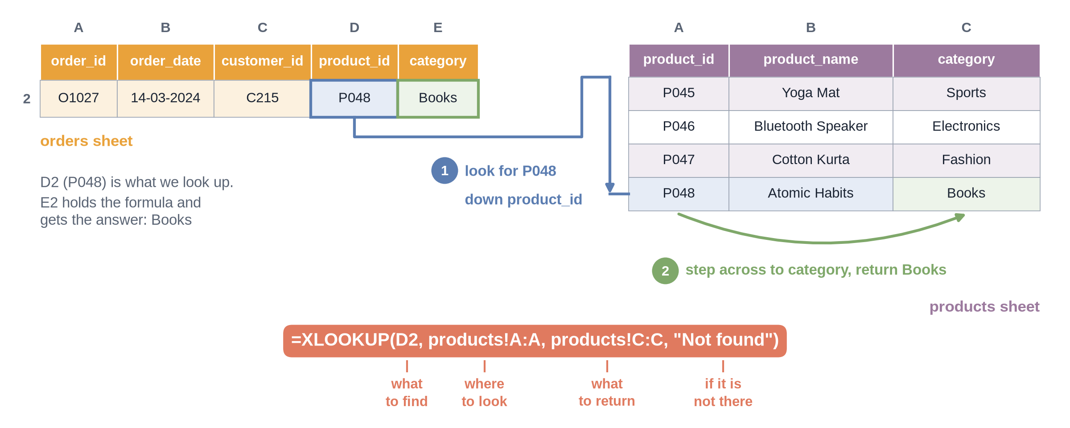
How XLOOKUP finds a category
Notes:
Video 2.4. Mention INDEX/MATCH and VLOOKUP as older options.

Slide 21
What the summary sheet tells us
₹23.2L
₹73.3L
32.4%
13.7%
Delhi revenue, the top city
Electronics revenue, half of all
Pune return rate
overall return rate
Notes:
Video 2.4. All from Summary sheet.

Slide 22
Recap – Video 2.4
SUMIFS adds with conditions
COUNTIFS counts, AVERAGEIFS averages
XLOOKUP brings category from products
Total check row catches spelling errors
PRACTICE TASK
Use AVERAGEIFS to find the average order value for Fashion (answer: about ₹2,354). Then find Fashion's return rate with COUNTIFS.
Notes:
Video 2.4.

Slide 23
Pivot tables
VIDEO 2.5 · 10 MIN
Screen recording
Notes:
Video 2.5.

Slide 24
Build a pivot in Google Sheets
1
2
3
4
5
Select
Insert
Rows
Columns
Values
Click any cell in orders_clean
Insert > Pivot table > New sheet
Add city_clean
Add category
Add revenue, SUM
Excel: Insert > PivotTable, then drag fields into Rows, Columns, Values.
Notes:
Video 2.5.

Slide 25
Pivot table or SUMIFS?
Pivot table
SUMIFS summary
Fast: drag and drop
Great for exploring
Shape changes when data changes
You control the layout
Feeds a fixed report and charts
Easy to check cell by cell
Notes:
Video 2.5. Pivot_check sheet holds the SUMIFS version so numbers can be compared.

Slide 26
Recap – Video 2.5
Rows, Columns, Values, Filters
Summarise by SUM, COUNTA, AVERAGE
Show values as % of total
Check against Pivot_check
PRACTICE TASK
Build a pivot: rows payment_clean, columns returned_clean, values COUNTA of order_id. Which payment mode has the highest return rate?
Notes:
Video 2.5. Answer: COD, about 19.1%.

Slide 27
Charts and a one-page report
VIDEO 2.6 · 8 MIN
Slides
Screen recording
Notes:
Video 2.6.

Slide 28
Pick the chart from the question
Question | Chart
Compare categories (cities) | Bar / column
Change over time (months) | Line
Share of a whole (2–4 parts) | Pie, use rarely
Relationship between two numbers | Scatter
Notes:
Video 2.6. More in Video 8.1.

Slide 29
Three questions, three answers
1
2
3
Top city?
Peak month?
Return problem?
Delhi: ₹23,23,405, 15.8% of all revenue.
October: ₹19,78,317, about 2.5x May, the weakest month.
Pune returns 32.4% of orders vs 13.7% overall, about 2.4x.
Notes:
Video 2.6. Report sheet answers are live formulas.

Slide 30
Recap – Video 2.6
Question first, then chart
Bar for comparison, line for time
Title says the finding
One page: KPIs, 3 answers, 3 charts
PRACTICE TASK
Add a fourth chart to your Report: revenue by category as a bar chart, with a title that states the finding.
Notes:
Video 2.6. Next: Module 3 statistics on this clean data.

