Slide 1
Statistics for analysts
MODULE 3 · STATISTICS
Average, spread, shape, correlation and A/B tests on ShopKart
Notes:
Deck title.

Slide 2
Types of data
VIDEO 3.1 · 6 MIN
Slides
Diagram slides
Notes:
Video 3.1.

Slide 3
Two big families
Categorical (labels)
Numerical (numbers)
Nominal: city, category, payment_mode
Binary: returned Y / N
Ordinal: rating 1 < 2 < 3 < 4 < 5
Maths: count, %, mode
Discrete: quantity, delivery_days
Continuous: unit_price, revenue
Maths: sum, mean, median, SD
Notes:
Video 3.1.

Slide 4
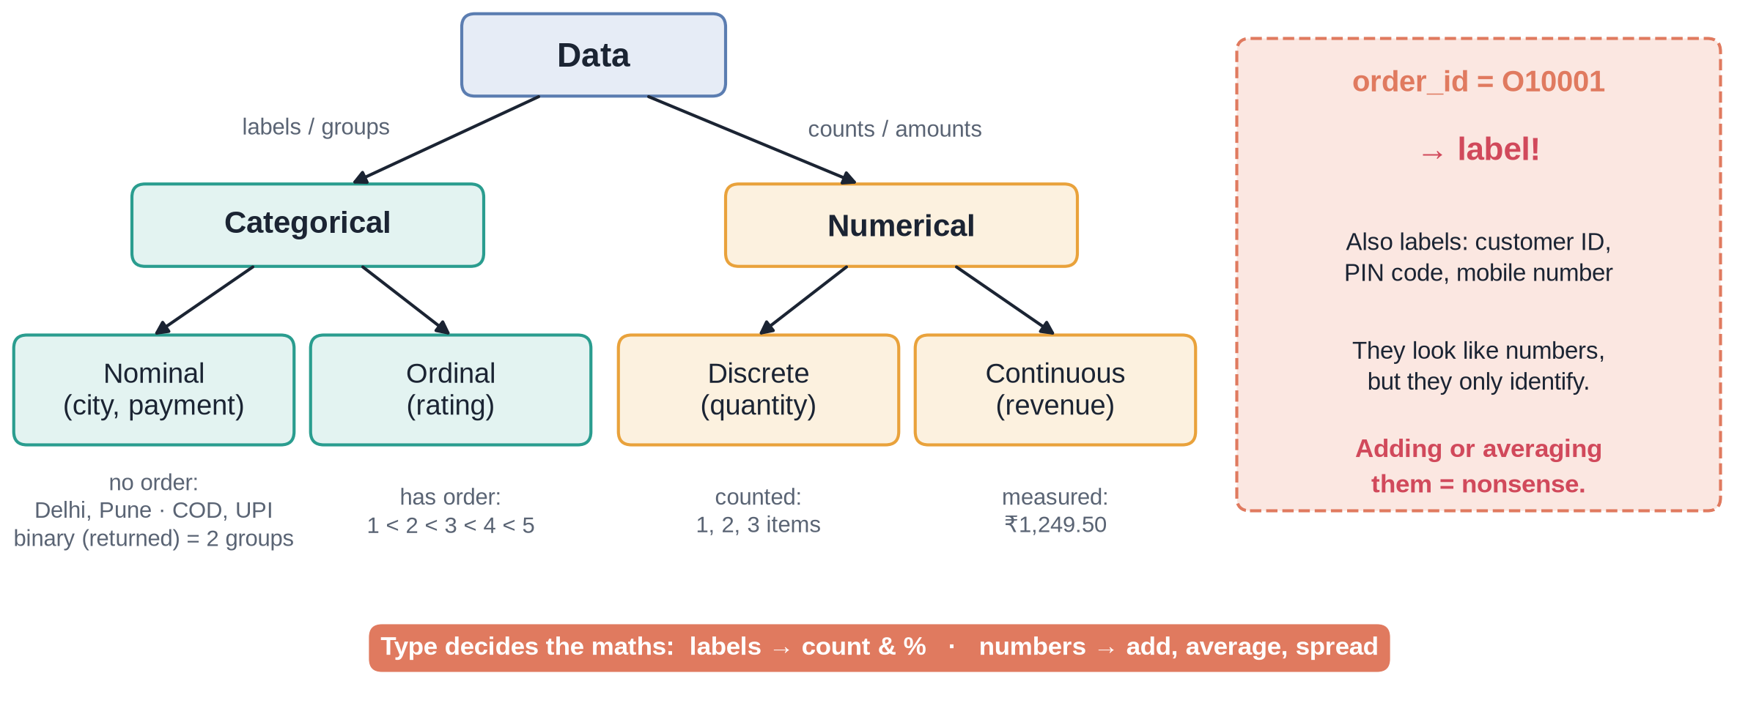
The data-type tree
Notes:
Video 3.1.

Slide 5
Recap – Video 3.1
Categorical = labels, numerical = amounts
Nominal has no order, ordinal does
Discrete counts, continuous measures
Type decides which maths is allowed
PRACTICE TASK
Classify every column in the customers table (customer_id, name, gender, age, city, signup_date, membership). Check with 3.1_Types.
Notes:
Video 3.1.

Slide 6
Mean, median and mode
VIDEO 3.2 · 7 MIN
Diagram slides
Screen recording
Notes:
Video 3.2.

Slide 7
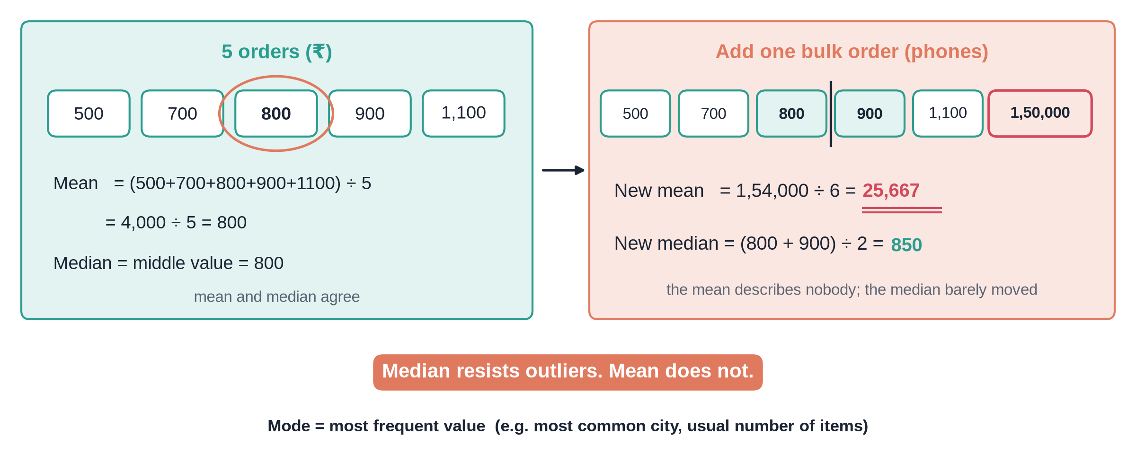
One bulk order breaks the average
Notes:
Video 3.2.

Slide 8
ShopKart order revenue, 5,000 orders
₹2,941
₹1,525
₹2,859
mean (average) order
median order
mean without 3 bulk orders
Notes:
Video 3.2. Mean is nearly double the median: a few big orders pull it up.

Slide 9
In Google Sheets
EXCEL
Mode suits categories and small whole numbers
For money, report the median as typical
=AVERAGE(data!K2:K5001)
→ 2,940.93
=MEDIAN(data!K2:K5001)
→ 1,524.80
=AVERAGEIF(data!K2:K5001,"<100000")
→ 2,858.65
=MODE(data!E2:E5001)
→ 1 (quantity)
Notes:
Video 3.2.

Slide 10
Recap – Video 3.2
Mean = total / count
Median = middle value
Mode = most frequent
Skewed money data: use the median
PRACTICE TASK
Find the mean and median of delivery_days. Are they close? Answer: 4.15 and 4. Explain why in one sentence.
Notes:
Video 3.2.

Slide 11
Spread: range, variance, SD, IQR, box plot
VIDEO 3.3 · 9 MIN
Diagram slides
Screen recording
Notes:
Video 3.3.

Slide 12
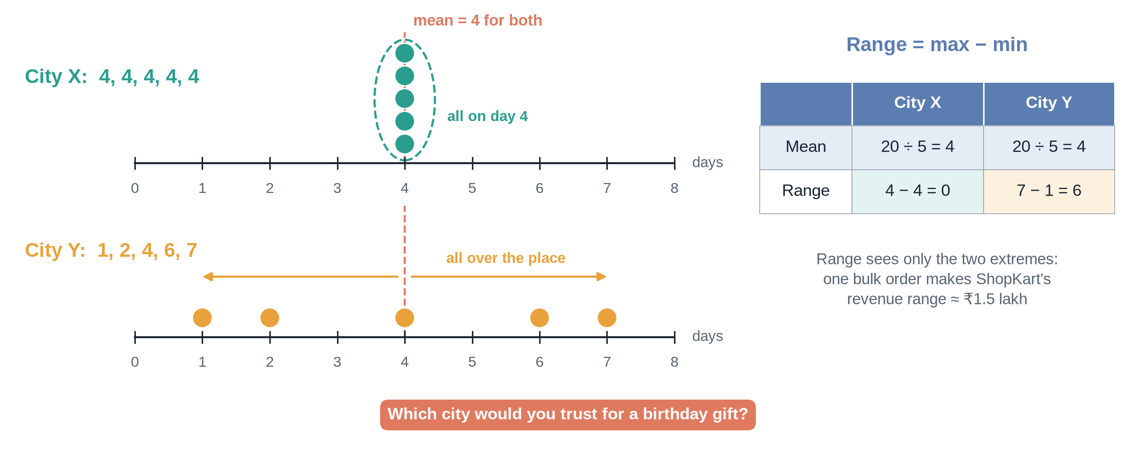
Same average, different promise
Notes:
Video 3.3.

Slide 13
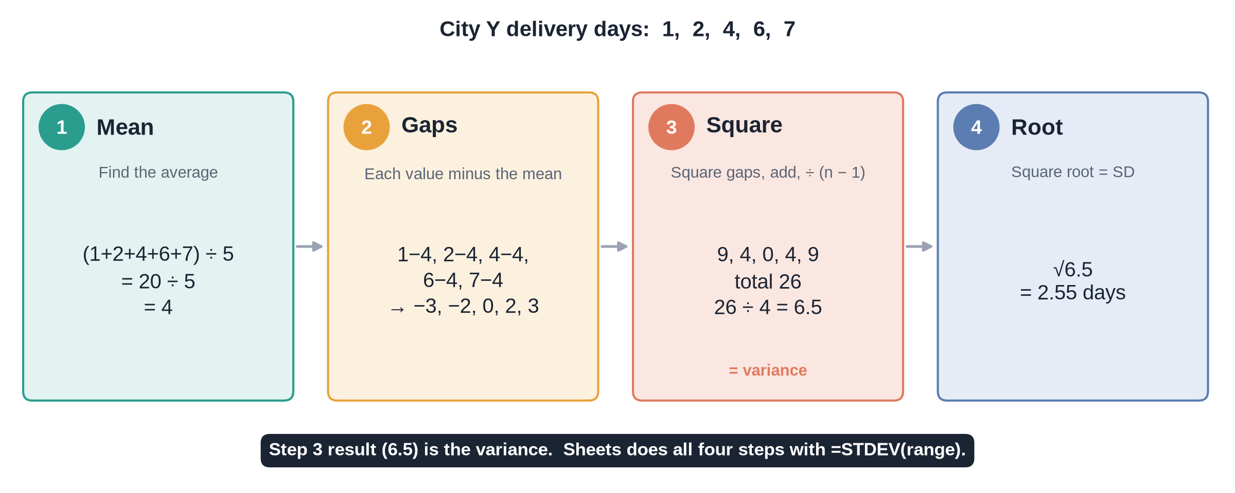
Standard deviation in four steps
Notes:
Video 3.3.

Slide 14
Spread on ShopKart
Measure | delivery_days | revenue (₹)
Mean | 4.15 | 2,940.93
SD | 1.53 | 6,025.46
Q1 / median / Q3 | 3 / 4 / 5 | 807 / 1,525 / 2,906
IQR | 2 | 2,098.54
Upper fence | 8 | 6,053.34
Orders above fence | 36 | 406
Notes:
Video 3.3.

Slide 15
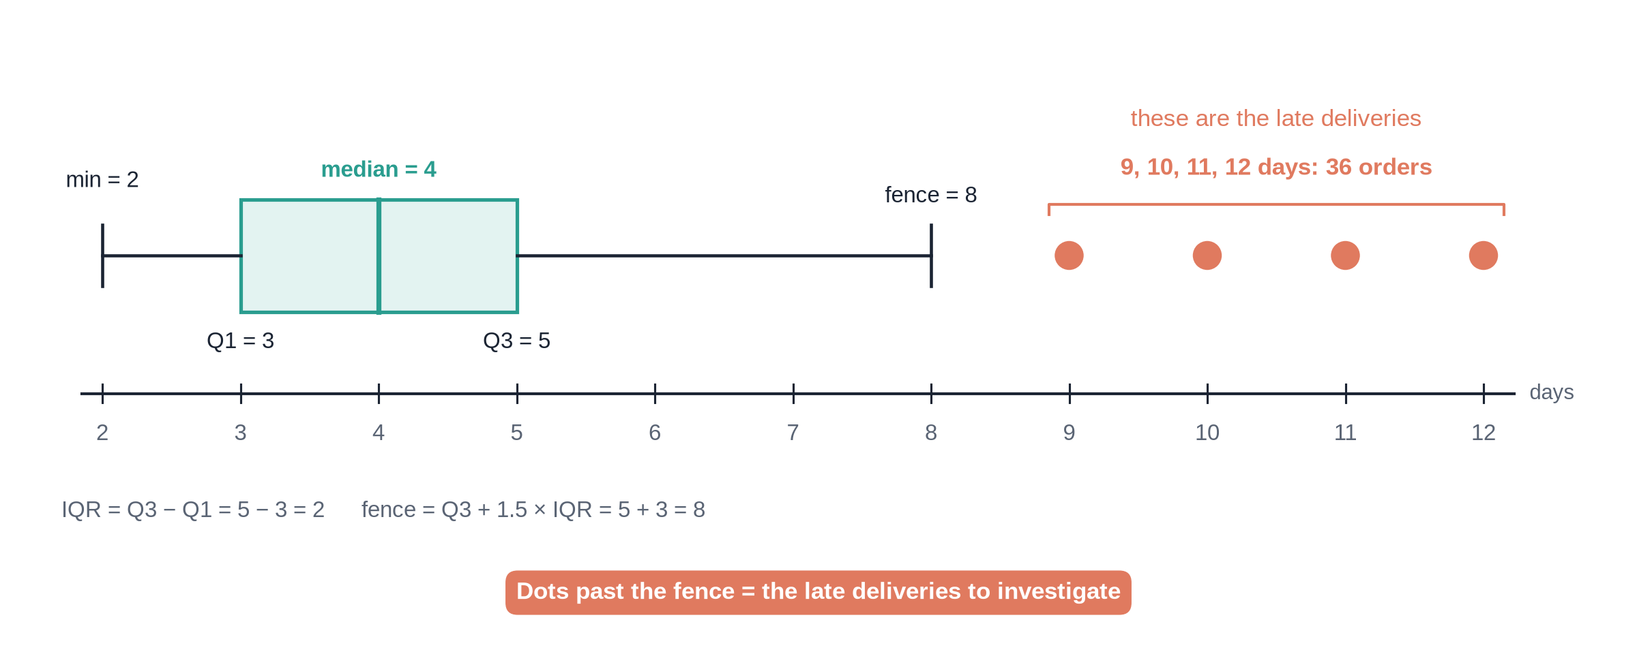
Box plot of delivery days
Notes:
Video 3.3.

Slide 16
Recap – Video 3.3
Range = max − min, sensitive to outliers
SD = typical distance from the mean
IQR = middle 50%, robust
Box plot shows five numbers + outliers
PRACTICE TASK
Use QUARTILE on unit_price to get Q1, median and Q3. Compute the IQR. Answer: 571, 1,213, 1,982; IQR 1,411.
Notes:
Video 3.3.

Slide 17
Distributions: histogram, normal, skew
VIDEO 3.4 · 7 MIN
Diagram slides
Slides
Notes:
Video 3.4.

Slide 18
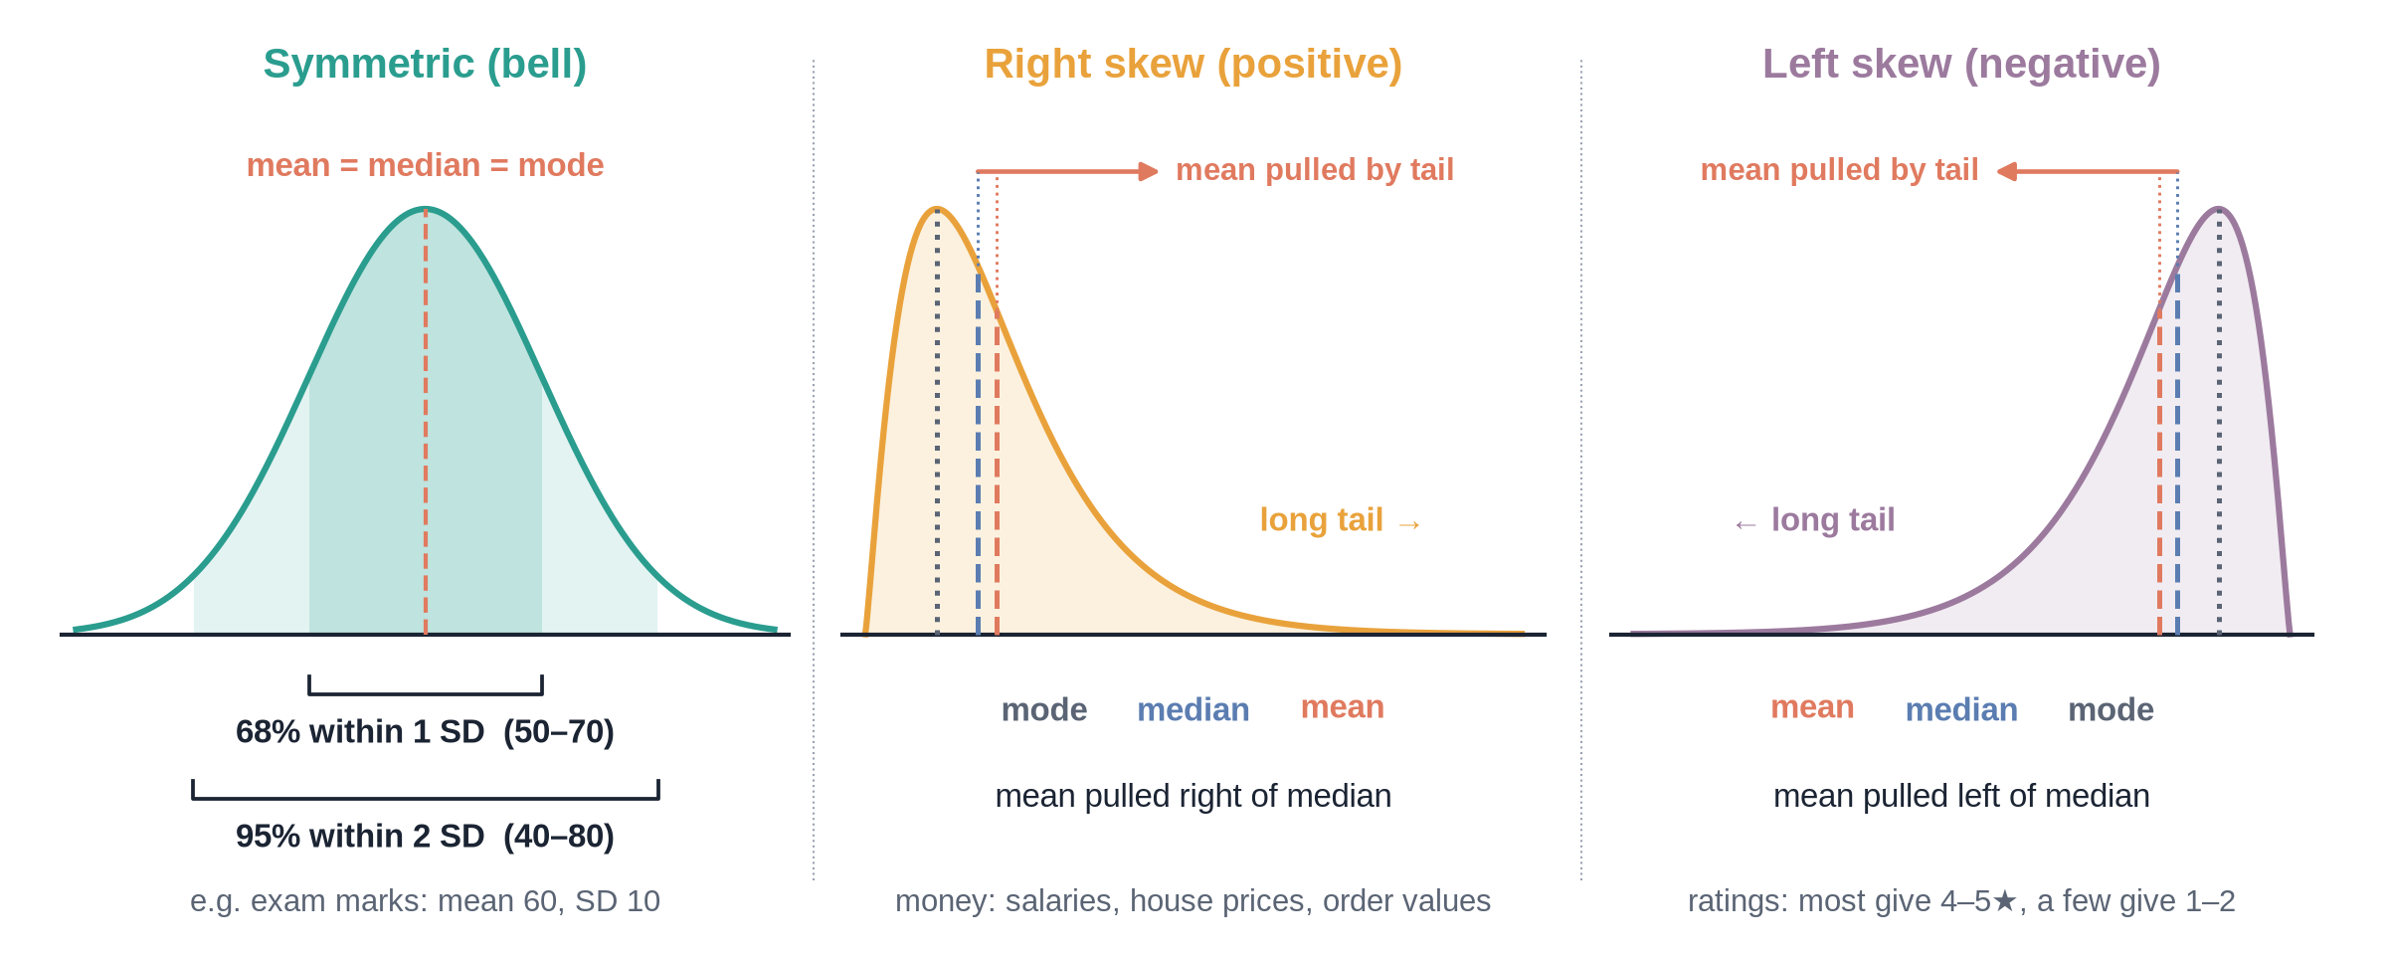
Three shapes
Notes:
Video 3.4.

Slide 19
ShopKart's two shapes
delivery_days: mild right skew
revenue: strong right skew
Peak at 3–4 days
Skewness 0.63
67% within 1 SD, 98% within 2 SD
Close to bell-shaped
1,638 orders under ₹1,000
Long tail up to ₹1,49,990
Skewness 10.5
Mean ₹2,941 far above median ₹1,525
Notes:
Video 3.4. Histograms are on 3.4_Distribution.

Slide 20
Recap – Video 3.4
Histogram = counts per bin
Normal: symmetric bell
Right skew: mean above median
Skewed? Report the median
PRACTICE TASK
Make a histogram of rating (1 to 5) with COUNTIF. Which way is it skewed? Answer: left, most ratings are 4 and 5.
Notes:
Video 3.4.

Slide 21
Correlation vs causation
VIDEO 3.5 · 7 MIN
Diagram slides
Slides
Notes:
Video 3.5.

Slide 22
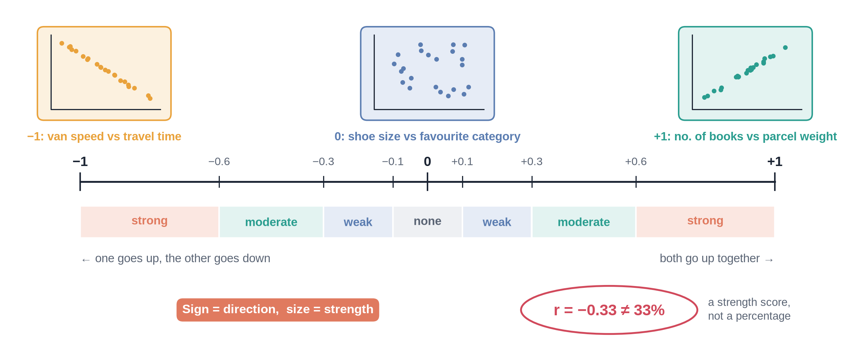
The correlation scale
Notes:
Video 3.5.

Slide 23
Correlations in ShopKart
+0.27
−0.33
−0.03
discount vs quantity (weak positive)
delivery days vs rating (moderate negative)
unit price vs quantity (no relationship)
Notes:
Video 3.5. =CORREL(range1, range2).

Slide 24
Why correlation is not causation
1
2
3
4
Hidden third factor
Reverse direction
Pure chance
The fix
Ice-cream sales and AC sales both rise in May. Heat drives both.
Do big orders get discounts, or do discounts create big orders?
With enough columns, some pairs match by luck.
Run a controlled experiment: an A/B test.
Notes:
Video 3.5.

Slide 25
Recap – Video 3.5
CORREL gives −1 to +1
Sign = direction, size = strength
Slow delivery goes with lower ratings
Correlation never proves cause
PRACTICE TASK
Use CORREL for delivery_days vs quantity. What does the number tell you? Write one sentence a manager would understand.
Notes:
Video 3.5.

Slide 26
Sampling and A/B testing intuition
VIDEO 3.6 · 9 MIN
Slides
Diagram slides
Notes:
Video 3.6.

Slide 27
A 1-in-10 sample vs all orders
Measure | All 5,000 | Sample of 500
Return rate | 13.7% | 13.0%
Avg delivery days | 4.15 | 4.07
Avg order value | ₹2,941 | ₹2,534
Bulk orders included | 3 | 0
Rates land close. The average order value misses because the sample skipped the rare bulk orders.
Notes:
Video 3.6.

Slide 28
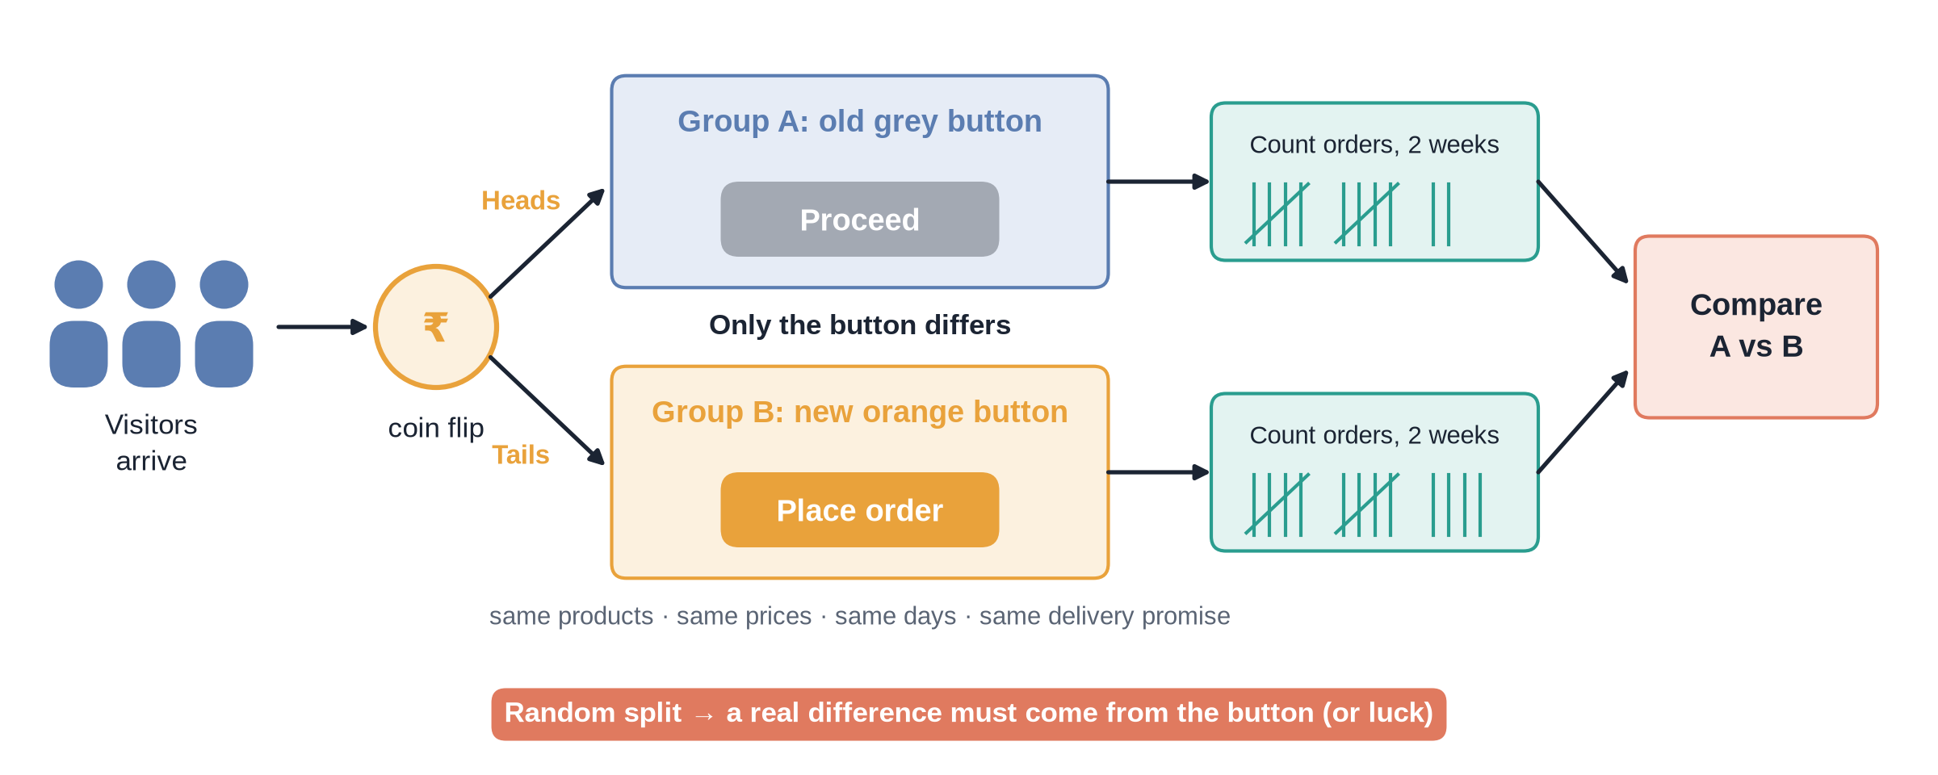
How an A/B test works
Notes:
Video 3.6. Clearly say: made-up example.

Slide 29
Made-up checkout button test
4.2%
4.8%
+14%
0.04
A: 420 orders / 10,000 visitors
B: 480 orders / 10,000 visitors
relative lift
p-value: chance a gap this big is pure luck
Notes:
Video 3.6. Teaching example, not ShopKart data.

Slide 30
Same rates, different confidence
10,000 visitors each
200 visitors each
4.2% vs 4.8%
p ≈ 0.04
Probably a real effect
4.0% vs 5.0% (8 vs 10 orders)
p ≈ 0.63
Could easily be luck
Notes:
Video 3.6. Sample size matters.

Slide 31
Recap – Video 3.6
A good sample is random and big enough
Rare events can hide from samples
A/B test: random split, change one thing
Small p (under 0.05): probably real
PRACTICE TASK
On 3.6_AB_Test change B's orders to 440. Is the result still probably real? Answer: no, p is about 0.49.
Notes:
Video 3.6. Next: Module 4 SQL on the same clean data.

