Slide 1
Pandas, Data Cleaning & EDA
MODULE 6
Rebuild the ShopKart cleaning in Python and answer real business questions
Notes:
Video 6.1: show 3 seconds before the hook.

Slide 2
DataFrames: load and inspect
VIDEO 6.1 · 9 MIN
Diagram slides
Screen recording
Notes:
Video 6.1: Hook: before cleaning, find every problem.

Slide 3
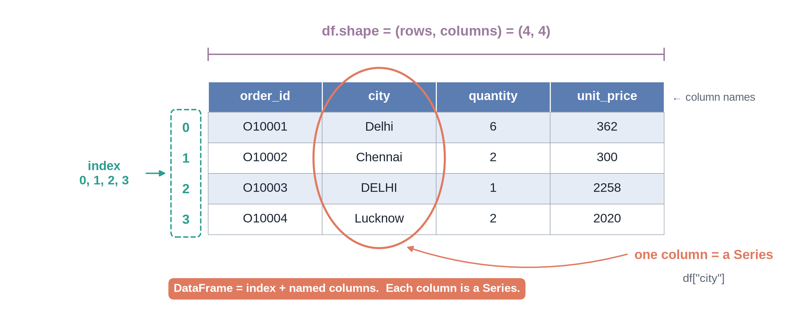
Anatomy of a DataFrame
Notes:
Video 6.1: Link: a list of dictionaries from 5.3 becomes this.

Slide 4
Five commands to inspect any table
Command | Tells you | ShopKart result
df.head() | First 5 rows | Looks fine at first
df.shape | Rows, columns | (5055, 12)
df.info() | Column types | unit_price is text
df.describe() | Number summary | max quantity 99
df.isnull().sum() | Blanks per column | discount 70, rating 263
Notes:
Video 6.1: Run each one live.

Slide 5
What inspection found in orders_raw.csv
5,055
55
27
99
rows for 5,000 orders
exact duplicate rows
spellings of 10 cities
max quantity (typo)
Notes:
Video 6.1: This becomes the to-do list for 6.3.

Slide 6
Recap – Video 6.1
DataFrame = table, Series = one column
head, shape, info, describe, isnull
Inspect before you clean
We found 8 problems
PRACTICE TASK
How many customers are Prime and how many Free? Which product has the lowest and highest list_price?
Notes:
Video 6.1: 289 Prime, 511 Free; Kajal ₹199, Tablet ₹18,999.

Slide 7
Select, filter and sort
VIDEO 6.2 · 9 MIN
Screen recording
Notes:
Video 6.2: Hook: show me slow COD orders.

Slide 8
Same question, three tools
Task | Excel | SQL | pandas
Pick columns | Hide columns | SELECT a, b | df[["a", "b"]]
Filter | Filter button | WHERE x = 'COD' | df[df["x"] == "COD"]
Two conditions | Two filters | WHERE a AND b | df[(a) & (b)]
Sort | Sort Z→A | ORDER BY x DESC | sort_values("x", ascending=False)
Count | COUNTA | COUNT(*) | len(df)
Notes:
Video 6.2: Learners already know two of the three columns.

Slide 9
Filtering in pandas
PYTHON
Each condition in its own brackets
& = AND, | = OR
pm = orders["payment_mode"]
days = orders["delivery_days"]
cod = orders[pm == "COD"]
len(cod) # 998
slow_cod = orders[(days >= 8) & (pm == "COD")]
len(slow_cod) # 22
orders.sort_values("delivery_days",
ascending=False).head()
Notes:
Video 6.2: Counts are on the RAW file.

Slide 10
Recap – Video 6.2
df["col"] or df[["a", "b"]]
Filter with a condition inside [ ]
& and |, with brackets
Raw data under-counts Delhi: 715 vs 813
PRACTICE TASK
How many raw orders have a rating of 1? Show Net Banking orders with 2-day delivery.
Notes:
Video 6.2: 19 orders rated 1.

Slide 11
Missing values, duplicates, types
VIDEO 6.3 · 12 MIN
Screen recording
Notes:
Video 6.3: Hook: same cleaning as Module 2, now in 10 lines.

Slide 12
Every fix needs a reason
Problem | Decision | Reason
55 duplicate rows | Drop | Double-counts revenue
27 city spellings | Strip, title, rename | Bombay = Mumbai
"₹1,299" prices | Make numbers | Maths needs numbers
Two date formats | Exact format each | Avoid dayfirst trap
Blank payment | "Unknown" | Do not guess
Blank discount | Fill 0 | Blank means none
Quantity 99 | Set to 1 | Typo; keep 10 phones
Blank rating | Keep blank | Not rated is real
Notes:
Video 6.3: Pause on the last row.

Slide 13
The dayfirst trap
PYTHON
1,933 ShopKart dates would flip
No error does not mean correct
coerce turns failures into NaT
Then check isnull() is 0
dates = pd.Series(["2025-01-02",
"02-01-2025"])
# Shortcut: no error, but WRONG for ISO rows
pd.to_datetime(dates, format="mixed",
dayfirst=True)
# 2025-02-01 <- 2 Jan became 1 Feb!
# 2025-01-02
# Safe: one exact format at a time
d1 = pd.to_datetime(dates, format="%Y-%m-%d",
errors="coerce")
d2 = pd.to_datetime(dates, format="%d-%m-%Y",
errors="coerce")
d1.fillna(d2)
Notes:
Video 6.3: Show the demo cell live; stress that nothing warns you.

Slide 14
Fill it or keep it missing?
discount blank → 0
rating blank → keep
Business rule: blank = no discount
Missing by accident, meaning known
Safe to fill
Customer chose not to rate
Filling with 0 drags average down
Filling with mean invents opinions
pandas skips NaN in mean()
Notes:
Video 6.3: The most important judgement call in the module.

Slide 15
The cleaning in pandas
PYTHON
df = df.drop_duplicates()
df["city"] = df["city"].str.strip().str.title()
df["city"] = df["city"].replace(rename_map)
df["unit_price"] = (df["unit_price"].astype(str)
.str.replace("₹", "").str.replace(",", "")
.astype(float).astype(int))
s_ = df["order_date"].astype(str)
df["order_date"] = pd.to_datetime(s_, format="%Y-%m-%d",
errors="coerce").fillna(pd.to_datetime(s_,
format="%d-%m-%Y", errors="coerce"))
df["payment_mode"] = (df["payment_mode"]
.replace({"upi": "UPI"}).fillna("Unknown"))
df["discount"] = df["discount"].fillna(0.0)
df["returned"] = df["returned"].replace(yes_no)
df.loc[df["quantity"] == 99, "quantity"] = 1
Notes:
Video 6.3: Full version with comments in M06_6.3_cleaning_solution.ipynb.

Slide 16
After cleaning
5,000
10
4
260
rows (55 duplicates gone)
cities (from 27 spellings)
quantity typos fixed
ratings kept missing on purpose
Notes:
Video 6.3: 263 blank ratings in raw; 3 were inside duplicate rows.

Slide 17
Recap – Video 6.3
drop_duplicates, str.strip, replace
fillna only when you know the meaning
Keep genuine missing values
Typos vs real outliers: check the product
Save orders_clean.csv
PRACTICE TASK
On the cleaned data: what % of orders have payment_mode Unknown? How many orders came from Pune?
Notes:
Video 6.3: 1.8% Unknown, 451 Pune orders.

Slide 18
New columns, apply, pd.cut
VIDEO 6.4 · 8 MIN
Screen recording
Notes:
Video 6.4: Hook: how much did ShopKart actually earn?

Slide 19
New columns in one line each
PYTHON
Total revenue ₹1,47,04,650
Total profit ₹31,40,750
apply reuses the 5.5 function
q = df["quantity"]
df["revenue"] = (q * df["unit_price"]
* (1 - df["discount"])).round(2)
cost = df["product_id"].map(cost_lookup)
df["profit"] = df["revenue"] - q * cost
d = df["order_date"]
df["order_month"] = d.dt.month
df["order_size"] = (df["revenue"]
.apply(order_size))
Notes:
Video 6.4: Revenue formula same as Excel and SQL.

Slide 20
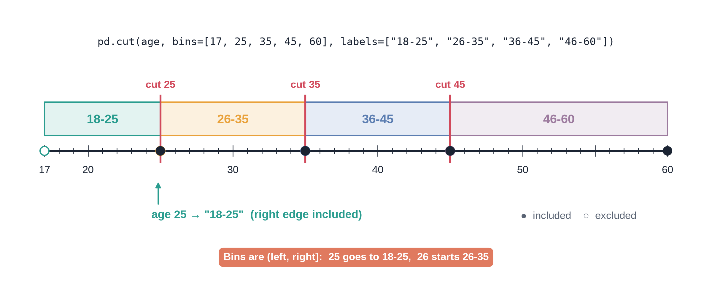
pd.cut age groups on a number line
Notes:
Video 6.4: Customers: 233, 395, 151, 21.

Slide 21
Recap – Video 6.4
Column maths works on all rows
.dt.month pulls parts of a date
apply runs your function per value
pd.cut turns numbers into groups
PRACTICE TASK
Make delivery_speed with pd.cut bins [0, 3, 5, 20] labelled Fast, Normal, Slow and count each.
Notes:
Video 6.4: Normal 2,152, Fast 1,905, Slow 943.

Slide 22
groupby and pivot_table
VIDEO 6.5 · 9 MIN
Diagram slides
Screen recording
Notes:
Video 6.5: Hook: which city returns the most?

Slide 23
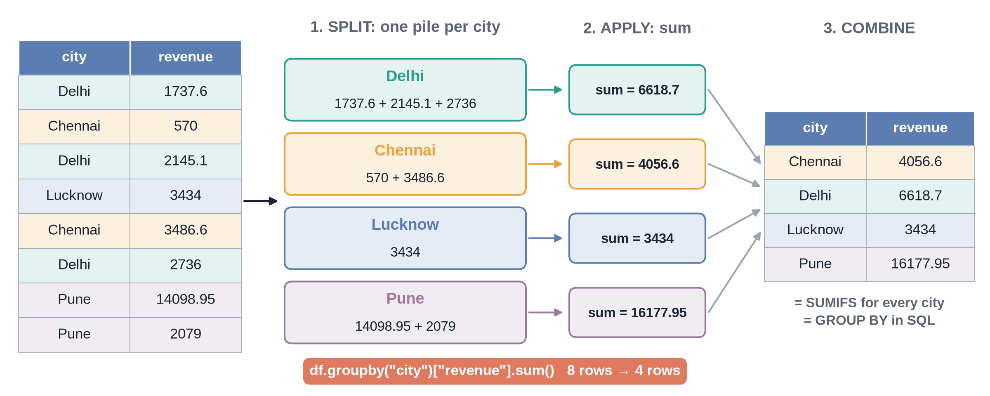
Split → apply → combine
Notes:
Video 6.5: Same as SQL GROUP BY and Excel SUMIFS.

Slide 24
groupby with several numbers
PYTHON
df.groupby("city").agg(
orders=("order_id", "count"),
revenue=("revenue", "sum"),
avg_rating=("rating", "mean"),
return_rate=("is_returned", "mean"),
).sort_values("revenue", ascending=False)
pd.pivot_table(df, index="city",
columns="payment_mode", values="revenue",
aggfunc="sum")
Notes:
Video 6.5: pivot_table = Excel pivot in one line.

Slide 25
One city stands out
32.4%
13.7%
2.4x
Pune return rate
overall return rate
Pune vs overall
Notes:
Video 6.5: Next highest city is 14.3% (Kolkata).

Slide 26
Recap – Video 6.5
value_counts counts each category
groupby + agg = GROUP BY
pivot_table = Excel pivot
Pune returns 32.4% of orders
PRACTICE TASK
Which payment mode has the highest average delivery_days? Pivot average rating by city and returned.
Notes:
Video 6.5: all modes are about 4.1-4.2 days; returned orders rate far lower.

Slide 27
Merge with products and customers
VIDEO 6.6 · 7 MIN
Screen recording
Notes:
Video 6.6: Hook: orders know product_id, not category.

Slide 28
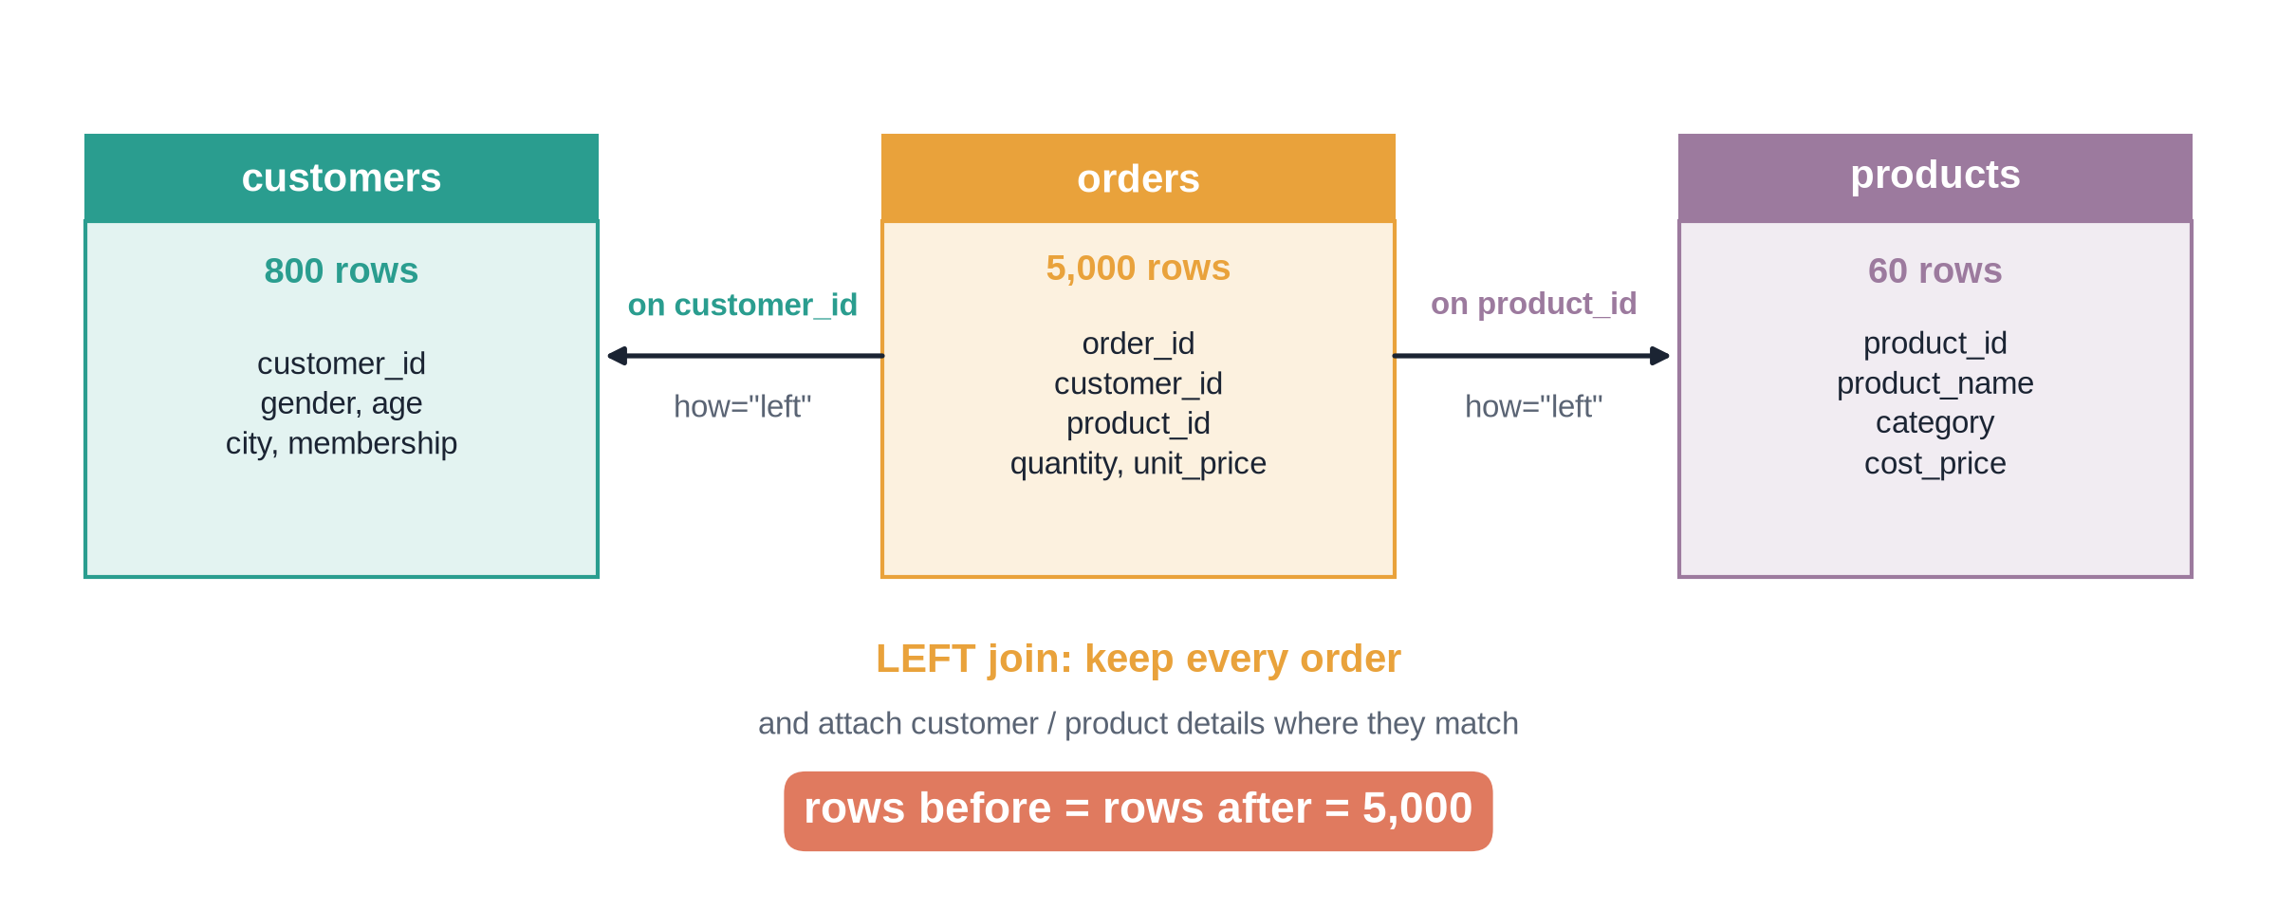
Two LEFT joins
Notes:
Video 6.6: Same picture as the Module 4 schema.

Slide 29
From raw file to shopkart_clean.csv
1
2
3
4
5
Load
Clean
Merge
Calculate
Save
orders_raw.csv, 5,055 rows
9 fixes, 5,000 rows
products and customers, how=left
revenue, profit, order_month
shopkart_clean.csv, 21 columns
Notes:
Video 6.6: This file feeds Modules 8 and 9; the Module 7 pipeline rebuilds it automatically. The Module 10 capstone pulls the same cleaned data straight from shopkart.db with SQL.

Slide 30
Recap – Video 6.6
merge(on=..., how="left")
Check lookup keys are unique first
Row count must stay 5,000
shopkart_clean.csv feeds Modules 8 and 9
PRACTICE TASK
Total revenue and profit per category. Which category makes the most profit?
Notes:
Video 6.6: Fashion, ₹11.31 lakh profit.

Slide 31
EDA: 5 business questions
VIDEO 6.7 · 11 MIN
Screen recording
Slides
Notes:
Video 6.7: Hook: the head of sales has five questions.

Slide 32
The five questions
1
2
3
Best month?
Top city?
Most returned?
Revenue by order_month
Revenue by city
Return rate by category
4
5
Discounts work?
Prime worth it?
Discount vs quantity and rating
Prime vs Free spend and frequency
Notes:
Video 6.7: Answer each with code, then one plain sentence.

Slide 33
Q1 and Q2: when and where
Oct
May
Delhi
45%
best month, ₹19.78 lakh (Nov ₹19.66 lakh)
weakest month, ₹7.87 lakh
top city, ₹23.23 lakh
revenue from Delhi, Bengaluru, Mumbai
Notes:
Video 6.7: Festive season drives the year; Oct and Nov nearly tied.

Slide 34
Q3: return rate by category
Category | Orders | Returned | Return rate
Fashion | 1,326 | 279 | 21.0%
Electronics | 1,152 | 155 | 13.5%
Home | 1,020 | 127 | 12.5%
Beauty | 750 | 71 | 9.5%
Books | 752 | 55 | 7.3%
Overall 13.7%. Pune 32.4% across all categories.
Notes:
Video 6.7: Fashion: size and fit.

Slide 35
Q4: what discounts do and do not do
Quantity goes up
Rating stays flat
No discount: 1.50 items
40% discount: 2.53 items
Correlation +0.27
About 3.8 to 4.0 at every level
Correlation -0.01
Correlation is not causation
Notes:
Video 6.7: Link back to Module 3, video 3.5.

Slide 36
Q5: Prime vs Free
Same
9.8
2x
average order: Prime ₹2,934, Free ₹2,949
orders per Prime customer (Free: 4.8)
revenue per customer: ₹28,720 vs ₹14,062
Notes:
Video 6.7: Same basket, twice as frequent.

Slide 37
Writing a finding people can act on
Start with the answer, not the method
One number that proves it
Compare with a baseline
Say what to do next
Flag what you cannot conclude
EXAMPLE
Pune returns 32.4% of orders, 2.4 times the 13.7% average, in every category. Check the delivery partner first.
Notes:
Video 6.7: Read the example aloud.

Slide 38
Recap – Video 6.7
EDA = question → number → so what
Oct-Nov peak, Delhi top city
Fashion and Pune lead returns
Prime orders twice as often
PRACTICE TASK
Open M06_eda_practice_questions.ipynb and answer the 8 questions with a written finding for each.
Notes:
Video 6.7: Next stop Module 7 (Data Engineering) turns this cleaning into an automatic pipeline; then Module 8 charts.

