Slide 1
Visualization & Storytelling
MODULE 8
Turn ShopKart numbers into charts and a story people act on

Slide 2
Choosing the right chart
VIDEO 8.1 · 7 MIN
Slides
Diagram slides
Notes:
8.1 hook: same numbers, two charts, two different stories.

Slide 3
First ask: what is this chart's job?
1
2
3
Compare
Trend
Distribution
Revenue by category → bar chart, sorted
Revenue by month → line chart
Order values → histogram or box plot
4
5
6
Relationship
Part of whole
One number
Discount vs quantity → scatter plot
2–3 parts only → pie; more → bar
Total revenue → KPI card
Notes:
8.1 Walk through each job with the ShopKart example.

Slide 4
Chart chooser for ShopKart questions
Question | Chart | Why
Which category earns most? | Bar | Compare lengths
How did sales move in 2025? | Line | Time on x-axis
How big is a typical order? | Histogram | Shape of values
Are returns slower to deliver? | Box plot | Compare spreads
Do discounts raise quantity? | Scatter | Two numbers
Which numbers move together? | Heatmap | Many pairs at once
Notes:
8.1 Same table is in the Chart Chooser cheat sheet.

Slide 5
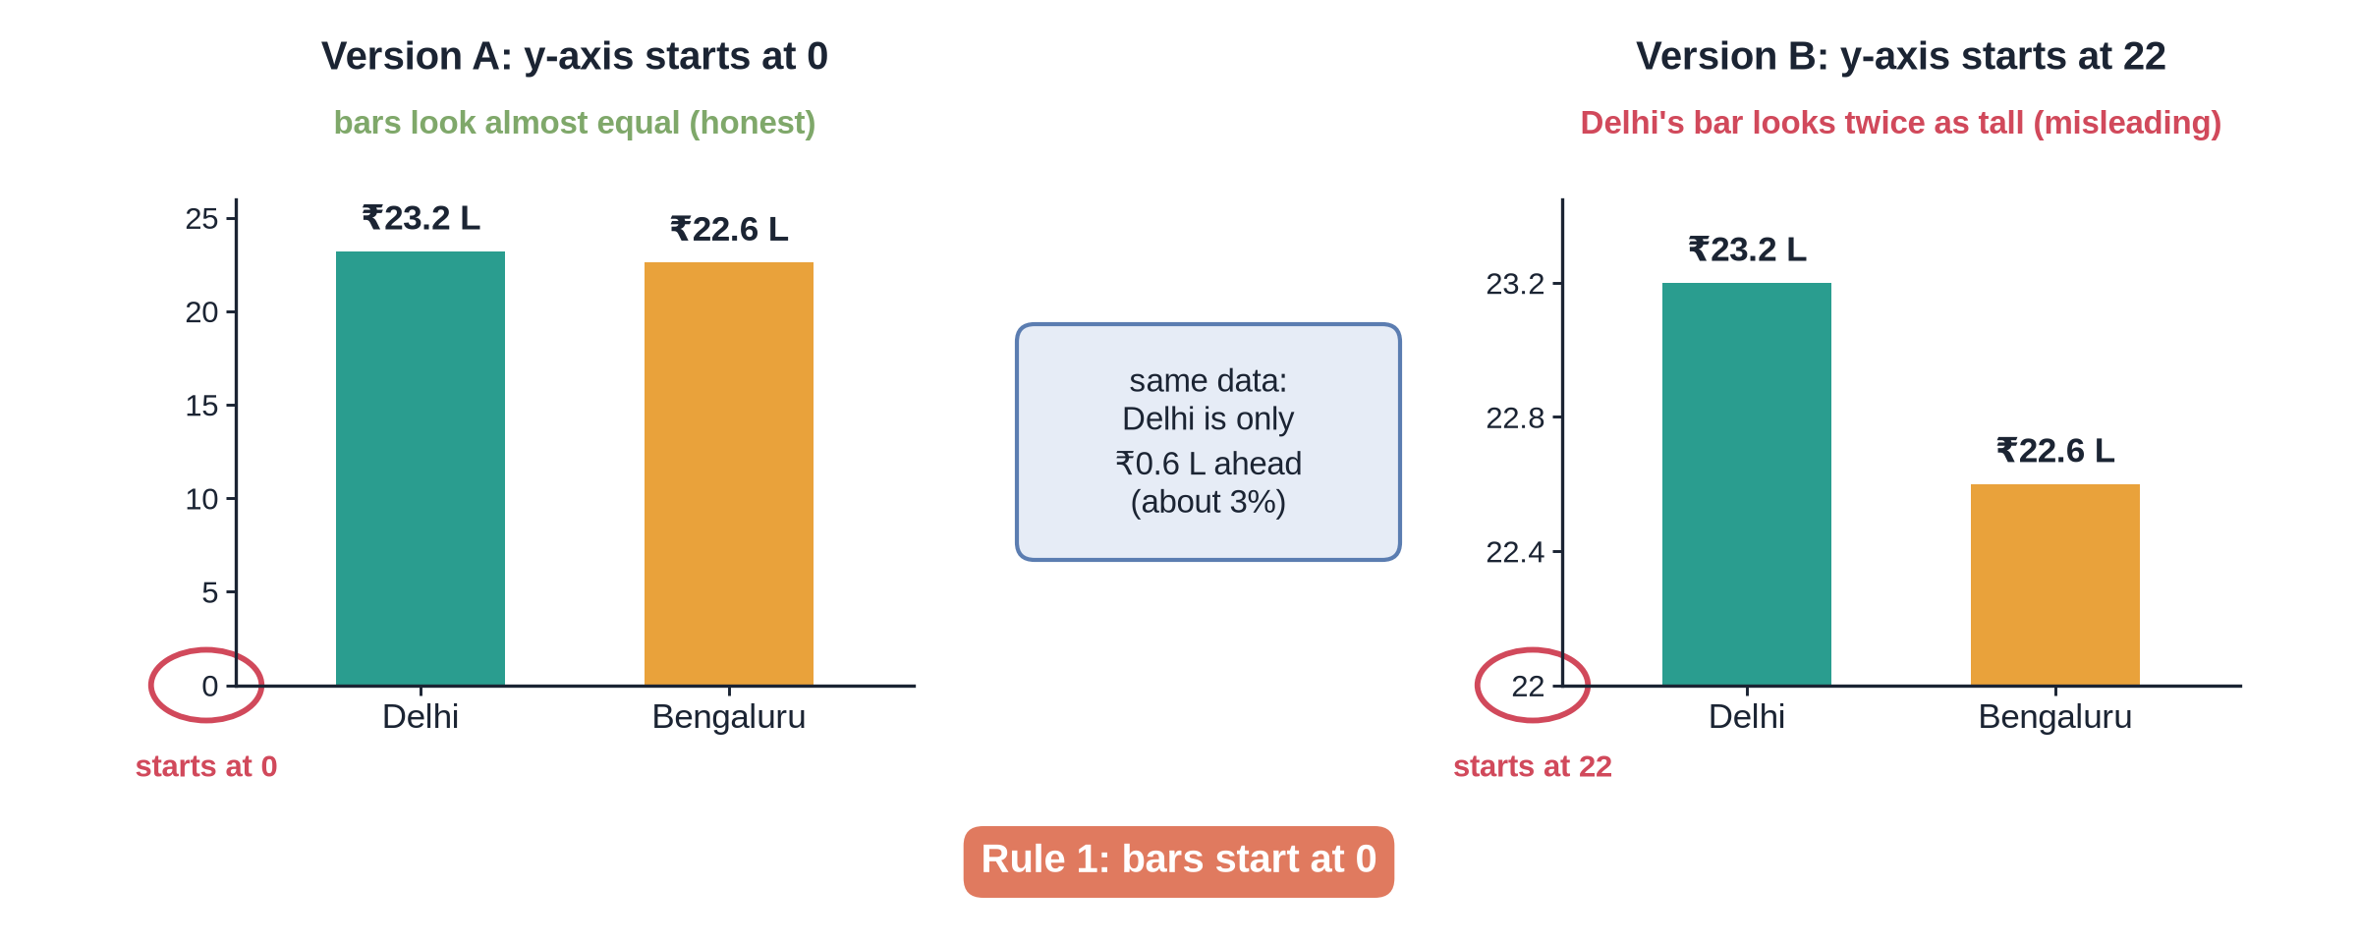
One fact, two pictures
Notes:
8.1 Diagram slide.

Slide 6
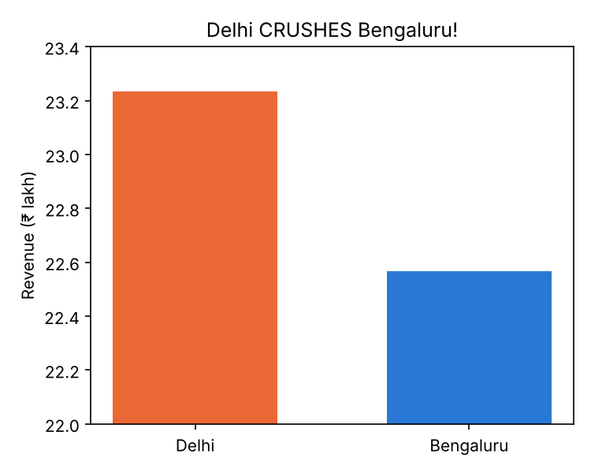
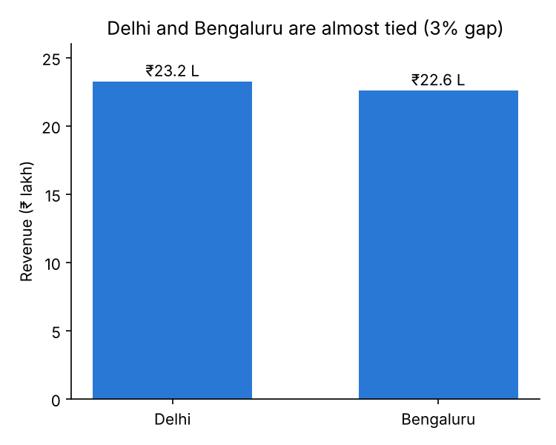
Makeover 1: the truncated axis
BEFORE
AFTER
Axis starting at ₹22 lakh makes a 3% gap look huge. Start bars at zero.
Notes:
8.1 Before/after images are on the slide.

Slide 7
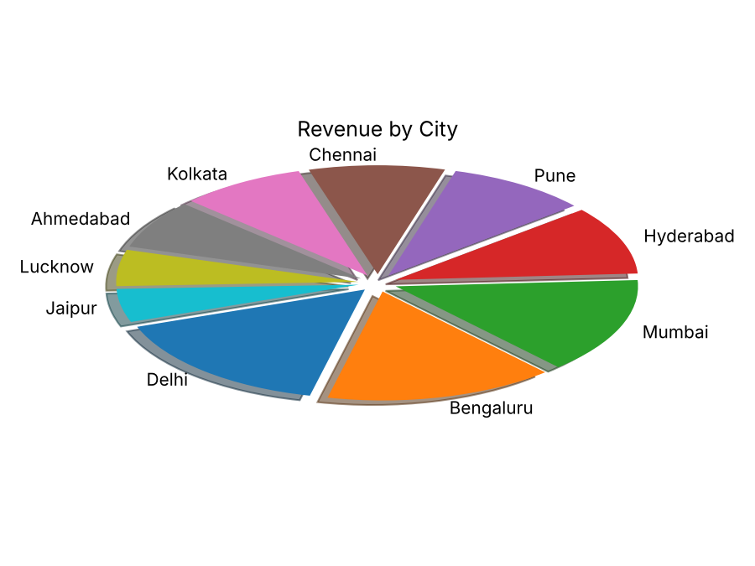
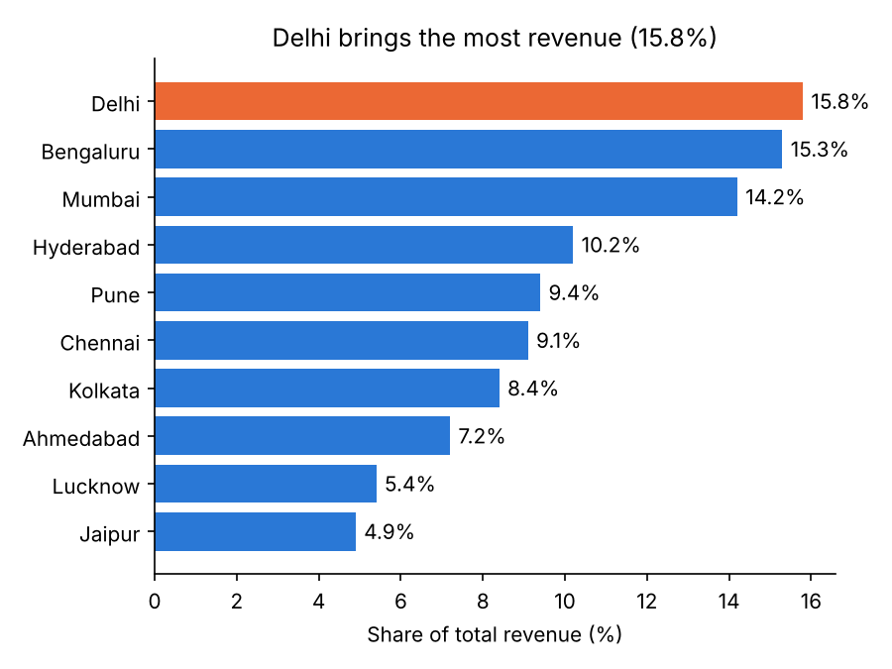
Makeover 2: the 3D pie
BEFORE
AFTER
Ten tilted slices can't be ranked. Sorted bars with labels can.
Notes:
8.1 Before/after images are on the slide.

Slide 8
Six rules for a clean chart
Bars always start at zero
Sort bars unless order has meaning
Label axes with units (₹ lakh, %)
One highlight colour, everything else grey
Remove 3D, shadows and heavy gridlines
Title says the finding, not the topic
5-SECOND TEST
If your audience needs more than 5 seconds to get the point, simplify.
Notes:
8.1 Show makeover 3 images here as the summary.

Slide 9
Recap – Video 8.1
Pick the chart by its job
Bars start at zero
Avoid 3D and crowded pies
Highlight one thing
Message titles
PRACTICE TASK
Find one bad chart in a news site or app. Write its job and sketch a better version.

Slide 10
Matplotlib: bar, line, histogram
VIDEO 8.2 · 8 MIN
Screen recording
Notes:
8.2 Open M08_8.2_Matplotlib_follow_along.ipynb.

Slide 11
The matplotlib pattern
PYTHON
Summarise first with groupby
figsize = width, height
Title, labels, then save
savefig before show
cat_rev = df.groupby("category")["revenue"].sum()
plt.figure(figsize=(8, 4))
plt.bar(cat_rev.index, cat_rev.values)
plt.title("Electronics brings half of revenue")
plt.xlabel("Category")
plt.ylabel("Revenue (₹ lakh)")
plt.tight_layout()
plt.savefig("images/chart.png", dpi=150)
plt.show()
Notes:
8.2 Framing slide before screen recording.

Slide 12
Recap – Video 8.2
plt.bar compares categories
plt.plot shows a trend
plt.hist shows a distribution
Always title + axis labels
savefig saves a PNG
PRACTICE TASK
Make a horizontal bar chart of revenue by city with a message title. Save it as a PNG.

Slide 13
Seaborn: statistical charts fast
VIDEO 8.3 · 8 MIN
Screen recording
Notes:
8.3 Open M08_8.3_Seaborn_follow_along.ipynb.

Slide 14
Five seaborn functions, five questions
Function | ShopKart question | Answer
countplot | Orders per category? | Fashion 1,326
barplot | Avg revenue per order? | Electronics ₹6,364
boxplot | Returns slower? | Median 5 vs 4 days
scatterplot | Discount vs quantity? | r = +0.27
heatmap | Delivery vs rating? | r = −0.33
Notes:
8.3 All answers come from the solution notebook.

Slide 15
Recap – Video 8.3
Seaborn takes data= and column names
hue splits by a category
barplot shows the mean
Heatmap of df.corr()
Correlation is not causation
PRACTICE TASK
Boxplot delivery_days by city. Which 3 cities wait longest? Do they match high-return cities?

Slide 16
Build a Power BI dashboard
VIDEO 8.4 · 10 MIN
Screen recording
Notes:
8.4 Follow M08_8.4_PowerBI_Dashboard_Build_Guide.md.

Slide 17
Dashboard build in six steps
1
2
3
4
5
6
Get data
Check types
Measures
Visuals
Slicers
Share
Load shopkart_clean.csv
Dates, numbers, text in Power Query
Five DAX KPIs
Cards, bar, line, city chart
City and membership
Format, export to PDF
Notes:
8.4 Show the mock-up image images/M08_dashboard_mockup.png.

Slide 18
The five DAX measures
EXCEL
A measure recalculates for every filter
DIVIDE avoids divide-by-zero errors
Format Return Rate % as percentage
Total Revenue = SUM(shopkart_clean[revenue])
Total Orders = COUNTROWS(shopkart_clean)
Return Rate % =
DIVIDE(
CALCULATE(COUNTROWS(shopkart_clean),
shopkart_clean[returned] = "Y"),
COUNTROWS(shopkart_clean))
Avg Rating = AVERAGE(shopkart_clean[rating])
Total Profit = SUM(shopkart_clean[profit])
Notes:
8.4 Type each one live.

Slide 19
Check: your cards should show (no filter)
₹147L
13.7%
3.96
Total revenue (₹1,47,04,650)
Return rate
Average rating
Notes:
8.4 Also: Total Orders 5,000; Total Profit ₹31,40,750 (₹31.4 L). Click Pune in the slicer: return rate jumps to 32.4%.

Slide 20
Recap – Video 8.4
Load CSV, check data types
Measures, not raw columns, for KPIs
Slicers filter every visual
Match your numbers to the guide
Export to PDF to share
PRACTICE TASK
Add a Category slicer. Select Fashion and Pune together: what return rate do you see?

Slide 21
Data storytelling
VIDEO 8.5 · 7 MIN
Slides
Face cam
Notes:
8.5 Hook: a dashboard is not a decision.

Slide 22
The 4-part story
1
2
3
4
Context
Insight
Evidence
Action
What the audience already knows
The one thing that changed
The chart and numbers that prove it
What we recommend, and who does it
Notes:
8.5 Insight in one sentence.

Slide 23
Topic titles vs message titles
Topic title (weak)
Message title (strong)
Return Rate by City
Monthly Revenue
Revenue by Category
Pune returns are 2.4x the average
Revenue peaks in October at ₹19.8 L
Electronics brings half of all revenue
Notes:
8.5 Every number here is computed from shopkart_clean.csv.

Slide 24
Rules for a findings slide
One message per slide
Title is a full sentence with a number
Grey for context, colour for the point
Show the comparison (vs average, vs last month)
End with a clear ask
STAY HONEST
Correlation is a clue, not proof. Recommend a test, not a verdict.

Slide 25
ShopKart returns: what Ops should do next
EXAMPLE FINDINGS DECK · 3 SLIDES
Example deck
Notes:
8.5 EXAMPLE DECK starts. Present these 3 slides as if to the ShopKart Ops head.

Slide 26
Pune returns are 2.4x the ShopKart average
32.4%
13.7%
14.3%
₹5.4L
Pune return rate (146 of 451 orders)
ShopKart average return rate
Next highest city (Kolkata)
Revenue in returned Pune orders
Notes:
Example deck slide 1 (Insight + context). Chart: images/M08_story1_pune_returns.png.

Slide 27
Pune returns more at every delivery speed
Delivery time | Other cities | Pune
2–4 days | 10.5% | 31.7%
5 days | 14.8% | 25.9%
6–7 days | 14.1% | 33.8%
8+ days | 19.7% | 48.8%
Pune deliveries average 5.8 days vs 4.0 elsewhere. Slow delivery is part of the story, not all of it.
Notes:
Example deck slide 2 (Evidence). Chart: images/M08_story2_pune_by_delivery.png.

Slide 28
Recommendation: start with Pune Fashion
1
2
3
Investigate
Test faster delivery
Track monthly
Pune Fashion returns are 38.8%. Audit sizing, quality and return reasons this month.
Pilot a faster courier for half of Pune orders; compare return rates.
Add Pune return rate to the dashboard; review every month.
Notes:
Example deck slide 3 (Recommendation). The pilot is an A/B test, as in Video 3.6.

Slide 29
Recap – Video 8.5
Context → insight → evidence → action
Message titles with real numbers
One point per slide
Recommend a test when unsure
PRACTICE TASK
Write a 3-slide story about Fashion returns using the same structure. Every number must come from your notebook.

