Slide 1
Capstone: why are ShopKart returns eating our profit?
MODULE 10 · CAPSTONE
SQL → pandas → charts → model → a 5-slide story
Notes:
Module 10 title. Everything from Modules 2–9 comes together on one business question.

Slide 2
From a one-line brief to a plan
VIDEO 10.1 · 8 MIN
Face cam
Diagram slides
Notes:
Video 10.1. Face cam intro, then diagram slide.

Slide 3
The brief from the manager
One message, no data dictionary, no instructions
Two questions hidden inside it
What is going on? This is analysis
Can we predict them? This is ML
We must also answer: how much money?
THE BRIEF
Returns are eating our profit. What's going on, and can we predict them?
Notes:
Video 10.1. Read the brief slowly, then split it into its two questions.

Slide 4
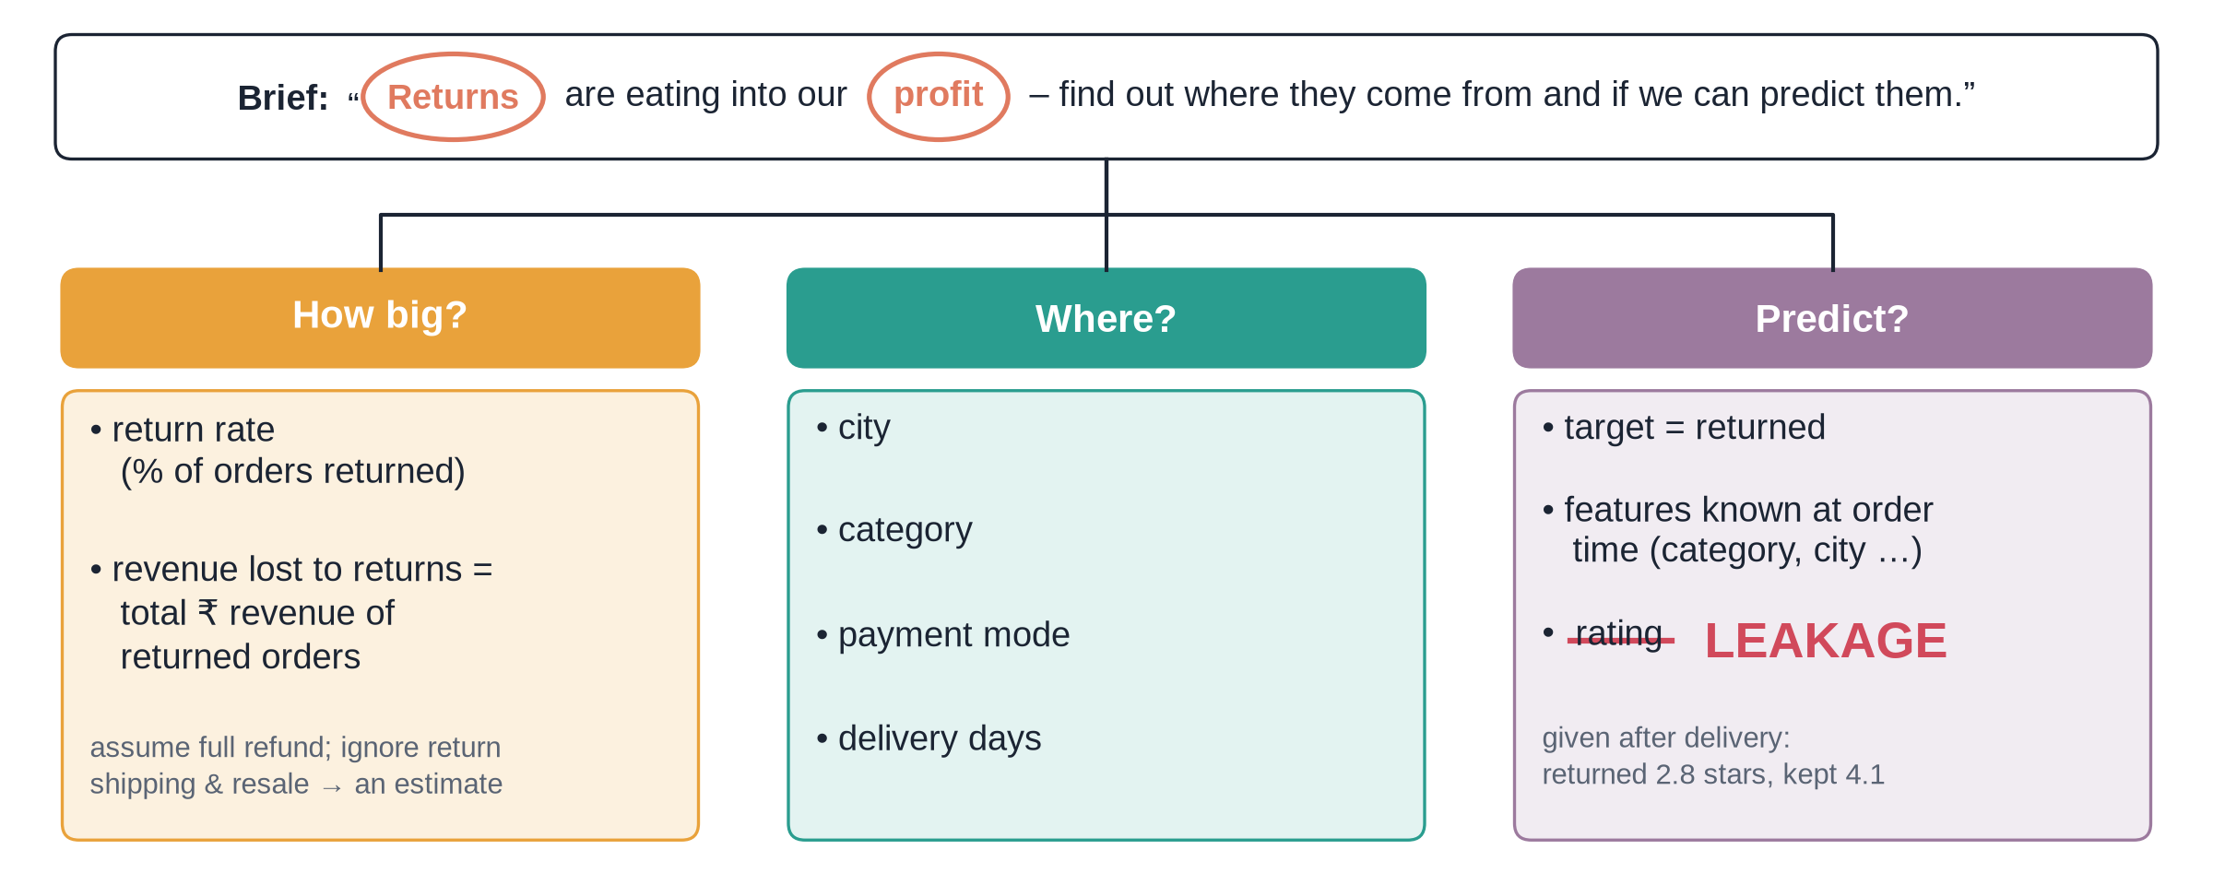
Turn the brief into questions
Notes:
Video 10.1. The question tree is the plan. Keep it on screen while you talk.

Slide 5
The capstone plan
1
2
3
4
5
6
Ask
SQL
Check
EDA
Model
Present
Split the brief into questions
Join orders, products, customers
Rows, missing, duplicates, Y/N
4 return-rate charts and ₹ lost
Tree vs logistic, judged on recall
5 slides, 3 insights, 3 actions
Notes:
Video 10.1. Each step after Ask maps to a module: SQL 4, Check 6, EDA 6 and 8, Model 9, Present 8.

Slide 6
Question → data → method
Question | Columns needed | Method
How big is the problem? | returned, revenue | Return rate, sum of ₹
Which cities? | city, returned | GROUP BY / groupby
Which categories? | category (products) | JOIN, then groupby
Payment and delivery? | payment_mode, delivery_days | Bands with CASE / pd.cut
Can we predict? | order-time columns only | Tree + logistic regression
Write this table before you write any code.
Notes:
Video 10.1. Point out that category lives in products, so we need a JOIN.

Slide 7
Recap – Video 10.1
A brief hides several questions – split it
Plan = question, data, method for each
Money question needs a clear definition
Rating is leakage: given after the return
PRACTICE TASK
Write your own question tree for the ShopKart brief on paper before watching 10.2. Add one question we did not list.
Notes:
Video 10.1 recap.

Slide 8
Build it: SQL → pandas → charts → model
VIDEO 10.2 · 20 MIN
Screen recording
Notes:
Video 10.2. Mostly Colab. Open M10_capstone_shopkart_solution.ipynb side by side with follow-along.

Slide 9
Step 1: one SQL query feeds Python
SQL
Same query as Q3 in the .sql file
pd.read_sql runs it in Colab
Result: 5,000 rows, 19 columns
Only rating has blanks (260)
SELECT o.*, p.category, p.cost_price,
c.gender, c.age, c.membership,
ROUND(o.quantity * o.unit_price
* (1 - o.discount), 2) AS revenue
FROM orders AS o
INNER JOIN products AS p
ON o.product_id = p.product_id
LEFT JOIN customers AS c
ON o.customer_id = c.customer_id;
Notes:
Video 10.2. Short version of Q3; the notebook lists columns explicitly.

Slide 10
Two traps to avoid
Leakage
The accuracy trap
Rating is given after delivery
Returned orders average 2.8 stars
Using it = cheating the test
Use only order-time columns
Only 13.7% of orders are returned
'Always No' scores 86.3% accuracy
…and catches zero returns
Judge on recall and precision
Notes:
Video 10.2. Show this before the model cells.

Slide 11
Recap – Video 10.2
SQL join → pd.read_sql → one DataFrame
Return rate = mean of a 0/1 column
4 charts: city, category, payment, delivery
₹21.5 lakh revenue came from returned orders
Logistic regression catches 55% of returns
PRACTICE TASK
Change the tree to max_depth=3 and 6. Write down recall and precision for each. Which would you ship, and why?
Notes:
Video 10.2 recap.

Slide 12
Present it – and submit your own capstone
VIDEO 10.3 · 7 MIN
Slides
Face cam
Notes:
Video 10.3. Slides first, face cam for the submission part.

Slide 13
Five slides, five jobs
1
2
3
4
5
Headline
Where
Why
Predict
Act
The problem in one number
The biggest leak
Drivers you can act on
Model, honestly judged
Three recommendations
Notes:
Video 10.3. Every slide title is a full sentence – the takeaway.

Slide 14
Returns cost ShopKart ₹21.5 lakh of revenue in 2025
13.7%
₹21.5 L
₹4.6 L
of orders returned (687 of 5,000)
revenue of returned orders – 14.6% of total
profit those orders would have made
Example slide 1 of 5. Assumption: full refund, no resale, return shipping ignored.
Notes:
Capstone deck example, slide 1. Headline number plus the assumption, said out loud.

Slide 15
Pune is the biggest leak: 1 in 3 orders comes back
City | Orders | Return rate | Revenue lost
Pune | 451 | 32.4% | ₹5.37 lakh
Kolkata | 414 | 14.3% | ₹1.75 lakh
Ahmedabad | 303 | 14.2% | ₹1.41 lakh
Bengaluru | 736 | 12.1% | ₹3.36 lakh
Delhi | 804 | 10.2% | ₹2.67 lakh
Mumbai | 759 | 9.1% | ₹1.84 lakh
Example slide 2 of 5. Pune: 9% of orders, 21% of returns, 25% of revenue lost.
Notes:
Capstone deck example, slide 2. Every category is 2–4x worse in Pune.

Slide 16
Slow delivery, COD and Fashion push returns up
Driver | Group | Return rate
Delivery | 2–3 days | 10.4%
Delivery | 8+ days | 30.3%
Payment | UPI | 12.1%
Payment | COD | 19.1%
Category | Books | 7.3%
Category | Fashion | 21.0%
Example slide 3 of 5. Overall return rate is 13.7%.
Notes:
Capstone deck example, slide 3. Best vs worst group for each driver.

Slide 17
A simple model flags risky orders – useful, not magic
Model (test set, 1,000 orders) | Accuracy | Precision | Recall
Always say 'No return' | 86.3% | – | 0%
Decision tree (depth 4) | 74.4% | 24.5% | 41.6%
Logistic regression | 65.2% | 20.9% | 55.5%
Example slide 4 of 5. Flagged orders return 20.9% vs 9.6% for the rest. Rating not used (leakage).
Notes:
Capstone deck example, slide 4. Explain why recall matters more here.

Slide 18
Three actions to cut returns
1
2
3
Fix Pune
Faster, prepaid
Fashion fit
Audit Pune courier and packaging this month; track Pune return rate weekly.
Speed up 6+ day routes; nudge COD buyers to UPI with a small prepaid offer.
Add size guides and real photos; confirm size before shipping flagged orders.
Example slide 5 of 5. Next step: pilot the model's confirmation calls in Pune for one month.
Notes:
Capstone deck example, slide 5. End with an action and an owner.

Slide 19
Your capstone: FitGym
?
D
S
The question
The data
The steps
Why are members leaving, and can we predict churn?
members_raw.csv (messy), plans.csv, fitgym.db
Same as ShopKart: SQL, clean, EDA, model, 5 slides
Notes:
Video 10.3. Point to 04_Assessments/Capstone_Brief_FitGym.md.

Slide 20
How your capstone is marked (pass at 60)
Criterion | Marks
Cleaning | 20
SQL / data prep | 15
EDA & insights | 25
Visualisation | 15
Model & evaluation | 15
Communication | 10
Full rubric in Capstone_Rubric.md – read it before you start.
Notes:
Video 10.3. EDA & insights carries the most marks.

Slide 21
Submit in four steps
1
2
3
4
Notebook
Slides
Video
Upload
Colab link, view access, runs top to bottom
5-slide PDF with real numbers
Optional 3-minute walkthrough
Submit all links on the course page
Notes:
Video 10.3. Share setting: Anyone with the link can view.

Slide 22
Recap – Video 10.3
Slide titles are takeaways, not topics
One number, one leak, drivers, model, actions
State assumptions next to the number
FitGym: same steps, new data, new mess
PRACTICE TASK
Download the FitGym files and read the brief. Write your question tree before opening Colab.
Notes:
Video 10.3 recap.

