Slide 1
Introduction to Generative AI
MODULE 1 · INTRODUCTION
What GenAI is, where LLMs fail, and how apps use them
Notes:
Deck title.

Slide 2
What Generative AI is
VIDEO 1.1 · 8 MIN
Notes:
SEGMENTS: Slides + Handwriting board
Video 1.1.

Slide 3
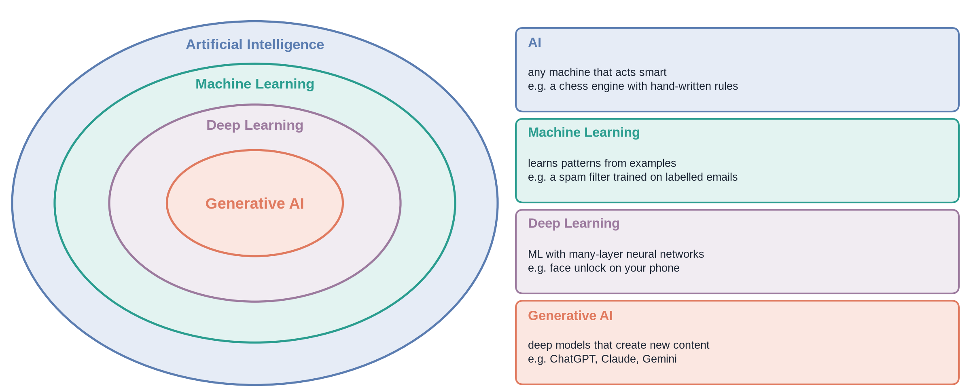
From AI to Generative AI
Notes:
✏ DRAW THIS SLIDE – hand-draw it live; the slide diagram is your reference
Video 1.1.
What to draw:
• Four nested circles: AI, Machine Learning, Deep Learning, Generative AI
• AI: chess engine with rules
• ML: spam filter learns from labelled emails
• DL: face unlock, many-layer neural network
• GenAI: ChatGPT / Claude / Gemini – creates new content

Slide 4
Two kinds of model
Discriminative: picks an answer
Generative: creates new things
Is this email spam? Yes / No
Which category is this ticket?
Output: a label or a number
Learns the boundary between groups
Write a reply to this customer
Summarise this 40-page policy
Output: text, image, code, audio
Learns what the data looks like
Notes:
Video 1.1.

Slide 5
What Generative AI produces
1
2
3
4
Text
Code
Images
Audio & video
Answers, summaries, emails, reports. ChatGPT, Claude, Gemini.
Functions, tests, explanations. GitHub Copilot, Claude Code.
Pictures from a sentence. DALL·E, Midjourney, Imagen.
Voices, music, short clips. ElevenLabs, Sora, Veo.
Notes:
Video 1.1.

Slide 6
Why it took off now
2017: the Transformer, a new neural-network design (Module 2)
Enormous amounts of text from the web, books and code
Powerful GPUs to train on all of it
2022: ChatGPT puts it in everyone's hands
Today: any developer can call a model with a few lines of code
Notes:
Video 1.1.

Slide 7
Recap – Video 1.1
AI ⊃ Machine Learning ⊃ Deep Learning ⊃ Generative AI
Discriminative models choose a label; generative models create new content
Large Language Models (LLMs) are the text branch of Generative AI
Transformers + data + GPUs made it possible; APIs made it available
TRY THIS
Write down three tasks from your own work or study. For each, decide: is it a discriminative job (pick a label) or a generative job (create something)?
Notes:
Video 1.1.

Slide 8
What LLMs can and cannot do
VIDEO 1.2 · 8 MIN
Notes:
SEGMENTS: Slides
Video 1.2.

Slide 9
Strong at, weak at
Strong at
Weak at
Writing fluent, well-structured text
Summarising and rewriting
Following instructions and formats
Combining ideas from many passages
Facts they never saw in training
Anything after their knowledge cutoff
Your private files and policies
Saying “I don't know” on their own
Notes:
Video 1.2.

Slide 10
Three ways a plain LLM fails
1
2
3
Hallucination
Knowledge cutoff
No private data
It produces a confident, fluent answer that is simply false, because it writes what sounds likely, not what is checked.
Training stopped on a date. Anything newer, like this year's policy, does not exist for the model.
It never read your company's documents. Ask about your own leave rules and it can only guess.
Notes:
Video 1.2.

Slide 11
Same question, two systems
Plain chatbot
Document assistant
Q: How many leave days can I carry over?
A: “Usually 5 to 10 days, depending on the company.”
Sounds right. It is a guess.
No source. You cannot check it.
Q: How many leave days can I carry over?
A: “Up to 8 days; they expire on 31 March (Source: leave_policy, p.4).”
Answer comes from your own policy
Citation lets anyone verify it
Notes:
Video 1.2.

Slide 12
The general fix: Retrieval-Augmented Generation
No private data → find the right passages in your documents and give them to the model
Knowledge cutoff → the passages are as new as the documents you add
Hallucination → rules: use only the passages, cite them, say so if the answer is missing
Retrieve → Augment the prompt → Generate the answer
Modules 4–7 build this up piece by piece
Notes:
Video 1.2.

Slide 13
Recap – Video 1.2
LLMs write fluent text, summarise, follow formats
They hallucinate, have a cutoff, and never saw your files
RAG retrieves your passages and puts them in the prompt
Citations make answers checkable
TRY THIS
Ask any chatbot a question about a document only you have (your college rules, a lease). Note what it does: guess, refuse, or ask for the text?
Notes:
Video 1.2.

Slide 14
The GenAI landscape and this course
VIDEO 1.3 · 9 MIN
Notes:
SEGMENTS: Slides + Handwriting board + Screen recording
Video 1.3.

Slide 15
Model families and providers (at the time of writing)
Provider | Model family | How you use it
OpenAI | GPT (e.g. gpt-4o-mini) | Closed: API and the ChatGPT app
Anthropic | Claude | Closed: API and the Claude apps
Google | Gemini (and open Gemma) | Closed API; Gemma weights are downloadable
Meta | Llama | Open weights: download and run it yourself
Mistral AI | Mistral | Both: open-weight models and a paid API
Notes:
Video 1.3.

Slide 16
Closed API models vs open-weight models
Closed model, via an API
Open-weight model, run yourself
Runs on the provider's servers
No hardware to manage; pay per token
Often the strongest models
Your text leaves your building: read the terms
You download the weights (the learned numbers)
Run on your own GPUs or a cloud host
Data stays with you; full control
You handle updates, scaling and safety
Notes:
Video 1.3.

Slide 17
Calling a model through an API
PYTHON · OPENAI SDK v1
from openai import OpenAI
client = OpenAI() # reads the OPENAI_API_KEY environment variable
response = client.chat.completions.create(
model="gpt-4o-mini",
messages=[
{"role": "system", "content": "You are a helpful HR assistant."},
{"role": "user", "content": "Explain notice period in two lines."},
],
temperature=0.2,
)
print(response.choices[0].message.content) # the generated text
print(response.usage) # tokens in, tokens out
Notes:
Video 1.3.

Slide 18
Paying per token: a quick sum
1,000
$0.30
$0.18
$0.48
questions a day, each 2,000 tokens in + 300 tokens out
input: 2,000,000 tokens × $0.15 per million
output: 300,000 tokens × $0.60 per million
per day (illustrative small-model prices)
Notes:
Video 1.3.

Slide 19
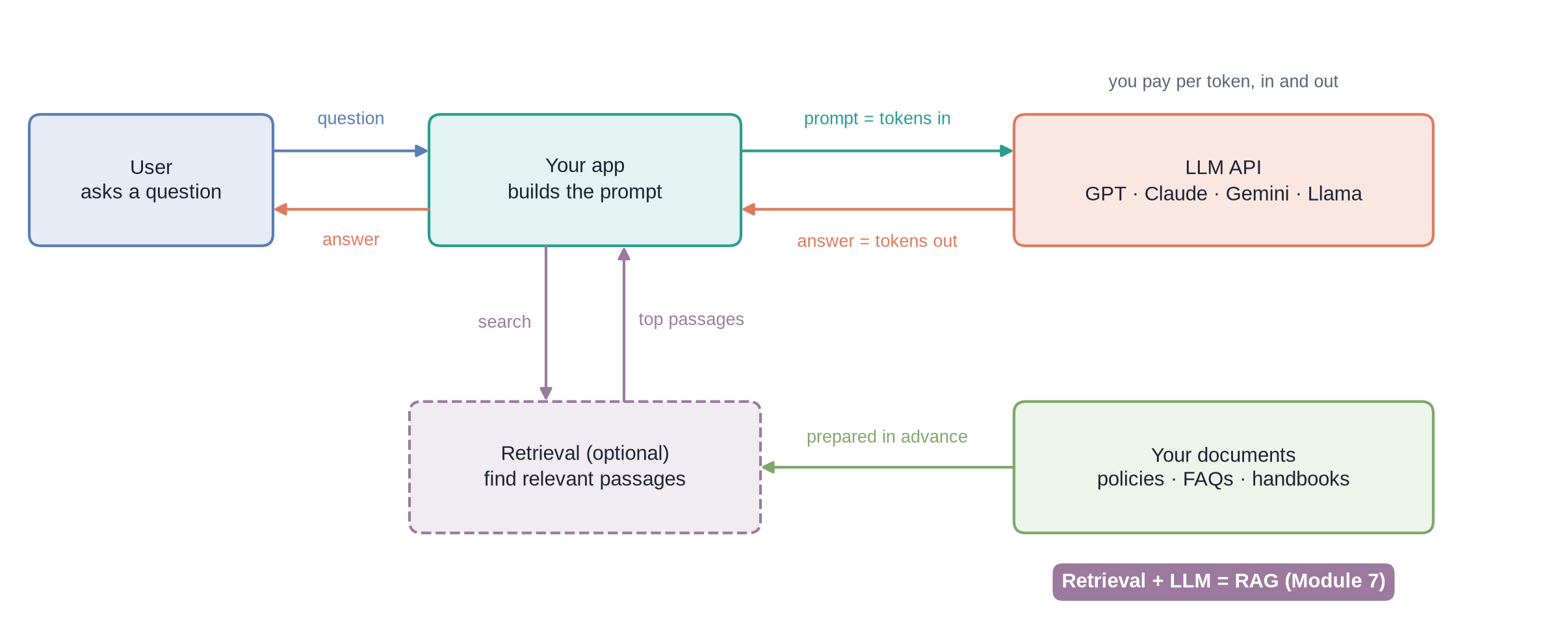
Anatomy of a GenAI app
Notes:
✏ DRAW THIS SLIDE – hand-draw it live; the slide diagram is your reference
Video 1.3. Draw the top row first (user, app, LLM API), then add the dashed retrieval box and documents.
What to draw:
• Top row: User → Your app (builds the prompt) → LLM API
• Arrows back: answer = tokens out, from LLM API to app to user
• Write 'you pay per token, in and out' above the LLM API box
• Dashed box under the app: Retrieval (optional), arrows 'search' and 'top passages'
• Your documents (policies, FAQs, handbooks) → Retrieval, labelled 'prepared in advance'
• Bottom pill: Retrieval + LLM = RAG

Slide 20
The course map
Module | Topic | Key ideas | Min
1 | Introduction to Generative AI | GenAI, LLM limits, RAG, the landscape | 25
2 | How LLMs work | Tokens, next-token prediction, attention, temperature, streaming | 40
3 | Prompt engineering | Roles, instructions, grounding, citations, refusals | 30
4 | Embeddings and similarity | Meaning as vectors, dimensions, cosine similarity | 30
5 | Vector databases | Index, upsert, metadata, filters, top-k search | 30
6 | Document ingestion and chunking | PDF text, cleaning, token chunks with overlap | 30
7 | Retrieval-Augmented Generation | The full pipeline and how it fails | 30
8 | Running GenAI in the real world | Observability, then we start the project | 10
Then | Capstone project: DocuMind | You build a PDF question-answering assistant using every idea | –
Notes:
Video 1.3.

Slide 21
Recap – Video 1.3
Model families: GPT, Claude, Gemini, Llama, Mistral
Closed API models vs open-weight models you run yourself
An app sends a request, gets tokens back, and pays per token
Anatomy: user → app → optional retrieval → LLM API → answer
PRACTICE TASK
Pick an assistant for a college handbook. Draw its anatomy from memory, mark the optional step, then compare with slide 19.
Notes:
Video 1.3.

