Slide 1
How LLMs work
MODULE 2 · HOW LLMS WORK
Tokens, next-token prediction, attention, temperature
Notes:
Deck title.

Slide 2
Tokens and tokenisation
VIDEO 2.1 · 9 MIN
Notes:
SEGMENTS: Slides + Screen recording
Video 2.1.

Slide 3
What is a token?
LLMs do not read letters or whole words: they read tokens
A token is a common piece of text: a word, part of a word, a space + word, a digit, a symbol
Each token has an ID number in the model's vocabulary
The model only ever sees lists of IDs, never the letters
Text → token IDs is called encoding; IDs → text is decoding
Notes:
Video 2.1.

Slide 4
Real tokens (cl100k_base)
Text | Characters | Tokens | How it splits
What is the refund policy? | 26 | 6 | What | ·is | ·the | ·refund | ·policy | ?
Refunds are accepted within 14 days. | 36 | 9 | Ref | unds | ·are | ·accepted | ·within | · | 14 | ·days | .
unbelievably | 12 | 3 | un | belie | vably
def count_tokens(text): | 23 | 5 | def | ·count | _tokens | (text | ):
Notes:
Video 2.1. Real output of tiktoken. · marks a leading space inside a token.

Slide 5
How a tokenizer learns its pieces (BPE)
1
2
3
4
Start small
Merge the most frequent pair
Repeat
Stop at a size
Begin with single bytes: every letter, digit and symbol is its own piece.
In a huge pile of text, find the pair that appears most often, like “t”+“h”, and make it one new piece.
Keep merging: “th”+“e” → “the”. Common words end up as one token; rare words stay in parts.
cl100k_base has about 100,000 pieces; the newer o200k_base about 200,000.
Notes:
Video 2.1.

Slide 6
Counting tokens in Python
PYTHON · tiktoken
encode: text → IDs; decode: IDs → the exact same text
len(enc.encode(text)) is the token count
Apps count tokens to estimate cost and check limits
Cutting text every N tokens is how chunking works (Module 6)
import tiktoken
enc = tiktoken.get_encoding("cl100k_base")
ids = enc.encode("What is the refund policy?")
print(ids) # [3923, 374, 279, 21639, 4947, 30]
print(len(ids)) # 6 <- the token count
print(enc.decode(ids)) # What is the refund policy?
# the tokenizer a given model uses
enc = tiktoken.encoding_for_model("gpt-4o-mini")
print(enc.name) # o200k_base
Notes:
Video 2.1.

Slide 7
Different models, different tokenizers
Tokenizer | Pieces | Used by (at the time of writing) | ID of “What” | Hindi question
cl100k_base | ≈ 100,000 | GPT-4, GPT-3.5 Turbo, text-embedding-3-small / -large | 3923 | 19 tokens
o200k_base | ≈ 200,000 | GPT-4o family, e.g. gpt-4o-mini | 4827 | 7 tokens
Others | varies | Claude, Gemini, Llama: each has its own tokenizer | different | different
Notes:
Video 2.1. Model-to-tokenizer mapping at the time of writing (tiktoken 0.14). IDs and Hindi counts are real.

Slide 8
Rules of thumb (English)
≈ 4
≈ ¾
≈ 300
characters per token
of a word per token: 100 tokens ≈ 75 words
words in a 400-token piece of text, about half a page
Notes:
Video 2.1.

Slide 9
Why tokens matter
Cost
Limits
APIs charge per million tokens
Input and output are priced separately
Output tokens usually cost more
More text in the prompt = higher bill
Every model has a maximum context, in tokens
text-embedding-3-small: up to 8,191 tokens per input
A 400-token piece of a handbook fits easily
The prompt + the answer must fit the LLM's window
Notes:
Video 2.1.

Slide 10
Recap – Video 2.1
Models read token IDs, not letters
BPE merges frequent pieces into one token
English ≈ 4 characters per token; Hindi and code use more
Tokens decide both cost and limits
Different models use different tokenizers: count with the right one
PRACTICE TASK
pip install tiktoken, then encode your own name, a Hindi sentence and one line of Python with cl100k_base and o200k_base. Which uses the most tokens per character?
Notes:
Video 2.1.

Slide 11
Next-token prediction and how models are trained
VIDEO 2.2 · 10 MIN
Notes:
SEGMENTS: Slides + Handwriting board
Video 2.2.

Slide 12
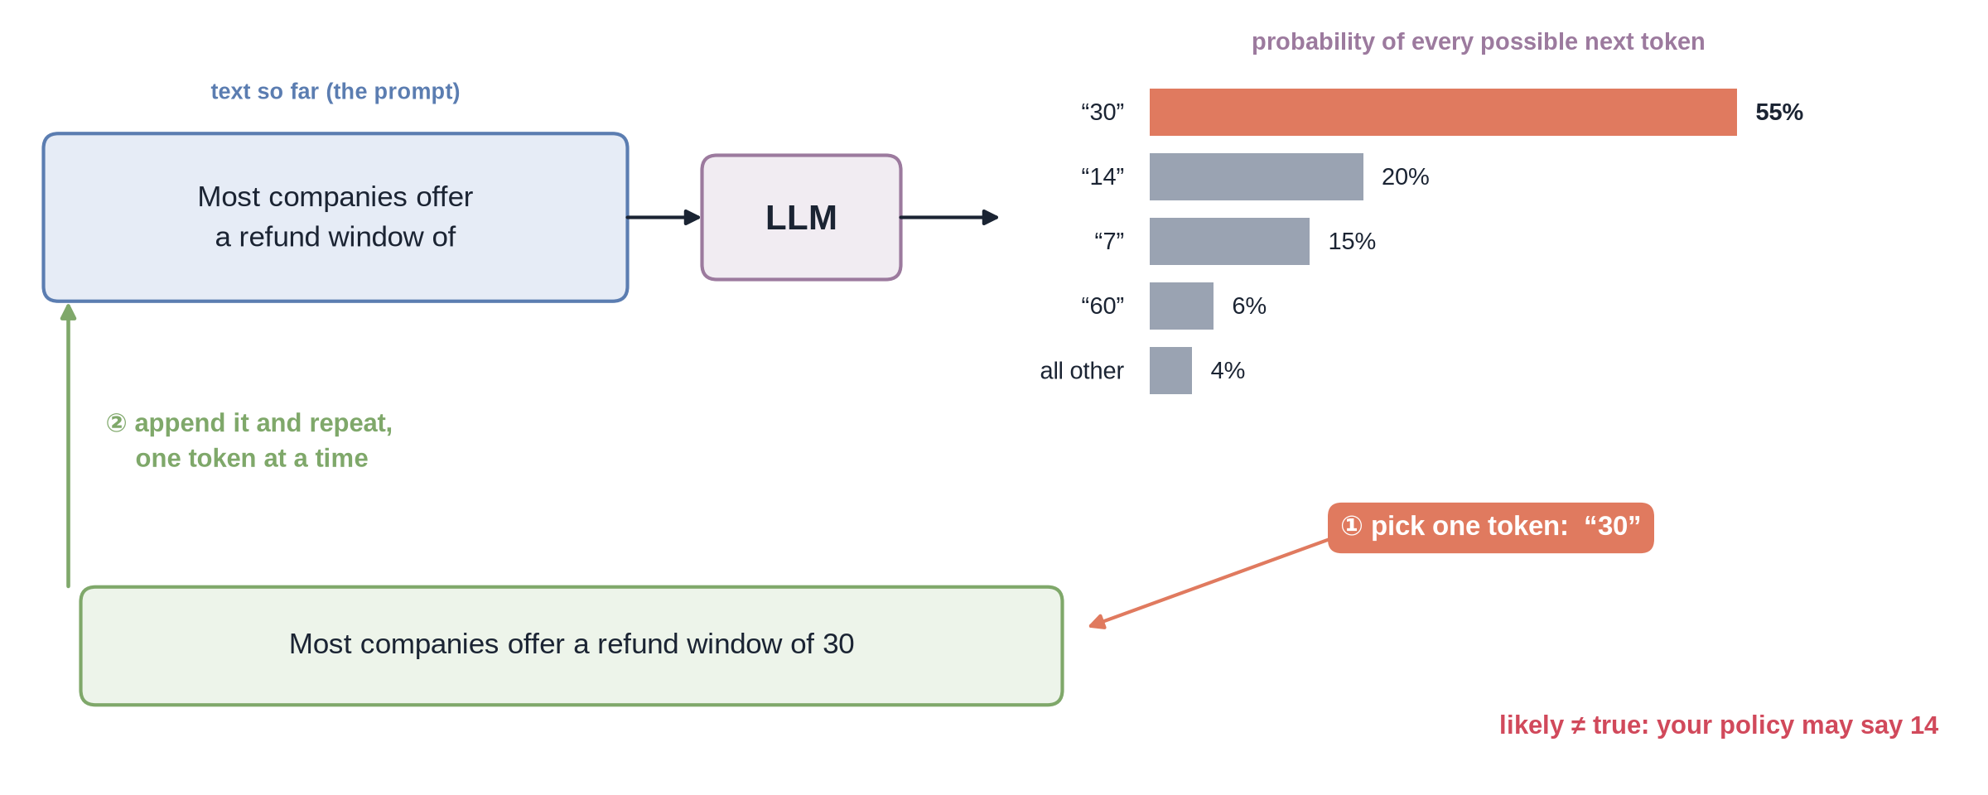
One token at a time
Notes:
✏ DRAW THIS SLIDE – hand-draw it live; the slide diagram is your reference
Video 2.2.
What to draw:
• Box: “Most companies offer a refund window of” → box LLM
• Bar chart: 30 = 55%, 14 = 20%, 7 = 15%, 60 = 6%, others 4%
• ① pick one token: 30
• ② append it to the text, arrow back to the start: repeat
• In red: likely ≠ true (your policy may say 14)

Slide 13
Autoregressive generation
Input: all the tokens so far
Output: a probability for every token in the vocabulary
Pick one token, add it to the text, run the model again
Stop at a special end token or at the output limit (max_tokens)
A 200-token answer = 200 runs of the model
Notes:
Video 2.2.

Slide 14
Three stages of training
1
2
3
Pretraining
Instruction tuning
Preference tuning
Read a huge amount of public text and learn to predict the next token. Result: knows language and many facts, but just continues text.
Train on many examples of instructions and good answers. Result: answers questions instead of rambling on.
Humans (or AI judges) rank answers; the model is nudged towards the preferred ones (RLHF and similar). Result: helpful, polite, safer.
Notes:
Video 2.2.

Slide 15
Base model vs chat model
Base model (pretraining only)
Chat model (all three stages)
Prompt: “What is the hostel curfew?”
Continues: “What is the mess timing? What is the fee …”
Great at language, not at helping
Same prompt
Answers the question, politely
But it never read your college's handbook: it may guess
Notes:
Video 2.2.

Slide 16
Why hallucination happens
What the model optimises
What you need
The most likely next token, given the text so far
Learned from public text, up to a cutoff date
No built-in “fact check” step
Fluent and confident by design
The true answer for your organisation
From documents it never saw
With a source you can check
→ give it the facts in the prompt (RAG, Module 7)
Notes:
Video 2.2.

Slide 17
Recap – Video 2.2
An LLM predicts a probability for every possible next token
It writes one token at a time and feeds each one back in
Pretraining → instruction tuning → preference tuning
Likely is not the same as true: that is why we use RAG
TRY THIS
Type the start of a sentence into any chatbot, e.g. “The capital of India is”, and ask it to continue with one word. Then try a sentence about your college's rules. Which answer can you trust, and why?
Notes:
Video 2.2.

Slide 18
Transformers and attention
VIDEO 2.3 · 10 MIN
Notes:
SEGMENTS: Slides + Handwriting board
Video 2.3.

Slide 19
Inside the model, from text to probabilities
1 · Text → token IDs (tokenizer)
2 · Each ID → a vector of numbers, plus its position in the text
3 · Many identical layers, each with attention + a feed-forward step
4 · Every layer refines each token's vector using the others
5 · Last layer → a probability for every possible next token
Notes:
Video 2.3.

Slide 20
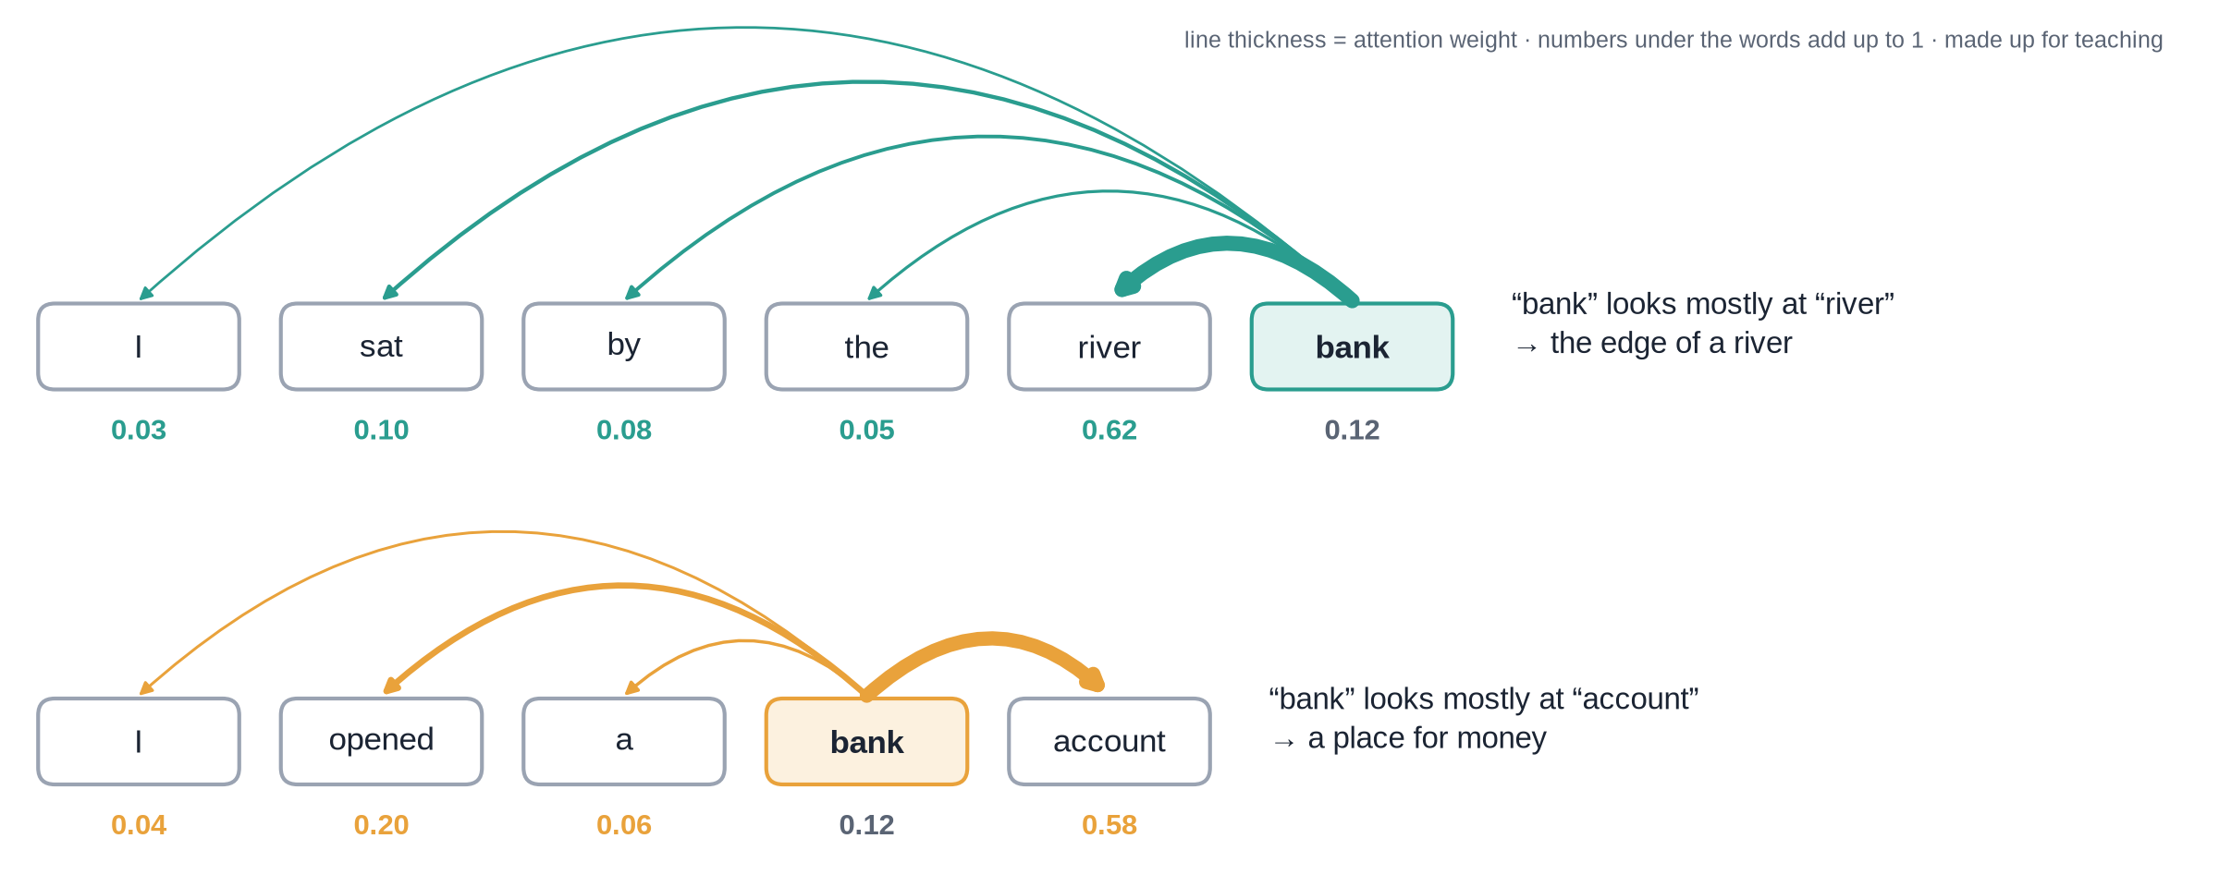
Attention: which words matter for “bank”?
Notes:
✏ DRAW THIS SLIDE – hand-draw it live; the slide diagram is your reference
Video 2.3.
What to draw:
• Row 1: I sat by the river bank — lines from “bank” to every word
• Thickest line to “river” (0.62): bank = edge of a river
• Row 2: I opened a bank account — thickest line to “account” (0.58)
• Write: same word, different meaning, decided by context
• Weights are made up for teaching; each row adds up to 1

Slide 21
A tiny attention example
Word that “bank” looks at | Weight | What it means
river | 0.62 | Most of the new meaning comes from here
bank (itself) | 0.12 | Keeps some of its own original meaning
sat | 0.10 | A little: someone is sitting there
by | 0.08 | A little: a place word
the | 0.05 | Almost nothing
I | 0.03 | Almost nothing
Total | 1.00 | New “bank” = weighted mix of all these
Notes:
Video 2.3.

Slide 22
Why text in the prompt shapes the answer
While writing, each new token attends to every token before it (never to future ones)
That includes everything you pasted into the prompt
Help desk: three paragraphs of the leave policy + the employee's question
Answer tokens give high weight to the policy's words: “12 days”, “casual leave”
This is the mechanism RAG relies on: right text in, grounded answer out
Notes:
Video 2.3.

Slide 23
Why transformers won
Before 2017: recurrent networks (RNNs)
Transformers (“Attention Is All You Need”, 2017)
Read one word at a time, left to right
Earlier words fade as the text gets longer
Hard to run in parallel: slow to train
Look at all tokens at once
Any token can attend to any other, near or far
Parallel on GPUs: train on far more text
The T in GPT: Generative Pre-trained Transformer
Notes:
Video 2.3.

Slide 24
What “large” means
10s–100s
Billions
Trillions
of layers stacked on top of each other
of learned numbers (parameters) in a modern LLM
of tokens of text read during pretraining
Notes:
Video 2.3.

Slide 25
Recap – Video 2.3
Tokens become vectors, then pass through many layers
Attention: each token looks at the others and mixes in what matters
Context decides meaning: river bank vs bank account
Facts in the prompt shape every answer token
Transformers read everything at once, so they scale
PRACTICE TASK
Write two sentences where one word changes meaning (e.g. “apple” the fruit vs Apple the company). For each, list the words that the ambiguous word should attend to most.
Notes:
Video 2.3.

Slide 26
Context window, temperature and streaming
VIDEO 2.4 · 11 MIN
Notes:
SEGMENTS: Slides + Handwriting board
Video 2.4.

Slide 27
The context window
128K
≈ 16K
≈ 2.3K
tokens: gpt-4o-mini's context window, prompt + answer (at the time of writing)
tokens: the most it can write in one answer
tokens: a prompt with 5 passages × 400 + rules + question
Notes:
Video 2.4.

Slide 28
What fits, and what does not
Context window = everything the model sees in one call: system prompt, passages, question, answer
Anything outside the window does not exist for the model
No memory between calls: chat apps resend the earlier messages every time
Bigger prompts cost more and take longer, even when they fit
So good apps send a few relevant passages, not the whole document
Notes:
Video 2.4.

Slide 29
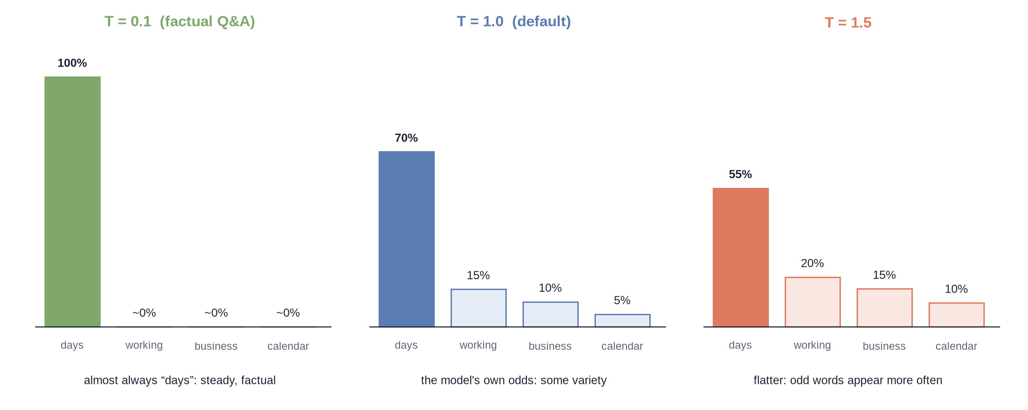
Temperature reshapes the odds
Notes:
✏ DRAW THIS SLIDE – hand-draw it live; the slide diagram is your reference
Video 2.4. Example: next token after “Refunds are accepted within 14”. Base odds 70/15/10/5.
What to draw:
• Write the prompt: “Refunds are accepted within 14 ...”
• Three bar charts, same 4 tokens: days, working, business, calendar
• T = 0.1: days ≈ 100%, others ≈ 0 (factual Q&A)
• T = 1.0: 70 / 15 / 10 / 5, the model's own odds
• T = 1.5: flatter, about 55 / 20 / 15 / 10

Slide 30
Two sampling knobs
Temperature
Top-p (nucleus sampling)
Low (0–0.3): sharp, repeatable, factual
Around 1: the model's natural variety
High (>1): creative, more mistakes
Answers from a document: keep it low, e.g. 0.1
Keep only the most likely tokens whose odds add up to p
top_p = 0.9: drop the unlikely tail
Usually tune temperature or top-p, not both
Many apps leave top-p at its default
Notes:
Video 2.4.

Slide 31
Temperature and streaming in code
PYTHON · OpenAI SDK v1
system = the rules; user = the passages + question (Module 3)
temperature=0.1: steady, factual answers
stream=True: each piece is sent as soon as it is generated
chunk.choices[0].delta.content = the new text
from openai import OpenAI
client = OpenAI() # key from OPENAI_API_KEY
stream = client.chat.completions.create(
model="gpt-4o-mini",
messages=[
{"role": "system", "content": RULES},
{"role": "user", "content": question},
],
temperature=0.1,
max_tokens=300,
stream=True,
)
for chunk in stream:
delta = chunk.choices[0].delta.content
if delta:
print(delta, end="", flush=True)
Notes:
Video 2.4.

Slide 32
Why stream?
1
2
3
Without streaming
With streaming
Same total
The user stares at a spinner until all 200 tokens are written, then sees everything at once.
The first words often appear within a second; the rest follows as the model writes.
Streaming does not make the model faster or cheaper. It only makes the wait feel shorter.
Notes:
Video 2.4.

Slide 33
Recap – Video 2.4
Context window = prompt + answer, in tokens; no memory between calls
Temperature sharpens (low) or flattens (high) the next-token odds
Top-p cuts off the unlikely tail
Factual assistants: low temperature + stream=True
PRACTICE TASK
Run the streaming snippet with temperature=1.2 and ask the same question three times. Compare the answers, then repeat with temperature=0.1.
Notes:
Video 2.4.

