Slide 1
Embeddings and similarity
MODULE 4 · EMBEDDINGS
How text becomes numbers, and how we measure closeness
Notes:
Deck title.

Slide 2
From words to vectors
VIDEO 4.1 · 9 MIN
Notes:
SEGMENTS: Slides + Handwriting board
Video 4.1.

Slide 3
Keyword search vs meaning search
Keyword search
Meaning search (embeddings)
Q: “how do refunds work?”
Looks for the letters r-e-f-u-n-d
FAQ page says “return policy”
No shared word → no result
Q: “how do refunds work?”
Turns the question into a position
“return policy” sits right next to it
Found, even with zero shared words
Notes:
Video 4.1.

Slide 4
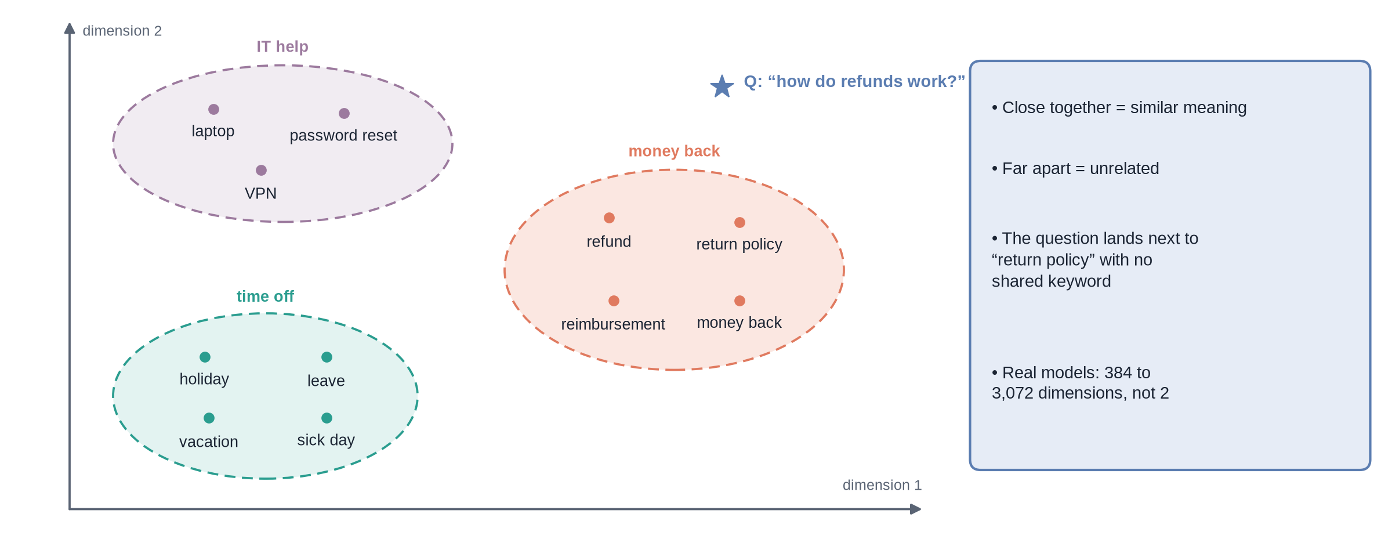
A map of meaning
Notes:
✏ DRAW THIS SLIDE – hand-draw it live; the slide diagram is your reference
Video 4.1. Draw the axes first, then one cluster at a time, then drop the question star last.
What to draw:
• Two axes: dimension 1, dimension 2
• Cluster 'money back': refund, return policy, reimbursement, money back
• Cluster 'time off': holiday, leave, vacation, sick day
• Cluster 'IT help': laptop, password reset, VPN
• Star for the question 'how do refunds work?' next to return policy
• Write: close = similar, far = unrelated, real models have 384 to 3,072 dimensions

Slide 5
A vector is just a list of numbers
A point on our map = two numbers, e.g. (7.0, 3.9)
A real embedding = hundreds or thousands of numbers, e.g. 1,536
A whole passage gets ONE vector, not one per word
No single number means “money” or “time”: meaning is spread across all of them
The model learned where to place text by reading huge amounts of it
Notes:
Video 4.1.

Slide 6
Where embeddings are used
1
2
3
4
Search by meaning
Suggestions
Grouping
Feeding an LLM
A shop search for “sneakers” also finds “running shoes”.
“Students who read this notice also read…”: nearby items.
Cluster 5,000 support tickets by topic; spot duplicate questions.
Find the few passages an LLM should read before it answers (RAG).
Notes:
Video 4.1.

Slide 7
Recap – Video 4.1
An embedding turns text into a position: a list of numbers
Similar meaning → close positions, even with no shared words
One vector per whole passage (or question)
Keyword search matches letters; embeddings match meaning
TRY THIS
Write five sentences from your college or office rules. Sketch them on a 2-D map: which ones would sit close together? Which question would land near each group?
Notes:
Video 4.1.

Slide 8
Embedding models in practice
VIDEO 4.2 · 9 MIN
Notes:
SEGMENTS: Slides + Handwriting board
Video 4.2.

Slide 9
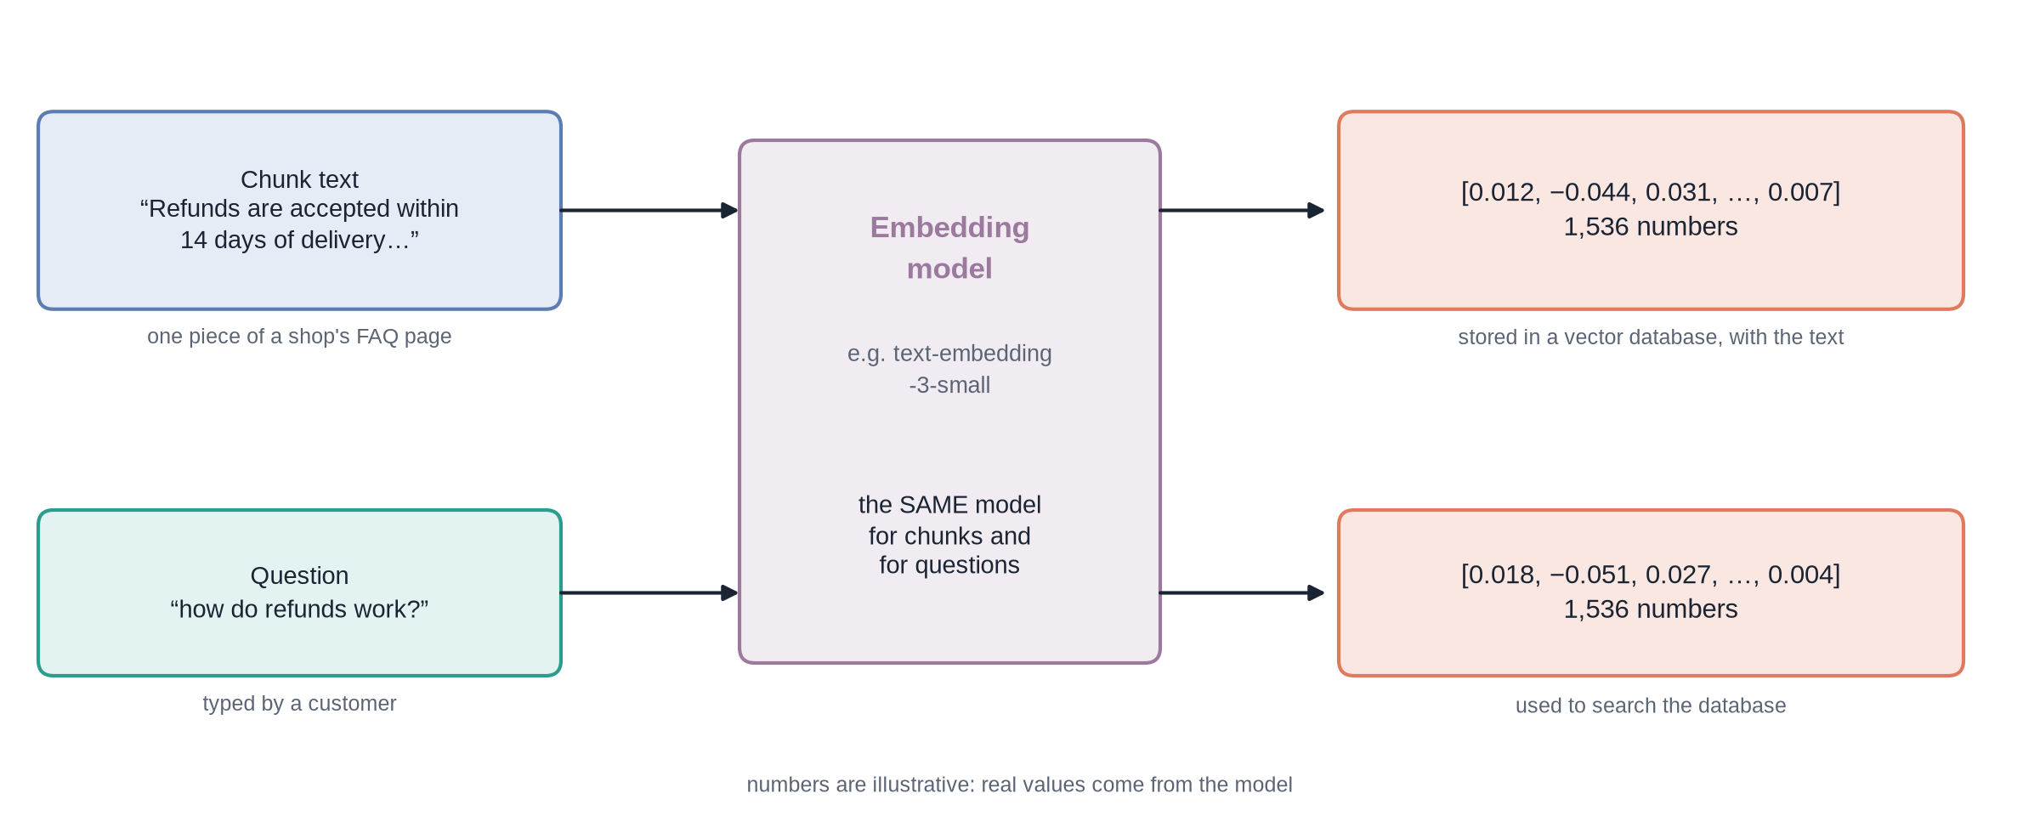
Text in, a fixed-length list of numbers out
Notes:
✏ DRAW THIS SLIDE – hand-draw it live; the slide diagram is your reference
Video 4.2. Stress the middle box: one model for both rows.
What to draw:
• Left top: chunk text 'Refunds are accepted within 14 days...'
• Left bottom: question 'how do refunds work?'
• Middle: one tall box 'Embedding model', write 'SAME model'
• Right: two lists [0.012, -0.044, ..., 0.007], each '1,536 numbers'
• Under the top list: stored in a vector database; under the bottom: used to search

Slide 10
Choosing an embedding model
Model | Dimensions | Runs where | Cost (at the time of writing)
OpenAI text-embedding-3-small | 1,536 | OpenAI API | ~$0.02 per million tokens
OpenAI text-embedding-3-large | 3,072 | OpenAI API | ~$0.13 per million tokens
all-MiniLM-L6-v2 (sentence-transformers) | 384 | Your own computer | Free, uses your CPU/GPU
Open models such as BGE or E5 | 768 – 1,024 | Own computer or a host | Free or hosting cost
Notes:
Video 4.2. Prices change: check the provider's pricing page before recording.

Slide 11
Your first embedding call
PYTHON
The key lives in the environment, never in the code
One input → one vector
usage tells you what the call cost
Open models: no API bill, smaller vectors
from openai import OpenAI
client = OpenAI() # reads OPENAI_API_KEY from env
resp = client.embeddings.create(
model="text-embedding-3-small",
input="How many days of annual leave do I get?")
vec = resp.data[0].embedding
print(len(vec)) # 1536
print(resp.usage.total_tokens) # tokens you pay for
# an open model, running on your own machine
from sentence_transformers import SentenceTransformer
model = SentenceTransformer("all-MiniLM-L6-v2")
vecs = model.encode(["text one", "text two"])
print(vecs.shape) # (2, 384)
Notes:
Video 4.2.

Slide 12
Embedding many texts: batches of 100
PYTHON
250 texts → calls of 100, 100 and 50
Sort by index: vector n must match text n
Rate limit hit? The SDK backs off and retries
Questions use the SAME function and model
from openai import OpenAI
client = OpenAI(max_retries=5) # waits, then retries
MODEL, BATCH = "text-embedding-3-small", 100
def embed_texts(texts):
vectors = []
for i in range(0, len(texts), BATCH):
batch = texts[i : i + BATCH]
resp = client.embeddings.create(
model=MODEL, input=batch)
ordered = sorted(resp.data, key=lambda d: d.index)
vectors.extend(d.embedding for d in ordered)
return vectors
def embed_query(question):
return embed_texts([question])[0]
Notes:
Video 4.2.

Slide 13
What embedding costs: a 300-chunk handbook
3
120K
$0.0024
API calls at 100 chunks per call
tokens: 300 chunks × 400 tokens
with -small at ~$0.02 per million tokens (-large: ~$0.016)
Notes:
Video 4.2. Prices change: re-check OpenAI's pricing page on the recording day.

Slide 14
Four rules for embeddings
1
2
3
4
Same model both sides
Re-embed on change
Dimensions must match
Keep the text
Stored texts and questions must use the same model, or their positions cannot be compared.
Switching models means embedding every stored text again.
An index built for 1,536 numbers cannot store a 3,072-number vector.
A vector cannot be turned back into words. Store the text next to it.
Notes:
Video 4.2.

Slide 15
Recap – Video 4.2
An embedding model turns any text into a fixed-length vector
Pick a model on quality, dimensions, cost and where it runs
Send texts in batches (e.g. 100 per call) and keep them in input order
Same model for texts and questions; change the model → re-embed everything
PRACTICE TASK
A help centre has 250 articles, each cut into 2 chunks of about 400 tokens. At 100 chunks per call, how many API calls do you make? How many tokens, and what does it cost at $0.02 per million?
Notes:
Video 4.2.

Slide 16
Measuring similarity
VIDEO 4.3 · 12 MIN
Notes:
SEGMENTS: Slides + Handwriting board
Video 4.3.

Slide 17
Three ways to compare two vectors
Measure | How to compute it | Similar vectors give
Dot product | Multiply matching numbers, add them up | A large positive number
Cosine similarity | Dot product ÷ (length of a × length of b) | Close to 1
Euclidean distance | Straight-line distance between the two points | Close to 0
Notes:
Video 4.3.

Slide 18
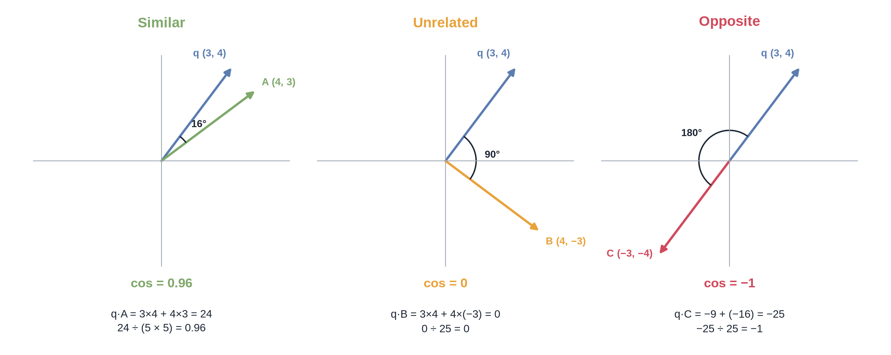
Cosine similarity is the angle
Notes:
✏ DRAW THIS SLIDE – hand-draw it live; the slide diagram is your reference
Video 4.3. Work the first panel fully on the board; the other two follow the same steps.
What to draw:
• Three small axes side by side: Similar, Unrelated, Opposite
• In each, the question arrow q = (3, 4)
• Similar: A = (4, 3), angle 16°, dot 24, lengths 5 and 5, cos 0.96
• Unrelated: B = (4, -3), angle 90°, dot 0, cos 0
• Opposite: C = (-3, -4), angle 180°, dot -25, cos -1

Slide 19
The worked example in one table
Pair | Dot product | Lengths | Cosine | Euclidean distance
q (3, 4) and A (4, 3) | 12 + 12 = 24 | 5 and 5 | 0.96 | √2 ≈ 1.41
q (3, 4) and B (4, −3) | 12 − 12 = 0 | 5 and 5 | 0 | √50 ≈ 7.07
q (3, 4) and C (−3, −4) | −9 − 16 = −25 | 5 and 5 | −1 | √100 = 10
Notes:
Video 4.3.

Slide 20
Cosine similarity in Python
PYTHON · numpy
@ is the dot product; norm is the length
Length 1 → cosine = dot product
All three measures then rank alike
A vector database does this for you, fast (Module 5)
import numpy as np
def cosine(a, b):
a, b = np.array(a), np.array(b)
return a @ b / (np.linalg.norm(a) * np.linalg.norm(b))
q = [3, 4]
print(cosine(q, [4, 3])) # 0.96
print(cosine(q, [4, -3])) # 0.0
print(cosine(q, [-3, -4])) # -1.0
# real vectors from OpenAI already have length 1,
# so a plain dot product IS the cosine:
scores = np.array(text_vecs) @ np.array(q_vec)
top5 = np.argsort(-scores)[:5] # 5 closest texts
Notes:
Video 4.3.

Slide 21
How apps show similarity scores
Raw score: 0.87, often rounded to 2–4 decimals
As a percentage: score × 100 → “87% match”
As a bar, stars or High / Medium / Low label
Hidden: only the top few results are shown
Threshold: below a cut-off you chose by testing → “I could not find this”
Notes:
Video 4.3.

Slide 22
What “87% match” means
It means
It does NOT mean
Cosine similarity 0.87, shown × 100
This text is closer to the question than the others
Useful for ranking and for spotting weak matches
Compare scores within one question
87% chance the answer is right
87% of the question is answered
A fixed pass mark: 0.5 is not always bad
Comparable across models or questions
Notes:
Video 4.3.

Slide 23
Recap – Video 4.3
Dot product: multiply and add; length: √(sum of squares)
Cosine = dot ÷ (length × length) = the angle: 1 same, 0 unrelated, −1 opposite
OpenAI vectors have length 1, so cosine and dot product rank the same
“% match” is a similarity score for ranking, not a probability
PRACTICE TASK
Compute the cosine similarity of q = (1, 2) with D = (2, 1) and with E = (2, 4). Which is more similar? (Answers: 0.8 and 1.0: E points in exactly the same direction.)
Notes:
Video 4.3.

