Slide 1
Vector databases
MODULE 5 · VECTOR DATABASES
Why they exist, indexes and records, searching and housekeeping
Notes:
Deck title.

Slide 2
Why a vector database
VIDEO 5.1 · 10 MIN
Notes:
SEGMENTS: Slides + Handwriting board
Video 5.1.

Slide 3
The job: find the closest chunks, fast
Every question becomes a vector, e.g. 1,536 numbers (Module 4)
We need the few stored chunk vectors closest to it, say the top 5
Simplest way: compare the question with every chunk (brute force)
1,000 chunks: instant. 10 million chunks: far too slow per question
A vector database makes this search fast, and keeps the data around it
Notes:
Video 5.1.

Slide 4
Why brute force does not scale
1,536
10 M
15 billion
multiplications to compare the question with one chunk
chunks in a large company's document collection
multiplications for one question, by brute force
Notes:
Video 5.1. 1,536 × 10,000,000 = 15.36 billion.

Slide 5
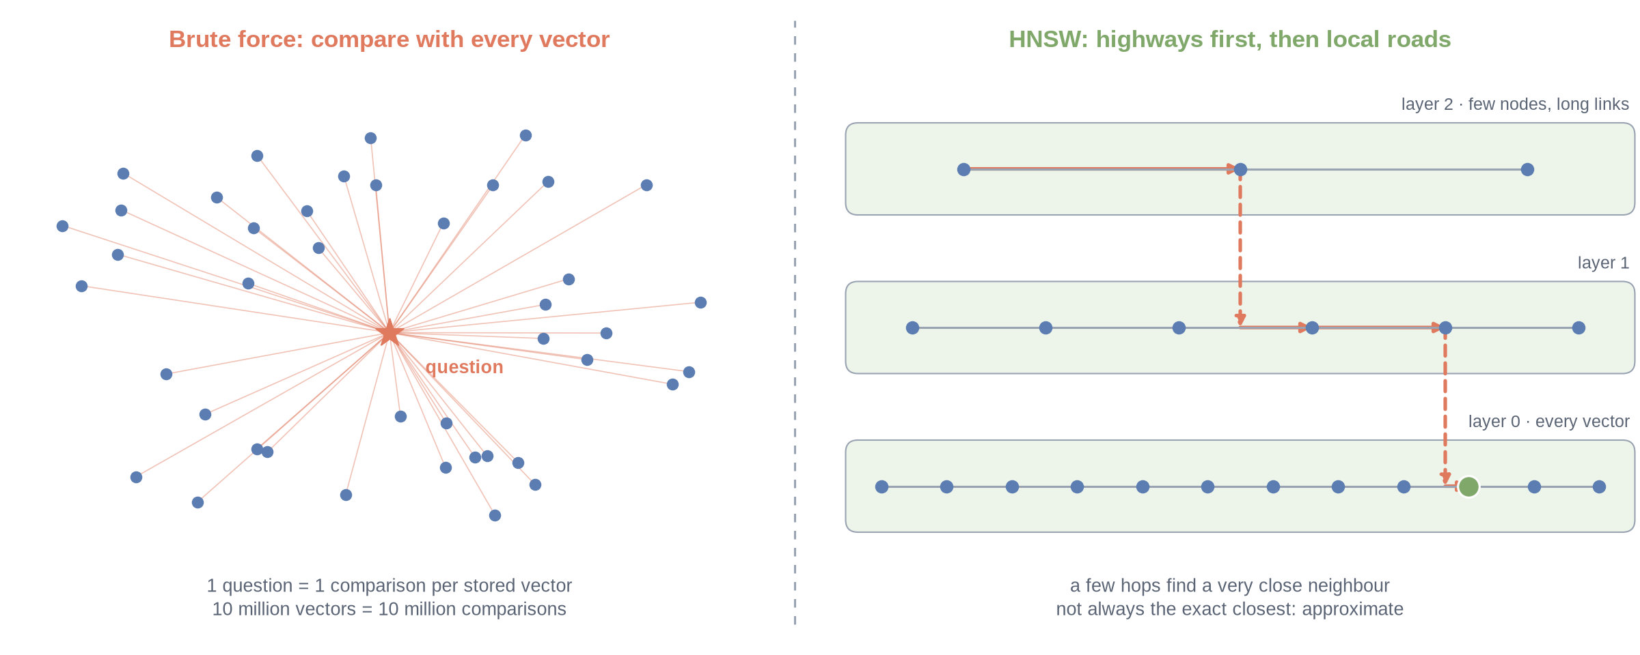
Exact search vs approximate search
Notes:
✏ DRAW THIS SLIDE – hand-draw it live; the slide diagram is your reference
Video 5.1.
What to draw:
• Left: a star (question) with lines to every dot: brute force, one comparison per vector
• Right: three stacked layers, few dots on top, every dot at the bottom
• Path: hop along the top layer, drop down, hop, drop down, land next to the answer
• Write: approximate = very close, much faster, not always the exact closest

Slide 6
What a vector database adds
1
2
3
4
ANN index
Storage + metadata
Filtering
Updates
Approximate nearest-neighbour search: a few hops instead of millions of comparisons.
Keeps the text, document name and page next to each vector.
Search only inside one document, one department or one customer.
Add, overwrite and delete records without rebuilding everything.
Notes:
Video 5.1.

Slide 7
Vector search options you will hear about
Option | What it is | A good fit when
Pinecone | Managed cloud vector database (serverless) | You do not want to run servers
pgvector | Vector search extension for PostgreSQL | Your data already lives in Postgres
Chroma | Lightweight open-source store, runs locally | Prototypes and notebooks
FAISS | Search library from Meta, not a full database | Fast search inside your own program
Weaviate, Qdrant | Open-source vector databases, self-host or cloud | You want open source and control
Notes:
Video 5.1.

Slide 8
Recap – Video 5.1
Brute force compares the question with every vector: exact but slow at scale
ANN indexes such as HNSW (graph) and IVF (clusters) trade a tiny bit of accuracy for speed
A vector database = ANN index + storage + metadata + filters + updates
Pinecone, pgvector, Chroma, FAISS, Weaviate, Qdrant: same ideas, different code
TRY THIS
A college has 2,000 PDFs of 50 pages each, about 4 chunks per page. Estimate the number of chunk vectors and the multiplications for one brute-force search (1,536 dimensions).
Notes:
Video 5.1.

Slide 9
Indexes and records
VIDEO 5.2 · 10 MIN
Notes:
SEGMENTS: Slides + Handwriting board + Screen recording
Video 5.2.

Slide 10
Creating an index (Pinecone)
PYTHON · PINECONE SDK
API key from the environment, never in code
Create only if missing, then connect
Every later call goes through index
import os
from pinecone import Pinecone, ServerlessSpec
pc = Pinecone(api_key=os.environ["PINECONE_API_KEY"])
INDEX = "help-desk"
if INDEX not in pc.list_indexes().names():
pc.create_index(
name=INDEX,
dimension=1536, # = embedding size
metric="cosine",
spec=ServerlessSpec(cloud="aws", region="us-east-1"),
)
index = pc.Index(INDEX)
Notes:
Video 5.2.

Slide 11
Four settings fixed at creation
The settings
Why they matter
name: help-desk
dimension: 1536
metric: cosine
serverless: aws, us-east-1
Dimension must equal the embedding size
Cosine suits OpenAI embeddings
Changing them means a new index
Serverless: pay for use, no servers to size
Notes:
Video 5.2.

Slide 12
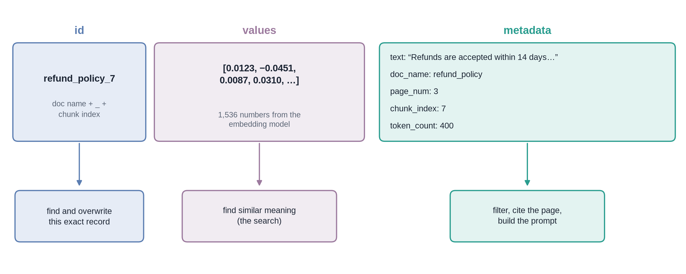
Anatomy of one record
Notes:
✏ DRAW THIS SLIDE – hand-draw it live; the slide diagram is your reference
Video 5.2.
What to draw:
• Three boxes side by side: id | values | metadata
• id: refund_policy_7 = doc name + _ + chunk index
• values: [0.0123, −0.0451, …] = 1,536 numbers
• metadata: text, doc_name, page_num, chunk_index, token_count
• Arrows down: id → overwrite, values → search, metadata → filter, cite, prompt

Slide 13
Saving chunks: upsert in batches
PYTHON · PINECONE SDK
Upsert = insert, or overwrite if the id exists
100 records per request
The text travels with the vector
records = []
for chunk, vec in zip(chunks, vectors):
records.append({
"id": f"{chunk['doc_name']}_{chunk['chunk_index']}",
"values": vec, # 1,536 floats
"metadata": {"text": chunk["text"],
"doc_name": chunk["doc_name"],
"page_num": chunk["page_num"]},
})
BATCH = 100
for i in range(0, len(records), BATCH):
index.upsert(vectors=records[i : i + BATCH])
Notes:
Video 5.2.

Slide 14
The re-ingest trap
1
2
3
4
First ingest
Re-ingest
Stale vectors
The fix
Chunk size 400 gives 30 chunks: ids refund_policy_0 to refund_policy_29.
Chunk size 800 gives 15 chunks. Upsert overwrites ids _0 to _14 only.
Ids _15 to _29 still hold the old text. Search can return them.
Delete all of the document's records first, then ingest it again.
Notes:
Video 5.2.

Slide 15
Recap – Video 5.2
An index has a name, a dimension, a metric and a cloud region
Dimension must match the embedding model, e.g. 1536 for text-embedding-3-small
A record = id + values + metadata; the text lives in the metadata
Upsert overwrites by id, so delete before re-ingesting with new settings
PRACTICE TASK
A PDF ingested with chunk size 400 made 48 chunks. You re-ingest it with chunk size 600 and get 32. Which ids are stale, and what would you do?
Notes:
Video 5.2.

Slide 16
Querying, filters and housekeeping
VIDEO 5.3 · 10 MIN
Notes:
SEGMENTS: Slides + Handwriting board + Screen recording
Video 5.3.

Slide 17
Searching: query the index
PYTHON · PINECONE SDK
top_k: how many matches to return
include_metadata: bring back the text
filter: optional condition on metadata
q_vec = embed("What is the refund window?") # same model!
res = index.query(
vector=q_vec,
top_k=5,
include_metadata=True,
filter={"doc_name": {"$eq": "refund_policy"}}, # optional
)
for m in res.matches:
print(m.id, round(m.score, 4), m.metadata["page_num"])
context = m.metadata["text"]
Notes:
Video 5.3.

Slide 18
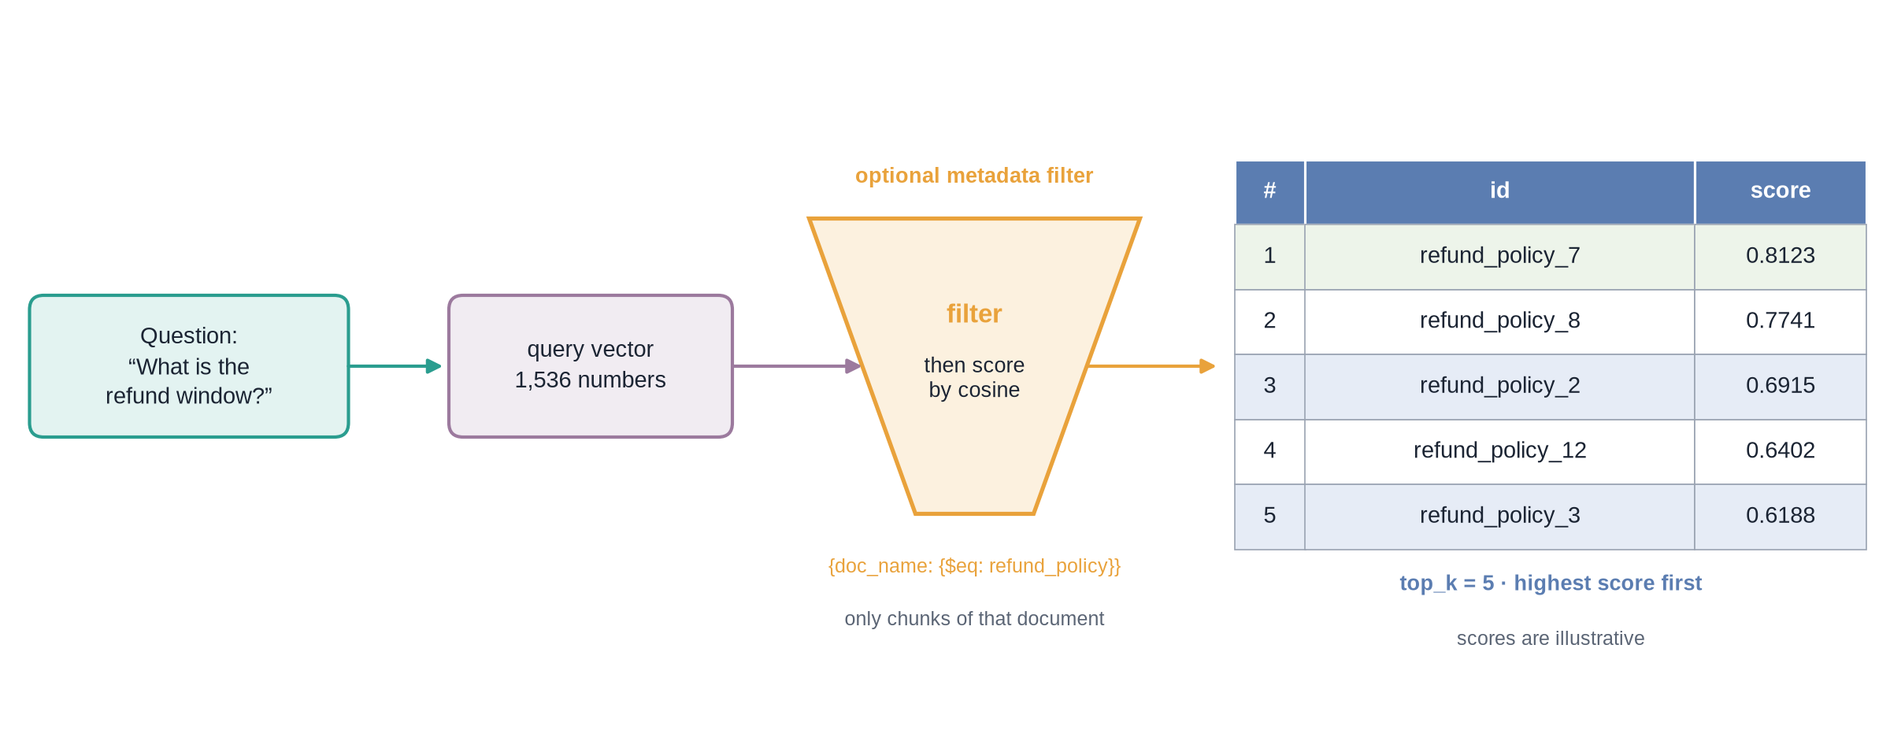
One search, step by step
Notes:
✏ DRAW THIS SLIDE – hand-draw it live; the slide diagram is your reference
Video 5.3.
What to draw:
• Question → query vector (1,536 numbers)
• Funnel: optional filter doc_name $eq refund_policy
• Inside the funnel: score candidates by cosine
• Table: top 5 ids with scores, highest first

Slide 19
What to keep from each match
Field | Comes from | Used for
id | match.id | Unique key of the chunk
score | match.score | Ranking; often shown as “% match”
text | metadata | Goes into the prompt; preview for the user
doc_name | metadata | Citation: which document
page_num | metadata | Citation: which page
chunk_index | metadata | Position inside the document
Notes:
Video 5.3. A cosine score is a similarity, not a probability: 0.81 does not mean 81% correct.

Slide 20
Housekeeping: delete and stats
PYTHON · PINECONE SDK
Delete is how you fix stale vectors
Stats: how many vectors, what dimension
Check delete-by-filter support for your index type
# remove every chunk of one document
index.delete(filter={"doc_name": {"$eq": "refund_policy"}})
# or, by id (works on every index type)
index.delete(ids=["refund_policy_0", "refund_policy_1"])
stats = index.describe_index_stats()
print(stats.total_vector_count, stats.dimension)
# keep tenants apart: one namespace each
index.upsert(vectors=batch, namespace="college_a")
Notes:
Video 5.3.

Slide 21
Listing what is stored: do not fake it
The tempting shortcut
Better options
Query with an all-zero dummy vector
top_k = 100: sees at most 100 chunks
One big PDF can fill all 100
Other documents vanish from the list
Keep a document registry (small table)
Update it on ingest and on delete
Or list record ids by prefix
Or one namespace per tenant
Notes:
Video 5.3.

Slide 22
Namespaces: rooms inside one index
A namespace is a separate partition inside the same index
A query searches one namespace only
Typical use: one namespace per customer (tenant) or per department
Delete a whole namespace in one call
Small apps: one default namespace + a metadata filter is enough
Notes:
Video 5.3.

Slide 23
Recap – Video 5.3
query = vector + top_k + include_metadata (+ optional filter)
Scores rank matches; a score is similarity, not probability
Metadata filters and namespaces narrow the search
To list contents, keep a registry or list ids; never a dummy-vector query
PRACTICE TASK
Write the filter dictionary that limits a search to the document “hr_handbook”. Then explain why a dummy-vector query with top_k = 100 might not list all 300 uploaded PDFs.
Notes:
Video 5.3.

