Slide 1
Document ingestion and chunking
MODULE 6 · INGESTION & CHUNKING
From PDF pages to token chunks with page numbers
Notes:
Deck title.

Slide 2
Getting text out of PDFs
VIDEO 6.1 · 9 MIN
Notes:
SEGMENTS: Slides + Handwriting board
Video 6.1.

Slide 3
Ingestion: four steps, once per document
1
2
3
4
Extract
Clean
Chunk
Embed + store
Pull the text out of the file, page by page, and keep the page numbers.
Fix what extraction breaks: line breaks, extra spaces, split words.
Cut the text into small, overlapping pieces of a fixed size.
Turn each chunk into a vector; save it with its text and page.
Notes:
Video 6.1.

Slide 4
What a PDF really stores
What you see
What the file stores
Headings and paragraphs
Tables with rows and columns
Two columns of text
Page numbers, headers, footers
Characters drawn at x, y positions
Fonts and sizes
No “paragraph” or “table” object
Sometimes only a photo of the text
Notes:
Video 6.1.

Slide 5
Step 1: read every page with pypdf
PYTHON
Pages are numbered from 1, like a human reads them
Result: a list of (page number, text) pairs
Blank pages are dropped, page numbers are kept
No text at all? Fail loudly, do not store nothing
from pypdf import PdfReader
def read_pdf_pages(path):
reader = PdfReader(path)
pages = []
for num, page in enumerate(reader.pages, start=1):
text = clean_text(page.extract_text() or "")
if text: # skip blank pages
pages.append((num, text))
if not pages:
raise ValueError(f"No extractable text in {path}")
return pages
Notes:
Video 6.1.

Slide 6
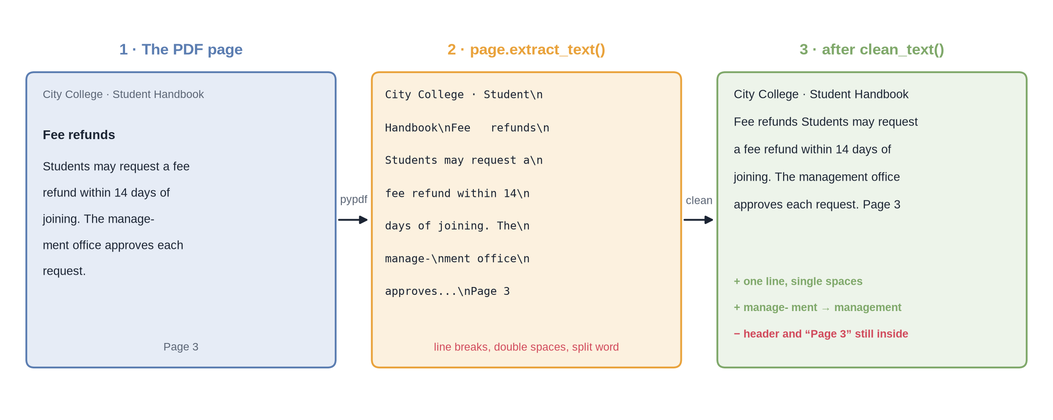
From PDF page to clean text
Notes:
✏ DRAW THIS SLIDE – hand-draw it live; the slide diagram is your reference
Video 6.1.
What to draw:
• Three panels: the PDF page, extract_text(), after clean_text()
• Page: header City College · Student Handbook, heading Fee refunds, body with “manage-” / “ment” split over a line, footer Page 3
• Raw text: \n after every line, double spaces, the split word
• Clean text: one line, single spaces, “management” joined
• Red note: header and Page 3 are still inside the text

Slide 7
clean_text: three rules
PYTHON
“manage- ment” → “management”
Side effect: “self- service” → “selfservice”
Rule 3 only works because rule 1 ran first
import re
def clean_text(text):
# 1. any run of spaces/newlines -> one space
text = re.sub(r"\s+", " ", text)
# 2. remove invisible control characters
text = re.sub(r"[\x00-\x08\x0b\x0c\x0e-\x1f]", "", text)
# 3. join words split at a line end
text = re.sub(r"(\w)-\s+(\w)", r"\1\2", text)
return text.strip()
Notes:
Video 6.1.

Slide 8
When extraction goes wrong
Problem | What you get | Usual fix
Scanned PDF | No text layer: extract_text() returns nothing | OCR before ingestion
Tables | Cells run into one line; which number is whose? | Table-aware extraction
Two columns | Lines from both columns mixed together | Layout-aware extraction
Headers, footers | Same title and page number on every page | Detect and drop repeated lines
Notes:
Video 6.1.

Slide 9
Recap – Video 6.1
Ingestion = extract, clean, chunk, embed + store; once per document
A PDF stores positioned characters, not paragraphs
pypdf extract_text() gives one string per page; number pages from 1
clean_text: single spaces, no control characters, joined hyphen-splits
Scanned pages, tables, columns and headers need extra care
TRY THIS
Open any PDF from your own files. Copy one page into a text editor. Find one table, one split word or one repeated header in the pasted text.
Notes:
Video 6.1.

Slide 10
Chunking with tokens and overlap
VIDEO 6.2 · 12 MIN
Notes:
SEGMENTS: Slides + Handwriting board
Video 6.2.

Slide 11
Why cut documents into chunks?
1
2
3
Input limits
Precise retrieval
Prompt cost
An embedding model accepts a limited input: 8,191 tokens for text-embedding-3-small at the time of writing. A long PDF does not fit.
One vector for a whole PDF is a blur. One vector per passage can point at the exact rule.
We send only the best few passages to the LLM, not every page. Fewer tokens: cheaper and faster.
Notes:
Video 6.2.

Slide 12
Flatten the pages, remember the pages
PYTHON
All pages become one long list of tokens
page_of has one entry per token: its page
Page 1 with 300 tokens → three hundred 1s
The guard stops a loop that never moves
import tiktoken
enc = tiktoken.get_encoding("cl100k_base")
def chunk_pages(pages, size=400, overlap=50):
if not 0 <= overlap < size:
raise ValueError("overlap must be smaller than size")
tokens, page_of = [], []
for page_num, text in pages:
ids = enc.encode(text)
tokens.extend(ids)
page_of.extend([page_num] * len(ids))
...
Notes:
Video 6.2.

Slide 13
The sliding window
PYTHON
Take 400 tokens, turn them back into text
Cite the page of the FIRST token
Move forward 400 − 50 = 350 tokens
The last slice may be shorter
chunks, start = [], 0
while start < len(tokens):
piece = tokens[start:start + size]
chunks.append({
"text": enc.decode(piece),
"page": page_of[start], # first token
"index": len(chunks),
"token_count": len(piece),
})
start += size - overlap # 400 - 50 = 350
return chunks
Notes:
Video 6.2.

Slide 14
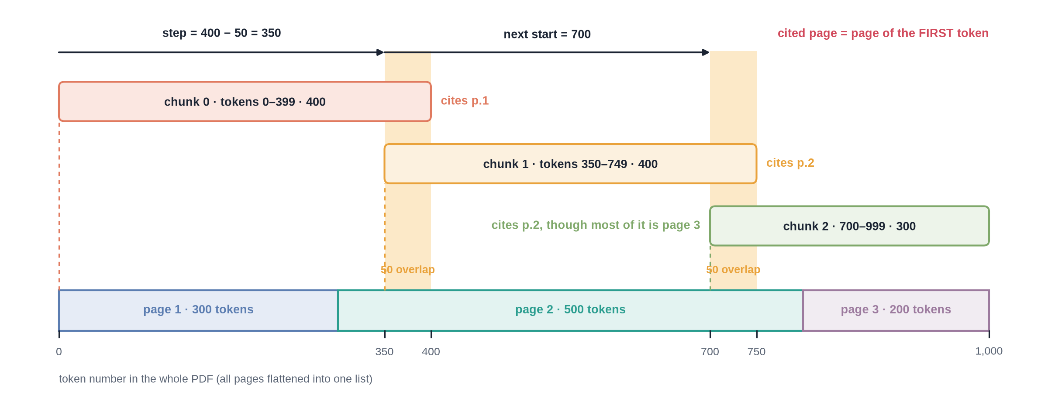
400-token windows over a 3-page PDF
Notes:
✏ DRAW THIS SLIDE – hand-draw it live; the slide diagram is your reference
Video 6.2.
What to draw:
• A strip of 1,000 tokens: page 1 = 0–299, page 2 = 300–799, page 3 = 800–999
• Chunk 0: tokens 0–399, cites p.1
• Chunk 1: starts at 350, tokens 350–749, cites p.2
• Chunk 2: starts at 700, tokens 700–999, only 300 tokens, cites p.2
• Shade the two 50-token overlaps; write step = 400 − 50 = 350
• Write in red: cited page = page of the FIRST token

Slide 15
Worked example: 1,000 tokens, size 400, overlap 50
Chunk | Start | Tokens | Count | Pages inside | Cited page
0 | 0 | 0–399 | 400 | 1 and 2 | p.1
1 | 350 | 350–749 | 400 | 2 | p.2
2 | 700 | 700–999 | 300 | 2 and 3 | p.2
– | 1,050 | stop: 1,050 ≥ 1,000
Notes:
Video 6.2.

Slide 16
One chunk, ready for the vector database
PYTHON
The text travels with the vector, so the answer can quote it
source + page become the citation
source also lets you filter or delete one document
record = {
"id": f"{doc_id}-{chunk['index']}", # "handbook-2"
"values": vector, # 1,536 floats
"metadata": {
"text": chunk["text"],
"source": doc_id,
"page": chunk["page"],
"chunk_index": chunk["index"],
"token_count": chunk["token_count"],
},
}
index.upsert(vectors=[record])
Notes:
Video 6.2.

Slide 17
Other chunking strategies
Strategy | How it splits | Good for
Fixed tokens | Every N tokens, with overlap | A simple, predictable baseline
Fixed characters | Every N characters | Quick scripts; sizes vary in tokens
Recursive | Paragraphs, then sentences, then words | Keeping sentences whole
By structure | Headings, sections, clauses | Policies, manuals, contracts
Semantic | Where the topic changes (embeddings) | Long, mixed documents
Small-to-big | Search small chunks, send the bigger parent | Precise search, full context
Notes:
Video 6.2.

Slide 18
Recap – Video 6.2
Chunk because of input limits, precise retrieval and prompt cost
Flatten pages into one token list plus a token → page map
Window of 400 tokens, step 400 − 50 = 350
Each chunk cites the page of its first token
Smarter splits exist: recursive, by structure, semantic, small-to-big
PRACTICE TASK
A PDF has 1,500 tokens. With size 400 and overlap 50, write down where each chunk starts and how many tokens it holds. Careful with the last ones: apply the loop exactly.
Notes:
Video 6.2.

Slide 19
Choosing chunk size, overlap and top-k
VIDEO 6.3 · 9 MIN
Notes:
SEGMENTS: Slides + Handwriting board
Video 6.3.

Slide 20
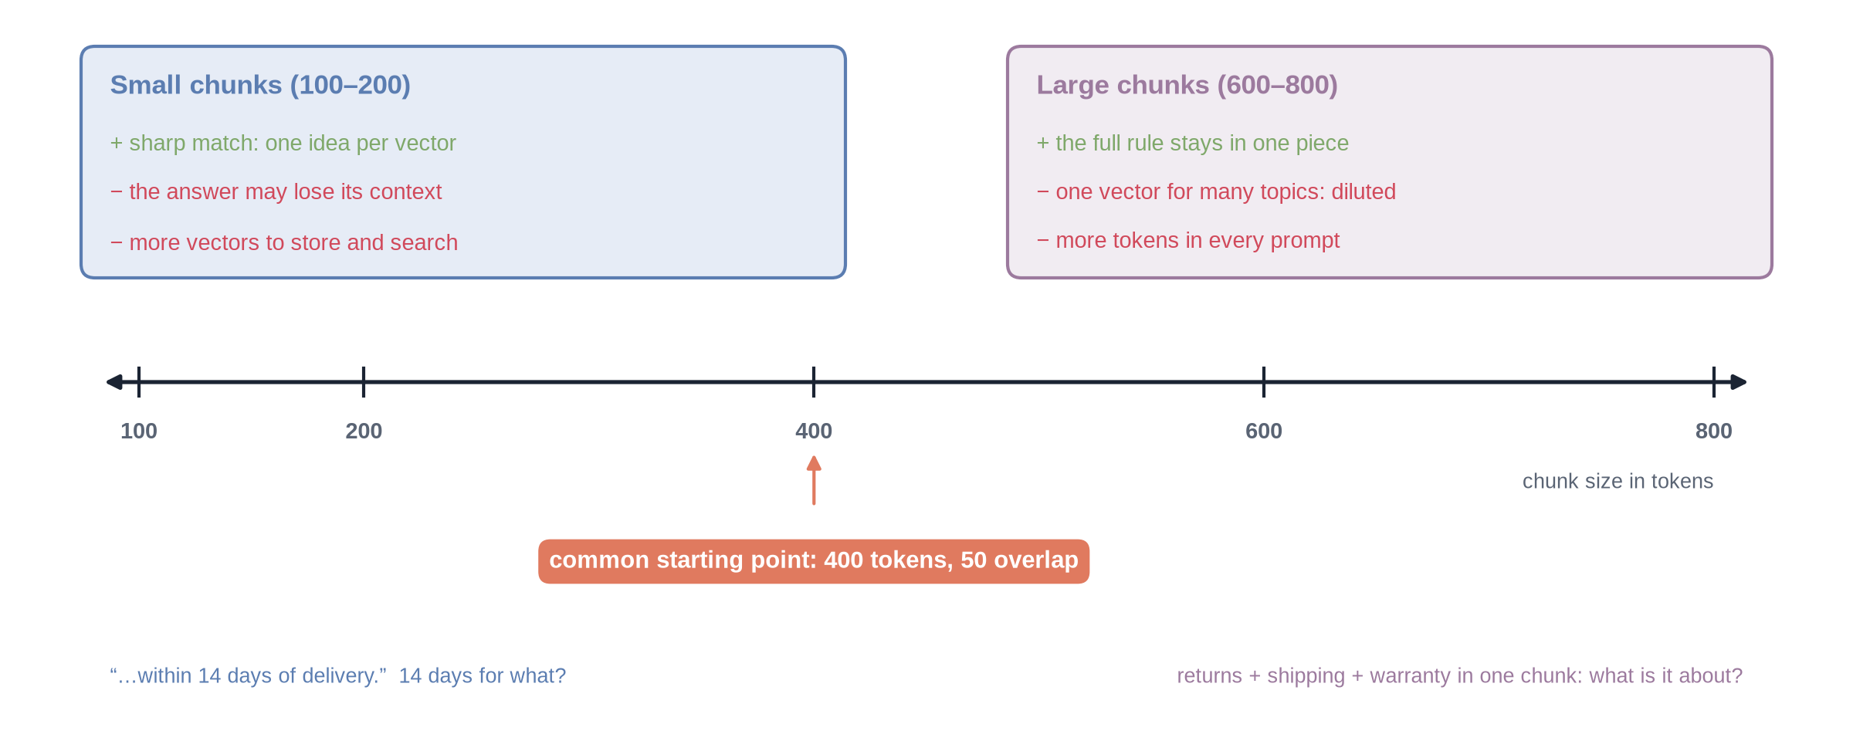
The chunk-size trade-off
Notes:
✏ DRAW THIS SLIDE – hand-draw it live; the slide diagram is your reference
Video 6.3.
What to draw:
• An axis of chunk size: 100, 200, 400, 600, 800 tokens
• Left box, small chunks: + sharp match; − loses context; − more vectors
• Right box, large chunks: + full rule in one piece; − diluted meaning; − more prompt tokens
• Arrow at 400: a common starting point, 400 / 50
• Examples: “within 14 days” (for what?) vs returns + shipping + warranty in one chunk

Slide 21
Context sent with every question
400
× 5
2,000
tokens per chunk
chunks retrieved (top-k)
tokens of context in every prompt
Notes:
Video 6.3.

Slide 22
When each setting takes effect
Setting | Typical range | Example | Takes effect
Chunk size | 200–800 tokens | 400 | At ingestion: re-ingest to change
Chunk overlap | 10–20% of size | 50 | At ingestion: re-ingest to change
Top-k | 3–8 chunks | 5 | At query time: the very next question
Embedding model | one per index | same for both | At ingestion: re-embed everything
Notes:
Video 6.3.

Slide 23
Two gotchas
1
2
Remove old chunks first
Overlap < chunk size
Ids are document + chunk number. Re-ingest with fewer chunks and the old high numbers stay behind. Delete by source, then ingest again.
The step is size − overlap. Size 100 with overlap 100 gives a step of 0: the loop never moves forward.
Notes:
Video 6.3.

Slide 24
Choosing settings like an engineer
Write 10–20 real questions you know the answers to
Ingest with one setting; ask every question; look at the retrieved chunks
Count: was the right passage in the top-k?
Change one setting, re-ingest, count again
Keep the setting that finds the right passage most often
Notes:
Video 6.3.

Slide 25
Recap – Video 6.3
Small chunks: precise but lose context; large: context but diluted
Overlap protects boundaries; it costs about 14% more vectors at 400/50
Context per question ≈ top-k × chunk size (5 × 400 = 2,000)
Size and overlap need re-ingesting (delete old chunks first); top-k does not
Choose with real test questions, not by guessing
PRACTICE TASK
Pick one PDF and five questions. Chunk it at size 200 and at size 800, retrieve top-5 for each question, and note whether the right passage appears.
Notes:
Video 6.3.

