Slide 1
Retrieval-Augmented Generation
MODULE 7 · RAG
Why RAG, the pipeline step by step, and how RAG fails
Notes:
Deck title.

Slide 2
Why RAG? RAG vs fine-tuning vs long context
VIDEO 7.1 · 10 MIN
Notes:
SEGMENTS: Slides + Handwriting board
Video 7.1.

Slide 3
Three ways to give a model your knowledge
1
2
3
RAG
Fine-tuning
Long context
Change the prompt. Find the few passages that matter and add them to every question.
Change the model. Train it further on your examples so the weights themselves change.
Change the prompt size. Paste the whole document into the prompt, every single time.
Notes:
Video 7.1.

Slide 4
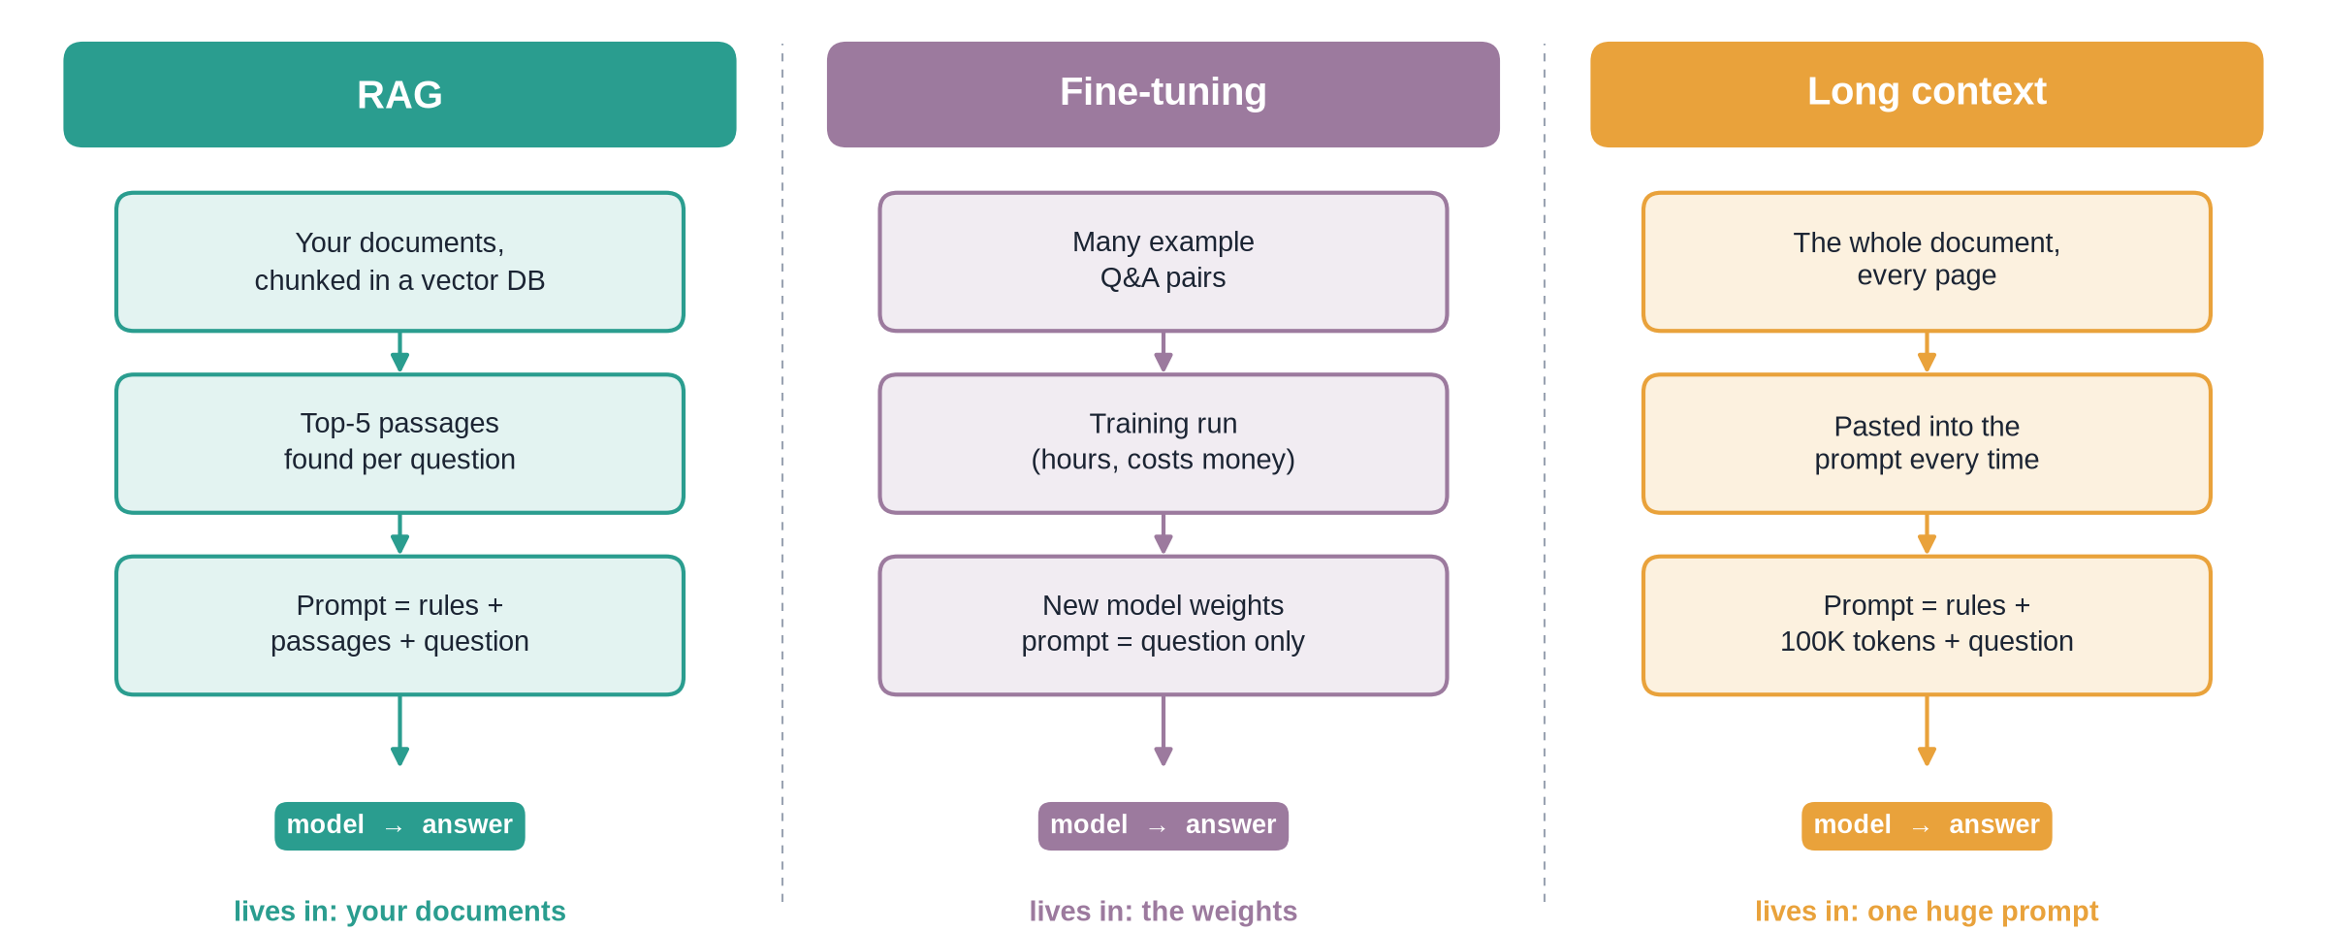
Where the knowledge lives
Notes:
✏ DRAW THIS SLIDE – hand-draw it live; the slide diagram is your reference
Video 7.1.
What to draw:
• Three columns: RAG, Fine-tuning, Long context
• RAG: documents chunked in a vector DB → top-5 passages → prompt = rules + passages + question → model
• Fine-tuning: example Q&A pairs → training run → new weights; prompt = question only
• Long context: whole document → pasted every time → prompt with ~100K tokens → model
• Bottom of each column: lives in documents / weights / one huge prompt

Slide 5
Fine-tuning: good at, bad at
Good at
Bad at
Style and tone: always formal, always short
Fixed output formats
Domain wording and behaviour
Shorter prompts once trained
Facts that change: retrain every update
No citations: no page to check
Needs many good examples
Hard to remove one wrong fact
Notes:
Video 7.1.

Slide 6
Why not paste the whole document?
128K
~2,000
~50×
tokens in the context window of a small model like gpt-4o-mini (at the time of writing)
tokens of context per question with RAG (5 chunks × 400)
more input tokens to paste a 200-page manual (~100K tokens)
Notes:
Video 7.1. ~500 tokens per dense page is a rough rule of thumb; real documents vary. Context window sizes change with every model release: check the provider's current documentation.

Slide 7
RAG vs fine-tuning vs long context
 | RAG | Fine-tuning | Long context
Knowledge lives in | Your documents | Model weights | The prompt
Update a fact | Re-ingest one document | Retrain | Paste the new version
Citations | Yes: source + page | No | Possible, less reliable
Cost per question | Low: few chunks | Low | High: whole document
Setup effort | Medium: pipeline | High: data + training | Low
Access control | Filter by metadata | Everyone sees all | Per request
Notes:
Video 7.1.

Slide 8
Not either-or: combining them
Most company assistants start with RAG: facts stay in documents
Add fine-tuning later for tone or a strict format, not for facts
Long context helps when one document must be read whole: a contract review
Bigger windows let RAG send more chunks, not zero chunks
A sensible first version: pure RAG, top-k = 5
Notes:
Video 7.1.

Slide 9
Recap – Video 7.1
RAG changes the prompt, fine-tuning changes the weights, long context changes the prompt size
Fine-tuning: style and format, not changing facts
Long context: costly per question; facts in the middle can be missed
RAG: fresh, cited, cheap per question
TRY THIS
Your company's leave policy changes every quarter and employees need the page to check. Write two sentences: which approach would you choose, and why not the other two?
Notes:
Video 7.1.

Slide 10
The RAG pipeline step by step
VIDEO 7.2 · 10 MIN
Notes:
SEGMENTS: Slides + Handwriting board
Video 7.2.

Slide 11
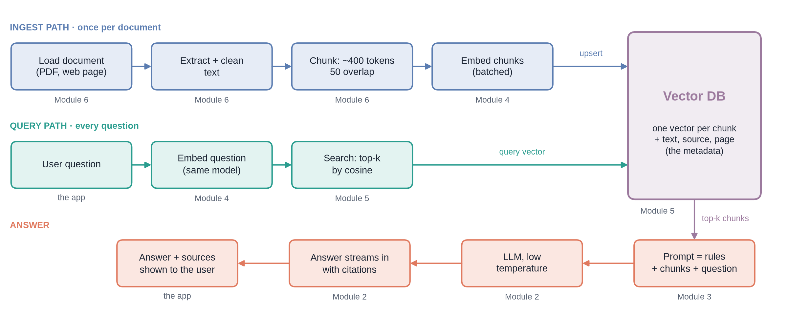
Two paths: ingest once, query every time
Notes:
✏ DRAW THIS SLIDE – hand-draw it live; the slide diagram is your reference
Video 7.2.
What to draw:
• Top row (blue), INGEST: load document → extract + clean → chunk 400 / 50 → embed (batched) → upsert into the vector DB
• Middle row (teal), QUERY: user question → embed (same model) → search top-k by cosine
• Vector DB box on the right: one vector per chunk + text, source, page
• Bottom row (coral), right to left: prompt = rules + chunks + question → LLM → answer streams with citations → answer + sources shown
• Under each box, write the module that taught it (2, 3, 4, 5, 6)

Slide 12
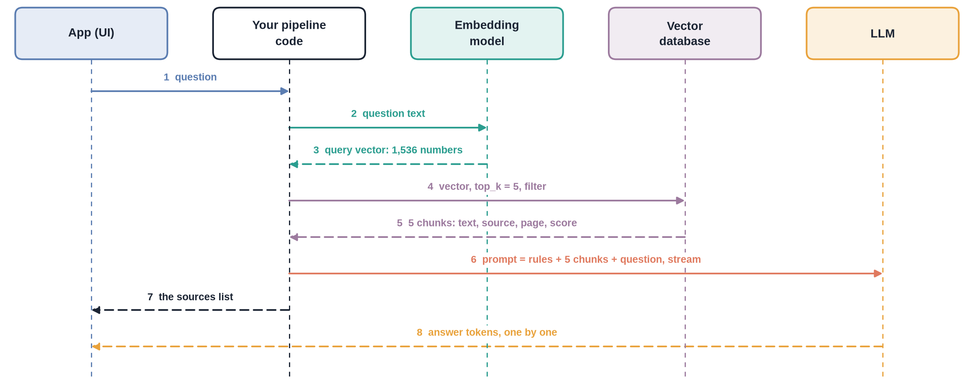
One question, step by step
Notes:
✏ DRAW THIS SLIDE – hand-draw it live; the slide diagram is your reference
Video 7.2. Draw the five lanes first, then add the arrows one at a time, in order, while you talk.
What to draw:
• Five lanes across the top: App, Your pipeline code, Embedding model, Vector database, LLM
• 1 app → pipeline: question
• 2–3 pipeline ↔ embedding model: question text, back 1,536 numbers
• 4–5 pipeline ↔ vector DB: vector + top_k + filter, back 5 chunks with text, source, page, score
• 6 pipeline → LLM: rules + chunks + question, stream on
• 7 pipeline → app: the sources list; 8 LLM → app: answer tokens one by one (dashed)

Slide 13
Pipeline sketch, part 1: ingest and retrieve
PYTHON
from openai import OpenAI
from pinecone import Pinecone
client = OpenAI() # reads OPENAI_API_KEY
index = Pinecone().Index("handbook") # reads PINECONE_API_KEY
def embed(texts): # 1,536 numbers per text
r = client.embeddings.create(model="text-embedding-3-small",
input=texts)
return [d.embedding for d in r.data]
def ingest(chunks): # once per document; chunk = {id, text, source, page}
vecs = embed([c["text"] for c in chunks]) # one batched call
index.upsert(vectors=[(c["id"], v, c) for c, v in zip(chunks, vecs)])
def retrieve(question, k=5): # every question
res = index.query(vector=embed([question])[0], top_k=k,
include_metadata=True)
return [{**m.metadata, "score": m.score} for m in res.matches]
Notes:
Video 7.2.

Slide 14
Pipeline sketch, part 2: build the prompt and generate
PYTHON · OPENAI SDK v1
RULES = ("Answer ONLY from the context passages. Cite (source, p.N). "
"If the answer is not there, say you could not find it.")
def answer(question, k=5):
chunks = retrieve(question, k)
if not chunks: # nothing found: no LLM call
return iter(["Sorry, I could not find that."]), []
context = "\n\n".join(f"[{i}] ({c['source']}, p.{c['page']})\n{c['text']}"
for i, c in enumerate(chunks, 1))
stream = client.chat.completions.create(
model="gpt-4o-mini", temperature=0.1, stream=True,
messages=[{"role": "system", "content": RULES},
{"role": "user",
"content": f"Context:\n{context}\n\nQuestion: {question}"}])
tokens = (p.choices[0].delta.content or "" for p in stream if p.choices)
return tokens, chunks
Notes:
Video 7.2.

Slide 15
What the LLM actually receives
MESSAGES
Rules in the system message
Each chunk numbered, with source and page
The model never sees the whole document: only these passages
system: Answer ONLY from the context passages.
Cite (source, p.N). If the answer is not
there, say you could not find it.
user: Context:
[1] (refund_policy, p.3)
Refunds are accepted within 14 days of delivery...
[2] (refund_policy, p.4)
Items marked final sale cannot be returned...
Question: What is the refund window?
Notes:
Video 7.2.

Slide 16
The app: stream the answer, then show the sources
PYTHON
A web app does the same: write tokens as they come
The score is cosine similarity: compare chunks, not a probability
tokens, sources = answer("What is the refund window?")
for t in tokens: # words appear as they arrive
print(t, end="", flush=True)
for i, s in enumerate(sources, 1):
print(f"\n[{i}] {s['source']} p.{s['page']}"
f" score {s['score']:.2f}")
Notes:
Video 7.2.

Slide 17
Each step: what goes in, what comes out
Step | Input | Output
Embed question | Question text | One vector, 1,536 numbers
Search | Vector, top-k, optional filter | k chunks: text, source, page, score
Build prompt | Rules + chunks + question | System and user messages
Generate | Messages, low temperature, stream | Answer tokens, one by one
Show | Tokens + sources list | Answer with citations you can check
Notes:
Video 7.2.

Slide 18
Recap – Video 7.2
Ingest path runs once per document; query path runs for every question
Query: embed → search top-k → build prompt → generate → show sources
Same embedding model for chunks and questions
The LLM sees only numbered chunks with source and page; stream the answer, keep the sources
PRACTICE TASK
Take the sketch on slides 13–14. Write down what changes if you set k = 1, and what changes with k = 10: the prompt size, the cost, and the risk of missing the answer.
Notes:
Video 7.2.

Slide 19
How RAG fails and how to debug it
VIDEO 7.3 · 10 MIN
Notes:
SEGMENTS: Slides + Handwriting board
Video 7.3.

Slide 20
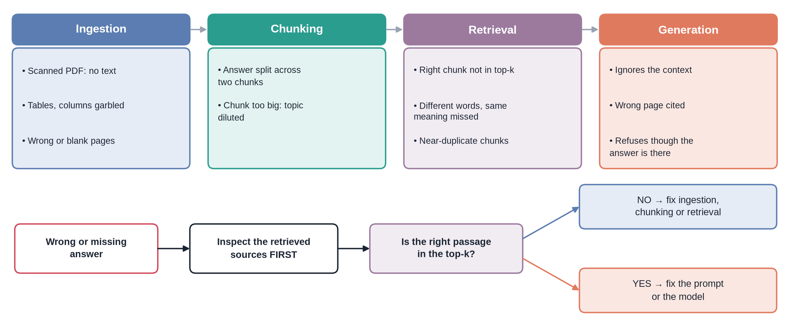
Where RAG can break
Notes:
✏ DRAW THIS SLIDE – hand-draw it live; the slide diagram is your reference
Video 7.3.
What to draw:
• Four stage boxes in a row: Ingestion → Chunking → Retrieval → Generation
• Under each, 2–3 failures (scanned PDF; answer split; right chunk not in top-k; ignores context)
• Bottom row: Wrong answer → Inspect the retrieved sources FIRST → Is the right passage in the top-k?
• NO → fix ingestion / chunking / retrieval. YES → fix prompt / model

Slide 21
Worked example: reading the retrieved sources
Rank | Source | Page | Score | Has the answer?
1 | student_handbook.pdf | 4 | 0.71 | No: leave rules
2 | student_handbook.pdf | 5 | 0.69 | No: medical leave
3 | exam_rules.pdf | 2 | 0.66 | No: exam timetable
4 | student_handbook.pdf | 12 | 0.64 | No: holidays
5 | exam_rules.pdf | 3 | 0.63 | No: hall tickets
7 (at k = 10) | student_handbook.pdf | 9 | 0.61 | Yes: “75% attendance”
Notes:
Video 7.3. Question: “What is the minimum attendance to sit the exam?” Illustrative numbers. With k = 10, page 9 appears at rank 7.

Slide 22
Symptom → likely cause → first fix
Symptom | Likely cause | First thing to try
“Couldn't find”, but it is in the document | Text not extracted, or chunk not retrieved | Check the chunk text; raise top-k
Half an answer | Answer split across chunks | More overlap or bigger chunks
Right topic, wrong detail | Similar chunks crowd out the right one | Metadata filter; re-ranking
Fact not in any source | Model added prior knowledge | Tighten the prompt; lower temperature
Wrong page cited | Chunk spans two pages | Store the page range, not only the first page
Synonyms missed | Vocabulary mismatch | Hybrid search; query rewriting
Notes:
Video 7.3.

Slide 23
Upgrades beyond a first version
1
2
3
4
Hybrid search
Re-ranking
Query rewriting
Metadata filters
Combine vector search with keyword search, so exact terms like “Form 16” are never missed.
Fetch 20 chunks, let a second model re-score them, keep the best 5.
Let an LLM rephrase or expand the question before searching.
Search only the right document, department or year, using the metadata stored with each chunk.
Notes:
Video 7.3.

Slide 24
Measure it: the four RAGAS metrics
1
2
3
4
Faithfulness
Answer relevancy
Context precision
Context recall
Is every claim in the answer supported by the retrieved context?
Does the answer actually address the question?
Are the useful chunks ranked near the top?
Did retrieval fetch everything needed for the reference answer?
Notes:
Video 7.3.

Slide 25
Recap – Video 7.3
Failures happen at four stages: ingest, chunk, retrieve, generate
Always inspect the retrieved sources first
Right passage missing → fix retrieval side; present → fix prompt / model
Measure with faithfulness, relevancy, context precision and recall
PRACTICE TASK
Write five questions about a document you know well, such as your college handbook. For each wrong answer from a RAG app, look at the retrieved sources and name the stage that failed.
Notes:
Video 7.3.

