Slide 1
Running GenAI in the real world
MODULE 8 · PRODUCTION
Observability, and then we start the project
Notes:
Deck title.

Slide 2
Running GenAI in the real world
VIDEO 8.1 · 10 MIN
Notes:
SEGMENTS: Slides + Handwriting board
Video 8.1.

Slide 3
A demo is not a product
A demo
A product
One person, a few questions
You watch every answer
Costs a few paise
If it breaks, you just try again
Hundreds of users, all day
Nobody watches each answer
A real monthly bill
Things go wrong quietly
Notes:
Video 8.1.

Slide 4
Observability: three things you record
1
2
3
Logs
Metrics
Traces
A diary of what happened: question received, chunks found, answer sent, errors.
Numbers over time: tokens, cost, response time, cache hit rate. Shown on a dashboard.
One request followed step by step: search took 0.15 s, the LLM took 2 s. Shows where the time goes.
Notes:
Video 8.1.

Slide 5
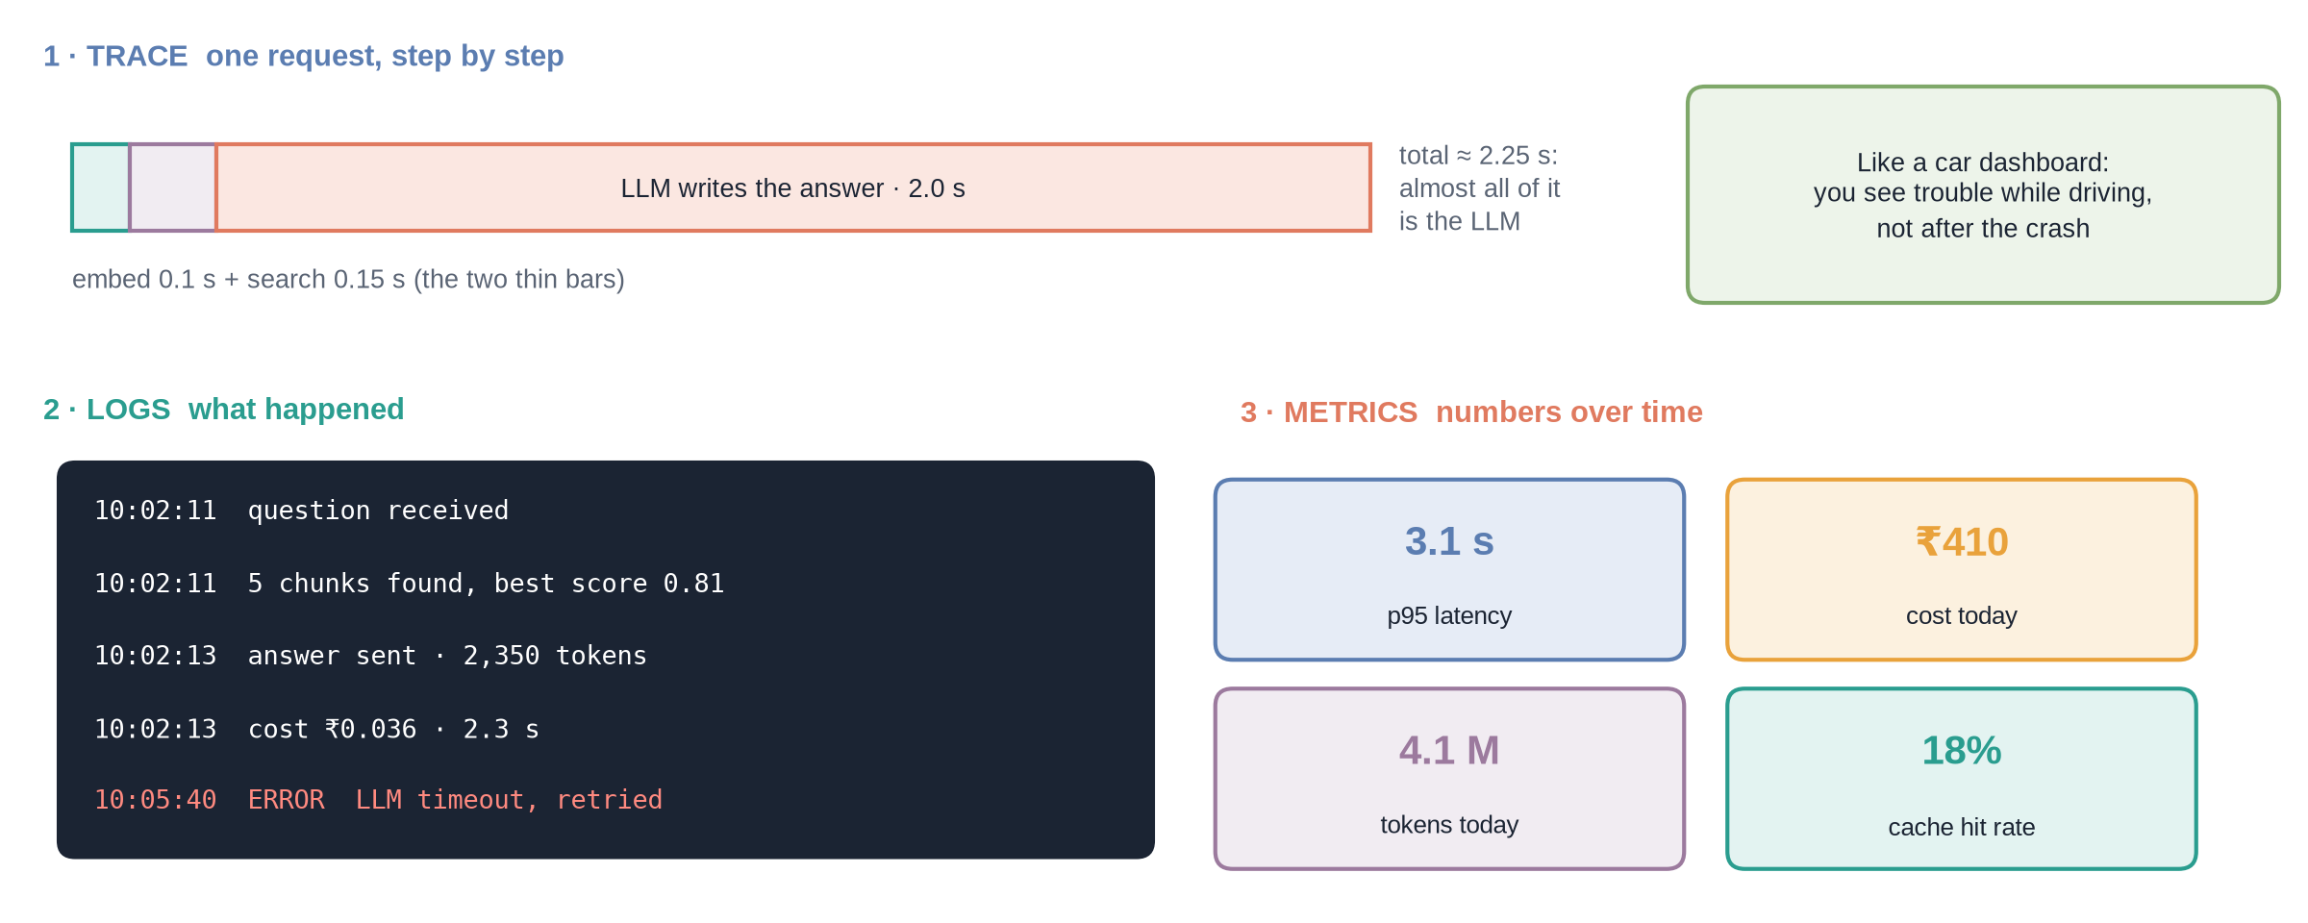
One request, seen three ways
Notes:
✏ DRAW THIS SLIDE – hand-draw it live; the slide diagram is your reference
Video 8.1.
What to draw:
• Top: a time line for one request: embed 0.1 s, search 0.15 s, LLM 2 s (the long bar)
• Write: total ≈ 2.25 s, almost all of it is the LLM
• Bottom left: a dark box with 4–5 log lines, one ERROR line in red
• Bottom right: four dashboard tiles: p95 latency, cost today, tokens today, cache hit rate
• Top right: 'like a car dashboard'

Slide 6
What to watch in a GenAI app
Metric | Why it matters | Example alert
Tokens per question | Tokens are the bill | Average jumps by 50%
Cost per day | Stay inside the budget | Above ₹500 today
Latency p50 / p95 | The wait users feel | p95 above 6 seconds
Errors and timeouts | Users get nothing | More than 2% of requests fail
Retrieval score | Did we find good passages? | Best score drops below 0.5
User feedback | Thumbs up or down | More thumbs down than usual
Notes:
Video 8.1.

Slide 7
Four more things a real app needs
1
2
3
4
Cost
Secrets
Guardrails
Quality
About ₹36 per 1,000 questions for a small RAG app (prices at the time of writing). Watch it every day.
API keys live in a .env file, never in your code or on GitHub.
Block tricks like “ignore your rules” and hide personal data before it reaches the model.
Check that answers are supported by the sources (faithfulness) using a fixed set of test questions.
Notes:
Video 8.1.

Slide 8
The whole journey
Module | What you can now explain
1 · Generative AI | What GenAI is, and why plain LLMs hallucinate
2 · How LLMs work | Tokens, next-token prediction, temperature, streaming
3 · Prompting | Roles, grounded prompts, citations, polite refusal
4 · Embeddings | Text as numbers, cosine similarity
5 · Vector databases | Index, records, metadata, top-k search
6 · Ingestion | PDF to clean text to overlapping chunks
7 · RAG | Retrieve, augment, generate, and how it fails
8 · Production | Observability, cost, secrets, guardrails, quality
Notes:
Video 8.1.

Slide 9
Let's start the project: DocuMind
An assistant that reads company PDFs and answers questions
Every answer shows the document and page as proof
It uses every idea from this course: chunks, embeddings, a vector database, a grounded prompt, RAG
No new theory needed, now we build it
Notes:
Video 8.1. First time students hear what DocuMind is. Keep it short and exciting; do not explain its code here.

Slide 10
Recap – Video 8.1
A product needs eyes on it: logs, metrics, traces
Watch tokens, cost, latency, errors and quality
Keep keys secret; add guardrails; test answers against sources
Next: build DocuMind with everything you learned
NEXT
As you build DocuMind, note which module taught each part you build.
Notes:
Video 8.1.

