Slide 1
GRIT
Angela Duckworth & Abdullah Anas Alsalman

Slide 2

What is “Grit”?
Grit is being passionate towards a long-term goal and, despite challenges or hindering obstacles, persevering until it is achieved.
What is not grit: natural talent, luck, ability to learn, nor is really wanting an outcome.
Those with grit are those who are achievers.

Slide 3
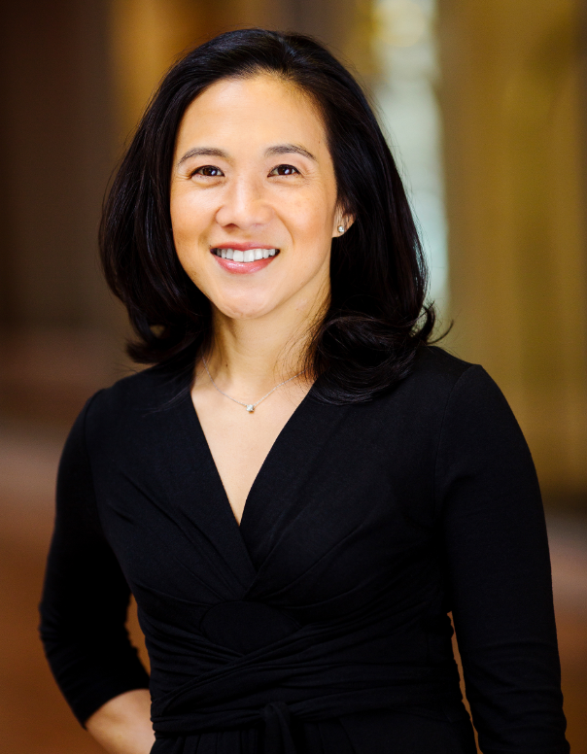

Angela Duckworth’s gritty book
Angela Duckworth, a Penn psychologist professor, made a book and led a Ted Talk about Grit. Many results from her researches were discussed in this presentation. She specifically emphasizes how much more could be discovered in this field.
Angela founded a summer school for underserved children that was profiled as a Harvard Kennedy School case study and, in 2018, celebrated its 25th anniversary.

Slide 4
Grit and passion
Interest
Practice
Purpose
Hope
Are all really important aspects contributing to grit.
Pursuing something you like, understand, and have hopes for will motivate you to continue working towards achieving it, which is in itself greater grit.
These, most of the time, show up in extracurriculars and community activities.

Slide 5
Am I gritty? Check your pulse!
You’re pursuing a years-long goal
You enjoy what you do every day
There’s an activity you love doing
Setbacks don’t discourage you
You finish what you start
You’re always improving

Slide 6
Grit Genes
Grit, like many things, is probably linked to your genes.
But grit, like many things, is definitely improvable with effort.

Slide 7
How do I increase Grit?
To increase grit, follow these simple steps:
Measure one specific aspect of performance (no multitasking).
Deliberately make efforts to improve it.
Repeat.
This technique will allow you to be mindful and resilient!
Here’s an example.

Slide 8

Measure an aspect of performance (Runner example)
If you want to become a faster runner, you can start by running and timing your speed with a stopwatch.
In this example, you only focus on one thing: “Speed” (distance over time).

Slide 9
2) Make efforts to improve it (Runner example)
After your run, try to re-strategize.
What variables contributed to a faster time, and what variables lead to you losing time?
Some variables could include: - Hydration - The weather - Held weight (Bag items or heavy clothing) - Your posture or stance - The path you used to reach point B starting from A
Try to tweak what you can. Experiment!

Slide 10

3) Repeat
Repeat Repeat Repeat Repeat Repeat Repeat Repeat Repeat Repeat Repeat Repeat Repeat Repeat Repeat Repeat

Slide 11
This works because
You can only “Improve” what you can “Measure.” Otherwise, what are you even aiming for?
Life is like a marathon, not a sprint.
In this example, we chose “running speed”, which is pretty direct, but what about something with more aspects, like studying for the TOEFL?

Slide 12

Measure an aspect of performance (TOEFL example)
If you’re studying for the TOEFL, you probably want to enhance your overall english usage abilities.
But to improve your grit, you have to focus on one thing at a time. Let’s say you want to enhance your the Speaking ability.
To do so, record yourself responding to a TOEFL prompt.

Slide 13
2) Make efforts to improve it (TOEFL example)
Then, listen to your recording.
Make sure to take note of what you would want to do differently.
Possible Variables: - Rate of speech (less “uhh”s) - Vocabulary - Topic Development
https://www.ets.org/pdfs/toefl/toefl-ibt-speaking-rubrics.pdf

Slide 14
3) Repeat
Repeat Repeat Repeat Repeat Repeat Repeat Repeat Repeat Repeat Repeat Repeat Repeat Repeat Repeat Repeat
Repeat Repeat Repeat Repeat Repeat Repeat Repeat Repeat Repeat Repeat Repeat Repeat Repeat Repeat Repeat

Slide 15
Remember (Relation to Positive Psychology)
It’s important that what you’re doing is something you’re passionate about because doing something you don’t really like will wear you out.
Also, don’t overwork yourself in a sudden, short period of time, even when it’s something you deeply enjoy, because that can lead to burnout and you might enjoy the activity less.

Slide 16
Check out
Angela Duckworth: https://angeladuckworth.com/qa/
CharacterLab: Grit Playbook: (more playbooks about other stuff!) https://characterlab.org/playbooks/grit/
TOEFL Speaking Grading Rubric: https://www.ets.org/pdfs/toefl/toefl-ibt-speaking-rubrics.pdf
Grit: Passion and Perseverance for long-term goals: https://www.dropbox.com/scl/fi/x09lzwh7gzoq08fi2j4eu/DuckworthPetersonMatthewsKelly_2007_PerseveranceandPassion.pdf?rlkey=5hof011ac5reiqmgw9ye7en0d&e=1&dl=0

Slide 17
Thank you

