Slide 1
AVCRIOA User Manual

Slide 2
STUDENT MANUAL

Slide 3
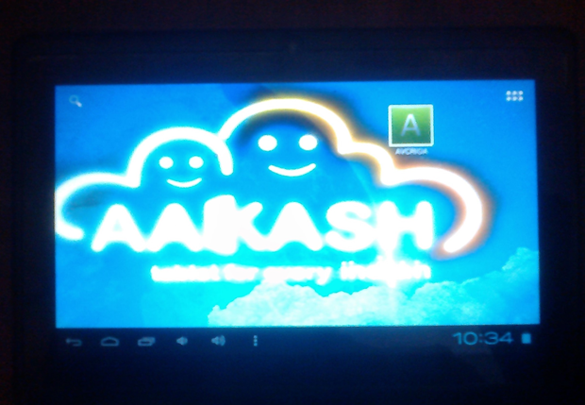
1. AVCRIOA application on aakash tablet.

Slide 4
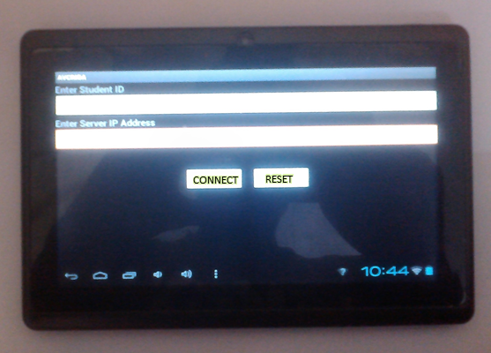
2. Student Login screen on aakash tablet. Once the student successfully logs in, he will be prompted to open the browser.

Slide 5
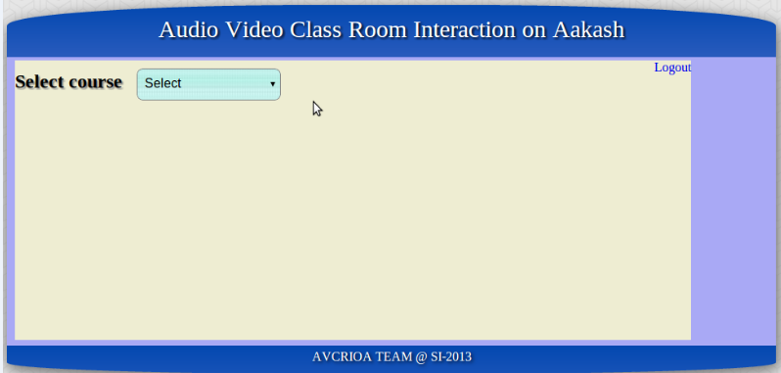
3. After login from the AVCRIOA apk this page will be shown to the student in the browser.
End session
This is the homepage view of AVCRIOA visible to student on the browser. He can choose a course from a list of his registered courses.

Slide 6
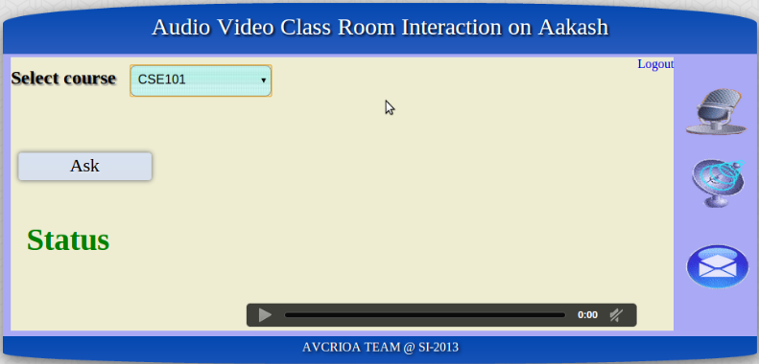
4. After choosing the course from the list of registered courses student will navigate to the Video Request interface where he can send a video request to instructor. After clicking
Chosen Course
The student can send a video request by clicking this button.
Shows audio doubt interface
Local Video of the student
Navigates to broadcasting
Navigates to text doubt form
Video request Status

Slide 7
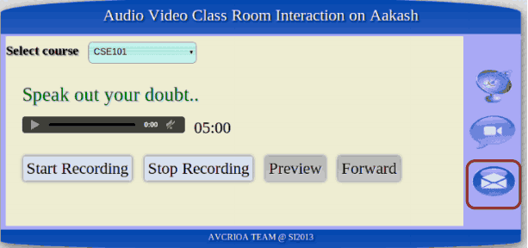
5. Interface for sending Audio GUI where he can record his doubt for 5 minutes and also preview (listen) his doubt and then forward (submit) the question.
Shows preview of audio doubt before submitting
Submits the audio doubt

Slide 8
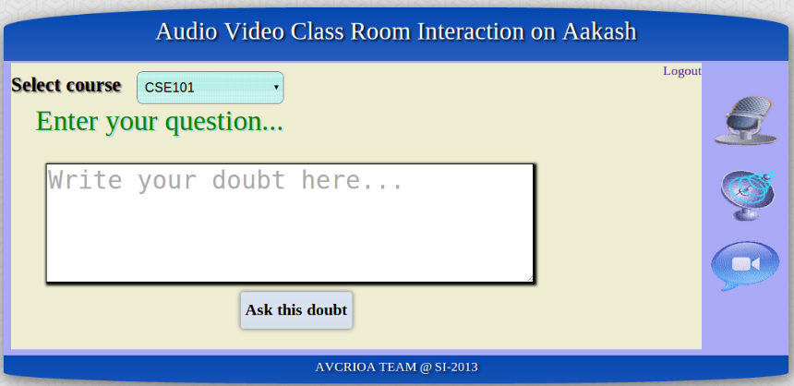
6. Form for submitting textual question enter your question in text area and then press “Ask this doubt” for submitting your question.
Click this button to submit

Slide 9
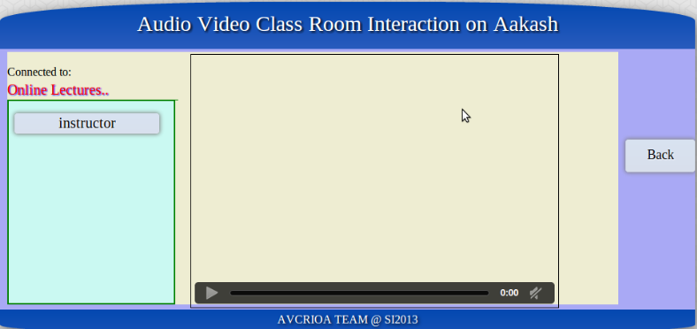
7. This is the student page where he can see the broadcaster list and then he can select.
Broadcaster’s Video
Go back to video requests
List of available broadcasters

Slide 10
INSTRUCTOR MANUAL

Slide 11
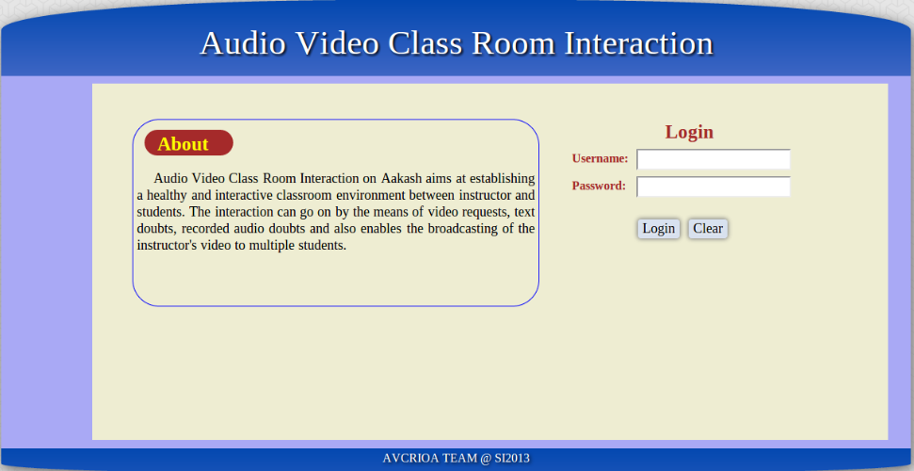
1. Login page for instructor where instructor can give credentials to login.

Slide 12
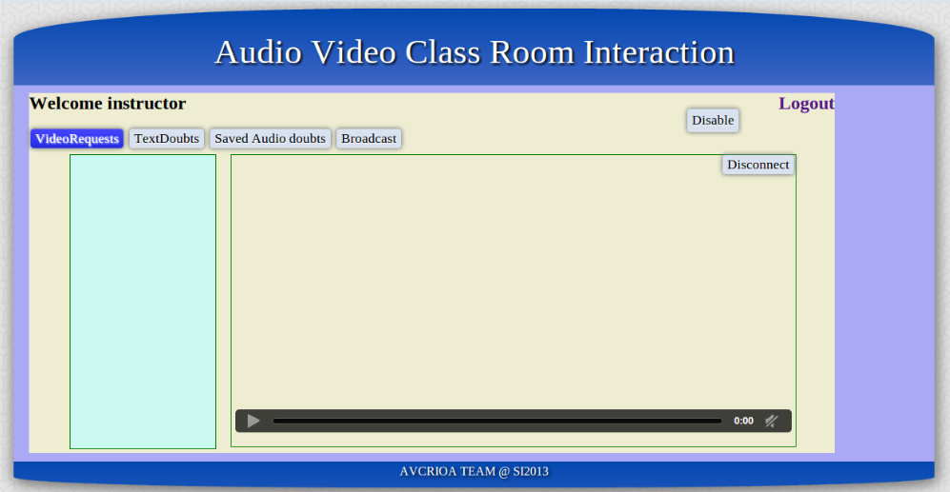
2. Video Request view for instructor. In the left pane you can see list of video requests sent by the students. You can choose, switch and disconnect the student request.
Disable Video Requests
3401
Student’s Video
1234
Disconnect a student
List of Video Requests

Slide 13
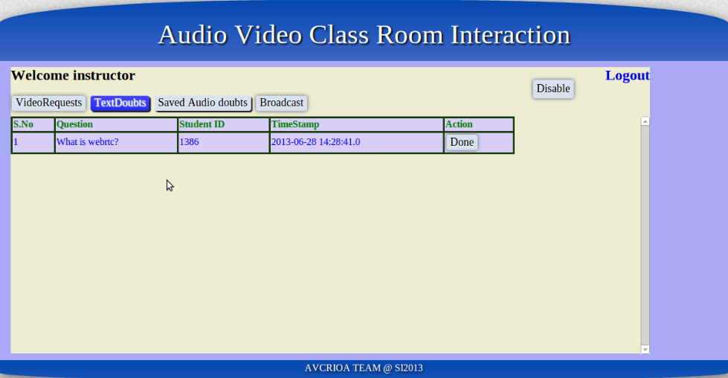
3. You can see the textual doubts posted by students with their information like student ID , date and time. Once you press the Done button the question will not be displayed.
List of Text Questions
Delete Question

Slide 14
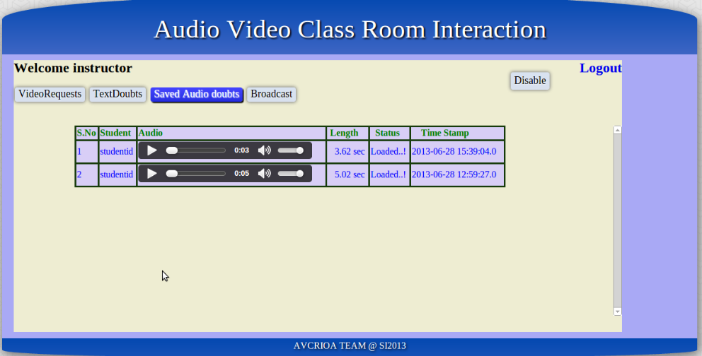
4. In this page List of audio doubts will be available with the duration. You can listen a audio doubt and its status will be displayed under “Status” tab
List of Audio Doubts

Slide 15
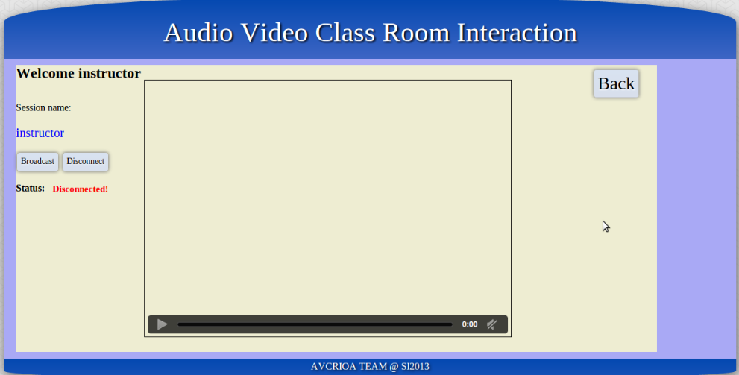
5. This is the broadcast page for instructor where he can start a broadcast
Stop the Broadcast
Go back to Video Request interface
Local Video of Broadcaster
Status of Broadcaster

