Slide 1

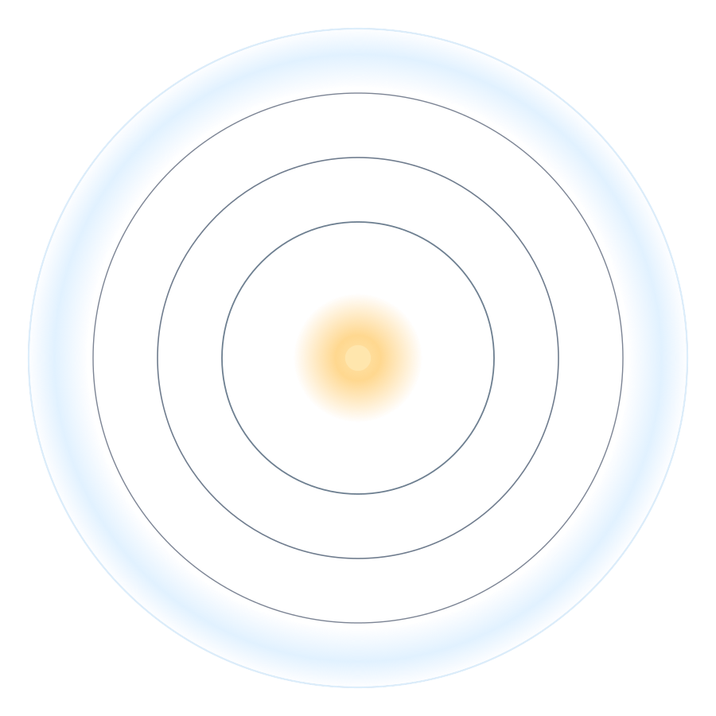
A PHYSICS THOUGHT EXPERIMENT, AUDITED
The Light of 33 AD
Where did it go, and could anyone still see us?
Sunlight bounced off Earth almost 2,000 years ago and never stopped moving. This is where that light is now, and what it still remembers about us, in plain language.
1,993
LIGHT-YEARS OUT
2,000 yrs
STILL TRAVELING
Forever
NEVER DESTROYED
Thought experiment conceived by Paul J. Clark on July 7, 2026.
Researched and compiled by Claude Fable 5 on July 7, 2026.
© Paul J. Clark 2026

Slide 2



THE BIG IDEA
Every day, Earth mails a photo of itself into space
You can see the Moon because sunlight bounces off it and into your eye. The exact same thing happens to Earth: about a third of the sunlight hitting us bounces back into space. That reflected light is basically a live snapshot of our planet, and it flies outward at the speed of light and never stops.
Sunlight hits Earth
Half the planet is lit at any moment.
A third bounces back
That reflected glow carries our image.
So the sunlight that reflected off Earth in the year 33 AD is a snapshot of that day, and after nearly 2,000 years it is now a giant expanding bubble almost 2,000 light-years across.
It travels forever
One light-year of distance for every year.
The Light of 33 AD · audited physics analysis
© Paul J. Clark 2026
02

Slide 3

QUESTION 1 · WHERE IS IT NOW?
A bubble of ancient light, 1,993 light-years wide
1,993
LIGHT-YEARS FROM EARTH, TODAY
The rule is simple: light covers one light-year of distance each year. From 33 AD to today is 1,993 years, so the leading edge of that 33 AD snapshot is now 1,993 light-years away in every direction. It is not a flat disk but a hollow shell, like the surface of an ever-growing balloon with Earth at the center.
~60 million
stars now sit inside the bubble
Half the sky
glows on the day-lit side
YOU ARE HERE · the bright edge
The Light of 33 AD · audited physics analysis
© Paul J. Clark 2026
03

Slide 4
THE JOURNEY
Stars the 33 AD light has already washed over
As the bubble expanded, it swept past one star after another. The year in parentheses is when our 33 AD snapshot reached that star.
Alpha Centauri
4.4 ly
37 AD
Vega
25 ly
58 AD
Pleiades
444 ly
477 AD
Orion Nebula
1,344 ly
1377 AD
Sirius
8.6 ly
42 AD
Aldebaran
65 ly
98 AD
Betelgeuse
~550 ly
~500s
Nearest black hole
1,926 ly
~1959 AD
Nearest known black hole = Gaia BH3, 33 times the Sun's mass. Distances to a few stars like Betelgeuse are genuinely uncertain and shown as approximate.
known distance
uncertain distance
The Light of 33 AD · audited physics analysis
© Paul J. Clark 2026
04

Slide 5

QUESTION 2 · CAN ANYONE READ IT?
The catch: the picture fades as the bubble grows
The light is not destroyed, but it spreads thinner and thinner as the bubble expands. Double the distance and the brightness drops to a quarter. By the time it reaches the edge today, it is almost unimaginably faint.
A SENSE OF SCALE
Earth vs. the Sun
Our whole planet shines about 7 billion times fainter than the Sun sitting right next to it.
Blocked light
HOW FAINT, EXACTLY?
Dust in the galaxy quietly absorbs a third to nearly half of the photons on the way out.
2.8 photons
The real limit
particles of Earth-light land on a one-square-meter patch at the edge, per day. A big 10-meter telescope there would catch roughly 220 of our photons in a whole day.
The problem is never the size of the telescope. It is that there are almost no photons left to catch.
The Light of 33 AD · audited physics analysis
© Paul J. Clark 2026
05

Slide 6



THE VERDICT, IN THREE LEVELS
What an alien could still figure out about us
SURVIVES
MAYBE
LOST FOREVER
That Earth is alive
A blurry map of the continents
Any single person or event
From the faint light alone, a patient observer could tell Earth is a wet, ocean-covered planet with plants, a 24-hour day and a 365-day year. Life itself is detectable.
Only with a trick: using a whole star as a giant magnifying lens. Even then you get a fuzzy, cloud-smeared outline of the landmasses, not a clear map.
A person, a city street, a specific event on one day in 33 AD: gone. Fewer than one photon from such a thing crosses any possible telescope. You cannot rebuild an image from zero light.
Recoverable in principle
Marginal, needs a natural lens
Impossible, a law of physics
The Light of 33 AD · audited physics analysis
© Paul J. Clark 2026
06

Slide 7
THE BOTTOM LINE
Could anyone, anywhere, watch the events of 33 AD?
No.
Not with any telescope that could ever be built. The information about individual people and events is not hidden or too far, it is simply gone: there are fewer than one photon of it left to collect anywhere in the universe.
What does survive: that Earth existed, was covered in water, was alive, spun once a day and orbited once a year. The planet's biography lasts. Its headlines do not.
The Light of 33 AD · audited physics analysis
© Paul J. Clark 2026
07

Slide 8
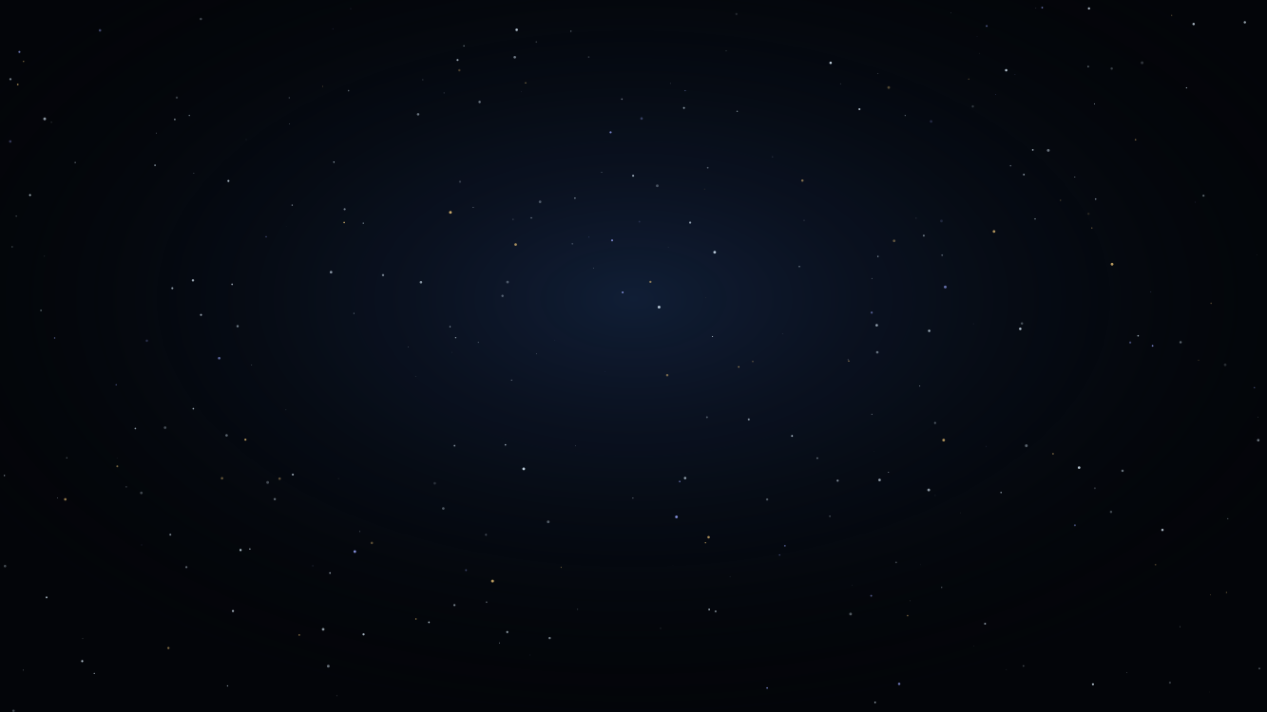

ONE LAST IDEA
Diluted, but never destroyed
DILUTED? YES
DESTROYED? NO
Spread across a bubble almost 2,000 light-years wide, the picture is faint beyond practical use, and dust scrambles part of it into a diffuse glow. As a usable photograph, it is effectively lost.
Physics says information is never truly erased. The photons still exist, just scattered and mixed. Half the bubble is heading out of the galaxy and will sail through empty space for billions of years.
A faint, unreadable record of Earth in 33 AD will outlast the Earth itself.
The Light of 33 AD · audited physics analysis
© Paul J. Clark 2026
08

Slide 9
IN ONE BREATH
Five things to remember
1
Earth is always broadcasting Reflected sunlight carries a live image of our planet outward at light-speed, every single day.
2
The 33 AD snapshot is 1,993 light-years out A hollow bubble of light nearly 2,000 light-years across, with roughly 60 million stars now inside it.
3
It has already passed famous stars Alpha Centauri, Sirius, Vega and the Orion Nebula have all been washed over by our ancient light.
4
The image fades, it does not vanish Just 2.8 photons per square meter per day reach the edge. Enough to prove life exists, not to see a face.
5
It outlives us Individual moments are lost forever, but a diluted record of a living Earth will outlast the planet itself.
The Light of 33 AD · audited physics analysis
© Paul J. Clark 2026
09

