Slide 1
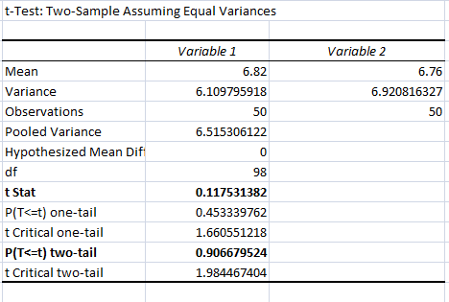
Solution (1/2)
Step 1:
First here we need to test does both performing equally or not.
So here set the hypothesis as below:
Let µ1 = mean score of Arielle.
µ2 = mean score of Boris.
Step 3:
Here Var(B) > Var(A) therefore ,
Var(B)/Var(A) = 1.132740998 < 2 .
Hence use pooled test . ( Assuming equal variances )
Step 4:
Usig excel data analysis I performed 2 sample t test(Assuming equal variance) and results are as follows:
Step 2:
Hypothesis testing.
Null hypothesis (Ho): µ1 = µ2 Vs
Alternate hypothesis (H1): µ1 ≠ µ2.
For this we need to perform 2 Sample t test. (Assuming equal variances)

Slide 2
Solution (2/2)
Step 6: CASE II
If the above test gets rejected then we can say that,
µ1≠ µ2 is true.
Then there exists 2 cases.
Step 5:
Decision rule:
Suppose level of significance (α) = 0.05
If p value ≤ 0.05 then we reject null hypothesis.
If p value > 0.05 then we fail to reject null hypothesis
From performed test below are the results
(a) µ1 > µ2 | P value = 0.453339762 > 0.05 | We fail to reject null hypothesis.
(b) µ1< µ2 | P value =0.546660238 > 0.05 | We fail to reject null hypothesis.
This means both sides have case here
t test statistics | 0.117531382
P value | 0.906679524
P value > 0.05, We fail to reject null hypothesis.
That means we accept null.
Therefore, µ1 = µ2
From this we can say that mean score of both participants are statistically equal.

