Slide 1
Parallel Processing
120CT Computer Architecture and Networks
Dr Dianabasi Nkantah
ab0480@coventry.ac.uk

Slide 2
This lecture ……
Parallel Processing
Flynn’s Taxonomy
Symmetric Multiprocessors (SMP)
Clusters
NUMA

Slide 3
Multiple Processor Organization
Single instruction, single data (SISD) stream
Single processor executes a single instruction stream to operate on data stored in a single memory
Uniprocessors fall into this category
Multiple instruction, single data (MISD) stream
A sequence of data is transmitted to a set of processors, each of which executes a different instruction sequence
Not commercially implemented
Single instruction, multiple data (SIMD) stream
A single machine instruction controls the simultaneous execution of a number of processing elements on a lockstep basis
Vector and array processors fall into this category
Multiple instruction, multiple data (MIMD) stream
A set of processors simultaneously execute different instruction sequences on different data sets
SMPs, clusters and NUMA systems fit this category
Notes:
A taxonomy first introduced by Flynn (Flynn, M., 1972) is still the most common way of categorizing systems with parallel processing capability. Flynn proposed the following categories of computer systems:
Single instruction, single data (SISD) stream: A single processor executes a single instruction stream to operate on data stored in a single memory. Uniprocessors fall into this category.
Single instruction, multiple data (SIMD) stream: A single machine instruction controls the simultaneous execution of a number of processing elements on a lockstep basis. Each processing element has an associated data memory, so that instructions are executed on different sets of data by different processors. Vector and array processors fall into this category.
Multiple instruction, single data (MISD) stream: A sequence of data is transmitted to a set of processors, each of which executes a different instruction sequence. This structure is not commercially implemented.
Multiple instruction, multiple data (MIMD) stream: A set of processors simultaneously execute different instruction sequences on different data sets. SMPs, clusters, and NUMA systems fit into this category.

Slide 4
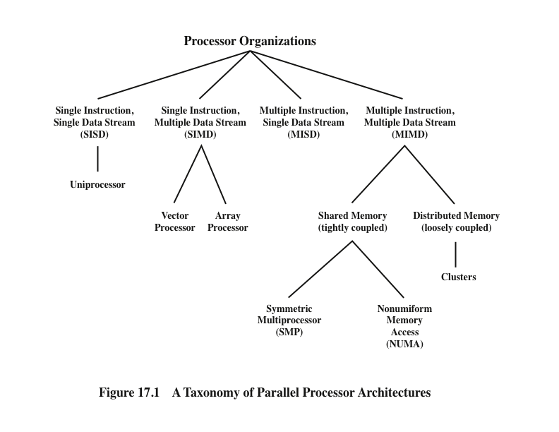
(Stallings, W., 2016)
Notes:
With the MIMD organization, the processors are general purpose; each is able to process all of the instructions necessary to perform the appropriate data transformation. MIMDs can be further subdivided by the means in which the processors communicate (Figure 17.1). If the processors share a common memory, then each processor accesses programs and data stored in the shared memory, and processors communicate with each other via that memory. The most common form of such system is known as a symmetric multiprocessor (SMP). In an SMP, multiple processors share a single memory or pool of memory by means of a shared bus or other interconnection mechanism; a distinguishing feature is that the memory access time to any region of memory is approximately the same for each processor. A more recent development is the non-uniform memory access (NUMA) organization. As the name suggests, the memory access time to different regions of memory may differ for a NUMA processor.
A collection of independent uniprocessors or SMPs may be interconnected to form a cluster. Communication among the computers is either via fixed paths or via some network facility.

Slide 5
Symmetric Multiprocessor (SMP)
A stand alone computer with the following characteristics:
Two or more similar processors of comparable capacity
Processors share same memory and I/O facilities
Processors are connected by a bus or other internal connection
Memory access time is approximately the same for each processor
All processors share access to I/O devices
Either through same channels or different channels giving paths to same devices
All processors can perform the same functions (hence “symmetric”)
System controlled by integrated operating system
Provides interaction between processors and their programs at job, task, file and data element levels
Notes:
Until fairly recently, virtually all single-user personal computers and most workstations contained a single general-purpose microprocessor. As demands for performance increase and as the cost of microprocessors continues to drop, vendors have introduced systems with an SMP organization. The term SMP refers to a computer hardware architecture and also to the operating system behavior that reflects that architecture. An SMP can be defined as a standalone computer system with the following characteristics:
1. There are two or more similar processors of comparable capability.
2. These processors share the same main memory and I/O facilities and are interconnected by a bus or other internal connection scheme, such that memory access time is approximately the same for each processor.
3. All processors share access to I/O devices, either through the same channels or through different channels that provide paths to the same device.
4. All processors can perform the same functions (hence the term symmetric).
5. The system is controlled by an integrated operating system that provides interaction between processors and their programs at the job, task, file, and data element levels.
Points 1 to 4 should be self-explanatory. Point 5 illustrates one of the contrasts
with a loosely coupled multiprocessing system, such as a cluster. In the latter, the physical unit of interaction is usually a message
or complete file. In an SMP, individual data elements can constitute the level of interaction, and there can be a high degree of cooperation
between processes.

Slide 6
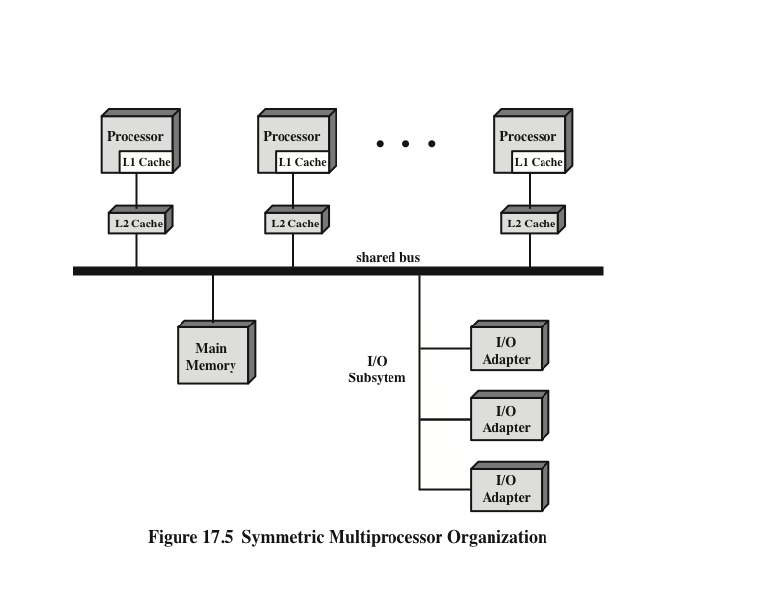
Symmetric Multiprocessor Organization
(Stallings, W., 2016)
Notes:
The most common organization for personal computers, workstations, and servers is the time-shared bus. The time-shared bus is the simplest mechanism for constructing a multiprocessor system (Figure 17.5). The structure and interfaces are basically the same as for a single-processor system that uses a bus interconnection. The bus consists of control, address, and data lines. To facilitate DMA transfers from I/O subsystems to processors, the following features are provided:
Addressing: It must be possible to distinguish modules on the bus to determine the source and destination of data.
Arbitration: Any I/O module can temporarily function as “master.” A mechanism is provided to arbitrate competing requests for bus control, using some sort of priority scheme.
Time-sharing: When one module is controlling the bus, other modules are locked out and must, if necessary, suspend operation until bus access is achieved.
These uniprocessor features are directly usable in an SMP organization. In this latter case, there are now multiple processors as well as multiple I/O processors all attempting to gain access to one or more memory modules via the bus.

Slide 7
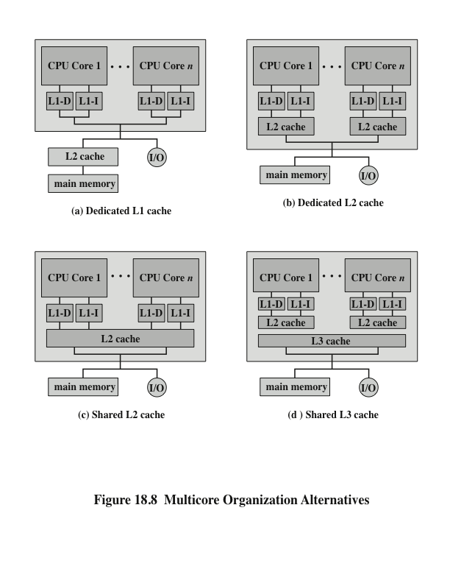
Multicore Organisation Alternatives
Stallings, 2016
Notes:
Figure 18.8 shows four general organizations for multicore systems. Figure 18.8a is an organization found in some of the earlier multicore computer chips and is still seen in embedded chips. In this organization, the only on-chip cache is L1 cache, with each core having its own dedicated L1 cache. Almost invariably, the L1 cache is divided into instruction and data caches. An example of this organization is the ARM11 MPCore.
The organization of Figure 18.8b is also one in which there is no on-chip cache sharing. In this, there is enough area available on the chip to allow for L2 cache. An example of this organization is the AMD Opteron. Figure 18.8c shows a similar allocation of chip space to memory, but with the use of a shared L2 cache. The Intel Core Duo has this organization. Finally, as the amount of cache memory available on the chip continues to grow, performance considerations dictate splitting off a separate, shared L3 cache, with dedicated L1 and L2 caches for each core processor. The Intel Core i7 is an example of this organization.
Another organizational design decision in a multicore system is whether the individual cores will be superscalar or will implement simultaneous multithreading (SMT). For example, the Intel Core Duo uses superscalar cores, whereas the Intel Core i7 uses SMT cores. SMT has the effect of scaling up the number of hardware-level threads that the multicore system supports. Thus, a multicore system with four cores and SMT that supports four simultaneous threads in each core appears the same to the application level as a multicore system with 16 cores. As software is developed to more fully exploit parallel resources, an SMT approach appears to be more attractive than a superscalar approach.

Slide 8
Clusters
Alternative to SMP as an approach to providing high performance and high availability
Particularly attractive for server applications
Defined as:
A group of interconnected whole computers working together as a unified computing resource that can create the illusion of being one machine
(The term whole computer means a system that can run on its own, apart from the cluster)
Each computer in a cluster is called a node
Benefits:
Absolute scalability
Incremental scalability
High availability
Superior price/performance
Applications:
Complex scientific problems
Search Engines
Web Servers
Email Servers
Databases
Notes:
An important and relatively recent development computer system design is clustering. Clustering is an alternative to symmetric multiprocessing as an approach to providing high performance and high availability and is particularly attractive for server applications. We can define a cluster as a group of interconnected, whole computers working together as a unified computing resource that can create the illusion of being one machine. The term whole computer means a system that can run on its own, apart from the cluster; in the literature, each computer in a cluster is typically referred to as a node.
Four benefits that can be achieved with clustering (These can also be thought of as objectives or design requirements):
• Absolute scalability: It is possible to create large clusters that far surpass the power of even the largest standalone machines. A cluster can have tens, hundreds, or even thousands of machines, each of which is a multiprocessor.
• Incremental scalability: A cluster is configured in such a way that it is possible to add new systems to the cluster in small increments. Thus, a user can start out with a modest system and expand it as needs grow, without having to go through a major upgrade in which an existing small system is replaced with a larger system.
• High availability: Because each node in a cluster is a standalone computer, the failure of one node does not mean loss of service. In many products, fault tolerance is handled automatically in software.
• Superior price/performance: By using commodity building blocks, it is possible to put together a cluster with equal or greater computing power than a single large machine, at much lower cost.

Slide 9
Clusters Compared to SMP
Both provide a configuration with multiple processors to support high demand applications
Both solutions are available commercially
SMP
Clustering
Easier to manage and configure
Much closer to the original single processor model for which nearly all applications are written
Less physical space and lower power consumption
Well established and stable
Far superior in terms of incremental and absolute scalability
Superior in terms of availability
All components of the system can readily be made highly redundant
Notes:
Both clusters and symmetric multiprocessors provide a configuration with multiple processors to support high-demand applications. Both solutions are commercially available, although SMP schemes have been around far longer.
The main strength of the SMP approach is that an SMP is easier to manage and configure than a cluster. The SMP is much closer to the original single-processor
model for which nearly all applications are written. The principal change required in going from a uniprocessor to an SMP is to the scheduler function. Another benefit of the SMP is that it usually takes up less physical space and draws less power than a comparable cluster. A final important benefit is that the SMP products are well established and stable.
Over the long run, however, the advantages of the cluster approach are likely to result in clusters dominating the high-performance server market. Clusters are far superior to SMPs in terms of incremental and absolute scalability. Clusters are also superior in terms of availability, because all components of the system can readily be made highly redundant.

Slide 10
Nonuniform Memory Access (NUMA)
Alternative to SMP and clustering
Uniform memory access (UMA)
All processors have access to all parts of main memory using loads and stores
Access time to all regions of memory is the same
Access time to memory for different processors is the same
Nonuniform memory access (NUMA)
All processors have access to all parts of main memory using loads and stores
Access time of processor differs depending on which region of main memory is being accessed
Different processors access different regions of memory at different speeds
Cache-coherent NUMA (CC-NUMA)
A NUMA system in which cache coherence is maintained among the caches of the various processors
Notes:
In terms of commercial products, the two common approaches to providing a multiple-processor system to support applications are SMPs and clusters. For some years, another approach, known as nonuniform memory access (NUMA), has been the subject of research and commercial NUMA products are now available.
Before proceeding, we should define some terms often found in the NUMA literature.
• Uniform memory access (UMA): All processors have access to all parts of main memory using loads and stores. The memory access time of a processor to all regions of memory is the same. The access times experienced by different processors are the same. The SMP organization discussed in Sections 17.2 and 17.3 is UMA.
• Nonuniform memory access (NUMA): All processors have access to all parts of main memory using loads and stores. The memory access time of a processor differs depending on which region of main memory is accessed. The last statement is true for all processors; however, for different processors, which memory regions are slower and which are faster differ.
• Cache-coherent NUMA (CC-NUMA): A NUMA system in which cache coherence is maintained among the caches of the various processors.
A NUMA system without cache coherence is more or less equivalent to a cluster. The commercial products that have received much attention recently are CC-NUMA systems, which are quite distinct from both SMPs and clusters. Usually, but unfortunately not always, such systems are in fact referred to in the commercial literature as CC-NUMA systems.

Slide 11
Motivation for cc-NUMA
SMP has practical limit to number of processors that can be used
Bus traffic limits to between 16 and 64 processors
In clusters each node has its own private main memory
Applications do not see a large global memory
Coherency is maintained by software rather than hardware
NUMA retains SMP flavor while giving large scale multiprocessing
Objective with NUMA is to maintain a transparent system wide memory while permitting multiple multiprocessor nodes, each with its own bus or internal interconnect system
Notes:
With an SMP system, there is a practical limit to the number of processors that can be used. An effective cache scheme reduces the bus traffic between any one processor and main memory. As the number of processors increases, this bus traffic also increases. Also, the bus is used to exchange cache-coherence signals, further adding to the burden. At some point, the bus becomes a performance bottleneck. Performance degradation seems to limit the number of processors in an SMP
configuration to somewhere between 16 and 64 processors. For example, Silicon Graphics’ Power Challenge SMP is limited to 64 R10000 processors in a single system; beyond this number performance degrades substantially.
The processor limit in an SMP is one of the driving motivations behind the development of cluster systems. However, with a cluster, each node has its own private main memory; applications do not see a large global memory. In effect, coherency is maintained in software rather than hardware. This memory granularity affects performance and, to achieve maximum performance, software must be tailored to this environment. One approach to achieving large-scale multiprocessing while retaining the flavor of SMP is NUMA. For example, the Silicon Graphics Origin NUMA system is designed to support up to 1024 MIPS R10000 processors [WHIT97] and the Sequent NUMA-Q system is designed to support up to 252 Pentium II processors [LOVE96].
The objective with NUMA is to maintain a transparent system wide memory while permitting multiple multiprocessor nodes, each with its own bus or other internal interconnect system.

Slide 12
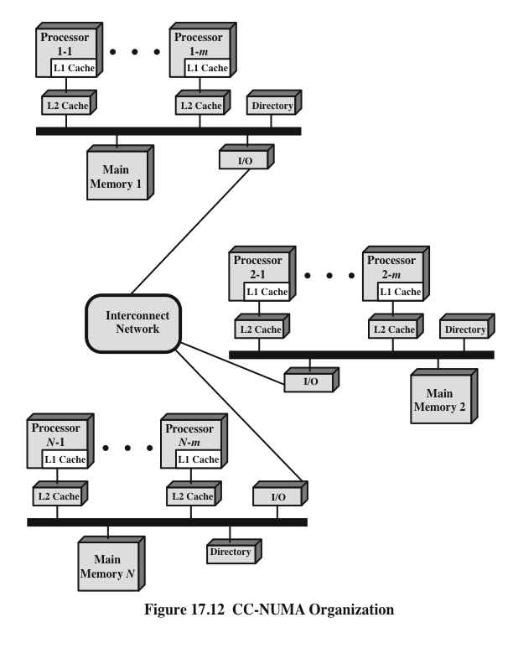
CC-NUMA Organization
(Stallings, W., 2016)
Notes:
Figure 17.12 depicts a typical CC-NUMA organization. There are multiple independent nodes, each of which is, in effect, an SMP organization. Thus, each node contains multiple processors, each with its own L1 and L2 caches, plus main memory. The node is the basic building block of the overall CC-NUMA organization. For example, each Silicon Graphics Origin node includes two MIPS R10000 processors; each Sequent NUMA-Q node includes four Pentium II processors. The nodes are interconnected by means of some communications facility, which could be a switching mechanism, a ring, or some other networking facility.
Each node in the CC-NUMA system includes some main memory. From the point of view of the processors, however, there is only a single addressable memory, with each location having a unique system wide address. When a processor initiates a memory access, if the requested memory location is not in that processor’s cache, then the L2 cache initiates a fetch operation. If the desired line is in the local portion of the main memory, the line is fetched across the local bus. If the desired line is in a remote portion of the main memory, then an automatic request is sent out to fetch that line across the interconnection network, deliver it to the local bus, and then deliver it to the requesting cache on that bus. All of this activity is automatic and transparent to the processor and its cache.
In this configuration, cache coherence is a central concern. Although implementations differ as to details, in general terms we can say that each node must maintain some sort of directory that gives it an indication of the location of various portions of memory and also cache status information.

Slide 13
NUMA Pros and Cons
Main advantage of a CC-NUMA system is that it can deliver effective performance at higher levels of parallelism than SMP without requiring major software changes
Bus traffic on any individual node is limited to a demand that the bus can handle
If many of the memory accesses are to remote nodes, performance begins to break down
Does not transparently look like an SMP
Software changes will be required to move an operating system and applications from an SMP to a CC-NUMA system
Concern with availability
Notes:
The main advantage of a CC-NUMA system is that it can deliver effective performance at higher levels of parallelism than SMP, without requiring major software changes. With multiple NUMA nodes, the bus traffic on any individual node is limited to a demand that the bus can handle. However, if many of the memory accesses are to remote nodes, performance begins to break down. There is reason to believe that this performance breakdown can be avoided. First, the use of L1 and L2 caches is designed to minimize all memory accesses, including remote ones. If much of the software has good temporal locality, then remote memory accesses should not be excessive. Second, if the software has good spatial locality, and if virtual memory is in use, then the data needed for an application will reside on a limited number of frequently used pages that can be initially loaded into the memory local to the running application. The Sequent designers report that such spatial locality does appear in representative applications [LOVE96]. Finally, the virtual memory scheme can be enhanced by including in the operating system a page migration mechanism that will move a virtual memory page to a node that is frequently using it; the Silicon Graphics designers report success with this approach [WHIT97].
Even if the performance breakdown due to remote access is addressed, there are two other disadvantages for the CC-NUMA approach [PFIS98]. First, a CC-NUMA does not transparently look like an SMP; software changes will be required to move an operating system and applications from an SMP to a CC-NUMA system. These include page allocation, already mentioned, process allocation, and load balancing by the operating system. A second concern is that of availability. This is a rather complex issue and depends on the exact implementation of the CC-NUMA system; the interested reader is referred to (G. Pfister, 1998, In Search of Clusters, Upper Saddle River, NJ: Preston Hall).

Slide 14
Further Reading
Computer Organization and Architecture – Designing for Performance (10th Edition), William Stallings [Chapters: 17, 18]
Computer Organization and Design – The Hardware/Software Interface (5th Edition), David A. Patterson & John L. Hennessy [Chapter: 6]

