Slide 1
History of Computers
120CT Computer Architecture and Networks
Dr Dianabasi Nkantah
ab0480@coventry.ac.uk

Slide 2

BBC Documentary on The History of Computers
https://www.youtube.com/watch?v=6dME3wgaQpM&list=PL1331A4548513EA81&index=1

Slide 3
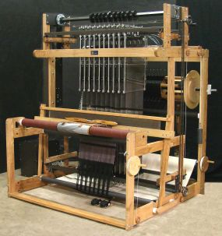
Pre-Digital Computer Systems
Jacquard Loom
Created by Joseph-Marie Jacquard in 1801
Used a system of punch cards to control an automatic weaving loom
Represents the first programmable device

Slide 4
Pre-Digital Computer Systems
Difference Engine
Designed by Charles Babbage in the 1800’s
Could have been the first analogue computer
Joined by Ada Lovelace, a mathematician who is held to be the person who wrote the first ever computer algorithm
This project failed due to withdrawal of government funding
Analytical Engine
Also designed by Charles Babbage
Could have been the world’s first true programmable computer
Would have been steam-powered

Slide 5
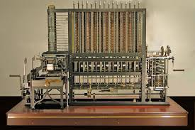
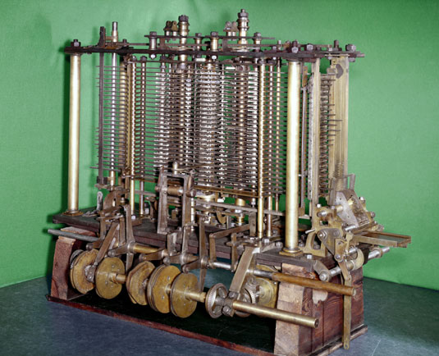
Difference & Analytical Engines
Difference Engine
Analytical Engine

Slide 6
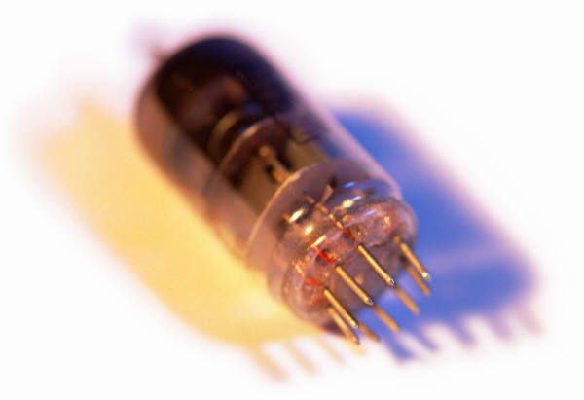
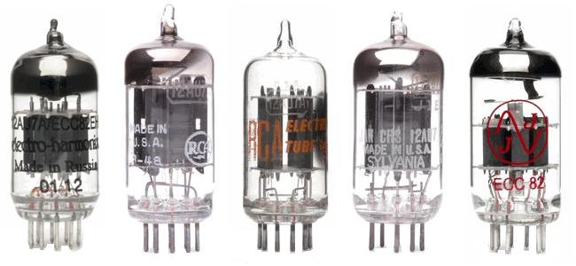
History of Computers
First Generation: Vacuum Tubes
ENIAC
Electronic Numerical Integrator And Computer
Designed and constructed at the University of Pennsylvania
Started in 1943 – completed in 1946
By John Mauchly and John Eckert
World’s first general purpose electronic digital computer
Army’s Ballistics Research Laboratory (BRL) needed a way to supply trajectory tables for new weapons accurately and within a reasonable time frame
Was not finished in time to be used in the war effort
Its first task was to perform a series of calculations that were used to help determine the feasibility of the hydrogen bomb
Continued to operate under BRL management until 1955 when it was disassembled
Notes:
The ENIAC (Electronic Numerical Integrator And Computer), designed
and constructed at the University of Pennsylvania, was the world’s first general purpose
electronic digital computer. The project was a response to U.S. needs
during World War II. The Army’s Ballistics Research Laboratory (BRL), an agency
responsible for developing range and trajectory tables for new weapons, was having
difficulty supplying these tables accurately and within a reasonable time frame.
Without these firing tables, the new weapons and artillery were useless to gunners.
The BRL employed more than 200 people who, using desktop calculators, solved
the necessary ballistics equations. Preparation of the tables for a single weapon
would take one person many hours, even days.
John Mauchly, a professor of electrical engineering at the University of
Pennsylvania, and John Eckert, one of his graduate students, proposed to build a
general-purpose computer using vacuum tubes for the BRL’s application. In 1943,
the Army accepted this proposal, and work began on the ENIAC.

Slide 7
ENIAC
Weighed
30
tons
Occupied
1500
square
feet
of
floor
space
Contained
more
than
18,000
vacuum
tubes
140 kW
Power
consumption
Capable
of
5000
additions
per
second
Decimal
rather
than
binary
machine
Memory
consisted
of 20 accumulators,
each
capable
of
holding
a
10 digit
number
Major
drawback
was the need
for manual programming
by setting
switches
and
plugging/
unplugging
cables
Notes:
The resulting machine was enormous, weighing 30 tons, occupying 1500 square feet of floor space,
and containing more than 18,000 vacuum tubes. When operating, it consumed
140 kilowatts of power. It was also substantially faster than any electromechanical
computer, capable of 5000 additions per second.
The ENIAC was a decimal rather than a binary machine. That is, numbers
were represented in decimal form, and arithmetic was performed in the decimal
system. Its memory consisted of 20 accumulators, each capable of holding a 10-digit
decimal number. A ring of 10 vacuum tubes represented each digit. At any time,
only one vacuum tube was in the ON state, representing one of the 10 digits. The
major drawback of the ENIAC was that it had to be programmed manually by
setting switches and plugging and unplugging cables.
The ENIAC was completed in 1946, too late to be used in the war effort.
Instead, its first task was to perform a series of complex calculations that were used
to help determine the feasibility of the hydrogen bomb. The use of the ENIAC for
a purpose other than that for which it was built demonstrated its general-purpose
nature. The ENIAC continued to operate under BRL management until 1955,
when it was disassembled.

Slide 8
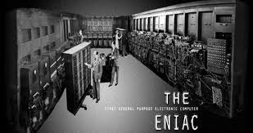
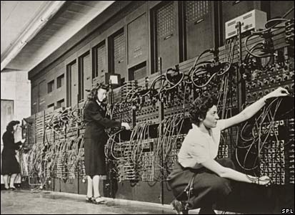
ENIAC
Notes:
The resulting machine was enormous, weighing 30 tons, occupying 1500 square feet of floor space,
and containing more than 18,000 vacuum tubes. When operating, it consumed
140 kilowatts of power. It was also substantially faster than any electromechanical
computer, capable of 5000 additions per second.
The ENIAC was a decimal rather than a binary machine. That is, numbers
were represented in decimal form, and arithmetic was performed in the decimal
system. Its memory consisted of 20 accumulators, each capable of holding a 10-digit
decimal number. A ring of 10 vacuum tubes represented each digit. At any time,
only one vacuum tube was in the ON state, representing one of the 10 digits. The
major drawback of the ENIAC was that it had to be programmed manually by
setting switches and plugging and unplugging cables.
The ENIAC was completed in 1946, too late to be used in the war effort.
Instead, its first task was to perform a series of complex calculations that were used
to help determine the feasibility of the hydrogen bomb. The use of the ENIAC for
a purpose other than that for which it was built demonstrated its general-purpose
nature. The ENIAC continued to operate under BRL management until 1955,
when it was disassembled.

Slide 9
John von Neumann
EDVAC (Electronic Discrete Variable Computer)
First publication of the idea was in 1945
Stored program concept
Attributed to ENIAC designers, most notably the mathematician John von Neumann
Program represented in a form suitable for storing in memory alongside the data
IAS computer
Princeton Institute for Advanced Studies
Prototype of all subsequent general-purpose computers
Completed in 1952
Notes:
The task of entering and altering programs for the ENIAC was extremely tedious.
But suppose a program could be represented in a form suitable for storing in memory
alongside the data. Then, a computer could get its instructions by reading them from
memory, and a program could be set or altered by setting the values of a portion of memory.
This idea, known as the stored-program concept, is usually attributed to the
ENIAC designers, most notably the mathematician John von Neumann, who was
a consultant on the ENIAC project. Alan Turing developed the idea at about the
same time. The first publication of the idea was in a 1945 proposal by von Neumann
for a new computer, the EDVAC (Electronic Discrete Variable Computer).
In 1946, von Neumann and his colleagues began the design of a new stored program
computer, referred to as the IAS computer, at the Princeton Institute for
Advanced Studies. The IAS computer, although not completed until 1952, is the
prototype of all subsequent general-purpose computers.

Slide 10
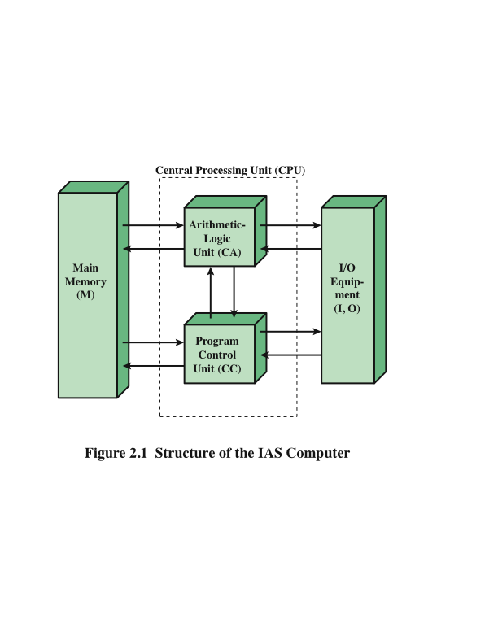
Structure of von Neumann Machine
[Stallings W, 2013]
Notes:
Figure 2.1 on this slide shows the general structure of the IAS computer. It consists of
• A main memory, which stores both data and instructions
• An arithmetic and logic unit (ALU) capable of operating on binary data
• A control unit, which interprets the instructions in memory and causes them
to be executed
• Input/output (I/O) equipment operated by the control unit

Slide 11
Commercial Computers
UNIVAC
1947 – Eckert and Mauchly formed the Eckert-Mauchly Computer Corporation to manufacture computers commercially
UNIVAC I (Universal Automatic Computer)
First successful commercial computer
Was intended for both scientific and commercial applications
Commissioned by the US Bureau of Census for 1950 calculations
The Eckert-Mauchly Computer Corporation became part of the UNIVAC division of the Sperry-Rand Corporation
UNIVAC II – delivered in the late 1950’s
Had greater memory capacity and higher performance
Backward compatible
Notes:
The 1950s saw the birth of the computer industry with
two companies, Sperry and IBM, dominating the marketplace.
In 1947, Eckert and Mauchly formed the Eckert-Mauchly Computer
Corporation to manufacture computers commercially. Their first successful machine
was the UNIVAC I (Universal Automatic Computer), which was commissioned by
the Bureau of the Census for the 1950 calculations. The Eckert-Mauchly Computer
Corporation became part of the UNIVAC division of Sperry-Rand Corporation,
which went on to build a series of successor machines.
The UNIVAC I was the first successful commercial computer. It was intended
for both scientific and commercial applications. The first paper describing the
system listed matrix algebraic computations, statistical problems, premium billings
for a life insurance company, and logistical problems as a sample of the tasks it could
perform.
The UNIVAC II, which had greater memory capacity and higher performance
than the UNIVAC I, was delivered in the late 1950s and illustrates several trends that
have remained characteristic of the computer industry. First, advances in technology
allow companies to continue to build larger, more powerful computers. Second,
each company tries to make its new machines backward compatible with the older
machines. This means that the programs written for the older machines can be
executed on the new machine. This strategy is adopted in the hopes of retaining the
customer base; that is, when a customer decides to buy a newer machine, he or she is
likely to get it from the same company to avoid losing the investment in programs.
The UNIVAC division also began development of the 1100 series of computers,
which was to be its major source of revenue. This series illustrates a distinction
that existed at one time. The first model, the UNIVAC 1103, and its successors
for many years were primarily intended for scientific applications, involving long
and complex calculations. Other companies concentrated on business applications,
which involved processing large amounts of text data. This split has largely disappeared,
but it was evident for a number of years.

Slide 12
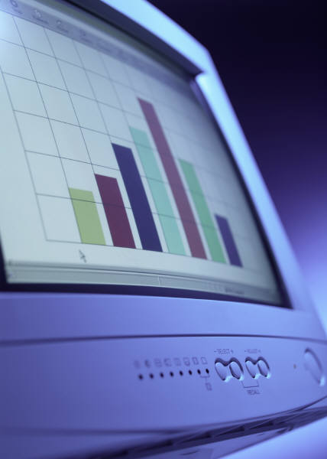

IBM
Was the major manufacturer of punched-card processing equipment
Delivered its first electronic stored-program computer (701) in 1953
Intended primarily for scientific applications
Introduced 702 product in 1955
Hardware features made it suitable to business applications
Series of 700/7000 computers established IBM as the overwhelmingly dominant computer manufacturer
Notes:
IBM, then the major manufacturer of punched-card processing equipment,
delivered its first electronic stored-program computer, the 701, in 1953. The 701 was
intended primarily for scientific applications. In 1955, IBM introduced
the companion 702 product, which had a number of hardware features that suited it
to business applications. These were the first of a long series of 700/7000 computers
that established IBM as the overwhelmingly dominant computer manufacturer.

Slide 13
The UK Computer Industry
Sinclair Computers
Founded by Sir Clive Sinclair
First UK company to offer small computers for home use
Produced first ever computers to be sold for less than £100
Acorn Computers
Formed in 1975 by Chris Curry and Hermann Hauser
Ceased trading in the 1990s
Its former engineering employees still active in the computer industry – responsible for the design and funding of the Raspberry Pi Computer
BBC Micro Computer
Acorn RISC Machine (ARM)
Later Advanced RISC Machine (ARM)
Amstrad (Alan Michael Sugar Trading)
Formed in 1960 when Lord Sugar was 21

Slide 14
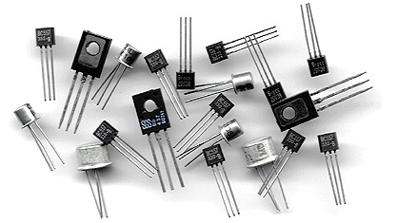
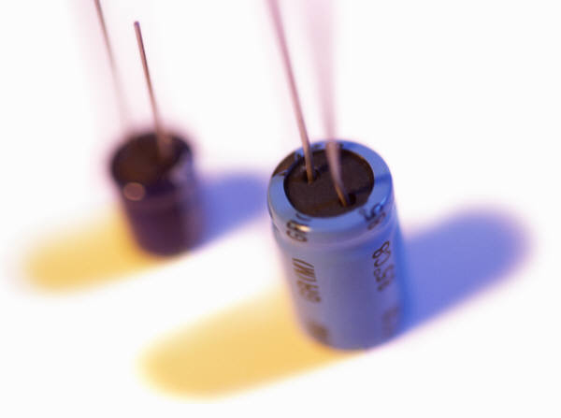
History of Computers
Second Generation: Transistors
Smaller
Cheaper
Dissipates less heat than a vacuum tube
Is a solid state device made from silicon
Was invented at Bell Labs in 1947
It was not until the late 1950’s that fully transistorized computers were commercially available
Notes:
The first major change in the electronic computer came with the replacement of
the vacuum tube by the transistor. The transistor is smaller, cheaper, and dissipates
less heat than a vacuum tube but can be used in the same way as a vacuum tube to
construct computers. Unlike the vacuum tube, which requires wires, metal plates, a
glass capsule, and a vacuum, the transistor is a solid-state device, made from silicon.
The transistor was invented at Bell Labs in 1947 and by the 1950s had
launched an electronic revolution. It was not until the late 1950s, however, that
fully transistorized computers were commercially available. IBM again was not the
first company to deliver the new technology. NCR and, more successfully, RCA
were the front-runners with some small transistor machines. IBM followed shortly
with the 7000 series.
The use of the transistor defines the second generation of computers.

Slide 15
Second Generation Computers
Introduced:
More complex arithmetic and logic units and control units
The use of high-level programming languages
Provision of system software which provided the ability to:
load programs
move data to peripherals and libraries
perform common computations
Appearance of the Digital Equipment Corporation (DEC) in 1957
PDP-1 was DEC’s first computer
This began the mini-computer phenomenon that would become so prominent in the third generation
Notes:
But there are other changes as well. The second generation saw the introduction
of more complex arithmetic and logic units and control units, the use of
high-level programming languages, and the provision of system software with the
computer. In broad terms, system software provided the ability to load programs,
move data to peripherals, and libraries to perform common computations, similar
to what modern OSes like Windows and Linux do.
The second generation is noteworthy also for the appearance of the Digital
Equipment Corporation (DEC). DEC was founded in 1957 and, in that year, delivered
its first computer, the PDP-1. This computer and this company began the minicomputer
phenomenon that would become so prominent in the third generation.

Slide 16
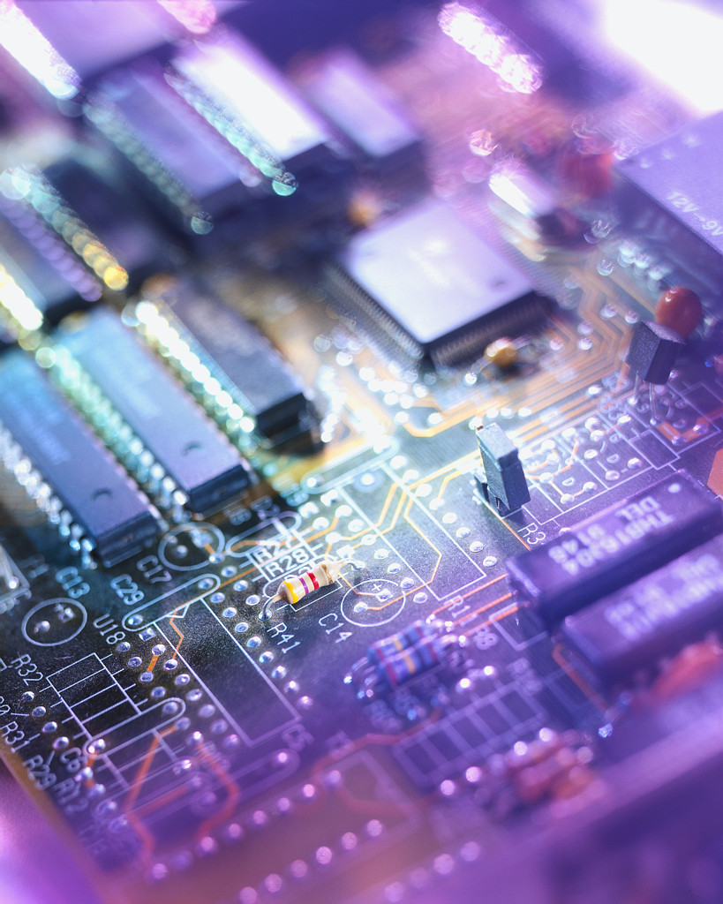
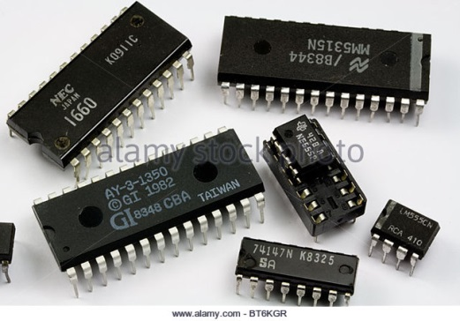
History of Computers
Third Generation: Integrated Circuits
1958 – the invention of the integrated circuit
Discrete component
Single, self-contained transistor
Manufactured separately, packaged in their own containers, and soldered or wired together onto masonite-like circuit boards
Manufacturing process was expensive and cumbersome
The two most important members of the third generation were the IBM System/360 and the DEC PDP-8
Notes:
A single, self-contained transistor is called a discrete component. Throughout the
1950s and early 1960s, electronic equipment was composed largely of discrete components—
transistors, resistors, capacitors, and so on. Discrete components were
manufactured separately, packaged in their own containers, and soldered or wired
together onto masonite-like circuit boards, which were then installed in computers,
oscilloscopes, and other electronic equipment. Whenever an electronic device called
for a transistor, a little tube of metal containing a pinhead-sized piece of silicon
had to be soldered to a circuit board. The entire manufacturing process, from transistor
to circuit board, was expensive and cumbersome.
These facts of life were beginning to create problems in the computer industry.
Early second-generation computers contained about 10,000 transistors. This
figure grew to the hundreds of thousands, making the manufacture of newer, more
powerful machines increasingly difficult.
In 1958 came the achievement that revolutionized electronics and started the
era of microelectronics: the invention of the integrated circuit. It is the integrated
circuit that defines the third generation of computers. In this section, we provide a
brief introduction to the technology of integrated circuits. Then we look at perhaps
the two most important members of the third generation, both of which were introduced
at the beginning of that era: the IBM System/360 and the DEC PDP-8.

Slide 17
Integrated Circuits
A computer consists of gates, memory cells, and interconnections among these elements
The gates and memory cells are constructed of simple digital electronic components
Data storage – provided by memory cells
Data processing – provided by gates
Data movement – the paths among components are used to move data from memory to memory and from memory through gates to memory
Control – the paths among components can carry control signals
Integrated Circuits exploit the fact that such components as transistors, resistors, and conductors can be fabricated from a semiconductor such as silicon
Many transistors can be produced at the same time on a single wafer of silicon
Transistors can be connected with a processor metallization to form circuits
Notes:
We can relate this to our four
basic functions as follows:
• Data storage: Provided by memory cells.
• Data processing: Provided by gates.
• Data movement: The paths among components are used to move data from
memory to memory and from memory through gates to memory.
• Control: The paths among components can carry control signals. For example,
a gate will have one or two data inputs plus a control signal input that activates
the gate. When the control signal is ON, the gate performs its function on the
data inputs and produces a data output. Similarly, the memory cell will store
the bit that is on its input lead when the WRITE control signal is ON and will
place the bit that is in the cell on its output lead when the READ control signal
is ON.
Thus, a computer consists of gates, memory cells, and interconnections among these
elements. The gates and memory cells are, in turn, constructed of simple digital
electronic components.
The integrated circuit exploits the fact that such components as transistors,
resistors, and conductors can be fabricated from a semiconductor such as silicon.
It is merely an extension of the solid-state art to fabricate an entire circuit in a tiny
piece of silicon rather than assemble discrete components made from separate
pieces of silicon into the same circuit. Many transistors can be produced at the same
time on a single wafer of silicon. Equally important, these transistors can be connected
with a process of metallization to form circuits.

Slide 18
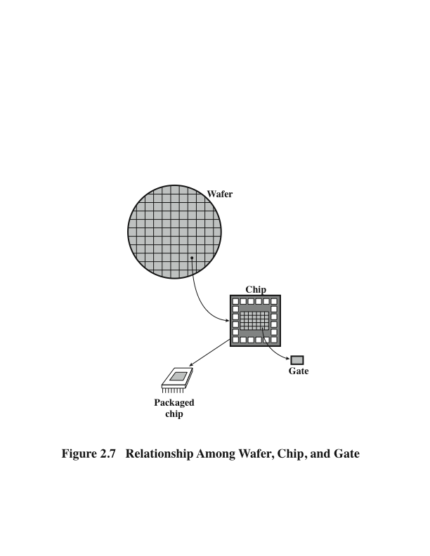
Wafer, Chip, and Gate Relationship
[Stallings W, 2013]
Notes:
Figure 2.7 on this slide depicts the key concepts in an integrated circuit. A thin wafer of
silicon is divided into a matrix of small areas, each a few millimeters square. The
identical circuit pattern is fabricated in each area, and the wafer is broken up into
chips. Each chip consists of many gates and/or memory cells plus a number of input
and output attachment points. This chip is then packaged in housing that protects
it and provides pins for attachment to devices beyond the chip. A number of these
packages can then be interconnected on a printed circuit board to produce larger
and more complex circuits.

Slide 19
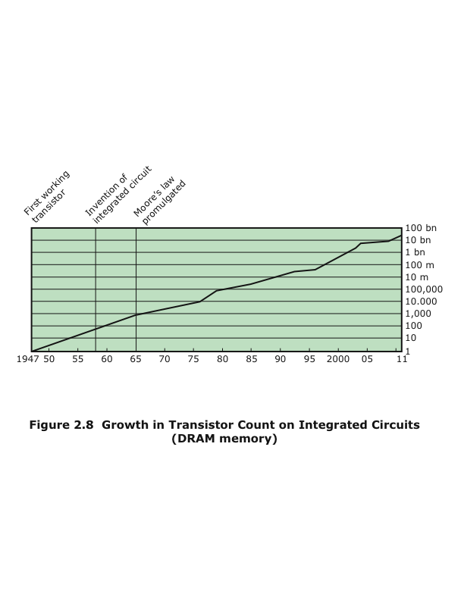
Chip Growth
[Stallings W, 2013]
Notes:
Initially, only a few gates or memory cells could be reliably manufactured
and packaged together. These early integrated circuits are referred to as small scale
Integration (SSI). As time went on, it became possible to pack more and more
Components on the same chip. This growth in density is illustrated in Figure 2.8; it is
one of the most remarkable technological trends ever recorded.

Slide 20

Moore’s Law
1965; Gordon Moore – co-founder of Intel
Observed number of transistors that could be put on a single chip was doubling every year
The pace slowed to a doubling every 18 months in the 1970’s but has sustained that rate ever since
Consequences of Moore’s law:
The cost of computer logic and memory circuitry has fallen at a dramatic rate
The electrical path length is shortened, increasing operating speed
Computer becomes smaller and is more convenient to use in a variety of environments
Reduction in power and cooling requirements
Fewer interchip connections
Notes:
The figure on this slide reflects the famous Moore’s law, which was propounded by Gordon Moore, cofounder of
Intel, in 1965. Moore observed that the number of transistors that could
be put on a single chip was doubling every year and correctly predicted that this
pace would continue into the near future. To the surprise of many, including Moore,
the pace continued year after year and decade after decade. The pace slowed to a
doubling every 18 months in the 1970s but has sustained that rate ever since.
The consequences of Moore’s law are profound:
1. The cost of a chip has remained virtually unchanged during this period of
rapid growth in density. This means that the cost of computer logic and memory
circuitry has fallen at a dramatic rate.
2. Because logic and memory elements are placed closer together on more
densely packed chips, the electrical path length is shortened, increasing
operating speed.
3. The computer becomes smaller, making it more convenient to place in a
variety of environments.
4. There is a reduction in power and cooling requirements.
5. The interconnections on the integrated circuit are much more reliable than
solder connections. With more circuitry on each chip, there are fewer interchip
connections.

Slide 21
Semiconductor Memory Microprocessors
LSI
Large
Scale Integration
Later
Generations
VLSI
Very Large Scale Integration
ULSI
Ultra Large
Scale
Integration
Notes:
Beyond the third generation there is less general agreement on defining generations
of computers. Table 2.2 (on the next slide – slide 46) suggests that there have been a number of later generations,
based on advances in integrated circuit technology. With the introduction
of large-scale integration (LSI), more than 1000 components can be placed on a
single integrated circuit chip. Very-large-scale integration (VLSI) achieved more
than 10,000 components per chip, while current ultra-large-scale integration (ULSI)
chips can contain more than one billion components.
With the rapid pace of technology, the high rate of introduction of new products,
and the importance of software and communications as well as hardware, the
classification by generation becomes less clear and less meaningful. It could be said
that the commercial application of new developments resulted in a major change in
the early 1970s and that the results of these changes are still being worked out. In
this section, we mention two of the most important of these results.

Slide 22
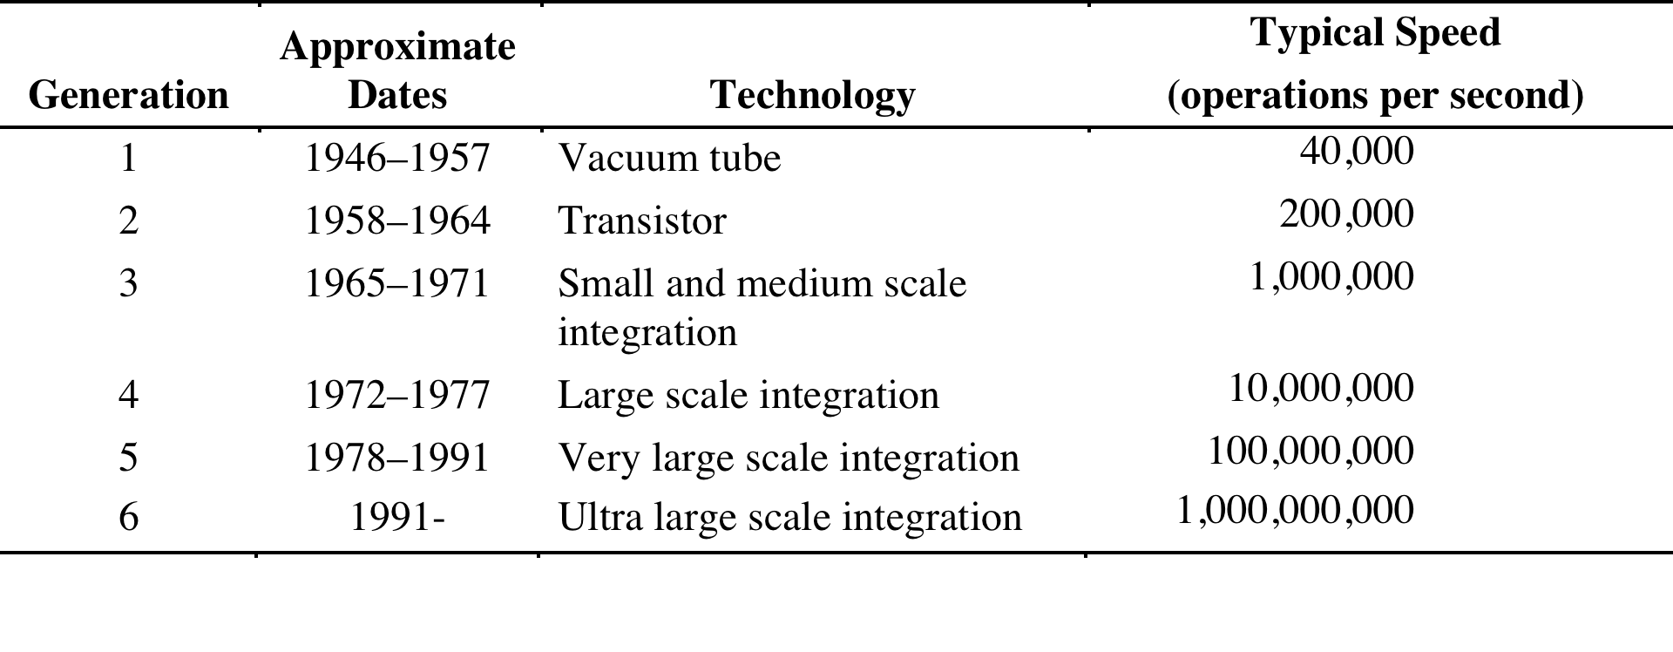
Computer Generations
Computer Generations
[Stallings W, 2013]
Notes:
It has become widely accepted to classify computers into generations based on the fundamental
hardware technology employed. Each new generation is characterized
by greater processing performance, larger memory capacity, and smaller
size than the previous one.

Slide 23
Microprocessors
The density of elements on processor chips continued to rise
More and more elements were placed on each chip so that fewer and fewer chips were needed to construct a single computer processor
1971 Intel developed 4004
First chip to contain all of the components of a CPU on a single chip
Birth of microprocessor
1972 Intel developed 8008
First 8-bit microprocessor
1974 Intel developed 8080
First general purpose microprocessor
Faster, has a richer instruction set, has a large addressing capability
Notes:
Just as the density of elements on memory chips has continued
to rise, so has the density of elements on processor chips. As time went on, more
and more elements were placed on each chip, so that fewer and fewer chips were
needed to construct a single computer processor.
A breakthrough was achieved in 1971, when Intel developed its 4004. The
4004 was the first chip to contain all of the components of a CPU on a single chip:
The microprocessor was born.
The 4004 can add two 4-bit numbers and can multiply only by repeated addition.
By today’s standards, the 4004 is hopelessly primitive, but it marked the beginning of
a continuing evolution of microprocessor capability and power.
This evolution can be seen most easily in the number of bits that the processor
deals with at a time. There is no clear-cut measure of this, but perhaps the best measure
is the data bus width: the number of bits of data that can be brought into or sent
out of the processor at a time. Another measure is the number of bits in the accumulator
or in the set of general-purpose registers. Often, these measures coincide, but
not always. For example, a number of microprocessors were developed that operate
on 16-bit numbers in registers but can only read and write 8 bits at a time.
The next major step in the evolution of the microprocessor was the introduction
in 1972 of the Intel 8008. This was the first 8-bit microprocessor and was almost twice
as complex as the 4004.
Neither of these steps was to have the impact of the next major event: the introduction
in 1974 of the Intel 8080. This was the first general-purpose microprocessor.
Whereas the 4004 and the 8008 had been designed for specific applications, the 8080
was designed to be the CPU of a general-purpose microcomputer. Like the 8008, the
8080 is an 8-bit microprocessor. The 8080, however, is faster, has a richer instruction
set, and has a large addressing capability.

Slide 24
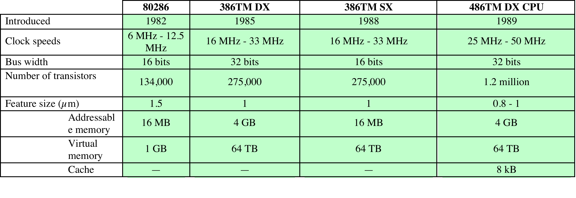
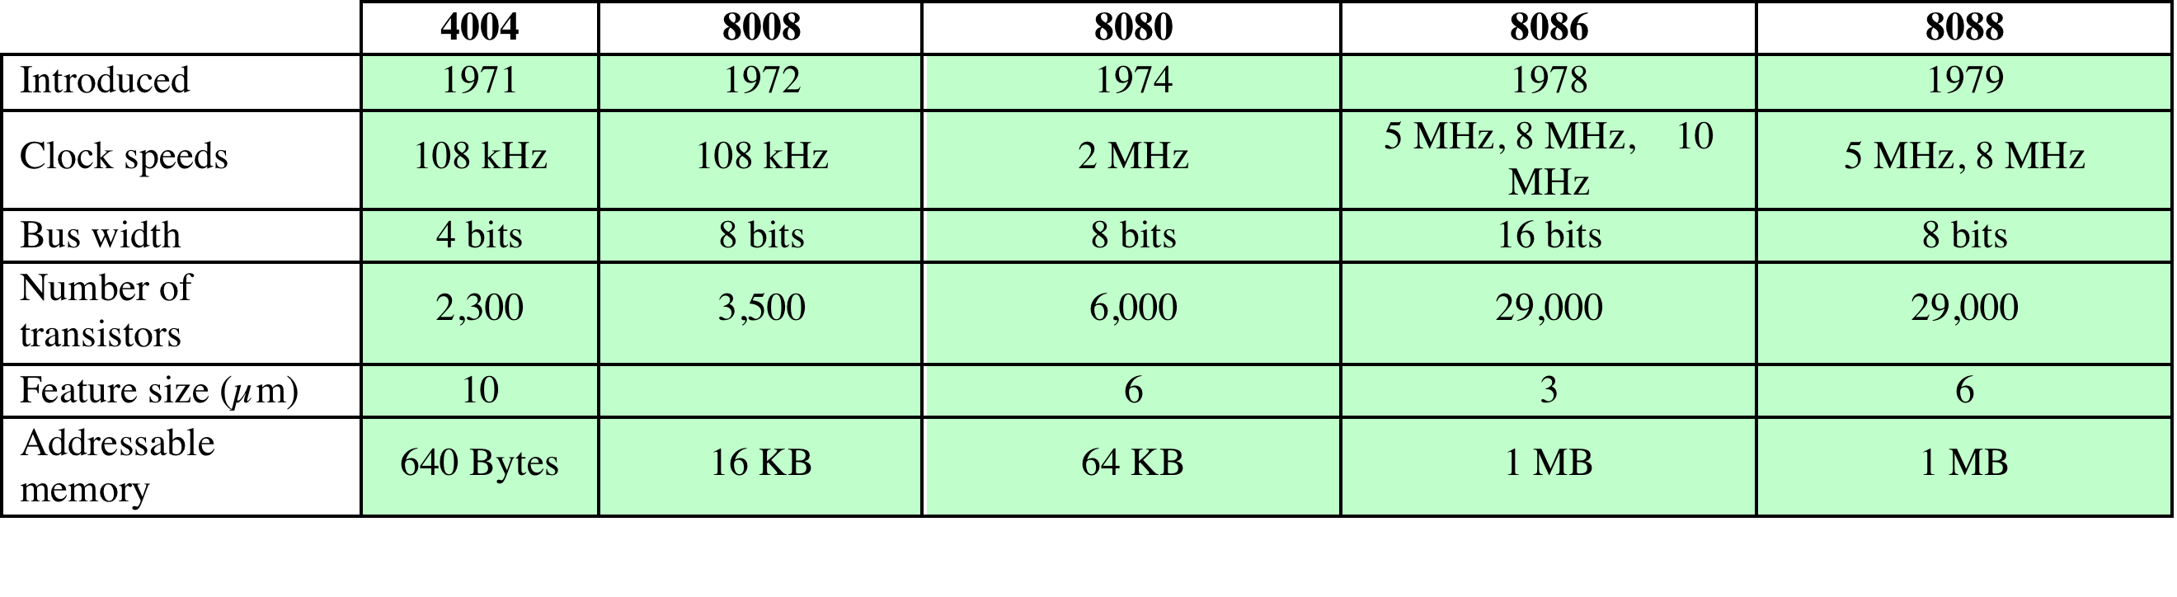
Evolution of Intel Microprocessors
a. 1970s Processors
b. 1980s Processors
[Stallings W, 2013]
Notes:
About the same time, 16-bit microprocessors began to be developed. However, it
was not until the end of the 1970s that powerful, general-purpose 16-bit microprocessors
appeared. One of these was the 8086. The next step in this trend occurred in 1981,
when both Bell Labs and Hewlett-Packard developed 32-bit, single-
chip microprocessors. Intel introduced its own 32-bit microprocessor, the 80386, in 1985 (Table 2.6).

Slide 25
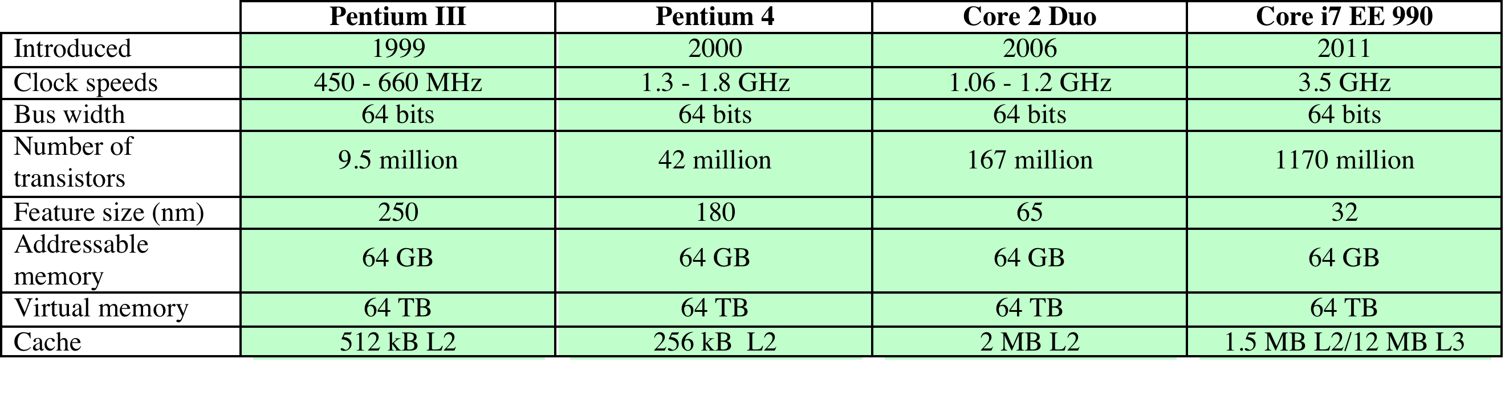
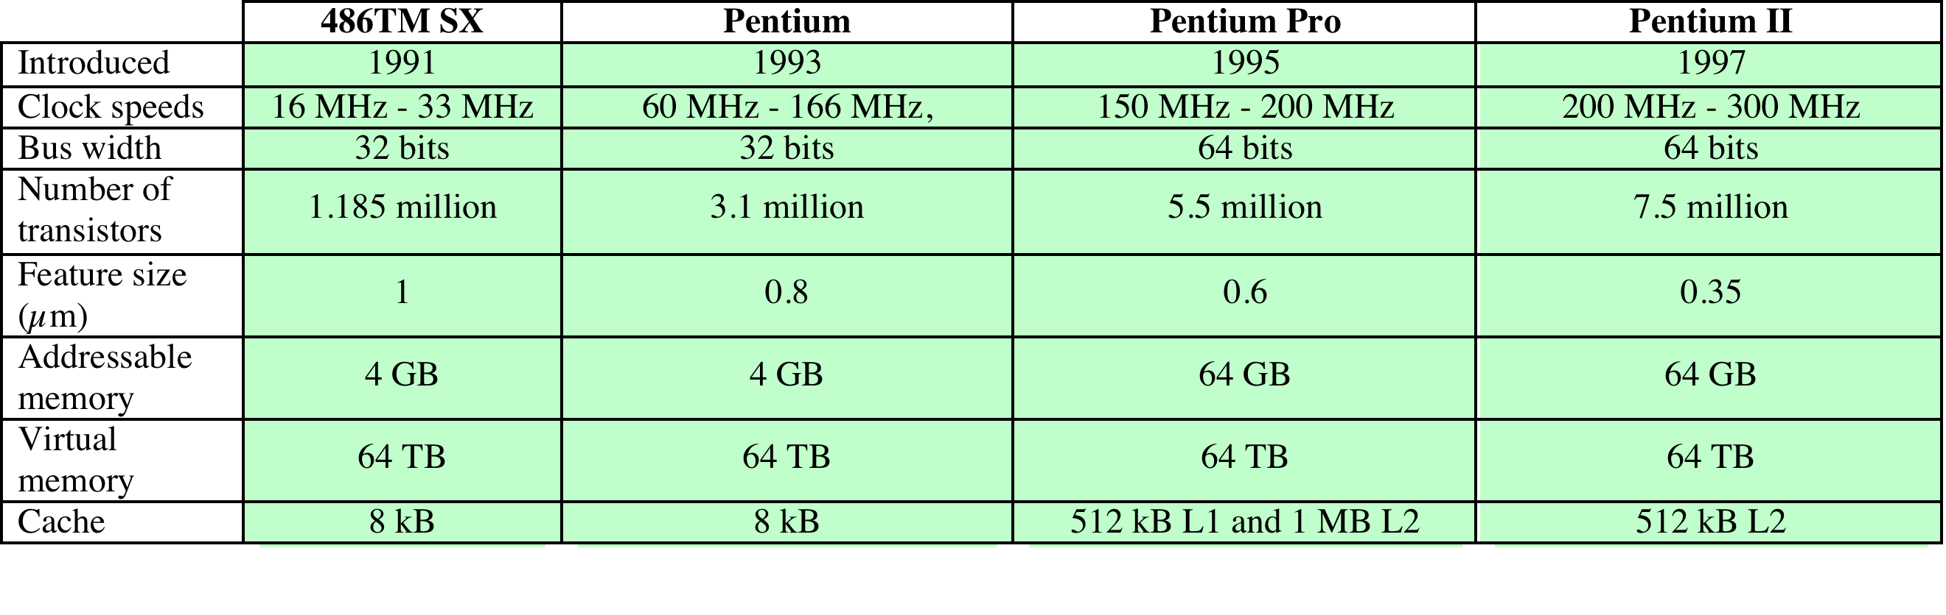
Evolution of Intel Microprocessors
c. 1990s Processors
d. Recent Processors
[Stallings W, 2013]
Notes:
Table 2.6 (continued)

Slide 26
Multicore Processors and GPGPUs
Multicore Processor
New approach to improving performance – placing multiple processors on the same chip
The use of multiple processors on the same chip is referred to as multiple cores, or multicore
General-purpose computing on GPUs
Chip with multiple general-purpose processors plus graphics processing units (GPUs)
GPU is a core designed to perform parallel operations on graphics data
Traditionally found on a plug-in graphics card – used to encode and render 2D and 3D graphics as well as process video
Now being used for general purpose computing

Slide 27
Further Reading
Computer Organization and Architecture – Designing for Performance (10th Edition), William Stallings [Chapter: 1]
Computer Organization and Design – The Hardware/Software Interface (5th Edition), David A. Patterson & John L. Hennessy [Chapter: 1]
Fundamentals of Computer Architecture, Mark Burrell [Chapter: 1]

Slide 28
Also This Week
Introduction to the Module
Basic Concepts
Number Systems
Decimal, Binary, Hexadecimal and Octal
Number conversion
Binary Arithmetic
Binary Coded Decimal
ASCII

