Slide 1
Introduction to 120CT Basic Concepts
120CT Computer Architecture and Networks
Dr Dianabasi Nkantah
ab0480@coventry.ac.uk

Slide 2
Today……….
Introduction to 120CT
Staff
What Computer Architecture is
Why study Computer Architecture?
Intended Learning Outcomes
Lecture and tutorial/lab sessions
Assessment
Structure and functions of computers
Classes of Computers
History of Computers

Slide 3
Staff Contact
Dr Dianabasi Nkantah (Module Leader)
E-mail: ab0480@coventry.ac.uk
Tel: 02477658361
Theta Centre Availability:
Monday (1pm – 2pm) – ECG-12
Friday (11am – 12noon) – ECG-12
Appointments can be arranged with staff via e-mail.
Notes:
Contact the module leader as soon as possible to raise any issues with the module.

Slide 4
Other Members of Staff on the Module
Dr Michael Odetayo (csx190@coventry.ac.uk)
Dr Kamal Bentahar (ab3735@coventry.ac.uk)
Mrs Amanda Brooks (ab3728@coventry.ac.uk)
Dr Xin Lu (ab5603@coventry.ac.uk)
Dr Mark Elshaw (ab0487@coventry.ac.uk)
Mr Nandor Verba
Mr James Westcott
Dr Rachid Anane (csx220@coventry.ac.uk)
Appointments can be arranged with staff via e-mail.

Slide 5

Architecture & Organisation
Architecture is those attributes visible to the programmer
Instruction set, number of bits used for data representation, I/O mechanisms, addressing techniques.
e.g. Is there a multiply instruction?
Organisation is how features are implemented
Control signals, interfaces, memory technology.
e.g. Is there a hardware multiply unit or is it done by repeated addition?
Notes:
Computer Architecture refers to those attributes of a system visible to a programmer; those attributes that have a direct impact on the logical execution of a program. Computer organisation refers to the operational units and their interconnections that realise the architectural specifications. Examples of architectural attributes include the instruction set, the number of bits used to represent various data types (e.g. numbers, characters), I/O mechanisms, and techniques for addressing memory. Organisational attributes include those hardware details transparent to the programmer, such as control signals, interfaces between the computer and peripherals, and the memory technology used. [Stallings, 2013]

Slide 6
Why study Computer Architecture
As a Software Developer, what if
Your program is running slowly?
Your program does not run correctly?
Your program consumes too much energy?
As a Computer Designer, what if
The hardware you designed is too difficult to program?
The hardware you designed is too slow because it does not provide the right primitives to the software?

Slide 7
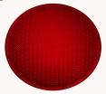
Why study Computer Architecture
CA listed as one of the core subjects that should be in the curriculum of all students in computer science and computer engineering by the IEEE/ACM Joint Task Force on Computing Curricula
The computer lies at the heart of computing
A professional in any field of computing should not regard the computer as just a black box that executes programs by magic
All students of computing should acquire some understanding and appreciation of a computer system’s functional components, their characteristics, their performance, and their interactions
Students need to understand Computer Architecture in order to make the best use of the software tools and computer languages they use to create programs

Slide 8
Levels of Transformation
Problem
Algorithm
Program/Language
Runtime System
ISA (Architecture)
120CT
Microarchitecture
Logic
Circuits
Electrons

Slide 9
Typical roles for which an understanding of CA would be useful
Programmers
Computer Architects
Compiler Writers
Operating System Designers
Database Programmers
Software Engineers
Hardware Designers
Games Developer
Security Analyst
IT Consultant
Computing Teachers
Computing Lecturers/Researchers

Slide 10
Module Summary
Provide students with a broad overview of computer architecture
Guide students in investigating operating systems
Explore aspects of computer hardware and software
Explore fundamental concepts of networking and the internet

Slide 11
Intended Learning Outcomes
On completion of this module, a student should be able to:
Demonstrate an understanding of the development of the computer and its major components
Explain the main components of a computer, and the function and operation of each
Demonstrate a basic understanding of Processor Pipelines and Instruction-level parallelism
Describe the purpose and basic features of an operating system and its role within a variety of computing systems and with a variety of input-output techniques, peripherals and storage devices
Demonstrate an understanding of network protocols and hardware, networked operating systems and cloud computing

Slide 12
Student Time on Module
Total time – 200 Hours
Lectures – 22 Hours
2 Hours a week (over 11 weeks)
Tutorial Lab Sessions – 22 Hours
2 Hours a week (over 11 weeks)
Self Study – 156 Hours
9.75 Hours a week (over 16 weeks)

Slide 13

Lectures and Lab/Tutorial Sessions
Lectures/Tutorial Sessions
Monday – 09:00-11:00 – ECG-26
ECU174 – Multimedia Computing
ECU175 – Games Technology
ECU177 – Computing
Friday – 16:00-18:00 – ECG-24
ECU178 – Computer Science
EECU007 – Ethical Hacking and Cybersecurity
Lab/Tutorial Sessions
2-Hour slots as allocated on timetables

Slide 14
Module Assessment
Two online Phase Tests (35 minutes each) – 25%
Phase Test 1 (w/c 30/10/17) – 10%
Phase Test 2 (w/c 04/12/17) – 15%
Activity-Led Learning (ALL) Projects – 25%
Assignment (only for students repeating the module – 11/12/17) – 25%
2-hour Examination (08-19/01/18) – 50%
Pass Requirement:
To pass this module, Module mark must be at least 40%, and Coursework (phase tests and projects) must be at least 35%, and Exam must be at least 35%.

Slide 15
Traffic Lights
Need to know to pass the module – >40%
May Need to know to excel on the module – >70%
Not necessary to pass the module

Slide 16
Resources
Essential Reading:
Lecture Notes on Moodle
Other materials:
Computer Organisation and Design: The hardware/Software Interface, DA Patterson & JL Hennessy (2014), 5th Edn
Fundamentals of Computer Architecture, M Burrell (2004)
Computer Organization and Architecture, W Stallings (2016), 10th Edition
Digital Fundamentals, TL Floyd (2016), 11th Edn

Slide 17
Computer Structure & Function
Structure is the way in which components relate to each other
Function is the operation of individual components as part of the structure
Computer functions are:
Data processing
Data storage
Data movement (in and out of the system)
Control

Slide 18
Structure - Top Level
Peripherals
Computer
Central
Processing
Unit
Main
Memory
Computer
Systems
Interconnection
Input/
Output
Communication lines
[Stallings W, 2013]

Slide 19
Structure - The CPU
CPU
Computer
Arithmetic
and
Logic Unit
I/O
Registers
System
Bus
CPU
Internal CPU
Interconnection
Memory
Control
Unit
[Stallings W, 2013]

Slide 20
Structure - The Control Unit
Control Unit
CPU
ALU
Sequencing
Logic
Internal
Bus
Control
Unit
Control Unit
Registers and
Decoders
Registers
Control
Memory
[Stallings W, 2013]

Slide 21
von Neumann/Turing
Stored Program concept
Main memory storing programs and data
ALU operating on binary data
Control unit interpreting instructions from memory and executing
Input and output equipment operated by control unit
Princeton Institute for Advanced Studies
IAS (von Neumann)
Bletchley Park (UK’s Code and Cipher School
Station X (Alan Turing)
Completed 1952

Slide 22
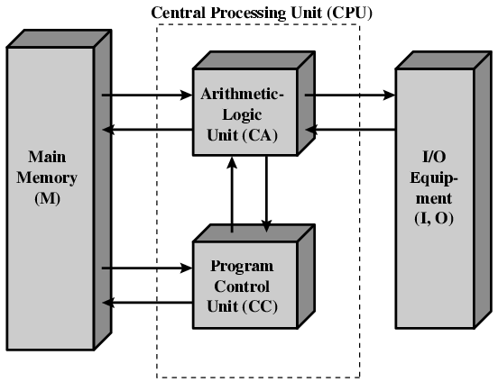
Structure of von Neumann machine
[Stallings W, 2013]

Slide 23
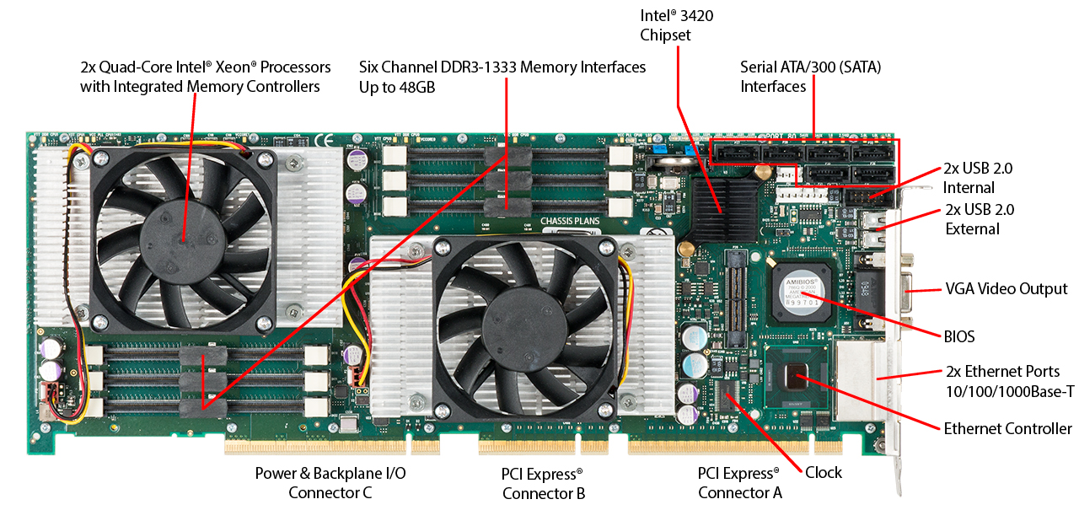
Motherboard with Two Intel Quad-Core Xeon Processors
Notes:
It will be instructive to look at some real-
world examples that illustrate the hierarchical structure of computers.
The figure on this slide is a photograph of the
motherboard for a computer built around two Intel Quad-Core
Xeon processor chips. Many of the elements labeled on the photograph are discussed subsequently
in this book. Here, we mention the most important, in addition to the processor
sockets:
■ PCI-Express slots for a high-end
display adapter and for additional peripherals
■ Ethernet controller and Ethernet ports for network connections.
■ USB sockets for peripheral devices.
■ Serial ATA (SATA) sockets for connection to disk memory.
■ Interfaces for DDR (double data rate) main memory.
■ Intel 3420 chipset is an I/O controller for direct memory access operations
between peripheral devices and main memory.

Slide 24
Registers
Memory buffer register (MBR)
Contains a word to be stored in memory or sent to the I/O unit
Or is used to receive a word from memory or from the I/O unit
Memory address register (MAR)
Specifies the address in memory of the word to be written from or read into the MBR
Instruction register (IR)
Contains the 8-bit opcode instruction being executed
Instruction buffer register (IBR)
Employed to temporarily hold the right-hand instruction from a word in memory
Program counter (PC)
Contains the address of the next instruction pair to be fetched from memory
Accumulator (AC) and multiplier quotient (MQ)
Employed to temporarily hold operands and results of ALU operations
Notes:
Memory buffer register (MBR): Contains a word to be stored in memory or sent
to the I/O unit, or is used to receive a word from memory or from the I/O unit.
• Memory address register (MAR): Specifies the address in memory of the word
to be written from or read into the MBR.
• Instruction register (IR ): Contains the 8-bit opcode instruction being executed.
• Instruction buffer register (IBR): Employed to hold temporarily the right-hand
instruction from a word in memory.
• Program counter (PC): Contains the address of the next instruction pair to be
fetched from memory.
• Accumulator (AC) and multiplier quotient (MQ): Employed to hold temporarily
operands and results of ALU operations. For example, the result of
multiplying two 40-bit numbers is an 80-bit number; the most significant 40 bits
are stored in the AC and the least significant in the MQ.

Slide 25
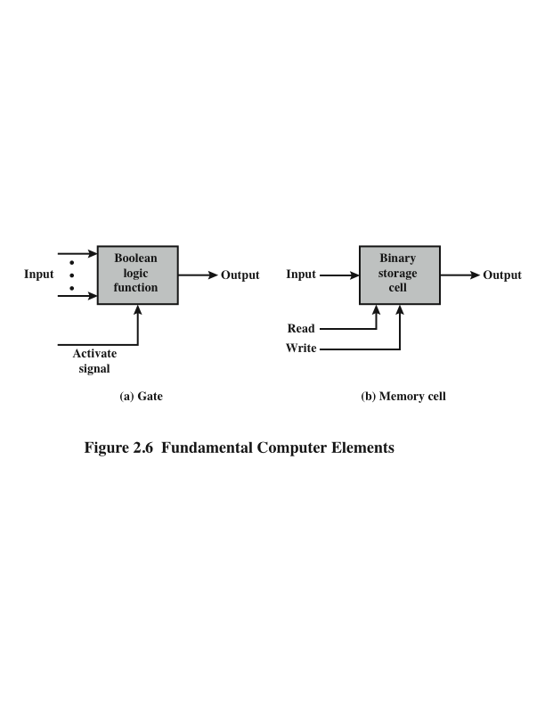
Microelectronics
[Stallings W, 2013]
Notes:
Microelectronics means, literally, “small electronics.” Since
the beginnings of digital electronics and the computer industry, there has been a
persistent and consistent trend toward the reduction in size of digital electronic
circuits. Before examining the implications and benefits of this trend, we need to
say something about the nature of digital electronics.
The basic elements of a digital computer, as we know, must perform storage,
movement, processing, and control functions. Only two fundamental types of components
are required (Figure 2.6): gates and memory cells. A gate is a device that
implements a simple Boolean or logical function, such as IF A AND B ARE TRUE
THEN C IS TRUE (AND gate). Such devices are called gates because they control
data flow in much the same way that canal gates control the flow of water. The
memory cell is a device that can store one bit of data; that is, the device can be in
one of two stable states at any time. By interconnecting large numbers of these
fundamental devices, we can construct a computer.

Slide 26
Classes of Computers
Personal Mobile Device (PMD)
A small wireless device to connect to the internet; they rely on batteries for power, and software is installed by downloading apps. Conventional examples are smart phones and tablets.
Personal Computer (PC)
A computer designed for use by an individual, usually incorporating a graphics display, a keyboard, and a mouse
Server
A computer used for running larger programs for multiple users, often simultaneously, and typically accessed only via a network
Supercomputer
A class of computers with the highest performance and cost; they are configured as servers and typically cost tens to hundreds of millions of pounds
Embedded Computer
A computer inside another device used for running one predetermined application or collection of software.

Slide 27
Also This Week
History of Computers
Number Systems
Decimal, Binary, Hexadecimal and Octal
Number conversion
Binary Arithmetic
Binary Coded Decimal
ASCII

