Slide 1
Number Systems
120CT Computer Architecture and Networks
Dr Dianabasi Nkantah
dianabasi.nkantah@coventry.ac.uk

Slide 2
Today ….
Number Systems
Decimal
Binary
Hexadecimal
Octal
Number conversion
Binary Arithmetic
Binary Coded Decimal
ASCII

Slide 3

Decimal Numbers
The position of each digit in a weighted number system is assigned a weight based on the base or radix of the system.
The radix of decimal numbers is ten, because only ten symbols (0 through 9) are used to represent any number.
The column weights of decimal numbers are powers of ten that increase from right to left beginning with 10⁰ =1:
…10⁵ 10⁴ 10³ 10² 10¹ 10⁰.
For fractional decimal numbers, the column weights are negative powers of ten that decrease from left to right:
10² 10¹ 10⁰. 10⁻¹ 10⁻² 10⁻³ 10⁻⁴ …

Slide 4
Decimal Numbers (Base 10) 0 1 2 3 4 5 6 7 8 9 10 11 12 13 14 15…
In decimal there are ten symbols to represent numbers, we call this the base 10 or radix 10.
0 1 2 3 4 5 6 7 8 9
To calculate the value of a number: multiply each symbol by a weight determined by its position, then add up the totals.
1 0 2 4
1×1000 0×100 2×10 4×1
1000 + 0 + 20 + 4 = 1024
The weights are factors of the base or radix.
10³ 10² 10¹ 10⁰ • 10⁻¹ 10⁻²
1000 100 10 1 • 1/10 1/100
× 10 (Radix)
÷ 10 (Radix)

Slide 6
Binary Numbers
For digital systems, the binary number system is used.
Binary has a radix of two and uses the digits 0 and 1 to represent quantities.
The column weights of binary numbers are powers of two that increase from right to left beginning with 2⁰ =1:
…2⁵ 2⁴ 2³ 2² 2¹ 2⁰.
For fractional binary numbers, the column weights are negative powers of two that decrease from left to right:
2² 2¹ 2⁰. 2⁻¹ 2⁻² 2⁻³ 2⁻⁴ …

Slide 7
Binary Numbers (Base 2) 0 1 10 11 100 101 110 111 1000 1001…
In binary there are two symbols to represent numbers, we call this the base 2 or radix 2.
0 1
To calculate the value of a number: multiply each symbol by a weight determined by its position, then add up the totals.
1 0 1 1
1×8 0×4 1×2 1×1
8 + 0 + 2 + 1 = 11
The weights are factors of the base or radix.
2³ 2² 2¹ 2⁰ • 2⁻¹ 2⁻²
8 4 2 1 • 1/2 1/4
× 2 (Radix)
÷ 2 (Radix)

Slide 9
Bytes, Nibbles and Words
A group of eight bits is called a byte
It represents one of 2⁸ = 256 possibilities
A group of four bits, or half a byte is called a nibble
It represents one of 2⁴ = 16 possibilities
Microprocessors handle data in chunks called words
The size of the word depends on the architecture of the microprocessor
Notes:
Within a group of bits, the bit in the 1’s column is called the least significant bit (lsb), and the bit at the other end is called the most significant bit (msb).

Slide 10

Prefixes for Binary multiples
Decimal Term | Abbreviation | Value | Binary Term | Abbreviation | Value
Kilobyte | KB | 10³ (1000 bytes) | Kibibyte | KiB | 2¹⁰ (1024 bytes)
megabyte | MB | 10⁶ | Mebibyte | MiB | 2²⁰
Gigabyte | GB | 10⁹ | Gigibyte | GiB | 2³⁰
Terabyte | TB | 10¹² | Tebibyte | TiB | 2⁴⁰
Petabyte | PB | 10¹⁵ | Pebibyte | PiB | 2⁵⁰
Exabyte | EB | 10¹⁸ | Exbibyte | EiB | 2⁶⁰
Zettabyte | ZB | 10²¹ | Zebibyte | ZiB | 2⁷⁰
yottabyte | YB | 10²⁴ | yobibyte | YiB | 2⁸⁰
The prefixes above work for bits as well as bytes, so gigabit (Gb) is 10⁹ bits while gibibits is 2³⁰ bits. See more on the IEC (International Electrotechnical Commission) site.
Notes:
The terabyte (TB) was originally 1,099,511,627,776 (2⁴⁰) bytes, although communications and secondary storage systems developers started using the term to mean 1,000,000,000,000 (10¹²) bytes. To reduce confusion , we now use the term tebibyte (TiB) for 2⁴⁰ bytes, defining terabyte (TB) to mean 10¹² bytes.

Slide 13
Hexadecimal Numbers
Decimal
Hexadecimal
Binary
Hexadecimal uses sixteen characters to represent numbers: the numbers 0 through 9 and the alphabetic characters A through F.
0 1 2 3 4 5 6 7 8 9 10 11 12 13 1415
0 1 2 3 4 5 6 7 8 9 A B C D E F
0000 0001 0010 0011 0100 0101 0110 0111 1000 1001 1010 1011 1100 1101 1110 1111
Large binary number can easily be converted to hexadecimal by grouping bits 4 at a time and writing the equivalent hexadecimal character.
Example
Express 1001 0110 0000 1110₂ in hexadecimal:
Solution
Group the binary number by 4-bits starting from the right. Thus, 960E

Slide 14
Hexadecimal Numbers
Decimal
Hexadecimal
Binary
Hexadecimal is a weighted number system. The column weights are powers of 16, which increase from right to left.
0 1 2 3 4 5 6 7 8 9 10 11 12 13 1415
0 1 2 3 4 5 6 7 8 9 A B C D E F
0000 0001 0010 0011 0100 0101 0110 0111 1000 1001 1010 1011 1100 1101 1110 1111
{
16³ 16² 16¹ 16⁰
Column weights
4096 256 16 1
Example
Express 1A2F₁₆ in decimal.
Solution
Start by writing the column weights:
4096 256 16 1
1 A 2 F₁₆
1(4096) + 10(256) +2(16) +15(1) =
6703₁₀

Slide 15
Hex Numbers (Base 16) 0 1 2 3 4 5 6 7 8 9 A B C D E F 10 11…
In hexadecimal there are sixteen symbols to represent numbers, we call this the base 16 or radix 16.
0 1 2 3 4 5 6 7 8 9 A B C D E F
To calculate the value of a number: multiply each symbol by a weight determined by its position, then add up the totals.
1 0 A F
1×4096 0×256 10×16 15×1
4096 + 0 + 160 + 15 = 4271
The weights are factors of the base or radix.
16³ 16² 16¹ 16⁰ • 16⁻¹ 16⁻²
4096 256 16 1 • 1/16 1/256
× 16 (Radix)
÷ 16 (Radix)

Slide 17


Slide 18
Octal Numbers
Decimal
Octal
Octal uses eight characters the numbers 0 through 7 to represent numbers. There is no 8 or 9 character in octal.
Binary
0 1 2 3 4 5 6 7 8 9 10 11 12 13 1415
0 1 2 3 4 5 6 7 10 1112 13 14 15 16 17
000 001 010 011 100 101 110 111 1000 1001 1010 1011 1100 1101 1110 1111
Binary number can easily be converted to octal by grouping bits 3 at a time and writing the equivalent octal character for each group.
Example
Express 1 001 011 000 001 110₂ in octal:
Solution
Group the binary number by 3-bits starting from the right. Thus, 113016₈

Slide 19
Octal Numbers
Decimal
Octal
Binary
Octal is also a weighted number system. The column weights are powers of 8, which increase from right to left.
0 1 2 3 4 5 6 7 8 9 10 11 12 13 1415
0 1 2 3 4 5 6 7 10 1112 13 14 15 16 17
000 001 010 011 100 101 110 111 1000 1001 1010 1011 1100 1101 1110 1111
{
8³ 8² 8¹ 8⁰
Column weights
512 64 8 1
Example
Express 3702₈ in decimal.
Solution
Start by writing the column weights:
512 64 8 1
3 7 0 2₈
1986₁₀
3(512) + 7(64) +0(8) +2(1) =

Slide 20
Octal Numbers (Base 8) 0 1 2 3 4 5 6 7 8 10 11 12 13 14 15 16…
In octal there are eight symbols to represent numbers, we call this the base 8 or radix 8.
0 1 2 3 4 5 6 7
To calculate the value of a number: multiply each symbol by a weight determined by its position, then add up the totals.
1 0 2 4
1×512 0×64 2×8 4×1
512 + 0 + 16 + 4 = 532
The weights are factors of the base or radix.
8³ 8² 8¹ 8⁰ • 8⁻¹ 8⁻²
512 64 8 1 • 1/8 1/64
× 8 (Radix)
÷ 8 (Radix)

Slide 21
Decimal – Binary – Octal – Hexadecimal Equivalents

Slide 22
BCD
Decimal
Binary
BCD
0 1 2 3 4 5 6 7 8 9 10 11 12 13 1415
0000 0001 0010 0011 0100 0101 0110 0111 1000 1001 1010 1011 1100 1101 1110 1111
0000 0001 0010 0011 0100 0101 0110 0111 1000 1001 0000 0001 0010 0011 0100 0101
Binary coded decimal (BCD) is a weighted code that is commonly used in digital systems when it is necessary to show decimal numbers such as in clock displays.
The table illustrates the difference between straight binary and BCD. BCD represents each decimal digit with a 4-bit code. Notice that the codes 1010 through 1111 are not used in BCD.
0001 0001 0001 0001 0001 0001
Notes:
BCD is less common than it used to be. One drawback of BCD is that it is an inefficient representation, as the binary values 1010₂ to 1111₂ are unused (some BCD representations use two of the unused codes to represent ‘+’ and ‘-’), and four bits for a single digit takes up space. Another drawback is that for the processors that have support in the ALU to perform BCD arithmetic, there is a requirement for additional circuitry. If a processor does not have support for BCD, it would take a lot of work by the programmer to perform BCD arithmetic.

Slide 23
IRA (International Reference Alphabet) or ASCII
ASCII is a code for alphanumeric characters and control characters.
In its original form, ASCII encoded 128 characters and symbols using 7-bits.
The first 32 characters are control characters, that are based on obsolete teletype requirements, so these characters are generally assigned to other functions in modern usage.
In 1981, IBM introduced extended ASCII, which is an 8-bit code and increased the character set to 256.
Other extended sets (such as Unicode) have been introduced to handle characters in languages other than English.

Slide 24
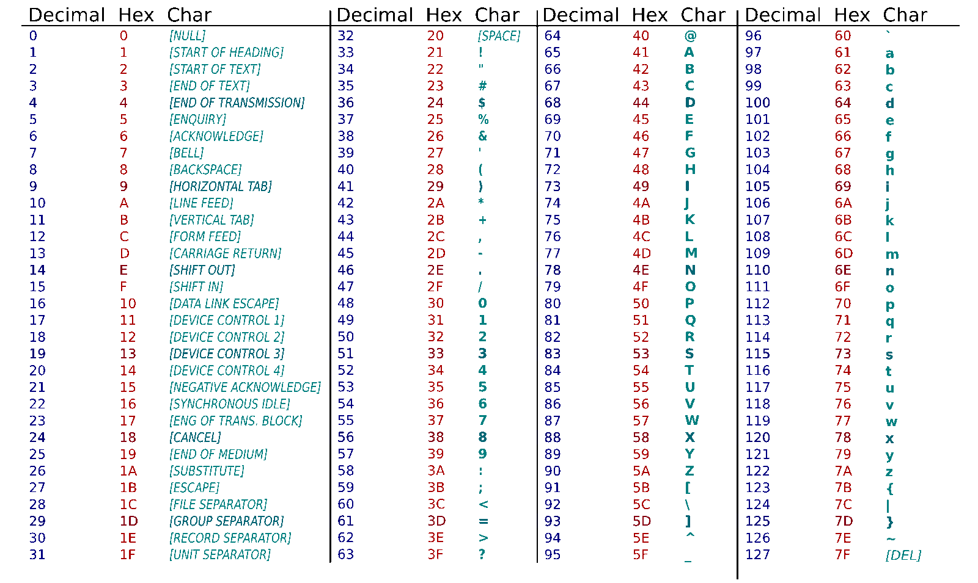
ASCII American Standard Code for Information Interchange
4F6E6C79200100207479706573206F662070656F706C6520756E6465727374616E642062696E657270

Slide 25
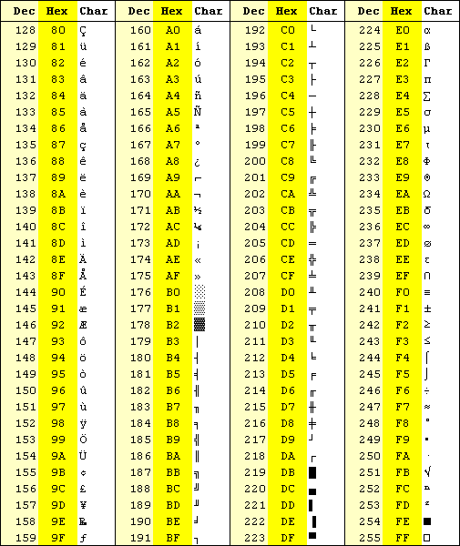
TABLE ASCII -II

Slide 26
Binary Addition
The rules for binary addition are
0 + 0 = 0 Sum = 0, carry = 0
0 + 1 = 1 Sum = 1, carry = 0
1 + 0 = 1 Sum = 1, carry = 0
1 + 1 = 10 Sum = 0, carry = 1
When an input carry = 1 due to a previous result, the rules are
1 + 0 + 0 = 01 Sum = 1, carry = 0
1 + 0 + 1 = 10 Sum = 0, carry = 1
1 + 1 + 0 = 10 Sum = 0, carry = 1
1 + 1 + 1 = 11 Sum = 1, carry = 1

Slide 27
Binary Subtraction
The rules for binary subtraction are
0 − 0 = 0
1 − 1 = 0
1 − 0 = 1
10 − 1 = 1 with a borrow of 1

Slide 29
Further Reading
Computer Organization and Architecture – Designing for Performance (10th Edition), William Stallings [Chapters: 9]
Digital Fundamentals (11th Edition), Thomas L. Floyd [Chapters: 2]
Fundamentals of Computer Architecture, Mark Burrell [Chapter: 2]

Slide 30
Next week ……
Data Representation in Computer Systems
Binary integers
Unsigned Binary numbers
Signed binary numbers
One's and Two's complement
Conversion
Arithmetic
Range of negative numbers

