Slide 1
Digital Logic
120CT Computer Architecture & Networks
Dr Dianabasi Nkantah
ab0480@coventry.ac.uk

Slide 2
Digital Logic
Digital Logic
Truth tables
Boolean expressions
Symbols of logic operators
Basic logic gates
Standard results
De Morgan laws
Simplifying circuits
Advanced Gates and Logic Circuit Design
NAND and NOR gates
XOR and XNOR gates

Slide 3

Digital Electronics
All digital computers today are built from electronic circuitry
Binary variables are used to represent information
Digital systems perform operations on these binary variables
Logic gates are simple digital circuits that take one or more binary inputs and produce a binary output
Notes:
The operation of the digital computer is based on the storage and processing of binary data.

Slide 4
Notes:
The operation of the digital computer is based on the storage and processing of binary data.

Slide 5
Boolean Algebra
This is a mathematical discipline used to design and analyze the behavior of the digital circuitry in digital computers and other digital systems
Named after George Boole
English mathematician
Proposed basic principles of the algebra in 1854
It is a convenient tool for:
Analysis
It is an economical way of describing the function of digital circuitry
Design
Given a desired function, Boolean algebra can be applied to develop a simplified implementation of that function
Notes:
2
The digital circuitry in digital computers and other digital systems is designed, and its behavior is analyzed, with the use of a mathematical discipline known as Boolean algebra. The name is in honor of an English mathematician George Boole, who proposed the basic principles of this algebra in 1854 in his treatise, An Investigation of the Laws of Thought on Which to Found the Mathematical Theories of Logic and Probabilities. In 1938, Claude Shannon, a research assistant in the Electrical Engineering Department at M.I.T., suggested that Boolean algebra could be used to solve problems in relay-switching circuit design. Shannon’s techniques were subsequently used in the analysis and design of electronic digital circuits. Boolean algebra turns out to be a convenient tool in two areas:
• Analysis: It is an economical way of describing the function of digital circuitry.
• Design: Given a desired function, Boolean algebra can be applied to develop a simplified implementation of that function.

Slide 6
Boolean Variables and Operations
Makes use of variables and operations
Are logical
A variable may take on the value 1 (TRUE) or 0 (FALSE)
Basic logical operations are AND, OR, and NOT
AND
Yields true (binary value 1) if and only if both of its operands are true
In the absence of parentheses the AND operation takes precedence over the OR operation
When no ambiguity will occur the AND operation is represented by simple concatenation instead of the dot operator
OR
Yields true if either or both of its operands are true
NOT
Inverts the value of its operand
Notes:
3
As with any algebra, Boolean algebra makes use of variables and operations. In this case, the variables and operations are logical variables and operations. Thus, a variable may take on the value 1 (TRUE) or 0 (FALSE). The basic logical operations
are AND, OR, and NOT, which are symbolically represented by dot, plus sign, and overbar:
A AND B = A * B
A OR B = A + B
NOT A = Ā
The operation AND yields true (binary value 1) if and only if both of its operands are true. The operation OR yields true if either or both of its operands are true. The unary operation NOT inverts the value of its operand.
In the absence of parentheses, the AND operation takes precedence over the OR operation. Also, when no ambiguity will occur, the AND operation is represented by simple concatenation instead of the dot operator.

Slide 7


Slide 9
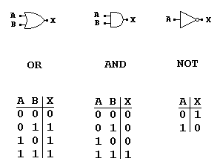

Slide 10
The Inverter
A
X
The inverter performs the Boolean NOT operation. When the input is LOW, the output is HIGH; when the input is HIGH, the output is LOW.
LOW (0) HIGH (1)
HIGH (1) LOW(0)
The NOT operation (complement) is shown with an overbar. Thus, the Boolean expression for an inverter is X = A
Notes:
As with any algebra, Boolean algebra makes use of variables and operations. In this case, the variables and operations are logical variables and operations. Thus, a variable may take on the value 1 (TRUE) or 0 (FALSE). The basic logical operations
are AND, OR, and NOT, which are symbolically represented by dot, plus sign, and overbar:
A AND B = A * B
A OR B = A + B
NOT A = Ā
The operation AND yields true (binary value 1) if and only if both of its operands are true. The operation OR yields true if either or both of its operands are true. The unary operation NOT inverts the value of its operand.
In the absence of parentheses, the AND operation takes precedence over the OR operation. Also, when no ambiguity will occur, the AND operation is represented by simple concatenation instead of the dot operator.

Slide 11
The Inverter
A
X
A group of inverters can be used to form the 1’s complement of a binary number:
Binary number
1 0 0 0 1 1 0 1
0 1 1 1 0 0 1 0
1’s complement

Slide 12
The AND Gate
A
X
B
The AND gate produces a HIGH output when all inputs are HIGH; otherwise, the output is LOW. For a 2-input gate, the truth table is
0 0
0 1
1 0
1 1
0
0
0
1
The AND operation is usually shown with a dot between the variables but it may be implied (no dot). Thus, the AND operation is written as X = A .B or X = AB
Notes:
As with any algebra, Boolean algebra makes use of variables and operations. In this case, the variables and operations are logical variables and operations. Thus, a variable may take on the value 1 (TRUE) or 0 (FALSE). The basic logical operations
are AND, OR, and NOT, which are symbolically represented by dot, plus sign, and overbar:
A AND B = A * B
A OR B = A + B
NOT A = Ā
The operation AND yields true (binary value 1) if and only if both of its operands are true. The operation OR yields true if either or both of its operands are true. The unary operation NOT inverts the value of its operand.
In the absence of parentheses, the AND operation takes precedence over the OR operation. Also, when no ambiguity will occur, the AND operation is represented by simple concatenation instead of the dot operator.

Slide 13
The AND Gate
A
X
B
The AND operation is used in computer programming as a selective mask. If you want to retain certain bits of a binary number but reset the other bits to 0, you could set a mask with 1’s in the position of the retained bits.
Example
If the binary number 10100011 is “ANDed” with the mask 00001111, what is the result?
00000011

Slide 14
The OR Gate
A
X
B
The OR gate produces a HIGH output if any input is HIGH; if all inputs are LOW, the output is LOW. For a 2-input gate, the truth table is
0 0
0 1
1 0
1 1
0
1
1
1
The OR operation is shown with a plus sign (+) between the variables. Thus, the OR operation is written as X = A + B
Notes:
As with any algebra, Boolean algebra makes use of variables and operations. In this case, the variables and operations are logical variables and operations. Thus, a variable may take on the value 1 (TRUE) or 0 (FALSE). The basic logical operations
are AND, OR, and NOT, which are symbolically represented by dot, plus sign, and overbar:
A AND B = A * B
A OR B = A + B
NOT A = Ā
The operation AND yields true (binary value 1) if and only if both of its operands are true. The operation OR yields true if either or both of its operands are true. The unary operation NOT inverts the value of its operand.
In the absence of parentheses, the AND operation takes precedence over the OR operation. Also, when no ambiguity will occur, the AND operation is represented by simple concatenation instead of the dot operator.

Slide 15
The OR Gate
A
X
B
The OR operation can be used in computer programming to set certain bits of a binary number to 1.
Example
ASCII letters have a 1 in the bit 5 position for lower case letters and a 0 in this position for capitals. (Bit positions are numbered from right to left starting with 0.) What will be the result if you “OR” an ASCII letter with the 8-bit mask 00100000?
Solution
The resulting letter will be the lower case of the letter.

Slide 16


Slide 17
Simplifying Logic Circuits
Two ways to simplify logic circuits:
Using Boolean Algebra Rules
Using Karnaugh Maps (Extra notes are provided on Moodle for Karnaugh Maps)

Slide 23
The NAND Gate
A
X
B
The NAND gate produces a LOW output when all inputs are HIGH; otherwise, the output is HIGH. For a 2-input gate, the truth table is
0 0
0 1
1 0
1 1
1
1
1
0
The NAND operation is shown with a dot between the variables and an overbar covering them. Thus, the NAND operation is written as X = A .B (Alternatively, X = AB)

Slide 24
The NAND Gate
A
X
B
The NAND gate is particularly useful because it is a “universal” gate – all other basic gates can be constructed from NAND gates.
Question
How would you connect a 2-input NAND gate to form a basic inverter?
Solution

Slide 25
The NOR Gate
A
X
B
The NOR gate produces a LOW output if any input is HIGH; if all inputs are HIGH, the output is LOW. For a 2-input gate, the truth table is
0 0
0 1
1 0
1 1
1
0
0
0
The NOR operation is shown with a plus sign (+) between the variables and an overbar covering them. Thus, the NOR operation is written as X = A + B

Slide 26
The NOR Gate
A
X
B
The NOR operation will produce a LOW if any input is HIGH.
Example
When is the LED ON for the circuit shown?
Solution
The LED will be on when any of the four inputs are HIGH.

Slide 27
The XOR Gate
A
X
B
The XOR gate produces a HIGH output only when both inputs are at opposite logic levels. The truth table is
Notice that the XOR gate will produce a HIGH only when exactly one input is HIGH.
0 0
0 1
1 0
1 1
0
1
1
0
The XOR operation is written as X = AB + AB. Alternatively, it can be written with a circled plus sign between the variables as X = A + B.

Slide 28
The XNOR Gate
A
B
The XNOR gate produces a HIGH output only when both inputs are at the same logic level. The truth table is
Notice that the XNOR gate will produce a HIGH when both inputs are the same. This makes it useful for comparison functions.
0 0
0 1
1 0
1 1
1
0
0
1
The XNOR operation shown as X = AB + AB. Alternatively, the XNOR operation can be shown with a circled dot between the variables. Thus, it can be shown as X = A . B.

Slide 29
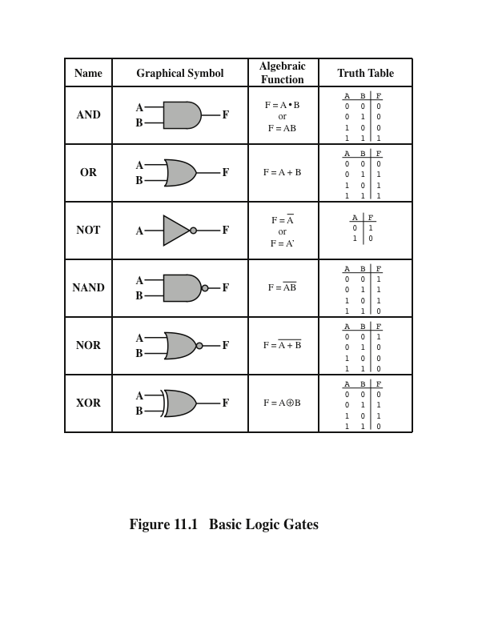
Logic Gates (Summary)
Stallings, W., 2016
Notes:
The fundamental building block of all digital logic circuits is the gate. Logical functions are implemented by the interconnection of gates.
A gate is an electronic circuit that produces an output signal that is a simple Boolean operation on its input signals. The basic gates used in digital logic are AND, OR, NOT, NAND, NOR, and XOR. Figure 11.1 depicts these six gates. Each gate is defined in three ways: graphic symbol, algebraic notation, and truth table. The symbology used on these slides is from the IEEE standard, IEEE Std 91. Note that the inversion (NOT) operation is indicated by a circle.
Each gate shown in Figure 11.1 has one or two inputs and one output. However, all of the gates except NOT can have more than two inputs. Thus, (X + Y + Z) can be implemented with a single OR gate with three inputs. When one or more of the values at the input are changed, the correct output signal appears almost instantaneously, delayed only by the propagation time of signals through the gate (known as the gate delay). In some cases, a gate is implemented with two outputs, one output being the negation of the other output.
Here we introduce a common term: we say that to assert a signal is to cause a signal line to make a transition from its logically false (0) state to its logically true (1) state. The true (1) state is either a high or low voltage state, depending on the type of electronic circuitry.
Typically, not all gate types are used in implementation. Design and fabrication are simpler if only one or two types of gates are used. Thus, it is important to identify functionally complete sets of gates. This means that any Boolean function can be implemented using only the gates in the set. The following are functionally complete sets:
AND, OR, NOT
AND, NOT
OR, NOT
NAND
NOR
It should be clear that AND, OR, and NOT gates constitute a functionally complete set, because they represent the three operations of Boolean algebra. For the AND and NOT gates to form a functionally complete set, there must be a way to synthesize the OR operation from the AND and NOT operations. This can be done by applying DeMorgan’s theorem.
Similarly, the OR and NOT operations are functionally complete because they can be used to synthesize the AND operation.

Slide 30
Further Reading
Computer Organization and Architecture – Designing for Performance (10th Edition), William Stallings [Chapter: 11]
Digital Fundamentals (11th Edition), Thomas L. Floyd [Chapters: 3, 4, 5]
Computer Organization and Design – The Hardware/Software Interface (5th Edition), David A. Patterson & John L. Hennessy [Appendix: B]
Fundamentals of Computer Architecture, Mark Burrell [Chapter: 3]

