Slide 1
Functional Units from Logic Gates (Combinational Circuits)
120CT Computer Architecture & Networks
Dr Dianabasi Nkantah
ab0480@coventry.ac.uk

Slide 2
Functional Units from Logic gates
Decoders
Encoders
Multiplexers
Comparators
Special use of the X-OR gate
Adder circuits
Full adder
4 bit adder
Arithmetic and Logic Unit
Arithmetic unit
Addition
2’s complement subtraction
Logic unit
Tri-state

Slide 3

Combinational Circuits
A combinational circuit is an interconnected set of gates
Its output at any time is a function of the inputs at that time
A combinational circuit can be defined in three ways:
Truth table
Graphical symbols
Boolean equations
Examples of Combinational Circuits that are functional units in a computer:
Decoders, Encoders, Multiplexers, Demultiplexers, Comparators, Adders

Slide 4
Decoders
A decoder is a logic circuit that detects the presence of a specific combination of bits at its input.

Slide 7
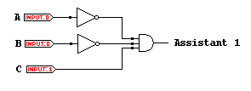

Slide 8
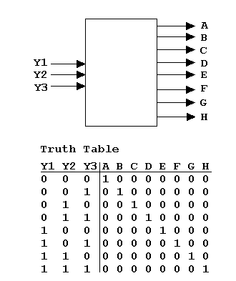
Decoders
Applications:
Instruction Decoding
Input/Output Selection
BCD-to-Decimal Decoding
Address decoding
Notes:
A 3-to-8 line decoder is also known as a 1-in-8 decoder. A 4-to-16 line decoder is also known as a 1-in-16 decoder.

Slide 9
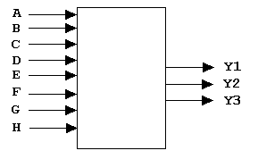
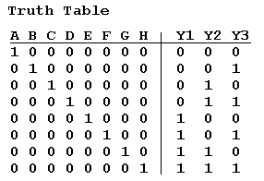
Encoders
An encoder accepts an active logic level on one of its inputs and converts it to a coded output, such as BCD or binary.
Applications:
Decimal-to-BCD Decoding
Assemblers (Software encoders)

Slide 10
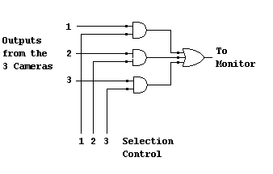
Multiplexers
A multiplexer (MUX) selects one data line from two or more input lines and routes data from the selected line to the output. The particular data line that is selected is determined by the select inputs.
Application:
Control of access to a shared bus by processors on a multi-processor system (Bus Arbiter)

Slide 11

Comparators
The function of a comparator is to compare the magnitudes of two binary numbers to determine the relationship between them. In the simplest form, a comparator can test for equality using XNOR gates.
Example
How could you test two 4-bit numbers for equality?
Solution
AND the outputs of four XNOR gates.
A₁
B₁
A₂
B₂
Output
A₃
B₃
A₄
B₄

Slide 12
Half-Adder
Schematic diagram of the half adder
EOR
T
S
(Sum)
B
C_{out}
(Carry out)
AND
Truth Table
T | B | S | C_{out}
0 | 0 | 0 | 0
0 | 1 | 1 | 0
1 | 0 | 1 | 0
1 | 1 | 0 | 1
1-bit addition
 | T
 | + B
C_{out} | S

Slide 14
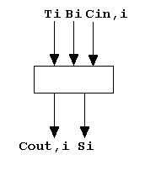

Slide 16


Slide 17
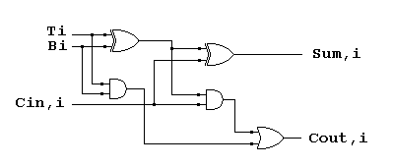

Slide 18
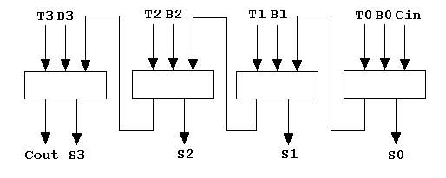
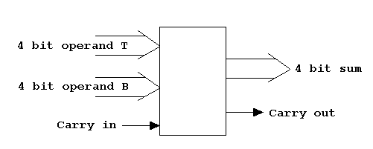
Notes:
To add two binary numbers (each with multiple bits), a multiple-bit parallel full-adder (combination of multiple full-adders) is required. For example, to add two 4-bit numbers, a 4-bit parallel adder is required. To add two 16-bit numbers, a 16-bit parallel adder is required.

Slide 19
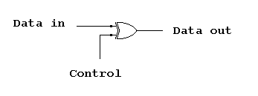

Slide 21
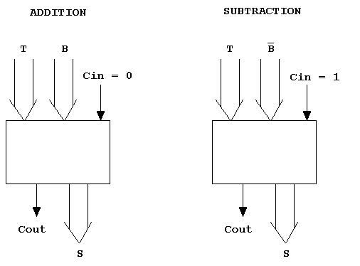

Slide 22
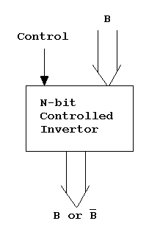
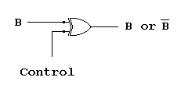

Slide 23
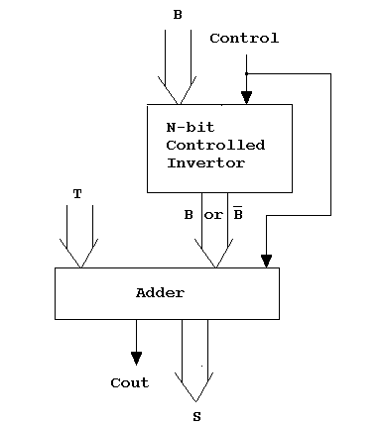

Slide 24
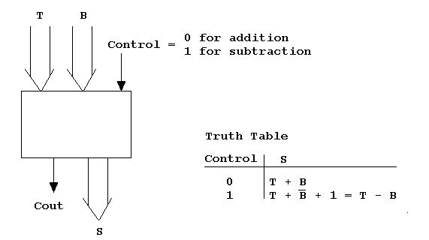

Slide 26
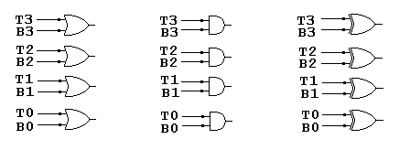

Slide 27
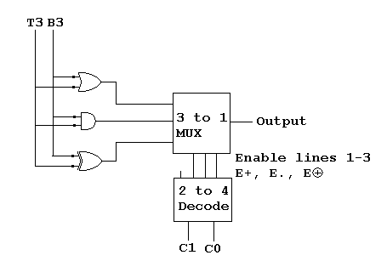

Slide 29
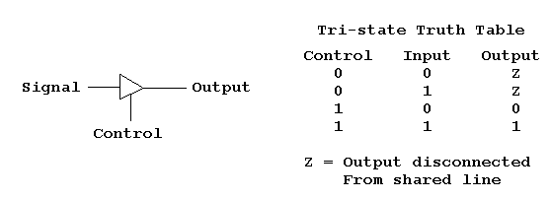
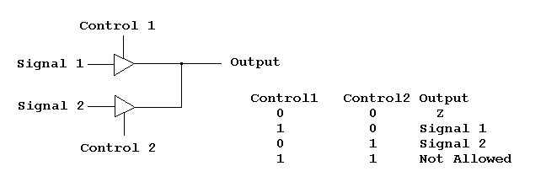

Slide 30
Further Reading
Computer Organization and Architecture – Designing for Performance (10th Edition), William Stallings [Chapter: 11]
Digital Fundamentals (11th Edition), Thomas L. Floyd [Chapter: 6]
Computer Organization and Design – The Hardware/Software Interface (5th Edition), David A. Patterson & John L. Hennessy [Appendix: A]
Fundamentals of Computer Architecture, Mark Burrell [Chapter: 4, 5]

Slide 31
Next Class ….
Introduction to Sequential Logic
Latches and Flip-flops
set, reset
truth table
clocked latch,
edge triggered FF
timing diagram, operation
D-type FF
clear & preset
toggles
Counters
Shift Registers

