Slide 1
Functional Units from Logic Gates
(Sequential Circuits)
120CT Computer Architecture & Networks
Dr Dianabasi Nkantah
ab0480@coventry.ac.uk

Slide 2
Functional Units from Logic gates
Introduction to Sequential Logic
  Latches and Flip-flops
    set, reset
    truth table
    clocked latch,
    edge triggered FF
      timing diagram, operation
      D-type FF
      clear & preset
      Toggles
Counters
Shift Registers

Slide 3

Sequential Circuits
The current output of a sequential circuit depends on the current input and the current state of the circuit
    i.e. the current output of a sequential circuit depends not only on the current input, but also on the past history of inputs

Slide 6

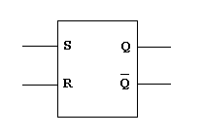
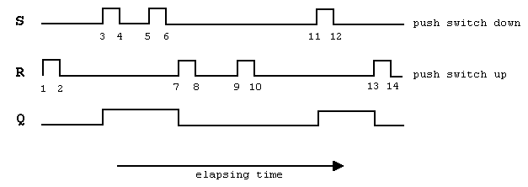

Slide 7
Latches
A latch is a temporary storage device that has two stable states (bistable). It is a basic form of memory.
The S-R (Set-Reset) latch is the most basic type. It can be constructed from NOR gates or NAND gates.
R
R
Q
Q
S
Q
Q
S
NOR Active-HIGH Latch NAND Active-LOW Latch

Slide 8
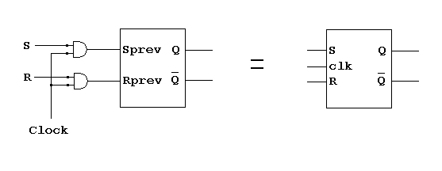

Slide 9
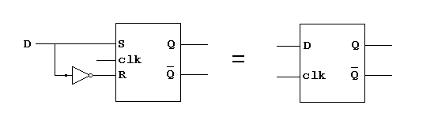

Slide 10
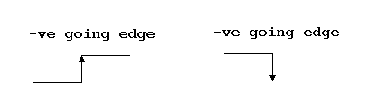

Slide 11
Flip-flops
A flip-flop differs from a latch in the manner it changes states.
A flip-flop is a clocked device, in which only the clock edge determines when a new bit is entered.
The active edge can be positive or negative.
Dynamic input indicator

Slide 12

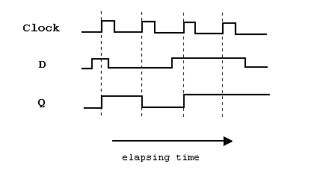
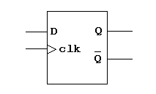

Slide 13
Flip-flops
The truth table for a positive-edge triggered D flip-flop shows an up arrow to remind you that it is sensitive to its D input only on the rising edge of the clock; otherwise it is latched. The truth table for a negative-edge triggered D flip-flop is identical except for the direction of the arrow.
(a) Positive-edge triggered (b) Negative-edge triggered

Slide 14
Flip-flops
The J-K flip-flop is more versatile than the D flip flop. In addition to the clock input, it has two inputs, labeled J and K. When both J and K = 1, the output changes states (toggles) on the active clock edge (in this case, the rising edge).
Notes:
The two control inputs for the J-K flip-flop are labelled J and K in honour of Jack Kilby, who invented the integrated circuit.

Slide 15
Flip-flops
A D-flip-flop does not have a toggle mode like the J-K flip-flop, but you can hardwire a toggle mode by connecting Q back to D as shown. This is useful in some counters.
For example, if Q is LOW, Q is HIGH and the flip-flop will toggle on the next clock edge. Because the flip-flop only changes on the active edge, the output will only change once for each clock pulse.
Q
D
CLK
CLK
Q
D flip-flop hardwired for a toggle mode

Slide 16
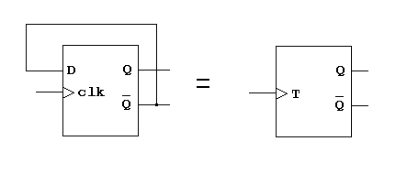

Slide 17
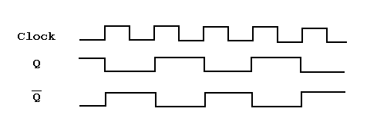

Slide 18
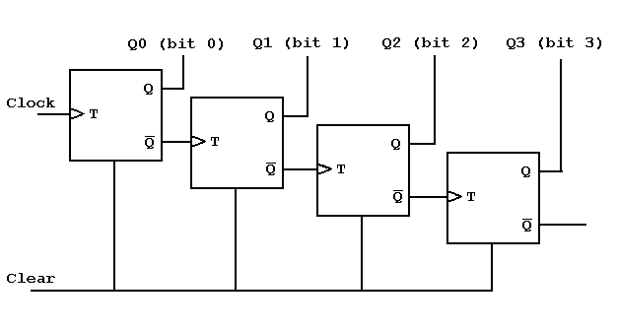

Slide 19
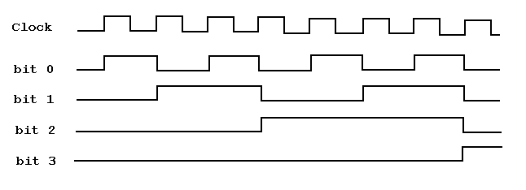
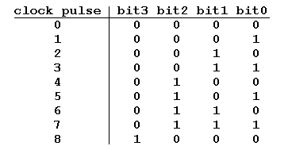

Slide 21
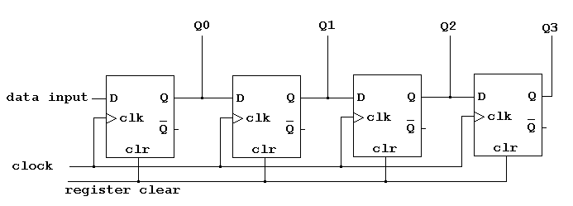

Slide 22
Example
The group of bits 10011101 is serially shifted (right-most bit first) into an 8-bit parallel output shift register with an initial state of 11000101. What is the content of the register after four clock pulses?
Solution:
Initial content of register: 11000101
Content of register after 1st clock pulse: 11100010
Content of register after 2nd clock pulse: 01110001
Content of register after 3rd clock pulse: 10111000
Content of register after 4th clock pulse: 11011100
The content of the register after four clock pulses is 11011100

Slide 23
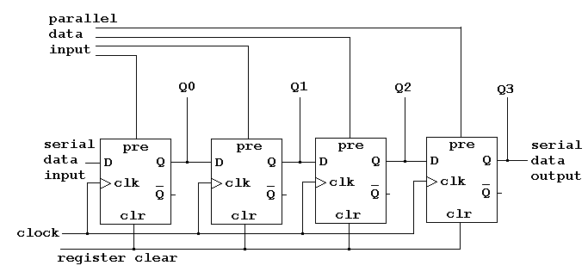

Slide 25
Further Reading
Computer Organization and Architecture – Designing for Performance (10th Edition), William Stallings [Chapters: 11]
Digital Fundamentals (11th Edition), Thomas L. Floyd [Chapters: 6, 7, 8, 9]
Computer Organization and Design – The Hardware/Software Interface (5th Edition), David A. Patterson & John L. Hennessy [Appendix: A]
Fundamentals of Computer Architecture, Mark Burrell [Chapter: 4, 5]

