Slide 1
Processors Instruction Pipelining
120CT Computer Architecture and Networks
Dr Dianabasi Nkantah
ab0480@coventry.ac.uk

Slide 2
Today……….
Components of a computer
Processor Organisation
Key Elements of Program Execution
Instruction Fetch and Execute
Interrupts
Register Organisation
User-visible Registers
Control and status registers
Instruction Pipelining and Instruction-level Parallelism
Pipeline Strategy
Pipeline Performance
Pipeline hazards
Dealing with branches
Superscalar Systems
Instruction-level Parallelism

Slide 3

Computer Components
Contemporary computer designs are based on concepts developed by John von Neumann at the Institute for Advanced Studies, Princeton
Referred to as the von Neumann architecture and is based on three key concepts:
Data and instructions are stored in a single read-write memory
The contents of this memory are addressable by location, without regard to the type of data contained there
Execution occurs in a sequential fashion (unless explicitly modified) from one instruction to the next
An alternative to the von Neumann architecture is the Harvard architecture
Notes:
Virtually all contemporary computer designs are based on concepts developed by John von Neumann at the Institute for Advanced Studies,
Princeton. Such a design is referred to as the von Neumann architecture and is based on three key concepts:
• Data and instructions are stored in a single read–write memory.
• The contents of this memory are addressable by location, without regard to the type of data contained there.
• Execution occurs in a sequential fashion (unless explicitly modified) from one instruction to the next.
The reasoning behind these concepts can be summarized as follows. There is a small set of basic logic components that can be
combined in various ways to store binary data and perform arithmetic and logical operations on that data. If there is a particular computation to be performed, a configuration of logic components designed specifically for that computation could be constructed. We can think of the process of connecting the various components in the desired configuration as a form of programming. The resulting “program” is
in the form of hardware and is termed a hardwired program.

Slide 4
Components
The Control Unit and the Arithmetic and Logic Unit constitute the Central Processing Unit
Data and instructions need to get into the system and results need to get out
Input/output
Temporary storage of code and results is needed
Main memory

Slide 5
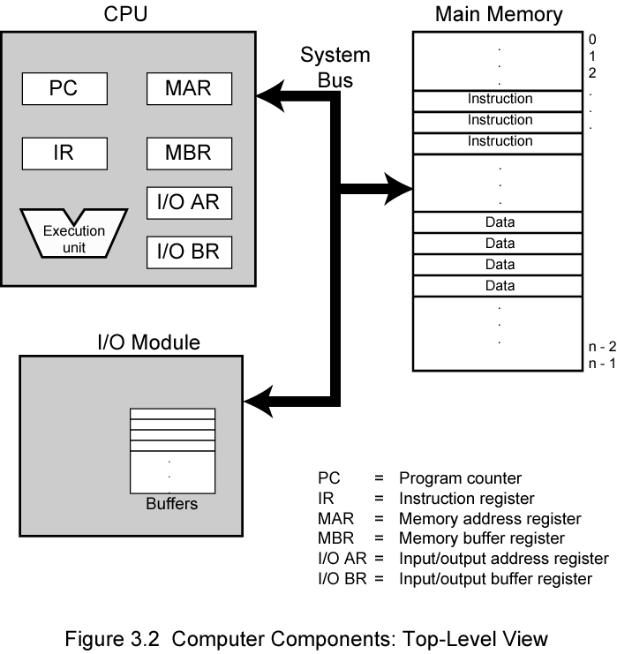
Computer Components: Top Level View
CU
Stallings, W., 2016
Notes:
The figure here illustrates the top-level components of the computer and suggests the interactions among them.
A memory module consists of a set of locations, defined by sequentially numbered addresses. Each location contains a binary number that can be interpreted as either an instruction or data. An I/O module transfers data from external devices to CPU and memory, and vice versa. It contains internal buffers for temporarily holding these data until they can be sent on.

Slide 6
Processor Organisation
The processor must be able to do the following:
Fetch instruction
The processor reads an instruction from memory (register, cache, main memory)
Interpret instruction
The instruction is decoded to determine what action is required
Fetch data
The execution of an instruction may require reading data from memory or an I/O module
Process data
The execution of an instruction may require performing some arithmetic or logical operation on data
Write data
The results of an execution may require writing data to memory or an I/O module
In order to do these things the processor needs to store some data temporarily and therefore needs a small internal memory (registers)
Notes:
22
To understand the organisation of the processor, let us consider the requirements placed on the processor, the things that it must do:
Fetch instruction: The processor reads an instruction from memory (register, cache, main memory).
Interpret instruction: The instruction is decoded to determine what action is required.
Fetch data: The execution of an instruction may require reading data from memory or an I/O module.
Process data: The execution of an instruction may require performing some arithmetic or logical operation on data.
Write data: The results of an execution may require writing data to memory or an I/O module.
To do these things, it should be clear that the processor needs to store some data temporarily. It must remember the location of the last instruction so that it can know where to get the next instruction. It needs to store instructions and data temporarily while an instruction is being executed. In other words, the processor needs a small internal memory.

Slide 7
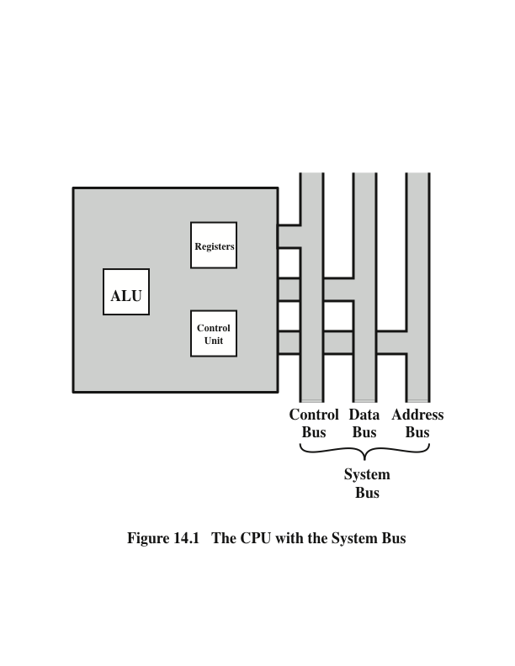
CPU With the System Bus
(W. Stallings, 2016)
Notes:
The figure on this slide is a simplified view of a processor, indicating its connection to the rest of the system via the system bus. A similar interface would be needed for any of the interconnection structures described during the lecture in week 7. Recall that the major components of the processor are an arithmetic and logic unit (ALU) and a control unit (CU). The ALU does the actual computation or processing of data. The control unit controls the movement of data and instructions into and out of the processor and controls the operation of the ALU. In addition, the figure shows a minimal internal memory, consisting of a set of storage locations, called registers.

Slide 8

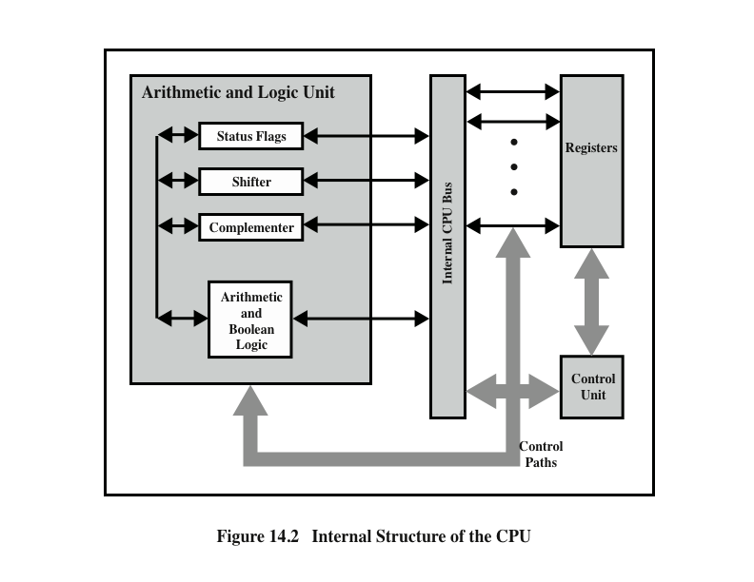
CPU Internal Structure
(W. Stallings, 2016)
Notes:
The figure on this slide is a slightly more detailed view of the processor. The data transfer and logic control paths are indicated, including an element labeled internal processor bus. This element is needed to transfer data between the various registers and the ALU because the ALU in fact operates only on data in the internal processor memory. The figure also shows typical basic elements of the ALU. Note the similarity between the internal structure of the computer as a whole and the internal structure of the processor. In both cases, there is a small collection of major elements (computer: processor, I/O, memory; processor: control unit, ALU, registers) connected by data paths.

Slide 9
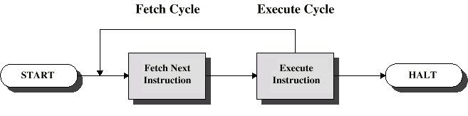
Basic Instruction Cycle
Two steps:
Fetch
Execute
Notes:
In its simplest form, instruction processing consists of two steps: The processor reads (fetches) instructions from memory one
at a time and executes each instruction. Program execution consists of repeating the process of instruction fetch and instruction execution. The instruction execution may involve several operations and depends on the nature of the instruction.
The processing required for a single instruction is called an instruction cycle. Using the simplified two-step description given previously, the instruction cycle is depicted in the figure here. The two steps are referred to as the fetch cycle and the execute
cycle. Program execution halts only if the machine is turned off, some sort of unrecoverable
error occurs, or a program instruction that halts the computer is encountered.

Slide 10
Fetch Cycle
Program Counter (PC) holds address of next instruction to fetch
Processor fetches instruction from memory location pointed to by PC
Increment PC
Unless told otherwise
Instruction loaded into the Instruction Register (IR)
Once the instruction has been fetched, the processor interprets (decodes) the instruction and performs required actions
Notes:
At the beginning of each instruction cycle, the processor fetches an instruction from memory. In a typical processor, a register called the program counter (PC) holds the address of the instruction to be fetched next. Unless instructed otherwise, the processor always increments the PC after each instruction fetch so that it will fetch the next instruction in sequence (i.e. the instruction located at the next higher memory address).
The fetched instruction is loaded into a register in the processor known as the instruction register (IR). The instruction contains bits that specify the action the processor is to take. The processor interprets the instruction and performs the required action.

Slide 11
Execute Cycle
After an instruction has been interpreted, the processor performs (executes) the required action. In general, these actions fall into the following four categories:
Processor-memory Transfer
Data transfer between CPU and main memory
Processor-I/O Transfer
Data transfer between CPU and I/O module
Data processing
Some arithmetic or logical operation on data
Control
Alteration of sequence of operations
e.g. jump
Combination of above

Slide 12
Interrupts
Mechanism by which other modules (e.g. I/O) may interrupt normal sequence of processing
Types of Interrupts:
Program
e.g. overflow, division by zero, attempt to execute an illegal machine instruction, reference outside a user’s allowed memory space
Timer
Generated by internal processor timer
Used in pre-emptive multi-tasking
I/O
Generated by an I/O controller – used to signal normal completion of an operation, request service from the processor, signal a variety of error conditions
Hardware failure
Generated by a failure such as power failure or memory parity error

Slide 13
Interrupt Cycle
Added to instruction cycle
Processor checks for interrupt
Indicated by an interrupt signal
If no interrupt, fetch next instruction
If interrupt pending:
Suspend execution of current program
Save context
Set PC to start address of interrupt handler routine
Process interrupt
Restore context and continue interrupted program

Slide 14
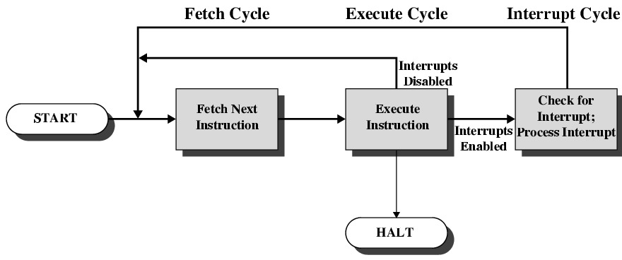
Instruction Cycle with Interrupts
Notes:
To accommodate interrupts, an interrupt cycle is added to the instruction
cycle, as shown in the figure here. In the interrupt cycle, the processor checks to see if
any interrupts have occurred, indicated by the presence of an interrupt signal. If no
interrupts are pending, the processor proceeds to the fetch cycle and fetches the
next instruction of the current program. If an interrupt is pending, the processor
does the following:
• It suspends execution of the current program being executed and saves its
context. This means saving the address of the next instruction to be executed
(current contents of the program counter) and any other data relevant to the
processor’s current activity.
• It sets the program counter to the starting address of an interrupt handler routine.
The processor now proceeds to the fetch cycle and fetches the first instruction
in the interrupt handler program, which will service the interrupt. The interrupt
handler program is generally part of the operating system. Typically, this program
determines the nature of the interrupt and performs whatever actions are needed.
In the case of an I/O interrupt, the handler determines which I/O module
generated the interrupt and may branch to a program that will write more data out
to that I/O module. When the interrupt handler routine is completed, the processor
can resume execution of the user program at the point of interruption.
It is clear that there is some overhead involved in this process. Extra instructions
must be executed (in the interrupt handler) to determine the nature of the interrupt
and to decide on the appropriate action. Nevertheless, because of the relatively large
amount of time that would be wasted by simply waiting on an I/O operation, the
processor can be employed much more efficiently with the use of interrupts.

Slide 15
Instruction Cycle
Includes the following stages:
Fetch
Read the next instruction from memory into the processor
Execute
Interpret the opcode and perform the indicated operation
Interrupt
If interrupts are enabled and an interrupt has occurred, save the current process state and service the interrupt
Notes:
35
We described the processor’s instruction cycle in an earlier lecture. To recall, an instruction cycle includes the following stages:
Fetch: Read the next instruction from memory into the processor.
Execute: Interpret the opcode and perform the indicated operation.
Interrupt: If interrupts are enabled and an interrupt has occurred, save the current process state and service the interrupt.
We are now in a position to elaborate somewhat on the instruction cycle. First, we must introduce one additional stage, known as the indirect cycle.

Slide 16
Multiple Interrupts
Disable interrupts
Processor will ignore further interrupts whilst processing one interrupt
Interrupts remain pending and are checked after first interrupt has been processed
Interrupts handled in sequence as they occur
Define priorities
Low priority interrupts can be interrupted by higher priority interrupts
When higher priority interrupt has been processed, processor returns to previous interrupt

Slide 17
Register Organisation
Within the processor there is a set of registers that function as a level of memory above main memory and cache in the hierarchy
The registers in the processor perform two roles:
User-Visible Registers
Control and Status Registers
Enable the machine or assembly language programmer to minimise main memory references by optimising use of registers
Used by the control unit to control the operation of the processor and by privileged operating system programs to control the execution of programs
Notes:
23
As we discussed last week, a computer system employs a memory hierarchy. At higher levels of the hierarchy, memory is faster, smaller, and more expensive (per bit). Within the processor, there is a set of registers that function as a level of memory above main memory and cache in the hierarchy. The registers in the processor perform two roles:
User-visible registers: Enable the machine- or assembly language programmer to minimize main memory references by optimising use of registers.
Control and status registers: Used by the control unit to control the operation of the processor and by privileged, operating system programs to control the execution of programs.
There is not a clean separation of registers into these two categories. For example, on some machines the program counter is user visible (e.g., x86), but on many it is not. For purposes of the following discussion, however, we will use these categories.

Slide 18
User-Visible Registers
Referenced by means of the machine language that the processor executes
Categories:
General purpose
Can be assigned to a variety of functions by the programmer
Data
May be used only to hold data and cannot be employed in the calculation of an operand address
Address
May be somewhat general purpose or may be devoted to a particular addressing mode
Examples: segment pointers, index registers, stack pointer
Condition codes
Also referred to as flags
Bits set by the processor hardware as the result of operations
Notes:
24
A user-visible register is one that may be referenced by means of the machine language that the processor executes. We can characterise these in the following categories:
General purpose
Data
Address
Condition codes
General-purpose registers can be assigned to a variety of functions by the programmer. Sometimes their use within the instruction set is orthogonal to the operation. That is, any general-purpose register can contain the operand for any opcode. This provides true general-purpose register use. Often, however, there are restrictions. For example, there may be dedicated registers for floating-point and stack operations.
In some cases, general-purpose registers can be used for addressing functions (e.g., register indirect, displacement). In other cases, there is a partial or clean separation between data registers and address registers. Data registers may be used only to hold data and cannot be employed in the calculation of an operand address.
Address registers may themselves be somewhat general purpose, or they may be
devoted to a particular addressing mode. Examples include the following:
Segment pointers: In a machine with segmented addressing, a segment register holds the address of the base of the segment. There may be multiple registers: for example, one for the operating system and one for the current process.
Index registers: These are used for indexed addressing and may be autoindexed.
Stack pointer: If there is user-visible stack addressing, then typically there is a dedicated register that points to the top of the stack. This allows implicit addressing; that is, push, pop, and other stack instructions need not contain an explicit stack operand.
There are several design issues to be addressed here. An important issue is whether to use completely general-purpose registers or to specialise their use. With the use of specialised registers, it can generally be implicit in the opcode which type of register a certain operand specifier refers to. The operand specifier must only identify one of a set of specialized registers rather than one out of all the registers, thus saving bits. On the other hand, this specialization limits the programmer’s flexibility.
Another design issue is the number of registers, either general purpose or data plus address, to be provided. Again, this affects instruction set design because more registers require more operand specifier bits. As we previously discussed, somewhere between 8 and 32 registers appears optimum. Fewer registers result in more memory references; more registers do not noticeably reduce memory references. However, a new approach, which finds advantage in the use of hundreds of registers, is exhibited in some RISC systems.
Finally, there is the issue of register length. Registers that must hold addresses obviously must be at least long enough to hold the largest address. Data registers should be able to hold values of most data types. Some machines allow two contiguous registers to be used as one for holding double-length values.
A final category of registers, which is at least partially visible to the user, holds condition codes (also referred to as flags). Condition codes are bits set by the processor hardware as the result of operations. For example, an arithmetic operation may produce a positive, negative, zero, or overflow result. In addition to the result itself being stored in a register or memory, a condition code is also set. The code may subsequently be tested as part of a conditional branch operation.
Condition code bits are collected into one or more registers. Usually, they form part of a control register. Generally, machine instructions allow these bits to be read by implicit reference, but the programmer cannot alter them.

Slide 19
Control and Status Registers
Four registers are essential to instruction execution:
Program counter (PC)
Contains the address of an instruction to be fetched
Instruction register (IR)
Contains the instruction most recently fetched
Memory address register (MAR)
Contains the address of a location in memory
Memory buffer register (MBR)
Contains a word of data to be written to memory or the word most recently read
Notes:
30
There are a variety of processor registers that are employed to control the operation of the processor. Most of these, on most machines, are not visible to the user. Some of them may be visible to machine instructions executed in a control or operating system mode.
Of course, different machines will have different register organisations and use different terminology. We list here a reasonably complete list of register types, with a brief description.
Four registers are essential to instruction execution:
Program counter (PC): Contains the address of an instruction to be fetched.
Instruction register (IR): Contains the instruction most recently fetched.
Memory address register (MAR): Contains the address of a location in memory.
Memory buffer register (MBR): Contains a word of data to be written to memory or the word most recently read.
Not all processors have internal registers designated as MAR and MBR, but some equivalent buffering mechanism is needed whereby the bits to be transferred to the system bus are staged and the bits to be read from the data bus are temporarily stored.
Typically, the processor updates the PC after each instruction fetch so that the PC always points to the next instruction to be executed. A branch or skip instruction will also modify the contents of the PC. The fetched instruction is loaded into an IR, where the opcode and operand specifiers are analysed. Data are exchanged with memory using the MAR and MBR. In a bus- organised system, the MAR connects directly to the address bus, and the MBR connects directly to the data bus. User-visible registers, in turn, exchange data with the MBR.
The four registers just mentioned are used for the movement of data between the processor and memory. Within the processor, data must be presented to the ALU for processing. The ALU may have direct access to the MBR and user-visible registers. Alternatively, there may be additional buffering registers at the boundary to the ALU; these registers serve as input and output registers for the ALU and exchange data with the MBR and user-visible registers.

Slide 20
Program Status Word (PSW)
Register or set of registers that contain status information
Common fields or flags include:
Sign
Zero
Carry
Equal
Overflow
Interrupt Enable/Disable
Supervisor
Notes:
31
Many processor designs include a register or set of registers, often known as the program status word (PSW), that contain status information. The PSW typically contains condition codes plus other status information. Common fields or flags include the following:
Sign: Contains the sign bit of the result of the last arithmetic operation.
Zero: Set when the result is 0.
Carry: Set if an operation resulted in a carry (addition) into or borrow (subtraction) out of a high-order bit. Used for multiword arithmetic operations.
Equal: Set if a logical compare result is equality.
Overflow: Used to indicate arithmetic overflow.
Interrupt Enable/Disable: Used to enable or disable interrupts.
Supervisor: Indicates whether the processor is executing in supervisor or user mode. Certain privileged instructions can be executed only in supervisor mode, and certain areas of memory can be accessed only in supervisor mode.

Slide 21
Example
If the last operation performed on a computer with a 8-bit word (2’s Complement representation) was an addition in which the two operands were 00010010 and 01000011, what would be the value of the following flags?
Carry
Zero
Overflow
Sign
Even Parity
Half-Carry

Slide 22
Solution
00010010 + 01000011 = 01010101
Carry = 0; Zero = 0; Overflow = 0; Sign = 0; Even parity = 1; Half-carry = 0.
Now repeat the problem with the addition of 11111111 and +1.

Slide 23
Pipelining Strategy
Similar to the use of an assembly line in a manufacturing plant
New inputs are accepted at one end before previously accepted inputs appear as outputs at the other end
To apply this concept to instruction execution we must recognize that an instruction has a number of stages
Notes:
38
Instruction pipelining is similar to the use of an assembly line in a manufacturing plant. An assembly line takes advantage of the fact that a product goes through various stages of production. By laying the production process out in an assembly line, products at various stages can be worked on simultaneously. This process is also referred to as pipelining, because, as in a pipeline, new inputs are accepted at one end before previously accepted inputs appear as outputs at the other end.
To apply this concept to instruction execution, we must recognise that, in fact, an instruction has a number of stages. In the last lecture (week 7), for example, the instruction cycle was broken up into 5 phases, which occur in sequence. Clearly, there should be some opportunity for pipelining.

Slide 24
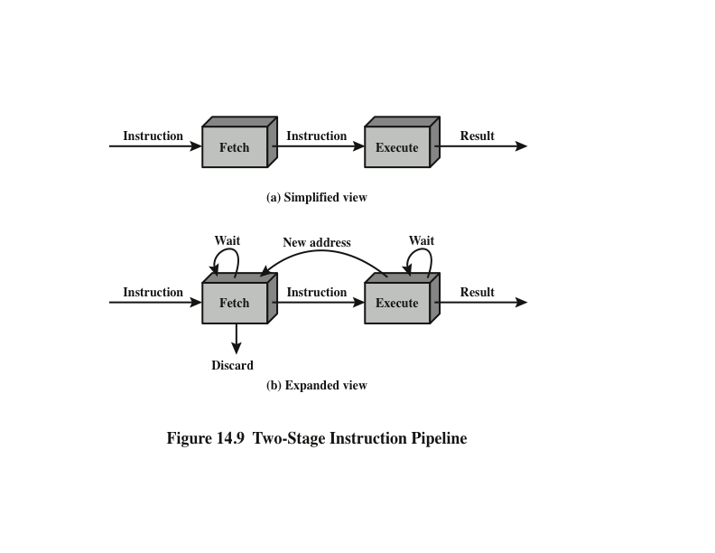
Two-Stage Instruction Pipeline
(W. Stallings, 2016)
Notes:
As a simple approach, consider subdividing instruction processing into two stages: fetch instruction and execute instruction. There are times during the execution of an instruction when main memory is not being accessed. This time could be used to fetch the next instruction in parallel with the execution of the current one. Figure (a) above depicts this approach. The pipeline has two independent stages. The first stage fetches an instruction and buffers it. When the second stage is free, the first stage passes it the buffered instruction. While the second stage is executing the instruction, the first stage takes advantage of any unused memory cycles to fetch and buffer the next instruction. This is called instruction prefetch or fetch overlap. Note that this approach, which involves instruction buffering, requires more registers. In general, pipelining requires registers to store data between stages.
It should be clear that this process will speed up instruction execution. If the fetch and execute stages were of equal duration, the instruction cycle time would be halved. However, if we look more closely at this pipeline (Figure (b) – Expanded view), we will see that this doubling of execution rate is unlikely for two reasons:
The execution time will generally be longer than the fetch time. Execution will involve reading and storing operands and the performance of some operation. Thus, the fetch stage may have to wait for some time before it can empty its buffer.
A conditional branch instruction makes the address of the next instruction to be fetched unknown. Thus, the fetch stage must wait until it receives the next instruction address from the execute stage. The execute stage may then have to wait while the next instruction is fetched.
Guessing can reduce the time loss from the second reason. A simple rule is the following: When a conditional branch instruction is passed on from the fetch to the execute stage, the fetch stage fetches the next instruction in memory after the branch instruction. Then, if the branch is not taken, no time is lost. If the branch is taken, the fetched instruction must be discarded and a new instruction fetched.

Slide 25
Additional Stages (Instruction Cycle)
Fetch instruction (FI)
Read the next expected instruction into a buffer
Decode instruction (DI)
Determine the opcode and the operand specifiers
Calculate operands (CO)
Calculate the effective address of each source operand
This may involve displacement, register indirect, indirect, or other forms of address calculation
Fetch operands (FO)
Fetch each operand from memory
Operands in registers need not be fetched
Execute instruction (EI)
Perform the indicated operation and store the result, if any, in the specified destination operand location
Write operand (WO)
Store the result in memory
Notes:
While these factors reduce the potential effectiveness of the two-stage pipe- line, some speedup occurs. To gain further speedup, the pipeline must have more stages. Let us consider the following decomposition of the instruction processing.
Fetch instruction (FI): Read the next expected instruction into a buffer.
Decode instruction (DI): Determine the opcode and the operand specifiers.
Calculate operands (CO): Calculate the effective address of each source operand. This may involve displacement, register indirect, indirect, or other forms of address calculation.
Fetch operands (FO): Fetch each operand from memory. Operands in registers need not be fetched.
Execute instruction (EI): Perform the indicated operation and store the result, if any, in the specified destination operand location.
Write operand (WO): Store the result in memory.
With this decomposition, the various stages will be of more nearly equal duration.

Slide 26
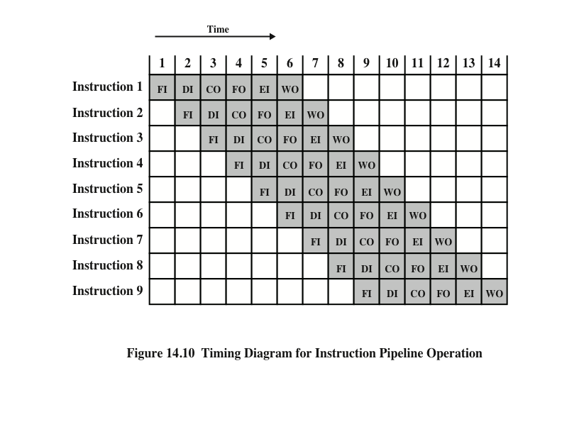
Timing Diagram for Instruction Pipeline Operation
[W. Stallings (2016)]
Notes:
39
For the sake of illustration, let us assume equal duration. Using this assumption, Figure 14.10 shows that a six-stage pipeline can reduce the execution time for 9 instructions from 54 time units to 14 time units.
Several comments are in order: The diagram assumes that each instruction goes through all six stages of the pipeline. This will not always be the case. For example, a load instruction does not need the WO stage. However, to simplify the pipeline hardware, the timing is set up assuming that each instruction requires all six stages. Also, the diagram assumes that all of the stages can be performed in parallel. In particular, it is assumed that there are no memory conflicts. For example, the FI, FO, and WO stages involve a memory access. The diagram implies that all these accesses can occur simultaneously. Most memory systems will not permit that. However, the desired value may be in cache, or the FO or WO stage may be null. Thus, much of the time, memory conflicts will not slow down the pipeline.

Slide 27
Pipeline Hazards
Occur when the pipeline, or some portion of the pipeline, must stall because conditions do not permit continued execution
Also referred to as a pipeline bubble
There are three types of hazards:
Resource
Data
Control
Notes:
A pipeline hazard occurs when the pipeline, or some portion of the pipeline, must stall because conditions do not permit continued execution. Such a pipeline stall is also referred to as a pipeline bubble. There are three types of hazards: resource, data, and control.

Slide 28
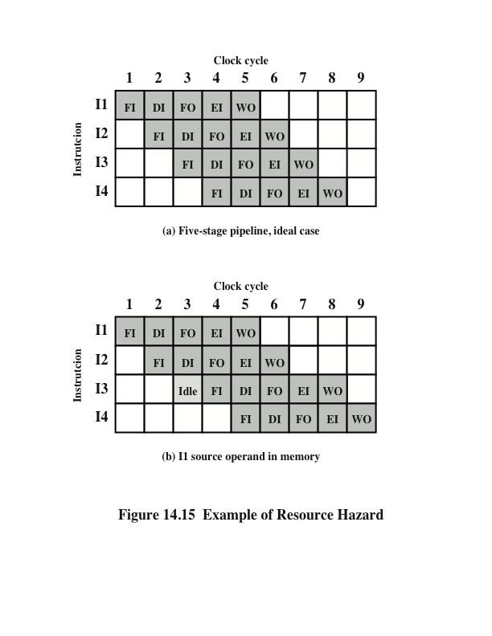
Resource Hazards
A resource hazard occurs when two or more instructions that are already in the pipeline need the same resource
The result is that the instructions must be executed in serial rather than parallel for a portion of the pipeline
A resource hazard is sometimes referred to as a structural hazard
[W. Stallings (2016)]
Notes:
A resource hazard occurs when two (or more) instructions that are already in the pipeline need the same resource. The result is that the instructions must be executed in serial rather than parallel for a portion of the pipeline. A resource hazard is sometime referred to as a structural hazard.
Let us consider a simple example of a resource hazard. Assume a simplified five-stage pipeline, in which each stage takes one clock cycle. Figure 14.15a shows the ideal case, in which a new instruction enters the pipeline each clock cycle. Now assume that main memory has a single port and that all instruction fetches and data reads and writes must be performed one at a time. Further, ignore the cache. In this case, an operand read to or write from memory cannot be performed in parallel with an instruction fetch. This is illustrated in Figure 14.15b, which assumes that the source operand for instruction I1 is in memory, rather than a register. Therefore, the fetch instruction stage of the pipeline must idle for one cycle before beginning the instruction fetch for instruction I3. The figure assumes that all other operands are in registers.
Another example of a resource conflict is a situation in which multiple instructions are ready to enter the execute instruction phase and there is a single ALU. One solutions to such resource hazards is to increase available resources, such as having multiple ports into main memory and multiple ALU units.

Slide 29
Data Hazards
Consider the following instructions:
ADD EAX, EBX //add the content of registers EAX & EBX; store result in EAX
SUB ECX, EAX //subtract the content of EAX from that of ECX; store the result in ECX

Slide 30
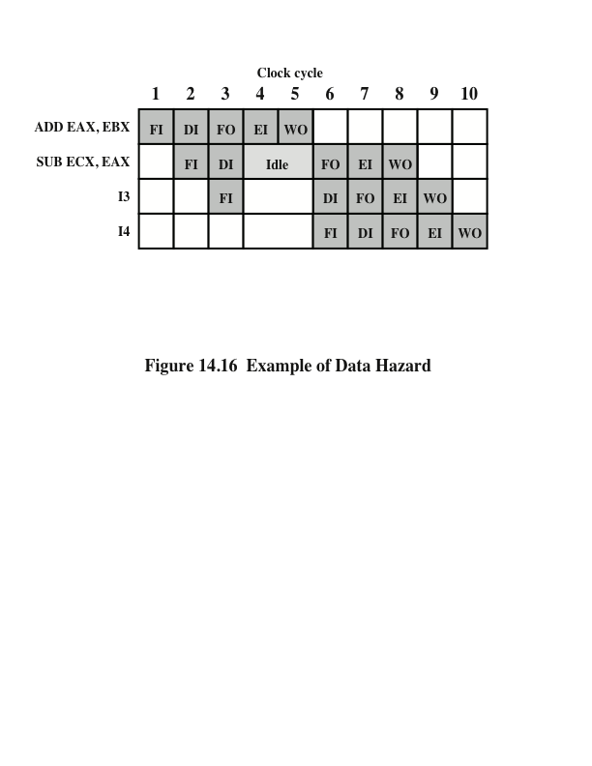
Data Hazards
A data hazard occurs when there is a conflict in the access of an operand location
RAW
Hazard
[W. Stallings (2016)]
Notes:
A data hazard occurs when there is a conflict in the access of an operand location. In general terms, we can state the hazard in this form: Two instructions in a program are to be executed in sequence and both access a particular memory or register operand. If the two instructions are executed in strict sequence, no problem occurs. However, if the instructions are executed in a pipeline, then it is possible for the operand value to be updated in such a way as to produce a different result than would occur with strict sequential execution. In other words, the program produces an incorrect result because of the use of pipelining.

Slide 31
Types of Data Hazard
Read after write (RAW), or true dependency
An instruction modifies a register or memory location
Succeeding instruction reads data in memory or register location
Hazard occurs if the read takes place before write operation is complete
Write after read (WAR), or antidependency
An instruction reads a register or memory location
Succeeding instruction writes to the location
Hazard occurs if the write operation completes before the read operation takes place
Write after write (WAW), or output dependency
Two instructions both write to the same location
Hazard occurs if the write operations take place in the reverse order of the intended sequence
Notes:
There are three types of data hazards;
• Read after write (RAW), or true dependency: An instruction modifies a register or memory location and a succeeding instruction reads the data in that memory or register location. A hazard occurs if the read takes place before the write operation is complete.
• Write after read (WAR), or antidependency: An instruction reads a register or memory location and a succeeding instruction writes to the location. A hazard occurs if the write operation completes before the read operation takes place.
• Write after write (WAW), or output dependency: Two instructions both write to the same location. A hazard occurs if the write operations take place in the reverse order of the intended sequence.
The example of Figure 14.16 is a RAW hazard. The other two hazards are best discussed in the context of superscalar organization.

Slide 32
Control Hazard
Also known as a branch hazard
Occurs when the pipeline makes the wrong decision on a branch prediction
Brings instructions into the pipeline that must subsequently be discarded
Dealing with Branches:
Multiple streams
Prefetch branch target
Loop buffer
Branch prediction
Delayed branch
Notes:
A control hazard, also known as a branch hazard, occurs when the pipeline makes the wrong decision on a branch prediction and therefore brings instructions into the pipeline that must subsequently be discarded. We discuss approaches to dealing with control hazards next.
One of the major problems in designing an instruction pipeline is assuring a steady flow of instructions to the initial stages of the pipeline. The primary impediment, as we have seen, is the conditional branch instruction. Until the instruction is actually executed, it is impossible to determine whether the branch will be taken or not.
A variety of approaches have been taken for dealing with conditional branches:
Multiple streams
Prefetch branch target
Loop buffer
Branch prediction
Delayed branch

Slide 33
Multiple Streams
A simple pipeline suffers a penalty for a branch instruction because it must choose one of two instructions to fetch next and may make the wrong choice
A brute-force approach is to replicate the initial portions of the pipeline and allow the pipeline to fetch both instructions, making use of two streams
Drawbacks:
With multiple pipelines there are contention delays for access to the registers and to memory
Additional branch instructions may enter the pipeline before the original branch decision is resolved
Notes:
42
A simple pipeline suffers a penalty for a branch instruction because it must choose one of two instructions to fetch next and may make the wrong choice. A brute-force approach is to replicate the initial portions of the pipeline and allow the pipeline to fetch both instructions, making use of two streams. There are two problems with this approach:
With multiple pipelines there are contention delays for access to the registers and to memory.
Additional branch instructions may enter the pipeline (either stream) before the original branch decision is resolved. Each such instruction needs an additional stream.
Despite these drawbacks, this strategy can improve performance. Examples of machines with two or more pipeline streams are the IBM 370/168 and the IBM 3033.

Slide 34
Prefetch Branch Target
When a conditional branch is recognized, the target of the branch is prefetched, in addition to the instruction following the branch
Target is then saved until the branch instruction is executed
If the branch is taken, the target has already been prefetched
Notes:
43
When a conditional branch is recognized, the target of the branch is prefetched, in addition to the instruction following the branch. This target is then saved until the branch instruction is executed. If the branch is taken, the target has already been prefetched.
The IBM 360/91 uses this approach.

Slide 35
Loop Buffer
Small, very-high speed memory maintained by the instruction fetch stage of the pipeline and containing the n most recently fetched instructions, in sequence
Benefits:
Instructions fetched in sequence will be available without the usual memory access time
If a branch occurs to a target just a few locations ahead of the address of the branch instruction, the target will already be in the buffer
This strategy is particularly well suited to dealing with loops
Similar in principle to a cache dedicated to instructions
Differences:
The loop buffer only retains instructions in sequence
Is much smaller in size and hence lower in cost
Notes:
44
A loop buffer is a small, very-high-speed memory maintained by the instruction fetch stage of the pipeline and containing the n most recently fetched instructions, in sequence. If a branch is to be taken, the hardware first checks whether the branch target is within the buffer. If so, the next instruction is fetched from the buffer. The loop buffer has three benefits:
1. With the use of prefetching, the loop buffer will contain some instruction sequentially ahead of the current instruction fetch address. Thus, instructions fetched in sequence will be available without the usual memory access time.
2. If a branch occurs to a target just a few locations ahead of the address of the branch instruction, the target will already be in the buffer. This is useful for the rather common occurrence of IF–THEN and IF–THEN–ELSE sequences.
3. This strategy is particularly well suited to dealing with loops, or iterations; hence the name loop buffer. If the loop buffer is large enough to contain all the instructions in a loop, then those instructions need to be fetched from memory only once, for the first iteration. For subsequent iterations, all the needed instructions are already in the buffer.
The loop buffer is similar in principle to a cache dedicated to instructions. The differences are that the loop buffer only retains instructions in sequence and is much smaller in size and hence lower in cost.

Slide 36
Branch Prediction
Various techniques can be used to predict whether a branch will be taken:
Predict never taken
Predict always taken
Predict by opcode
Taken/not taken switch
Branch history table
These approaches are static
They do not depend on the execution history up to the time of the conditional branch instruction
These approaches are dynamic
They depend on the execution history
Notes:
45
Various techniques can be used to predict whether a branch will be taken. Among the more common are the following:
• • • • •
Predict never taken
Predict always taken
Predict by opcode
Taken/not taken switch
Branch history table
The first three approaches are static: they do not depend on the execution history up to the time of the conditional branch instruction. The latter two approaches are dynamic: They depend on the execution history.
The first two approaches are the simplest. These either always assume that the branch will not be taken and continue to fetch instructions in sequence, or they always assume that the branch will be taken and always fetch from the branch target. The predict-never-taken approach is the most popular of all the branch prediction methods.
Studies analyzing program behavior have shown that conditional branches are taken more than 50% of the time (Lilja, 1988), and so if the cost of prefetching from either path is the same, then always prefetching from the branch target address should give better performance than always prefetching from the sequential path. However, in a paged machine, prefetching the branch target is more likely to cause a page fault than prefetching the next instruction in sequence, and so this performance penalty should be taken into account. An avoidance mechanism may be employed to reduce this penalty.
The final static approach makes the decision based on the opcode of the branch instruction. The processor assumes that the branch will be taken for certain branch opcodes and not for others. (Lilja, 1988) reports success rates of greater than 75% with this strategy.
Dynamic branch strategies attempt to improve the accuracy of prediction by recording the history of conditional branch instructions in a program. For example, one or more bits can be associated with each conditional branch instruction that reflect the recent history of the instruction. These bits are referred to as a taken/ not taken switch that directs the processor to make a particular decision the next time the instruction is encountered. Typically, these history bits are not associated with the instruction in main memory. Rather, they are kept in temporary high- speed storage. One possibility is to associate these bits with any conditional branch instruction that is in a cache. When the instruction is replaced in the cache, its history is lost. Another possibility is to maintain a small table for recently executed branch instructions with one or more history bits in each entry. The processor could access the table associatively, like a cache, or by using the low-order bits of the branch instruction’s address.

Slide 37
Superscalar Processors
Term first coined in 1987
Refers to a machine that is designed to improve the performance of the execution of scalar instructions
In most applications the bulk of the operations are on scalar quantities
Represents the next step in the evolution of high-performance general-purpose processors
Essence of the approach is the ability to execute instructions independently and concurrently in different pipelines
Concept can be further exploited by allowing instructions to be executed in an order different from the program order
Notes:
The term superscalar, first coined in 1987 (Agerwala and Cocke, 1987), refers to a machine that is designed to improve the performance of the execution of scalar instructions. In most applications, the bulk of the operations are on scalar quantities. Accordingly, the superscalar approach represents the next step in the evolution of high-performance general-purpose processors.
The essence of the superscalar approach is the ability to execute instructions independently and concurrently in different pipelines. The concept can be further exploited by allowing instructions to be executed in an order different from the program order.

Slide 38
Instruction-level Parallelism and Superscalar Processors
Instruction level parallelism
Refers to the degree to which the instructions of a program can be executed in parallel
A combination of compiler based optimisation and hardware techniques can be used to maximise instruction level parallelism
Limitations:
True data dependency
Procedural dependency
Resource conflicts
Output dependency
Antidependency
Notes:
The superscalar approach depends on the ability to execute multiple instructions in parallel. The term instruction-level parallelism refers to the degree to which, on average, the instructions of a program can be executed in parallel. A combination of compiler-based optimization and hardware techniques can be used to maximize instruction-level parallelism. Before examining the design techniques used in super-scalar machines to increase instruction-level parallelism, we need to look at the fundamental limitations to parallelism with which the system must cope. (Johnson, 1991) lists five limitations:
• True data dependency
• Procedural dependency
• Resource conflicts
• Output dependency
• Antidependency

Slide 39

Design Issues
Instruction-Level Parallelism
and Machine Parallelism
Instruction level parallelism
Instructions in a sequence are independent
Execution can be overlapped
Governed by data and procedural dependency
Machine Parallelism
Ability to take advantage of instruction level parallelism
Governed by number of parallel pipelines
Notes:
(Jouppi and Wall, 1989) makes an important distinction between the two related concepts of instruction-level parallelism and machine parallelism. Instruction-level parallelism exists when instructions in a sequence are independent and thus can be executed in parallel by overlapping.
The degree of instruction-level parallelism is determined by the frequency of true data dependencies and procedural dependencies in the code. These factors, in turn, are dependent on the instruction set architecture and on the application. Instruction-level parallelism is also determined by what (Jouppi and Wall, 1989) refers to as operation latency: the time until the result of an instruction is available for use as an operand in a subsequent instruction. The latency determines how much of a delay a data or procedural dependency will cause.
Machine parallelism is a measure of the ability of the processor to take advantage of instruction-level parallelism. Machine parallelism is determined by the number of instructions that can be fetched and executed at the same time (the number of parallel pipelines) and by the speed and sophistication of the mechanisms that the processor uses to find independent instructions.
Both instruction-level and machine parallelism are important factors in enhancing performance. A program may not have enough instruction-level parallelism to take full advantage of machine parallelism. The use of a fixed-length instruction set architecture, as in a RISC, enhances instruction-level parallelism. On the other hand, limited machine parallelism will limit performance no matter what the nature of the program.

Slide 40
Further Reading
Computer Organization and Architecture – Designing for Performance (10th Edition), William Stallings [Chapters: 14, 16]
Computer Organization and Design – The Hardware/Software Interface (5th Edition), David A. Patterson & John L. Hennessy [Chapter: 4]
Fundamentals of Computer Architecture, Mark Burrell [Chapter: 13]

