Slide 1
Memory Architecture
120CT Computer Architecture and Networks
Dr Dianabasi Nkantah
ab0480@coventry.ac.uk

Slide 2
Today……………
Computer Memory
RAM
ROM
Memory Hierarchy
Cache

Slide 3
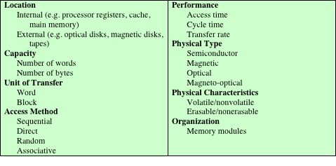
Memory: Key Characteristics of Computer Memory Systems
Key Characteristics of Computer Memory Systems
Notes:
The complex subject of computer memory is made more manageable if we classify
memory systems according to their key characteristics. The most important of these
are listed in Table here.
The term location in the table refers to whether memory is internal and external
to the computer. Internal memory is often equated with main memory. But there
are other forms of internal memory. The processor requires its own local memory, in
the form of registers. Further, as we shall see, the control unit
portion of the processor may also require its own internal memory. Cache is
another form of internal memory. External memory consists of peripheral storage
devices, such as disk and tape, that are accessible to the processor via I/O controllers.
An obvious characteristic of memory is its capacity. For internal memory, this is
typically expressed in terms of bytes (1 byte = 8 bits) or words. Common word lengths
are 8, 16, 32 and 64 bits. External memory capacity is typically expressed in terms of bytes.
A related concept is the unit of transfer. For internal memory, the unit
of transfer is equal to the number of electrical lines into and out of the memory
module. This may be equal to the word length, but is often larger, such as 64, 128, or
256 bits. To clarify this point, consider three related concepts for internal memory:
• Word: The “natural” unit of organisation of memory. The size of a word is typically
equal to the number of bits used to represent an integer and to the instruction
length. Unfortunately, there are many exceptions. For example, the CRAY
C90 (an older model CRAY supercomputer) has a 64-bit word length but uses
a 46-bit integer representation. The Intel x86 architecture has a wide variety of
instruction lengths, expressed as multiples of bytes, and a word size of 32 bits.
• Addressable units: In some systems, the addressable unit is the word. However,
many systems allow addressing at the byte level. In any case, the relationship
between the length in bits A of an address and the number N of addressable
units is 2^{A} = N.
• Unit of transfer: For main memory, this is the number of bits read out of or
written into memory at a time. The unit of transfer need not equal a word or
an addressable unit. For external memory, data are often transferred in much
larger units than a word, and these are referred to as blocks.
A variety of physical types of memory have been employed. The most common
today are semiconductor memory, magnetic surface memory (used for disk and
Tape) and optical and magneto-optical.
Several physical characteristics of data storage are important. In a volatile
memory, information decays naturally or is lost when electrical power is switched
off. In a nonvolatile memory, information once recorded remains without deterioration
until deliberately changed; no electrical power is needed to retain information.
Magnetic-surface memories are nonvolatile. Semiconductor memory (memory
on integrated circuits) may be either volatile or nonvolatile. Nonerasable memory
cannot be altered, except by destroying the storage unit. Semiconductor memory of
this type is known as read-only memory (ROM). Of necessity, a practical nonerasable
memory must also be nonvolatile.
For random-access memory, the organisation is a key design issue. In this context,
organization refers to the physical arrangement of bits to form words.

Slide 4

Capacity and Performance:
The two most important characteristics of memory
Three performance parameters are used:
Access time (latency)
For random-access memory it is the time it takes to perform a read or write operation
For non-random-access memory it is the time it takes to position the read-write mechanism at the desired location
Memory cycle time
Access time plus any additional time required before second access can commence
Additional time may be required for transients to die out on signal lines or to regenerate data if they are read destructively
Concerned with the system bus, not the processor
Transfer rate
The rate at which data can be transferred into or out of a memory unit
For random-access memory it is equal to 1/(cycle time)
Notes:
From a user’s point of view, the two most important characteristics of memory
are capacity and performance. Three performance parameters are used:
• Access time (latency): For random-access memory, this is the time it takes to
perform a read or write operation, that is, the time from the instant that an
address is presented to the memory to the instant that data have been stored
or made available for use. For non-random-access memory, access time is the
time it takes to position the read–write mechanism at the desired location.
• Memory cycle time: This concept is primarily applied to random-access memory
and consists of the access time plus any additional time required before a second
access can commence. This additional time may be required for transients to die
out on signal lines or to regenerate data if they are read destructively. Note that
memory cycle time is concerned with the system bus, not the processor.
• Transfer rate: This is the rate at which data can be transferred into or out of a
memory unit. For random-access memory, it is equal to 1/(cycle time).

Slide 5

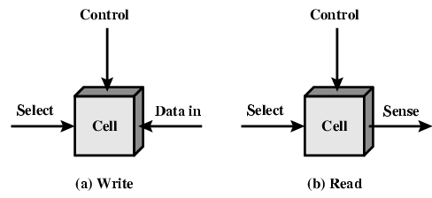
Memory Cell Operation
Notes:
In earlier computers, the most common form of random-access storage for computer
main memory employed an array of doughnut-shaped ferromagnetic loops
referred to as cores. Hence, main memory was often referred to as core, a term that
persists to this day. The advent of, and advantages of, microelectronics has long
since vanquished the magnetic core memory. Today, the use of semiconductor chips
for main memory is almost universal. Key aspects of this technology are explored
in this section.
The basic element of a semiconductor memory is the memory cell. Although a variety
of electronic technologies are used, all semiconductor memory cells share certain
properties:
• They exhibit two stable (or semistable) states, which can be used to represent
binary 1 and 0.
• They are capable of being written into (at least once), to set the state.
• They are capable of being read to sense the state.
The figure here depicts the operation of a memory cell. Most commonly, the cell
has three functional terminals capable of carrying an electrical signal. The select
terminal, as the name suggests, selects a memory cell for a read or write operation.
The control terminal indicates read or write. For writing, the other terminal
provides an electrical signal that sets the state of the cell to 1 or 0. For reading, that
terminal is used for output of the cell’s state. The details of the internal organisation,
functioning, and timing of the memory cell depend on the specific integrated
circuit technology used and are beyond the scope of this book, except for a brief
summary. For our purposes, we will take it as given that individual cells can be
selected for reading and writing operations.

Slide 6
Semiconductor Memory Types
Memory Type | Category | Erasure | Write Mechanism | Volatility
Random-access memory (RAM) | Read-write memory | Electrically, byte-level | Electrically | Volatile
Read-only memory (ROM) | Read-only memory | Not possible | Masks | Nonvolatile
Programmable ROM (PROM) |  |  | Electrically
Erasable PROM (EPROM) | Read-mostly memory | UV light, chip-level
Electrically Erasable PROM (EEPROM) |  | Electrically, byte-level
Flash memory |  | Electrically, block-level
Notes:
All of the memory types that we will explore in this lecture are random access. That is,
individual words of memory are directly accessed through wired-in addressing logic.
The table here lists the major types of semiconductor memory. The most common
is referred to as random-access memory (RAM). This is, in fact, a misuse of the
term, because all of the types listed in the table are random access. One distinguishing
characteristic of memory that is designated as RAM is that it is possible
both to read data from the memory and to write new data into the memory easily
and rapidly. Both the reading and writing are accomplished through the use of
electrical signals.
The other distinguishing characteristic of RAM is that it is volatile. A RAM
must be provided with a constant power supply. If the power is interrupted, then
the data are lost. Thus, RAM can be used only as temporary storage. The two traditional
forms of RAM used in computers are DRAM and SRAM.

Slide 7
Semiconductor Memory
RAM
Misnamed as all semiconductor memory is random access
Read/Write
Volatile
Temporary storage
Static or dynamic

Slide 8
Dynamic RAM (DRAM)
RAM technology is divided into two technologies:
Dynamic RAM (DRAM)
Static RAM (SRAM)
DRAM
Made with cells that store data as charge on capacitors
Presence or absence of charge in a capacitor is interpreted as a binary 1 or 0
This depends on the threshold voltage of the transistor connected to the capacitor
Requires periodic charge refreshing to maintain data storage
The term dynamic refers to tendency of the stored charge to leak away, even with power continuously applied
Notes:
RAM technology is divided into two technologies: dynamic and
static. A dynamic RAM (DRAM) is made with cells that store data as charge on
capacitors. The presence or absence of charge in a capacitor is interpreted as a
binary 1 or 0. Because capacitors have a natural tendency to discharge, dynamic
RAMs require periodic charge refreshing to maintain data storage. The term
dynamic refers to this tendency of the stored charge to leak away, even with power
continuously applied.

Slide 9
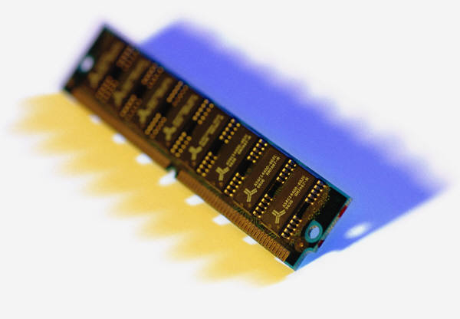
Static RAM (SRAM)
Digital device that uses the same logic elements used in the processor
Binary values are stored using traditional flip-flop logic gate configurations
Will hold its data as long as power is supplied to it
Notes:
In contrast, a static RAM (SRAM) is a digital device that uses the
same logic elements used in the processor. In a SRAM, binary values are stored
using traditional flip-flop logic-gate configurations. A static RAM will hold its data as long as power is supplied to it.

Slide 10
Static RAM
Bits stored as on/off switches
No charges to leak
No refreshing needed when powered
More complex construction
Larger per bit
More expensive
Does not need refresh circuits
Faster
Used for Cache
Digital
Uses flip-flops

Slide 11
SRAM versus DRAM
Both volatile
Power must be continuously supplied to the memory to preserve the bit values
Dynamic cell
Simpler to build, smaller
More dense (smaller cells = more cells per unit area)
Less expensive
Requires the supporting refresh circuitry
Tend to be favored for large memory requirements
Used for main memory
Static
Faster
Used for cache memory (both on and off chip)
DRAM
SRAM
Notes:
Both static and dynamic RAMs are volatile; that is,
power must be continuously supplied to the memory to preserve the bit values.
A dynamic memory cell is simpler and smaller than a static memory cell. Thus, a
DRAM is more dense (smaller cells = more cells per unit area) and less expensive
than a corresponding SRAM. On the other hand, a DRAM requires the supporting
refresh circuitry. For larger memories, the fixed cost of the refresh circuitry is more
than compensated for by the smaller variable cost of DRAM cells. Thus, DRAMs
tend to be favored for large memory requirements. A final point is that SRAMs are
somewhat faster than DRAMs. Because of these relative characteristics, SRAM is
used for cache memory (both on and off chip), and DRAM is used for main memory.

Slide 12

Synchronous DRAM (SDRAM)
One of the most widely used forms of DRAM
Exchanges data with the processor synchronised to an external clock signal and running at the full speed of the processor/memory bus without imposing wait states
With synchronous access the DRAM moves data in and out under control of the system clock
The processor or other master issues the instruction and address information which is latched by the DRAM
The DRAM then responds after a set number of clock cycles
Meanwhile the master can safely do other tasks while the SDRAM is processing
Notes:
One of the most widely used forms of DRAM is the synchronous DRAM
(SDRAM). Unlike the traditional DRAM, which is asynchronous, the
SDRAM exchanges data with the processor synchronized to an external clock signal
and running at the full speed of the processor/memory bus without imposing
wait states.
In a typical DRAM, the processor presents addresses and control levels to
the memory, indicating that a set of data at a particular location in memory should
be either read from or written into the DRAM. After a delay, the access time, the
DRAM either writes or reads the data. During the access-time delay, the DRAM
performs various internal functions, such as activating the high capacitance of the
row and column lines, sensing the data, and routing the data out through the output
buffers. The processor must simply wait through this delay, slowing system
performance.
With synchronous access, the DRAM moves data in and out under control of
the system clock. The processor or other master issues the instruction and address
information, which is latched by the DRAM. The DRAM then responds after a set
number of clock cycles. Meanwhile, the master can safely do other tasks while the
SDRAM is processing the request.

Slide 13
Double Data Rate SDRAM (DDR SDRAM)
SDRAM can only send data once per bus clock cycle
Double-data-rate SDRAM can send data twice per clock cycle, once on the rising edge of the clock pulse and once on the falling edge
Developed by the JEDEC Solid State Technology Association (Electronic Industries Alliance’s semiconductor-engineering-standardisation body)
Notes:
SDRAM is limited by the fact that it can only send data to the processor once per
bus clock cycle. A new version of SDRAM, referred to as double-data-rate SDRAM
can send data twice per clock cycle, once on the rising edge of the clock pulse and
once on the falling edge.
DDR DRAM was developed by the JEDEC Solid State Technology
Association, the Electronic Industries Alliance’s semiconductor-engineering-standardization
body. Numerous companies make DDR chips, which are widely used in
desktop computers and servers.

Slide 14
Read Only Memory (ROM)
Contains a permanent pattern of data that cannot be changed or added to
No power source is required to maintain the bit values in memory
Data or program is permanently in main memory and never needs to be loaded from a secondary storage device
Data is actually wired into the chip as part of the fabrication process
Disadvantages of this:
No room for error, if one bit is wrong the whole batch of ROMs must be thrown out
Data insertion step includes a relatively large fixed cost
Notes:
As the name suggests, a read-only memory (ROM) contains a permanent pattern
of data that cannot be changed. A ROM is nonvolatile; that is, no power source is
required to maintain the bit values in memory. While it is possible to read a ROM,
it is not possible to write new data into it. An important application of ROMs is
microprogramming. Other potential applications include
• Library subroutines for frequently wanted functions
• System programs
• Function tables
For a modest-sized requirement, the advantage of ROM is that the data or program
is permanently in main memory and need never be loaded from a secondary storage
device.
A ROM is created like any other integrated circuit chip, with the data actually
wired into the chip as part of the fabrication process. This presents two problems:
• The data insertion step includes a relatively large fixed cost, whether one or
thousands of copies of a particular ROM are fabricated.
• There is no room for error. If one bit is wrong, the whole batch of ROMs must
be thrown out.

Slide 15
Read Only Memory (ROM) – Potential Applications
Permanent storage
Nonvolatile
Microprogramming
Library subroutines
Systems programs (e.g. BIOS)
Function tables

Slide 16
Types of ROM
Written during manufacture
Very expensive for small runs
Programmable (once)
PROM
Needs special equipment to program
Read “mostly”
Erasable Programmable (EPROM)
Erased by UV
Electrically Erasable (EEPROM)
Takes much longer to write than read
Flash memory
Erase whole memory electrically

Slide 17
Programmable ROM (PROM)
Less expensive alternative
Nonvolatile and may be written into only once
Writing process is performed electrically and may be performed by supplier or customer at a time later than the original chip fabrication
Special equipment is required for the writing process
Provides flexibility and convenience
Attractive for high volume production runs
Notes:
When only a small number of ROMs with a particular memory content is
needed, a less expensive alternative is the programmable ROM (PROM). Like the
ROM, the PROM is nonvolatile and may be written into only once. For the PROM,
the writing process is performed electrically and may be performed by a supplier
or customer at a time later than the original chip fabrication. Special equipment is
required for the writing or “programming” process. PROMs provide flexibility and
convenience. The ROM remains attractive for high-volume production runs.

Slide 18
Read-Mostly Memory
EPROM
Erasable programmable read-only memory
Erasure process can be performed repeatedly
More expensive than PROM but it has the advantage of the multiple update capability
EEPROM
Electrically erasable programmable read-only memory
Can be written into at any time without erasing prior contents
Combines the advantage of non-volatility with the flexibility of being updatable in place
More expensive than EPROM
Flash Memory
Intermediate between EPROM and EEPROM in both cost and functionality
Uses an electrical erasing technology, does not provide byte-level erasure
Microchip is organised so that a section of memory cells are erased in a single action or “flash”
Notes:
Another variation on read-only memory is the read-mostly memory, which is
useful for applications in which read operations are far more frequent than write
operations but for which nonvolatile storage is required. There are three common
forms of read-mostly memory: EPROM, EEPROM, and flash memory.
The optically erasable programmable read-only memory (EPROM) is read
and written electrically, as with PROM. However, before a write operation, all the
storage cells must be erased to the same initial state by exposure of the packaged
chip to ultraviolet radiation. Erasure is performed by shining an intense ultraviolet
light through a window that is designed into the memory chip. This erasure process
can be performed repeatedly; each erasure can take as much as 20 minutes to
perform. Thus, the EPROM can be altered multiple times and, like the ROM and
PROM, holds its data virtually indefinitely. For comparable amounts of storage, the
EPROM is more expensive than PROM, but it has the advantage of the multiple
update capability.
A more attractive form of read-mostly memory is electrically erasable programmable
read-only memory (EEPROM). This is a read-mostly memory that can
be written into at any time without erasing prior contents; only the byte or bytes
addressed are updated. The write operation takes considerably longer than the read
operation, on the order of several hundred microseconds per byte. The EEPROM
combines the advantage of non-volatility with the flexibility of being updatable in
place, using ordinary bus control, address, and data lines. EEPROM is more expensive
than EPROM and also is less dense, supporting fewer bits per chip.
Another form of semiconductor memory is flash memory (so named because
of the speed with which it can be reprogrammed). First introduced in the mid-1980s,
flash memory is intermediate between EPROM and EEPROM in both cost and
functionality. Like EEPROM, flash memory uses an electrical erasing technology.
An entire flash memory can be erased in one or a few seconds, which is much faster
than EPROM. In addition, it is possible to erase just blocks of memory rather than
an entire chip. Flash memory gets its name because the microchip is organized so
that a section of memory cells are erased in a single action or “flash.” However,
flash memory does not provide byte-level erasure. Like EPROM, flash memory
uses only one transistor per bit, and so achieves the high density (compared with
EEPROM) of EPROM.

Slide 19
Memory Hierarchy
Design constraints on a computer’s memory can be summed up by three questions:
How much, how fast, how expensive
There is a trade-off among capacity, access time, and cost
Faster access time, greater cost per bit
Greater capacity, smaller cost per bit
Greater capacity, slower access time
The way out of the memory dilemma is not to rely on a single memory component or technology, but to employ a memory hierarchy
Notes:
The design constraints on a computer’s memory can be summed up by three questions:
How much? How fast? How expensive?
The question of how much is somewhat open ended. If the capacity is there,
applications will likely be developed to use it. The question of how fast is, in a sense,
easier to answer. To achieve greatest performance, the memory must be able to
keep up with the processor. That is, as the processor is executing instructions, we
would not want it to have to pause waiting for instructions or operands. The final
question must also be considered. For a practical system, the cost of memory must
be reasonable in relationship to other components.
As might be expected, there is a trade-off among the three key characteristics
of memory: capacity, access time, and cost. A variety of technologies are used to
implement memory systems, and across this spectrum of technologies, the following
relationships hold:
• Faster access time, greater cost per bit
• Greater capacity, smaller cost per bit
• Greater capacity, slower access time
The dilemma facing the designer is clear. The designer would like to use memory
technologies that provide for large-capacity memory, both because the capacity
is needed and because the cost per bit is low. However, to meet performance
requirements, the designer needs to use expensive, relatively lower-capacity memories
with short access times.
The way out of this dilemma is not to rely on a single memory component or
technology, but to employ a memory hierarchy.

Slide 20
Memory Hierarchy
Registers
In CPU
Internal or Main memory
May include one or more levels of cache
“RAM”
External memory
Backing store

Slide 21
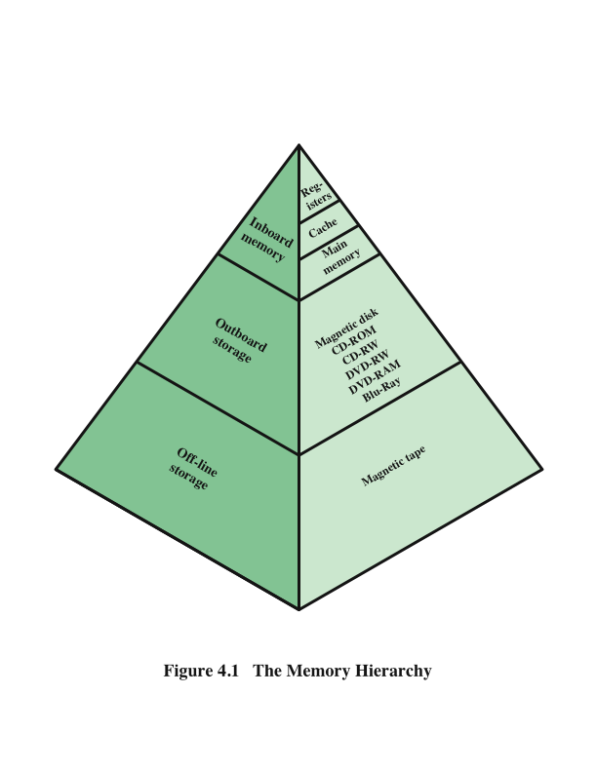
Memory Hierarchy
(Stallings, W., 2016)
Notes:
A typical hierarchy is illustrated in the
Figure here. As one goes down the hierarchy, the following occur:
a. Decreasing cost per bit
b. Increasing capacity
c. Increasing access time
d. Decreasing frequency of access of the memory by the processor
Thus, smaller, more expensive, faster memories are supplemented by larger,
cheaper, slower memories. The key to the success of this organization is item (d)
:decreasing frequency of access. We examine this concept in greater detail when we
discuss the cache, later in this chapter, and virtual memory in Chapter 8. A brief
explanation is provided at this point.
The use of two levels of memory to reduce average access time works in principle,
but only if conditions (a) through (d) apply. By employing a variety of technologies,
a spectrum of memory systems exists that satisfies conditions (a) through
(c). Fortunately, condition (d) is also generally valid.
The basis for the validity of condition (d) is a principle known as locality of
reference [DENN68]. During the course of execution of a program, memory references
by the processor, for both instructions and data, tend to cluster. Programs
typically contain a number of iterative loops and subroutines. Once a loop or subroutine
is entered, there are repeated references to a small set of instructions.
Similarly, operations on tables and arrays involve access to a clustered set of data
words. Over a long period of time, the clusters in use change, but over a short period
of time, the processor is primarily working with fixed clusters of memory references.
Accordingly, it is possible to organize data across the hierarchy such that the
percentage of accesses to each successively lower level is substantially less than that
of the level above. Consider the two-level example already presented. Let level 2
memory contains all program instructions and data. The current clusters can be
temporarily placed in level 1. From time to time, one of the clusters in level 1 will
have to be swapped back to level 2 to make room for a new cluster coming in to
level 1. On average, however, most references will be to instructions and data contained
in level 1.
This principle can be applied across more than two levels of memory, as suggested
by the hierarchy shown in Figure 4.1. The fastest, smallest, and most expensive
type of memory consists of the registers internal to the processor. Typically, a
processor will contain a few dozen such registers, although some machines contain
hundreds of registers. Main memory is the principal internal memory system of
the computer. Each location in main memory has a unique address. Main memory
is usually extended with a higher-speed, smaller cache. The cache is not usually
visible to the programmer or, indeed, to the processor. It is a device for staging
the movement of data between main memory and processor registers to improve
performance.

Slide 22
Principle of Locality of Reference
This principle states that memory references tend to cluster
Over a long period of time, the clusters in use change
However, over a short period of time, the processor is primarily working with fixed clusters of memory references

Slide 23
Principle of Locality of Reference
Two types of locality:
Spatial Locality
This refers to the tendency of execution to involve a number of memory locations that are clustered
It reflects the tendency of a processor to handle instructions sequentially
Also reflects the tendency of a program to access data locations sequentially
Temporal Locality
This refers to the tendency for a processor to access memory locations that have been used recently

Slide 24
Principle of Locality of Reference
Example:
for (int i = 0; i < 1000; i++)
myArray[i] = 2*i;
The repetition of this line of code is an example of temporal locality; references to the variable, i exhibit temporal locality
References to the variable, myArray[i] exhibit spatial locality

Slide 25
Cache
Small amount of fast memory
Sits between normal main memory and CPU
May be located on CPU chip or module

Slide 26
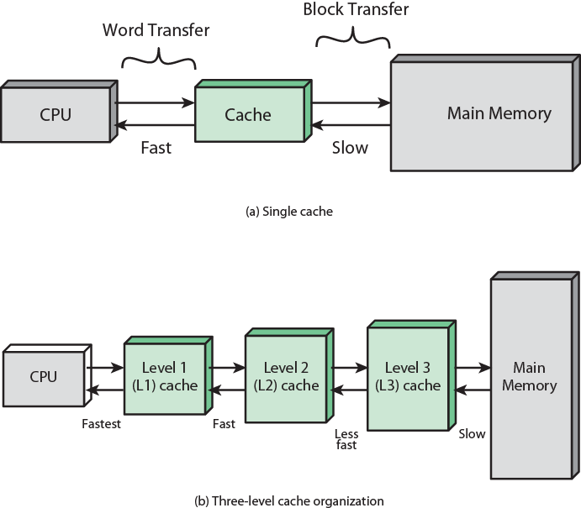
Cache and Main Memory
(Stallings, W., 2016)
Notes:
Cache memory is designed to combine the memory access time of expensive, high-speed
memory combined with the large memory size of less expensive, lower-speed
memory.
The concept is illustrated in the Figure here. There is a relatively large and slow
main memory together with a smaller, faster cache memory. The cache contains a
copy of portions of main memory. When the processor attempts to read a word of
memory, a check is made to determine if the word is in the cache. If so, the word is
delivered to the processor. If not, a block of main memory, consisting of some fixed
number of words, is read into the cache and then the word is delivered to the processor.
Because of the phenomenon of locality of reference, when a block of data is
fetched into the cache to satisfy a single memory reference, it is likely that there will
be future references to that same memory location or to other words in the block.
The second Figure depicts the use of multiple levels of cache. The L2 cache is slower
and typically larger than the L1 cache, and the L3 cache is slower and typically
larger than the L2 cache.

Slide 27
Cache operation – overview
CPU requests contents of memory location
Check cache for this data
If present, get from cache (fast)
If not present, read required block from main memory to cache
Then deliver from cache to CPU
Cache includes tags to identify which block of main memory is in each cache slot

Slide 28
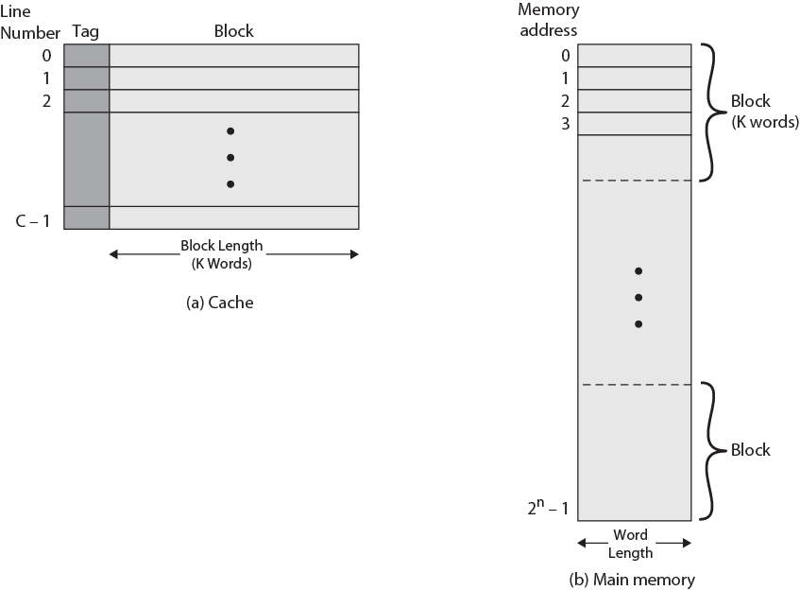
Cache/Main Memory Structure
Notes:
Figure on slide depicts the structure of a cache/main-memory system.

Slide 29
Mapping Function
Direct Mapping
Associative Mapping
Set Associative mapping

Slide 30
Direct Mapping
Each block of main memory maps to only one cache line
i.e. if a block is in cache, it must be in one specific place

Slide 31
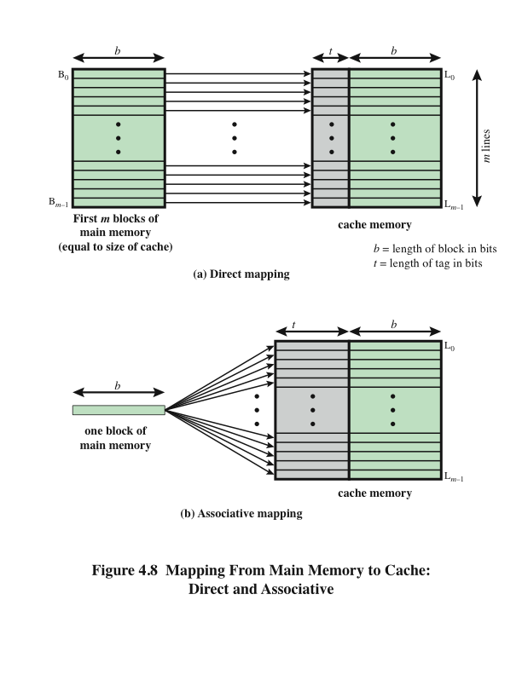
Direct Mapping
Associative Mapping
(Stallings, W., 2016)
Notes:
The mapping is expressed as
i = j modulo m
where
i = cache line number
j = main memory block number
m = number of lines in the cache
Figure 4.8a shows the mapping for the first m blocks of main memory. Each
block of main memory maps into one unique line of the cache. The next m blocks
of main memory map into the cache in the same fashion; that is, block B_{m} of main
memory maps into line L₀ of cache, block _{Bm+1} maps into line L₁, and so on.

Slide 32
Direct Mapping pros & cons
Simple
Inexpensive
Fixed location for given block
If a program accesses 2 blocks that map to the same line repeatedly, cache misses are very high

Slide 33
Victim Cache
Lower miss penalty
Originally proposed as an approach to reduce the conflict misses of direct mapped caches without affecting its fast access time
Remember what was discarded
Already fetched
Use again with little penalty
Fully associative
4 to 16 cache lines
Between direct mapped L1 cache and next memory level
Notes:
One approach to lower the miss penalty is to remember what was discarded
in case it is needed again. Since the discarded data has already been fetched, it can
be used again at a small cost. Such recycling is possible using a victim cache. Victim
cache was originally proposed as an approach to reduce the conflict misses of direct
mapped caches without affecting its fast access time. Victim cache is a fully associative
cache, whose size is typically 4 to 16 cache lines, residing between a direct mapped L1
cache and the next level of memory.

Slide 34
Associative Mapping
A main memory block can load into any line of cache
Memory address is interpreted as tag and word
Tag uniquely identifies block of memory
Every line’s tag is examined for a match
Cache searching gets expensive

Slide 35
Set Associative Mapping
Compromise that exhibits the strengths of both the direct and associative approaches while reducing their disadvantages
Cache is divided into a number of sets
Each set contains a number of lines
A given block maps to any line in a given set
e.g. Block B can be in any line of set I
E.g. 2 lines per set
2 way associative mapping
A given block can be in one of 2 lines in only one set
Notes:
Set-associative mapping is a compromise that
exhibits the strengths of both the direct and associative approaches while reducing
their disadvantages.

Slide 36
Replacement Algorithms
Once the cache has been filled, when a new block is brought into the cache, one of the existing blocks must be replaced
For direct mapping there is only one possible line for any particular block and no choice is possible
For the associative and set-associative techniques a replacement algorithm is needed
To achieve high speed, an algorithm must be implemented in hardware
Notes:
Once the cache has been filled, when a new block is brought into the cache, one
of the existing blocks must be replaced. For direct mapping, there is only one possible
line for any particular block, and no choice is possible. For the associative
and set-associative techniques, a replacement algorithm is needed. To achieve high
speed, such an algorithm must be implemented in hardware.

Slide 37
The four most common replacement algorithms are:
Least recently used (LRU)
Most effective
Replace that block in the set that has been in the cache longest with no reference to it
Because of its simplicity of implementation, LRU is the most popular replacement algorithm
First-in-first-out (FIFO)
Replace that block in the set that has been in the cache longest
Easily implemented as a round-robin or circular buffer technique
Least frequently used (LFU)
Replace that block in the set that has experienced the fewest references
Could be implemented by associating a counter with each line
Random
Notes:
A number of algorithms
have been tried. We mention four of the most common. Probably the most
effective is least recently used (LRU): Replace that block in the set that has been in
the cache longest with no reference to it. For two-way set associative, this is easily
implemented. Each line includes a USE bit. When a line is referenced, its USE bit
is set to 1 and the USE bit of the other line in that set is set to 0. When a block is to
be read into the set, the line whose USE bit is 0 is used. Because we are assuming
that more recently used memory locations are more likely to be referenced, LRU
should give the best hit ratio. LRU is also relatively easy to implement for a fully
associative cache. The cache mechanism maintains a separate list of indexes to all
the lines in the cache. When a line is referenced, it moves to the front of the list.
For replacement, the line at the back of the list is used. Because of its simplicity of
implementation, LRU is the most popular replacement algorithm.
Another possibility is first-in-first-out (FIFO): Replace that block in the set
that has been in the cache longest. FIFO is easily implemented as a round-robin
or circular buffer technique. Still another possibility is least frequently used (LFU):
Replace that block in the set that has experienced the fewest references. LFU could
be implemented by associating a counter with each line. A technique not based on
usage (i.e., not LRU, LFU, FIFO, or some variant) is to pick a line at random from
among the candidate lines. Simulation studies have shown that random replacement
provides only slightly inferior performance to an algorithm based on usage (Smith A, 1982).

Slide 38
Unified Versus Split Caches
It has become common to split cache:
One dedicated to instructions
One dedicated to data
Both exist at the same level, typically as two L1 caches
Advantages of unified cache:
Higher hit rate
Balances load of instruction and data fetches automatically
Only one cache needs to be designed and implemented
Trend is toward split caches at the L1 and unified caches for higher levels
Advantages of split cache:
Eliminates cache contention between instruction fetch/decode unit and execution unit
Important in pipelining
Notes:
When the on-chip cache first made an appearance,
many of the designs consisted of a single cache used to store references to both data
and instructions. More recently, it has become common to split the cache into two:
one dedicated to instructions and one dedicated to data. These two caches both exist
at the same level, typically as two L1 caches. When the processor attempts to fetch an
instruction from main memory, it first consults the instruction L1 cache, and when the
processor attempts to fetch data from main memory, it first consults the data L1 cache.
There are two potential advantages of a unified cache:
• For a given cache size, a unified cache has a higher hit rate than split caches
because it balances the load between instruction and data fetches automatically.
That is, if an execution pattern involves many more instruction fetches
than data fetches, then the cache will tend to fill up with instructions, and if an
execution pattern involves relatively more data fetches, the opposite will occur.
• Only one cache needs to be designed and implemented.
The trend is toward split caches at the L1 and unified caches for higher levels,
particularly for superscalar machines, which emphasize parallel instruction execution
and the prefetching of predicted future instructions. The key advantage of the
split cache design is that it eliminates contention for the cache between the instruction
fetch/decode unit and the execution unit. This is important in any design that
relies on the pipelining of instructions. Typically, the processor will fetch instructions
ahead of time and fill a buffer, or pipeline, with instructions to be executed. Suppose
now that we have a unified instruction/data cache. When the execution unit performs
a memory access to load and store data, the request is submitted to the unified cache.
If, at the same time, the instruction prefetcher issues a read request to the cache for
an instruction, that request will be temporarily blocked so that the cache can service
the execution unit first, enabling it to complete the currently executing instruction.
This cache contention can degrade performance by interfering with efficient use of
the instruction pipeline. The split cache structure overcomes this difficulty.

Slide 39
External Memory
Magnetic Disk
Circular platter constructed of nonmagnetic material, called substrate, coated with a magnetizable material.
Solid State Devices
Memory device made with solid state components that can be used as replacement to hard disk drive (HDD)
Optical Memory
Magnetic tape
Use the same reading and recording techniques as disk systems
Medium is flexible polyester tape coated with magnetizable material

Slide 40
Further Reading
Computer Organization and Architecture – Designing for Performance (10th Edition), William Stallings [Chapters: 4, 5, 6]
Computer Organization and Design – The Hardware/Software Interface (5th Edition), David A. Patterson & John L. Hennessy [Chapter: 5]
Fundamentals of Computer Architecture, Mark Burrell [Chapter: 7]

