Slide 1
Input/ Output Module & Devices
Computer Interconnection
120CT Computer Architecture and Networks
Dr Dianabasi Nkantah
ab0480@coventry.ac.uk

Slide 2
I/O Modules and External Devices

Slide 3

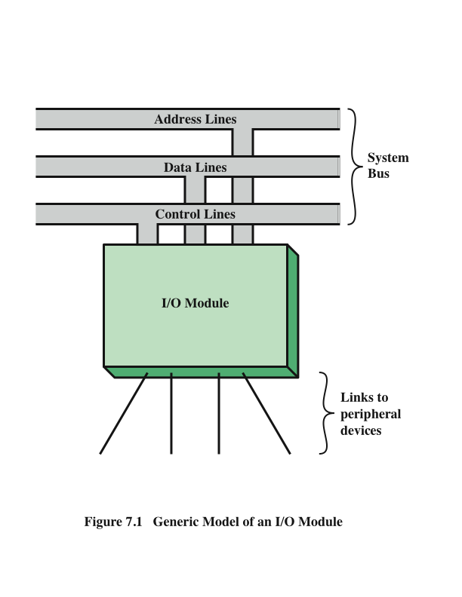
Generic
Model of an I/O Module
Stallings, W., 2016
Notes:
An I/O module is required. This module has two major functions
• Interface to the processor and memory via the system bus or central switch
• Interface to one or more peripheral devices by tailored data links

Slide 4
External Devices
Three categories:
Human readable
  Suitable for communicating with the computer user
  Video display terminals (VDTs), printers
Machine readable
  Suitable for communicating with equipment
  Magnetic disk and tape systems, sensors and actuators
Communication
  Suitable for communicating with remote devices such as a terminal, a machine readable device, or another computer
Provide a means of exchanging data between the external environment and the computer
Attach to the computer by a link to an I/O module
  The link is used to exchange control, status, and data between the I/O module and the external device
peripheral device
  An external device connected to an I/O module
Notes:
I/O operations are accomplished through a wide assortment of external devices
that provide a means of exchanging data between the external environment
and the computer. An external device attaches to the computer by a link to
an I/O module (Figure 7.1). The link is used to exchange control, status, and
data between the I/O module and the external device. An external device connected
to an I/O module is often referred to as a peripheral device or, simply, a
peripheral.
We can broadly classify external devices into three categories:
• Human readable: Suitable for communicating with the computer user
• Machine readable: Suitable for communicating with equipment
• Communication: Suitable for communicating with remote devices
Examples of human-readable devices are video display terminals (VDTs) and
printers. Examples of machine-readable devices are magnetic disk and tape systems,
and sensors and actuators, such as are used in a robotics application. Note
that we are viewing disk and tape systems as I/O devices in this chapter, whereas
in Chapter 6 we viewed them as memory devices. From a functional point of view,
these devices are part of the memory hierarchy, and their use is appropriately discussed
in Chapter 6. From a structural point of view, these devices are controlled by
I/O modules and are hence to be considered in this chapter.
Communication devices allow a computer to exchange data with a remote
device, which may be a human-readable device, such as a terminal, a machine readable
device, or even another computer.

Slide 5
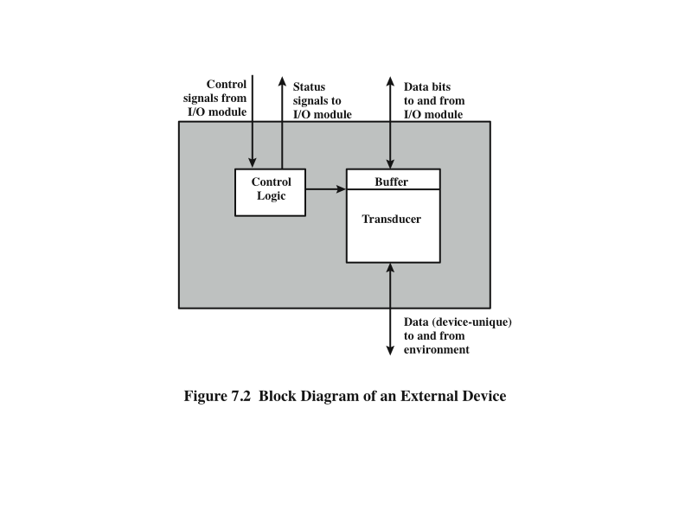
External
Device
Block
Diagram
Stallings, W., 2016
Notes:
In very general terms, the nature of an external device is indicated in
Figure 7.2. The interface to the I/O module is in the form of control, data, and status
signals. Control signals determine the function that the device will perform, such as
send data to the I/O module (INPUT or READ), accept data from the I/O module
(OUTPUT or WRITE), report status, or perform some control function particular
to the device (e.g., position a disk head). Data are in the form of a set of bits to
be sent to or received from the I/O module. Status signals indicate the state of the
device. Examples are READY/NOT-READY to show whether the device is ready
for data transfer.
Control logic associated with the device controls the device’s operation in
response to direction from the I/O module. The transducer converts data from electrical
to other forms of energy during output and from other forms to electrical during
input. Typically, a buffer is associated with the transducer to temporarily hold
data being transferred between the I/O module and the external environment; a
buffer size of 8 to 16 bits is common.

Slide 6

Keyboard/Monitor
Most common means of computer/user interaction
User provides input through the keyboard
The monitor displays data provided by the computer
International Reference Alphabet (IRA)/ASCII
Keyboard Codes
Basic unit of exchange is the character
  Associated with each character is a code
  Each character in this code is represented by a unique 7-bit binary code
    128 different characters can be represented
Characters are of two types:
  Printable
    Alphabetic, numeric, and special characters that can be printed on paper or displayed on a screen
  Control
    Have to do with controlling the printing or displaying of characters
    Example is carriage return
    Other control characters are concerned with communications procedures
When the user depresses a key it generates an electronic signal that is interpreted by the transducer in the keyboard and translated into the bit pattern of the corresponding IRA code
This bit pattern is transmitted to the I/O module in the computer
On output, IRA code characters are transmitted to an external device from the I/O module
The transducer interprets the code and sends the required electronic signals to the output device either to display the indicated character or perform the requested control function
Notes:
The most common means of computer/user interaction is a keyboard/monitor
arrangement. The user provides input through the keyboard. This input is then
transmitted to the computer and may also be displayed on the monitor. In addition,
the monitor displays data provided by the computer.
The basic unit of exchange is the character. Associated with each character
is a code, typically 7 or 8 bits in length. The most commonly used text code is the
International Reference Alphabet (IRA). Each character in this code is represented
by a unique 7-bit binary code; thus, 128 different characters can be represented.
Characters are of two types: printable and control. Printable characters are
the alphabetic, numeric, and special characters that can be printed on paper or displayed
on a screen. Some of the control characters have to do with controlling the
printing or displaying of characters; an example is carriage return. Other control
characters are concerned with communications procedures. See Appendix F for
details.
For keyboard input, when the user depresses a key, this generates an
electronic signal that is interpreted by the transducer in the keyboard and
translated into the bit pattern of the corresponding IRA code. This bit pattern
is then transmitted to the I/O module in the computer. At the computer, the
text can be stored in the same IRA code. On output, IRA code characters are
transmitted to an external device from the I/O module. The transducer at the
device interprets this code and sends the required electronic signals to the output
device either to display the indicated character or perform the requested
control function.

Slide 7
I/O Modules
The major functions for an I/O module fall into the following categories:
Control and timing
Coordinates the flow of traffic between internal resources and external devices
Processor communication
Involves command decoding, data, status reporting, address recognition
Device communication
Involves commands, status information, and data
Data buffering
Performs the needed buffering operation to balance device and memory speeds
Error detection
Detects and reports transmission errors
Module Function
Notes:
The major functions or requirements for an I/O module fall into the following
categories:
• Control and timing
• Processor communication
• Device communication
• Data buffering
• Error detection
During any period of time, the processor may communicate with one or more
external devices in unpredictable patterns, depending on the program’s need for I/O.
The internal resources, such as main memory and the system bus, must be shared
among a number of activities, including data I/O. Thus, the I/O function includes a
control and timing requirement, to coordinate the flow of traffic between internal
resources and external devices. For example, the control of the transfer of data from
an external device to the processor might involve the following sequence of steps:
1. The processor interrogates the I/O module to check the status of the attached
device.
2. The I/O module returns the device status.
3. If the device is operational and ready to transmit, the processor requests the
transfer of data, by means of a command to the I/O module.
4. The I/O module obtains a unit of data (e.g., 8 or 16 bits) from the external device.
5. The data are transferred from the I/O module to the processor.
If the system employs a bus, then each of the interactions between the processor
and the I/O module involves one or more bus arbitrations.
The preceding simplified scenario also illustrates that the I/O module must
communicate with the processor and with the external device. Processor communication
involves the following:
• Command decoding: The I/O module accepts commands from the processor,
typically sent as signals on the control bus. For example, an I/O module for a
disk drive might accept the following commands: READ SECTOR, WRITE
SECTOR, SEEK track number, and SCAN record ID. The latter two commands
each include a parameter that is sent on the data bus.
• Data: Data are exchanged between the processor and the I/O module over the
data bus.
• Status reporting: Because peripherals are so slow, it is important to know the
status of the I/O module. For example, if an I/O module is asked to send data
to the processor (read), it may not be ready to do so because it is still working
on the previous I/O command. This fact can be reported with a status signal.
Common status signals are BUSY and READY. There may also be signals to
report various error conditions.
• Address recognition: Just as each word of memory has an address, so does
each I/O device. Thus, an I/O module must recognize one unique address for
each peripheral it controls.
On the other side, the I/O module must be able to perform device communication.
This communication involves commands, status information, and data
(Figure 7.2).
An essential task of an I/O module is data buffering. The need for this function
is apparent from Figure 2.11. Whereas the transfer rate into and out of main
memory or the processor is quite high, the rate is orders of magnitude lower for
many peripheral devices and covers a wide range. Data coming from main memory
are sent to an I/O module in a rapid burst. The data are buffered in the I/O module
and then sent to the peripheral device at its data rate. In the opposite direction, data
are buffered so as not to tie up the memory in a slow transfer operation. Thus, the
I/O module must be able to operate at both device and memory speeds. Similarly, if
the I/O device operates at a rate higher than the memory access rate, then the I/O
module performs the needed buffering operation.
Finally, an I/O module is often responsible for error detection and for subsequently
reporting errors to the processor. One class of errors includes mechanical
and electrical malfunctions reported by the device (e.g., paper jam, bad disk track).
Another class consists of unintentional changes to the bit pattern as it is transmitted
from device to I/O module. Some form of error-detecting code is often used
to detect transmission errors. A simple example is the use of a parity bit on each
character of data. For example, the IRA character code occupies 7 bits of a byte.
The eighth bit is set so that the total number of 1s in the byte is even (even parity)
or odd (odd parity). When a byte is received, the I/O module checks the parity to
determine whether an error has occurred.

Slide 8
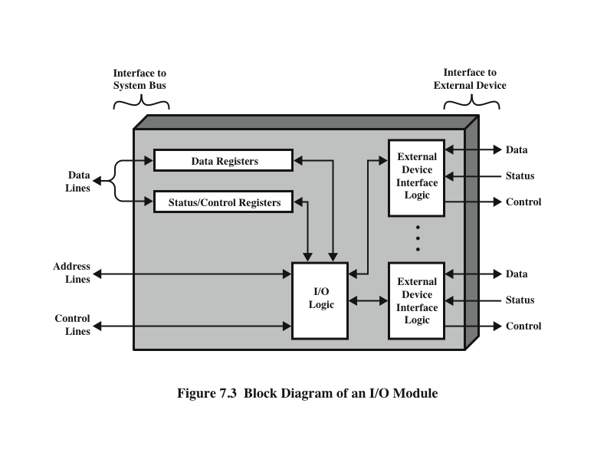
I/O Module Structure
Stallings, W., 2016
Notes:
I/O modules vary considerably in complexity and the number of external devices
that they control. We will attempt only a very general description here. Figure 7.3 provides a general
block diagram of an I/O module. The module connects to the rest of the computer
through a set of signal lines (e.g., system bus lines). Data transferred to and from the
module are buffered in one or more data registers. There may also be one or more
status registers that provide current status information. A status register may also
function as a control register, to accept detailed control information from the processor.
The logic within the module interacts with the processor via a set of control
lines. The processor uses the control lines to issue commands to the I/O module.
Some of the control lines may be used by the I/O module (e.g., for arbitration and
status signals). The module must also be able to recognize and generate addresses
associated with the devices it controls. Each I/O module has a unique address or, if
it controls more than one external device, a unique set of addresses. Finally, the I/O
module contains logic specific to the interface with each device that it controls.
An I/O module functions to allow the processor to view a wide range of devices
in a simple-minded way. There is a spectrum of capabilities that may be provided.
The I/O module may hide the details of timing, formats, and the electromechanics
of an external device so that the processor can function in terms of simple read and
write commands, and possibly open and close file commands. In its simplest form,
the I/O module may still leave much of the work of controlling a device (e.g., rewind
a tape) visible to the processor.
An I/O module that takes on most of the detailed processing burden, presenting
a high-level interface to the processor, is usually referred to as an I/O channel or
I/O processor. An I/O module that is quite primitive and requires detailed control
is usually referred to as an I/O controller or device controller. I/O controllers are
commonly seen on microcomputers, whereas I/O channels are used on mainframes.
In what follows, we will use the generic term I/O module when no confusion
results and will use more specific terms where necessary.

Slide 9
Techniques for I/O Operations
Three techniques are possible for I/O operations:
Programmed I/O
  Data are exchanged between the processor and the I/O module
  Processor executes a program that gives it direct control of the I/O operation
  When the processor issues a command it must wait until the I/O operation is complete
  If the processor is faster than the I/O module this is wasteful of processor time
  Interrupt-driven I/O
  Processor issues an I/O command, continues to execute other instructions, and is interrupted by the I/O module when the latter has completed its work
  Direct memory access (DMA)
  The I/O module and main memory exchange data directly without processor involvement
Notes:
Three techniques are possible for I/O operations. With programmed I/O, data are
exchanged between the processor and the I/O module. The processor executes a program
that gives it direct control of the I/O operation, including sensing device status,
sending a read or write command, and transferring the data. When the processor
issues a command to the I/O module, it must wait until the I/O operation is complete.
If the processor is faster than the I/O module, this is wasteful of processor time.
With interrupt-driven I/O, the processor issues an I/O command, continues to execute
other instructions, and is interrupted by the I/O module when the latter has completed
its work. With both programmed and interrupt I/O, the processor is responsible for
extracting data from main memory for output and storing data in main memory for
input. The alternative is known as direct memory access (DMA). In this mode, the I/O
module and main memory exchange data directly, without processor involvement.

Slide 10
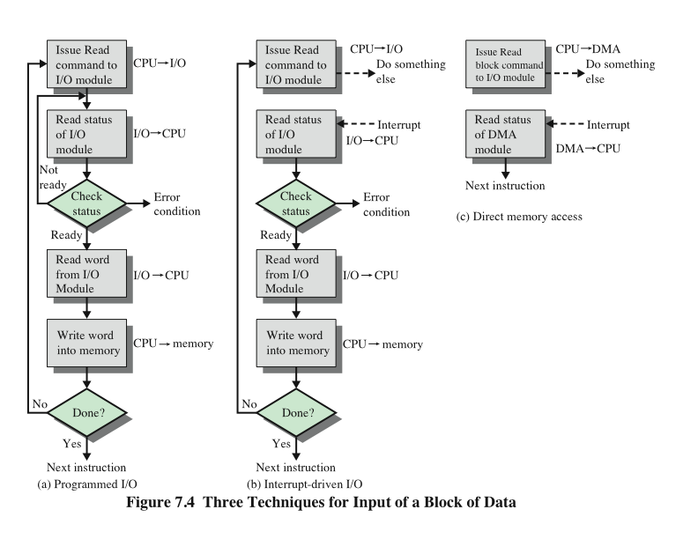
Three
Techniques for Input of a
Block of Data
Stallings, W., 2016
Notes:
Figure 7.4a gives an example of the use of programmed I/O to read in a block of
data from a peripheral device (e.g., a record from tape) into memory. Data are read
in one word (e.g., 16 bits) at a time. For each word that is read in, the processor must
remain in a status-checking cycle until it determines that the word is available in the
I/O module’s data register. This flowchart highlights the main disadvantage of this
technique: it is a time-consuming process that keeps the processor busy needlessly.

Slide 11
I/O Commands
There are four types of I/O commands that an I/O module may receive when it is addressed by a processor:
Control
  used to activate a peripheral and tell it what to do
Test
  used to test various status conditions associated with an I/O module and its peripherals
Read
  causes the I/O module to obtain an item of data from the peripheral and place it in an internal buffer
Write
  - causes the I/O module to take an item of data from the data bus and subsequently transmit that data item to the peripheral
Notes:
To execute an I/O-related instruction, the processor issues an address, specifying the
particular I/O module and external device, and an I/O command. There are four types
of I/O commands that an I/O module may receive when it is addressed by a processor:
• Control: Used to activate a peripheral and tell it what to do. For example, a
magnetic-tape unit may be instructed to rewind or to move forward one record.
These commands are tailored to the particular type of peripheral device.
• Test: Used to test various status conditions associated with an I/O module and
its peripherals. The processor will want to know that the peripheral of interest
is powered on and available for use. It will also want to know if the most
recent I/O operation is completed and if any errors occurred.
• Read: Causes the I/O module to obtain an item of data from the peripheral
and place it in an internal buffer (depicted as a data register in Figure 7.3). The
processor can then obtain the data item by requesting that the I/O module
place it on the data bus.
• Write: Causes the I/O module to take an item of data (byte or word) from the
data bus and subsequently transmit that data item to the peripheral.

Slide 12
Computer Interconnection

Slide 13
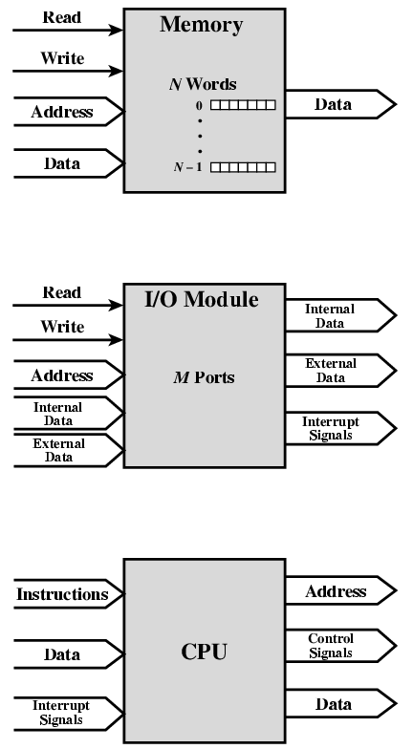
Computer Interconnection
Stallings, W., 2013
Notes:
A computer consists of a set of components or modules of three basic types
(processor, memory, I/O) that communicate with each other. In effect, a computer is
a network of basic modules. Thus, there must be paths for connecting the modules.
The collection of paths connecting the various modules is called the interconnection
structure. The design of this structure will depend on the exchanges that
must be made among modules.
The figure here suggests the types of exchanges that are needed by indicating the
major forms of input and output for each module type:
• Memory: Typically, a memory module will consist of N words of equal length.
Each word is assigned a unique numerical address (0, 1, …, N - 1). A word of
data can be read from or written into the memory. The nature of the operation
is indicated by read and write control signals. The location for the operation is
specified by an address.
• I/O module: From an internal (to the computer system) point of view, I/O
is functionally similar to memory. There are two operations, read and write.
Further, an I/O module may control more than one external device. We can
refer to each of the interfaces to an external device as a port and give each
a unique address (e.g., 0, 1, …, M - 1). In addition, there are external data
paths for the input and output of data with an external device. Finally, an I/O
module may be able to send interrupt signals to the processor.
• Processor: The processor reads in instructions and data, writes out data after
processing, and uses control signals to control the overall operation of the
system. It also receives interrupt signals.

Slide 14
Memory Connection
Receives and sends data
Receives addresses (of locations)
Receives control signals
  Read
  Write
  Timing

Slide 15
Input/Output Connection(1)
Similar to memory from computer’s viewpoint
Output
  Receive data from computer
  Send data to peripheral
Input
  Receive data from peripheral
  Send data to computer

Slide 16
Input/Output Connection(2)
Receive control signals from computer
Send control signals to peripherals
  e.g. spin disk
Receive addresses from computer
  e.g. port number to identify peripheral
Send interrupt signals (control)

Slide 17
CPU Connection
Reads instruction and data
Writes out data (after processing)
Sends control signals to other units
Receives (& acts on) interrupts

Slide 18
Buses
There are a number of possible interconnection systems
Single and multiple BUS structures have been the most common for decades
  e.g. Control/Address/Data bus (PC)
  e.g. Unibus (DEC-PDP)

Slide 19
What is a Bus?
A communication pathway connecting two or more devices
Usually broadcast
Often grouped
  A number of channels in one bus
    e.g. 32 bit data bus is 32 separate single bit channels

Slide 20
Data Bus
Data lines that provide a path for moving data among system modules
May consist of 32, 64, 128, or more separate lines
The number of lines is referred to as the width of the data bus
The number of lines determines how many bits can be transferred at a time
The width of the data bus
is a key factor in
determining overall
system performance
Notes:
A system bus consists, typically, of from about fifty to hundreds of separate lines.
The data lines provide a path for moving data among system modules. These
lines, collectively, are called the data bus. The data bus may consist of 32, 64, 128, or
even more separate lines, the number of lines being referred to as the width of the
data bus. Because each line can carry only 1 bit at a time, the number of lines determines
how many bits can be transferred at a time. The width of the data bus is a key
factor in determining overall system performance. For example, if the data bus is
32 bits wide and each instruction is 64 bits long, then the processor must access the
memory module twice during each instruction cycle.

Slide 21
Address bus
Identify the source or destination of data
  e.g. CPU needs to read an instruction (data) from a given location in memory
Bus width determines maximum memory capacity of system
  e.g. 8080 has 16 bit address bus giving 64k address space

Slide 22
Control Bus
Control and timing information
  Memory read/write signal
  Interrupt request
  Clock signals

Slide 23
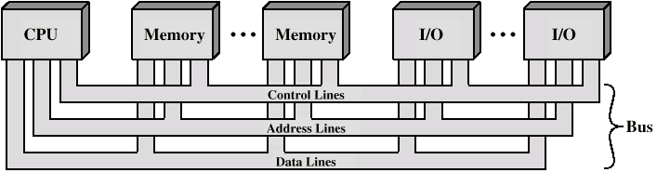
Bus Interconnection Scheme
Notes:
The operation of the bus is as follows. If one module wishes to send data to
another, it must do two things: (1) obtain the use of the bus, and (2) transfer data
via the bus. If one module wishes to request data from another module, it must (1)
obtain the use of the bus, and (2) transfer a request to the other module over the
appropriate control and address lines. It must then wait for that second module to
send the data.

Slide 24
Single Bus Problems
Lots of devices on one bus leads to:
  Propagation delays
    Long data paths mean that co-ordination of bus use can adversely affect performance
    If aggregate data transfer approaches bus capacity
Most systems use multiple buses to overcome these problems

Slide 25
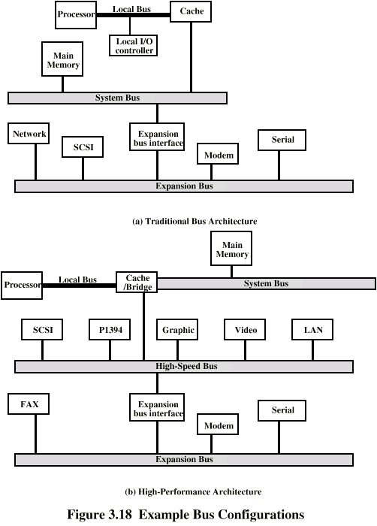
Traditional Bus Architecture
(with cache)
Stallings, W., 2013
Notes:
If a great number of devices are connected to the bus, performance will suffer.
There are two main causes:
1. In general, the more devices attached to the bus, the greater the bus length
and hence the greater the propagation delay. This delay determines the time
it takes for devices to coordinate the use of the bus. When control of the bus
passes from one device to another frequently, these propagation delays can
noticeably affect performance.
2. The bus may become a bottleneck as the aggregate data transfer demand
approaches the capacity of the bus. This problem can be countered to some
extent by increasing the data rate that the bus can carry and by using wider
buses (e.g., increasing the data bus from 32 to 64 bits). However, because the
data rates generated by attached devices (e.g., graphics and video controllers,
network interfaces) are growing rapidly, this is a race that a single bus is
ultimately destined to lose.
Accordingly, most bus-based computer systems use multiple buses, generally
laid out in a hierarchy. A typical traditional structure is shown in the figure here. There
is a local bus that connects the processor to a cache memory and that may support
one or more local devices. The cache memory controller connects the cache not only
to this local bus, but to a system bus to which are attached all of the main memory
modules. In contemporary systems, the cache is in the same chip as the processor, and
so an external bus or other interconnect scheme is not needed, although there may
also be an external cache. The use of a cache structure
insulates the processor from a requirement to access main memory frequently.
Hence, main memory can be moved off of the local bus onto a system bus. In this way,
I/O transfers to and from the main memory across the system bus do not interfere
with the processor’s activity.
It is possible to connect I/O controllers directly onto the system bus. A more
efficient solution is to make use of one or more expansion buses for this purpose.
An expansion bus interface buffers data transfers between the system bus and the
I/O controllers on the expansion bus. This arrangement allows the system to support
a wide variety of I/O devices and at the same time insulate memory-to-processor
traffic from I/O traffic.
The figure here shows some typical examples of I/O devices that might be attached
to the expansion bus. Network connections include local area networks (LANs)
such as a 10-Mbps Ethernet and connections to wide area networks (WANs) such as
a packet-switching network. SCSI (small computer system interface) is itself a type
of bus used to support local disk drives and other peripherals. A serial port could be
used to support a printer or scanner.
This traditional bus architecture is reasonably efficient but begins to break
down as higher and higher performance is seen in the I/O devices. In response to
these growing demands, a common approach taken by industry is to build a high-speed
bus that is closely integrated with the rest of the system, requiring only a
bridge between the processor’s bus and the high-speed bus. This arrangement is
sometimes known as a mezzanine architecture.
The figure on the next slide shows a typical realization of this approach. Again, there is a local
bus that connects the processor to a cache controller, which is in turn connected to
a system bus that supports main memory. The cache controller is integrated into a
bridge, or buffering device, that connects to the high-speed bus. This bus supports
connections to high-speed LANs, such as Fast Ethernet at 100 Mbps, video and
graphics workstation controllers, as well as interface controllers to local peripheral
buses, including SCSI and FireWire. The latter is a high-speed bus arrangement
specifically designed to support high-capacity I/O devices. Lower-speed devices are
still supported off an expansion bus, with an interface buffering traffic between the
expansion bus and the high-speed bus.
The advantage of this arrangement is that the high-speed bus brings high demand
devices into closer integration with the processor and at the same time is
independent of the processor. Thus, differences in processor and high-speed bus
speeds and signal line definitions are tolerated. Changes in processor architecture
do not affect the high-speed bus, and vice versa.

Slide 26
High Performance Bus
Stallings, W., 2013

Slide 27
Point-to-Point Interconnect
Principal reason for change was the electrical constraints encountered with increasing the frequency of wide synchronous buses
At higher and higher data rates it becomes increasingly difficult to perform the synchronization and arbitration functions in a timely fashion
A conventional shared bus on the same chip magnified the difficulties of increasing bus data rate and reducing bus latency to keep up with the processors
Has lower latency, higher data rate, and better scalability
Notes:
The shared bus architecture was the standard approach to interconnection between
the processor and other components (memory, I/O, and so on) for decades. But
contemporary systems increasingly rely on point-to-point interconnection rather
than shared buses.
The principal reason driving the change from bus to point-to-point interconnect
was the electrical constraints encountered with increasing the frequency of wide
synchronous buses. At higher and higher data rates, it becomes increasingly difficult
to perform the synchronization and arbitration functions in a timely fashion. Further,
with the advent of multi-core chips, with multiple processors and significant memory
on a single chip, it was found that the use of a conventional shared bus on the same
chip magnified the difficulties of increasing bus data rate and reducing bus latency
to keep up interconnect has lower latency, higher data rate, and better scalability.

Slide 28
PCI and PCIe
Peripheral Component Interconnect (PCI)
  A popular high bandwidth, processor independent bus that can function as a mezzanine or peripheral bus
  Delivers better system performance for high speed I/O subsystems
  PCI Express (PCIe)
  Point-to-point interconnect scheme intended to replace bus-based schemes such as PCI
  Key requirement is high capacity to support the needs of higher data rate I/O devices, such as Gigabit Ethernet
  Another requirement deals with the need to support time dependent data streams
Notes:
The peripheral component interconnect (PCI) is a popular high-bandwidth, processor independent
bus that can function as a mezzanine or peripheral bus. Compared with
other common bus specifications, PCI delivers better system performance for high speed
I/O subsystems (e.g., graphic display adapters, network interface controllers,
and disk controllers).
Intel began work on PCI in 1990 for its Pentium-based systems. Intel soon
released all the patents to the public domain and promoted the creation of an
industry association, the PCI Special Interest Group (SIG), to develop further and
maintain the compatibility of the PCI specifications. The result is that PCI has been
widely adopted and is finding increasing use in personal computer, workstation, and
server systems. Because the specification is in the public domain and is supported
by a broad cross section of the microprocessor and peripheral industry, PCI products
built by different vendors are compatible.
As with the system bus discussed in the preceding slides, the bus-based PCI
scheme has not been able to keep pace with the data rate demands of attached
devices. Accordingly, a new version, known as PCI Express (PCIe) has been developed.
PCIe is a point-to-point interconnect scheme intended to replace
bus-based schemes such as PCI.
A key requirement for PCIe is high capacity to support the needs of higher data
rate I/O devices, such as Gigabit Ethernet. Another requirement deals with the need
to support time-dependent data streams. Applications such as video-on-demand and
audio redistribution are putting real-time constraints on servers too. Many communications
applications and embedded PC control systems also process data in real-
time.
Today’s platforms must also deal with multiple concurrent transfers at ever-increasing
data rates. It is no longer acceptable to treat all data as equal—it is more important,
for example, to process streaming data first since late real-time data is as useless as no
data. Data needs to be tagged so that an I/O system can prioritize its flow throughout
the platform.

Slide 29
Further Reading
Computer Organization and Architecture – Designing for Performance (10th Edition), William Stallings [Chapters: 3, 7]
Fundamentals of Computer Architecture, Mark Burrell [Chapters: 6, 12]

