Slide 1
RISC Amdahl’s Law
120CT Computer Architecture and Networks
Dr Dianabasi Nkantah
ab0480@coventry.ac.uk

Slide 2

RISC and CISC
Reduced Instruction Set Computers
One operation per clock tick
Complex Instruction Set Computers
One instruction may take multiple clock ticks to run
It can fetch operands and do operations in a single operation

Slide 3
Characteristics of Reduced Instruction Set Architectures
One machine instruction per machine cycle
Machine cycle --- the time it takes to fetch two operands from registers, perform an ALU operation, and store the result in a register
Register-to-register operations
Only simple LOAD and STORE operations accessing memory
This simplifies the instruction set and therefore the control unit
Simple addressing modes
Simplifies the instruction set and the control unit
Simple instruction formats
Generally only one or a few formats are used
Instruction length is fixed and aligned on word boundaries
Opcode decoding and register operand accessing can occur simultaneously
Notes:
Although a variety of different approaches to reduced instruction set architecture have been taken, certain characteristics are common to all of them:
• One instruction per cycle
• Register-to-register operations
• Simple addressing modes
• Simple instruction formats
Here, we provide a brief discussion of these characteristics. Specific examples are explored later in this chapter.
The first characteristic listed is that there is one machine instruction per machine cycle. A machine cycle is defined to be the time it takes to fetch two operands from registers, perform an ALU operation, and store the result in a register. Thus, RISC machine instructions should be no more complicated than, and execute about as fast as, microinstructions on CISC machines (discussed in Part Four). With simple, one-cycle instructions, there is little or no need for microcode; the machine instructions can be hardwired. Such instructions should execute faster than comparable machine instructions on other machines, because it is not necessary to access a microprogram control store during instruction execution.
A second characteristic is that most operations should be register to register, with only simple LOAD and STORE operations accessing memory. This design feature simplifies the instruction set and therefore the control unit. For example, a RISC instruction set may include only one or two ADD instructions (e.g., integer add, add with carry); the VAX has 25 different ADD instructions. Another benefit is that such an architecture encourages the optimization of register use, so that frequently accessed operands remain in high-speed storage.
A third characteristic is the use of simple addressing modes. Almost all RISC instructions use simple register addressing. Several additional modes, such as displacement and PC-relative, may be included. Other, more complex modes can be synthesized in software from the simple ones. Again, this design feature simplifies the instruction set and the control unit.
A final common characteristic is the use of simple instruction formats. Generally, only one or a few formats are used. Instruction length is fixed and aligned on word boundaries. Field locations, especially the opcode, are fixed. This design feature has a number of benefits. With fixed fields, opcode decoding and register operand accessing can occur simultaneously. Simplified formats simplify the control unit. Instruction fetching is optimized because word-length units are fetched. Alignment on a word boundary also means that a single instruction does not cross page boundaries.

Slide 4
Why CISC ?
(Complex Instruction Set Computer)
There is a trend to richer instruction sets which include a larger and more complex number of instructions
Two principal reasons for this trend:
A desire to simplify compilers
A desire to improve performance
There are two advantages to smaller programs:
The program takes up less memory
Should improve performance
Fewer instructions means fewer instruction bytes to be fetched
In a paging environment smaller programs occupy fewer pages, reducing page faults
More instructions fit in cache(s)
Notes:
We have noted the trend to richer instruction sets, which include a larger number of instructions and more complex instructions. Two principal reasons have motivated this trend: a desire to simplify compilers and a desire to improve performance. Underlying both of these reasons was the shift to HLLs on the part of programmers; architects attempted to design machines that provided better support for HLLs.
It is not the intent of this chapter to say that the CISC designers took the wrong direction. Indeed, because technology continues to evolve and because architectures exist along a spectrum rather than in two neat categories, a black-and-white assessment is unlikely ever to emerge. Thus, the comments that follow are simply meant to point out some of the potential pitfalls in the CISC approach and to pro- vide some understanding of the motivation of the RISC adherents.
The first of the reasons cited, compiler simplification, seems obvious, but it is not. The task of the compiler writer is to build a compiler that generates good (fast, small, fast and small) sequences of machine instructions for HLL programs (i.e., the compiler views individual HLL statements in the context of surrounding HLL statements). If there are machine instructions that resemble HLL statements, this task is simplified. This reasoning has been disputed by the RISC researchers ([HENN82], [RADI83], [PATT82b]). They have found that complex machine instructions are often hard to exploit because the compiler must find those cases that exactly fit the construct. The task of optimizing the generated code to minimize code size, reduce instruction execution count, and enhance pipelining is much more difficult with a complex instruction set. As evidence of this, studies cited earlier in this chapter indicate that most of the instructions in a compiled program are the relatively simple ones.
The other major reason cited is the expectation that a CISC will yield smaller, faster programs. Let us examine both aspects of this assertion: that programs will be smaller and that they will execute faster.
There are two advantages to smaller programs. First, because the program takes up less memory, there is a savings in that resource. With memory today being so inexpensive, this potential advantage is no longer compelling. More important, smaller programs should improve performance, and this will happen in three ways. First, fewer instructions means fewer instruction bytes to be fetched. Second, in a paging environment, smaller programs occupy fewer pages, reducing page faults. Third, more instructions fit in cache(s).

Slide 5
Amdahl’s Law
Gene Amdahl [Amdahl G, 1967]
Deals with the potential speedup of a program using multiple processors compared to a single processor
Illustrates the problems facing industry in the development of multi-core machines
Software must be adapted to a highly parallel execution environment to exploit the power of parallel processing
Can be generalised to evaluate and design technical improvement in a computer system
Notes:
When considering system performance, computer system designers look for
ways to improve performance by improvement in technology or change in
design. Examples include the use of parallel processors, the use of a memory
cache hierarchy, and speedup in memory access time and I/O transfer rate
due to technology improvements. In all of these cases, it is important to note
that a speedup in one aspect of the technology or design does not result in a
corresponding improvement in performance. This limitation is succinctly
expressed by Amdahl’s law.
Amdahl’s law was first proposed by Gene Amdahl in [Amdahl G, 1967] and deals
with the potential speedup of a program using multiple processors compared to a
single processor.
Amdahl’s law illustrates the problems facing industry in the development of multi-core
machines with an ever-growing number of cores: The software that runs on such
machines must be adapted to a highly parallel execution environment to exploit the
power of parallel processing.

Slide 6
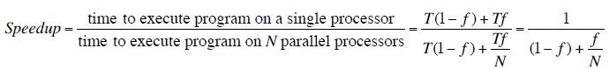
Amdahl’s Law Formula
For program running on single processor
Fraction f of code infinitely parallelizable with no scheduling overhead
Fraction (1-f) of code inherently serial
T is total execution time for program on single processor
N is number of processors that fully exploit parallel portions of code
Conclusions
f small, parallel processors has little effect
N ->∞, speedup bound by 1/(1 – f)
Diminishing returns for using more processors

Slide 7
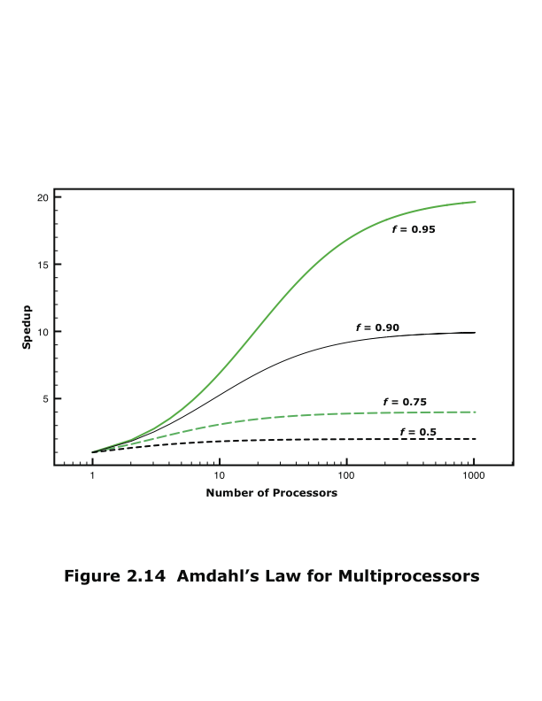
Amdahl’s Law
(Stallings, W., 2016)
Notes:
Consider a program running on a single processor such that a fraction
(1 – f) of the execution time involves code that is inherently serial and a fraction
f that involves code that is infinitely parallelizable with no scheduling overhead.
Let T be the total execution time of the program using a single processor. Then the
speedup using a parallel processor with N processors that fully exploits the parallel
portion of the program is as follows:
Speedup =
Time to execute program on a single processor
Time to execute program on N parallel processors
=T(1 - f) + Tf
T(1 - f) +Tf
N
= 1
(1 - f) +f
N
This equation is illustrated in Figure 2.14. Two important conclusions can be
drawn:
1. When f is small, the use of parallel processors has little effect.
2. As N approaches infinity, speedup is bound by 1/(1 – f), so that there are
diminishing returns for using more processors.
These conclusions are too pessimistic, an assertion first put forward in
[Gustafson J, 1988]. For example, a server can maintain multiple threads or multiple tasks
to handle multiple clients and execute the threads or tasks in parallel up to the limit
of the number of processors. Many database applications involve computations on
massive amounts of data that can be split up into multiple parallel tasks.

Slide 8
Amdahl’s Law
Potential speed up of program using multiple processors
Concluded that:
Code needs to be parallelizable
Speed up is bound, giving diminishing returns for more processors
Task dependent
Servers gain by maintaining multiple connections on multiple processors
Databases can be split into parallel tasks

Slide 9
Further Reading
Computer Organization and Architecture – Designing for Performance (10th Edition), William Stallings [Chapters: 12, 13 and Appendix B]
Computer Organization and Design – The Hardware/Software Interface (5th Edition), David A. Patterson & John L. Hennessy [Chapter: 2 and Appendix A]
Fundamentals of Computer Architecture, Mark Burrell

