Slide 1
Machine Instructions, Assembly Language, Machine Sequence and Micro-operations
120CT Computer Architecture and Networks
Dr Dianabasi Nkantah
ab0480@coventry.ac.uk

Slide 2

Machine Instruction Characteristics
The operation of the processor is determined by the instructions it executes, referred to as machine instructions or computer instructions
The collection of different instructions that the processor can execute is referred to as the processor’s instruction set
Each instruction must contain the information required by the processor for execution
Notes:
2
The operation of the processor is determined by the instructions it executes, referred to as machine instructions or computer instructions. The collection of different instructions that the processor can execute is referred to as the processor’s instruction set.
Each instruction must contain the information required by the processor for execution.

Slide 3
Elements of a Machine Instruction
Operation code (opcode)
Specifies the operation to be performed. The operation is specified by a binary code, known as the operation code, or opcode
Source operand reference
The operation may involve one or more source operands, that is, operands that are inputs for the operation
Result operand reference
The operation may produce a result
Next instruction reference
This tells the processor where to fetch the next instruction after the execution of this instruction is complete
Notes:
• Operation code: Specifies the operation to be performed (e.g., ADD, I/O). The operation is specified by a binary code, known as the operation code, or opcode.
• Source operand reference: The operation may involve one or more source operands, that is, operands that are inputs for the operation.
• Result operand reference: The operation may produce a result.
• Next instruction reference: This tells the processor where to fetch the next instruction after the execution of this instruction is complete.

Slide 4
Instruction Representation
Within the computer each instruction is represented by a sequence of bits
The instruction is divided into fields, corresponding to the constituent elements of the instruction
Stallings, W. (2016)
Notes:
5
Within the computer, each instruction is represented by a sequence of bits. The instruction is divided into fields, corresponding to the constituent elements of the instruction.
A simple example of an instruction format is shown in Figure 12.2 (10.2) on this slide. With most instruction sets, more than one format is used. During instruction execution, an instruction is read into an instruction register (IR) in the processor. The processor must be able to extract the data from the various instruction fields to perform the required operation.
It is difficult for the programmer to deal with binary representations of machine instructions. Thus, it has become common practice to use a symbolic representation of machine instructions.

Slide 5

Instruction Representation
Opcodes are represented by abbreviations called mnemonics
Examples include:
ADD Add
SUB Subtract
MUL Multiply
DIV Divide
LOAD Load data from memory
STOR Store data to memory
Operands are also represented symbolically
Each symbolic opcode has a fixed binary representation
The programmer specifies the location of each symbolic operand
Notes:
5
Opcodes are represented by abbreviations, called mnemonics, that indicate
the operation. Common examples include
ADD Add
SUB Subtract
MUL Multiply
DIV Divide
LOAD Load data from memory
STOR Store data to memory
Operands are also represented symbolically. For example, the instruction
ADD R, Y may mean add the value contained in data location Y to the contents of register
R. In this example, Y refers to the address of a location in memory, and R refers
to a particular register. Note that the operation is performed on the contents of a
location, not on its address.
Thus, it is possible to write a machine-language program in symbolic form.
Each symbolic opcode has a fixed binary representation, and the programmer specifies
the location of each symbolic operand. For example, the programmer might
begin with a list of definitions:
X = 513
Y = 514
and so on. A simple program would accept this symbolic input, convert opcodes and
operand references to binary form, and construct binary machine instructions.
Machine-language programmers are rare to the point of nonexistence. Most
programs today are written in a high-level language or, failing that, assembly language. However, symbolic machine language
remains a useful tool for describing machine instructions, and we will use it for that
purpose.

Slide 6

Assembly Language: Computation of the formula –> N = I+J+K
Address Content
0010 0010 0000 0001
0001 0010 0000 0010
0001 0010 0000 0011
0011 0010 0000 0100
0000 0000 0000 0010
0000 0000 0000 0011
0000 0000 0000 0100
0000 0000 0000 0000
Address Contents
2201
1202
1203
3204
0002
0003
0004
0000
(a) Binary Program
(b) Hexadecimal Program
Notes:
A processor can understand and execute machine instructions. Such instructions are simply binary numbers stored in the computer. If a programmer wished to program directly in machine language, then it would be necessary to enter the program as binary data.
Consider the simple BASIC statement N=I+J+K
Suppose we wished to program this statement in machine language and to initialize I, J, and K to 2, 3, and 4, respectively. This is shown in Figure (a). The program starts in location 101 (hexadecimal). Memory is reserved for the four variables starting at location 201. The program consists of four instructions:
Load the contents of location 201 into the AC.
Add the contents of location 202 to the AC.
Add the contents of location 203 to the AC.
Store the contents of the AC in location 204.
This is clearly a tedious and very error-prone process.
A slight improvement is to write the program in hexadecimal rather than
binary notation (Figure (b)). We could write the program as a series of lines. Each line contains the address of a memory location and the hexadecimal code of the binary value to be stored in that location. Then we need a program that will accept this input, translate each line into a binary number, and store it in the specified location.
For more improvement, we can make use of the symbolic name or mnemonic of each instruction. This results in the symbolic program shown in Figure ©. Each line of input still represents one memory location. Each line consists of three fields, separated by spaces. The first field contains the address of a location. For an instruction, the second field contains the three-letter symbol for the opcode. If it is a memory-referencing instruction, then a third field contains the address. To store arbitrary data in a location, we invent a pseudoinstruction with the symbol DAT. This is merely an indication that the third field on the line contains a hexadecimal number to be stored in the location specified in the first field.
For this type of input we need a slightly more complex program. The program accepts each line of input, generates a binary number based on the second and third (if present) fields, and stores it in the location specified by the first field.
The use of a symbolic program makes life much easier but is still awkward. In particular, we must give an absolute address for each word. This means that the program and data can be loaded into only one place in memory, and we must know that place ahead of time. Worse, suppose we wish to change the program some day by adding or deleting a line. This will change the addresses of all subsequent words.
A much better system, and one commonly used, is to use symbolic addresses. This is illustrated in Figure (d). Each line still consists of three fields. The first field is still for the address, but a symbol is used instead of an absolute numerical address. Some lines have no address, implying that the address of that line is one more than the address of the previous line. For memory-reference instructions, the third field also contains a symbolic address.
With this last refinement, we have an assembly language. Programs written in assembly language (assembly programs) are translated into machine language by an assembler. This program must not only do the symbolic translation discussed earlier but also assign some form of memory addresses to symbolic addresses.
The development of assembly language was a major milestone in the evolution of computer technology. It was the first step to the high-level languages in use today. Although few programmers use assembly language, virtually all machines provide one. They are used, if at all, for systems programs such as compilers and I/O routines.

Slide 7
Assembly Language: Computation of the formula –> N = I+J+K
Address Instruction
LDA 201
ADD 202
ADD 203
STA 204
DAT 2
DAT 3
DAT 4
DAT 0
Label Operation Operand
FORMUL LDA I
ADD J
ADD K
STA N
I DATA 2
J DATA 3
K DATA 4
N DATA 0
(c) Symbolic Program
(d) Assembly Program
Notes:
A processor can understand and execute machine instructions. Such instructions are simply binary numbers stored in the computer. If a programmer wished to program directly in machine language, then it would be necessary to enter the program as binary data.
Consider the simple BASIC statement N=I+J+K
Suppose we wished to program this statement in machine language and to initialize I, J, and K to 2, 3, and 4, respectively. This is shown in Figure (a). The program starts in location 101 (hexadecimal). Memory is reserved for the four variables starting at location 201. The program consists of four instructions:
Load the contents of location 201 into the AC.
Add the contents of location 202 to the AC.
Add the contents of location 203 to the AC.
Store the contents of the AC in location 204.
This is clearly a tedious and very error-prone process.
A slight improvement is to write the program in hexadecimal rather than
binary notation (Figure (b)). We could write the program as a series of lines. Each line contains the address of a memory location and the hexadecimal code of the binary value to be stored in that location. Then we need a program that will accept this input, translate each line into a binary number, and store it in the specified location.
For more improvement, we can make use of the symbolic name or mnemonic of each instruction. This results in the symbolic program shown in Figure ©. Each line of input still represents one memory location. Each line consists of three fields, separated by spaces. The first field contains the address of a location. For an instruction, the second field contains the three-letter symbol for the opcode. If it is a memory-referencing instruction, then a third field contains the address. To store arbitrary data in a location, we invent a pseudoinstruction with the symbol DAT. This is merely an indication that the third field on the line contains a hexadecimal number to be stored in the location specified in the first field.
For this type of input we need a slightly more complex program. The program accepts each line of input, generates a binary number based on the second and third (if present) fields, and stores it in the location specified by the first field.
The use of a symbolic program makes life much easier but is still awkward. In particular, we must give an absolute address for each word. This means that the program and data can be loaded into only one place in memory, and we must know that place ahead of time. Worse, suppose we wish to change the program some day by adding or deleting a line. This will change the addresses of all subsequent words.
A much better system, and one commonly used, is to use symbolic addresses. This is illustrated in Figure (d). Each line still consists of three fields. The first field is still for the address, but a symbol is used instead of an absolute numerical address. Some lines have no address, implying that the address of that line is one more than the address of the previous line. For memory-reference instructions, the third field also contains a symbolic address.
With this last refinement, we have an assembly language. Programs written in assembly language (assembly programs) are translated into machine language by an assembler. This program must not only do the symbolic translation discussed earlier but also assign some form of memory addresses to symbolic addresses.
The development of assembly language was a major milestone in the evolution of computer technology. It was the first step to the high-level languages in use today. Although few programmers use assembly language, virtually all machines provide one. They are used, if at all, for systems programs such as compilers and I/O routines.

Slide 8
Machine Language vs. Assembly Language
Our language is one of words and phrases, the microprocessor language is a string of 1s and 0s.
1101 0110 0000 0010
ADD.B D2,D3
Machine language
Assembler
Assembly language

Slide 9
Assembly Language
Programming Language that is one step away from machine language
Each assembly language instruction is translated into one machine instruction by the assembler
Assembly language is hardware dependent
A different assembly language for each type of processor
Assembly language instructions can make reference to specific registers in the processor

Slide 10
Assembler
A program that translates assembly language into machine code
Assembly language
A symbolic representation of the machine language of a specific processor, augmented by additional type of statements that facilitate program writing, and that provides instructions to the assembler

Slide 11
Compiler
A program that converts another program from some source language (or programming language) to machine language (object code)
Executable Code
The machine code generated by a source code language processor such as an assembler or compiler.
This is software in the form that can be run on the computer

Slide 12
Instruction Set
The collection of all possible instructions for a particular computer
The collection of machine language instructions that a particular processor understands
Linker
A utility program that combines one or more files containing object code from separately compiled program modules into a single file containing loadable or executable code
Loader
A program routine that copies an executable program into memory for execution

Slide 13
Machine Language, or Machine Code
The binary representation of a computer program which is actually read and interpreted by the computer.
A program in machine code consists of a sequence of machine instructions
Instructions are binary strings
Object Code
The machine language representation of binary source code
Object code is created by a compiler or assembler, and is then turned into executable code by the linker

Slide 14
Assembly Language Elements
Label Mnemonic Operand(s) ;comment
Optional
Opcode name
or
Directive name
or
Macro name
Zero or more
Optional
Notes:
The label is optional. If it is present, the assembler defines the label as equivalent to the address into which the first byte of the object code generated for that instruction will be loaded. The programmer may subsequently use the label as an address or as data in another instruction’s address field. The assembler replaces the label with the assigned value when creating an object program. Labels are most frequently used in branch instructions.
A label makes a program location easier to find and remember. It can easily be moved to correct a program; the assembler will automatically change the address in all instructions that use the label when the program is reassembled. The programmer does not have to calculate the relative or absolute memory addresses; they just use labels as needed.
The mnemonic is the name of the operation or function of the assembly language statement.
Each operand identifies an immediate value, a register value, or a memory location. Typically, the assembly language provides conventions for distinguishing among the three types of operand references, as well as conventions for indicating addressing mode.
All assembly language allow the placement of comments in the program. A comment can either occur at the right-hand end of an assembly statement or it can occupy an entire text line. The comment begins with a special character that signals to the assembler that the rest of the line is a comment and is to be ignored by the assembler.

Slide 15
Example
L2: SUB EAX, EDX ; subtract contents of register EDX
; from contents of EAX and store
; result in EAX
JG L2 ; jump to L2 if the result of
; subtraction is positive

Slide 16
Type of Assembly Language Statements
Instructions
Directly translated into machine language instructions
Directives
Also called pseudo-instructions
Not directly translated into machine language instructions
They are instructions to the assembler to perform specified actions e.g.
Define constants
Initialise areas of memory
Macro definitions
Similar to subroutines
A subroutine is a section of a program that is written once, and can be used multiple times by calling the subroutine from any point in the program
A section of code that the programmer writes once, and then can use many times

Slide 17
Addressing Modes
Immediate
Direct
Indirect
Register
Register indirect
Displacement
Stack
Notes:
The address field or fields in a typical instruction format are relatively small. We would like to be able to reference a large range of locations in main memory or, for some systems, virtual memory. To achieve this objective, a variety of addressing techniques has been employed. They all involve some trade-off between address range and/or addressing flexibility; on the one hand, and the number of memory references in the instruction and/or the complexity of address calculation, on the other. Here, we examine the most common addressing techniques, or modes:
• Immediate
• Direct • Indirect • Register
• Register indirect
• Displacement • Stack

Slide 18
Immediate Addressing
Example:
LDA #92
Simplest form of addressing
Operand = A
This mode can be used to define and use constants or set initial values of variables
Typically the number will be stored in two’s complement form
The leftmost bit of the operand field is used as a sign bit
Advantage:
no memory reference other than the instruction fetch that is required to obtain the operand, thus saving one memory or cache cycle in the instruction cycle
Disadvantage:
The size of the number is restricted to the size of the address field, which, in most instruction sets, is small compared with the word length
Notes:
3
The simplest form of addressing is immediate addressing, in which the operand value is present in the instruction
Operand = A
This mode can be used to define and use constants or set initial values of variables. Typically, the number will be stored in two’s complement form; the leftmost bit of the operand field is used as a sign bit. When the operand is loaded into a data register, the sign bit is extended to the left to the full data word size. In some cases, the immediate binary value is interpreted as an unsigned nonnegative integer.
The advantage of immediate addressing is that no memory reference other than the instruction fetch is required to obtain the operand, thus saving one memory or cache cycle in the instruction cycle. The disadvantage is that the size of the number is restricted to the size of the address field, which, in most instruction sets, is small compared with the word length.

Slide 19
Direct Addressing
Address field contains the effective address of the operand
Effective address (EA) = address field (A)
Was common in earlier generations of computers
Requires only one memory reference and no special calculation
Limitation is that it provides only a limited address space
Example:
LDA 92
Notes:
5
A very simple form of addressing is direct addressing, in which the address field contains the effective address of the operand:
EA = A
The technique was common in earlier generations of computers but is not common on contemporary architectures. It requires only one memory reference and no special calculation. The obvious limitation is that it provides only a limited address space.

Slide 20
Indirect Addressing
Example:
LDA [92]
Reference to the address of a word in memory which contains a full-length address of the operand
EA = (A)
Parentheses are to be interpreted as meaning contents of
Advantage:
For a word length of N an address space of 2^{N} is now available
Disadvantage:
Instruction execution requires two memory references to fetch the operand
One to get its address and a second to get its value
Notes:
7
With direct addressing, the length of the address field is usually less than the word length, thus limiting the address range. One solution is to have the address field refer to the address of a word in memory, which in turn contains a full-length address of the operand. This is known as indirect addressing:
EA = (A)
As defined earlier, the parentheses are to be interpreted as meaning contents of. The obvious advantage of this approach is that for a word length of N, an address space of 2^{N} is now available. The disadvantage is that instruction execution requires two memory references to fetch the operand: one to get its address and a second to get its value.
Although the number of words that can be addressed is now equal to 2^{N}, the number of different effective addresses that may be referenced at any one time is limited to 2^{K}, where K is the length of the address field. Typically, this is not a burdensome restriction, and it can be an asset. In a virtual memory environment, all the effective address locations can be confined to page 0 of any process. Because the address field of an instruction is small, it will naturally produce low-numbered direct addresses, which would appear in page 0. (The only restriction is that the page size must be greater than or equal to 2^{K}.) When a process is active, there will be repeated references to page 0, causing it to remain in real memory. Thus, an indirect memory reference will involve, at most, one page fault rather than two.
A rarely used variant of indirect addressing is multilevel or cascaded indirect addressing:
EA = ( . . . (A) . . . )
In this case, one bit of a full-word address is an indirect flag (I). If the I bit is 0, then the word contains the EA. If the I bit is 1, then another level of indirection is invoked. There does not appear to be any particular advantage to this approach, and its disadvantage is that three or more memory references could be required to fetch an operand.

Slide 21
Register Addressing
Example:
LDA R3
Address field refers to a register rather than a main memory address
EA = R
Advantages:
Only a small address field is needed in the instruction
No time-consuming memory references are required
Disadvantage:
The address space is very limited
Notes:
10
Register addressing is similar to direct addressing. The only difference is that the address field refers to a register rather than a main memory address:
EA = R
To clarify, if the contents of a register address field in an instruction is 5, then register R5 is the intended address, and the operand value is contained in R5. Typically, an address field that references registers will have from 3 to 5 bits, so that a total of from 8 to 32 general-purpose registers can be referenced.
The advantages of register addressing are that (1) only a small address field is needed in the instruction, and (2) no time-consuming memory references are required. The memory access time for a register internal to the processor is much less than that for a main memory address. The disadvantage of register addressing is that the address space is very limited.
If register addressing is heavily used in an instruction set, this implies that the processor registers will be heavily used. Because of the severely limited number of registers (compared with main memory locations), their use in this fashion makes sense only if they are employed efficiently. If every operand is brought into a register from main memory, operated on once, and then returned to main memory, then a wasteful intermediate step has been added. If, instead, the operand in a register remains in use for multiple operations, then a real savings is achieved. An example is the intermediate result in a calculation.
It is up to the programmer or compiler to decide which values should remain in registers and which should be stored in main memory. Most modern processors employ multiple general-purpose registers, placing a burden for efficient execution on the assembly-language programmer (e.g., compiler writer).

Slide 22
Register Indirect Addressing
Example:
LDA [R3]
Analogous to indirect addressing
The only difference is whether the address field refers to a memory location or a register
EA = (R)
Address space limitation of the address field is overcome by having that field refer to a word-length location containing an address
Uses one less memory reference than indirect addressing
Notes:
13
Just as register addressing is analogous to direct addressing, register indirect addressing is analogous to indirect addressing. In both cases, the only difference is whether the address field refers to a memory location or a register. Thus, for register indirect address,
EA = (R)
The advantages and limitations of register indirect addressing are basically the same as for indirect addressing. In both cases, the address space limitation (limited range of addresses) of the address field is overcome by having that field refer to a word- length location containing an address. In addition, register indirect addressing uses one less memory reference than indirect addressing.

Slide 23
Displacement Addressing
Combines the capabilities of direct addressing and register indirect addressing
EA = A + (R)
Requires that the instruction have two address fields, at least one of which is explicit
The value contained in one address field (value = A) is used directly
The other address field refers to a register whose contents are added to A to produce the effective address
Most common uses:
Relative addressing
Base-register addressing
Indexing
Notes:
15
A very powerful mode of addressing combines the capabilities of direct addressing and register indirect addressing. It is known by a variety of names depending on the context of its use, but the basic mechanism is the same. We will refer to this as displacement addressing:
EA = A + ( R )
Displacement addressing requires that the instruction have two address fields, at least one of which is explicit. The value contained in one address field (value = A) is used directly. The other address field, or an implicit reference based on opcode, refers to a register whose contents are added to A to produce the effective address.
Three of the most common uses of displacement addressing are:
• Relative addressing • Base-register addressing
• Indexing

Slide 24
Stack Addressing
A stack is a linear array of locations
Sometimes referred to as a pushdown list or last-in-first-out queue
A stack is a reserved block of locations
Items are appended to the top of the stack so that the block is partially filled
Associated with the stack is a pointer whose value is the address of the top of the stack
The stack pointer is maintained in a register
Thus references to stack locations in memory are in fact register indirect addresses
Is a form of implied addressing
The machine instructions need not include a memory reference but implicitly operate on the top of the stack
Notes:
21
The final addressing mode that we consider is stack addressing. A stack is a linear array of locations. It is sometimes referred to as a pushdown list or last-in-first-out queue. The stack is a reserved block of locations. Items are appended to the top of the stack so that, at any given time, the block is partially filled. Associated with the stack is a pointer whose value is the address of the top of the stack. Alternatively, the top two elements of the stack may be in processor registers, in which case the stack pointer references the third element of the stack. The stack pointer is maintained in a register. Thus, references to stack locations in memory are in fact register indirect addresses.
The stack mode of addressing is a form of implied addressing. The machine instructions need not include a memory reference but implicitly operate on the top of the stack.

Slide 25
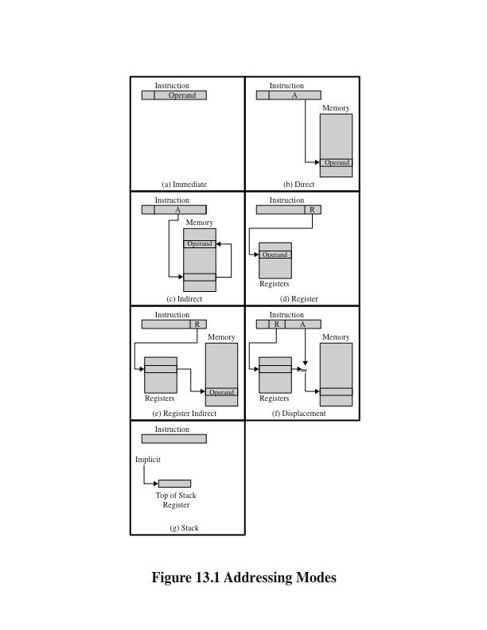
Addressing Modes
Stallings, W. (2016)
Notes:
These addressing modes are illustrated in Figure 13.1 on this slide. The following notation is used in these lecture slides:
A = contents of an address field in the instruction R = contents of an address field in the instruction that refers to a register
EA = actual (effective) address of the location containing the referenced operand
(X) = contents of memory location X or register X

Slide 26
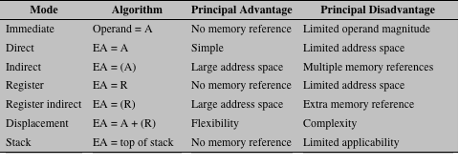
Basic Addressing Modes
Notes:
The table above indicates the address calculation performed for each addressing
mode.
Before beginning this discussion, two comments need to be made. First, virtually all computer architectures provide more than one of these addressing modes. The question arises as to how the processor can determine which address mode is being used in a particular instruction. Several approaches are taken. Often, different opcodes will use different addressing modes. Also, one or more bits in the instruction format can be used as a mode field. The value of the mode field determines which addressing mode is to be used.
The second comment concerns the interpretation of the effective address (EA). In a system without virtual memory, the effective address will be either a main memory address or a register. In a virtual memory system, the effective address is a virtual address or a register. The actual mapping to a physical address is a function of the memory management unit (MMU) and is invisible to the programmer.

Slide 27
Micro-operations

Slide 28
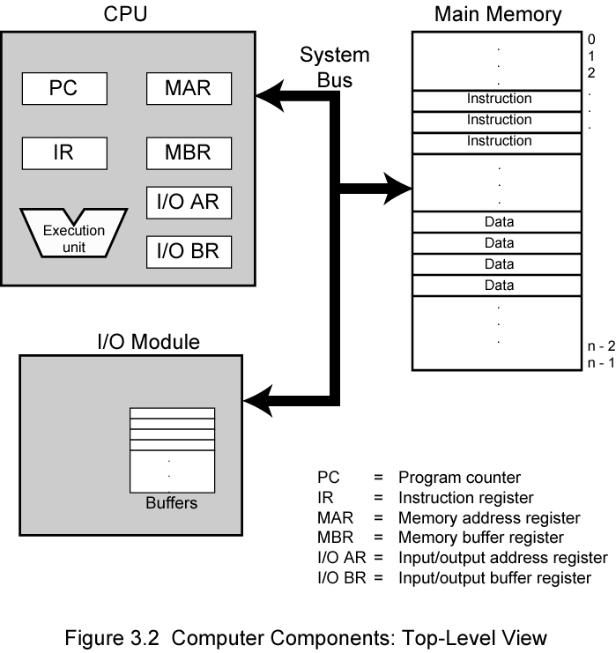
Computer Components: Top Level View
CU
Stallings, W. (2016)
Notes:
The figure above illustrates these top-level components and suggests the interactions
among them.
A memory module consists of a set of locations, defined by sequentially
numbered addresses. Each location contains a binary number that can be interpreted
as either an instruction or data. An I/O module transfers data from external devices
to CPU and memory, and vice versa. It contains internal buffers for temporarily
holding these data until they can be sent on.

Slide 29
The Program Counter PC holds the address of the next machine code instruction which will be executed.
The Index Register X is used to hold the starting address in main store of a data structure.
MAR holds the store address of any item which is being read-from or written-to the store.
MDR holds the data on its way from the store during a ‘read’ or to the store during a ‘write’.

Slide 30
The items we have met in the processor so far are seen on the diagram, except general purpose registers.
What else do we need to make our ‘data flow’ complete?

Slide 31
We can add general purpose registers that can be used for holding data while it is being processed. Even when there are many general purpose registers which are theoretically equivalent, it is common to use one more than the others for calculations – the Accumulator

Slide 32
The Accumulator continued
It is often the source or the destination of data in a single machine code instruction. Sometimes both!
For simplicity, in this lecture we will assume that our architecture has a single accumulator

Slide 33
The Instruction Register IR holds the machine code instruction while it is being executed. It is split into the Opcode part (Op) which holds the opcode so that it can be decoded by the control unit and the Address part (Addr) which holds any operand addresses need to identify data.

Slide 34
We now have a more-or-less complete data flow picture for our simple processor together with how it links to the store (memory).
Only the data flow is shown, so we miss out the control unit and its connections
We can now analyse how a single machine code instruction might be dealt with during the running of a program.

Slide 35
General sequence or ‘instruction cycle’
First - we need to fetch the instruction from the store where the program is held.
Second - the opcode needs to be examined or ‘decoded’ by the controller to see what needs doing.
Third - any data needed must be fetched from the store using a method specified by the operand address.
Fourth - any data transformation must be done
Fifth - the result must be written somewhere.
One this sequence has taken place, it starts again for the next machine code instruction.

Slide 36
The ‘phases’ of the ‘instruction cycle’ are called :-
Instruction fetch
Decode
Operand fetch
Execute
Write

Slide 37
Can any phases be missed out?
The ‘instruction fetch’ and ‘decode’ phases of the cycle must always be done.
If the ‘write’ phase is missing, then the instruction effectively does nothing – it is a ‘no operation’ or NOP instruction (occasionally useful for synchronisation).
The instruction may not have any operands to fetch so the operand fetch phase may be missing.
There may be no data transformation to be done in the ALU so this phase also may be missing.

Slide 38
A number of data movements (micro-operations) are needed for each one of the phases in the instruction cycle. We can use a ‘descriptive notation’ to analyse exactly what goes on.
The ‘descriptive notation’ is called a Register Transfer Language or RTL.
It is only a means of describing the data movements, NOT a programming language.
It is different for each machine architecture.
It is ‘informal’ but has a number of conventions.
One data movement or activity per line
Each line represents everything that is done in a single machine time period called a ‘beat’ or clock ‘tick’.
There are some activities shown in brackets to indicate that they are external to the CPU or not real data movements.

Slide 39
Suppose we have a very simple instruction which only loads the Accumulator with an item of data given in the instruction (i.e. immediate mode addressing). It might be written as :- LDA #42
Load the accumulator with the number 42.
The RTL description may be as follows :-
Instruction fetch
PC → MAR send a copy of PC contents to MAR
(increment PC) this indicates that PC has 1 added to it so it points at the next instruction
MAR → store the instruction is fetched from store
Store → MDR and placed in the MDR

Slide 40
Decode
MDR → IR instruction is moved to instruction register
(decode) decoding of opcode occurs
Operand fetch nothing to do here - data (42) is part of the instruction (immediate mode)
Execute no data transformations to do
Write
IR_{ADDR} → Acc a simple write to a register

Slide 41
Suppose we wanted a slightly different machine code instruction such as :-
ADD #42
Add the number 42 to the accumulator.
Need to change RTL description very little from previous - Only phase really different is ‘execute’ (though result written away comes from different place)
We do have to indicate how this occurs and to maintain our convention of ‘each line represents everything that is done in a single beat’
Need to be creative with our notation!

Slide 42
Instruction fetch
PC → MAR send a copy of PC contents to MAR
(increment PC) PC has 1 added to it so it points to the next instruction
MAR → store the instruction is fetched from store
store → MDR and placed in the MDR
Decode
MDR → IR instruction is moved to instruction register
(decode) decoding of opcode occurs
Operand fetch nothing to do, 42 is part of immediate mode instruction
Execute
IR_{ADDR} → IB put the data (42) into the ALU’s input buffer
Acc → ALU(via bus) plus IB → OB Acc contents taken via bus to other ALU input, an add takes place in the ALU and result is put into OB
Write
OB → Acc a simple write to a register
ONLY LAST TWO PHASES ARE DIFFERENT!

Slide 43
To summarise (so far) :-
An instruction cycle happens for each machine code instruction.
The cycle can be broken down into phases.
Each phase consists of a number of steps (micro-operations).
Each step (micro-operation) can be described by using RTL.

Slide 44
Control Structures, Sequences and the Decoder.
We have developed a more-or-less complete data flow picture for our simple CPU.

Slide 45
We can make other modifications to this instruction to show different features such as alternative addressing modes.
ADD 1234
Add to the accumulator the number found in address 1234 in the store.
(this is a direct mode instruction)
Operand fetch phase is principal one affected except that the Instruction Register’s address part now holds 1234 as address of the data required.
Operand fetch
IR_{ADDR} → MAR the address of the data required is put into the MAR
MAR → store the data address is sent to the store
store → MDR and the data there is fetched and placed in MDR
The only other alteration is a slight modification of the ‘execute’ phase as follows.
Execute
MDR → IB put data (from location 1234) into ALU’s input buffer

Slide 46
We can see the modifications needed to this same instruction if the alternative addressing mode was ‘indirect’.
ADD [1234]
Add to Acc the number whose address is found in store address 1234.
(this is an indirect mode instruction)
Operand fetch
IR_{ADDR} → MAR address of the address required is put into the MAR
MAR → store this is sent to the store
Store → MDR and the data there (an address) is fetched and
placed in the MDR
MDR → MAR this is now address of data so needs to be put in MAR
MAR → store and then sent to the store
store → MDR and data there (‘real’ data) is fetched & placed in MDR
The remainder of the instruction is identical to the previous one.

Slide 47
Finally, we should look briefly at entirely different instruction that simply writes the contents of the Accumulator away to an address in store.
STA #1234
Store the accumulator at address 1234 in the store.
Instruction fetch as usual
PC → MAR send a copy of PC contents to MAR
(increment PC) PC has 1 added to it so it points to the next instruction
MAR → store the instruction is fetched from store
store → MDR and placed in the MDR
Decode as usual
MDR → IR instruction is moved to instruction register
(decode) decoding of opcode occurs
Operand fetch nothing to do here, data 1234 is part of the instruction.
Execute no data transformations to do
Write
Acc → MDR put contents of Acc into MDR so it can be written away
IR_{ADDR} → MAR put the address to write it to in the MAR
(store write) a signal is sent to the store to cause the ‘write’

Slide 48
We can now see :-
all instructions made up of activities (micro-operations) which can be easily described using RTL
they are also in small segments of activity or ‘routines’ which appear in many different instructions or more than once
it is relatively easy to patch these together and gain greater understanding of
the CPU’s activities and
the operation of the instruction set.

Slide 49
Summary
An instruction cycle happens for each machine code instruction.
The cycle can be broken down into phases.
Each phase consists of a number of steps (micro-operations).
Each step (micro-operation) can be described by using RTL.

Slide 50
Further Reading
Computer Organization and Architecture – Designing for Performance (10th Edition), William Stallings [Chapters: 12, 13 and Appendix B]
Computer Organization and Design – The Hardware/Software Interface (5th Edition), David A. Patterson & John L. Hennessy [Chapter: 2 and Appendix A]
Fundamentals of Computer Architecture, Mark Burrell

