Slide 1
Introduction to Operating Systems Process Scheduling Memory Management
120CT Computer Architecture and Networks
Dr Dianabasi Nkantah
ab0480@coventry.ac.uk

Slide 2
Today……
What is an operating system (OS)
Evolution of OS
The kernel
The main functions of the OS
Types of OS
Scheduling
Long-Term
Medium-Term
Short-Term Scheduling
I/O Scheduling
Memory Management
Swapping
Partitioning
Paging
Virtual Memory

Slide 3

What is an operating system?
An operating system is a computer program that manages the computer hardware.
It also provides control/services to application programs
Acts as a go-between for the computer user and computer hardware.
Computer software is divided into two broad categories: the Operating System and application programs

Slide 4
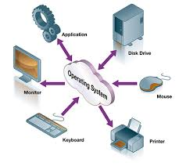
Where operating system fits in
Banking
System
Airline
Reservation
Games
Compiler
Editors
Command
Interpreter
Operating System
Machine Language
Microprogramming
Physical Devices

Slide 5
Goals of operating system
Manage/execute user/application programs.
Make the computer system easy to use.
Deal with the needs of the user.
Use the computer hardware in an efficient manner.
Speed is the key. We are not willing to wait.

Slide 6
Different operating systems
TRON
eCOS
TinyOS
Symbian
MS-DOS
Windows (3.1, NT, 95, XP, 7, 8, 10)
Unices (BSD, Linux, Minix, OS X, etc)
Pre-X MacOS
BeOS
RiscOS
AmigOS
. . .

Slide 7
Bootstrap process
OS responsible for loading other programs into memory.
The OS (a program) needs to be loaded into memory
The solution is the bootstrap program.
Typically stored in ROM, EPROM or other non-volatile memory
Initialises all aspects of system and loads operating system

Slide 8

Bootstrap process
CPU
Bootloader
Operating System
Disk
Memory
Run bootloader
Load operating system
Run operating system

Slide 9

Evolution of operating systems
Batch systems
Multiprogramming
Time-sharing systems
Parallel systems
Real-time systems

Slide 10
The kernel
The kernel is part of the operating system, and closer to the hardware, to provide:
device driver control
process management
memory management
system calls
The kernel contains the “internal programs” for the most often used operations

Slide 11
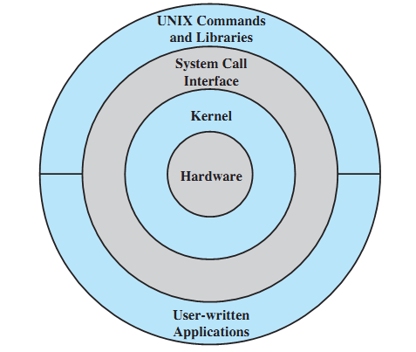
The kernel
It is the core of the operating system
It is a small piece of code loaded into the device memory at booting

Slide 12
What the OS does
OS are very complex and big.
Manage different resources in a computer system.
Resembles an organisation with several managers at the top level.
Each manager is responsible for managing their section, but interact with others.

Slide 13
Main activities
A modern operating system has at least four duties:
Memory management
Process management
Device management
File management

Slide 14
Memory Management
One of the responsibilities of a modern operating system is memory management.
Size of the programs and data to be processed grown as memory has grown.
Memory allocation must be managed to prevent applications from running out of memory.

Slide 15
Manage processes
A process is a basic unit of execution in an Operating System
A process is a program in execution
Different processes may run several instances of the same program
Processes need access to resources such as memory, I/O devices etc.

Slide 16
Process model
The operating system controls the execution of processes.
Determining the interleaving pattern for execution and allocating resources to processes.
A process must be in main memory before it can run.

Slide 17
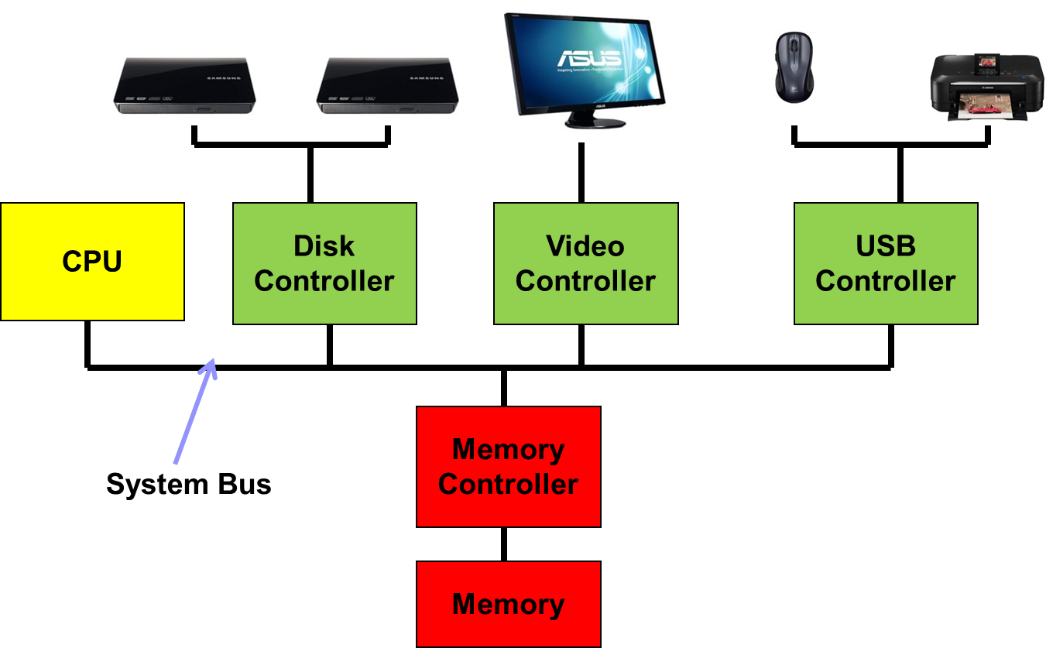
Device management

Slide 18
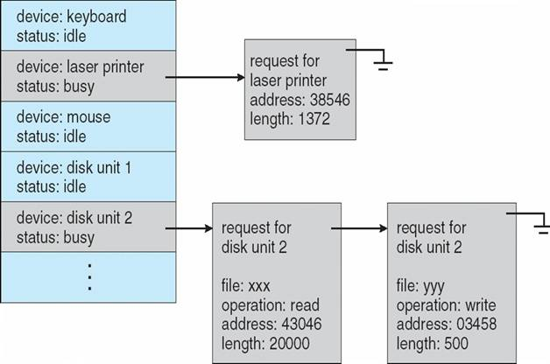



Device-status Table
Status: Idle
Status: Busy
Status: Idle
Status: Idle
Status: Busy

Slide 19
Device management
The device manager monitors every input/output device to ensure that the device is functioning properly.
The device manager maintains a queue for each input/output device.
The device manager controls the different policies for accessing input/output devices.

Slide 20
File management
Computer applications need to store and retrieve information.
While a process is running, the computer applications can store a limited amount of information with the process
But for some applications, such as airline reservations, this is far too small.

Slide 21

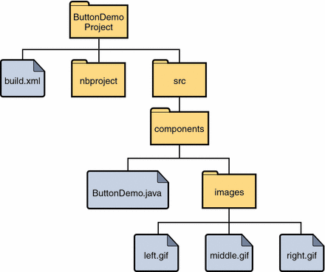

What do we use?

Slide 22
File management
Files typically stored within a hierarchical structure: they are placed in logical “containers” that are arranged in a tree like structure
The file system starts at the root of the tree
In OS such as UNIX and Linux this “container” is called a "directory“ and “sub-directory” for the leaf
In OS such as Windows and Macintosh it is referred to as "folder" and "subfolder“

Slide 23







File Operations
What operations should we be able
to perform on files?
Create
Delete
Open
Close
Read/write
Append
Seek
Get attributes
Set attributes
Rename

Slide 24
Pathnames
/
The file /usr/local/bin/crisp
usr
usr
local
local
bin
bin
crisp
Directories

Slide 25
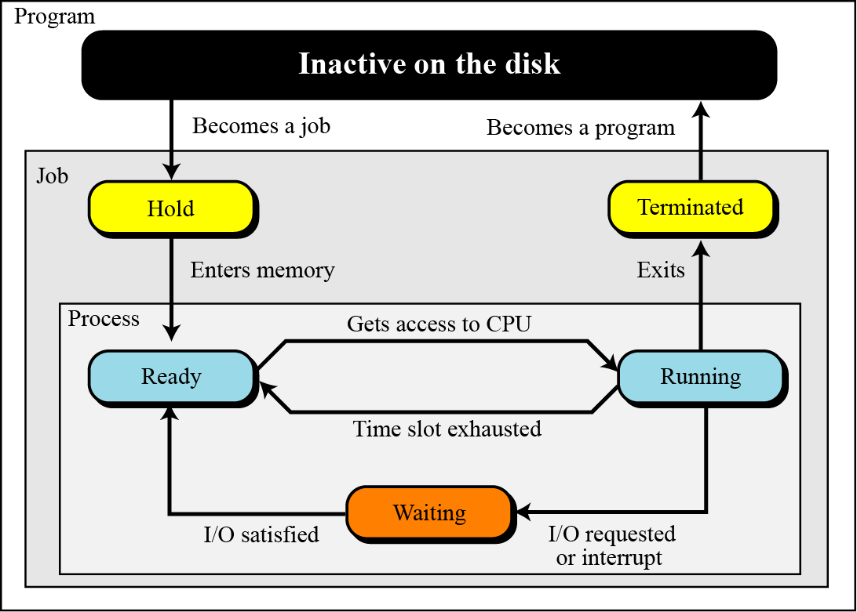
Process management

Slide 26
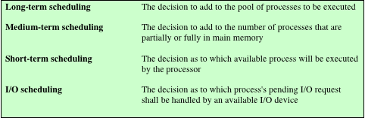
Scheduling
The key to multiprogramming
Four types are typically involved:
Notes:
The key to multiprogramming is scheduling. In fact, four types of scheduling are
typically involved. We will explore these presently. But first, we introduce
the concept of process. This term was first used by the designers of the Multics
OS in the 1960s. It is a somewhat more general term than job. Many definitions
have been given for the term process, including
• A program in execution
• The “animated spirit” of a program
• That entity to which a processor is assigned

Slide 27
Long Term Scheduling
Determines which programs are submitted for processing
Once submitted, a job becomes a process for the short term scheduler
In some systems a newly created process begins in a swapped-out condition, in which case it is added to a queue for the medium-term scheduler
Batch system
Newly submitted jobs are routed to disk and held in a batch queue
The long-term scheduler creates processes from the queue when it can
Time-sharing system
A process request is generated when a user attempts to connect to the system
OS will accept all authorized comers until the system is saturated
At that point a connection request is met with a message indicating that the system is full and to try again later
Notes:
The long-term scheduler determines which programs are admitted to the system for
processing. Thus, it controls the degree of multiprogramming (number of processes
in memory). Once admitted, a job or user program becomes a process and is
added to the queue for the short-term scheduler. In some systems, a newly created
process begins in a swapped-out condition, in which case it is added to a queue for
the medium-term scheduler.
In a batch system, or for the batch portion of a general-purpose OS, newly
submitted jobs are routed to disk and held in a batch queue. The long-term scheduler
creates processes from the queue when it can. There are two decisions involved
here. First, the scheduler must decide that the OS can take on one or more additional
processes. Second, the scheduler must decide which job or jobs to accept and
turn into processes. The criteria used may include priority, expected execution time,
and I/O requirements.
For interactive programs in a time-sharing system, a process request is generated
when a user attempts to connect to the system. Time-sharing users are not
simply queued up and kept waiting until the system can accept them. Rather, the
OS will accept all authorized comers until the system is saturated, using some predefined
measure of saturation. At that point, a connection request is met with a
message indicating that the system is full and the user should try again later.

Slide 28
Medium-Term Scheduling and Short-Term Scheduling
Medium-Term
Short-Term
Part of the swapping function
Swapping-in decision is based on the need to manage the degree of multiprogramming
Swapping-in decision will consider the memory requirements of the swapped-out processes
Also known as the dispatcher
Executes frequently and makes the fine-grained decision of which job to execute next
Notes:
Medium-term scheduling is part of the swapping function, described in the next lecture.
Typically, the swapping-in decision is based on the need to manage the degree of
multiprogramming. On a system that does not use virtual memory, memory management
is also an issue. Thus, the swapping-in decision will consider the memory
requirements of the swapped-out processes.
The long-term scheduler executes relatively infrequently and makes the coarse grained
decision of whether or not to take on a new process, and which one to take.
The short-term scheduler, also known as the dispatcher, executes frequently and
makes the fine-grained decision of which job to execute next.

Slide 29
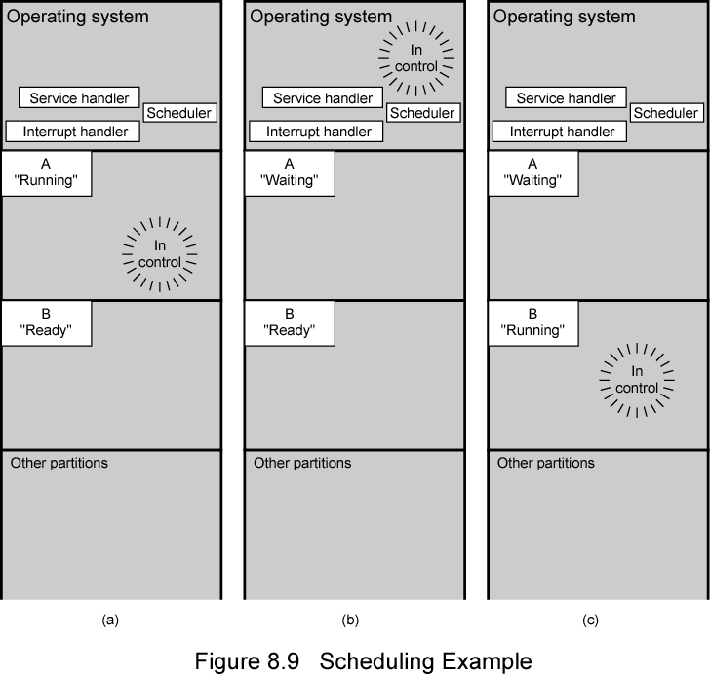
Scheduling Example
(Stallings, W., 2016)
Notes:
To understand how the OS manages the scheduling of the
various jobs in memory, let us begin by considering the simple example in the figure above.
The figure shows how main memory is partitioned at a given point in time. The
kernel of the OS is, of course, always resident. In addition, there are a number of
active processes, including A and B, each of which is allocated a portion of memory.
We begin at a point in time when process A is running. The processor is executing
instructions from the program contained in A’s memory partition. At some
later point in time, the processor ceases to execute instructions in A and begins
executing instructions in the OS area. This will happen for one of three reasons:
1. Process A issues a service call (e.g., an I/O request) to the OS. Execution of A
is suspended until this call is satisfied by the OS.
2. Process A causes an interrupt. An interrupt is a hardware-generated signal to
the processor. When this signal is detected, the processor ceases to execute A
and transfers to the interrupt handler in the OS. A variety of events related
to A will cause an interrupt. One example is an error, such as attempting to
execute a privileged instruction. Another example is a timeout; to prevent any
one process from monopolizing the processor, each process is only granted the
processor for a short period at a time.
3. Some event unrelated to process A that requires attention causes an interrupt.
An example is the completion of an I/O operation.
In any case, the result is the following. The processor saves the current context
data and the program counter for A in A’s process control block and then begins
executing in the OS. The OS may perform some work, such as initiating an I/O
operation. Then the short-term-scheduler portion of the OS decides which process
should be executed next. In this example, B is chosen. The OS instructs the processor
to restore B’s context data and proceed with the execution of B where it left off.

Slide 30
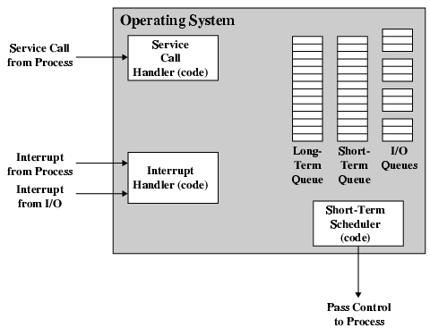
Key Elements of O/S
(Stallings, W., 2013)
Notes:
This simple example highlights the basic functioning of the short-term scheduler.
Figure above shows the major elements of the OS involved in the multiprogramming
and scheduling of processes. The OS receives control of the processor at the
interrupt handler if an interrupt occurs and at the service-call handler if a service
call occurs. Once the interrupt or service call is handled, the short-term scheduler is
invoked to select a process for execution.
To do its job, the OS maintains a number of queues. Each queue is simply a
waiting list of processes waiting for some resource. The long-term queue is a list of
jobs waiting to use the system. As conditions permit, the high-level scheduler will
allocate memory and create a process for one of the waiting items. The short-term
queue consists of all processes in the ready state. Any one of these processes could
use the processor next. It is up to the short-term scheduler to pick one. Generally,
this is done with a round-robin algorithm, giving each process some time in turn.
Priority levels may also be used. Finally, there is an I/O queue for each I/O device.
More than one process may request the use of the same I/O device. All processes
waiting to use each device are lined up in that device’s queue.

Slide 31
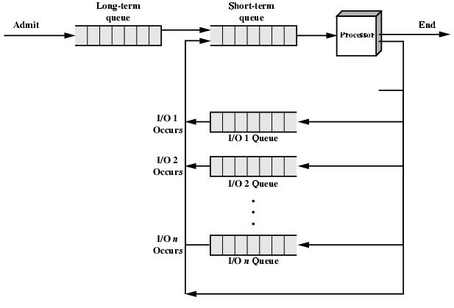
Process Scheduling
(Stallings, W., 2013)
Notes:
Figure above suggests how processes progress through the computer under the
control of the OS. Each process request (batch job, user-defined interactive job) is
placed in the long-term queue. As resources become available, a process request
becomes a process and is then placed in the ready state and put in the short-term
queue. The processor alternates between executing OS instructions and executing
user processes. While the OS is in control, it decides which process in the short-term
queue should be executed next. When the OS has finished its immediate tasks, it
turns the processor over to the chosen process.
As was mentioned earlier, a process being executed may be suspended for
a variety of reasons. If it is suspended because the process requests I/O, then it
is placed in the appropriate I/O queue. If it is suspended because of a timeout or
because the OS must attend to pressing business, then it is placed in the ready state
and put into the short-term queue.
Finally, we mention that the OS also manages the I/O queues. When an I/O
operation is completed, the OS removes the satisfied process from that I/O queue
and places it in the short-term queue. It then selects another waiting process (if any)
and signals for the I/O device to satisfy that process’s request.

Slide 32
Memory Management
Uni-program
Memory split into two
One for Operating System (monitor)
One for currently executing program
Multi-program
“User” part of memory is sub-divided and shared among active processes

Slide 33
Swapping
Problem: I/O is so slow compared with CPU that even in multi-programming system, CPU can be idle most of the time
Solutions:
Increase main memory
Expensive
Leads to larger programs
Swapping

Slide 34
What is Swapping?
Long term queue of processes stored on disk
Processes “swapped” in as space becomes available
As a process completes it is moved out of main memory
If none of the processes in memory are ready (i.e. all I/O blocked)
Swap out a blocked process to intermediate queue
Swap in a ready process or a new process
But swapping is an I/O process…

Slide 35
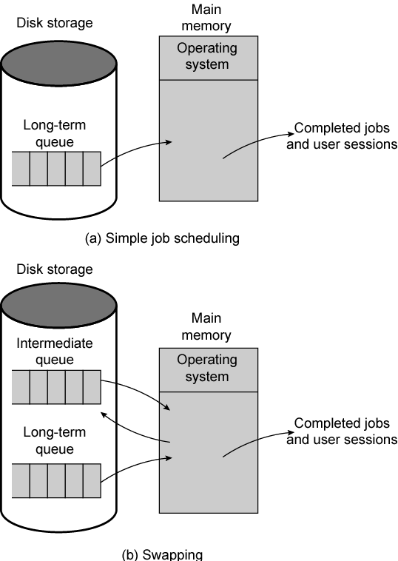
Use of Swapping
(Stallings, W., 2016)
Notes:
Main memory could be expanded, and so be able to accommodate
more processes. But there are two flaws in this approach. First, main memory
is expensive, even today. Second, the appetite of programs for memory has grown
as fast as the cost of memory has dropped. So larger memory results in larger processes,
not more processes.
Another solution is swapping, depicted in the figure above. We have a long-term
queue of process requests, typically stored on disk. These are brought in, one at a
time, as space becomes available. As processes are completed, they are moved out
of main memory. Now the situation will arise that none of the processes in memory
are in the ready state (e.g., all are waiting on an I/O operation). Rather than remain
idle, the processor swaps one of these processes back out to disk into an intermediate
queue. This is a queue of existing processes that have been temporarily kicked out
of memory. The OS then brings in another process from the intermediate queue, or
it honors a new process request from the long-term queue. Execution then continues
with the newly arrived process.
Swapping, however, is an I/O operation, and therefore there is the potential
for making the problem worse, not better. But because disk I/O is generally the
fastest I/O on a system (e.g., compared with tape or printer I/O), swapping will usually
enhance performance. A more sophisticated scheme, involving virtual memory,
improves performance over simple swapping. This will be discussed shortly. But
first, we must prepare the ground by explaining partitioning and paging.

Slide 36
Partitioning
Splitting memory into sections to allocate to processes (including Operating System)
Fixed-sized partitions
May not be equal size
Process is fitted into smallest hole that will take it (best fit)
Some wasted memory
Leads to variable sized partitions

Slide 37
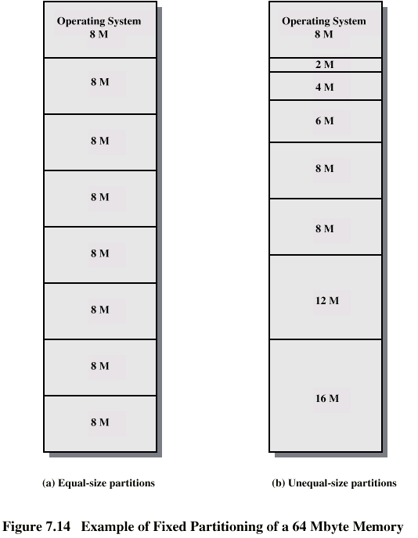
Fixed Partitioning
(Stallings, W., 2016)
Notes:
In most cases, a process will not require exactly as much memory as provided by the
partition. For example, a process that requires 3M bytes of memory would be placed
in the 4M partition of Figure (b) above, wasting 1M that could be used by another process.
A more efficient approach is to use variable-size partitions. When a process is
brought into memory, it is allocated exactly as much memory as it requires and no more.

Slide 38
Variable Sized Partitions (1)
Allocate exactly the required memory to a process
This leads to a hole at the end of memory, too small to use
Only one small hole - less waste
When all processes are blocked, swap out a process and bring in another
New process may be smaller than swapped out process
Another hole

Slide 39
Variable Sized Partitions (2)
Eventually have lots of holes (fragmentation)
Solutions:
Coalesce - Join adjacent holes into one large hole
Compaction - From time to time go through memory and move all hole into one free block (c.f. disk de-fragmentation)

Slide 40
Paging
Split memory into equal sized, small chunks -page frames
Split programs (processes) into equal sized small chunks – pages
Allocate the required number page frames to a process
Operating System maintains list of free frames
A process does not require contiguous page frames
Use page table to keep track

Slide 41
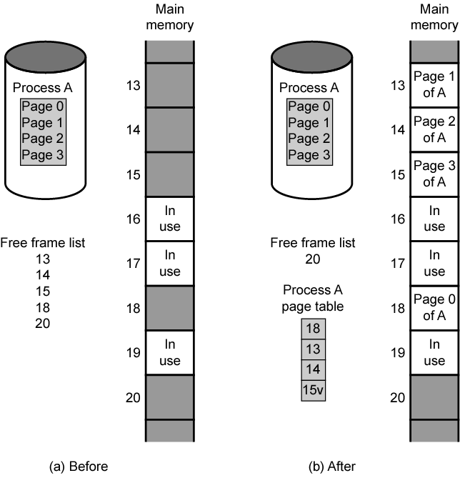
Allocation of Free Frames
(Stallings, W., 2016)
Notes:
Both unequal fixed-size and variable-size partitions are inefficient in the use of
memory. Suppose, however, that memory is partitioned into equal fixed-size chunks
that are relatively small, and that each process is also divided into small fixed-size
chunks of some size. Then the chunks of a program, known as pages, could be
assigned to available chunks of memory, known as frames, or page frames. At most,
then, the wasted space in memory for that process is a fraction of the last page.
Figure above shows an example of the use of pages and frames. At a given point
in time, some of the frames in memory are in use and some are free. The list of free
frames is maintained by the OS. Process A, stored on disk, consists of four pages.
When it comes time to load this process, the OS finds four free frames and loads the
four pages of the process A into the four frames.

Slide 42
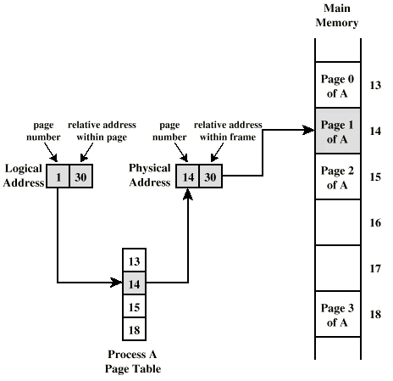
Logical and Physical Addresses - Paging
(Stallings, W., 2016)
Notes:
Now suppose, as in this example, that there are not sufficient unused contiguous
frames to hold the process. Does this prevent the OS from loading A?
The answer is no, because we can once again use the concept of logical address. A
simple base address will no longer suffice. Rather, the OS maintains a page table
for each process. The page table shows the frame location for each page of the
process. Within the program, each logical address consists of a page number and
a relative address within the page. Recall that in the case of simple partitioning, a
logical address is the location of a word relative to the beginning of the program;
the processor translates that into a physical address. With paging, the logical-to-
physical address translation is still done by processor hardware. The processor
must know how to access the page table of the current process. Presented with a
logical address (page number, relative address), the processor uses the page table
to produce a physical address (frame number, relative address). An example is
shown in Figure above.
This approach solves the problems raised earlier. Main memory is divided
into many small equal-size frames. Each process is divided into frame-size pages:
smaller processes require fewer pages, larger processes require more. When a
process is brought in, its pages are loaded into available frames, and a page table
is set up.

Slide 43
Virtual Memory
Demand Paging
Each page of a process is brought in only when it is needed
Principle of locality
When working with a large process execution may be confined to a small section of a program (subroutine)
It is better use of memory to load in just a few pages
If the program references data or branches to an instruction on a page not in main memory, a page fault is triggered which tells the OS to bring in the desired page
Advantages:
More processes can be maintained in memory
Time is saved because unused pages are not swapped in and out of memory
Disadvantages:
When one page is brought in, another page must be thrown out (page replacement)
If a page is thrown out just before it is about to be used the OS will have to go get the page again
Thrashing
When the processor spends most of its time swapping pages rather than executing instructions
Notes:
With the use of paging, truly effective multiprogramming
systems came into being. Furthermore, the simple tactic of breaking a process up
into pages led to the development of another important concept: virtual memory.
To understand virtual memory, we must add a refinement to the paging
scheme just discussed. That refinement is demand paging, which simply means that
each page of a process is brought in only when it is needed, that is, on demand.
Consider a large process, consisting of a long program plus a number of arrays
of data. Over any short period of time, execution may be confined to a small section
of the program (e.g., a subroutine), and perhaps only one or two arrays of data
are being used. This is the principle of locality, which we introduced in Appendix
4A. It would clearly be wasteful to load in dozens of pages for that process when
only a few pages will be used before the program is suspended. We can make better
use of memory by loading in just a few pages. Then, if the program branches
to an instruction on a page not in main memory, or if the program references data
on a page not in memory, a page fault is triggered. This tells the OS to bring in the
desired page.
Thus, at any one time, only a few pages of any given process are in memory,
and therefore more processes can be maintained in memory. Furthermore, time is
saved because unused pages are not swapped in and out of memory. However, the
OS must be clever about how it manages this scheme. When it brings one page in, it
must throw another page out; this is known as page replacement. If it throws out a
page just before it is about to be used, then it will just have to go get that page again
almost immediately. Too much of this leads to a condition known as thrashing: the
processor spends most of its time swapping pages rather than executing instructions.
The avoidance of thrashing was a major research area in the 1970s and led to a variety
of complex but effective algorithms. In essence, the OS tries to guess, based on
recent history, which pages are least likely to be used in the near future.
With demand paging, it is not necessary to load an entire process into main
memory. This fact has a remarkable consequence: It is possible for a process to be
larger than all of main memory. One of the most fundamental restrictions in programming
has been lifted. Without demand paging, a programmer must be acutely
aware of how much memory is available. If the program being written is too large,
the programmer must devise ways to structure the program into pieces that can
be loaded one at a time. With demand paging, that job is left to the OS and the
hardware. As far as the programmer is concerned, he or she is dealing with a huge
memory, the size associated with disk storage.
Because a process executes only in main memory, that memory is referred to
as real memory. But a programmer or user perceives a much larger memory—that
which is allocated on the disk. This latter is therefore referred to as virtual memory.
Virtual memory allows for very effective multiprogramming and relieves the user of
the unnecessarily tight constraints of main memory.

Slide 44
Bonus
We do not need all of a process in memory for it to run
We can swap in pages as required
So - we can now run processes that are bigger than total memory available!
Main memory is called real memory
User/programmer sees much bigger memory - virtual memory

Slide 45
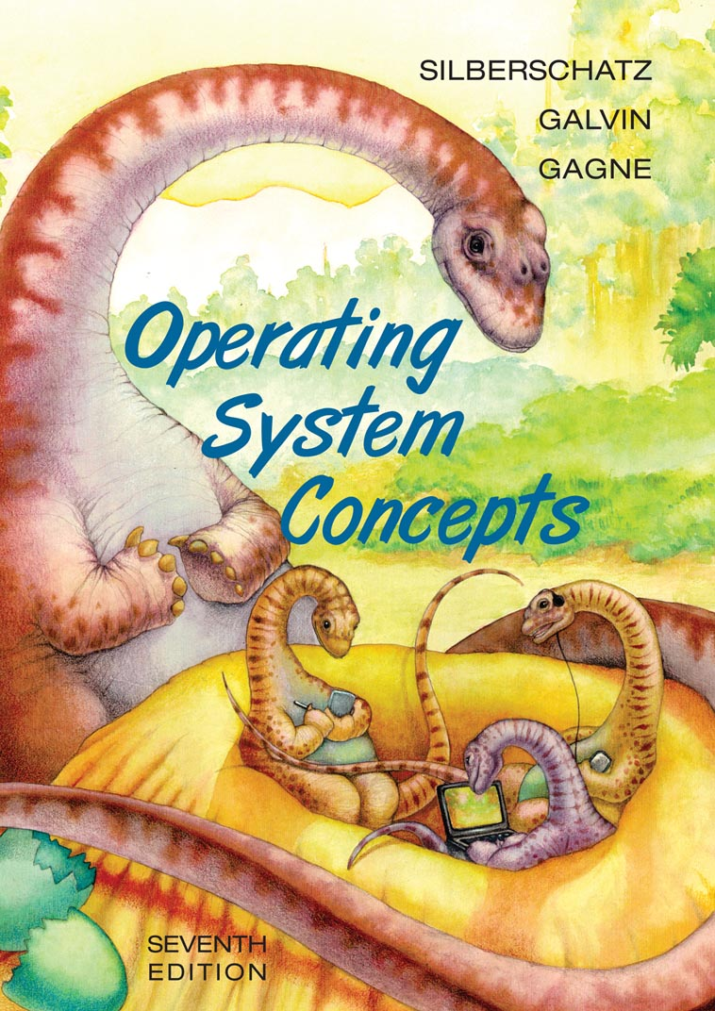
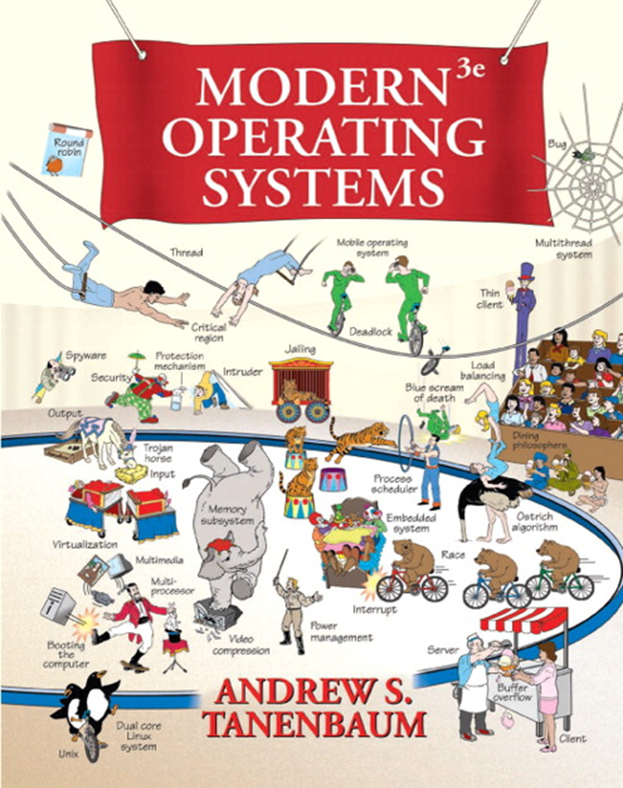
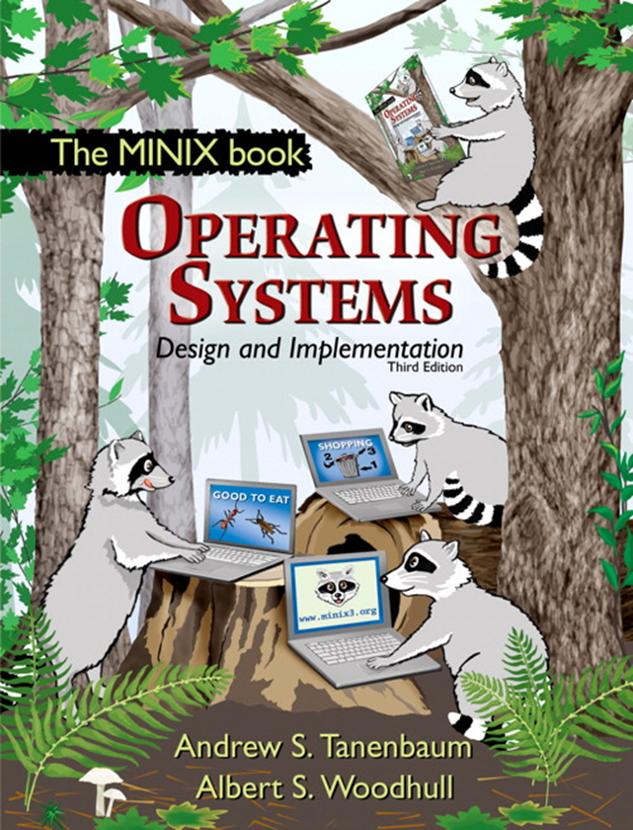
Additional Reading Resources
Computer Organization and Architecture Designing for Performance (Tenth Edition) - William Stalling – Chapter 8

