Slide 1
IP Addressing

Slide 2
IP Address v4
An IPv4 address is 32 bits long
The IPv4 addresses are unique and universal
IPv4 uses 32-bit addresses, which means that the address space is 232 or 4,294,967,296(Maximum available theoretically)
IPv4 have 2 types of notations:
  Doted decimal
Denoted in decimal format each byte is separated by dot eg: 117.149.29.2 Mostly used by human configurations
  Binary notation
In binary format eg: 01110101 10010101 00011101 00000010
Mostly used by devices for processing

Slide 3
IPv4 Classes(Classfull Address)
The address space is divided into five classes: A, B, C, D, and E
Division is based on the first byte in doted decimal format Class A
Range of first octet or byte is between 0 to 127
First byte is network and last 3 bytes are Host (N.H.H.H)
First bit always will be zero (0xxxxxxx. xxxxxxxx. xxxxxxxx. xxxxxxxx) Used for unicasting, valid host IP
Class B
Range of first octet or byte is between 128 to 191
First 2 bytes is network and last 2 byte are Host (N.N.H.H)
First bit always will be zero (10xxxxxxx. xxxxxxxx. xxxxxxxx. xxxxxxxx)
Used for unicasting, valid host IP

Slide 4
IPv4 Classes
Class C
Range of first octet or byte is between 192 to 223
First 3 bytes is network and last byte are Host (N.N.N.H)
First bit always will be zero (110xxxxx. xxxxxxxx. xxxxxxxx. xxxxxxxx) Used for unicasting, valid host IP
Class D
Range of first octet or byte is between 224 to 239
First 2 bytes is network and last 2 byte are Host (N.N.H.H)
First bit always will be zero (1110xxxx. xxxxxxxx. xxxxxxxx. xxxxxxxx) Used for Multicasting, Special Address
Class E
Range of first octet or byte is between 240 to 255
First 2 bytes is network and last 2 byte are Host (N.N.H.H)
First bit always will be zero (1111xxxx. xxxxxxxx. xxxxxxxx. xxxxxxxx) Used for research purpose

Slide 5
Netid & Host ID
Class A :- first byte netid and last 3 bytes hostid (N.H.H.H)
Class B :- first 2 bytes netid and last 2 bytes hostid (N.N.H.H)
Class C :- first 3 bytes netid and last byte hostid (N.N.N.H)
Subnet mask helps to identify netid and hostid
CIDR value is total number of network bits in subnetmask

Slide 6
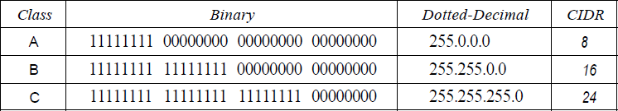
Subnet Mask and CIDR in Classful IPv4
The mask can help us to find the netid and the hostid
  For example, the mask for a class A address has eight 1s, which means the first 8 bits of any address in class A define the netid; the next 24 bits define the hostid.
CIDR value is number I’s (ones) in the subnet mask(network bits), usually for class A,B,C CIDR values will be 8,16,24 respectively
Given below table shows various subnet mask, CIDR values of class A,B,C

Slide 7
Address Depletion Problem in Internet
Because of limited number of IP and increasing demand of IP in internet over years lead to depletion of IP address
Solution of depletion are mainly
  NAT
  Sub netting
  IPv6

Slide 8
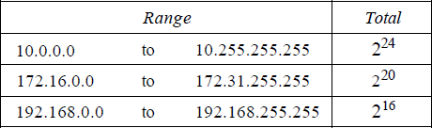
Network Address Translation(NAT)
IP address have public range and private range
Public range is used for communication in internet and can used only with permission of internet authorities
Private IP can be used for local communication without permission of Internet authorities
Given below table shows private ranges of class A,B,C

Slide 9
Network Address Translation(NAT)
Public IP should be unique globally
Private IP should be unique inside a organization, not globally
NAT router consist of public IP in exit interface and internal interface consist of Private IPs
192.168.1.2
192.168.1.3
192.168.1.4
NAT
Router
16.32.64.128
Internet
192.168.1.7
192.168.1.6
192.168.1.5

Slide 10
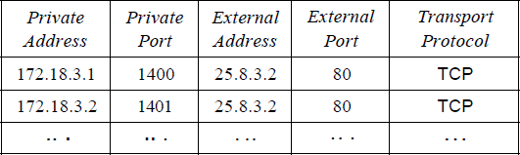
Network Address Translation(NAT)
Address Translation : Replace outgoing packets Source IP address as NAT router public IP and replaces incoming packet Destination IP with private (Private to public and public to private)
Translation is done with help of translation table which consist of IP address of private range and public range and port address
Below table showing Translation table in NAT

Slide 11
Benefits of NAT
Prevent the depletion of IPv4 address
Provide more security by hiding public source and destination IPs.
Allows to use own private addressing system.
Removes the process of address renumbering at the time of changing network

Slide 12
Classless Addressing
There is no classes hierarchy in the IP address but address is still granted in blocks.
Restriction
To simplify the handling of addresses, the Internet authorities impose three restrictions on classless address blocks:
  The addresses in a block must be contiguous, one after another.
  The number of addresses in a block must be a power of 2 (I, 2, 4, 8, ..)
  The first address must be evenly divisible by the number of addresses.

Slide 13
Subnetting
Subnetting means creating subnetwork
Subnetting means increasing networks bits(i.e. 1s) in subnet mask
If network bit is increased host bits will be decreased, so number of host will be decreased
A Class A network have 8 bits for network (2²⁴IP address available) if you wanted smaller block IP from class A increase the network bits / decreasing host bits

Slide 14
Supernetting
Supernetting means creating bigger network from smaller one
Supernetting means decreasing networks bits(i.e. 1s) in subnet mask
If network bit is decreased host bits will be increased, so number of host will be decreased
A Class C network have 24 bits for network (2⁸IP address available) if you wanted bigger block IP from class C decrease the network bits / increasing host bits
Supernetting just opposite of subnetting

Slide 15
VLSM (Variable Length Subnet Mask)
Subnetting and supernetting is achieved by varying default subnet mask
Usually in classful IP address have 8,16,24 default CIDR values for Class A, B, C respectively, but in classless IP no default CIDR value / subnet mask is available CIDR value may be varying
Benefits
Effectively manage the available IP address space
Reduce the number of routing table entries
Simple network configuration
Proper use of full IP address

Slide 16
Limitations of IPv4
Exponential growth of the Internet and the impending exhaustion of the IPv4 address space
Need for simpler configuration
Requirement for security at the IP level
Need for better support for prioritized and real-time delivery of data

Slide 17
IPv6
An IPv6 address consists of 16 bytes (octets); it is 128 bits long
IPv6 specifies hexadecimal colon notation. In this notation,
128 bits is divided into eight sections, each 2 bytes in length. Two bytes in hexadecimal
notation requires four hexadecimal digits. Therefore, the address consists of 32 hexadecimal
digits, with every four digits separated by a colon
128 bits = 16 bytes = 32 hexadecimal digits
IPv6 has a much larger address space; 2¹²⁸ addresses are available

Slide 18
IPv6
Example IPv6
FDEC: 0074 : 0000 : 0000 : 0000 : BOFF : 0000 : FFFO
Types of IPv6 Address
Unicast address : Packet delivered to one node
Multicast address : Packet delivered to group of nodes
Any cast address : Similar to multicast but delivered to nearest node
Reserved Address

Slide 19
IPv6 Features
New header format
Large address space
Stateless and stateful address configuration
IPsec header support required
Better support for prioritized delivery
New protocol for neighboring node interaction
Extensibility

Slide 20
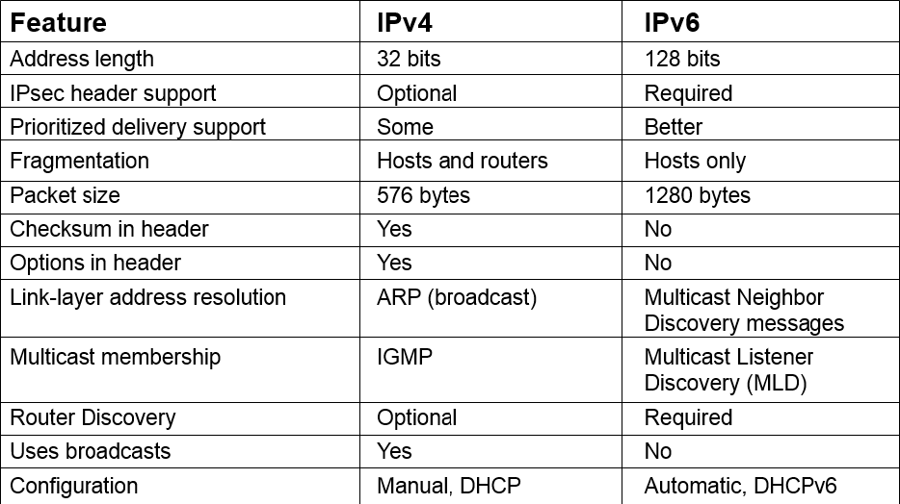
Comparison of IPv4 and IPv6

