Slide 1

STW120CT
Computer Architecture and Networks
Machine Instructions, Assembly Language, Machine Sequence and Micro-operations

Slide 2
Machine Instruction Characteristics
The operation of the processor is determined by the instructions it executes, referred to as machine instructions or computer instructions
The collection of different instructions that the processor can execute is referred to as the processor’s instruction set
Each instruction must contain the information required by the processor for execution
Notes:
2
The operation of the processor is determined by the instructions it executes, referred to as machine instructions or computer instructions. The collection of different instructions that the processor can execute is referred to as the processor’s instruction set.
Each instruction must contain the information required by the processor for execution.

Slide 3
Elements of a Machine Instruction
Operation code (opcode)
Specifies the operation to be performed. The operation is specified by a binary code, known as the operation code, or opcode
Source operand reference
The operation may involve one or more source operands, that is, operands that are inputs for the operation
Result operand reference
The operation may produce a result
Next instruction reference
This tells the processor where to fetch the next instruction after the execution of this instruction is complete
Notes:
• Operation code: Specifies the operation to be performed (e.g., ADD, I/O). The operation is specified by a binary code, known as the operation code, or opcode.
• Source operand reference: The operation may involve one or more source operands, that is, operands that are inputs for the operation.
• Result operand reference: The operation may produce a result.
• Next instruction reference: This tells the processor where to fetch the next instruction after the execution of this instruction is complete.

Slide 4
Assembly language
Assembly language is a programming language that is one step away from machine language
Assembly language is hardware dependent
  A different assembly language for each type of processor
Consists of four elements: label, mnemonic, operand, and comment
Assembly language statements are one of four types: instruction, directive, macro-definition, and comment

Slide 5
Example
L2: SUB EAX, EDX ; subtract contents of register EDX
; from contents of EAX and store
; result in EAX
JG L2 ; jump to L2 if the result of
; subtraction is positive

Slide 6
Assembly Language Elements
Label Mnemonic Operand(s) ;comment
Optional
Opcode name
or
Directive name
or
Macro name
Zero or more
Optional
Notes:
The label is optional. If it is present, the assembler defines the label as equivalent to the address into which the first byte of the object code generated for that instruction will be loaded. The programmer may subsequently use the label as an address or as data in another instruction’s address field. The assembler replaces the label with the assigned value when creating an object program. Labels are most frequently used in branch instructions.
A label makes a program location easier to find and remember. It can easily be moved to correct a program; the assembler will automatically change the address in all instructions that use the label when the program is reassembled. The programmer does not have to calculate the relative or absolute memory addresses; they just use labels as needed.
The mnemonic is the name of the operation or function of the assembly language statement.
Each operand identifies an immediate value, a register value, or a memory location. Typically, the assembly language provides conventions for distinguishing among the three types of operand references, as well as conventions for indicating addressing mode.
All assembly language allow the placement of comments in the program. A comment can either occur at the right-hand end of an assembly statement or it can occupy an entire text line. The comment begins with a special character that signals to the assembler that the rest of the line is a comment and is to be ignored by the assembler.

Slide 7
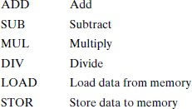

Instruction Representation
The instruction is divided into fields, corresponding to the constituent elements of the instruction.
Opcodes are represented by mnemonics, that indicate the operation. Common examples include:

Slide 8
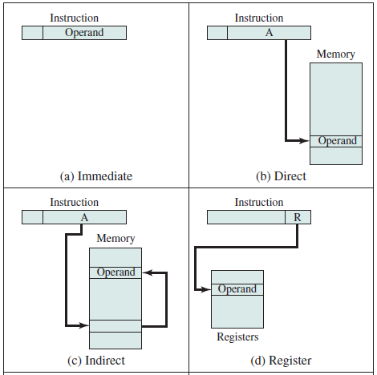
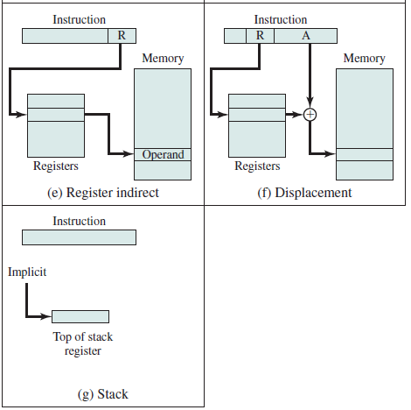
Addressing modes
the most common addressing techniques, or modes:
  Immediate
  Direct
  Indirect
  Register
  Register indirect
  Displacement
  Stack

Slide 9
Immediate: initializing a variable, no additional memory, operand is mentioned explicitly.
Direct: Address of memory location is given explicitly, content at the memory location provided.
Indirect: Address of variable is stored, variable contains the content.
Register: instruction specifies the address of the register
Register indirect: address stored in CPU register, which contains the address of memory, that will be taken in another register
Displacement: combines the capabilities of direct addressing and register indirect addressing.
Stack: The stack mode of addressing is a form of implied addressing.
Notes:
Immediate Addressing
The simplest form of addressing is immediate addressing, in which the operand value is present in the instruction
Operand = A
This mode can be used to define and use constants or set initial values of variables. Typically, the number will be stored in two’s complement form; the leftmost bit of the operand field is used as a sign bit. When the operand is loaded into a data register, the sign bit is extended to the left to the full data word size. In some cases, the immediate binary value is interpreted as an unsigned nonnegative integer.
The advantage of immediate addressing is that no memory reference other than the instruction fetch is required to obtain the operand, thus saving one memory or cache cycle in the instruction cycle. The disadvantage is that the size of the number is restricted to the size of the address field, which, in most instruction sets, is small compared with the word length.
Direct Addressing
A very simple form of addressing is direct addressing, in which the address field contains the effective address of the operand:
EA = A
The technique was common in earlier generations of computers but is not common on contemporary architectures. It requires only one memory reference and no special calculation. The obvious limitation is that it provides only a limited address space.
Indirect Addressing
With direct addressing, the length of the address field is usually less than the word length, thus limiting the address range. One solution is to have the address field refer to the address of a word in memory, which in turn contains a full-length address of the operand.
Register addressing
Register addressing is similar to direct addressing. The only difference is that the address field refers to a register rather than a main memory address:
EA = R
To clarify, if the contents of a register address field in an instruction is 5, then register R5 is the intended address, and the operand value is contained in R5. Typically, an address field that references registers will have from 3 to 5 bits, so that a total of from 8 to 32 general-purpose registers can be referenced.
The advantages of register addressing are that (1) only a small address field is needed in the instruction, and (2) no time-consuming memory references are required. The memory access time for a register internal to the processor is much less than that for a main memory address. The disadvantage of register addressing is that the address space is very limited.
If register addressing is heavily used in an instruction set, this implies that the processor registers will be heavily used. Because of the severely limited number of registers (compared with main memory locations), their use in this fashion makes sense only if they are employed efficiently. If every operand is brought into a register from main memory, operated on once, and then returned to main memory, then a wasteful intermediate step has been added. If, instead, the operand in a register remains in use for multiple operations, then a real savings is achieved. An example is the intermediate result in a calculation.
It is up to the programmer or compiler to decide which values should remain in registers and which should be stored in main memory. Most modern processors employ multiple general-purpose registers, placing a burden for efficient execution on the assembly-language programmer (e.g., compiler writer).
Register Indirect Addressing
Just as register addressing is analogous to direct addressing, register indirect addressing is analogous to indirect addressing. In both cases, the only difference is whether the address field refers to a memory location or a register. Thus, for register indirect address,
EA = (R)
The advantages and limitations of register indirect addressing are basically the same as for indirect addressing. In both cases, the address space limitation (limited range of addresses) of the address field is overcome by having that field refer to a word- length location containing an address. In addition, register indirect addressing uses one less memory reference than indirect addressing.
Displacement Addressing
A very powerful mode of addressing combines the capabilities of direct addressing and register indirect addressing. It is known by a variety of names depending on the context of its use, but the basic mechanism is the same. We will refer to this as displacement addressing:
EA = A + ( R )
Displacement addressing requires that the instruction have two address fields, at least one of which is explicit. The value contained in one address field (value = A) is used directly. The other address field, or an implicit reference based on opcode, refers to a register whose contents are added to A to produce the effective address.
Three of the most common uses of displacement addressing are:
• Relative addressing
• Base-register addressing
• Indexing
Stack Addressing
The final addressing mode that we consider is stack addressing. A stack is a linear array of locations. It is sometimes referred to as a pushdown list or last-in-first-out queue. The stack is a reserved block of locations. Items are appended to the top of the stack so that, at any given time, the block is partially filled. Associated with the stack is a pointer whose value is the address of the top of the stack. Alternatively, the top two elements of the stack may be in processor registers, in which case the stack pointer references the third element of the stack. The stack pointer is maintained in a register. Thus, references to stack locations in memory are in fact register indirect addresses.
The stack mode of addressing is a form of implied addressing. The machine instructions need not include a memory reference but implicitly operate on the top of the stack.

Slide 10
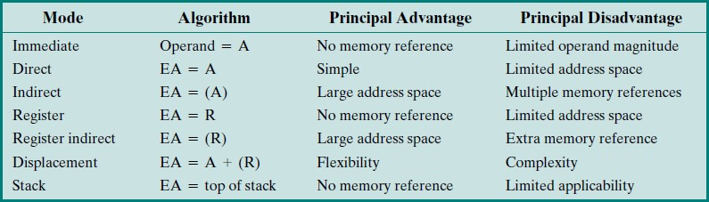
Basic Addressing Modes
A = contents of an address field in the instruction
R = contents of an address field in the instruction that refers to a register
EA = actual (effective) address of the location containing the referenced operand
(X) = contents of memory location X or register X
Notes:
two comments need to be made. First, virtually all computer architectures provide more than one of these addressing modes. The question arises as to how the processor can determine which address mode is being used in a particular instruction. Several approaches are taken. Often, different opcodes will use different addressing modes. Also, one or more bits in the instruction format can be used as a mode field. The value of the mode field determines which addressing mode is to be used.
The second comment concerns the interpretation of the effective address (EA). In a system without virtual memory, the effective address will be either a main memory address or a register. In a virtual memory system, the effective address is a virtual address or a register. The actual mapping to a physical address is a function of the memory management unit (MMU) and is invisible to the programmer.

Slide 11
General sequence or ‘instruction cycle’
First - we need to fetch the instruction from the store where the program is held.
Second - the opcode needs to be examined or ‘decoded’ by the controller
to see what needs doing.
Third - any data needed must be fetched from the store using a method specified by the operand address.
Fourth - any data transformation must be done
Fifth - the result must be written somewhere.

Slide 12
Register transfer language
A number of data movements (micro-operations) are needed for each one of the phases in the instruction cycle
It is different for each machine architecture.

Slide 13
References
Computer Organization and Architecture – Designing for Performance (10th Edition), William Stallings
Computer Organization and Design – The Hardware/Software Interface (5th Edition), David A. Patterson & John L. Hennessy

