Slide 1
Operating System

Slide 2
Operating System
Operating System is a program that:
manages the computer hardware
provides a basis for application programs, and
acts as an intermediary between the computer user
and the computer hardware.
Two Basic Functions of Operating System are:
Resource Management
Virtual Machine

Slide 3
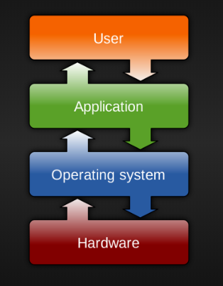
How does it work?

Slide 4
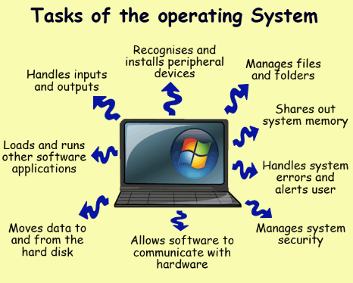
What does OS do ?

Slide 5
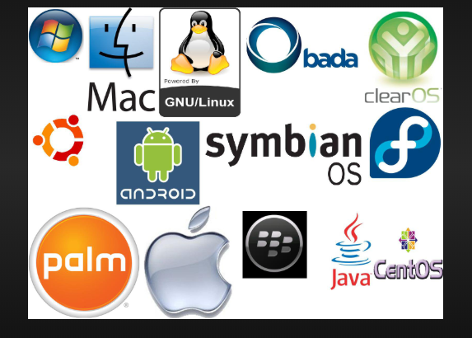
Examples of OS
  TRON
  eCOS
  TinyOS
  Symbian
  MS-DOS
  Windows (3.1, NT, 95, XP, 7, 8, 10)
  Unices (BSD, Linux, Minix, OS X, etc)
  Pre-X MacOS
  BeOS
  RiscOS
  AmigOS

Slide 6
Goals of OS
Manage/execute user/application programs.
Make the computer system easy to use.
Deal with the needs of the user.
Use the computer hardware in an efficient manner.
Speed is the key. We are not willing to wait.

Slide 7
Types of OS
Batch System
Execute processes in groups
Time Sharing
Processor time is shared among multiple users
main objective is to maximize Response Time
Multiprogramming
Allows more than one programs at a time
Main objective is to maximize CPU Usage during I/O wait,
e.g: PC
Real Rime
Distributed
Multiprocessor(Parallel processing)

Slide 8
OS Structure
OS is made of:
Shell
includes the User Interface (CLI, or GUI)
User interacts with the OS through Shell
Kernel
Program remaining in main memory when the computer is running
Heart of OS
Interacts with hardware

Slide 9
The Kernel
The kernel is part of the operating system, and closer to the hardware, to provide:
  device driver control
  process management
  memory management
  system calls
The kernel contains the “internal programs” for the most often used operations

Slide 10
Process
Program in execution
Progresses in sequential fashion
Also referred as
jobs (in batch processing system)
user programs or tasks (in time-shared system)
It is a unit of work in a system
Requires system resources for completion

Slide 11
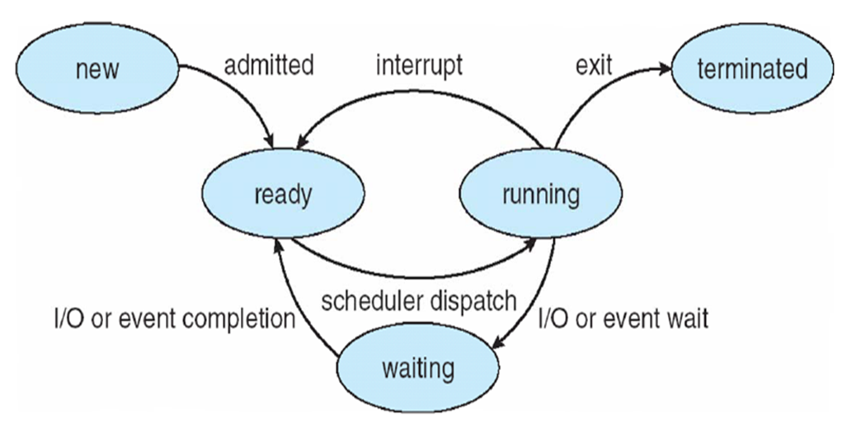
Process States
As a process executes, it changes state
new: The process is being created.
running: Instructions are being executed.
waiting: The process is waiting for some event to occur.
ready: The process is waiting to be assigned to a process.
terminated: The process has finished execution.

Slide 12
Threads
Also called lightweight process
A sequential execution stream within a process
Cannot run on its own, hence is not solely a representation of program

Slide 13
Bootstrap Process
OS responsible for loading other programs into memory.
The OS (a program) needs to be loaded into memory
The solution is the bootstrap program.
  Typically stored in ROM, EPROM or other non-volatile memory
  Initializes all aspects of system and loads operating system

Slide 14

Bootstrap process
CPU
Bootloader
Operating System
Disk
Memory
Run bootloader
Load operating system
Run operating system

Slide 15
Activities of OS
A modern operating system has at least four duties:
  Memory management
  Process management
  Device management
  File management

Slide 16
Memory Management
One of the responsibilities of a modern operating system is memory management.
Size of the programs and data to be processed grown as memory has grown.
Memory allocation must be managed to prevent applications from running out of memory.

Slide 17
Manage Process
A process is a basic unit of execution in an Operating System
A process is a program in execution
Different processes may run several instances of the same program
Processes need access to resources such as memory, I/O devices etc

Slide 18
Process Model
The operating system controls the execution of processes.
Determining the interleaving pattern for execution and allocating resources to processes.
A process must be in main memory before it can run.

Slide 19
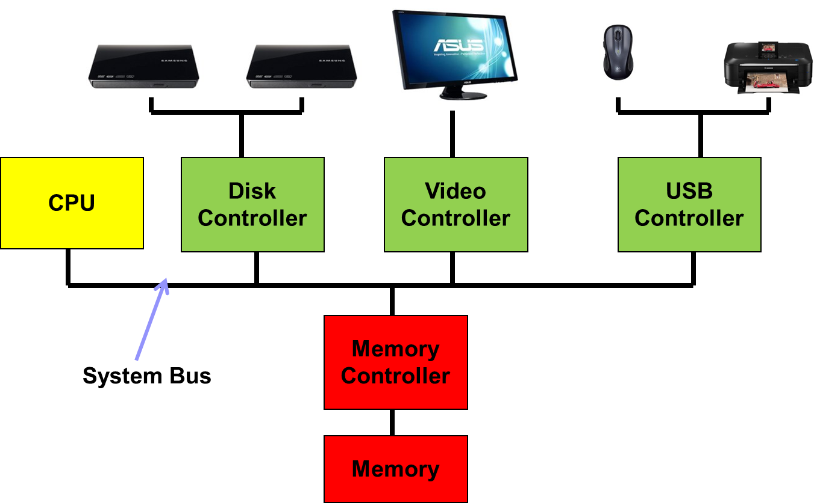
Managing Devices

Slide 20
Device Management
The device manager monitors every input/output device to ensure that the device is functioning properly.
The device manager maintains a queue for each input/output device.
The device manager controls the different policies for accessing input/output devices.

Slide 21
File Management
Computer applications need to store and retrieve information.
While a process is running, the computer applications can store a limited amount of information with the process
  But for some applications, such as airline reservations, this is far too small.

Slide 22
Scheduling
When in time sharing system, CPU switches between processes
The switch between the processes maximize the CPU utilization
One process can get CPU time when another is waiting for I/O operations to complete
Increases throughput
Process scheduler selects available process for execution in CPU

Slide 23
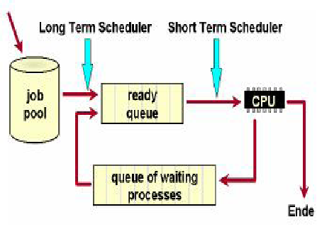
Scheduler…

Slide 24
Scheduling Queues
Job queue
  set of all processes in the system.
Ready queue
  set of all processes residing in main memory,
  ready and waiting to execute.
  Queue header points to the first and last processes in ready queue
Device queues
  set of processes waiting for an I/O device.
Process migrate between various queues(sometimes multiple times) for its termination

Slide 25
Scheduling…
At first process is kept into ready queue
Then, from the queue any of the processes is selected for execution (i.e. dispatched)
During execution, one of the following three cases may arise:
  Process could issue an I/O request and kept in I/O queue
  May create child process and wait for its termination
  Removed forcibly from CPU, due to interrupt, this is kept back to ready queue

Slide 26
Scheduler
It is an OS program (module) that selects the next job to be admitted for execution
Main objective of scheduling is to:
  Increase CPU utilization
  Increase throughput
Types of scheduler:
  Long Term Scheduler
  Short Term Scheduler
  Medium Term Scheduler

Slide 27
Long Term Scheduler
Also called job scheduler
selects which processes should be brought into the ready queue from batch queue
Executes less frequently (seconds, even minutes)
controls the degree of multiprogramming
Responsible for
  selecting the processes from secondary storage device
  loading them into main memory for execution

Slide 28
Short Term Scheduler
Also called CPU scheduler
selects which process should be executed next and allocates CPU
invoked very frequently (in milliseconds),hence should be fast
The process of assigning the CPU to a process is also called process dispatching
The program responsible is known as dispatcher

Slide 29
Medium Term Scheduler
When a process may be in need of some I/O operation, then it may be removed to hard disk.
Later, it can be reloaded into main memory and continued from where it was left earlier
This saving of the suspended process is said to be swapped out or rolled out
This swapping is done by medium term scheduler

Slide 30
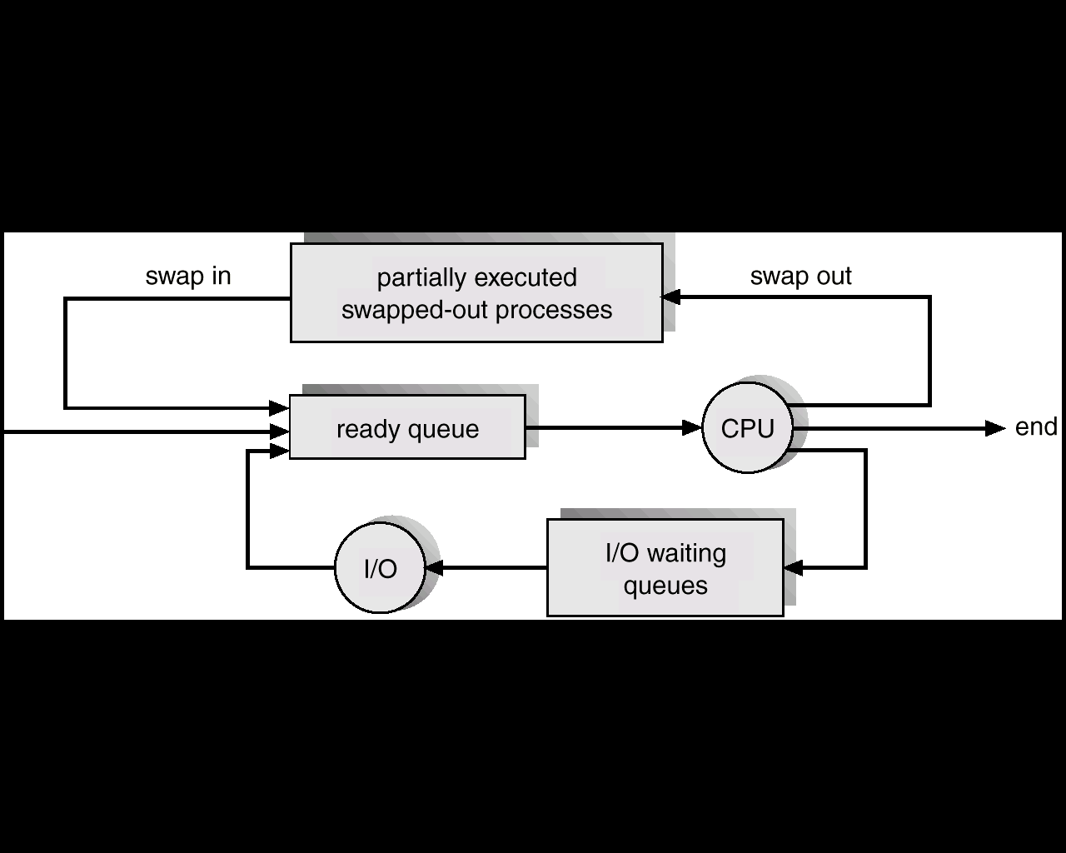
Medium Term Scheduler

Slide 31
Scheduling
Basis of multiprogrammed OS
The run of a process: CPU Burst
The wait for an I/O: I/O Burst
A process with more CPU Burst is called CPU Bound.
A process with more I/O Burst is called I/O Bound.
CPU–I/O Burst Cycle – Process execution consists of a cycle of CPU execution and I/O wait.
Both start and end by CPU burst.
Switches between CPU burst and I/O burst multiple times before termination

Slide 32
Scheduling Criteria
CPU Utilization:
  Average time during which CPU is busy executing user programs and/or system programs.
  The more the better
Throughput:
  Average amount of work completed per unit time
  The higher the better
Turnaround Time(TAT):
  Time elapsed from time of submission of task to the task it is completed
  Total time from time waited to get into the memory, from memory to ready queue, CPU time and I/O time
  Hence,
TAT = process finish time – process arrival time

Slide 33
Scheduling Criteria
Waiting Time(WT):
  Total time spent waiting in suspended state and ready state
  Hence,
Response Time:
  Interval between the submission of request and start of the system’s first response
All these times should be as less as possible
Other criteria: fairness, balance etc.
  WT = TAT – Processing Time

