Slide 1
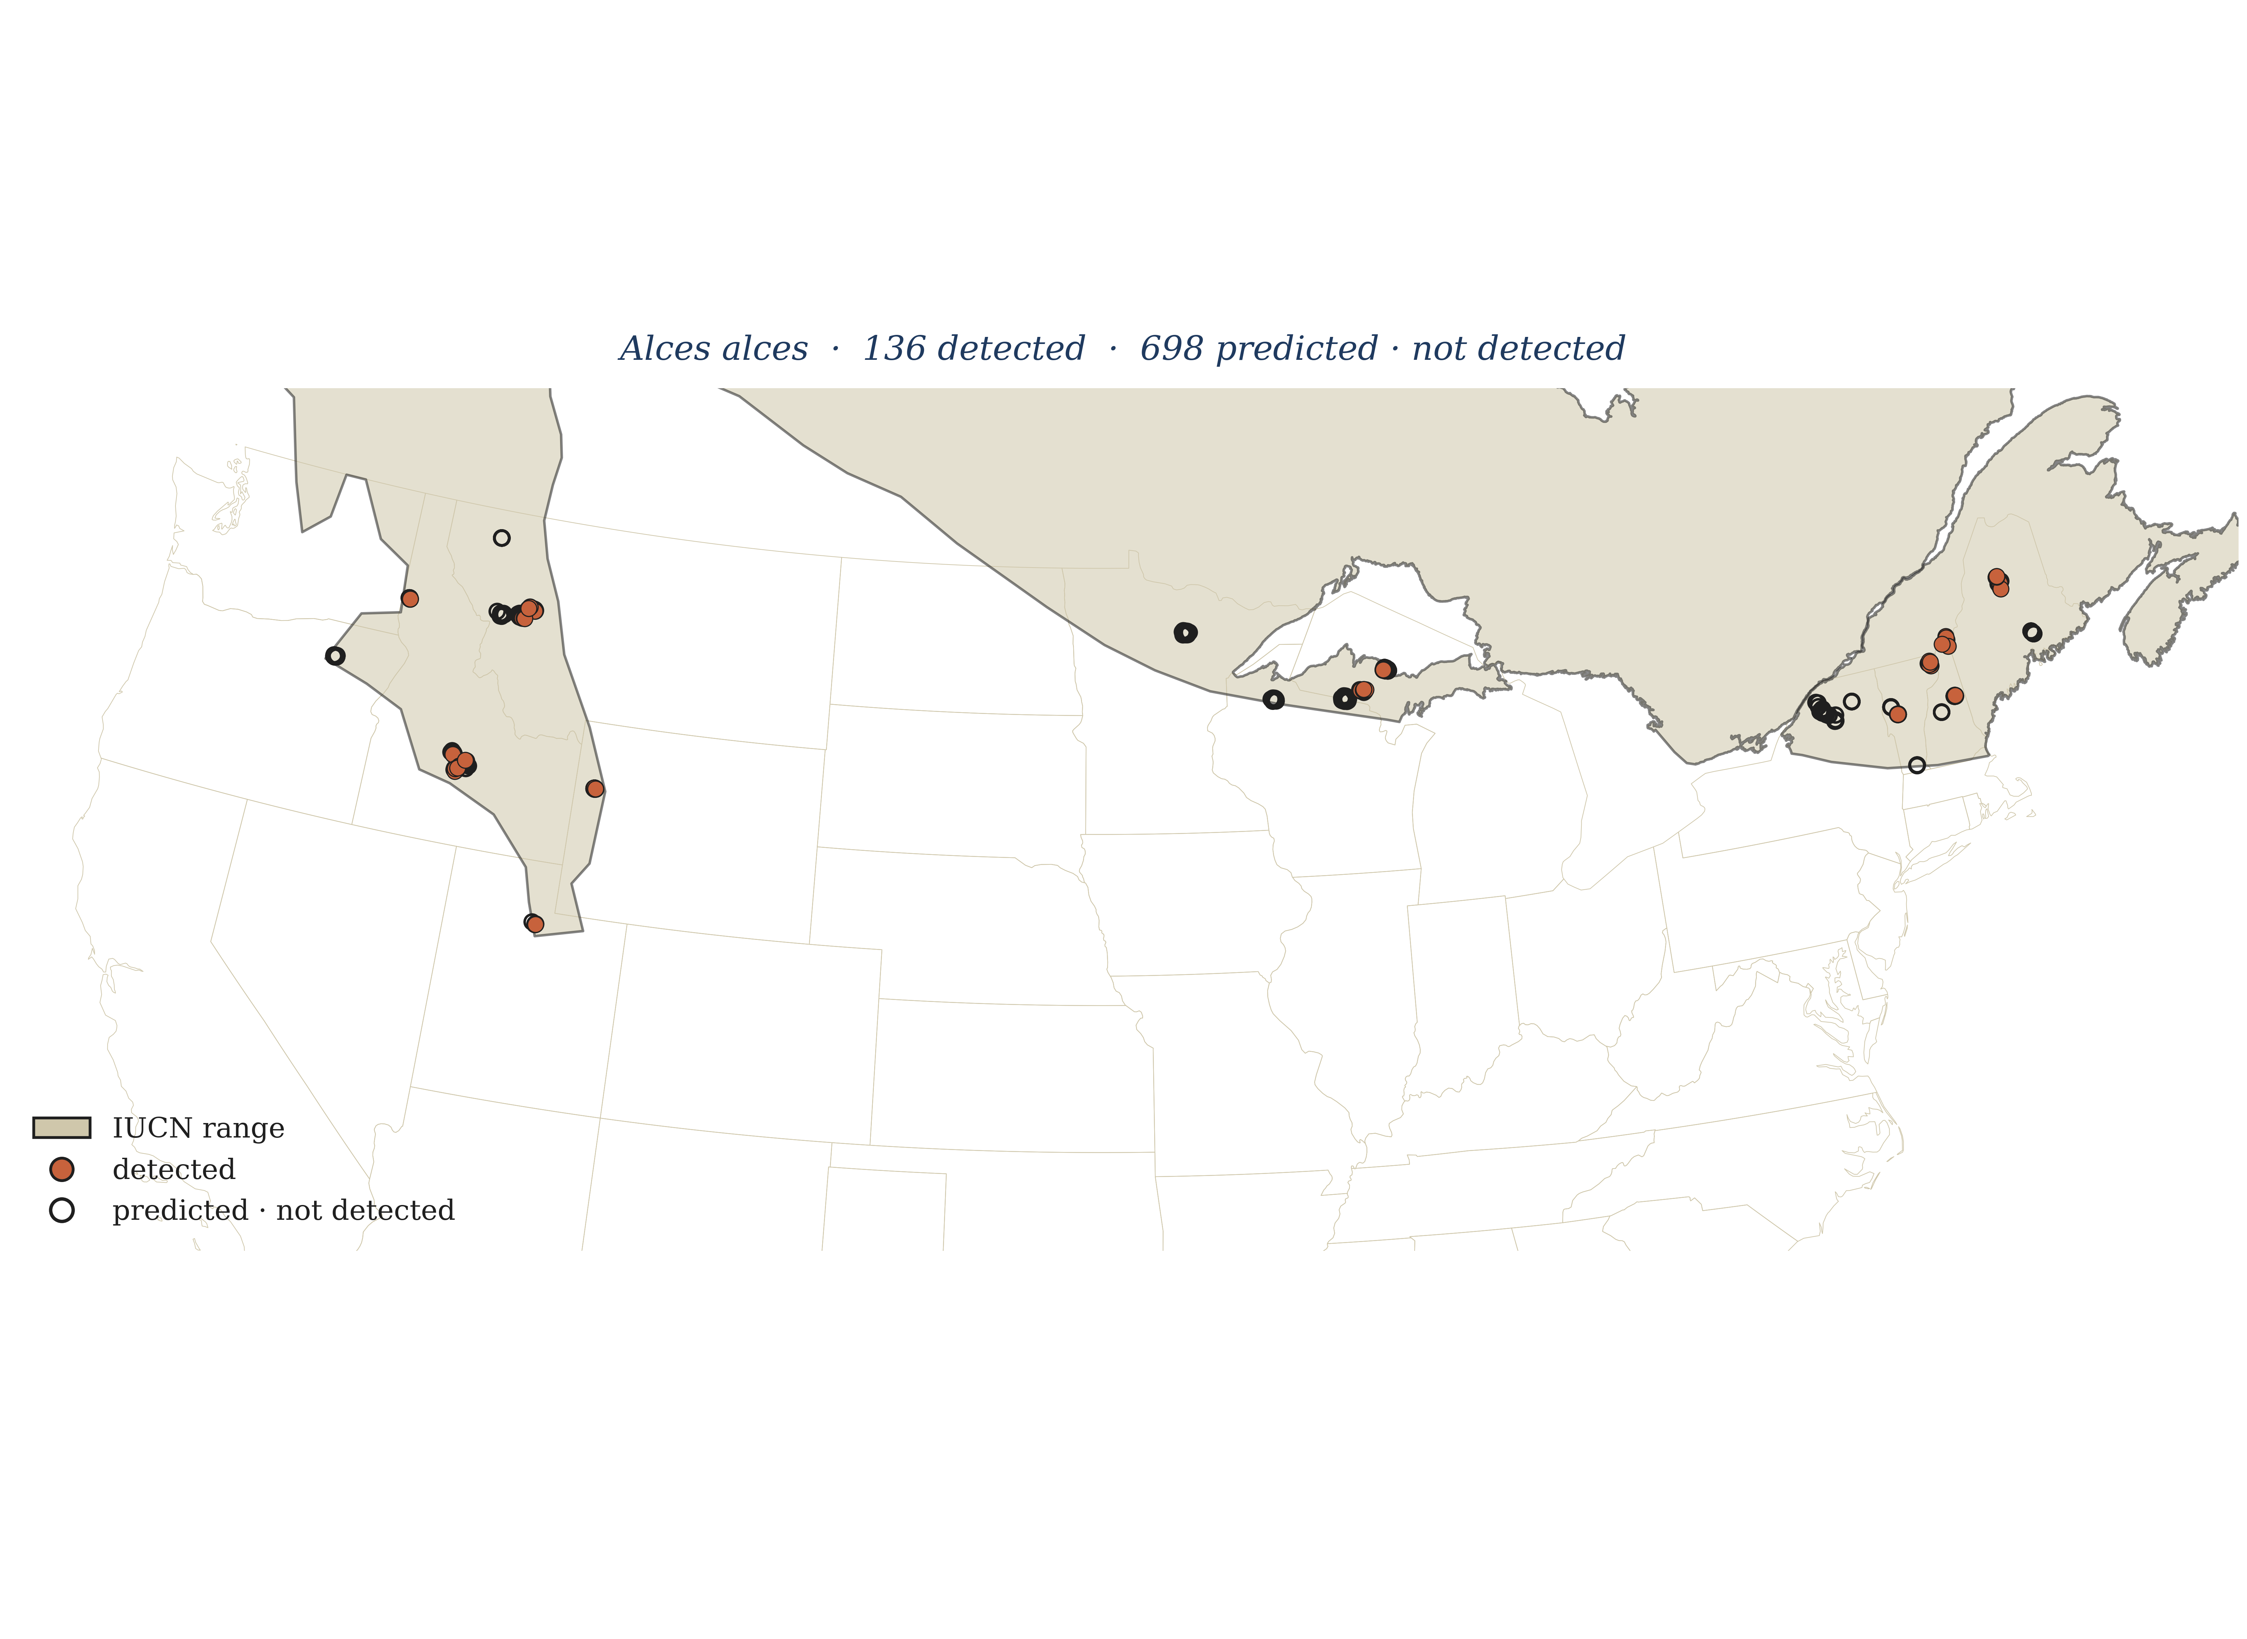
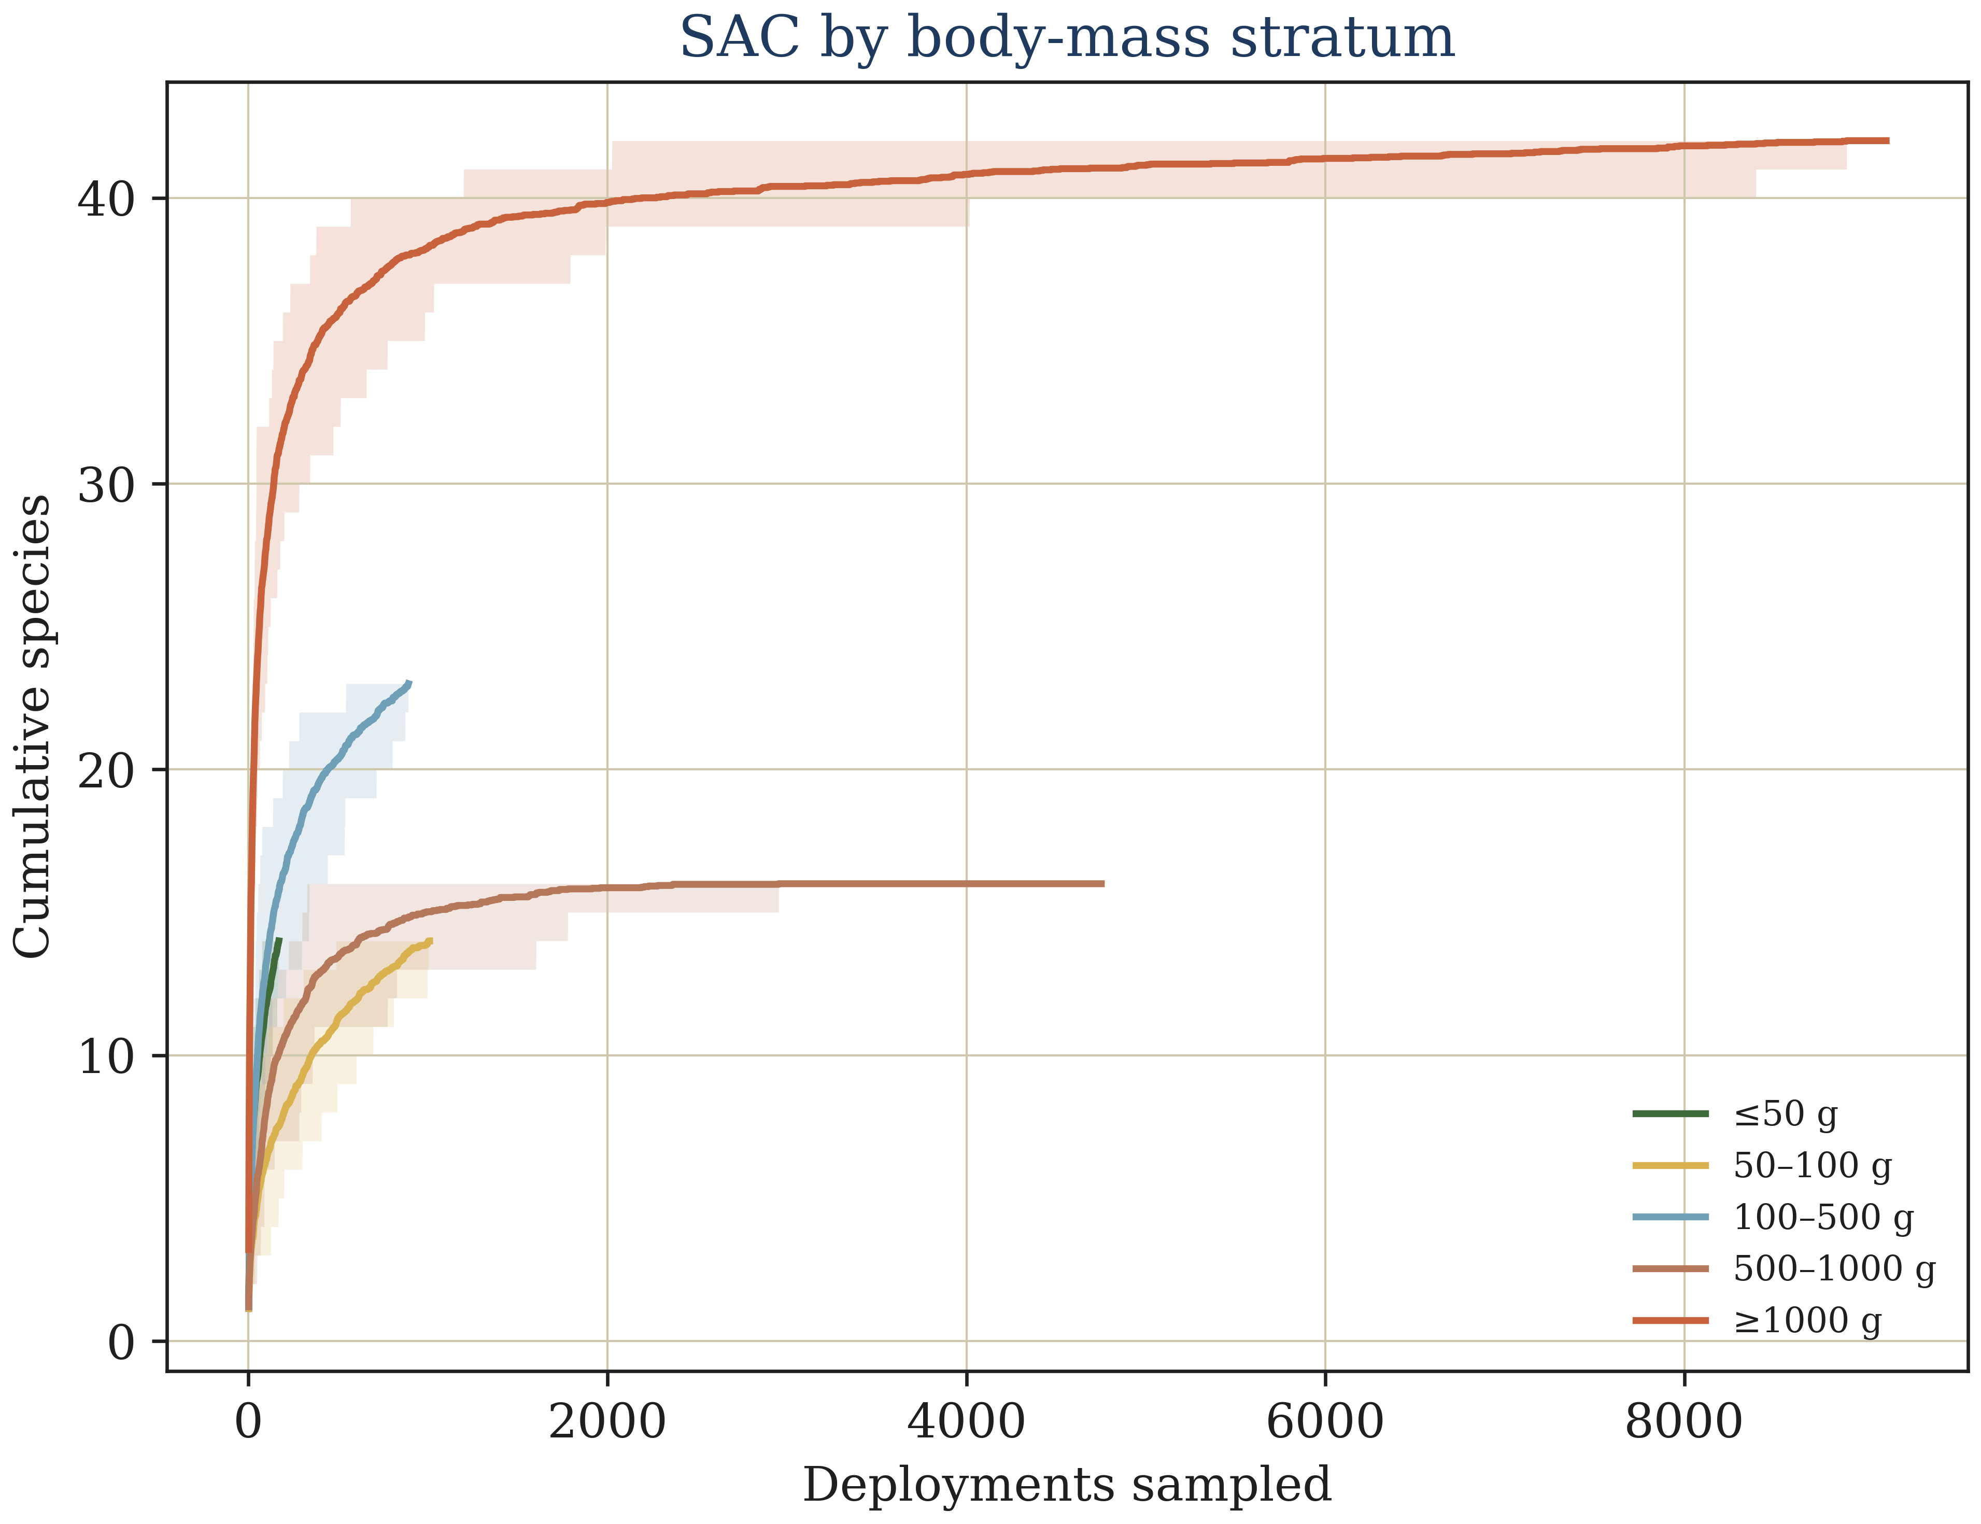
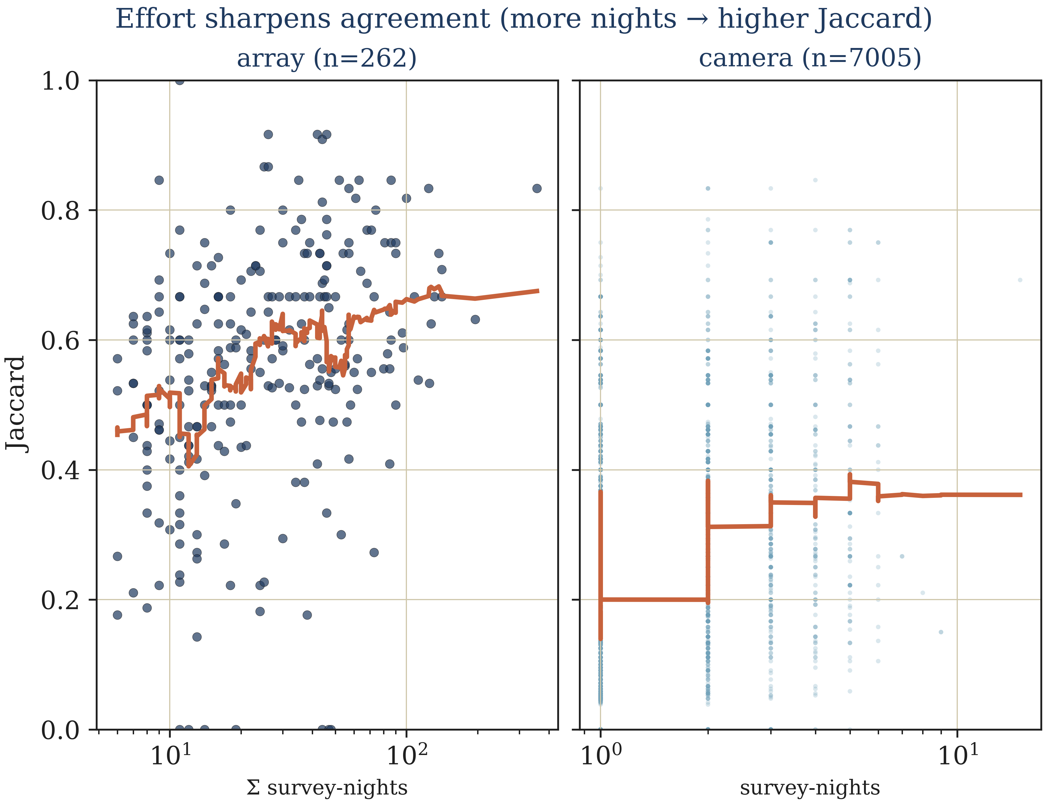
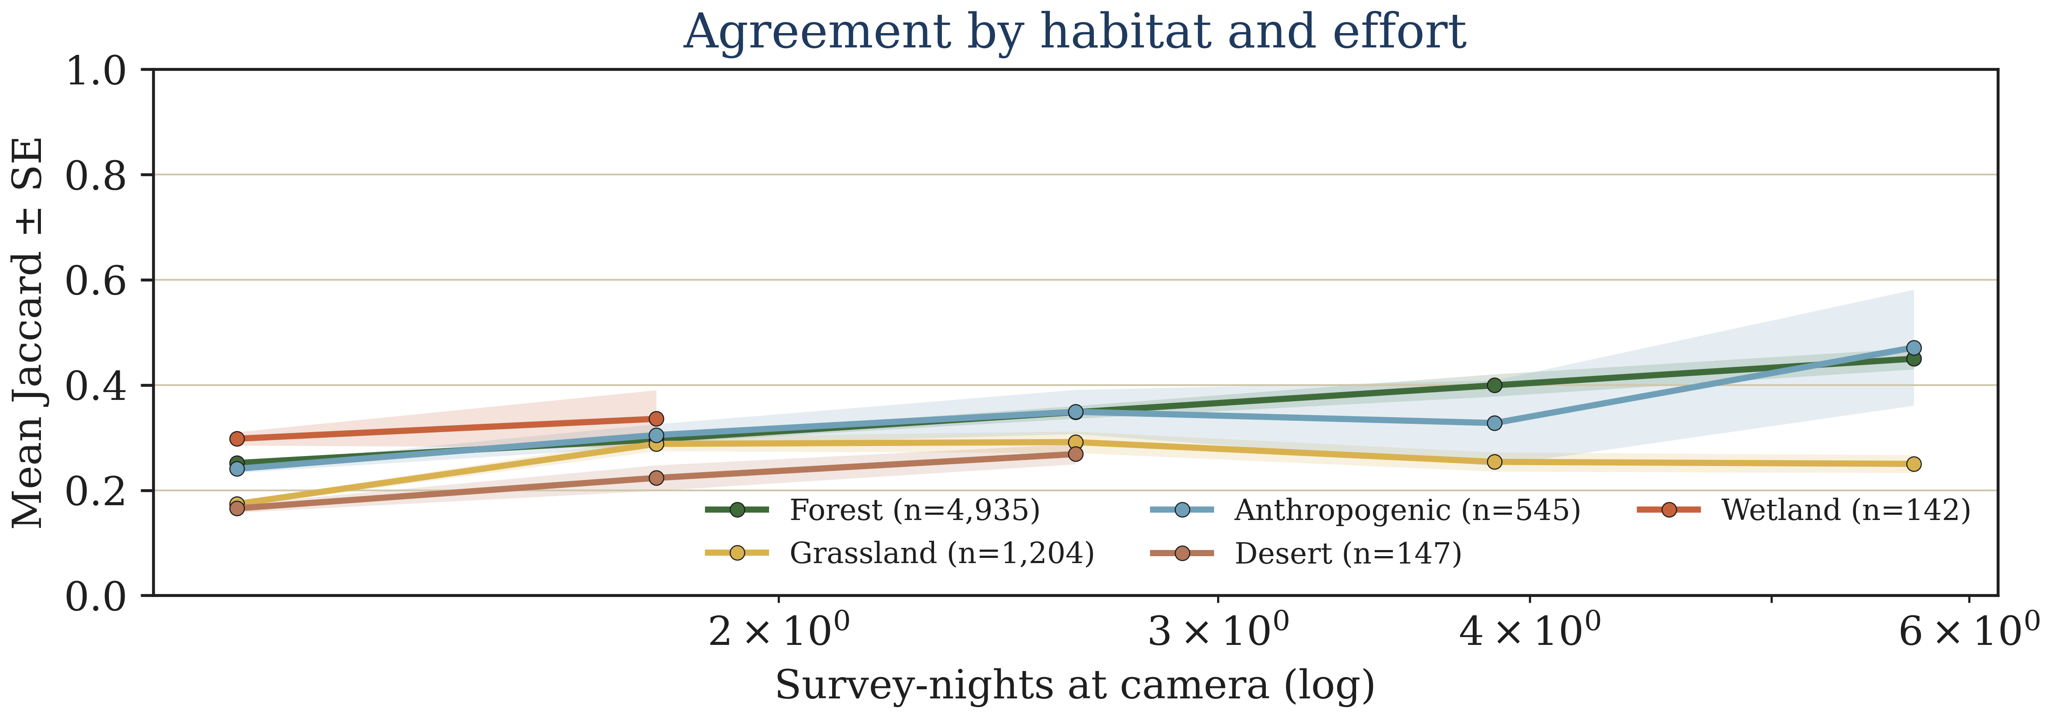
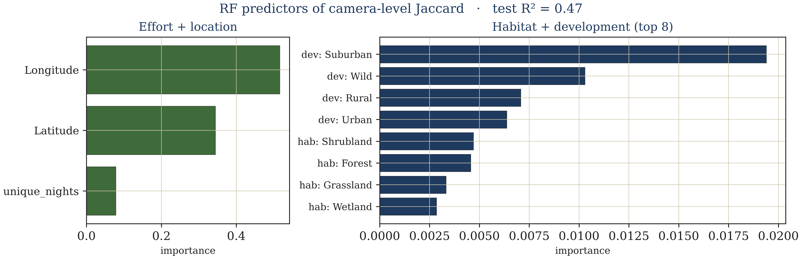
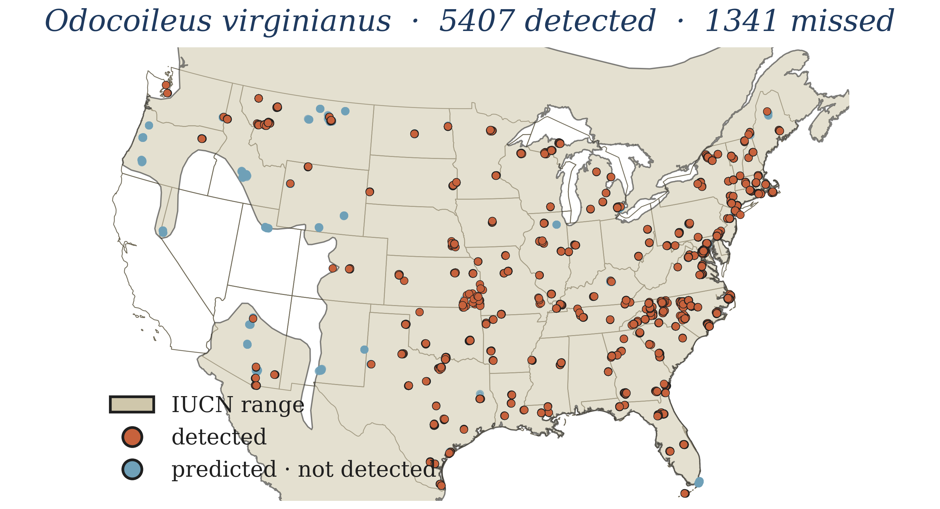
GEORGIA TECH · HUMAN-AUGMENTED ANALYTICS GROUP
Do cameras and range maps see the same biodiversity?
Spatial Camera-Trap Audit
Cliff [[FILL: surname]] · Kefei Yan · Jacquie Carroll
Neelima Pandey · John Hiedo
Advisors: Jenny McGuire · Steve Mussmann · Emily Weigel
OMSCS Conference 2026
Bridging Empirical and Modeled Biodiversity: Snapshot USA × IUCN × COMBINE
①
Motivation
[[SILH]]
Across the U.S., camera traps record mammals through Snapshot USA (SSUSA). IUCN Red List maps — drawn largely from expert opinion — are the global standard for species ranges. The two views of biodiversity are rarely checked against each other, so misalignments persist unnoticed in conservation planning.
“When maps and cameras disagree, which one should we trust?”
②
Data Sources
[[SILH]]
SSUSA
IUCN
COMBINE
713,319 records
733 polygons
6,110 species
109 species · 2019–2024
575 species · Red List
Body-mass traits
Hero: cross-source agreement mapped by ecoregion.
③
Body-Mass Strata — where SAC is computed
≤ 50 g
→
50–100 g
→
100–500 g
→
500–1000 g
→
≥ 1000 g
small-bodied
small-medium
medium
medium-large
large-bodied
④
[[SILHOUETTE]]
[[SILHOUETTE]]
[[SILHOUETTE]]
[[SILHOUETTE]]
[[SILHOUETTE]]
Results
+
=
SAC alone misclassifies 4.4% of array-years as adequate.
[[SILH]]
Species-accumulation curves — when does an array look complete?
Binomial CI-gap — how many species could still be missing?
False-plateau array-years — apparent completeness but missed species.
⑤
Supporting Analysis
⑥
Takeaways & Next Steps
Community composition is most stable for mammals above 100 g. Below 50 g, sparse detections drive high variance in both accumulation curves and IUCN overlap. Multi-year rollups (2019–2024) dampen single-year noise. Calendar-night effort — not camera-night, which inflates ~10× — is the correct denominator when pooling across arrays.
Empirical and modeled biodiversity views mostly agree for mid-sized mammals.
SAC alone under-reports sampling gaps; the CI-gap classifier catches false plateaus.
Cross-source validation is a cheap, reproducible audit for any camera-trap benchmark.
Next: extend to body-mass and guild-level stratified audits across all SSUSA years.
github.com / cliff003/ HAAG_Spatial_Camera_Trap_Fall2025
[[QR]]
Human-Augmented Analytics Group · Georgia Tech
#F6EFD8
#E8DEBF
#1F1F1F
#1F3A5F
#C7623C
#3F6B3A
#D9B24F
#6FA0B8
#B5785A
#706A58
#CFC7AB
OMSCS Conference 2026 · Poster & Demo Session · May 12, 2026
[[FILL: presenter email]]
v0.4.0 · 2026-04-20 17:28

